Slide 1



The AE9/AP9 Next Generation Radiation Specification Models – Progress Report
20 November 2014
R.A. Quinn¹,T. P. O’Brien² ,S. L. Huston¹,
W. R. Johnston³, G. P. Ginet⁴,
and T. B. Guild²
¹Atmospheric and Environmental Research, Inc.
²Aerospace Corporation
³Air Force Research Laboratory,
Space Vehicles Directorate, Kirtland AFB, NM
⁴MIT Lincoln Laboratory

Slide 2
Outline
Version 1.20 – release imminent!
  Issues noted
  Validation update
Version 1.5 plans
Version 2.0 plans
Summary

Slide 3
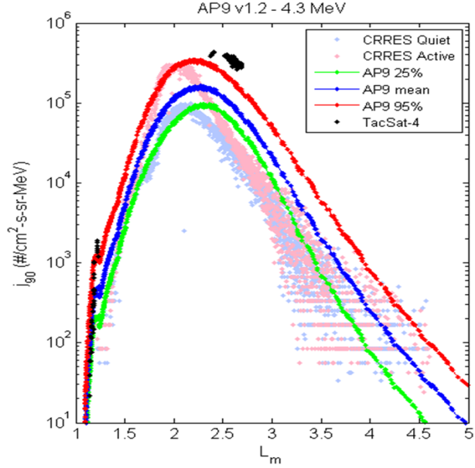
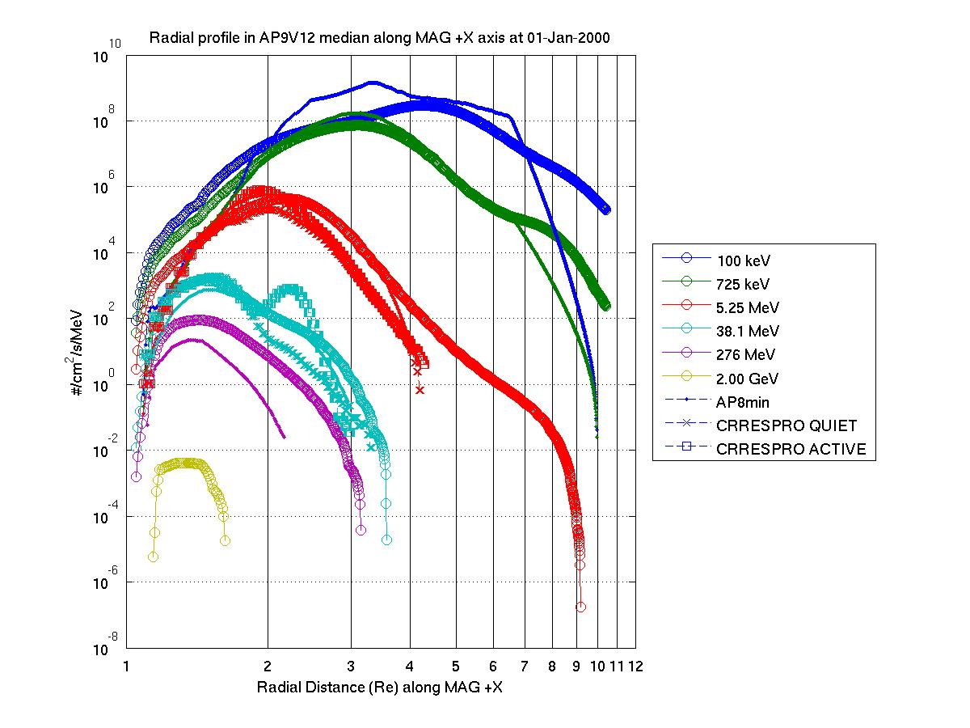
Version 1.20 – Database Updates
New data set (first new data to be added):
  TacSat-4/CEASE proton data—captures new observations of elevated 1-10 MeV protons
  Additional plasma data: THEMIS/ESA
New electron templates
  Improvements for inner zone electrons and for >3 MeV spectra
New proton templates
  Incorporate E/K/Φ and E/K/h_{min} profiles observed by RBSP/Relativistic Proton Spectrometer
  Extend proton energies to 2 GeV
Low altitude taper
  Force fast fall-off of flux for h_{min} < 100 km.
  Cleans up radial scalloping at altitudes below ~1000 km
Radial Profile in AP9 V1.20
2 GeV
Radial Distance along +X MAG

Slide 4
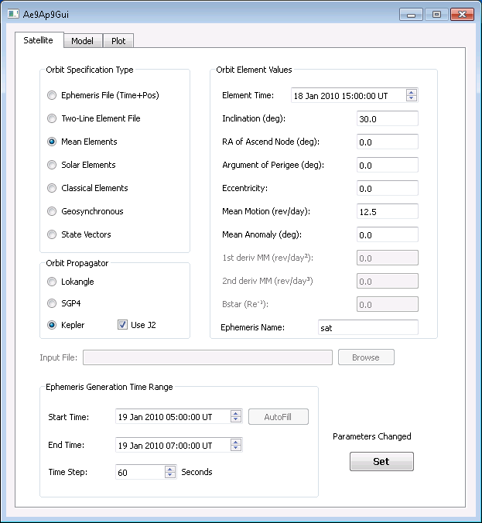
Version 1.20 – Software Updates
Feature improvements
  More options for orbit element input and coordinates
  Third party developers guide (available now)
  Pitch angle tool—make internal pitch angle calculations accessible to users
  Easy extraction of adiabatic invariant coordinates
  Improved error messages

Slide 5
Issues Noted
Issues identified by D. Heynderickx in V1.05 *
* Not a comprehensive list—these were selected as more significant issues, other reported issues will be checked as well
model/ regime | issue | assessment
AP9 in LEO | SAA is too big/has wrong shape (fluxes do not fall off fast enough at SAA edges) | Known V1.05 issue, has been significantly addressed in V1.20
AP9 in LEO | Fluxes are higher than Azur data for E<10 MeV; altitude gradients are different | Azur data is lower than other data sets, particularly S3-3 at these energies; don’t yet know if this is climatological or instrumental
AP9 in LEO | Energy spectra is more like a power law, not an exponential as in AP8 and data sets | AP9 template spectra are exponential; spectra in given flux map bins may be power law or exponential; still investigating
AE9 in GEO | Fluxes are higher than IGE-2006 despite both models using LANL data | May be a difference in LANL data set versions used; still investigating
Issue identified by AE9/AP9 team in V1.05/V1.20
AP9 in LEO | Artifacts of localized high flux “stripes” near the SAA at low altitude (<400 km) | Consequence of PA bin weighting in LEO for omnidirectional flux calculations; fix is in development

Slide 6
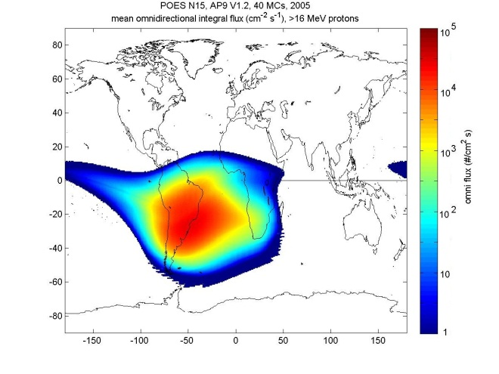
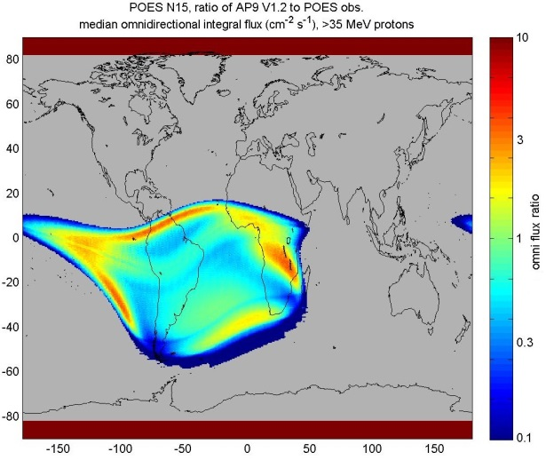
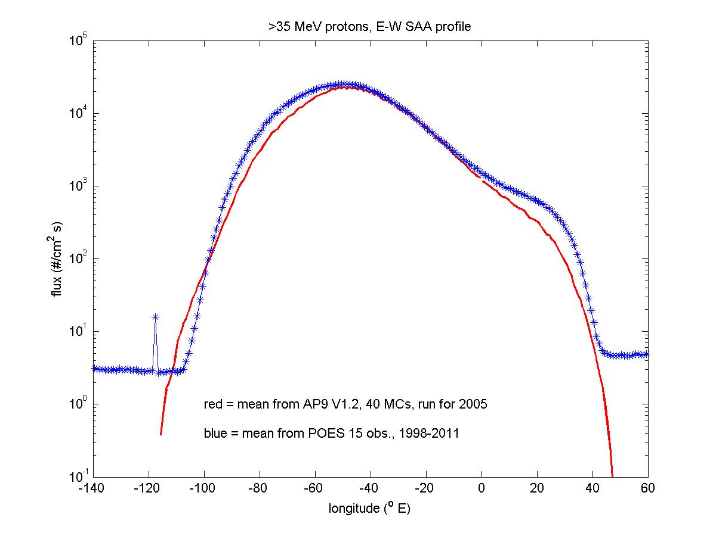
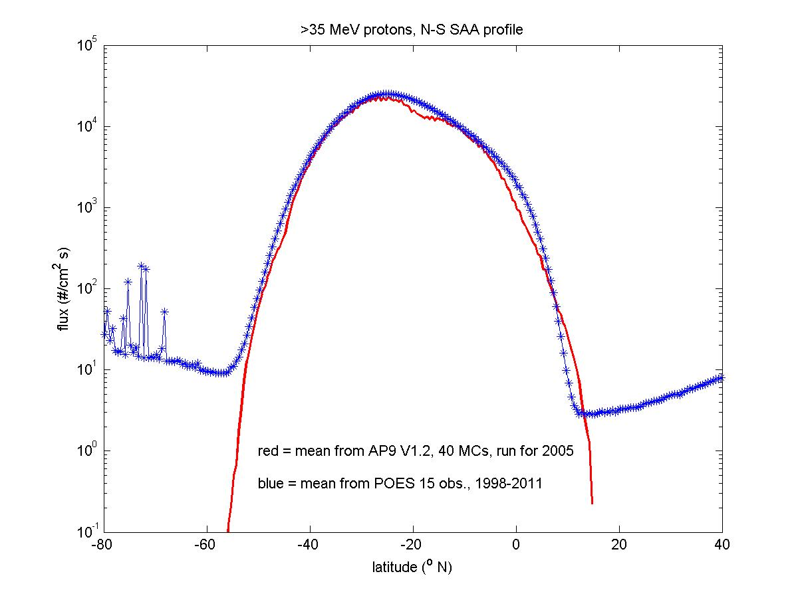
AP9 V1.20 Validation—SAA
>35 MeV protons
SAA flux profiles are improved in V1.20 as compared to POES observations
Ratio of AP9 V1.20 median to POES data
East-west profile
North-south profile
POES MEPED background
electron contamination

Slide 7
AP9 LEO Issue
AP9 V1.20 combines many data sets: Polar, HEO, CRRES, S3-3
S3-3, Polar not used in LEO
AZUR data not used (yet)
Depending on where you look, data sets agree or disagree
Spread of data typically increases as L decreases
The model typically splits the difference

Slide 8
AE9 GEO Issue
10
10
AE9 is higher than IGE at GEO, looks like AE8
One-year average of AE9 V1.20 calibrated LANL data are often well above IGE for same year
All data were calibrated to CRRES MEA and HEEF
In some K/L bins data spread is 100x across large energy range (typically larger K, lower pitch angle)
It is not a simple calibration issue
AE9 V1.20
K^{1/2}=0.2, log₁₀Φ=-0.525
L*=6.34, α₀ ~ 63º
8
10
6
10
/sr/s/MeV
2
4
lanl97a_sopa
10
lanl095_sopa
Median Flux, #/cm
lanl046_sopa
2
10
lanl02a_sopa
scatha_sc3
0
polar_histe
10
crres_heef
-2
crres_mea
LANL and IGE for Year 2003
10
model
9
10
8
LANL02A AE9 V1.20 Calibration
10
AE9 V1.20
K^{1/2}=1.8, log₁₀Φ=-0.525
L*=6.34, α₀ ~ 7.5º
8
LANL095 AE9 V1.20 Calibration
10
6
LANL97A AE9 V1.20 Calibration
10
7
IGE-2006
10
/sr/s/MeV
4
/s/sr/MeV
2
10
6
2
10
2
#/cm
10
5
Median Flux, #/cm
10
0
10
Data spread is ~100x!
4
10
-2
10
3
10
-2
-1
0
1
10
10
MeV
10
10

Slide 9
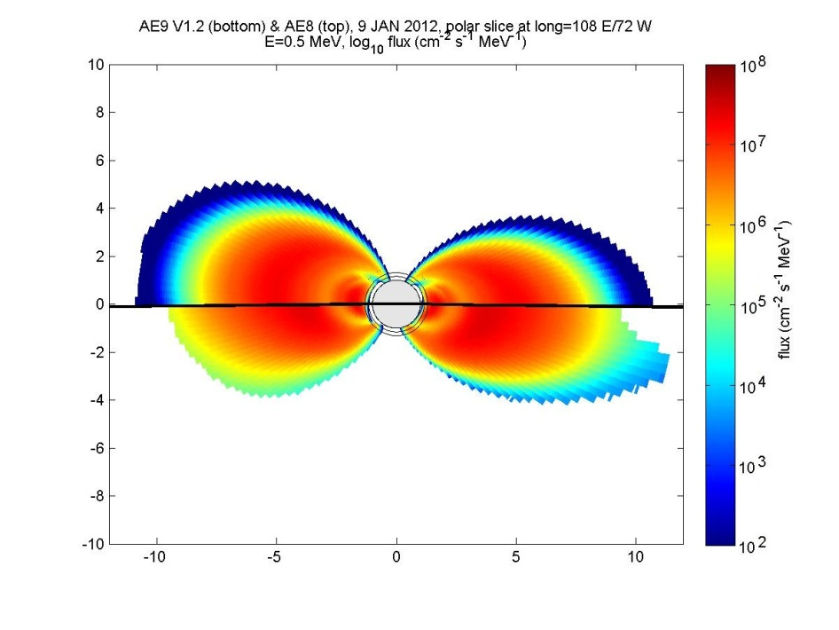
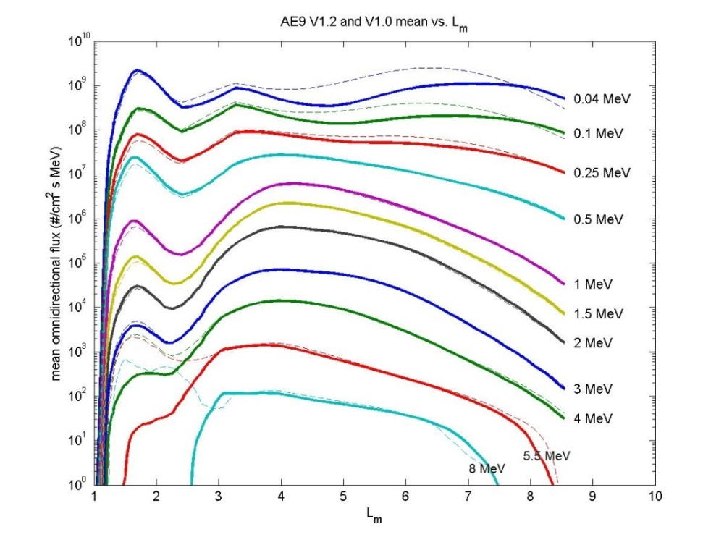
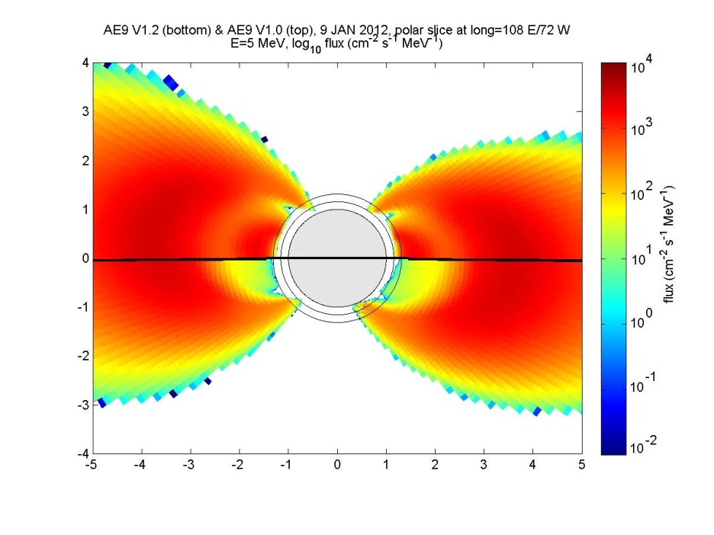
AE9 V1.20 Model Comparison
AE8 0.5 MeV
AE9 V1.20
AE9 V1.0 5 MeV
AE9 V1.20
Inner zone electrons at E>3 MeV are lower in V1.20 than V1.00
  Result is more consistent with Van Allen Probe results

Slide 10
Version 1.5
New data:
  Protons: Azur, Van Allen/MagEIS & REPT
  Electrons: DEMETER/IDP, Van Allen/MagEIS & REPT
  Plasma: SCATHA/SC8, AMPTE/CCE & CHEM
New features
  Introduce kernel-based methods for fast dose/effects calculations
  Fix flux-to-fluence calculations to cover variable time steps—supports optimizing time steps for shorter run times
  Capability for parallelization across scenarios—improves run times (may be available sooner as an interim release, V1.25)
  IGRF update (if new coefficients are available in time)
  Allow selection of time period for calculation of fluence—supports different time periods for different effects
Expected public release in Q4 2015
International collaborators on board—with new model name: IRENE
  International Radiation Environment Near Earth

Slide 11
Version 2.0
Major feature changes:
  Sample solar cycle—introduces a full solar cycle reanalysis as a flythrough option
  New module frameworks for e.g. plasma species correlations, SPM stitching with AE9/AP9, auroral electrons, additional coordinates for MLT variation in SPM
  AP9 improvements: solar cycle variation in LEO, east-west effect
  Incorporate untrapped solar protons with statistics
  Parallelization capability for runs on clusters—needed to speed up long runs
  Mac OSX build?
New data
  Van Allen/MagEIS & REPT protons and electrons
  PAMELA protons—addresses high energy proton spectra
  Other international data sets: possibilities include Cluster/RAPID-IIMS, ESA SREMs, CORONAS, NINA, Akebono/EXOS-D, SAC-C, Jason2
Subsequent releases will include new data
  DSX/SWx, ERG

Slide 12
Summary
AE9/AP9 improves upon AE8/AP8 to address modern space system design needs
  More coverage in energy, time & location for trapped energetic particles & plasma
  Includes estimates of instrument error & space weather statistical fluctuations
  Designed to be updateable as new data sets become available
Version 1.05 is now available to the public, V1.20 will be available soon
Review paper published in Space Science Reviews: http://link.springer.com/article/10.1007/s11214-013-9964-y
Updates are in the works
  Improvements to the user utilities (no change to underlying environments)
  Improvements to the model environments (new data)
  Additional capabilities (new features, new models)
  For future versions, collaborative development is the goal
  Being proposed as part of new ISO standard
  Discussions have begun on collaboration with international partners
  We have benefitted already from discussions with colleagues in Europe

Slide 13
Points of Contact
Comments, questions, etc. are welcome and encouraged!
Please send feedback, requests for model or documentation, etc., to (copy all):
  Bob Johnston, Air Force Research Laboratory, AFRL.RVBXR.AE9.AP9.Org.Mbx@us.af.mil
  Paul O’Brien, Aerospace Corporation, paul.obrien@aero.org
  Gregory Ginet, MIT Lincoln Laboratory, gregory.ginet@ll.mit.edu
Information available on NASA SET website:
  http://lws-set.gsfc.nasa.gov/radiation_model_user_forum.html
V1.20 code public release is expected in Oct-Nov 2014
  To be available at AFRL’s Virtual Distributed Laboratory website, https://www.vdl.afrl.af.mil/
  In the meantime for V1.05 contact Gregory Ginet, MIT Lincoln Laboratory, gregory.ginet@ll.mit.edu

Slide 14
BACKUP Material

Slide 15
Outline
Introduction & Background
Architecture & Data
Application
Comparisons with AE8/AP8 and Data
Future Plans
Summary

Slide 16
The Team
Gregory Ginet/MIT-LL, ex-PI, gregory.ginet@ll.mit.edu
Paul O’Brien/Aerospace, PI, paul.obrien@aero.org
Bob Johnston/AFRL, PI,
AFRL.RVBXR.AE9.AP9.Org.Mbx@us.af.mil
Tim Guild/Aerospace
Joe Mazur/Aerospace
Stuart Huston/Boston College/AER
Dan Madden/Boston College
Rick Quinn/AER
Christopher Roth/AER
Paul Whelan/AER
Reiner Friedel/LANL
Steve Morley/LANL
Chad Lindstrom/AFRL
Yi-Jiun Caton/AFRL
John Machuzak/AFRL
Michael Starks/AFRL, PM
Thanks to:
James Metcalf/AFRL
Kara Perry/AFRL
Seth Claudepierre/Aerospace
Brian Wie/NRO/NGC
Tim Alsruhe/SCITOR
Clark Groves/USAF
International Contributors:
CNES/ONERA, France
ESA/SRREMS, Europe
JAXA, Japan
Hope to add more…

Slide 17
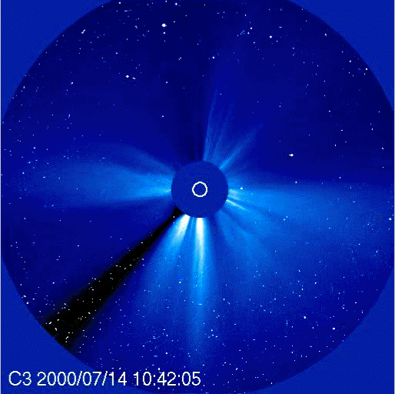
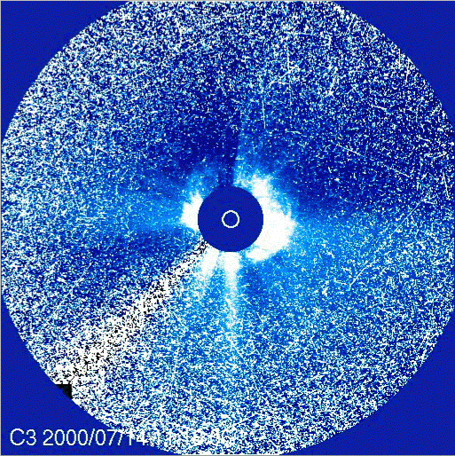
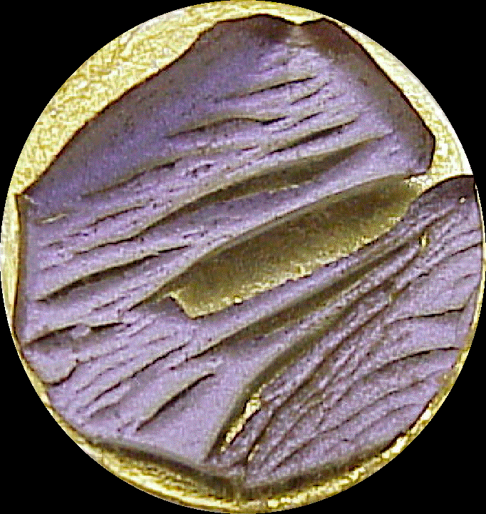
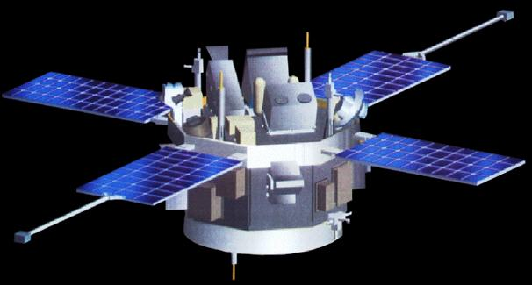

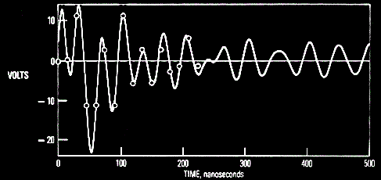

Energetic Particle & Plasma Hazards
False stars in star tracker CCDs
before
after
No energetic protons
Many energetic protons
Surface degradation from radiation
Solar array power decrease due to radiation damage
Electronics degrade due to total radiation dose
Solar array arc discharge
Single event effects in microelectronics:
bit flips, fatal latch-ups
1101 ⇒ 0101
Spacecraft components become radioactive
Electromagnetic pulse from vehicle discharge
Induced
Voltage
Time
Distribution F

Slide 18
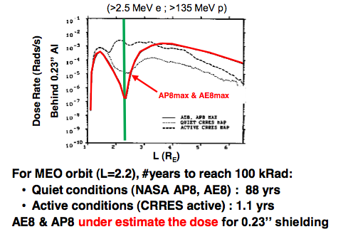
The Need for AE9/AP9
Prior to AE9/AP9, the industry standard models were AE8/AP8 which suffered from
  inaccuracies and lack of indications of uncertainty leading to excess margin
  no plasma specification with the consequence of unknown surface dose
  no natural dynamics with the consequence of no internal charging or worst case proton single event effects environments
AE8/AP8 lacked the ability to trade actual environmental risks like other system risks
AE8/AP8 could never answer questions such as “how much risk can be avoided by doubling the shielding mass?”
Example: Medium-Earth Orbit (MEO)
System acquisition requires accurate environment specifications without unreasonable or unknown margins.

Slide 19
Requirements
Summary of SEEWG, NASA workshop & AE/AP-9 outreach efforts:
Priority | Species | Energy | Location | Sample Period | Effects
1 | Protons | >10 MeV (> 80 MeV) | LEO & MEO | Mission | Dose, SEE, DD, nuclear activation
2 | Electrons | > 1 MeV | LEO, MEO & GEO | 5 min, 1 hr, 1 day, 1 week, & mission | Dose, internal charging
3 | Plasma | 30 eV – 100 keV (30 eV – 5 keV) | LEO, MEO & GEO | 5 min, 1 hr, 1 day, 1 week, & mission | Surface charging & dose
4 | Electrons | 100 keV – 1 MeV | MEO & GEO | 5 min, 1 hr, 1 day, 1 week, & mission | Internal charging, dose
5 | Protons | 1 MeV – 10 MeV (5 – 10 MeV) | LEO, MEO & GEO | Mission | Dose (e.g. solar cells)
(indicates especially desired or deficient region of current models)
Inputs:
  Orbital elements, start & end times
  Species & energies of concern (optional: incident direction of interest)
Outputs:
  Mean and percentile levels for whole mission or as a function of time for omni- or unidirectional, differential or integral particle fluxes [#/(cm² s) or #/(cm² s MeV) or #/(cm² s sr MeV) ] aggregated over requested sample periods

Slide 20
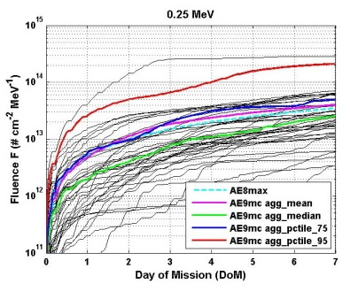
What is AE9/AP9?
AE9/AP9 specifies the natural trapped radiation environment for satellite design
Its unprecedented coverage in particles and energies address the major space environmental hazards
AE9/AP9 includes uncertainties and dynamics that have never been available for use in design
  The uncertainty allows users to estimate design margins (95 percentile rather than arbitrary factors)
  Dynamic scenarios allow users to create worst cases for internal charging, single event effects, and assess mission life
AE8, AE9 in GTO
AE8MAX
AE9 Mean
AE9 Median
AE9 Scenarios 75%
AE9 Scenarios 95%
“Turn-Key” system for ingesting new data sets ensures that the model can be updated easily
The model architecture and its datasets are superior to AE8/AP8 in every way
V1.0 released 20 January 2012 to US Government and Contractors
V1.0 cleared for public release on 5 September 2012 (Current version is 1.05)

Slide 21
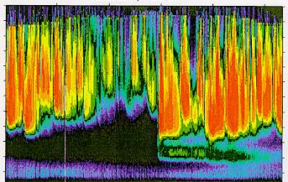
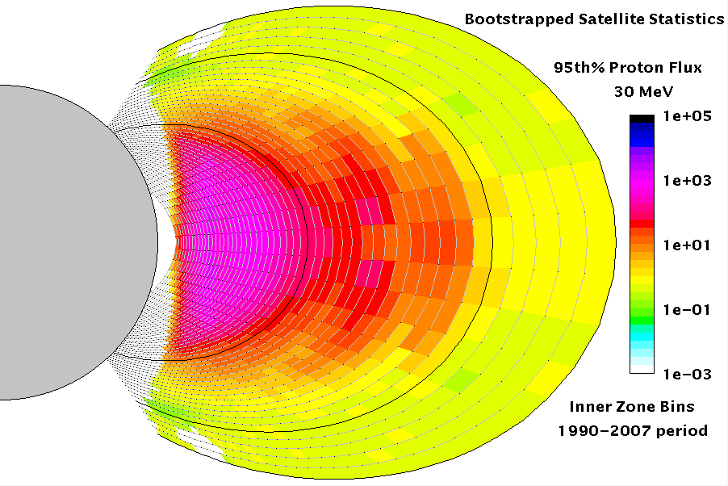
Architecture Overview
Satellite data
Satellite data & theory
User’s orbit
7.0
L shell (Re)
95th
+
1.0
18 months
75th
=
Dose
50th
Energy (keV)
Mission time
Flux maps
Derive from empirical data
  Systematic data cleaning applied
Create maps for median and 95th percentile of distribution function
  Maps characterize nominal and extreme environments
Include error maps with instrument uncertainty
Apply interpolation algorithms to fill in the gaps
Statistical Monte-Carlo Model
Compute spatial and temporal correlation as spatiotemporal covariance matrices
  From data (V 1.0)
  Use one-day (protons) and 6 hour (electrons) sampling time (V 1.0)
Set up N^{th}-order auto-regressive system to evolve perturbed maps in time
  Covariance matrices give SWx dynamics
  Flux maps perturbed with error estimate give instrument uncertainty
User application
  Runs statistical model N times with different random seeds to get N flux profiles
  Computes dose rate, dose or other desired quantity derivable from flux for each scenario
  Aggregates N scenarios to get median, 75th and 90th confidence levels on computed quantities

Slide 22
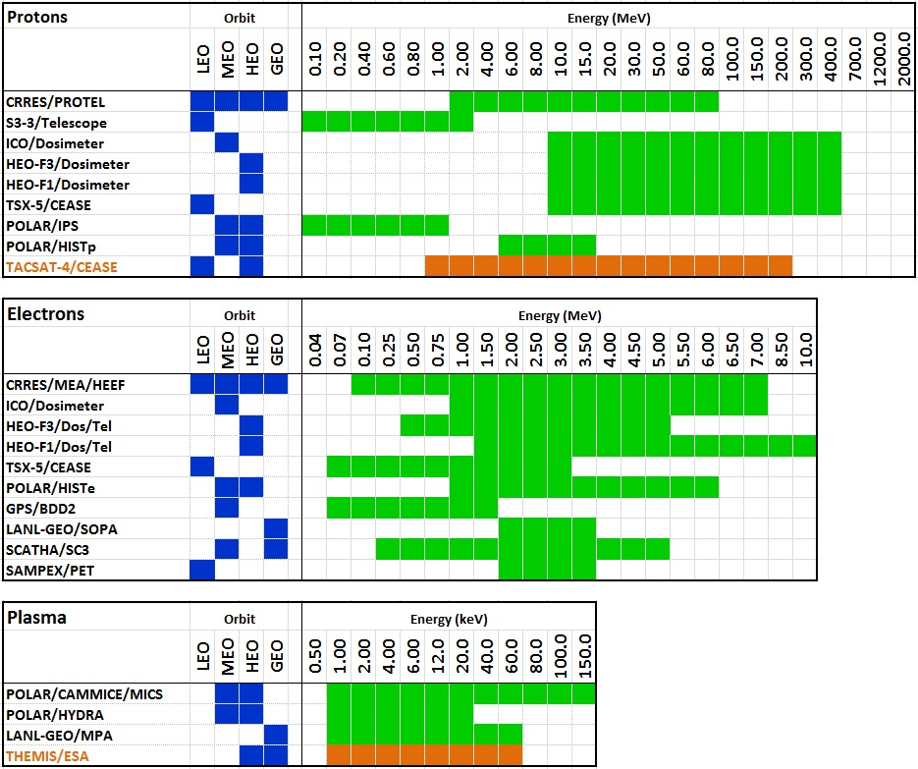
Data Sets – Energy Coverage
new in V1.20

Slide 23
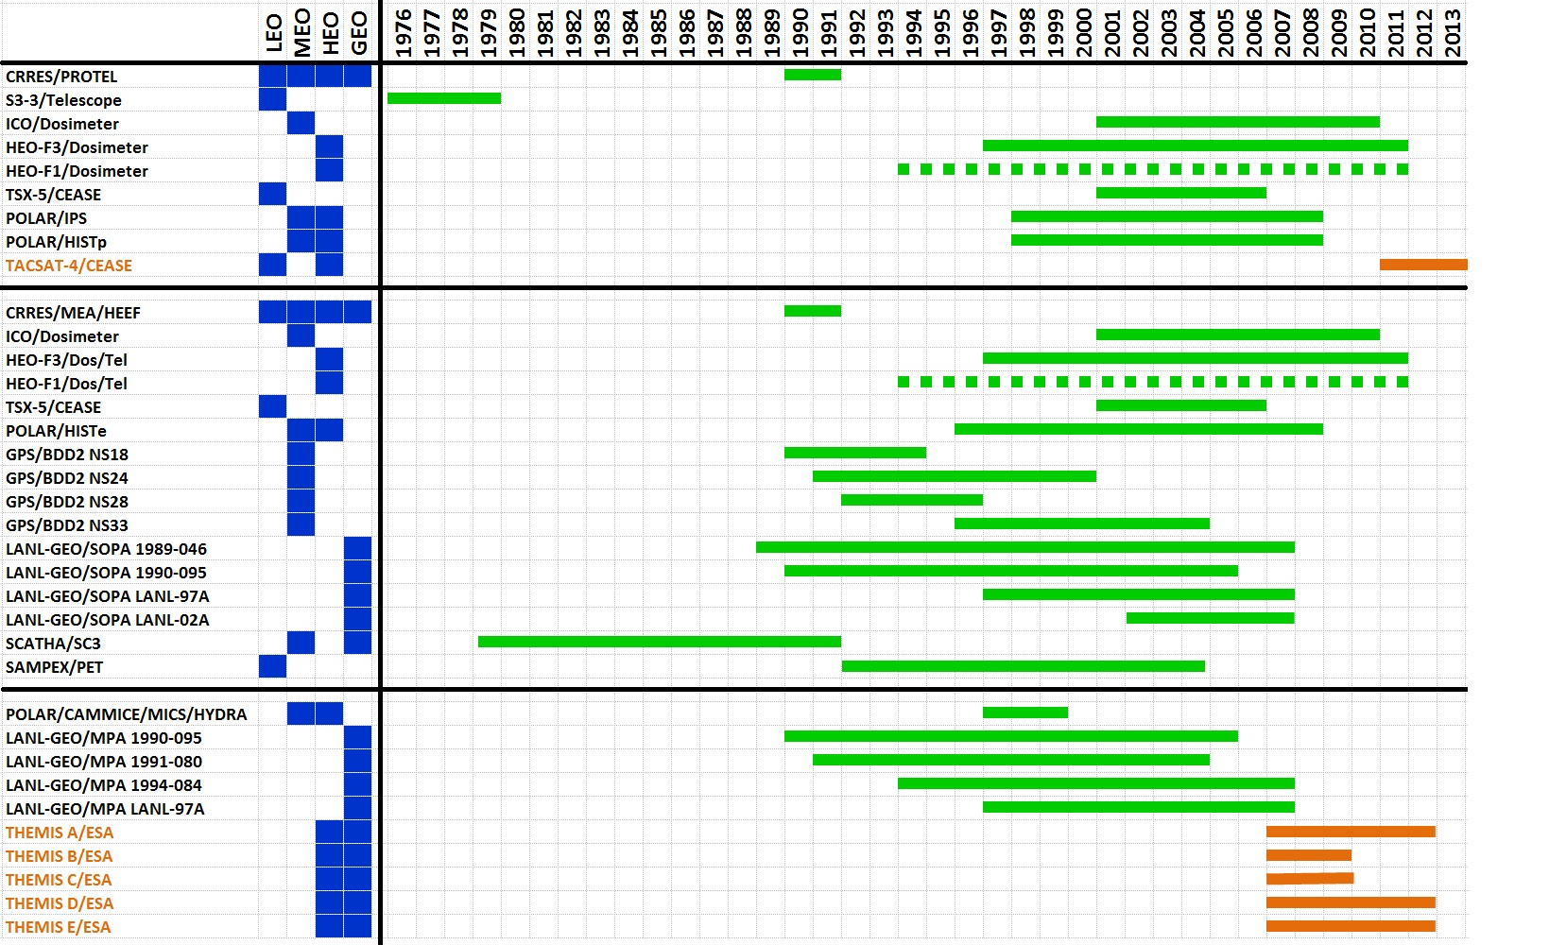
Data Sets – Temporal Coverage
plasma electrons protons
new in V1.20
AP8 released
AE8 released

Slide 24
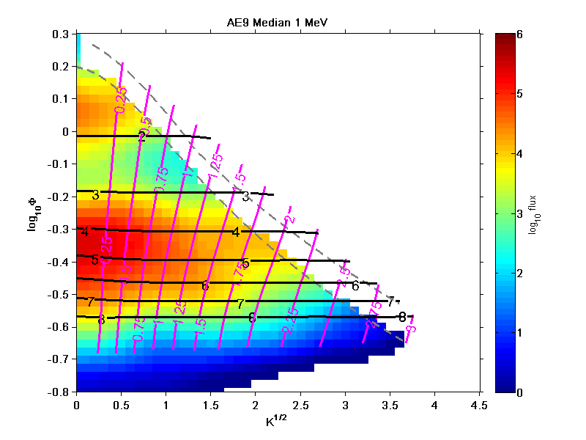
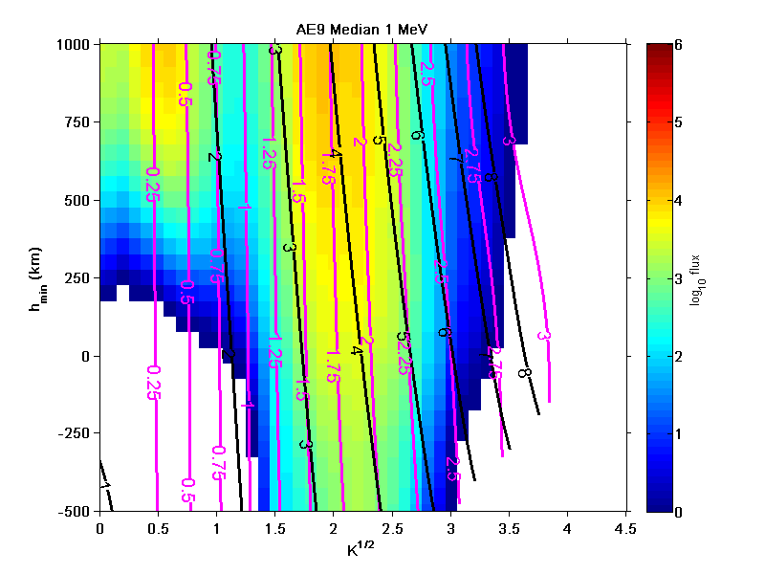
Coordinate System
Primary coordinates are E, K, Φ
  IGRF/Olson-Pfitzer ‘77 Quiet B-field model
  Minimizes variation of distribution across magnetic epochs
(K, Φ) grid is inadequate for LEO
  Not enough loss cone resolution
  No “longitude” or “altitude” coordinate
        Invariants destroyed by altitude-dependent density effects
        Earth’s internal B field changes amplitude & moves around
        What was once out of the loss-cone may no longer be and vice-versa
        Drift loss cone electron fluxes cannot be neglected
Version 1.0 splices in a LEO grid onto the (Φ, K) grid at 1000 km
  Minimum mirror altitude coordinate h_{min} to replace Φ
  Capture quasi-trapped fluxes by allowing h_{min} < 0 (electron drift loss cone)
  min(h_{min}) set to – 500 km

Slide 25
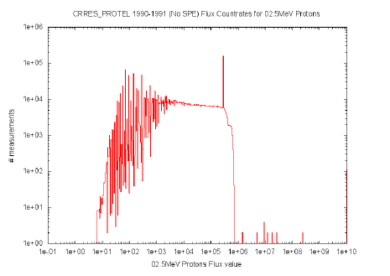
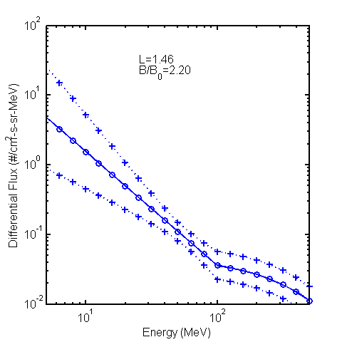
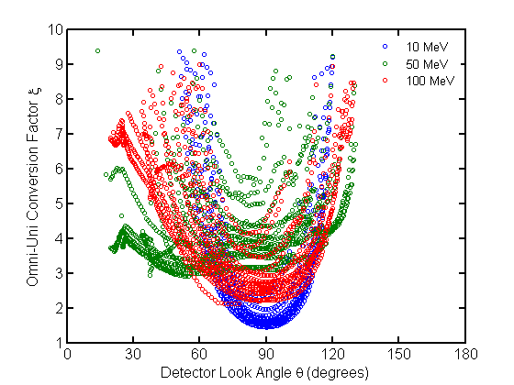
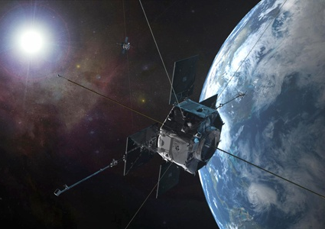
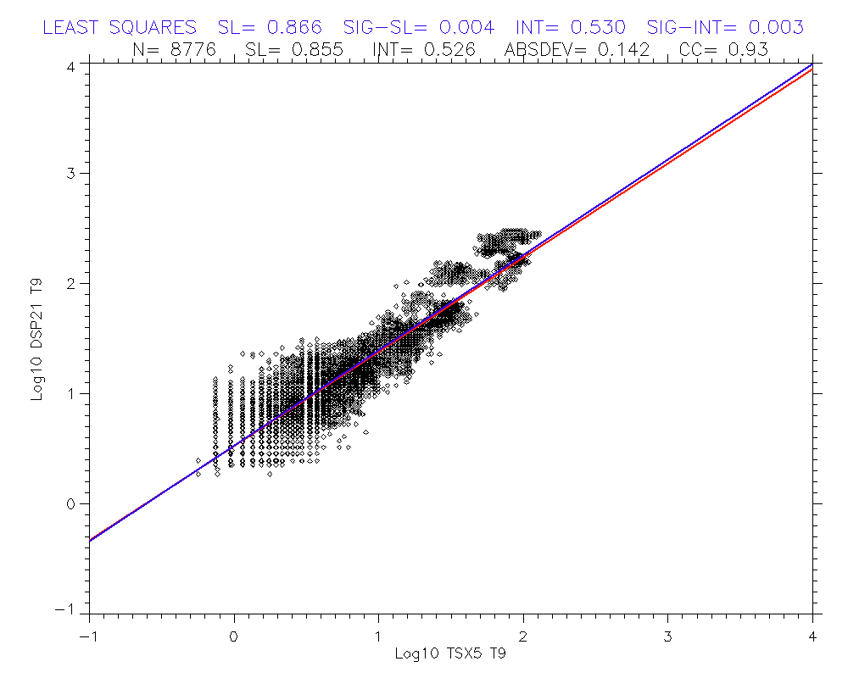
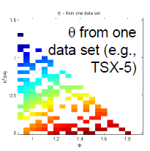
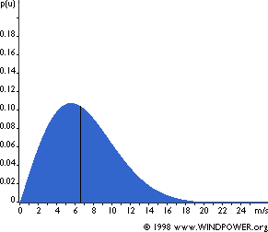
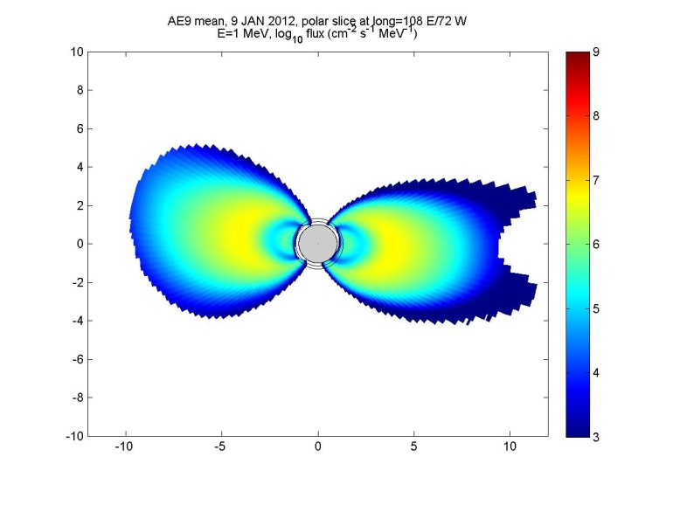
Building Flux Maps
Example for a dosimeter data set
Sensor model
Sensor 1 data
Cleaning
Cross-calibration
Spectral inversion
Angle mapping (j₉₀)
Bootstrap initializing with variances
Flux map – sensor 1
Flux map – sensor 2
.
.
.
Flux – map sensor N
Template interpolation
Statistical reduction (50th & 95 %)
50th & 95 % Flux maps

Slide 26
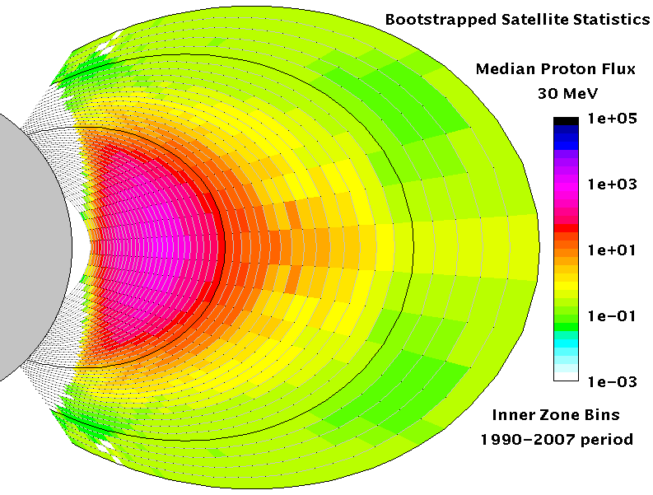
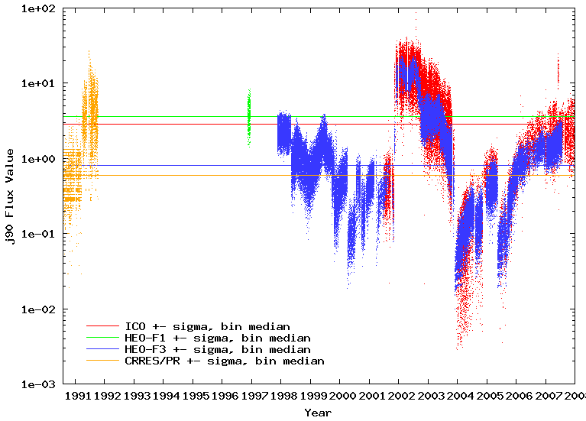
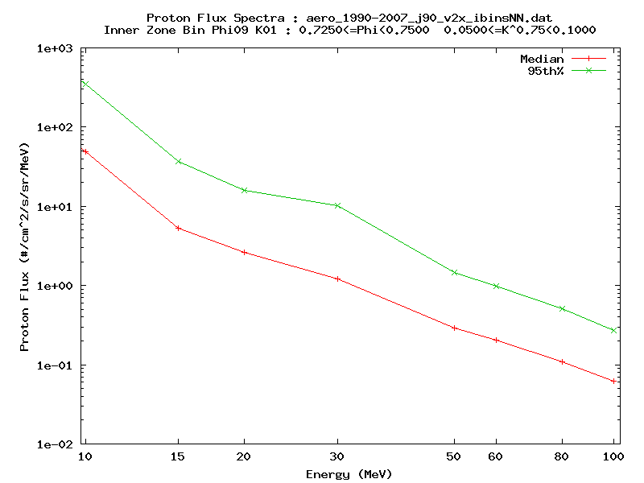
Example: Proton Flux Maps
50th %
95th %
F
j₉₀[#/(cm² s str MeV)]
j₉₀[#/(cm² s str MeV)]
j₉₀[#/(cm² s str MeV)]
50th %
Year
Energy (MeV)
Time history data
Energy spectra
95th %
Flux maps (30 MeV)

Slide 27
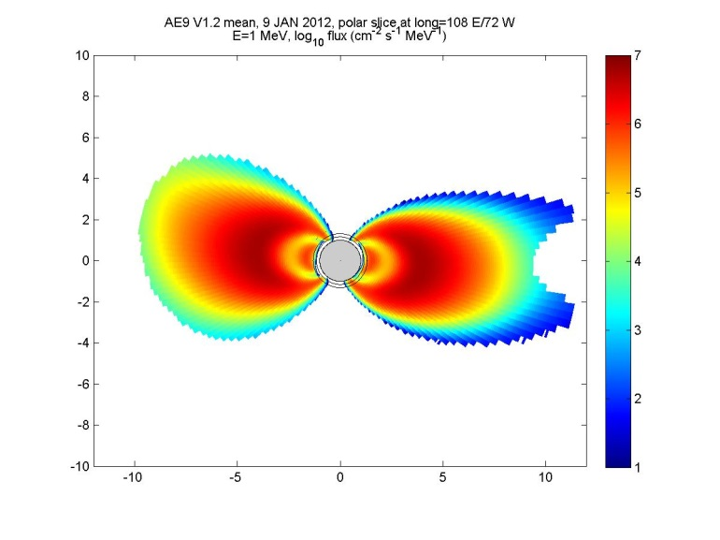
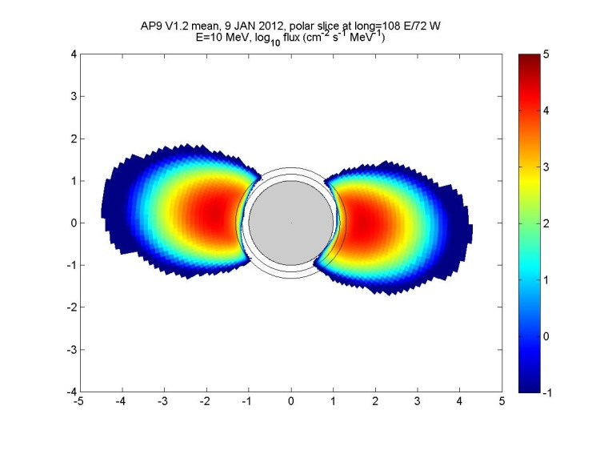
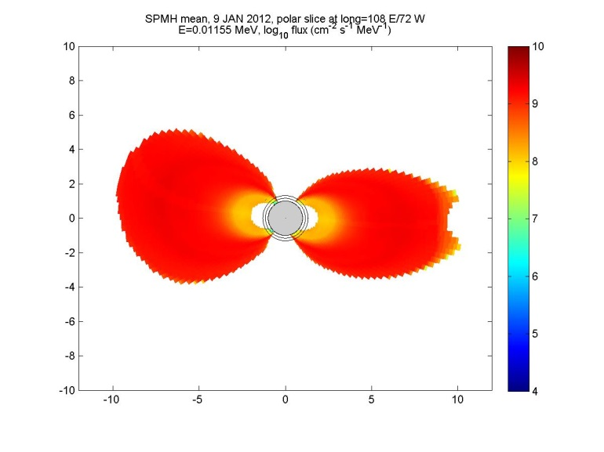
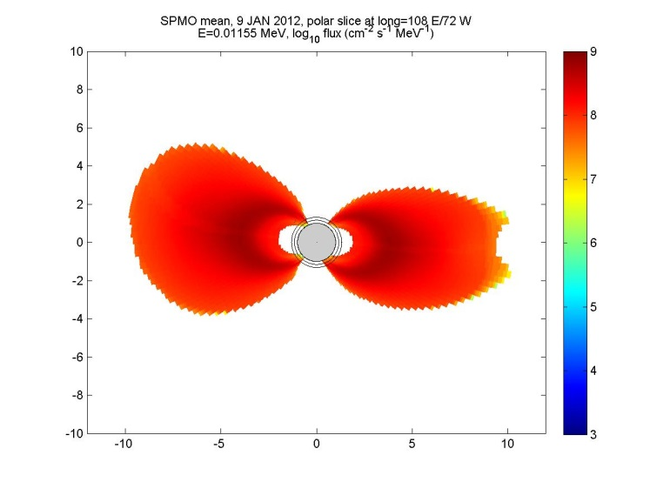
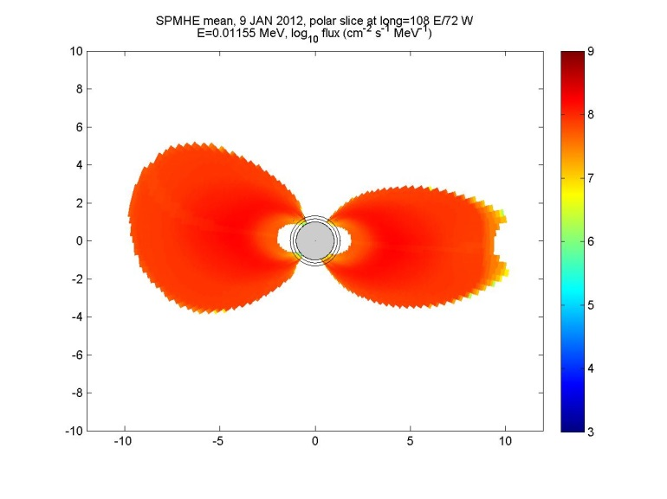
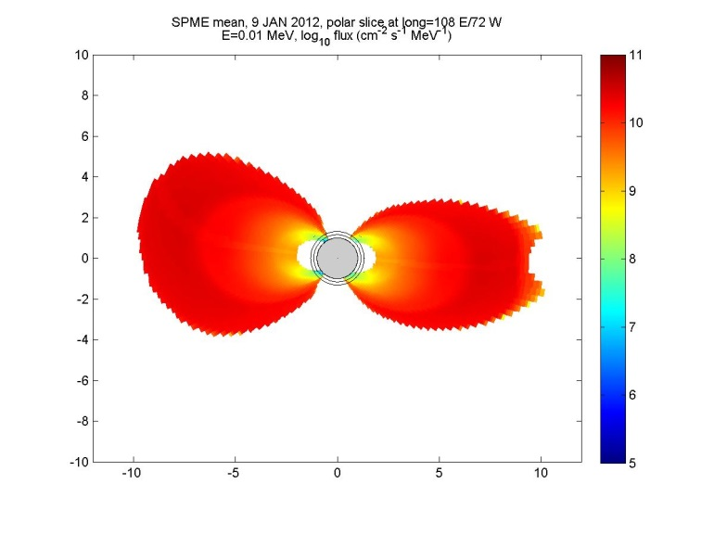
Gallery of Mean Flux Maps
AE9 1 MeV
AP9 10 MeV
SPMH 12 keV
SPMO 12 keV
SPMHE 12 keV
SPME 10 keV
GEOC coordinates

Slide 28
Software Applications (1)
Primary product: AP9/AE9 “flyin()” routine modeled after ONERA/IRBEM Library
  C++ code with command line operations
  Input: ephemeris
  Runs single Monte-Carlo scenario
  Output: flux values along orbit
    Unidirectional or Omnidirectional
    Differential or Integral
    Mean (no instrument error or SWx)
    Perturbed Mean (no SWx)
    Full Monte-Carlo
  Wrappers available for C and Fortran
  Source available for other third party applications on request

Slide 29
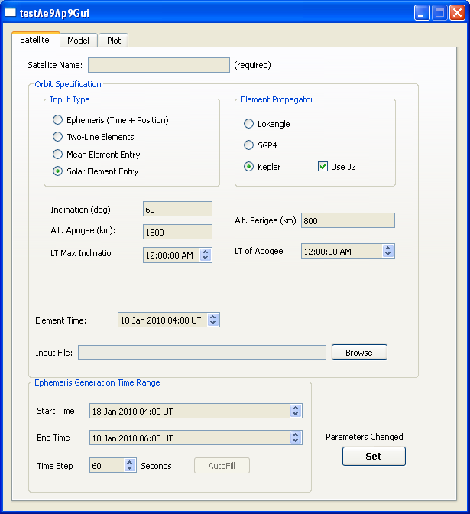
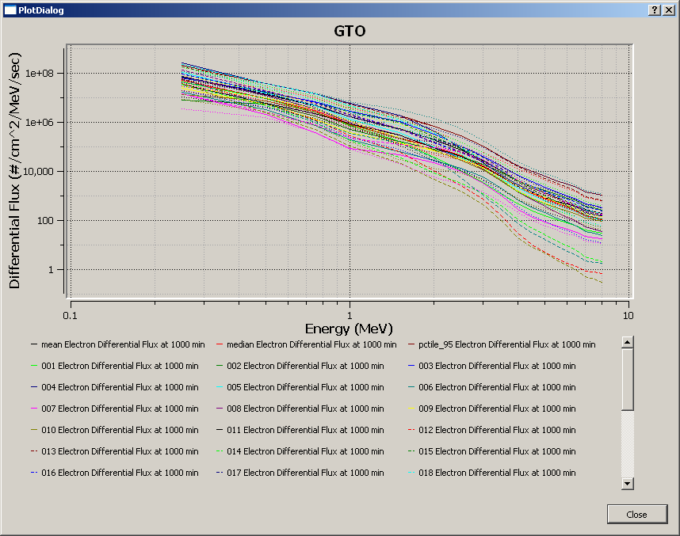
Software Applications (2)
  However… an application tool is provided to demonstrate completed capability
    Accessible by command line or GUI interface
    Contains orbit propagator, Monte-Carlo aggregator and SHIELDOSE-2 dose estimation applications
    Contains historical models AE8, AP8, CRRESELE, CRRESPRO and CAMMICE/MICS
    Provides simple plot and text file outputs
  We expect other developers to create new software tools incorporating the model

Slide 30
AP9/AE9 Code Stack
GUI input and outputs
  User-friendly access to AE-9/AP-9 with nominal graphical outputs
High-level Utility Layer
  Command line C++ interface to utilities for producing mission statistics
  Provides access to orbit propagator and other models (e.g. AP8/AE8, CRRES)
  Aggregates results of many MC scenarios (flux, fluence, mean, percentiles)
  Provides dose rate and dose for user-specified thicknesses (ShieldDose-2)
Application Layer
  Simple C++ interface to single Monte-Carlo scenario “flyin()” routines
AP9/AE9 Model Layer
  Main workhorse; manages DB-access, coordinate transforms and Monte Carlo cycles; error matrix manipulations
Low-level Utility Layer
  DB-access, Magfield, GSL/Boost

Slide 31
Run Modes
Static Mean/Percentile
  Flux maps initialized to mean or percentile values
  Flux maps remain static throughout run
  Flux output is always the mean or selected percentile
  Percentiles are appropriate only for comparing with measurements at a given location
Perturbed Mean/Percentile
  Flux maps are initialized with random perturbations
  Flux maps remain static throughout run
  Multiple runs provide confidence intervals based on model uncertainties
  Appropriate for cumulative/integrated quantities (e.g., fluence, TID)
Monte Carlo
  Flux maps are initialized with random perturbations
  Flux maps evolve over time
  Multiple runs provide confidence intervals including space weather (e.g., worst-case over specified time intervals)
  Needed for estimate of uncertainty in time-varying quantities (e.g., SEE rates, deep dielectric charging)

Slide 32
What Type of Run
Spec Type | Type of Run | Duration | Notes
Total Dose | Perturbed Mean | Several orbits or days | SPME+AE9, SPMH+AP9+Solar
Displacement Damage (proton fluence) | Perturbed Mean | Several orbits or days | AP9+Solar
Proton SEE (proton worst case) | Monte Carlo | Full Mission | AP9+Solar
Internal Charging (electron worst case) | Monte Carlo | Full Mission | AE9 (no SPME)
Run 40 scenarios through either static Perturbed Mean or dynamic Monte Carlo
Compute statistics by comparing results across scenarios (e.g., in what fraction of scenarios does the design succeed)
Do not include plasma (SPM*) models in worst case runs

Slide 33
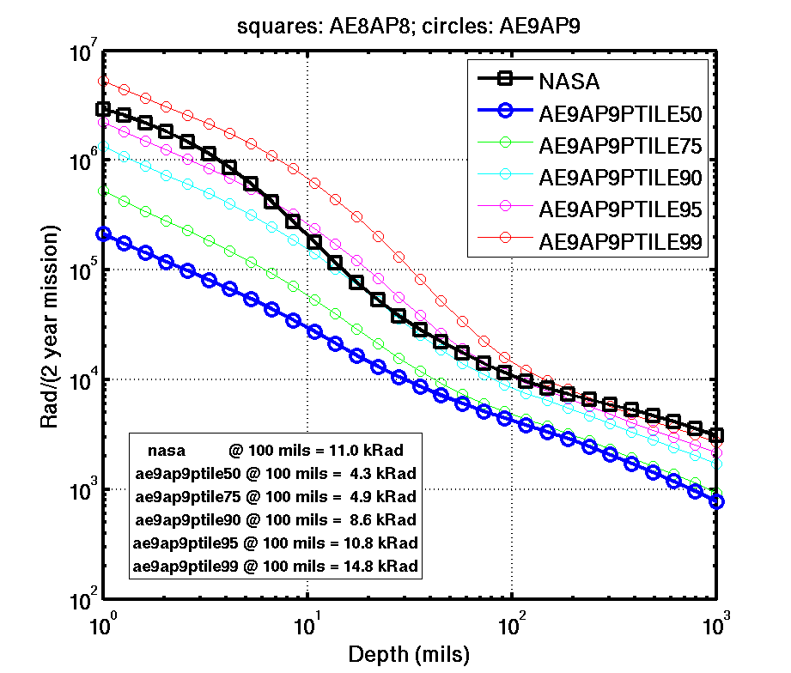
AE9/AP9 Use Example: LEO Dipper
A rarely-used mission orbit (150 x 1500 km, 83º inclination) required an analysis of trades between two hazardous environments:
  Perigee dips at ~150 km yield intense atomic oxygen erosion of exposed polymers
  Higher apogees expose the vehicle to radiation dose and SEE hazards from the inner Van Allen belt protons
AE9/AP9 places the mission in the context of normal (blue) or extreme (red) radiation environments
The AE9/AP9 environment percentiles informed the program of the margin they will have for EEE parts selection
AE9/AP9 allows new concepts to trade space environment hazards against other mission constraints.

Slide 34
Model & Data Comparisons

Slide 35
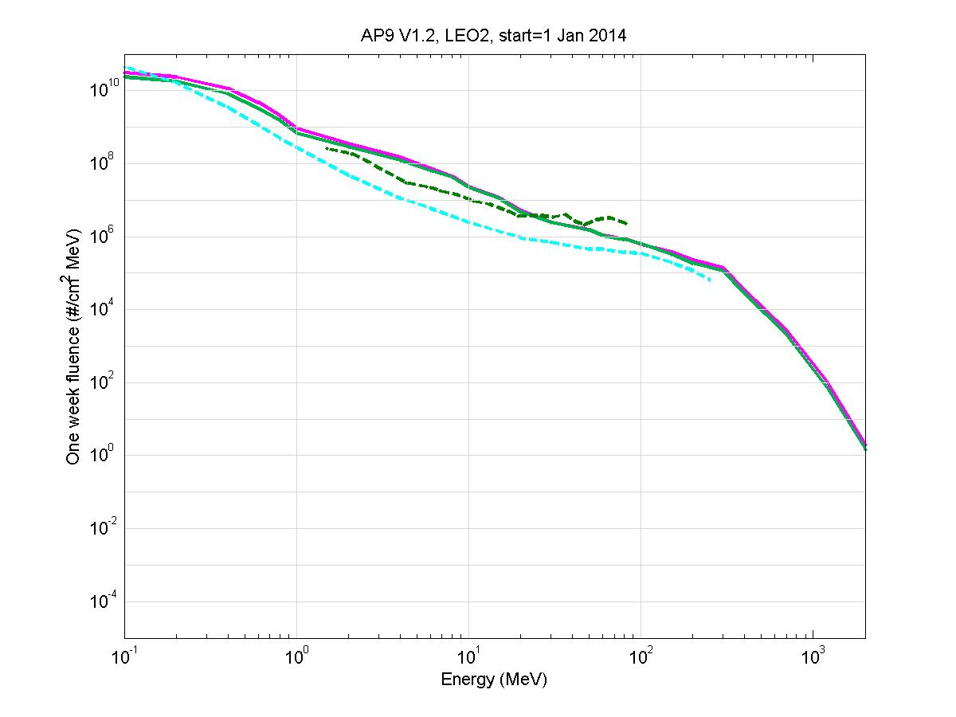
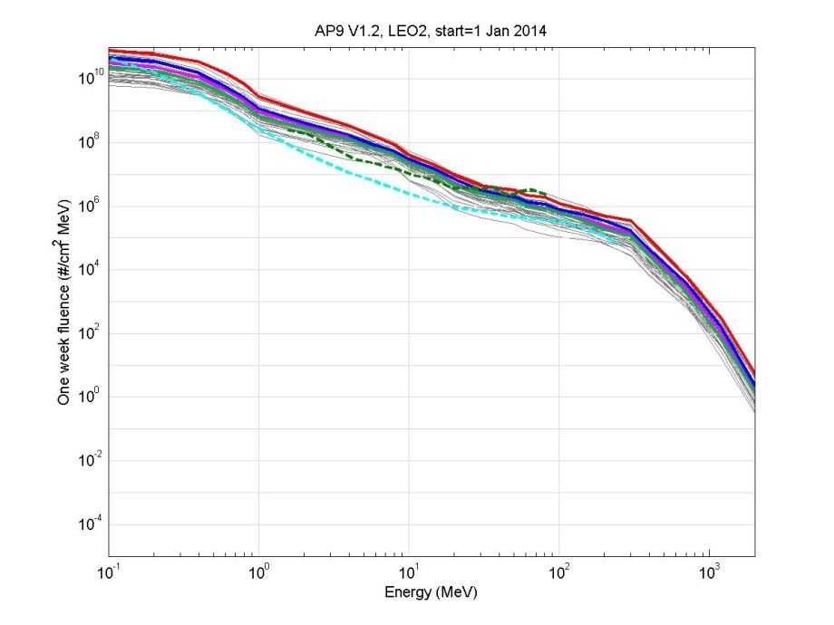
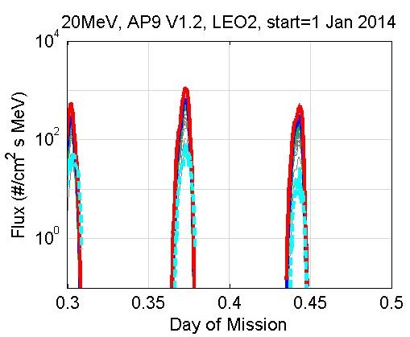
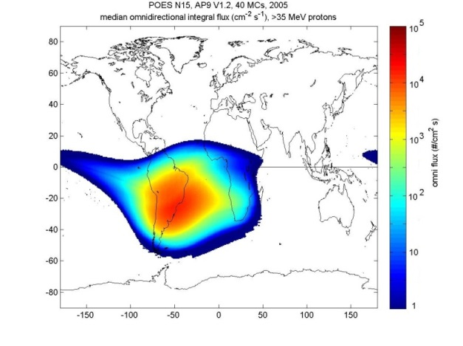
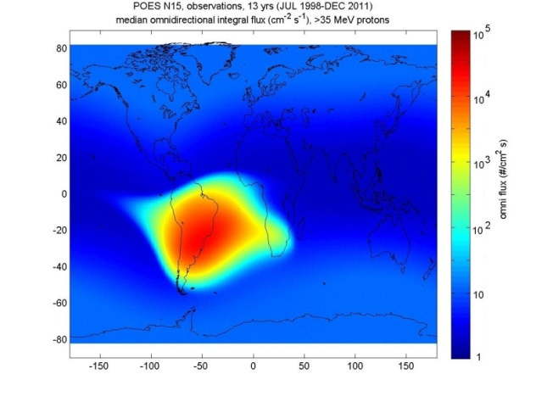
Example—AP9 in LEO
Mean Spectra
Monte Carlo Spectra
>35 MeV map
20 MeV time series
AP9 model vs. POES data

Slide 36
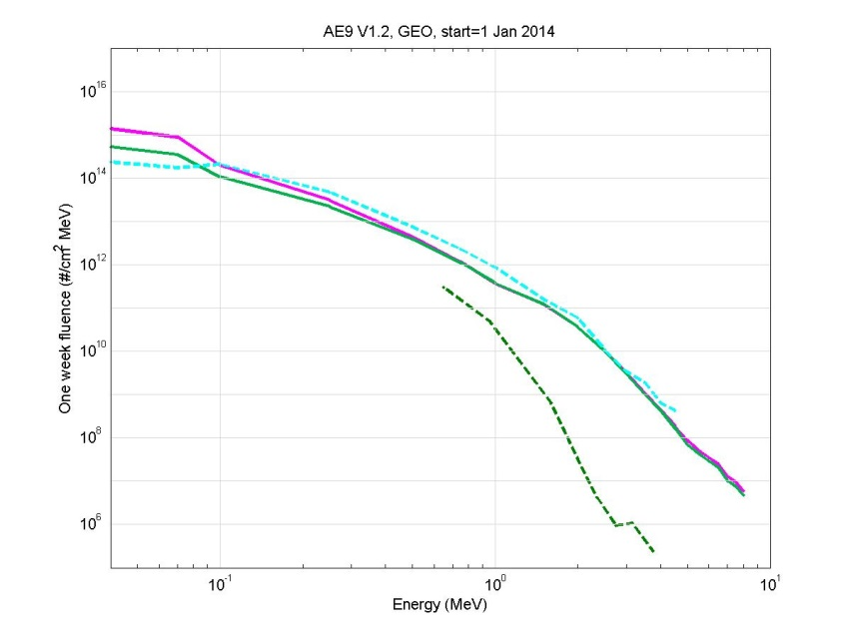
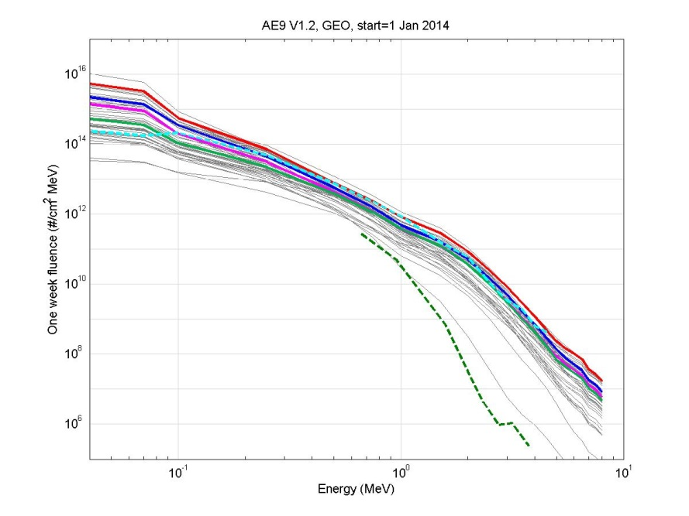


Example—AE9 in GEO
Mean Spectra
Monte Carlo Spectra
2 MeV time series
10 years
Compare to GOES >2 MeV fluence

Slide 37




AE9/AP9 Compared to AE8/AP8
AE8
AE9 V1.2
0.1 MeV
AP8
AP9 V1.2
1 MeV
Z (R_{E})
Z (R_{E})
X (R_{E})
X (R_{E})
AE8
AE9 V1.2
1 MeV
AP8
AP9 V1.2
30 MeV
Z (R_{E})
Z (R_{E})
X (R_{E})
X (R_{E})

Slide 38




AE9-to-AE8 flux ratio
ratio
100
10
1
0.1
0.01
ratio
100
10
1
0.1
0.01
Z (R_{E})
0.1 MeV
Z (R_{E})
X (R_{E})
X (R_{E})
ratio
100
10
1
0.1
0.01
ratio
100
10
1
0.1
0.01
1 MeV
Z (R_{E})
Z (R_{E})
X (R_{E})
X (R_{E})

Slide 39




AP9-to-AP8 flux ratio
ratio
100
10
1
0.1
0.01
ratio
100
10
1
0.1
0.01
Z (R_{E})
1 MeV
Z (R_{E})
X (R_{E})
X (R_{E})
ratio
100
10
1
0.1
0.01
ratio
100
10
1
0.1
0.01
30 MeV
Z (R_{E})
Z (R_{E})
X (R_{E})
X (R_{E})

Slide 40
Known Issues—V1.0
No reliable data for inner zone electrons at lower energy (<~ 600 keV)
  Spectral and spatial extrapolation can lead to large deviations (e.g., comparison to POES and DEMETER data)
  No worse than AE8
No data for high energy protons (> 200 MeV)
  No data – spectra are extrapolated based on physical models
  The primary reason for flying the Relativistic Proton Spectrometer (RPS) on the Van Allen Probes
SPMO (plasma oxygen) and SPME (plasma electron) have small errors which do not reflect the uncertainty in the measurements
  Not much data (one instrument) with uncorrelated errors
  Spectral smoothness was imposed at the expense of clamping the error bar
Error in the primary variables θ₁ (log 50th percentile) and θ₂ (log 95th-50th percentile) capped at factor of 100 (electrons) and 10 (protons)
  Large variations in these quantities can quickly lead to obviously unrealistic variations in fluxes derived from our assumed non-Gaussian distributions
  Does not limit representation of space weather variation which is captured in θ₂ (95th %)
RBSP/Van Allen Probe data will be incorporated into V2.0 and should address many of the V1.0 deficiencies

Slide 41
International Collaboration
Boulder workshop October 2012
  Proposed AE9/AP9/SPM as an ISO standard
  Initiated participation from ESA, Russia, Japan
Santorini Workshop June 2013
Azur data
  Obtained data set from Daniel Heynderickx
  Will be incorporated into next release
SPENVIS
We invite additional collaboration
  New data sets
  Additional applications & functionality
International collaboration on future updates, (as with IGRF, IRI)
A new name:
  IRENE -- International Radiation Environment Near Earth
  Will gradually replace “AE9/AP9” as international involvement increases

Slide 42
Recent AE9/AP9 Improvements
CmdLineAe9Ap9 Program
Support more SHIELDOSE2 options
Improved Linux compiler optimization settings
Documented command-line options
Multiple file limit resolved
MJD conversion fixed
User’s Guide Document
Additional information provided for
  SHIELDOSE2 model parameters
  Legacy model ‘advanced’ options
  Model performance tuning
  Orbit definition parameters
  Coordinate system details
  Modified Julian Date conversions
Graphical User Interface
Clarified labels & error messages
Added more ‘tooltip’ information
Various GUI behavior fixes
New Utility Programs
PlasmaIntegral
  Adjusts Plasma integral flux calculations (for non-GUI runs)
CoordsAe9Ap9
  Calculates ‘Adiabatic Invariant’ coordinates from satellite ephemeris

Slide 43



Comparison of AE8/AP8 (legacy) models to external implementations
Model Run Parameters
Ax8 in CmdlineAe9Ap9, IRBEM and SPENVIS
CRRES satellite orbit (GTO)
Fixed Epoch & Shift SAA options ‘on’
28 Feb 2005 (arbitrary), 24 hours, Δt=120 sec
Comparison Results
Most model results nearly matching
  Different magnetic field models used
Integral Flux results match
Differential Flux results near match
  Differences due to calculation method
SHIELDOSE2 results mostly match
  Slight offset due to Diff Flux differences
Full report documents all findings

Slide 44


Future Versions
One major pitfall of AE8/AP8 was the cessation of updates derived from new space environment data and industry feedback
To insure that AE9/AP9 remains up to date and responsive to program evolution, the following actions must occur in 2013 to 2015:
  Complete full documentation of V1.0 and release underlying database
  Add these industry-requested capabilities: solar cycle dependence of LEO protons; a “sample solar cycle”; local time dependence of plasmas; longitude dependence of LEO electrons
  Ensure ongoing collection of new data to fill holes, improve accuracy, and reduce uncertainty (e.g. Van Allen Probes, with emphasis on inner belt protons; AFRL/DSX; TacSat-4, foreign and domestic environment datasets)
  Establish mechanism for annual updates to result in V1.20 in 2014, V1.5 in 2015, V2.0 in 2016
NOAA/NGDC has offered to coordinate 5-year updates after 2015
  NGDC hosted an international collaboration workshop for AE9/AP9 in October 2012
Relativistic Proton Spectrometer
NASA Van Allen Probes (RBSP)
Launch August 2012
Keeping the model alive will insure that it stays in step with concerns in program acquisition and lessons from space system flight experience.

Slide 45

Version 1.05
We rediscovered an error in SHIELDOSE2 (NIST version)
  Swapped data tables for Bremsstrahlung in some geometries
  SPENVIS and OMERE had the fix already
  IRBEM-LIB did not (it does now)
  All implementations now agree to within 20% or better
Public release in August 2013

Slide 46
Thank You

