Slide 1
Development of Magnetospheric and Rapid 1D Shielding Analysis Tools for Simulating Heavy Ions in the SEPEM System Fan Lei (Radmod Research), Pete Truscott (Kallisto Consultancy) , Daniel Heynderickx (DH Consultancy), Athina Varotsou (TRAD), Piers Jiggens (ESA/ESTEC & Rhea), Hugh Evans (ESA/ESTEC & Rhea), M. A. Shea, Don F. Smart (CSPAR, University of Alabama at Huntsville)
Currently the Solar Energetic Particle Environment Models (SEPEM) system treats only protons within the interplanetary environment, and the shielding analysis is performed using detailed Monte Carlo Geant4-based tools. ESA’s ESHIEM (Energetic Solar Heavy Ion Environment Models) project is extending this capability in order to treat all heavier solar ion species, and to allow assessment of magnetospheric shielding in near-Earth orbits as a function of ion species and charge state. In addition, the physical (material) shielding model is being updated to use more efficient ion shielding analysis rather than very lengthy Monte Carlo techniques.
The ESHIEM Project is sponsored by ESA under Contract 4000107025/12/NL/GLC, supported by the Technology Research Programme

Slide 2
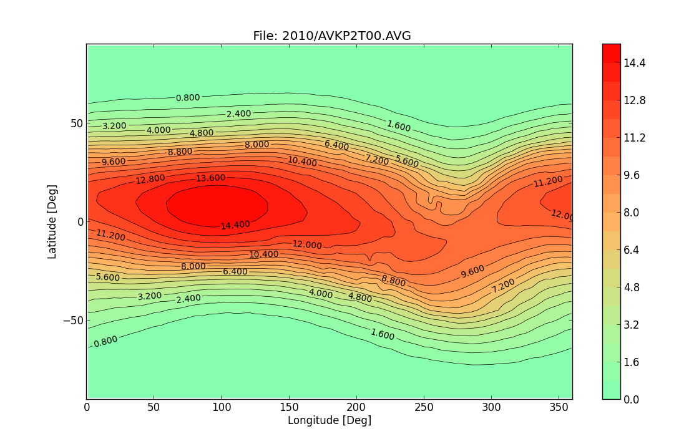
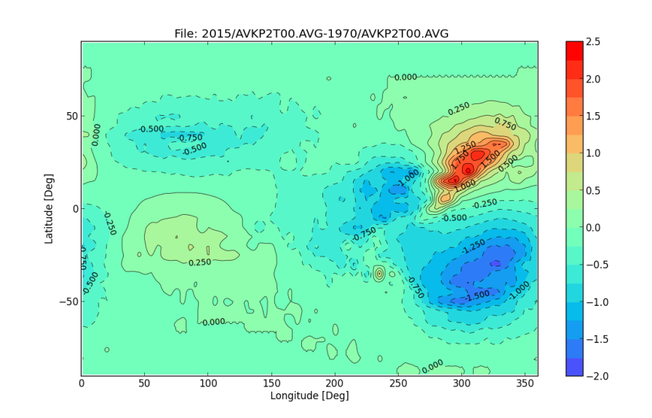
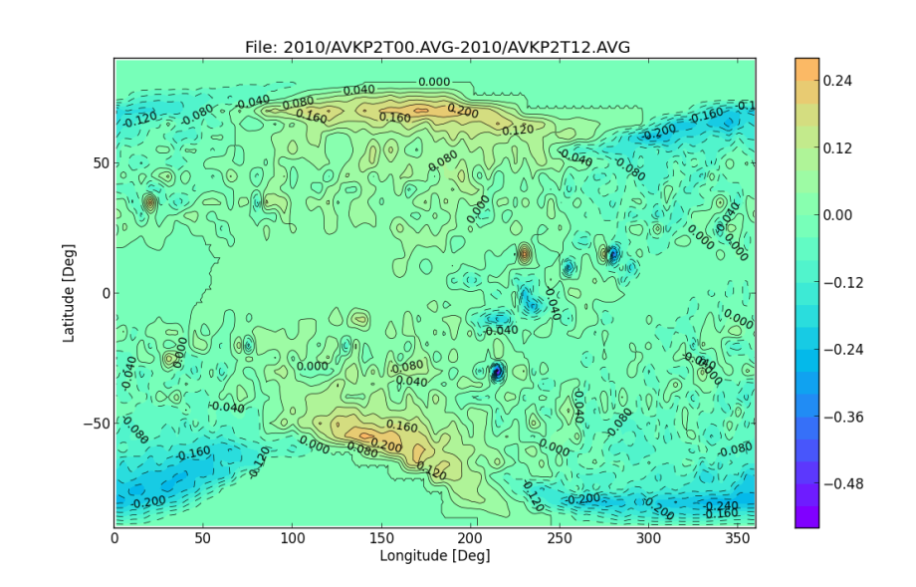
Magnetospheric Shielding Model (MSM)
Interpolates from extensive new database of MAGNETOCOSMIC geomagnetic cut-off maps:
5º x 5º longitude and latitude grid at 450km
DGRF/IGRF field models with Tsyganenko 1989c model (Kp 0-9)
Epochs for geomagnetic fields 1955 to 2015
Every 3 hrs in UT
Cut-off rigidities interpolated and extrapolated to all space within the magnetosphere, based on the approach of Shea and Smart used in the RCINTUT3 program
Example of a pre-calculated cut-off (GV) map. It is for 01/01/2010, UT=0 and Kp =0.
Changes in the rigidity cut-off (GV) between 1975 and 2010. UT= 0 hr and Kp = 2
Changes in the rigidity cut-off (GV) between UT = 0 and 12 hrs. It is for 01/01/2010, Kp =2.

Slide 3
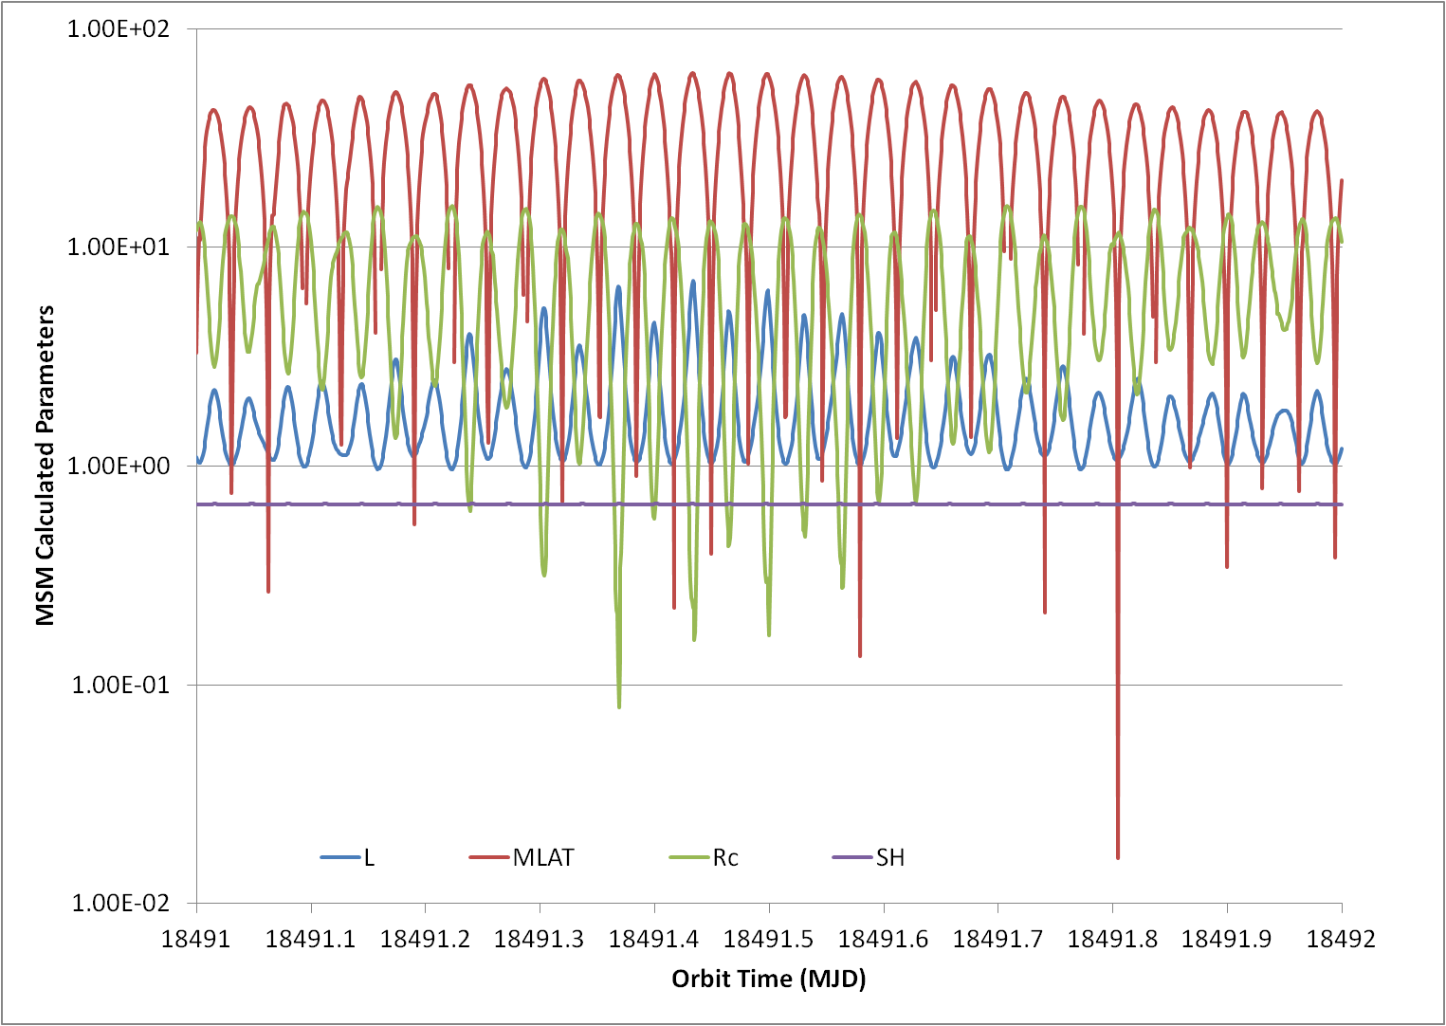
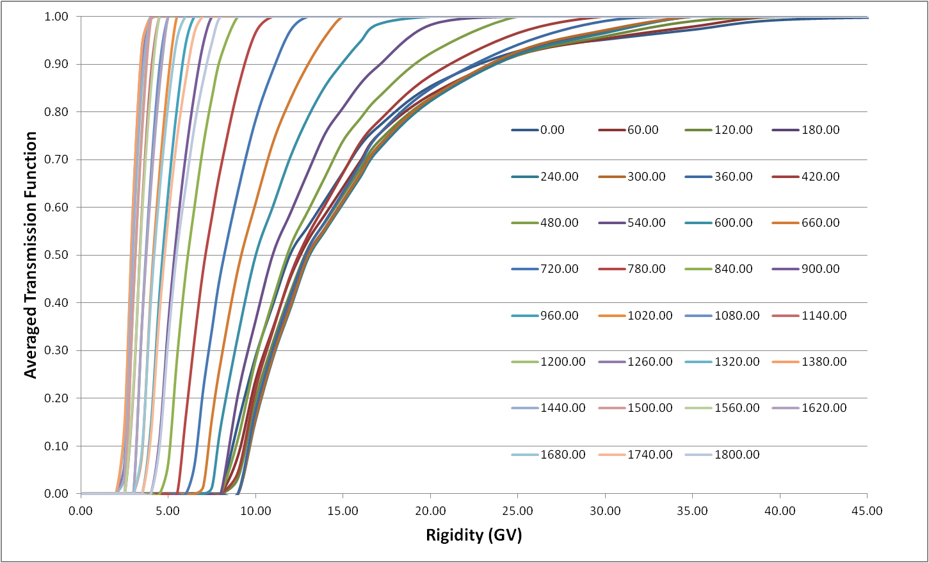
MSM Example: One Day ISS Orbits
MSM in the updated SEPEM system:
Inputs:
Orbit files from the new SPICE based orbit propagator
User specified or system calculated geomagnetic condition (Kp)
Outputs:
Vertical cut-off rigidity
McIlwain parameter
Magnetic latitude
Earth shadowing factor
Transmission function
Averaged over 4π direction
0.1 – 60 GV range
On the right are plots of MSM results for an One-day orbit file of the ISS, produced using the SEPEM Orbit generator, used as input to the MSM.
The MSM calculated vertical rigidity cutoff (Rc), McIlwain parameter (L), Magnetic latitude (MLAT) and Earth shadowing factor (SH), plotted as functions of the orbital time.
The MSM calculated transmission function at each orbit positions for the first 30 mins of the orbit file, which is in 1 min time resolution.

Slide 4
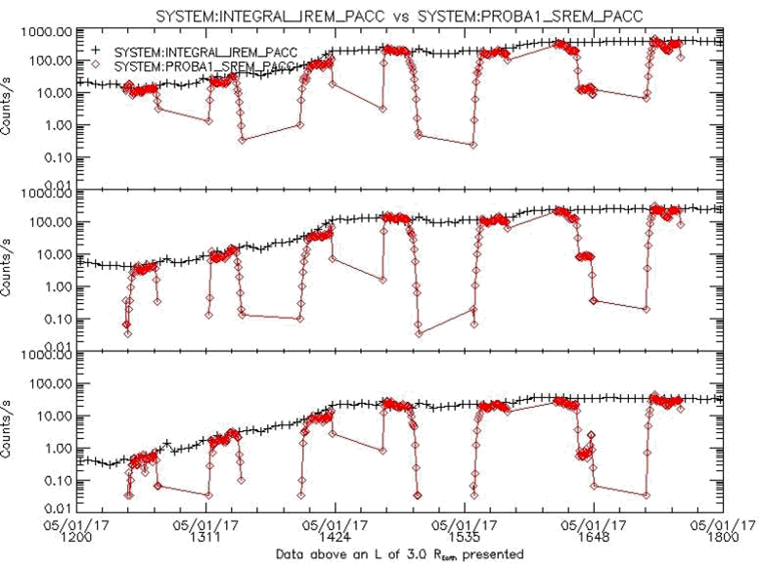
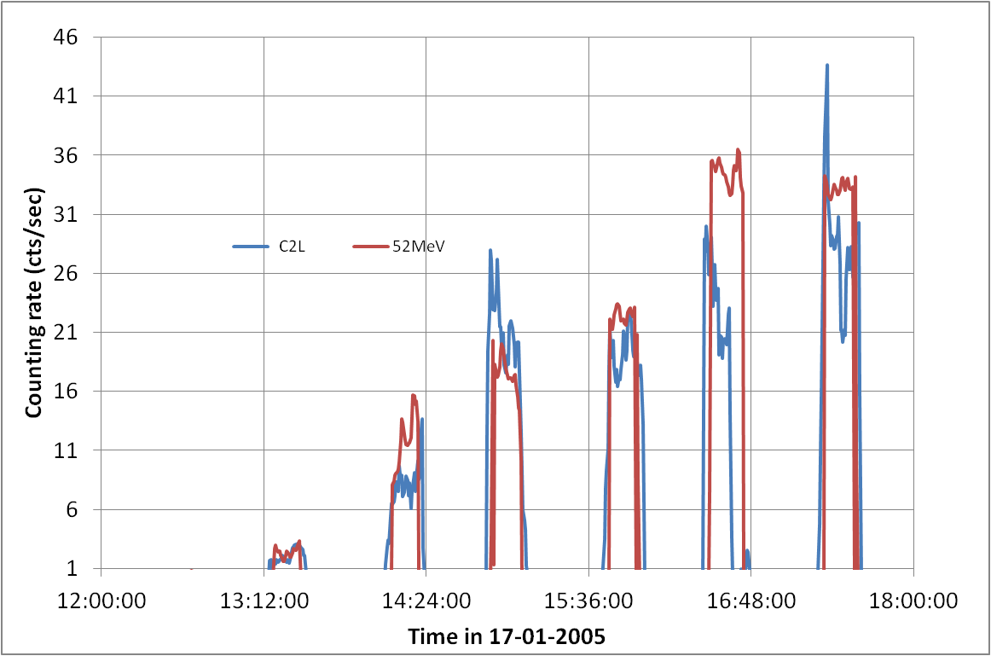
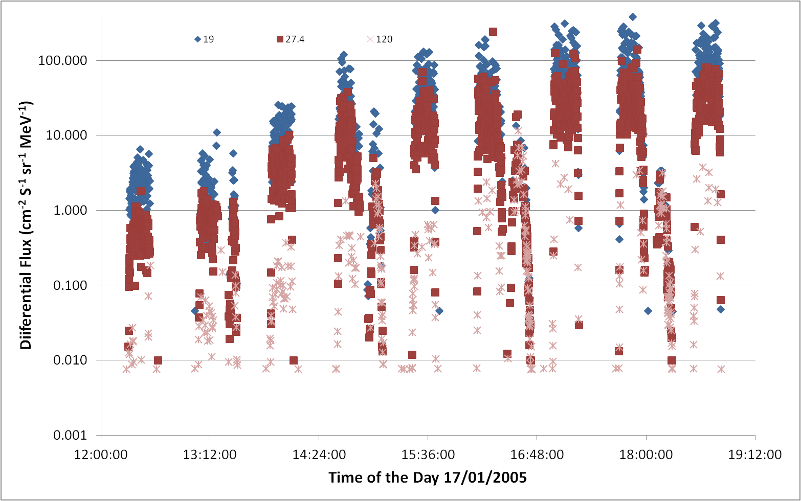
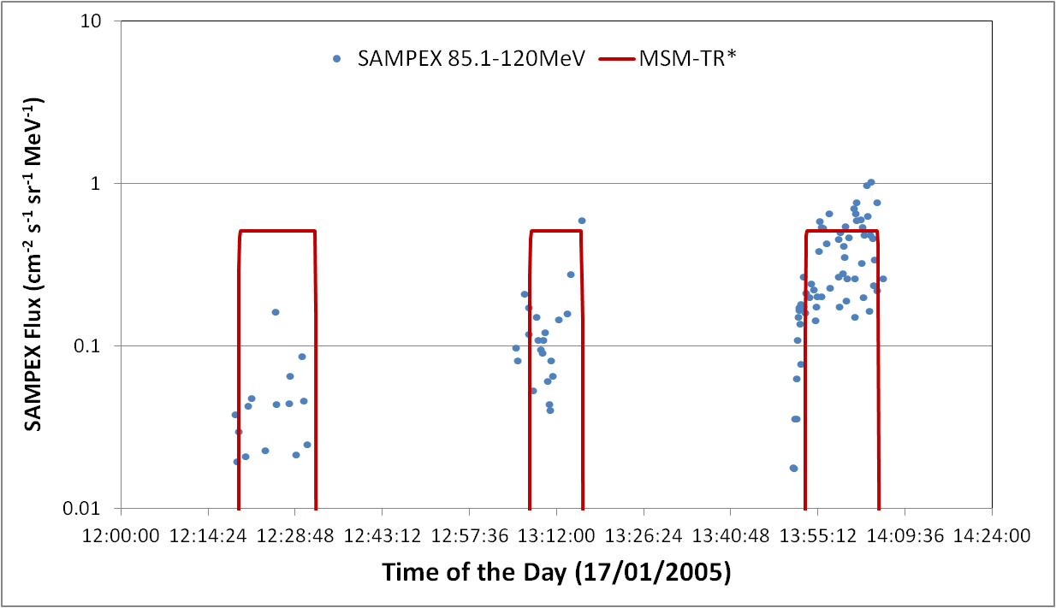
MSM Validation: The 17/01/2005 SEP Event
INTEGRAL and PROBA1 SREM data: left) The SEP observed by SREM. INTEGRAL in interplanetary space and PROBA1 in polar orbit; right) PROBA1 and INTEGRAL multiplied by the MSM transmission function.
SAMPEX data: left) SAMPEX data of the SEP event; right) SAMPEX data in the 85.1-120 MeV channel and the corresponding MSM transmission function.

Slide 5
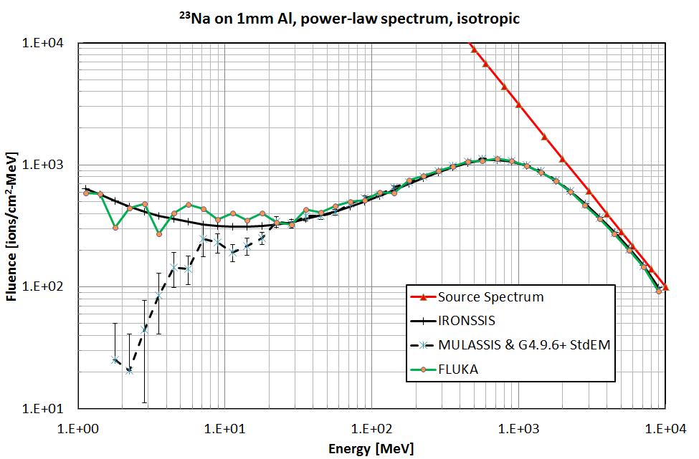
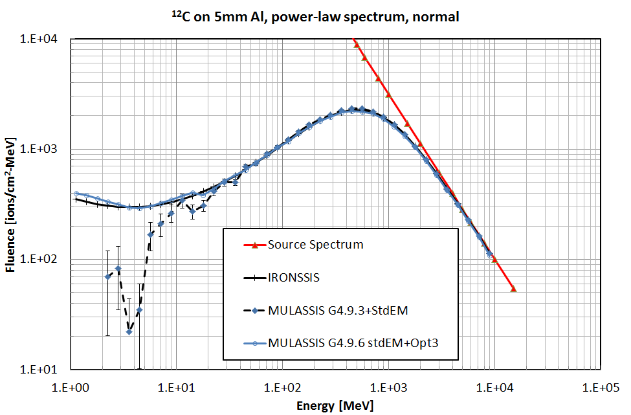
Ion Rapid ONe-dimensional Shielding Simulation Software (IRONSSIS)
Implemented as optional alternative to MULASSIS (Geant4-based 1D shielding analysis software) which is currently in SEPEM
Treats 1D multi-layer shielding structures of any material(s) using straight-ahead CSDA (continuous slowing-down approximation) approach
Output fluence, LET spectra, total ionising dose (TID) and displacement damage effects (if non-ionising energy loss coefficient are provided by user)
Uses heavy ion stopping powers and ranges from Geant4:
ICRU-49 – protons and α-particles
ICRU-73 – PASS model results for selected ions
²³Na ions incident with power-law spectrum (in red) on 1mm Al shield (isotropic incidence) – IRONSSIS, MULASSIS and FLUKA lines show spectra of ions leaving shield
¹²C ions incident with power-law spectrum (in red) on 5mm Al shield (normal incidence) – IRONSSIS and MULASSIS lines show spectra of ions leaving shield

