Slide 1
M. Echim, H Lamy, Y Voitenko - Brussels
E. Yordanova, M André, H. Breuillard - Uppsala/Kiruna
W. Macek, A. Wawrzaszek - Warsaw
G. Consolini, R. Bruno, G. Pallochia, MF Marcucci - Rome
P. Kovacs, A. Koppan - Budapest
G. Voitcu, C Munteanu, E. Teodorescu, C. Negrea – Bucharest
K. Mursula, I. Virtanen, P. Vaisanen - Oulu
Z. Voeroes, Y. Narita, N. Dwivedi, T. Zaqarashvili - Graz
T. Chang - MIT, USA
J. Johnson - Princeton, USA
K-H Glassmeier - Braunschweig

Slide 2
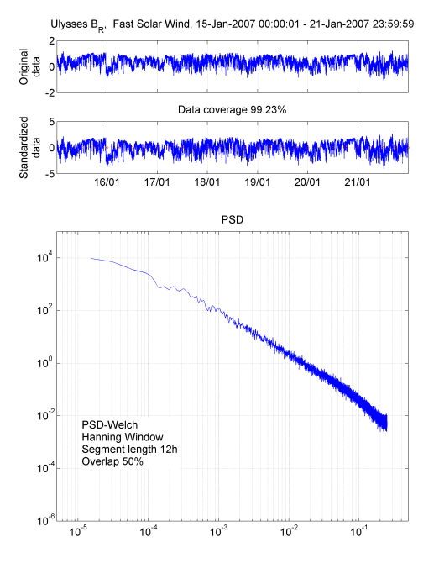
Solar System Plasma Turbulence and Intermittency
over the Solar Cycle from in-Situ Measurements in
the Heliosphere and Planetary Environments
Probability distribution function analysis of plasma and magnetic field data.
Spectral analysis of the magnetic and plasma data

