Slide 1
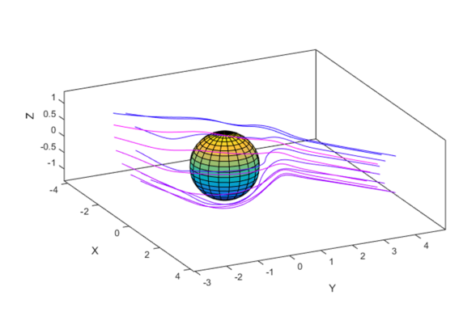
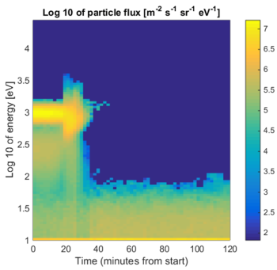
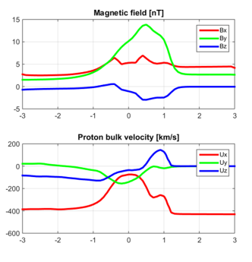
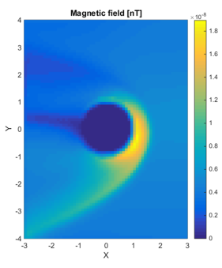
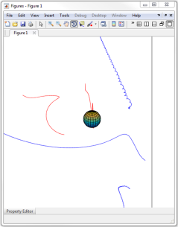
IMPEx/FMI-HWA planetary simulations database and Matlab tools for easy access
IMPEx provides a web-based infrastructure for inter-comparison of measurements and models in planetary plasma science.
observational databases (CDAWeb, AMDA, CLWeb),
numerical simulation databases (FMI-HWA, LATMOS, SINP).
FMI HWA provides simulations with HYB and GUMICS
Online plotting and data download.
IMPEx-FMI-Matlab is an m-file package which facilitates retrieving the data directly in your Matlab, at your chosen coordinate sets.

