Slide 1
Provision of Web Based Space Weather Services
Catherine Burnett, ESWW-11, Liege, 17-21st November 2014
Notes:
The Met Office has a responsibility, as the UK risk owner, to raise the level of understanding about space weather, provide an operational forecast and warning service and help organisations be prepared for potential impacts.

Slide 2
Communication Challenges in Providing Web Pages
Diverse user group with wide range of space weather knowledge
General public
Government decision makers
Industry
Scientific experts
Diverse user requirements
Interest in different types of space weather & its impacts
Speed of updates
Method of communication – beyond the web page

Slide 3
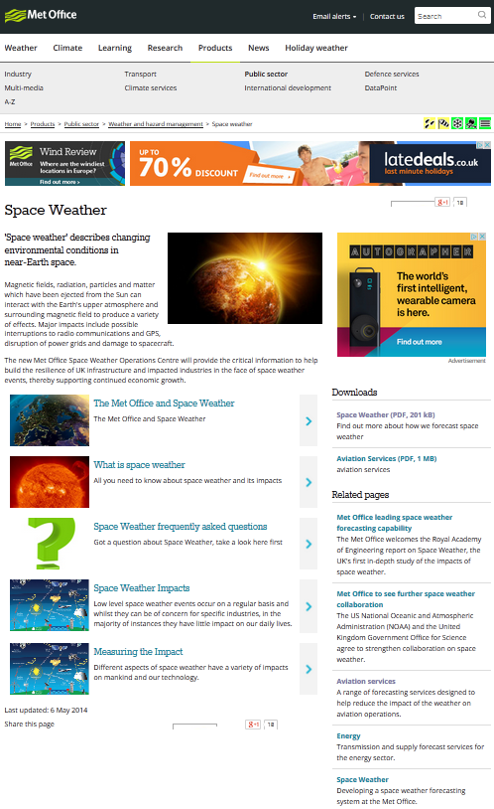
Public Web Pages
To be written in non-scientific terms
Linked to pages explaining meaning of forecasts and space weather impacts
Include education pages as well as forecasts

Slide 4
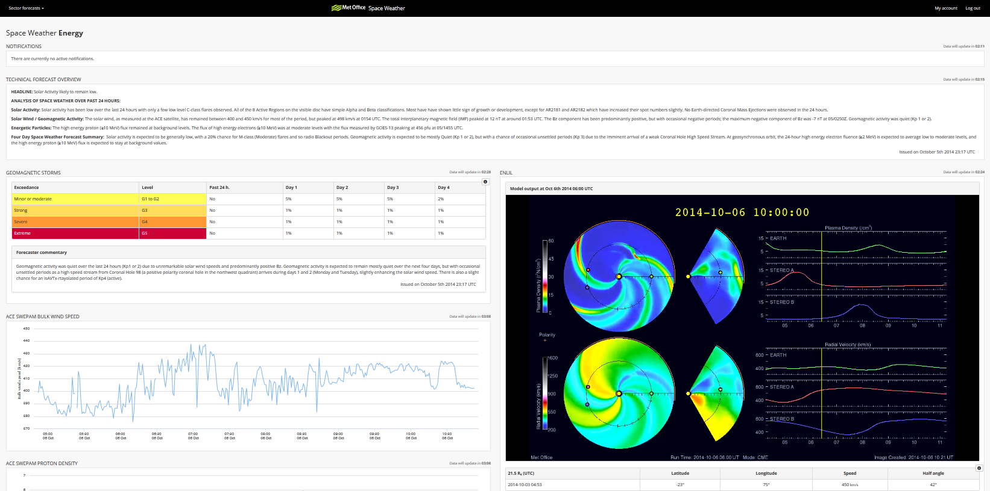
Sector Specific web pages
Tailored to the requirements of different industry sectors

Slide 5
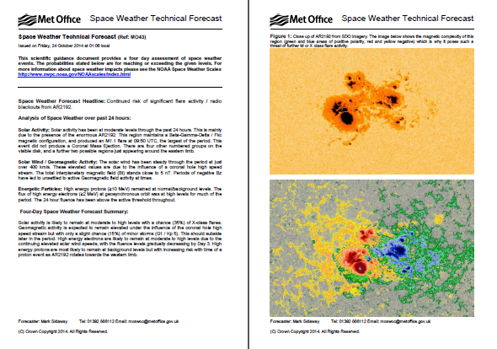
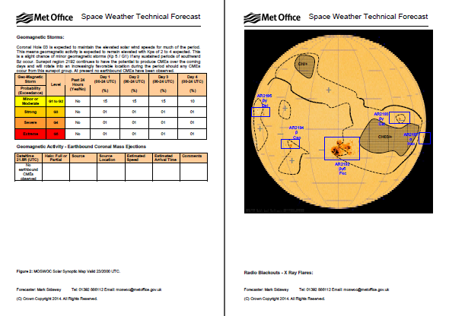
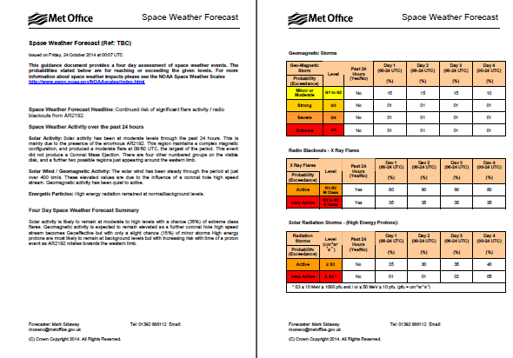
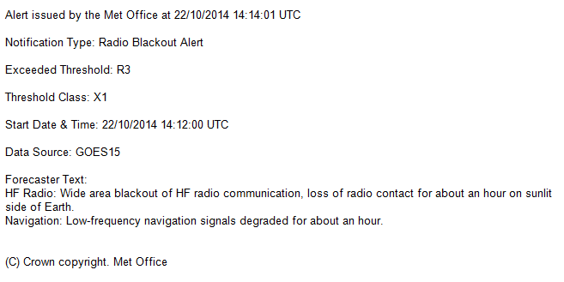
Supporting products

Slide 6
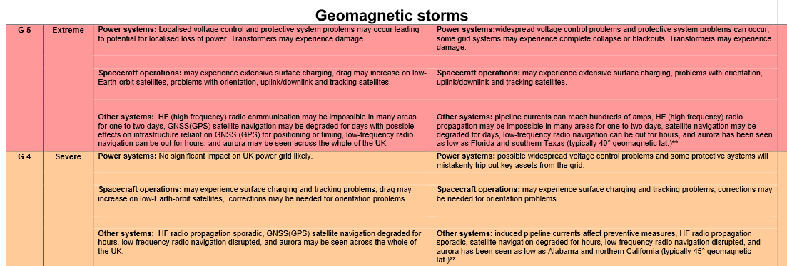
Conclusions
Provide products tailored to user groups
written in comprehensible manner
usable format (web pages, emails, coded data)
Users set preferences for alerts and warning thresholds
Impacts related to UK & Global infrastructure

