Slide 1
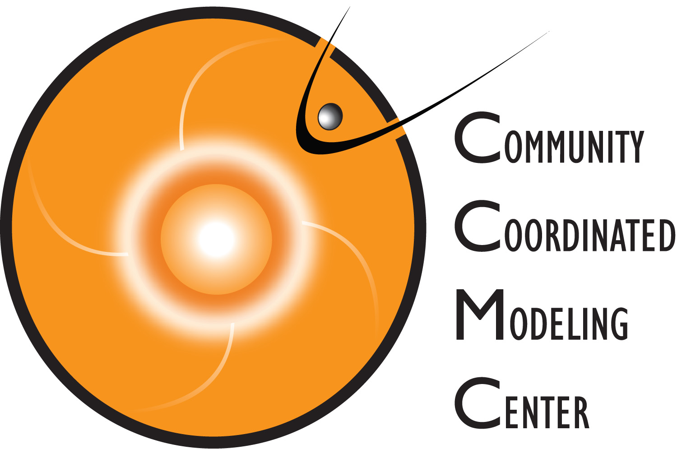
Accelerating Implementation of Advanced Space Weather Models and Forecasting Systems in Operations.
M. Kuznetsova, M. Maddox, S. Bakshi, J. Boblitt, A. Chulaki, A. Glocer, P. Macneice, M. L. Mays, A-M. Mendoza, R. Mullinix, K. Patel, A. Pembroke, A. Pulkkinen, L. Rastaetter, S. Shim, A. Taktakishvili, C. Wiegand, Y. Zheng.
MODELS • DATA • TOOLS • SYSTEMS • SERVICES • DATABASES

Slide 2
Community Coordinated Modeling Center
A multi-agency partnership to
support research and development
for next generation of space science & space weather models
Established in 2000 as an essential element of the
National Space Weather Program
Designed to be a long-term & flexible solution to the
Research-to-Operations (R2O) transition problem
Notes:
Game changing step in space weather program
Changed the way how simulations are utilized in research.
Paved the way for progress in space science research to space weather operations.

Slide 3
CCMC Goals
Facilitate
Research,
& Development
Support
Research-2-Operations
Transition
Address
Space Weather Needs
of NASA
CCMC Partners: International Research Community, Model Owners,
NASA Engineers and Mission Specialists,
Operational Space Weather agencies (NOAA, DoD, UK Met Office).
Notes:
The CCMC Now is pursuing the following goals:
Facilitate research, education and development of next generation Space weather models and tools.
Support research models and advanced forecasting techniques transition to operations.
Address unique space weather needs of NASA user.

Slide 4
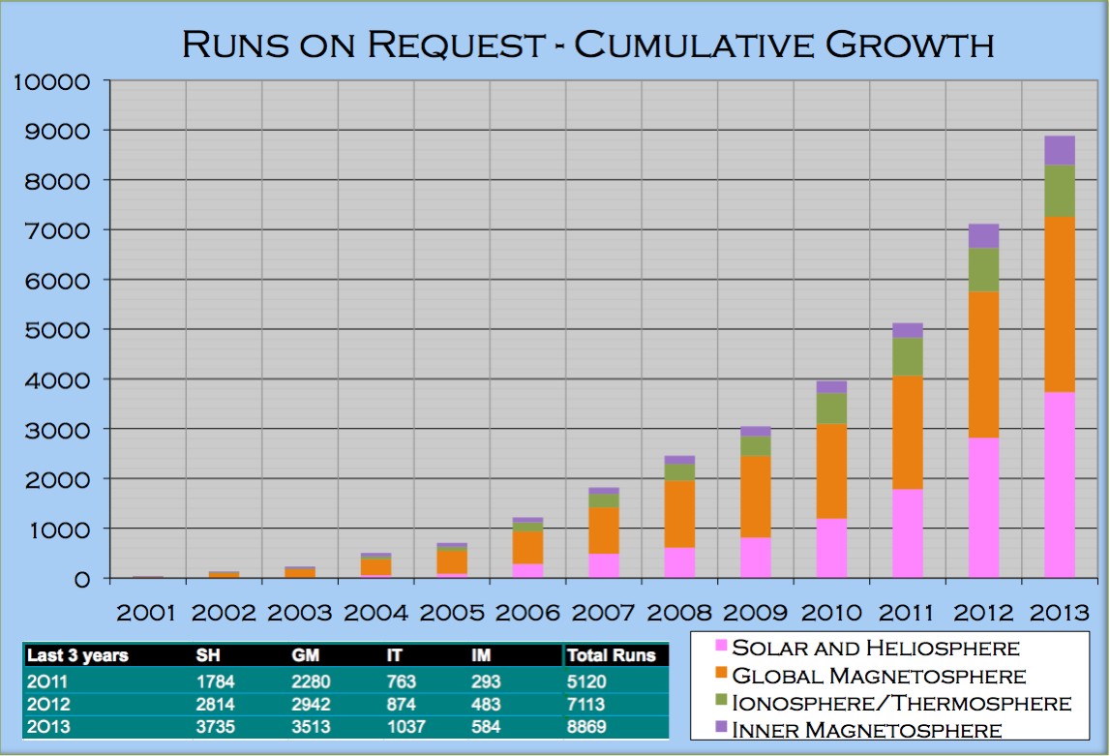
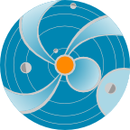
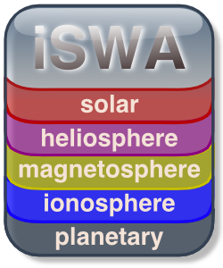
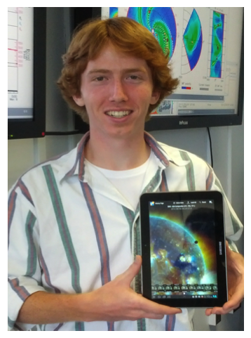
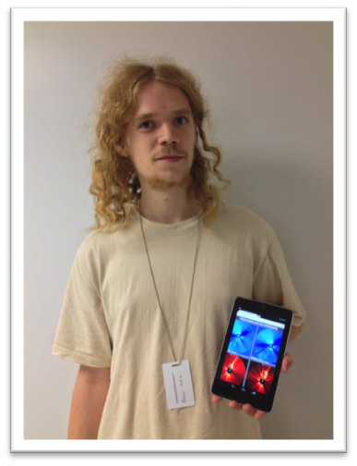
CCMC Assets & Services
(elements of R2O transition)
Models
Simulation
Services
Assessment,
Metrics & Validation
(> 10,500 runs)
(expanding collection: > 60)
Tools, Systems,
Databases for dissemination, analysis, forecasting, validation
Space Weather
Services
for NASA’s missions
Hands-on
Education
Space Weather Research Center
StereoCAT
DONKI
FastTrack
ScoreBoard
Notes:
CCMC Core Assets and Services
MODELS: The CCMC hosts a unique and expanding collection of state-of-the-art space science and space weather models developed by the international research community. As of November 2014, there are more than 60 models and model combinations that cover the entire domain from the solar corona to Earth’s upper atmosphere. This is a big change from 2 models in 2000-2002.
As a model repository, the CCMC serves as a corporate memory to capture the lessons and benefits of the development. The CCMC collaborates with individual model owners as well as major modeling programs to bring in new models, it also maintains, enhances, and evolves models that currently reside at the CCMC.
CCMC is inclusive. Many proposals that include model development now promise to deliver the final model version to the CCMC. As a designated recipient of LWS (Living With a Star) strategic capabilities deliverables, the CCMC is expecting a significant increase in both the quantity and complexity of models within the next 3-5 years.
SIMULATION SERVICES: Models are served to the international research community
through one-of-a-kind web-based interactive Runs-on-Request (RoR) service.
User-configurable input parameters and model settings.
Maximize return on investments into model development.
Many of models are continuously running in real-time.
MERTICS & VALIDATION
The development of predictive space-weather capabilities requires more than just assembling a collection of models and model combinations. Confidence assessment is an essential element of predictive model development that ultimately makes forecasting valuable for end users. Defining metrics formats that are relevant to specific applications is a challenging task that requires an understanding of both science and engineering sides of the space environment impact problem. CCMC is leading a series of community-wide model validation projects such as the CEDAR, GEM, and SHINE Metrics Challenges. The CCMC, because of its neutrality, is uniquely placed to test and validate models as an unbiased agent.
MULTI-PURPOSE TOOLS, SYSTEMS, DATABASES
The CCMC is developing multi-purpose tools for research, analysis, M&V, and forecasting
SPACE WEATHER SERVICES FOR NASA
SWRC is the CCMC’s in-house research-based space weather prototyping team. It was established in 2010 to address NASA’s unique interplanetary space weather needs and to provide custom space weather services to NASA’s internal users. The SWRC monitors the space environment in real-time, test-drives forefront space weather models and forecasting techniques, demonstrates their operational potential to operational agencies, builds and maintains knowledge bases, and provides feedback to developers. Interactive and agile in-house prototyping is an essential element of the CCMC function to fill the gaps in transitioning models and tools from research to operations
HANDS-ON EDUCATION
The CCMC assets and activities provide unique, multi-faceted, and multi-layered opportunities for hands-on education and knowledge dissemination. Working with students is a part of CCMC everyday life.

Slide 5
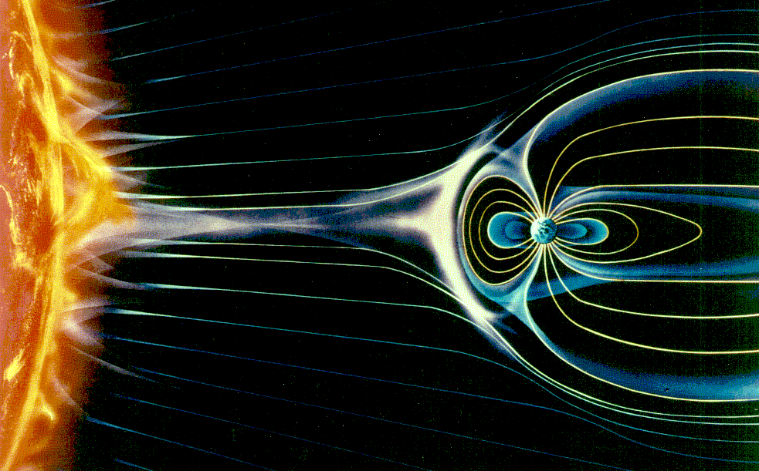
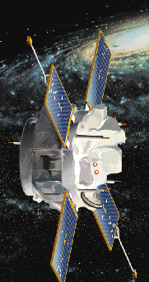
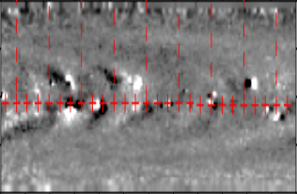
Expanding Collection of Models
Heliospheric Tomography
LFM-MIX
GUMICS
SWMF / GM+IM+IE
OpenGGCM
PFSS
EMMREM
ANMHD
Solar/SW Monitors
Fok RC
Fok RB
CRCM
CIMI
RCM
WINDMI
Ovation
Tsyganenko
LANLstar
Plasmasphere
VERB
Weimer
CTIPe
TIEGCM
AbbyNormal
USU-GAIM
SAMI3
GITM
IRI
MSESE
Triple-DA
PBMOD
PREDICCS
Coronal Magnetograms
WSA
ENLIL
MAS
ENLIL Cone
CorHel
SWMF-SC
SWMF-IH
Corona
Heliosphere
Magnetosphere-Ionosphere
> 60, from Sun to Earth and beyond

Slide 6
Linking Space Environment Models with Engineering Models Calculating Impacts
Space radiation analysis, D. Fry et al., NASA JSC/SRAG
Surface charging modeling, H. Garret et al., NASA JPL
Internal charging, J. Minow et al. , NASA MSFC
SEU modeling, K. Label et al., NASA GSFC
Satellite drag & conjunction assessment, L. Newman, GSFC
……….
Solar Shield, A. Pulkkinen, NASA GSFC

Slide 7
CCMC Assets & Services
(elements of R2O transition)
Models
Simulation
Services
Assessment,
Metrics & Validation
(> 10,500 runs)
(expanding collection: > 60)
Tools, Systems,
Databases for dissemination, analysis, forecasting, validation
Space Weather
Services
for NASA’s missions
Hands-on
Education
Space Weather Research Center
StereoCAT
DONKI
FastTrack
ScoreBoard
Notes:
CCMC Core Assets and Services
MODELS: The CCMC hosts a unique and expanding collection of state-of-the-art space science and space weather models developed by the international research community. As of November 2014, there are more than 60 models and model combinations that cover the entire domain from the solar corona to Earth’s upper atmosphere. This is a big change from 2 models in 2000-2002.
As a model repository, the CCMC serves as a corporate memory to capture the lessons and benefits of the development. The CCMC collaborates with individual model owners as well as major modeling programs to bring in new models, it also maintains, enhances, and evolves models that currently reside at the CCMC.
CCMC is inclusive. Many proposals that include model development now promise to deliver the final model version to the CCMC. As a designated recipient of LWS (Living With a Star) strategic capabilities deliverables, the CCMC is expecting a significant increase in both the quantity and complexity of models within the next 3-5 years.
SIMULATION SERVICES: Models are served to the international research community
through one-of-a-kind web-based interactive Runs-on-Request (RoR) service.
User-configurable input parameters and model settings.
Maximize return on investments into model development.
Many of models are continuously running in real-time.
MERTICS & VALIDATION
The development of predictive space-weather capabilities requires more than just assembling a collection of models and model combinations. Confidence assessment is an essential element of predictive model development that ultimately makes forecasting valuable for end users. Defining metrics formats that are relevant to specific applications is a challenging task that requires an understanding of both science and engineering sides of the space environment impact problem. CCMC is leading a series of community-wide model validation projects such as the CEDAR, GEM, and SHINE Metrics Challenges. The CCMC, because of its neutrality, is uniquely placed to test and validate models as an unbiased agent.
MULTI-PURPOSE TOOLS, SYSTEMS, DATABASES
The CCMC is developing multi-purpose tools for research, analysis, M&V, and forecasting
SPACE WEATHER SERVICES FOR NASA
SWRC is the CCMC’s in-house research-based space weather prototyping team. It was established in 2010 to address NASA’s unique interplanetary space weather needs and to provide custom space weather services to NASA’s internal users. The SWRC monitors the space environment in real-time, test-drives forefront space weather models and forecasting techniques, demonstrates their operational potential to operational agencies, builds and maintains knowledge bases, and provides feedback to developers. Interactive and agile in-house prototyping is an essential element of the CCMC function to fill the gaps in transitioning models and tools from research to operations
HANDS-ON EDUCATION
The CCMC assets and activities provide unique, multi-faceted, and multi-layered opportunities for hands-on education and knowledge dissemination. Working with students is a part of CCMC everyday life.

Slide 8
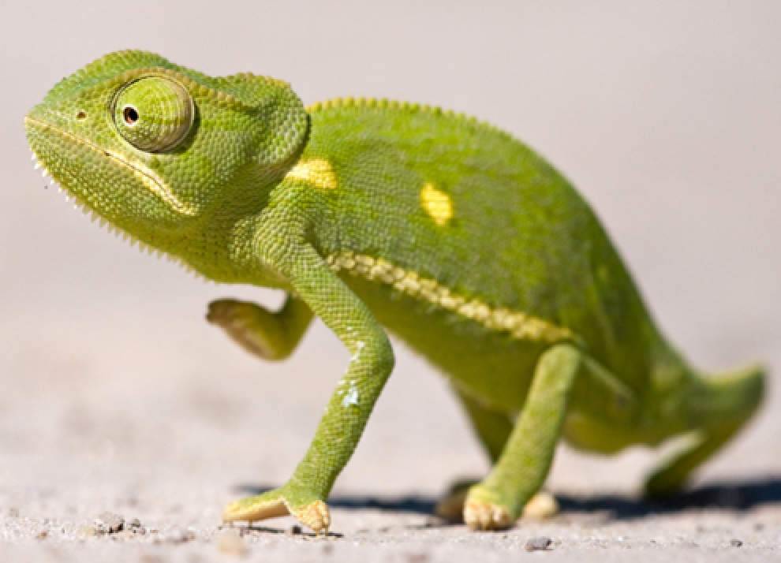
Simulation Services
Runs-on-Request
Event-Triggered Real-time Simulations
Input Parameters
Generation Tool
StereoCAT - CME Analysis Tool
> 10,500 runs
EEGGL – Eruptive Event Generator by Gibson-Low
FastTrack
WSA-Enlil-Cone
Model Output Standards, Conversion, Access, Interpolation Libraries
Continuous
Real-time Simulations
Ensemble Simulations
KAMELEON
Notes:
SIMULATION SERVICES:
Runs-on-Request
Models are served to the international research community
through one-of-a-kind web-based interactive Runs-on-Request (RoR) service.
Maximize return on investments into model development.
Models are exposed to a huge user-base
Models are tested by a large number of users, while source code is not distributed
INPUT PARAMETERS GENERATION TOOLS
Stereo Coronal Mass Ejection Analysis Tool (StereoCAT) is a component of the CCMC’s on-line Input Parameters Generation Suite that enables RoR users and space weather forecasters to quickly calculate the kinematic properties of Coronal Mass Ejections (CMEs). With a few mouse clicks, StereoCAT uses triangulation of SOHO and STEREO coronagraph images to determine CME speed, direction, and opening angle. The derived CME parameters can be utilized as input for a broad range of CME propagation models (including real-time Enlil-Cone model of CME propagation).
User configurable input parameters
From simple observable parameters and time series (e.g. ACE solar wind) to complex magnetograms and coronagraph images analysis (e.g., StereoCAT)
EVENT-TRIGGERED REAL-TIME SIMULATIONS
1-Click system to submit event-triggered forecasting simulations (e.g., Enlil Cone Model).
Enables any interested person to generate forecasts.
CONTINOUS REAL-TIME SIMULATIONS
Models continuously running in real-time (with real-time drivers).
Data flow monitoring and controlling systems
ENSEMBLE SIMULATIONS
to address uncertainties in input parameters

Slide 9
Driver Swapping (MI Coupling) Patch-Panel Tool
Enabled by Kameleon
High-Latitude Electric Potential Models
Particle Precipitation
Models
Penetration Electric Field Models
empirical
data assimilation
global MHD
empiricalanalyticl
global MHD
inner magnetosphere
Heelis
Weimer
Foster
Heppner & Maynard
Ridley
AMIE
SuperDARN
SWMF
OpenGGCM
LFM
Fuller-Rowell & Evans
Hardy et al.
Ovation Prime
Hardy et al.
Ovation Prime
Roble & Ridley
SWMF
OpenGGCM
LFM
Driven by SWMF:
FRC
CRCM
RCM
Driven by Tsyganenko:
- RCM
All drivers are converted to a common format.
The tool is called as a KAMELEON subroutine to provide values on the grid;
call kameleon (model, time, mlts, mlats, variables, values_output)
Ionosphere/Thermosphere Models:
CTIPe/TIE-GCM/GITM

Slide 10
CCMC Assets & Services
(elements of R2O transition)
Models
Simulation
Services
Assessment,
Metrics & Validation
(> 10,500 runs)
(expanding collection: > 60)
Tools, Systems,
Databases for dissemination, analysis, forecasting, validation
Space Weather
Services
for NASA’s missions
Hands-on
Education
Space Weather Research Center
StereoCAT
DONKI
FastTrack
ScoreBoard
Notes:
CCMC Core Assets and Services
MODELS: The CCMC hosts a unique and expanding collection of state-of-the-art space science and space weather models developed by the international research community. As of November 2014, there are more than 60 models and model combinations that cover the entire domain from the solar corona to Earth’s upper atmosphere. This is a big change from 2 models in 2000-2002.
As a model repository, the CCMC serves as a corporate memory to capture the lessons and benefits of the development. The CCMC collaborates with individual model owners as well as major modeling programs to bring in new models, it also maintains, enhances, and evolves models that currently reside at the CCMC.
CCMC is inclusive. Many proposals that include model development now promise to deliver the final model version to the CCMC. As a designated recipient of LWS (Living With a Star) strategic capabilities deliverables, the CCMC is expecting a significant increase in both the quantity and complexity of models within the next 3-5 years.
SIMULATION SERVICES: Models are served to the international research community
through one-of-a-kind web-based interactive Runs-on-Request (RoR) service.
User-configurable input parameters and model settings.
Maximize return on investments into model development.
Many of models are continuously running in real-time.
MERTICS & VALIDATION
The development of predictive space-weather capabilities requires more than just assembling a collection of models and model combinations. Confidence assessment is an essential element of predictive model development that ultimately makes forecasting valuable for end users. Defining metrics formats that are relevant to specific applications is a challenging task that requires an understanding of both science and engineering sides of the space environment impact problem. CCMC is leading a series of community-wide model validation projects such as the CEDAR, GEM, and SHINE Metrics Challenges. The CCMC, because of its neutrality, is uniquely placed to test and validate models as an unbiased agent.
MULTI-PURPOSE TOOLS, SYSTEMS, DATABASES
The CCMC is developing multi-purpose tools for research, analysis, M&V, and forecasting
SPACE WEATHER SERVICES FOR NASA
SWRC is the CCMC’s in-house research-based space weather prototyping team. It was established in 2010 to address NASA’s unique interplanetary space weather needs and to provide custom space weather services to NASA’s internal users. The SWRC monitors the space environment in real-time, test-drives forefront space weather models and forecasting techniques, demonstrates their operational potential to operational agencies, builds and maintains knowledge bases, and provides feedback to developers. Interactive and agile in-house prototyping is an essential element of the CCMC function to fill the gaps in transitioning models and tools from research to operations
HANDS-ON EDUCATION
The CCMC assets and activities provide unique, multi-faceted, and multi-layered opportunities for hands-on education and knowledge dissemination. Working with students is a part of CCMC everyday life.

Slide 11
Assessment: Metrics & Validation
Forecasting
Methods ScoreBoards
Event-Based M&V to Trace Model Improvement
Impacts vs Space Environment Events Forecasts
2003/10/27 - 10/30
2006/12/13 - 12/16
2010/04/04 - 04/07
2011/08/05 - 08/07
………………………
Surface Charging
Testing predictive capability before the event onset.
A list of events.
High quality data.
A library of metrics.
Simulate the same set of events over and over…
A need for database of space environment impacts.
Examples:
CME Arrival Prediction
Flare Forecasts
SEP Forecasts
Examples:
TEC, Neutral density, Ground magnetic perturbations
A need for database of
events & alerts.

Slide 12
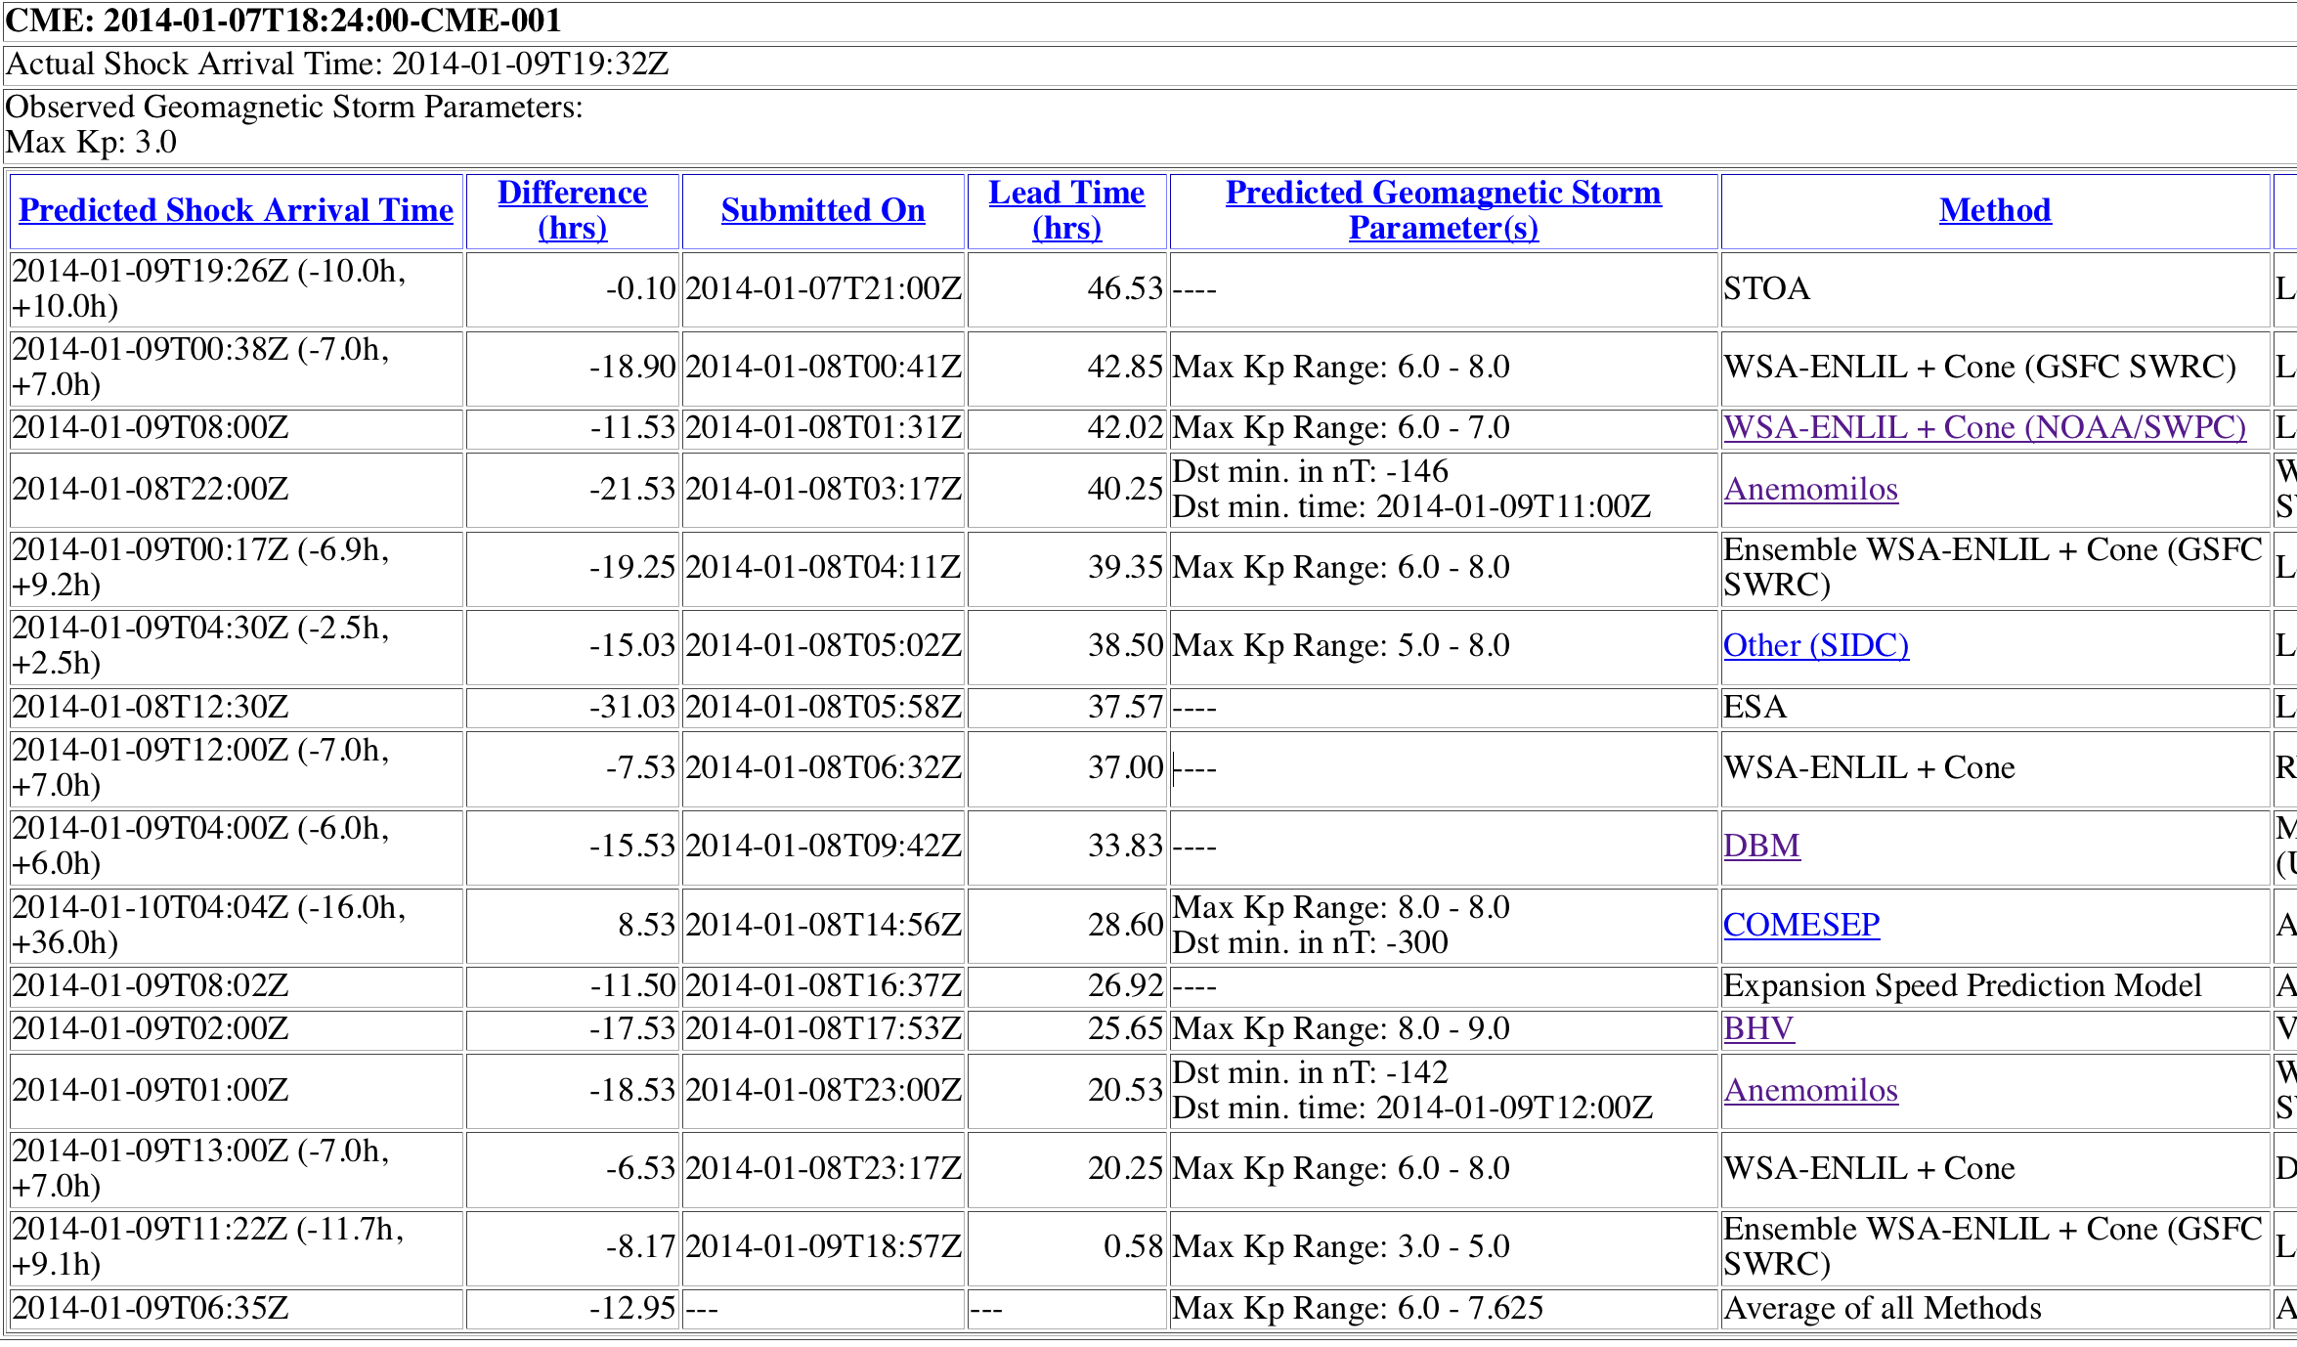
Scoreboard of CME Arrival Prediction
Ensemble of different CME models
Community-Wide Space Weather Ensemble Forecasting & Validation Activity
Future ScoreBoards Planning:
Flare forecasts
SEP forecasts
Auroral Boundaries
High Speed Streams

Slide 13
Operational Geospace Model Validation
in support of SWPC geospace model selection
Community-wide efforts (2008 -2012) led by the CCMC established a foundation for operational geospace model selection based on model ability to reproduce dB/dt and regional K index.
Example of events-based metrics: 6 events

Slide 14
Space Environment Effects (SEE) Database
Database Of Notifications Knowledge Information (DONKI)
Allow mission specialists to submit SEE reports
Allow users to search SEE archive
CHANDRA Radiation Effect
Link SEE reports to space weather activities in DONKI database (Flare, CME, HSS, Geomagnetic Storms, etc)

Slide 15
Outlook
CCMC is a:
Asset of NASA, NSF & international space weather community.
Playground for scientists.
Hub for collaborative research & development.
Testbed-Showroom-Superstore for end users and operational agencies.
CCMC continues pushing frontiers of research, development and experimental space weather forecasting.
Partnership is a key for further progress.

