Slide 1
FMI’s space weather service in LUOVA
Tiera Laitinen, Eija Tanskanen, Ari Viljanen,
Minna Palmroth, Kirsti Kauristie, Kristiina Säntti
Finnish Meteorological Institute

Slide 2
What is LUOVA?
Luonnononnettomuuksien varoitusjärjestelmä
(natural hazards early warning system)
A closed system for official use
Coordinated by the ministry of transport and communication
24/7 duty service
Began operation in 2012

Slide 3
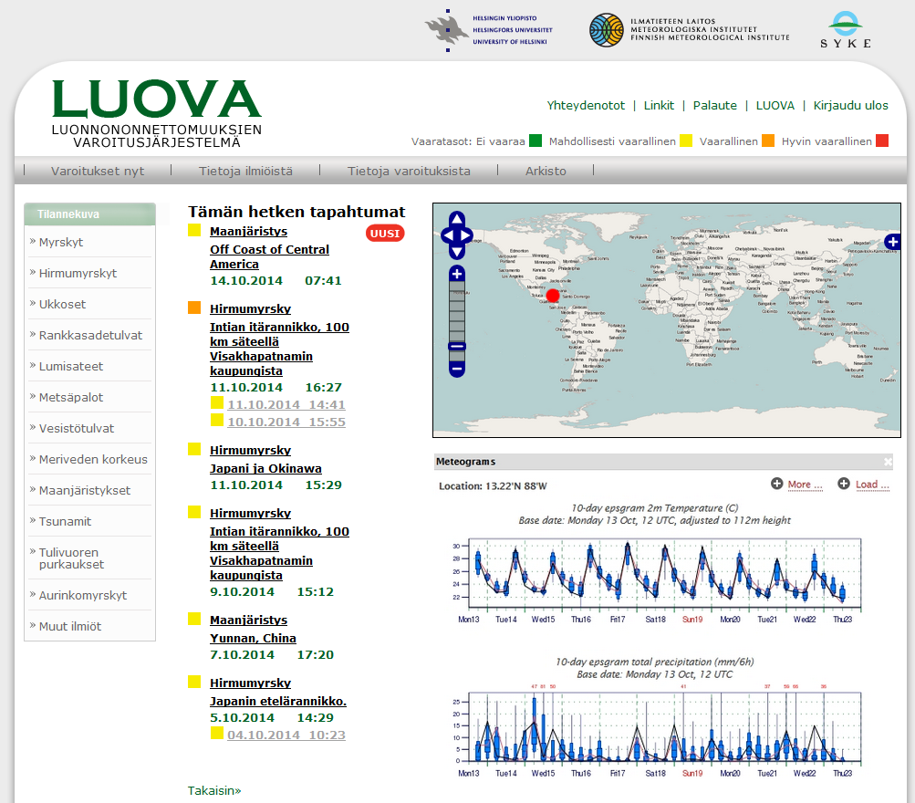
Warnings are distributed through
LUOVA portal
SMS messages
e-mail

Slide 4
Warnings are issued on
All natural phenomena that pose a threat on Finnish citizens (in Finland or abroad), infrastructure or economy.
Worldwide:
Earthquakes
Tsunamis
Major storms
Volcanic eruptions
Large forest fires
In Finland only:
Thunder
Heavy rain
Exceptional sea level
River/lake flooding
Space weather

Slide 5
LUOVA end users
Prime minister’s office
Ministry of the interior
Ministry of transport and communications
Ministry of foreign affairs
Ministry of agriculture and forestry
Finnish red cross
Radiation and nuclear safety authority
Local emergency services
Defence forces

Slide 6
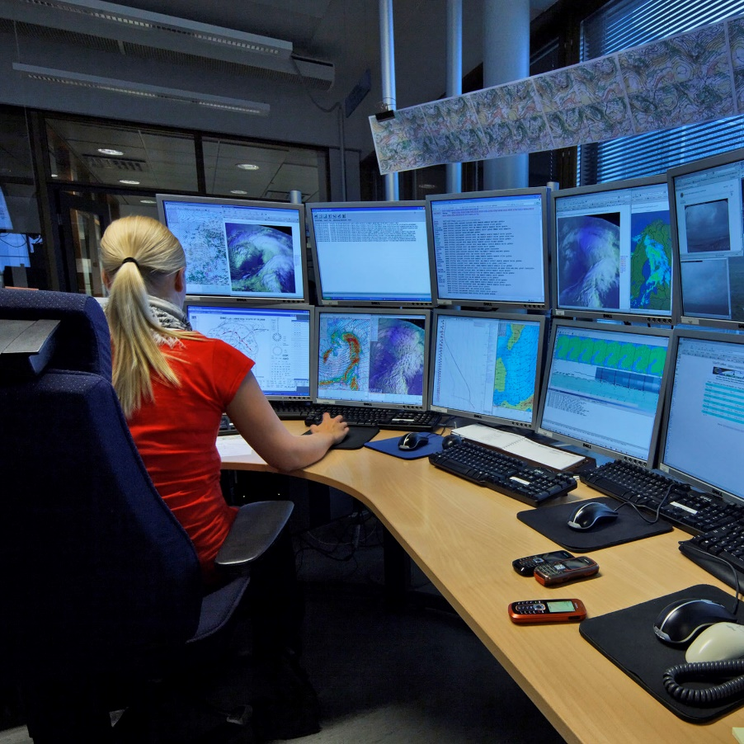
LUOVA contributors
Finnish Meteorological Institute
  Weather, sea level, space weather
  Technical maintenance, 24/7 duty
Finnish Environment Institute
  Flooding (rivers and lakes)
  24/7 on-call duty when flooding occurs
Institute of Seismology
  Earthquakes
  24/7 on-call duty

Slide 7
LUOVA duty operators
Meteorologists at FMI
  MSc education
Produce weather-related warnings themselves
Receive information from SYKE and seismologists in LUOVA operative tool
Phone contact to experts when situation is acute
Publish warnings in LUOVA portal

Slide 8
Space weather in LUOVA
Space weather monitoring was added to LUOVA in spring 2013.
The routines and instructions for space weather monitoring were created by FMI space scientists.
Education for LUOVA operators was arranged.
Scientists support LUOVA operators mainly during office hours.
We are planning to commence a regural on-call-duty cycle of space scientists from January 2015.

Slide 9
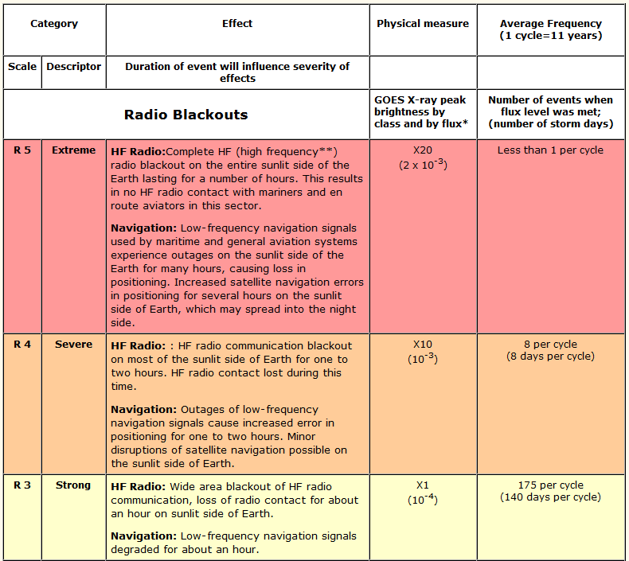
SW warnings are based on NOAA scales
Currently we warn for:
Geomagnetic storms G5
Solar radiation storm S5, S4 and S3
Radio blackouts R5 and R4.
Expect <10 warnings per solar cycle in each category.

Slide 10
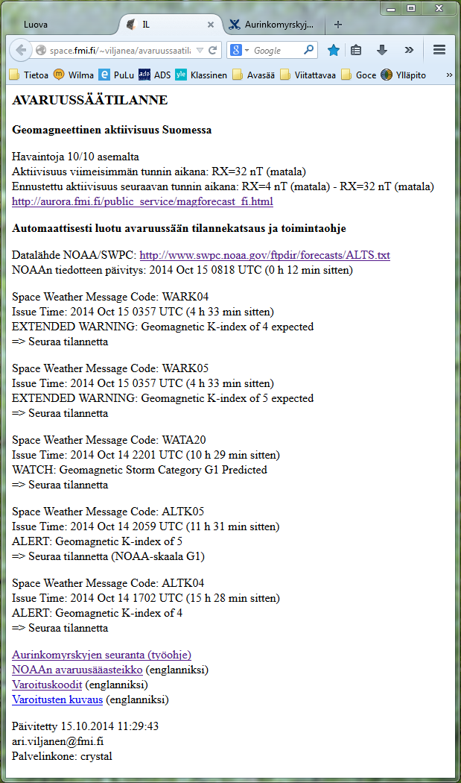
NOAA alerts interpreted automatically
Magnetic activity
in Finland
A script checks the NOAA warnings and alerts.
Essential information is distilled for the LUOVA operator.
If LUOVA threshold is exceeded, the script instructs the operator to issue a LUOVA warning.
Interpreted
NOAA
messages
Links to
instructions

Slide 11
Instructions to operators
LUOVA hazard level | Very dangerous | Dangerous | Potentially dangerous | Not dangerous
Events | Not in use for SWE | G5, R5, S5 (if confirmed by scientist) | R4, S4, S3 | Special cases
Action |  | - Call scientist - Issue warning (yellow if scientist not reached) - Follow the situation | - Call scientist if something unclear - Issue warning - Follow the situation | As instructed by scientist
What to report |  | (Model text for each SW event type) | (Model text for each SW event type)

Slide 12
Education
LUOVA operators are MSc meteorologists
  No expertise in space weather, but background in physics
  Need simple instructions and education in space weather basics.
Introductory lectures were organised, covering
  Solar eruptions, solar wind, magnetosphere, auroras
  forecast timescales: solar observations, solar wind L1 measurement, observations on ground
  Event types, NOAA scales, frequencies, effects
  FMI and other measurements, information sources.
A scientist spent an hour with each operator on duty
  Personal walk-through of the information sources and what to
  write in a LUOVA space weather warning.
Re-education planned next year

Slide 13
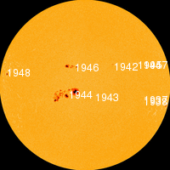
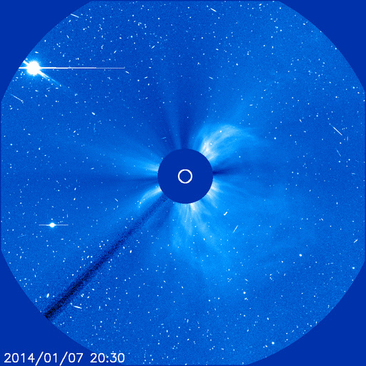
Case: proton event on 9 Jan 2014
An X1 flare in AR1944, at 18:32 UT on 7 Jan sent a CME earthward.
Caused R3 radio blackout and a few hours later S2 solar radiation
  Just below LUOVA criteria
On 8 Jan at 23:20 UT proton flux rose above 1000 pfu
  NOAA gave S3 alert at 23:34 UT
A G3 geomagnetic was predicted (but no G class storm occurred)

Slide 14
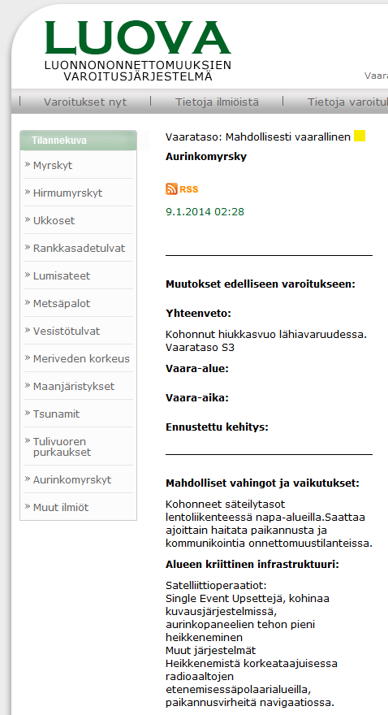
Case: proton event on 9 Jan 2014
At 2:28 Finland local time (0:28 UT) on 9 Jan, LUOVA warning for S3 solar radiation storm was issued.
LUOVA duty person produced the warning using model texts.
FMI scientists followed the event the next day, but space weather calmed down and no further warning was needed.

Slide 15
FMI space weather tools
Monitoring currently based on NOAA alerts
FMI has also own observations and tools for analysis during an event:
  Magnetometers, auroral cameras
  GIC models
  Magnetospheric simulations
  Nowcast model for low-energy electrons
  (talk by N. Ganushkina).
Primarily research tools, these are now being developed for operational use.

Slide 16
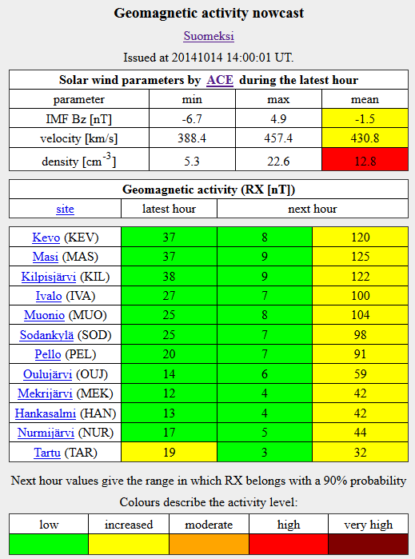
Magnetic activity in Finland
FMI operates a magnetometer network in Finland (part of IMAGE).
A statistical model predicts the activity during the next hour from ACE solar wind.

Slide 17
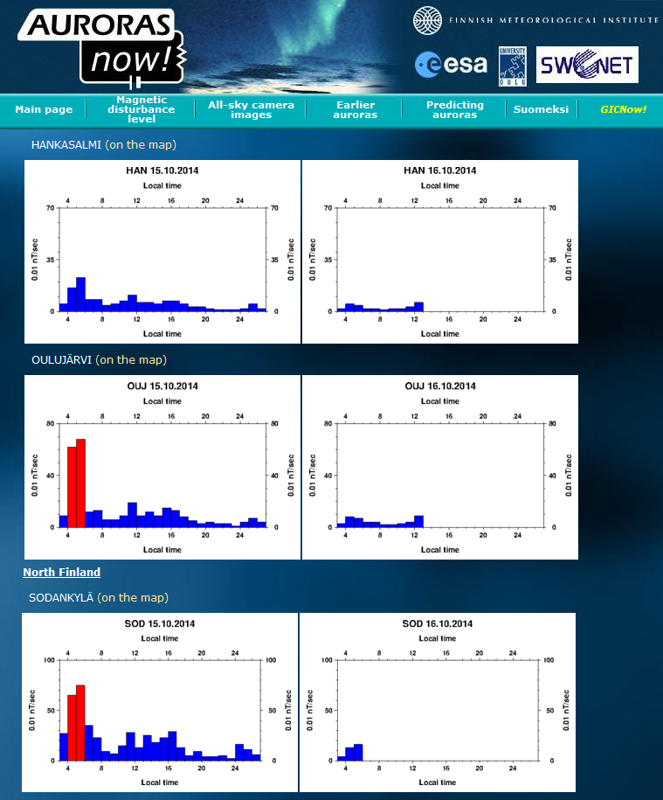
Aurora nowcast
Based on magnetic activity level
Includes e-mail alert service wintertime

Slide 18
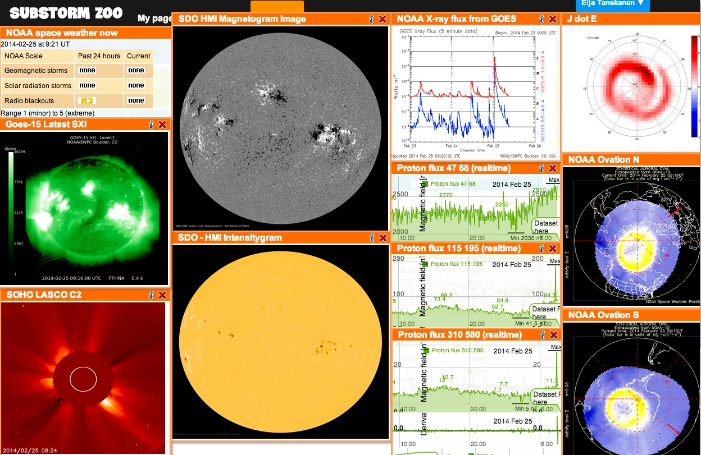
Substorm zoo: a dashboard and time series analysis tool also available to LUOVA operators

Slide 19
Conclusions
Challenges
Meteorologists not able to interpret SW data
  On-call duty planned
SW not relevant to all customers
  Only largest storms
  Need tailoring of alert distribution
SW as a part of a wider hazard warning system
Cost-effective 24/7 duty
Use weather service’s operational experience
Synergy in communication solutions
Increases awareness

