Slide 1
Real-time magnetospheric simulation on GOCE decay
Tiera Laitinen¹, Ilja Honkonen^{1,2},
Minna Palmroth¹, Pekka Janhunen¹
1) Finnish Meteorological Institute
2) NASA/GSFC

Slide 2
Outline
GOCE decay and re-entry
GUMICS
  The only European global magnetosphere-ionosphere simulation model
  Real-time capable parallel version GUMICS-5
Space weather effects in GOCE decay
  Increase in the decay rate during space weather events
  Decay rate variations are well reproduced by GUMICS simulation and a simple atmospheric density perturbation model.

Slide 3
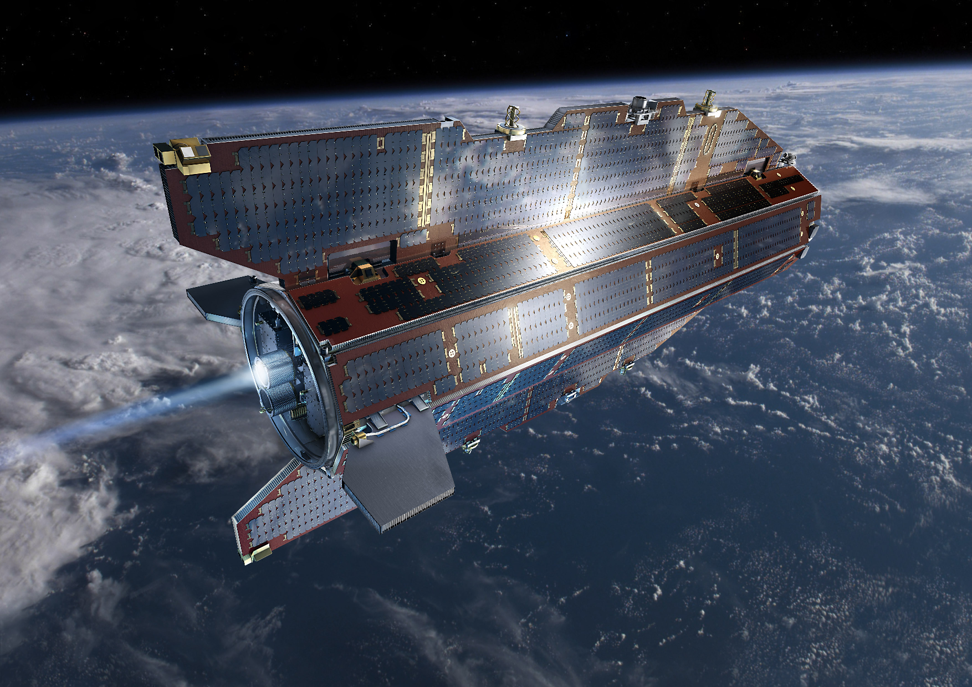

Slide 4
GOCE re-entry
Ran out of propellant 21 Oct 2013.
Re-entered atmosphere 11 Nov near Falkland.
Re-entry gained wide media attention also in Finland.
FMI launched a campaign to test real-time modelling of space weather effects on GOCE orbit.
FMI supported Geodetic Institute in informing Finnish authorities on the satellite (LUOVA warnings)
Information was also provided to ESA SSA/SST (debris surveillance and tracking)

Slide 5
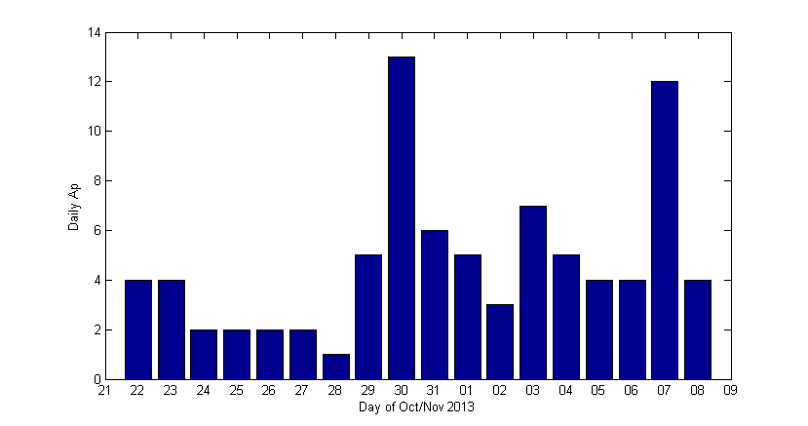
Space weather during GOCE decay
There were no major storms, but moderate geomagnetic disturbances occurred.
The most interesting was 30 October.

Slide 6
Real-time space weather modelling

Slide 7
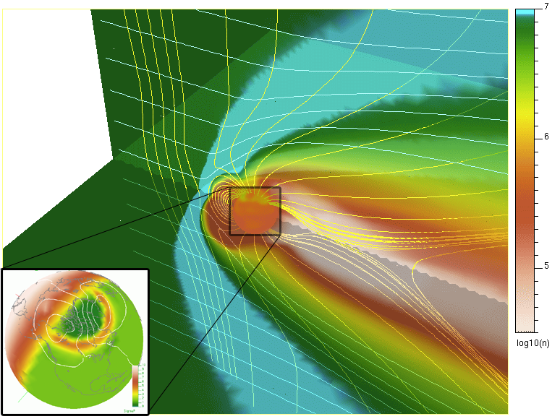
GUMICS
Global magnetosphere-ionosphere coupling simulation model
The only one of its kind in Europe
Developed at FMI since 1993
Dozens of scientific publications
MHD magnetosphere
Electrostatic ionosphere

Slide 8
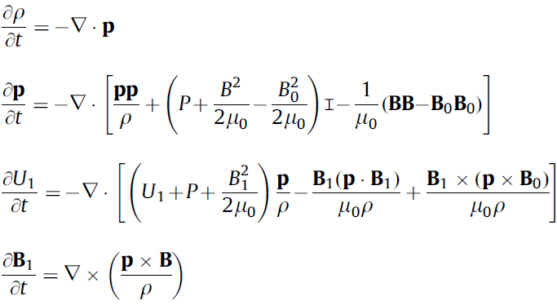
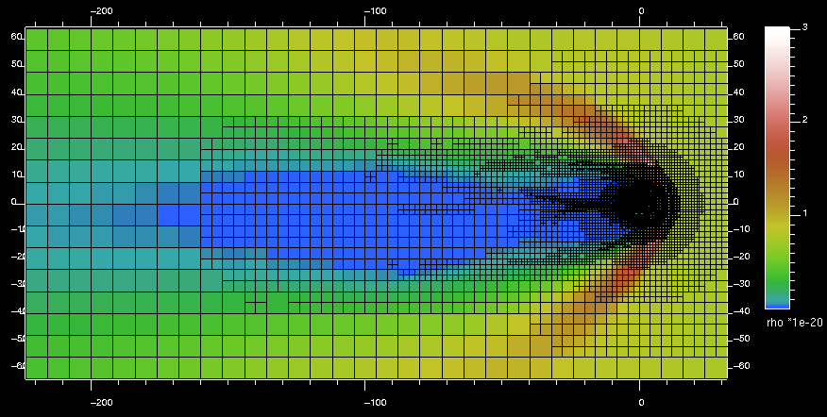
GUMICS: magnetosphere

Slide 9
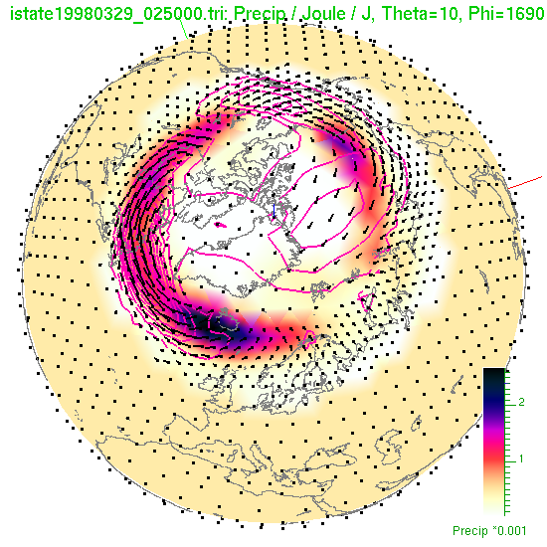

GUMICS: ionosphere
6.11.2014
9

Slide 10
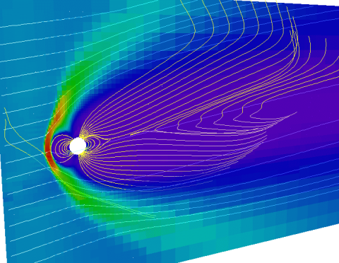
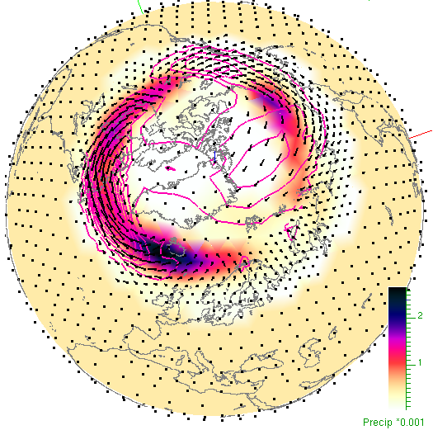
GUMICS: M-I-coupling
Solar wind
B, n, T, v, …
Mapped along
dipole field lines:
Φ
J‖
e– prec.
Φ, Σ, J, E,
e– prec., …

Slide 11
GUMICS-5
A new parallel version of the code
  Currently under validation and finalisation.
Capable of faster than real time running
  with moderate resolution, ~ 0.5 - 1 RE
  requires ~ 100 cores.
First technical real time operations test was performed during the GOCE case

Slide 12
Chained run system
Solar wind propagation from L1 takes ~ 1 h.
Allows ~ 20 min prediction time.
Latest
solar wind
from ACE
New run every 20 min
Initial state from the previous run
Run extended beyond
measured solar wind with constant input

Slide 13
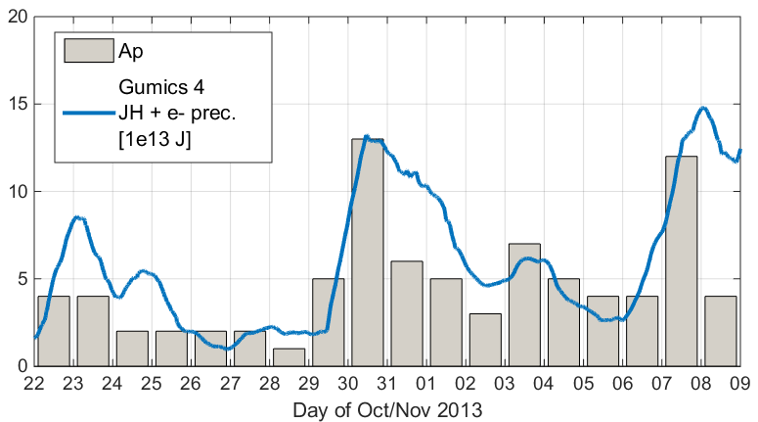
GUMICS results
Real-time simulations were done with GUMICS-5.
Later the period was simulated with GUMICS-4
with better resolution.
Joule heating +
electron precipitation.
Integral over 24 h
(heat accumulation).

Slide 14
From Joule heating
to air drag

Slide 15
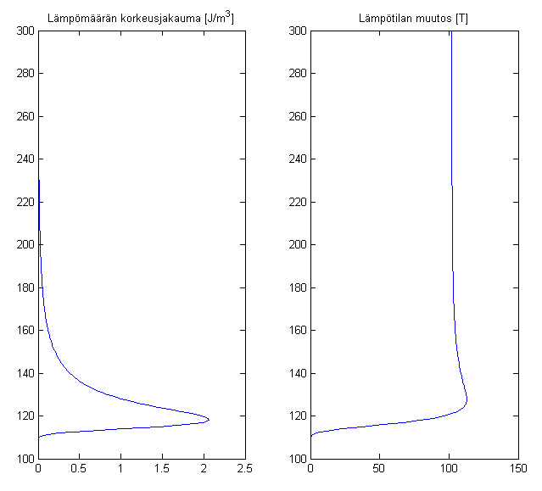
A toy model for heat deposition
Quiet time atmospheric profiles from NRLMSISE-00
JH from GUMICS
Assume globally even heat distribution
Assume heating profile with maximum at 120 km
Height [km]
Extra heat
from SWE
Temperature
change

Slide 16
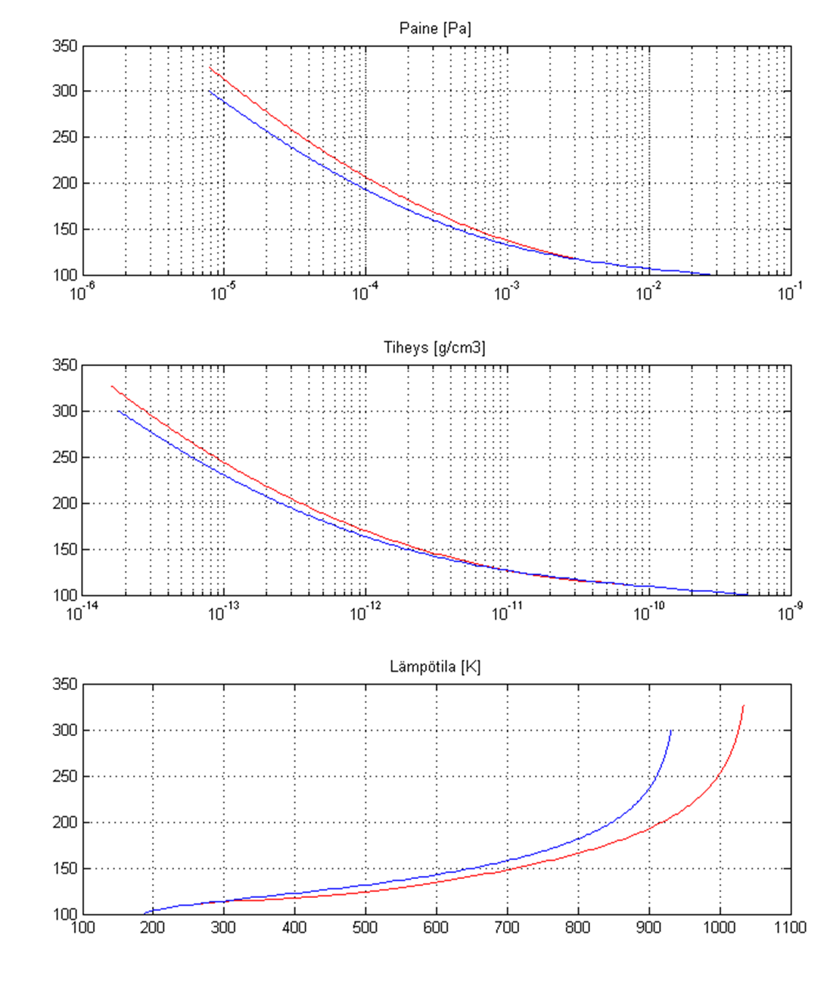
Density increases above ~130 km
Height [km]
Pressure
Atmospheric profiles
without and with
ionospheric heating
Density
Height [km]
Temperature
Height [km]

Slide 17
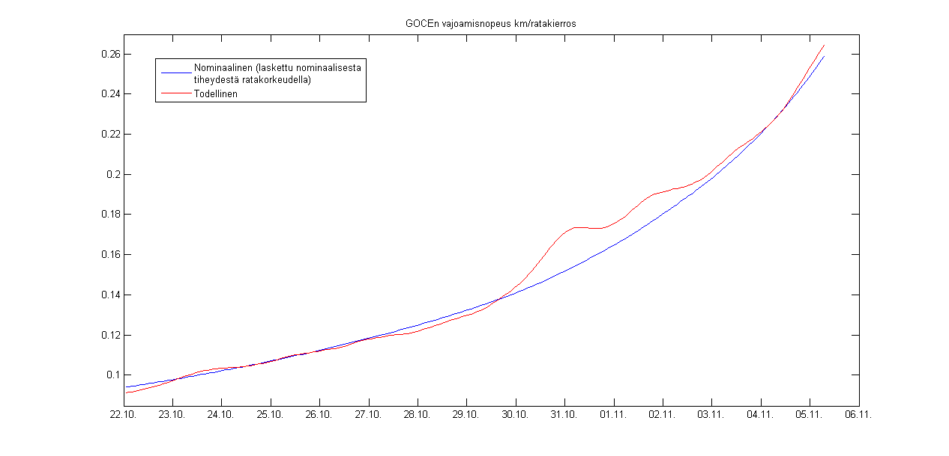
Extracting changes in decay rate
Nominal density at orbit from NRLMSISE-00
Fit to the real decay rate (get air drag coefficient)
  Fitted density is the nominal decay rate
Calculate difference of real and nominal decay rate
Real decay rate
Decay rate
[km/orbit]
Space weather effect?
Nominal decay rate in a time-invariant atmosphere

Slide 18
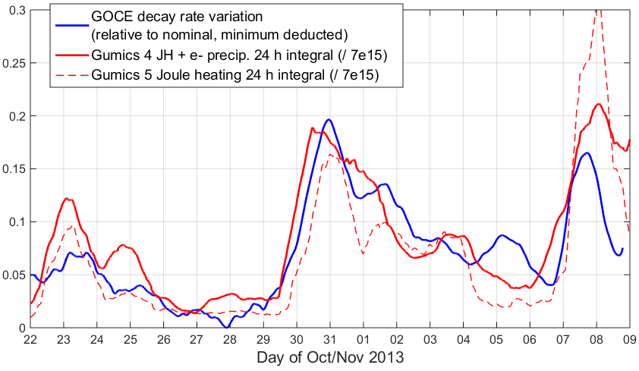
Simulation predicts orbit variations

Slide 19
Conclusions & discussion
Global MHD simulation predicts variations in GOCE decay rate.
This analysis was done afterwards, but the procedure could be implemented as a forecast routine (with forecast time ~ 20 min).
The forecast time could be lengthened with solar wind data from
  a measurement sunward of L1
  an accurate solar wind simulation.

