Slide 1
Long-term evolution of magnetic fields on the Sun
Alexei A. Pevtsov
US National Solar Observatory

Slide 2
What is Space Climate Anyway?
SW–SC Similarities
SW – SC differences
Same drivers (solar eruptive events, open magnetic fields/CHs, solar wind)
Similar spatial scales (quiet Sun, large-scale magnetic fields).
Both changes in each system and interaction of systems play role
Different time scales (what scales? Do space “seasons”/ regular cyclic variations are “climate”? )
Random component plays more important role in SC vs. SW (less predictable); external drivers do play role.

Slide 3
What is Space Climate Anyway?
Space Climate (SC) is the description of the long-term pattern of Space Weather (SW) in a particular place in heliosphere.
How long is “long-term”? SC change refers to periods over multiple solar cycles. SC variability is represented by periodic or intermittent changes related SW (cycle).

Slide 4
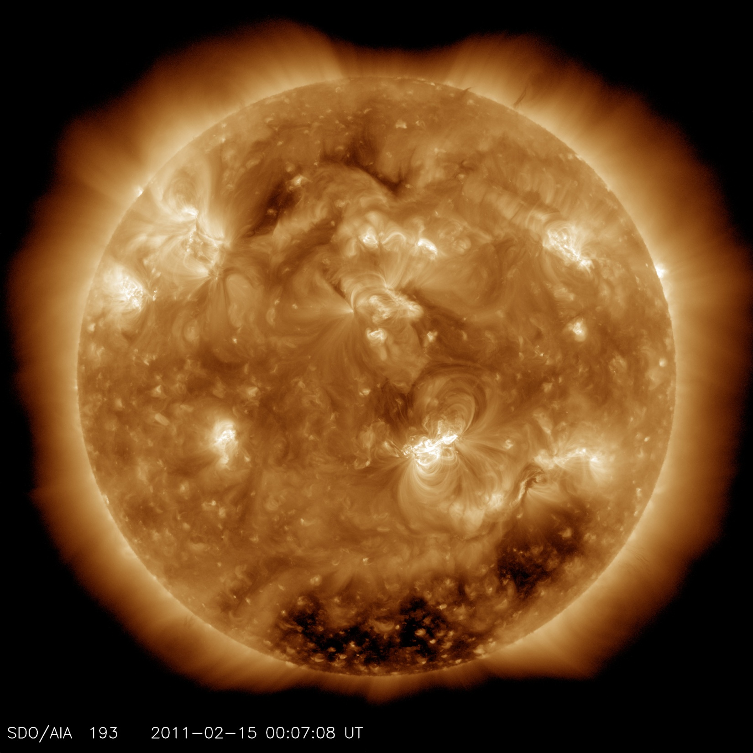
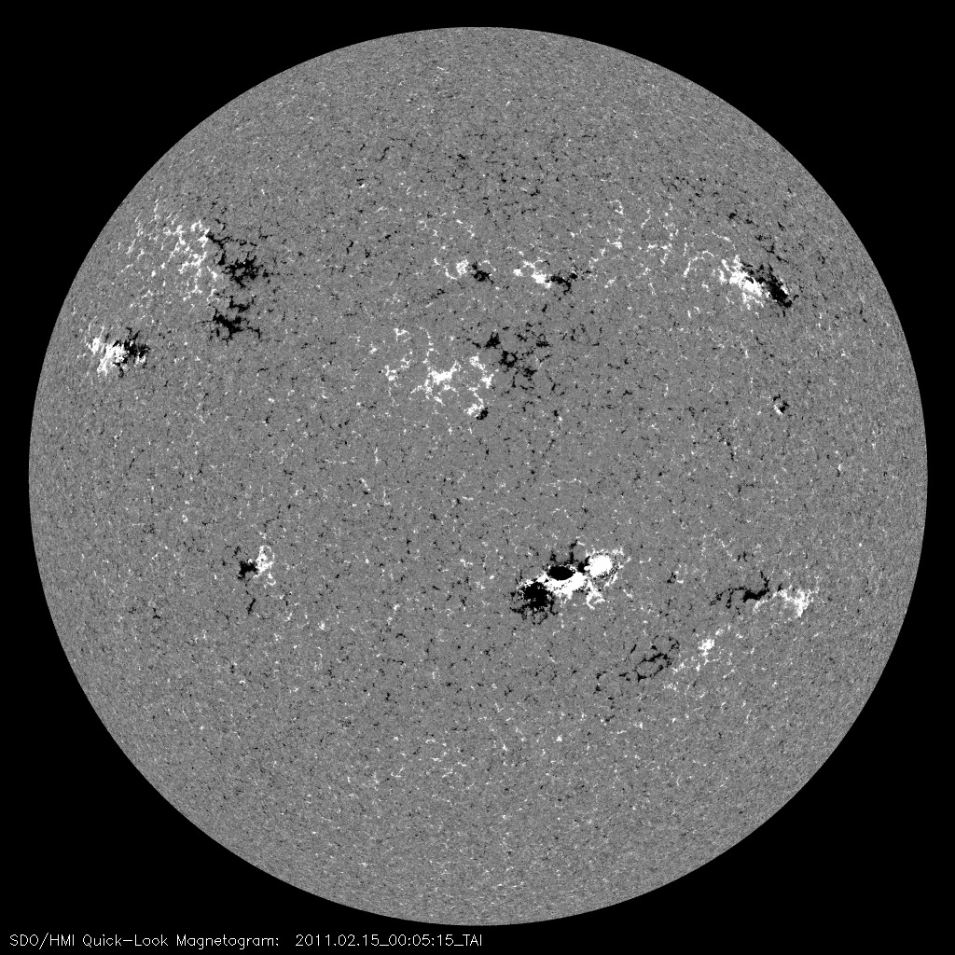
Where on the Sun the SW/SC originates from?
QS
ARs
Cheung et al. 2014
CHs

Slide 5
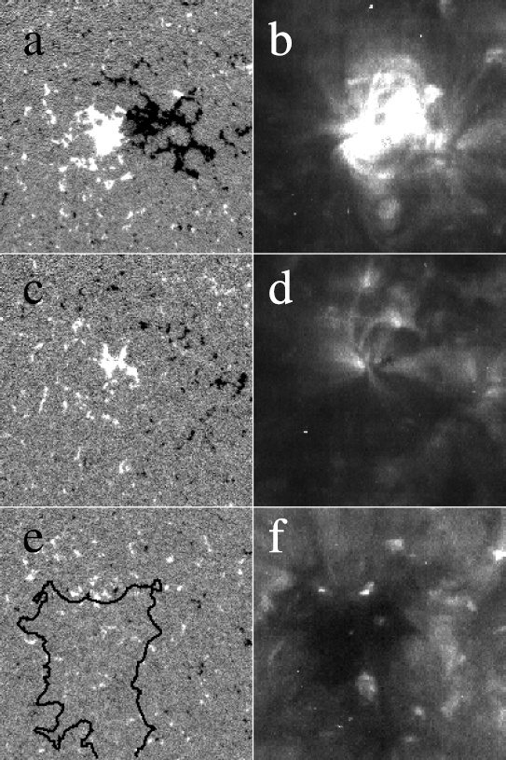
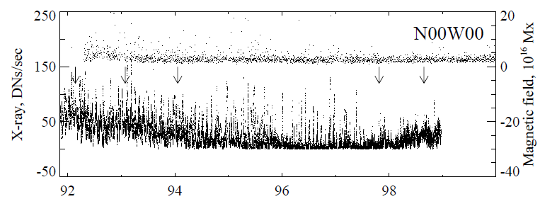
Is it all about Active Regions?
Total magnetic flux in QS is about 10x of flux in ARs (Harvey 1992, Sanchez Almeida 2003, 2009).
QS flux does not change with solar cycle (Harvey 1992, Pevtsov & Acton 2001).
(Some) CHs are related to ARs magnetic fields
Karachik et al (2010)

Slide 6
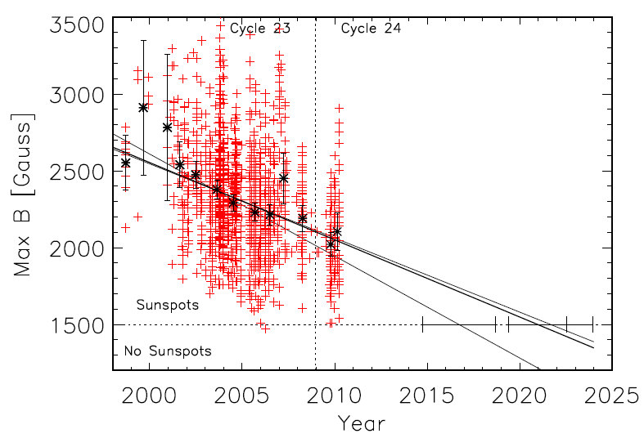
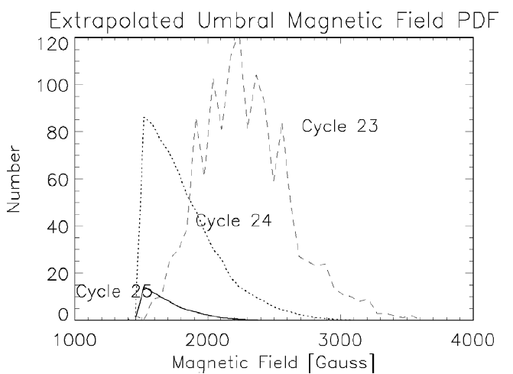
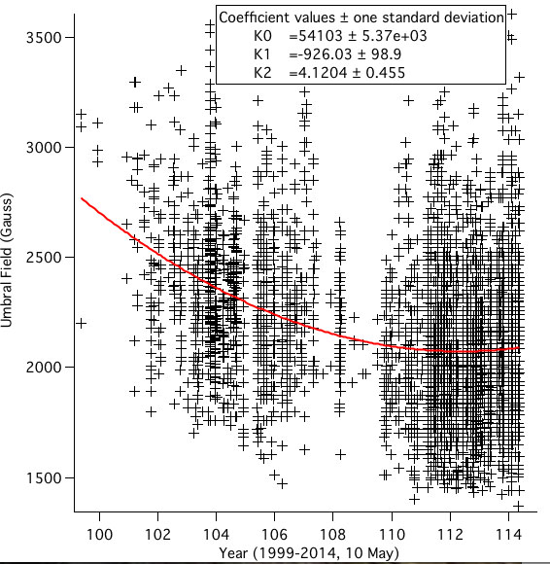
Does Magnetic Field of Sunspots is weakening?
Penn and Livingston (2011)
PDF retains shape, mean shifting 46 G yr⁻¹

Slide 7
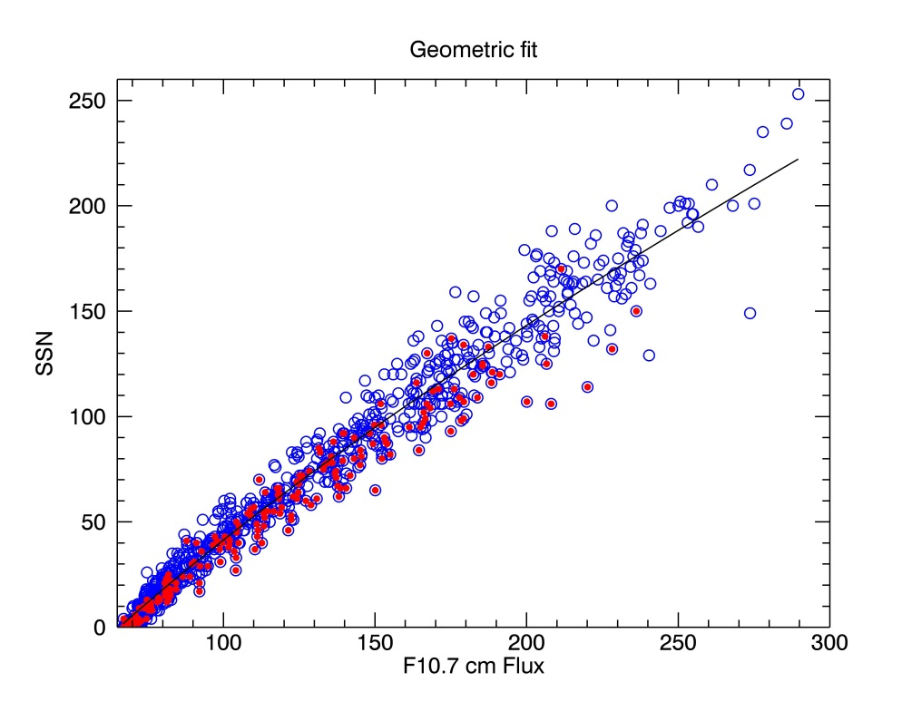
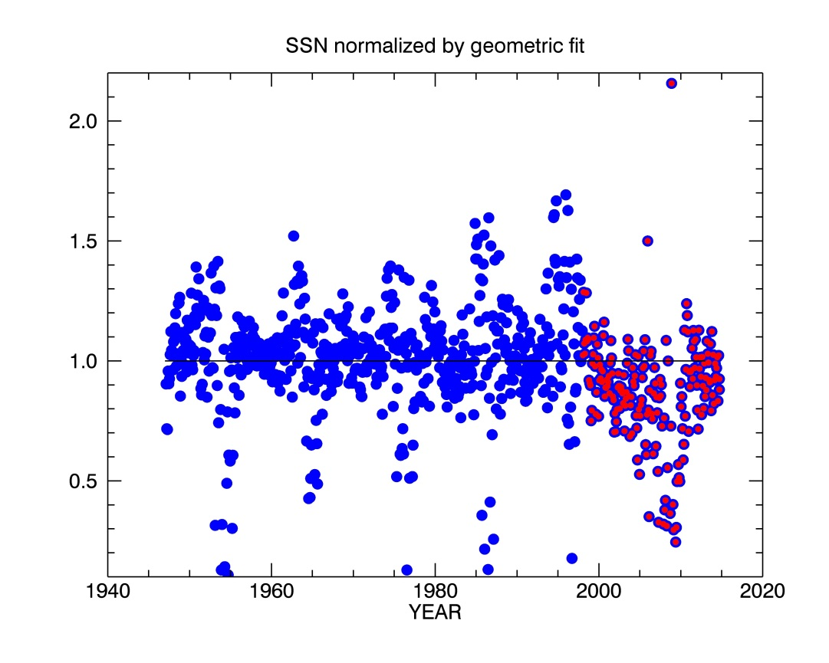
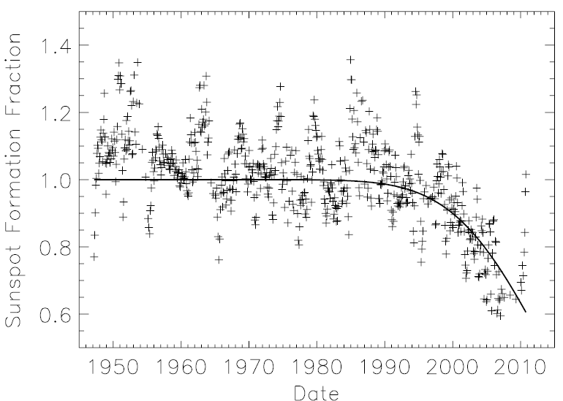
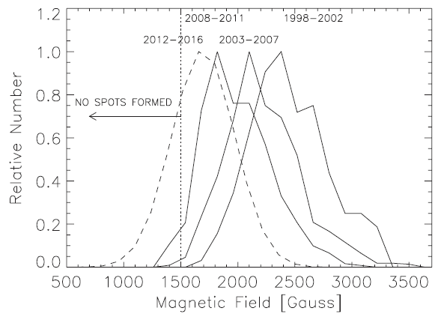
Sunspot Field Strength and 10.7 cm Radio Flux
PDF retains shape, mean shifts 46 Gyr⁻¹
Ratio of spots field strength to 10.7 cm flux anomaly consistent with decreasing sunspot field strength
1947 – 1997 (blue), 1998 – 2014 (red)
Livingston, Penn, Svalgaard (2012)

Slide 8
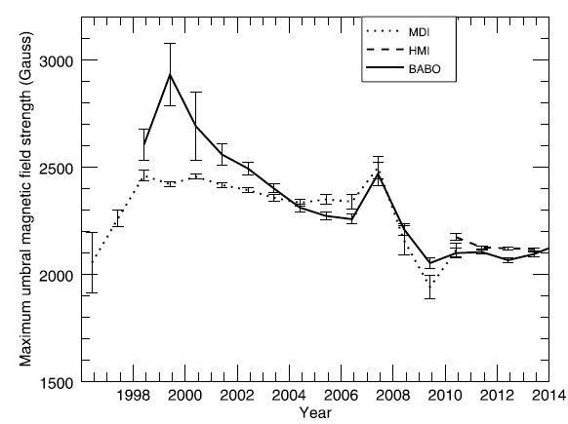
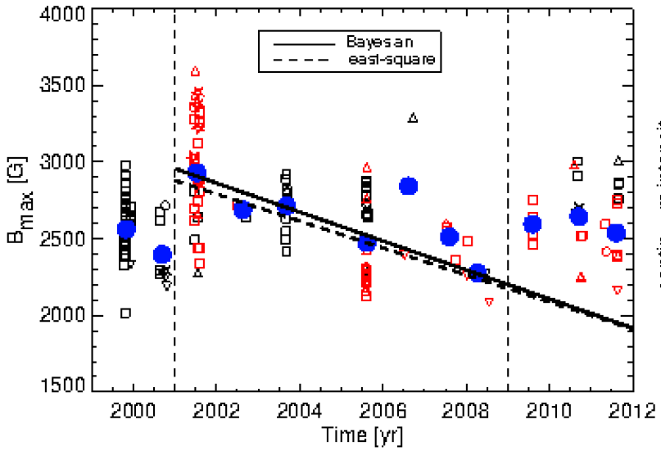
Cycle Variation in Sunspot Field Strengths
Watson et al. (2011; 2014)
Rezaei, Beck, & W. Schmidt (2012)
Penn & Livingston (2006): 1.9% /yr increase
Mathew et al (2007) – (MDI, 160 spots 1998-2004) slight decrease in umbral intensity
Schad & Penn (2010) – (>10000 umbra, KPVT/ SPMG) no significant variation with cycle both intensity and field.

Slide 9
Historical Records of Sunspot Field Strengths
US Mount Wilson Observatory (MWO), 1917-2014 (dig. In progress)
SU Sun Service, 1957-2011, CrAO, 2012-present (digitized)
MWO
SOLIS
23 Oct 2014

Slide 10
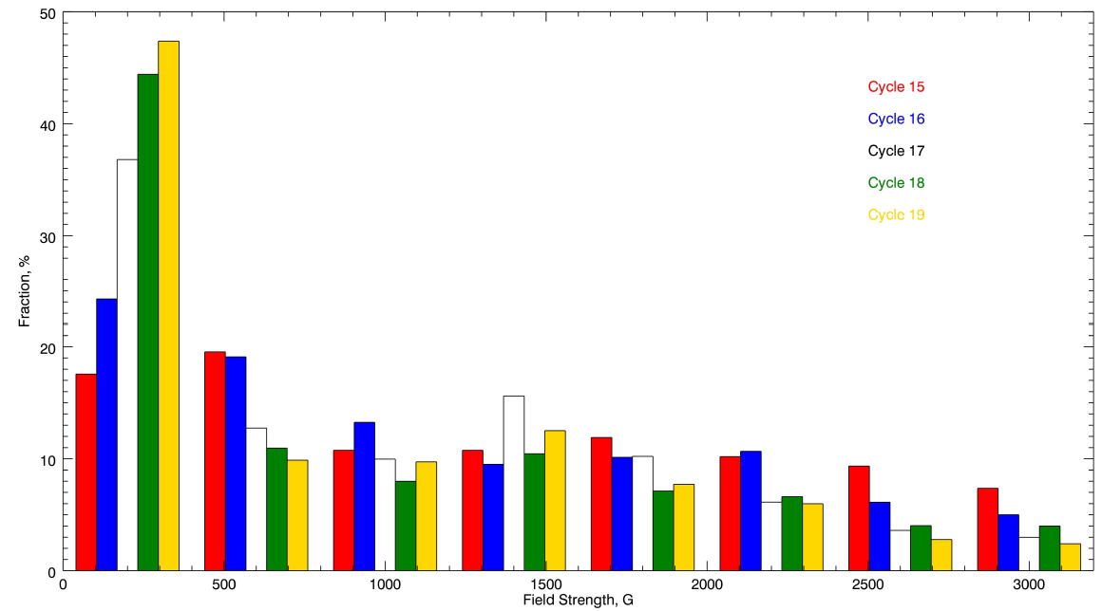
Beware of Systematics in Historical Data.
pit flood
6173
5250
New grading
Tlatov et al (2014)

Slide 11
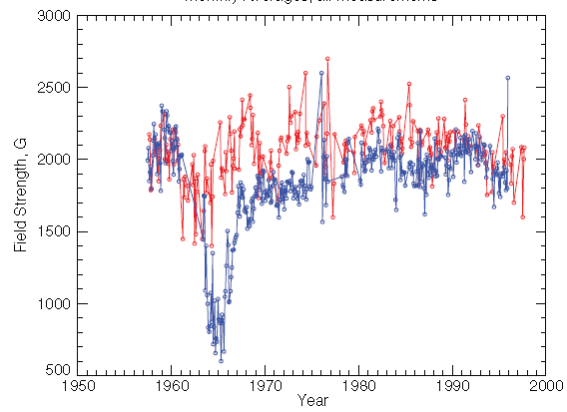
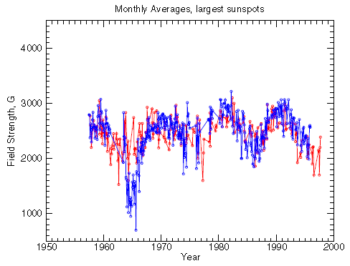
Change in Instrumentation, Observer’s Bias etc
All measurements
Daily largest sunspot
CrAO (blue) and Pulkovo (red)
Pevtsov et al (2011)

Slide 12
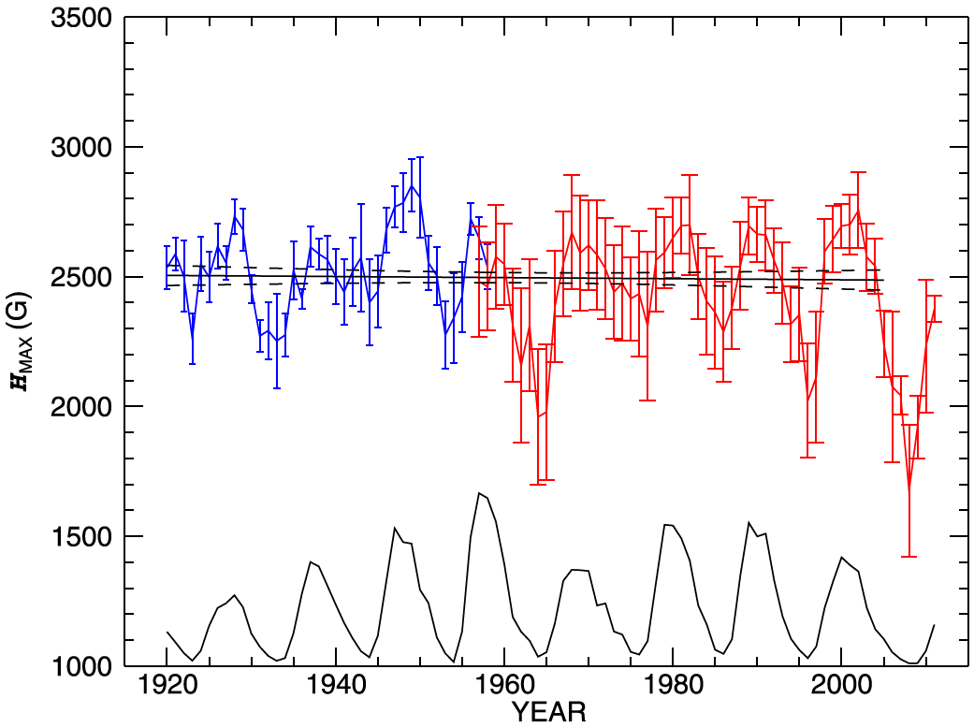
MWO FSU Data
Long-term trends may appear due to inclusion of smaller/weaker field features
Strong fields show only variations with solar cycle, and no secular trend
Penn & Livingston (2006): decline in field strengths –52 G/year
Watson et al (2011) –70 G/year
-83.5 G/yr (C19), -47.1 (C20), -97.9 (C21), -85.1 (C22), -118.7 G/yr (C23)

Slide 13
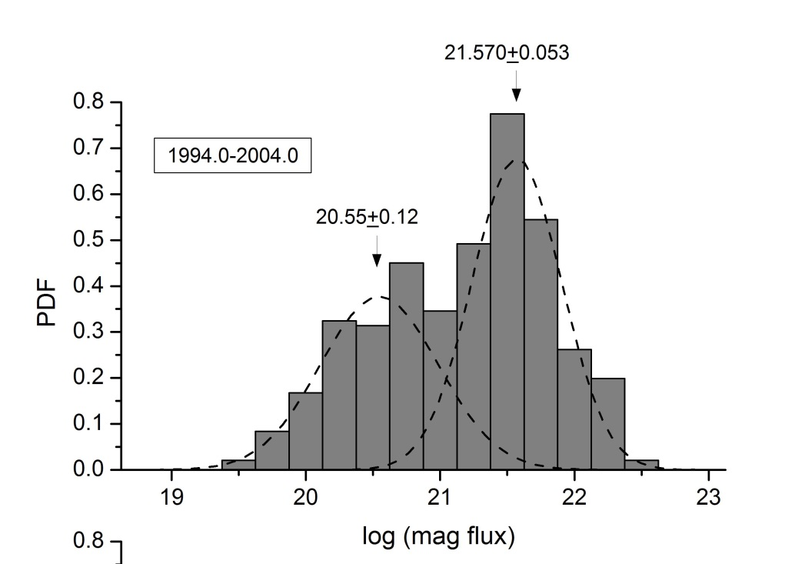
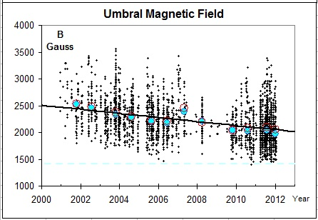
Large sunspots contribution
Mean of two contributions
Nagovitsyn et al (2012)
Penn & Livingston (2011)

Slide 14
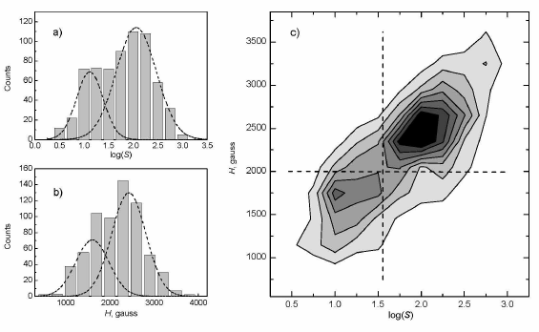
Magnetic field: CrAO, 1994-2014
Sunspot area: Kislovodsk/Pulkovo Observatory
Nagovitsyn et al (2014, in preparation)

Slide 15
Area – magnetic field relation
SDO/HMI
SOHO/MDI
SDO/HMI
Munoz- Jaramillo et al (2014)
Ringnes & Jensen (1960)

Slide 16
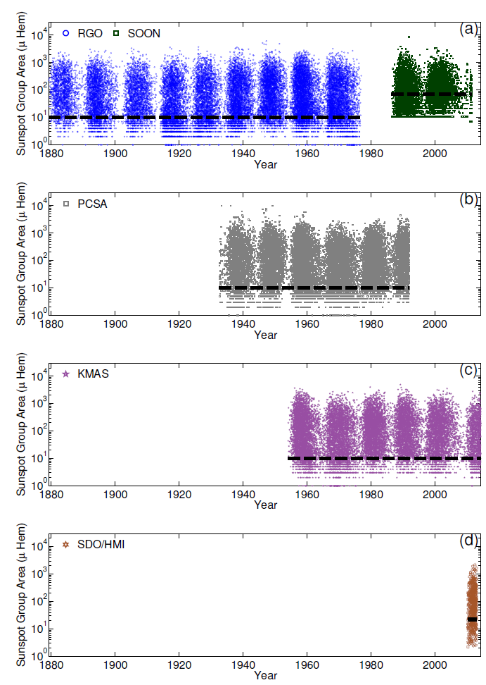
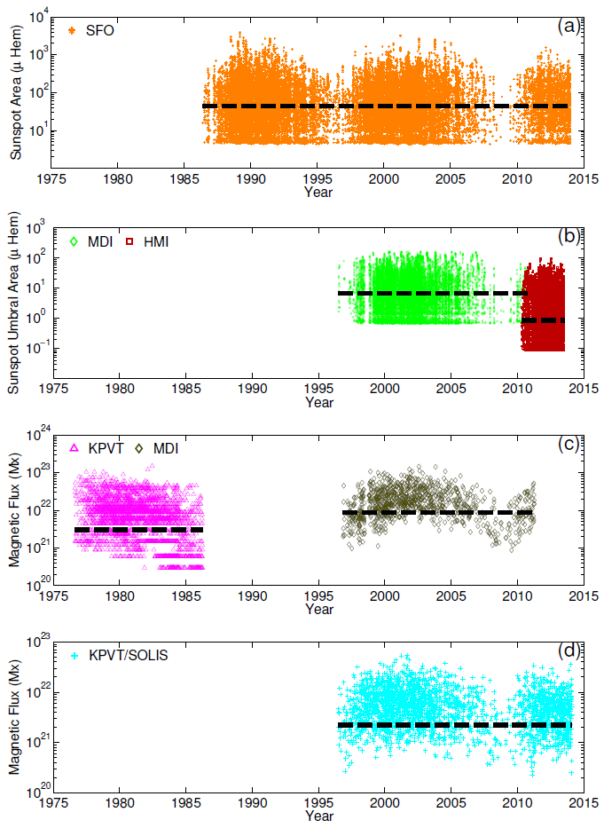
Group areas
Sunspot areas

Slide 17
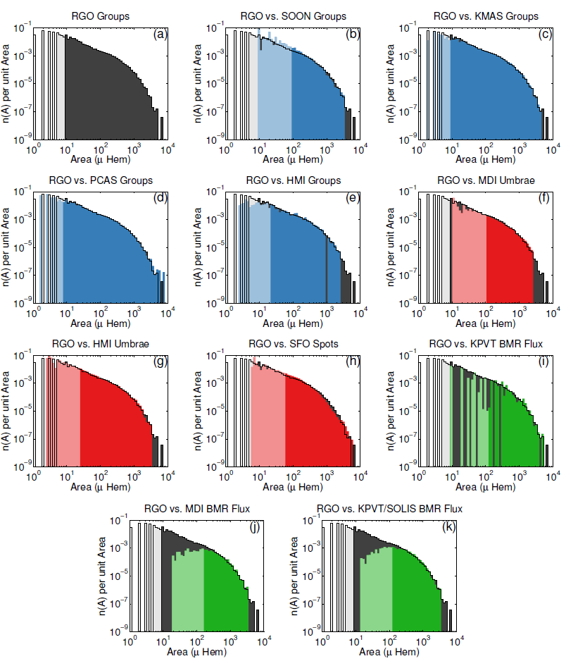
Munoz- Jaramillo et al (2014)

Slide 18
(Weibull) – “fragmentation”
(log-normal) – “growth and aggregation”
Munoz- Jaramillo et al (2014)

Slide 19
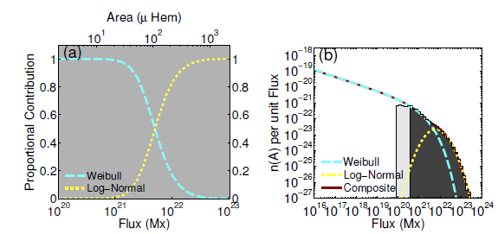
Transition between relative contribution of Weibull and log-normal is about the same as in Tlatov & Pevtsov (2014, small-large sunspots) and may indicate that sunspots in two categories arise from two different generation mechanisms: one directly connected to the global component of the dynamo (and the generation of bipolar active regions), and the other with the
small-scale component of the dynamo (and the fragmentation of magnetic structures due to their interaction with turbulent convection).

Slide 20
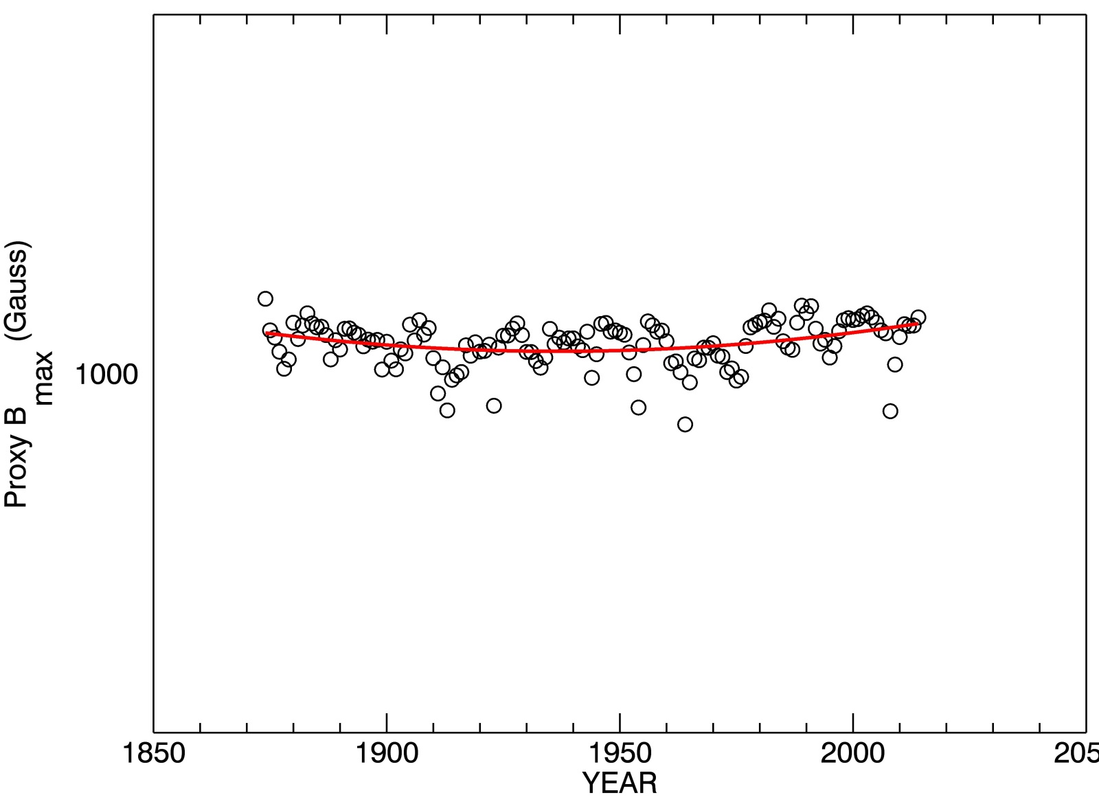
All sunspots
RGO and SOON

Slide 21
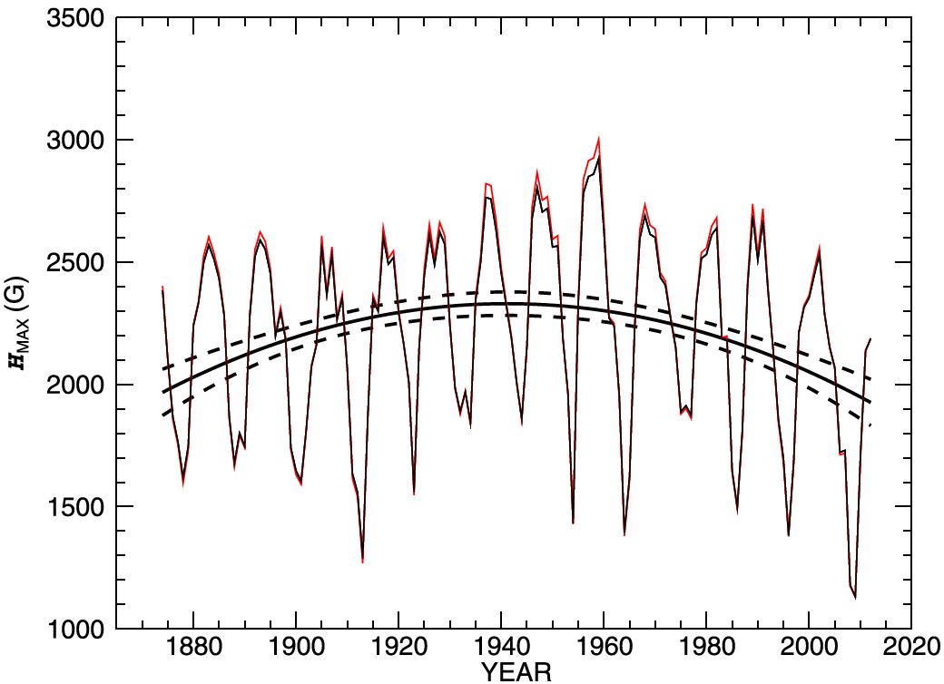
Daily largest sunspots
RGO and SOON
Pevtsov et al (2014)
Solar cycle variations with amplitude about 1000 G
Magnetic field proxy shows variations with solar cycle
Much weaker secular trend (300 G increase-decrease) with a broad maximum in 1950th – Gleissberg Cycle?

Slide 22
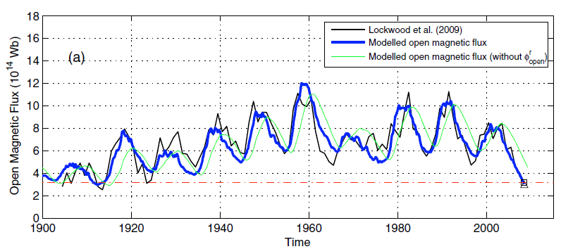
Open Magnetic Flux
Vieira & Solanki (2010)
Lockwood et al. (2009) – reconstructed from geomagnetic aa-index

Slide 23
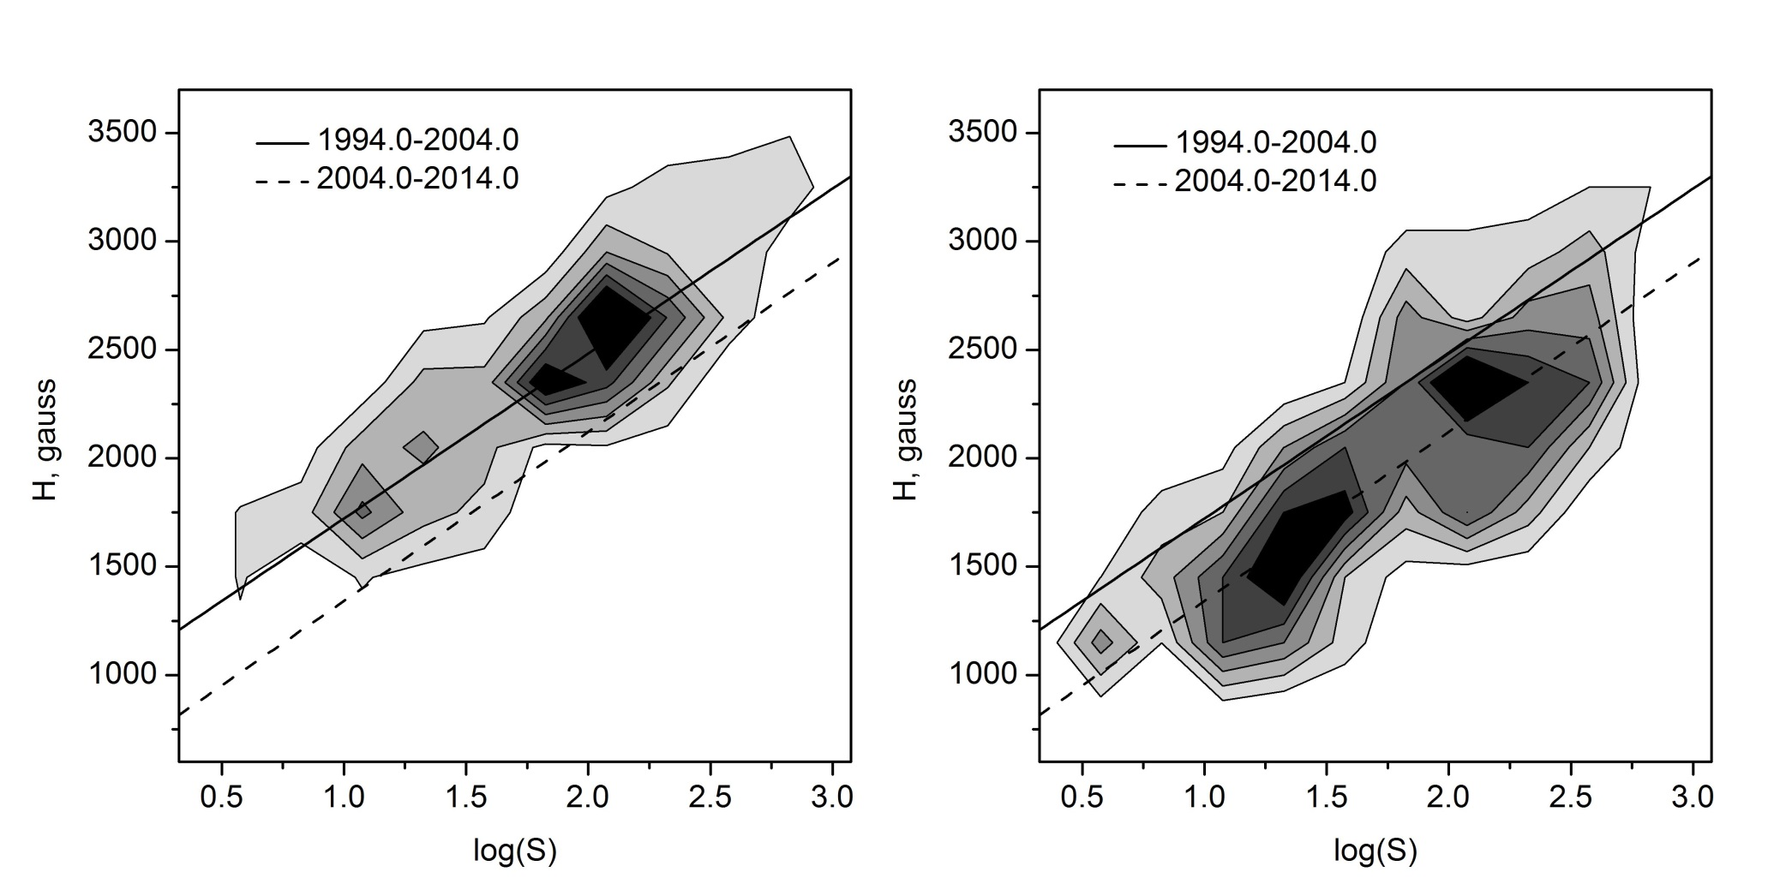
Sunspot area-field strength: 2D PDFs
Nagovitsyn et al (2014, in preparation)

Slide 24
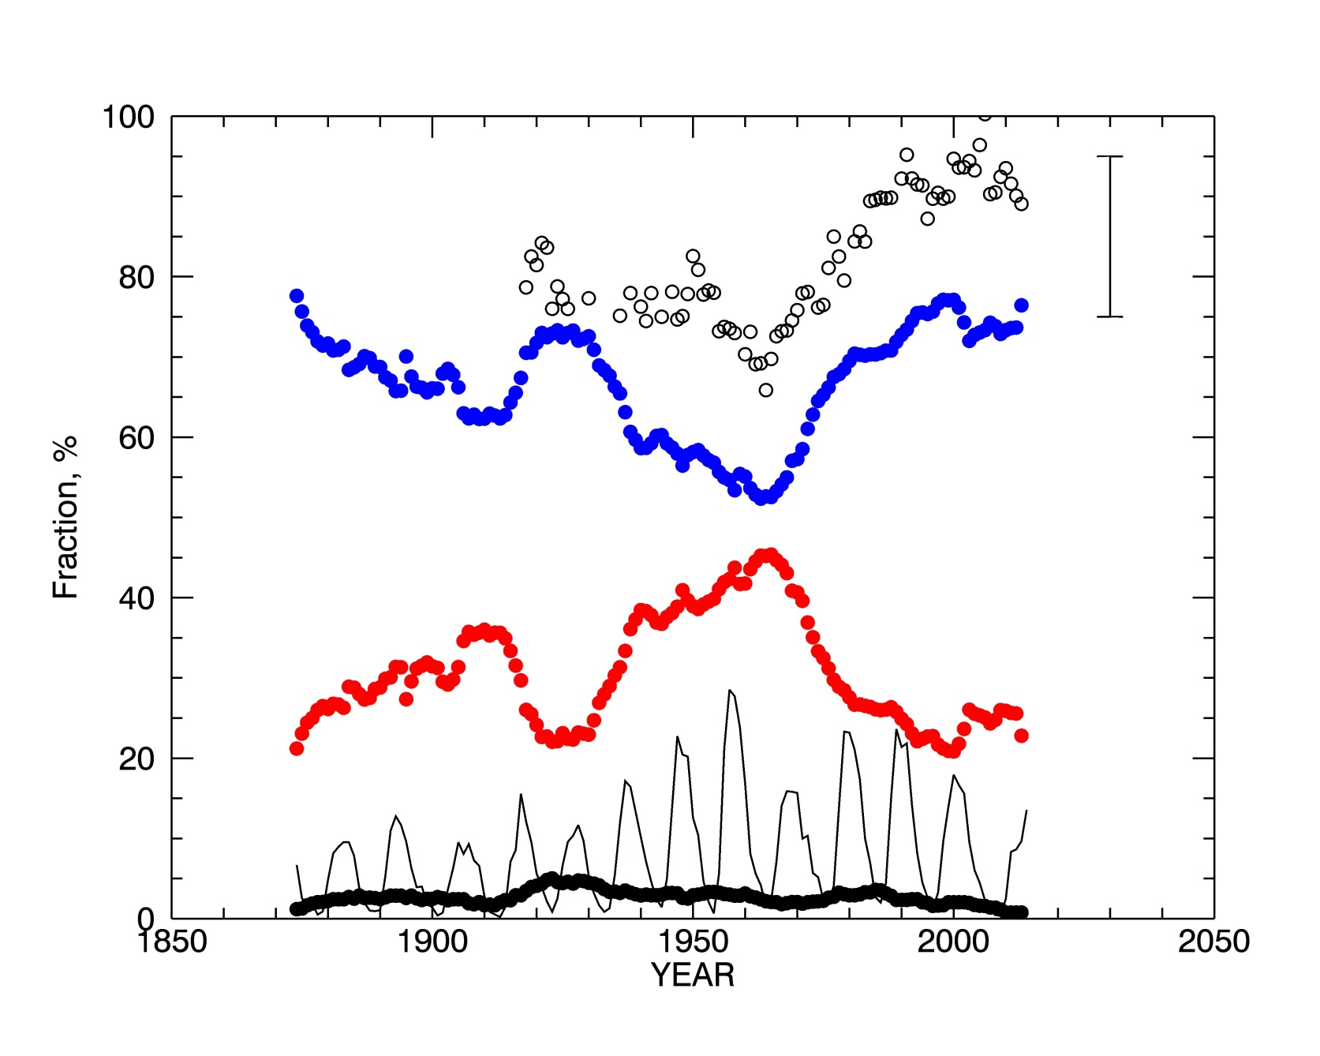
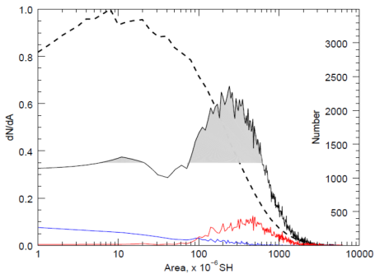
MWO field strength
700 G
50-1000 MSH
11-50 MSH
>1000 MSH

Slide 25
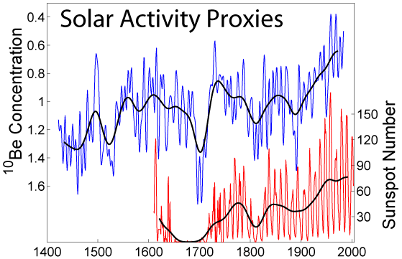
How about Real Space Climate Time Scales?
Concentration of cosmogenic isotopes (¹⁴C and ¹⁰Be) in terrestrial archives can be used to derive proxy for solar activity over last 11,000+ years (e.g., Usoskin et al 2007).
Relies on models of long-term changes in radioisotope production; known changes of geomagnetic field.
Derived proxy only represents open flux in heliosphere.
Grand minima (Gm) appear to be a stochastic process.
There is a tendency for Grand minima to “cluster” in groups or produce long Gm-free periods.

Slide 26
Concluding Remarks
Modern sunspot field strength do not exhibit a strong decline in sunspot field strengths.
Sunspot field strength vary with solar cycle (solar min/max – weaker/stronger sunspots).
Long-term (100-years) trends are present, but the amplitude is much smaller than cycle variations.
Both cycle and long-term variations may be related to changes in sunspot size distribution.
Analysis of cosmogenic isotopes indicates the presence of long term variations in open magnetic field on the Sun. Appearance of Gm is a stochastic process.

