Slide 1
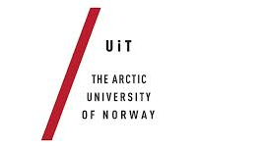


Geomagnetic Variations along Concurrent Latitudes due to Ionospheric Currents
Inge Edvardsen – UiT & Baker Hughes
Magnar Gullikstad Johnsen - UiT
Unni Pia Løvhaug - UiT

Slide 2
Outline
Magnetic Directional Surveying
Auroral electrojet and Dipole declination/declination
Substorm current wedge model
Reproducing a real substorm measured at Tromsø
Analyse the result from the model with respect to variations in declination along concurrent geomagnetic latitudes

Slide 3
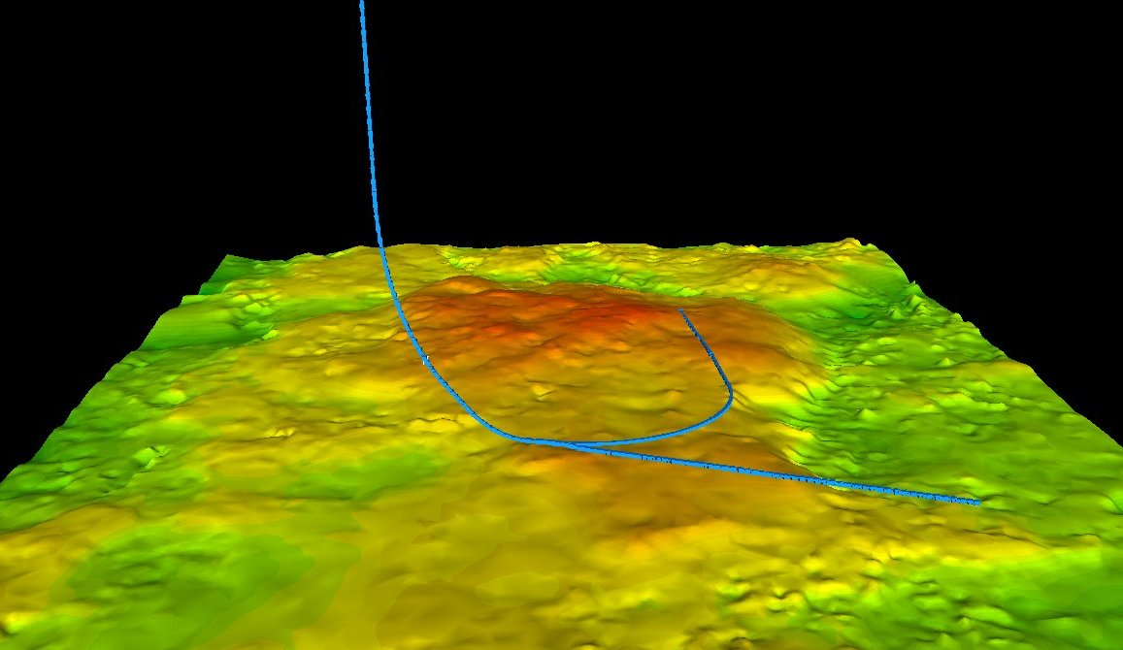
3

Slide 4
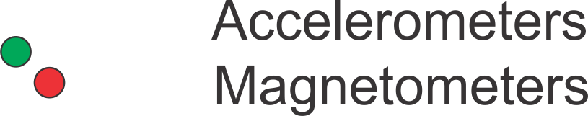
Magnetic Directional Surveying
Inclination
Azimuth
Horizontal
Vertical
4

Slide 5
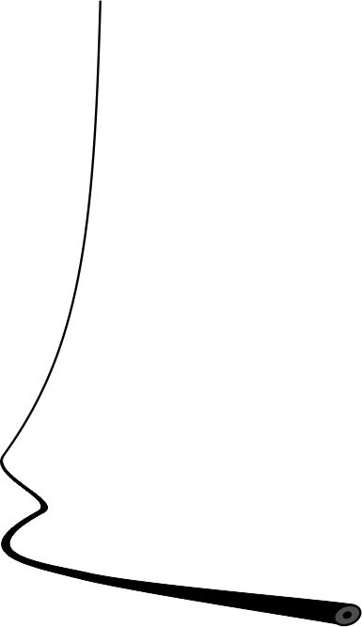
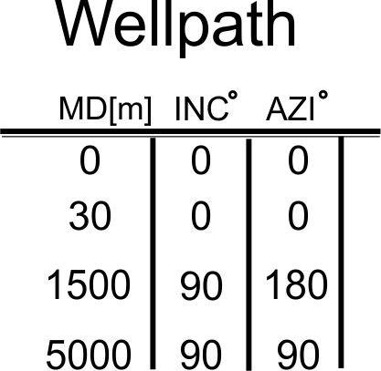
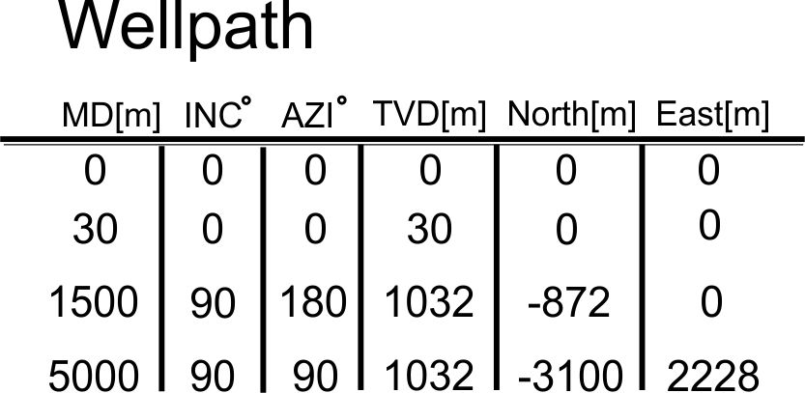
Magnetic Directional Surveying
5

Slide 6
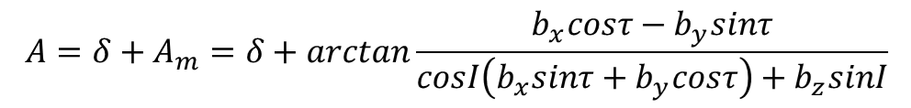
Magnetic Directional Surveying
General formula for azimuth
A – Azimuth
A_{m} – Magnetic azimuth
δ – Declination
b_{x}, b_{y}, b_{z} – Magnetometer measurements
τ – Toolface
I – Inclination
6

Slide 7
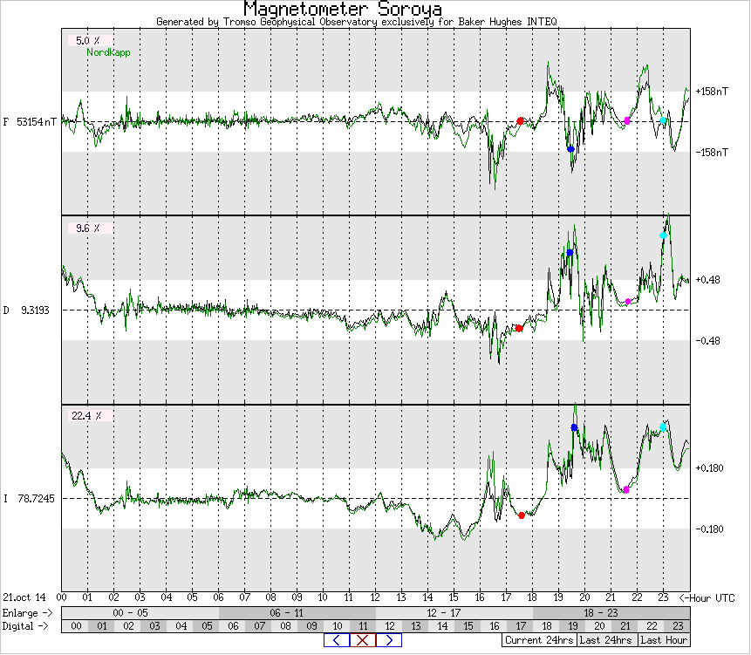
Magnetic Directional Surveying
7

Slide 8
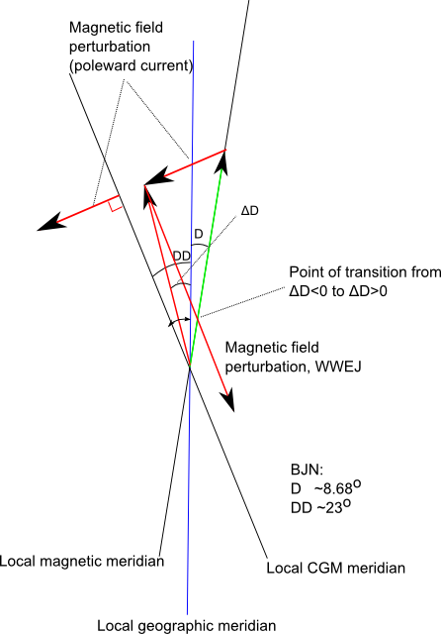
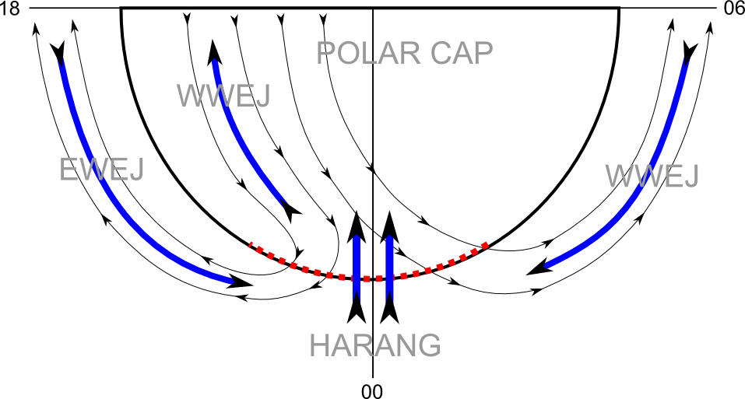
Auroral electrojet and the effect from the current on the declination
SPE 166226

Slide 9
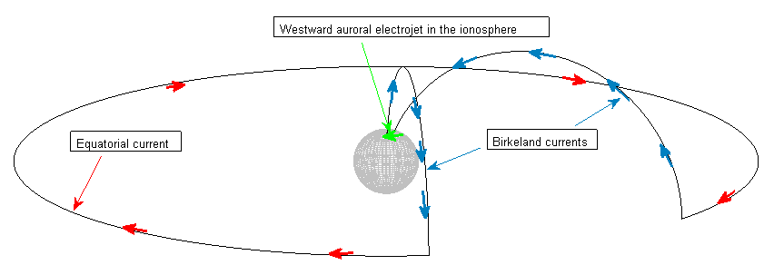
Substorm current wedge model
First order physics model

Slide 10
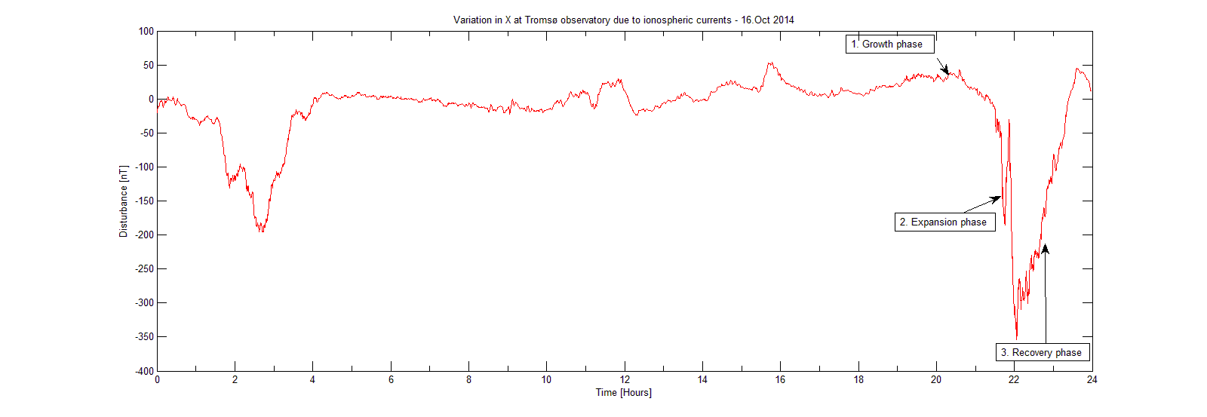
Substorm to reproduce

Slide 11
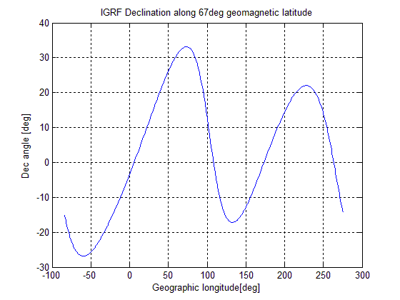
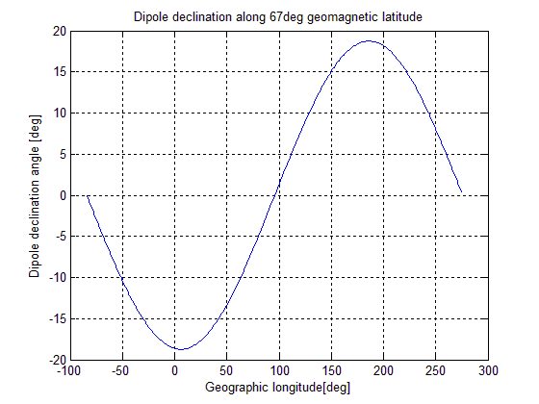
Delta dipole declination / declination along 67deg geomagnetic latitude

Slide 12
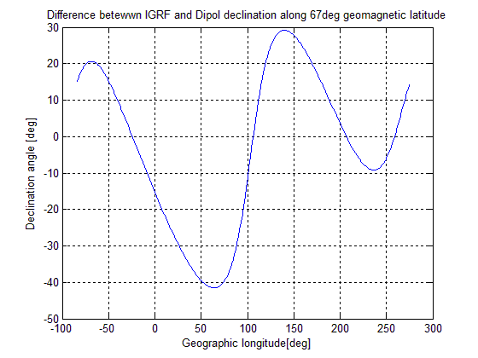
Delta dipole declination / declination along 67deg geomagnetic latitude

Slide 13
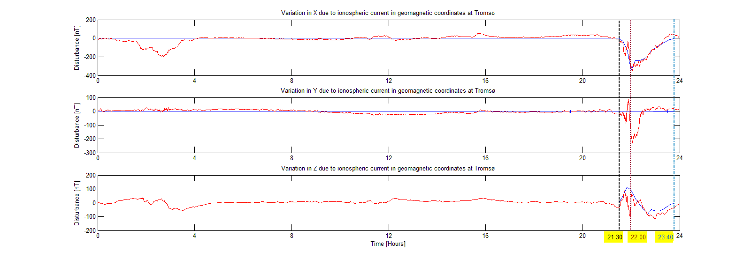
Reproduced substorm
16.Oct 2014
Based on a geocentric dipole magnetic field model
Current wedge 60 deg
Magnetic midnight: 21.30.
I_max = 194.15kA @22.00.

Slide 14

Study of declination variation along concurrent geomagnetic latitudes
Tromsø
Yamal
Alaska
Labrador Sea

Slide 15
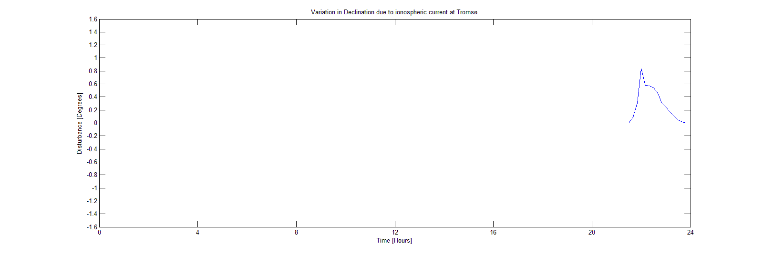
Declination variation - Tromsø
16.Oct 2014
Baker Hughes acceptance limit for declination variation
Maximum deviation for declination variation at Tromsø

Slide 16
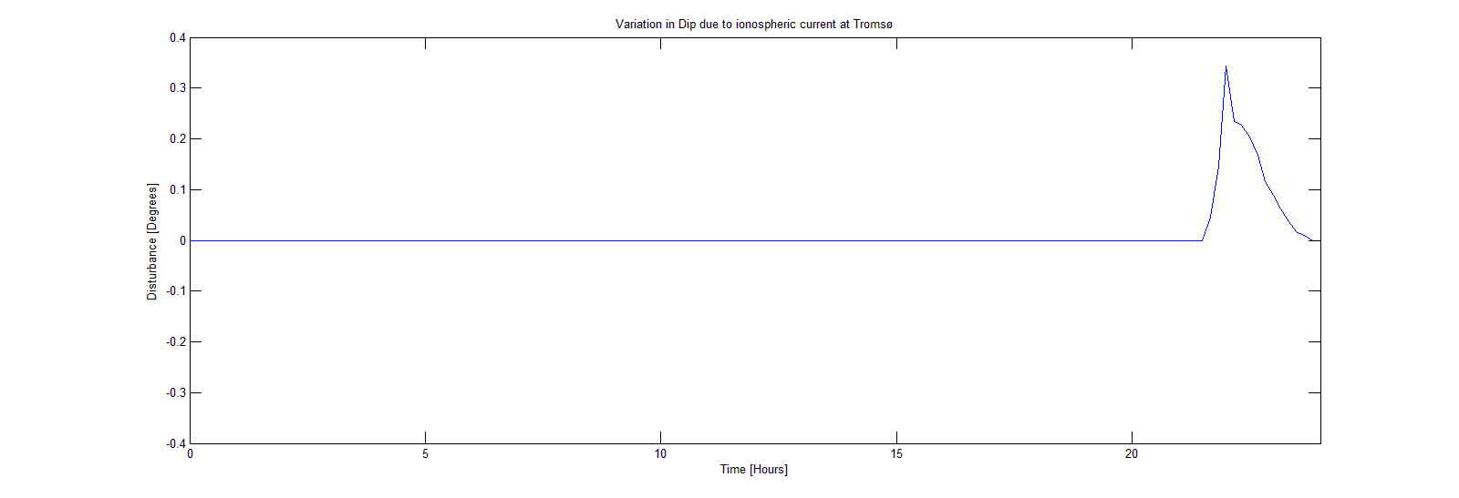
Dip (inclination) variation - Tromsø
16.Oct 2014
Baker Hughes acceptance limit for dip variation
Maximum deviation for declination dip at Tromsø

Slide 17
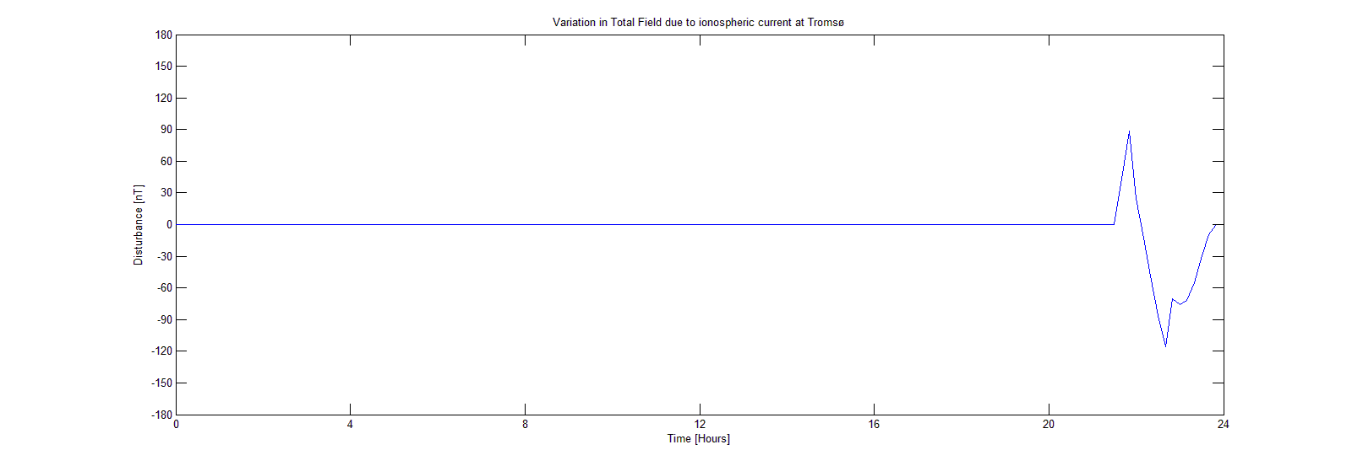
Total Field variation - Tromsø
16.Oct 2014
Baker Hughes acceptance limit for total field variation
Maximum deviation for total field at Tromsø

Slide 18
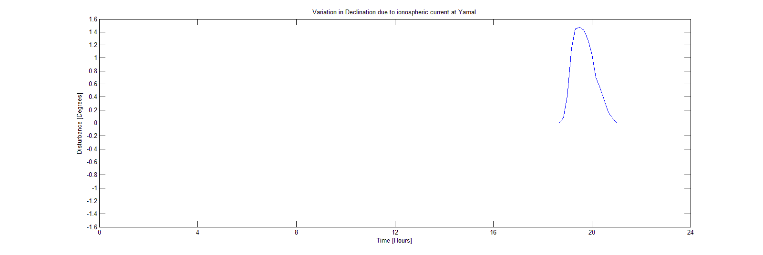
Declination variation - Yamal
16.Oct 2014
Baker Hughes acceptance limit for declination variation
Maximum deviation for declination variation at Yamal
Maximum deviation for declination variation at Tromsø

Slide 19
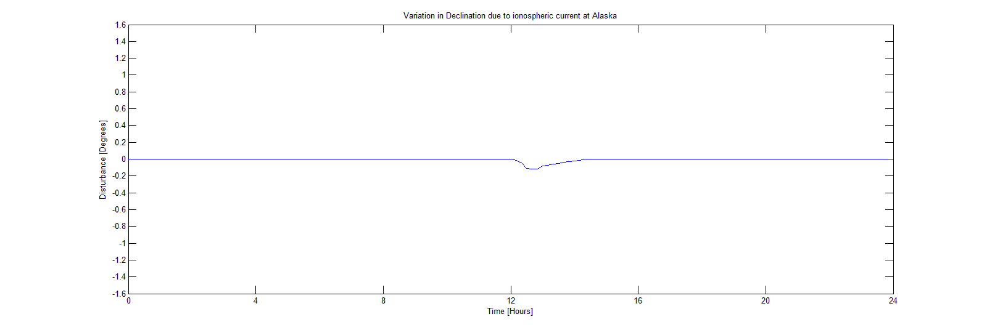
Declination variation - Alaska
16.Oct 2014
Baker Hughes acceptance limit for declination variation
Maximum deviation for declination variation at Alaska
Maximum deviation for declination variation at Tromsø

Slide 20
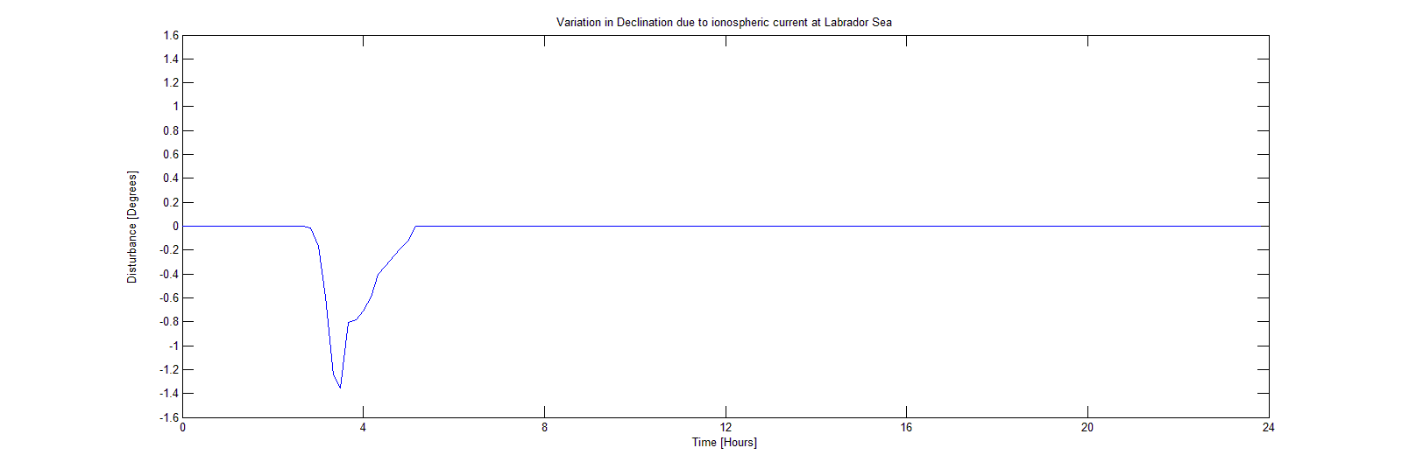
Declination variation – Labrador Sea
16.Oct 2014
Baker Hughes acceptance limit for declination variation
Maximum deviation for declination variation at Labrador Sea
Maximum deviation for declination variation at Tromsø

Slide 21

Study of declination variation along concurrent geomagnetic latitudes
Tromsø
Yamal
Alaska
Labrador Sea

Slide 22
Summary
At higher latitudes the substorm electrojet will often disturb the geomagnetic field, resulting in deviations larger than what is accepted by drilling companies.
Azimuth is directly affected by any variation in declination.
Along concurrent geomagnetic latitude, the declination variation caused by substorm electrojet will vary in both strength and sign.

Slide 23
Geomagnetic Variations along Concurrent Latitudes due to Ionospheric Currents
Inge Edvardsen – UiT & Baker Hughes
Magnar Gullikstad Johnsen - UiT
Unni Pia Løvhaug - UiT

