Slide 1
Construction of a long term interplanetary He dataset in the framework of the ESA ESHIEM project
D. Heynderickx, DH Consultancy, Belgium
A. Varotsou, A. Samaras, TRAD, France
I. Sandberg, NKUA, Greece
P. Truscott, Kallisto Consultancy, UK
R. Vainio, E. Valtonen, Univ. Turku, Finland
F. Lei, RadMod Research, UK
P. Jiggens, A. Hilgers, ESA/ESTEC, The Netherlands

Slide 2
Context
Solar Energetic Particle Environment Modelling (SEPEM): ESA contract to establish reference proton dataset and event list, and build a database and web server for statistical modelling (http://dev.sepem.oma.be)
New activity—Energetic Solar Heavy-Ion Environment Models (ESHIEM, ESA Contract 4000107025) to:
Construct a long-term He dataset to complement the SEPEM H dataset; required energy range: 5–200 (300) MeV/nuc
Establish new heavy ion abundance tables
Combine both into a virtual ion dataset
Update the SEPEM radiation effects tools (TID, SEU)
Implement geomagnetic shielding

Slide 3
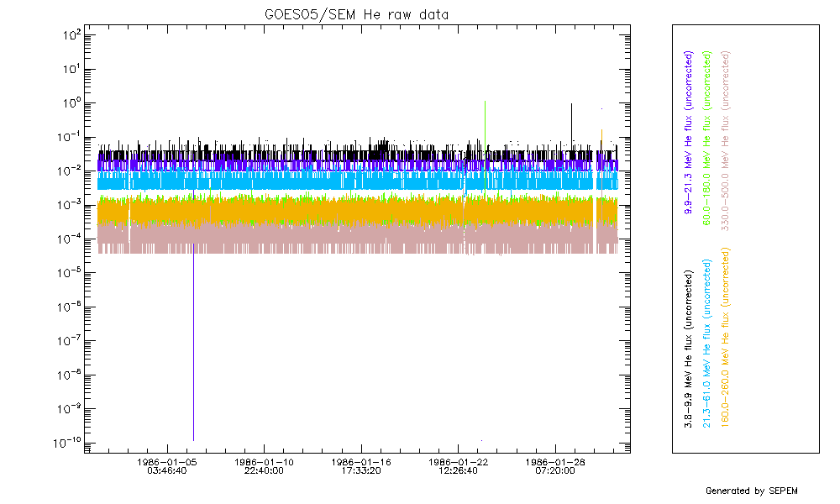
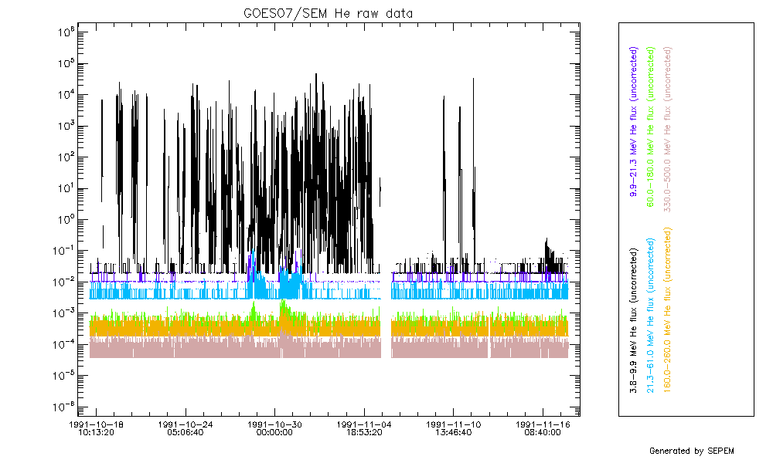
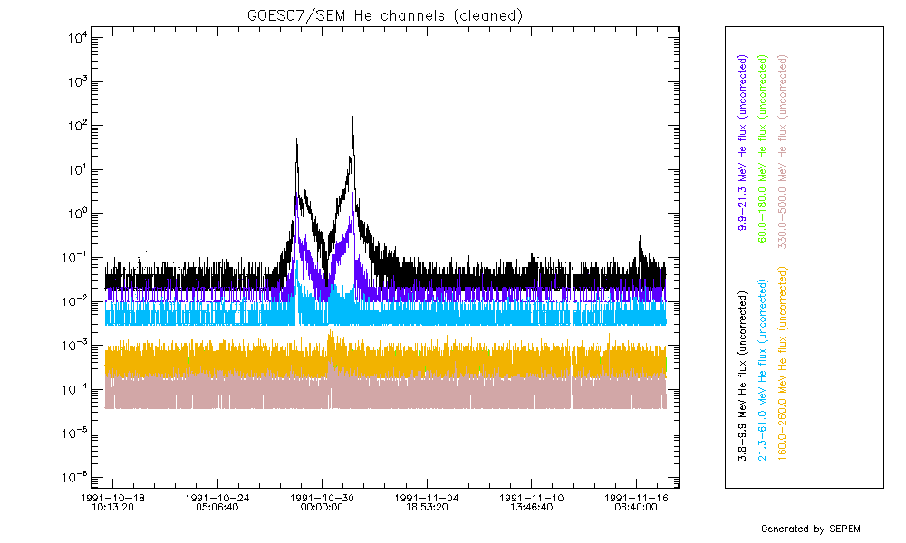
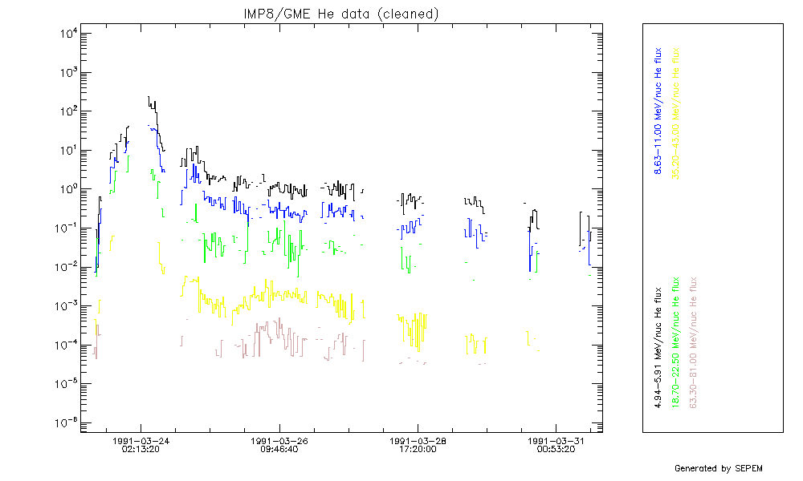
He datasets (1)
IMP8/GME: Nov 1973 – Oct 2001, 1.14–81.0 MeV/nuc (21 channels)
+ science quality instrument, high energy resolution, long duration
– data gaps, saturation, low time resolution (30 m)
Used for period before GOES05 (1984) and calibration of GOES data
GOES/SEM/EPS: Jan 1984 — present, 1.0–125.0 MeV/nuc (6 channels)
+ long duration, no saturation, minor data gaps
– data spikes, high background levels (A4–A6)
Used from Jan 1984 up to present, spikes removed and gaps filled, energy channels re-defined using IMP8/GME data

Slide 4
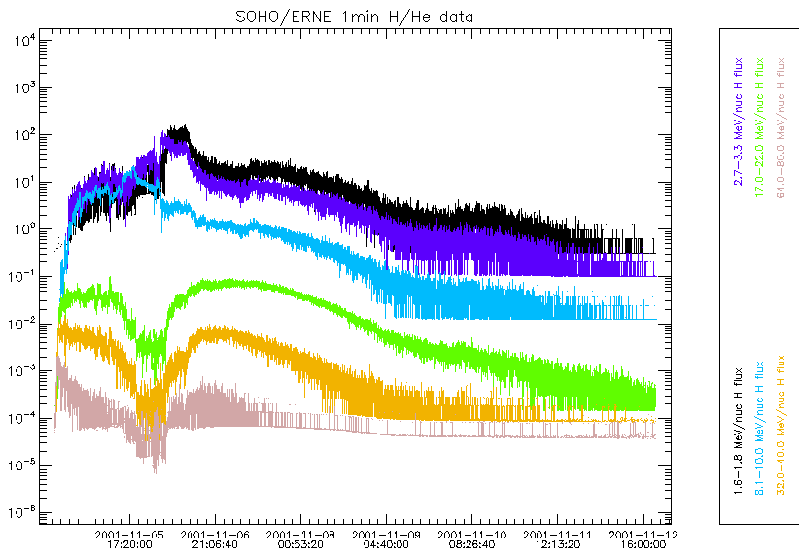
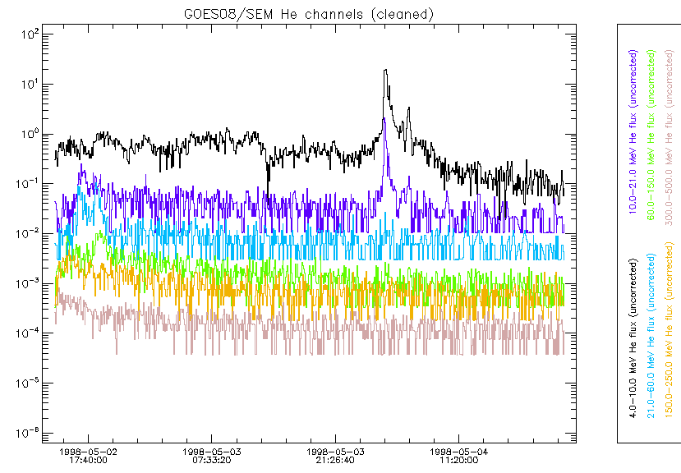
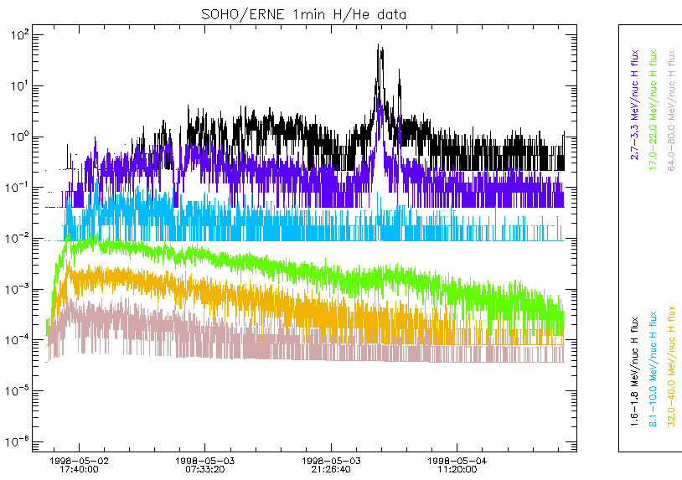
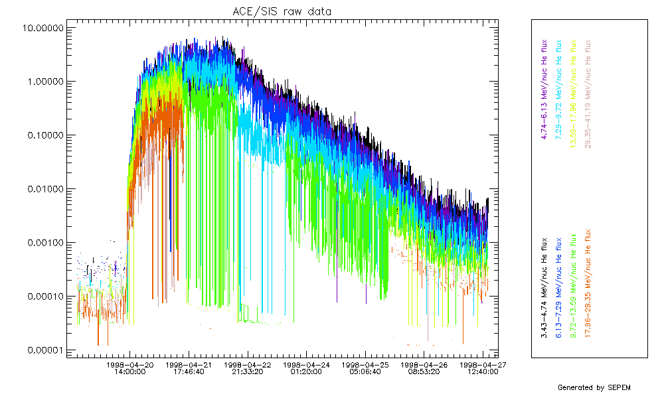
He datasets (2)
ACE/SIS: Sep 1997 — present, 3.43–41.2 MeV/nuc (8 channels)
+ science quality instrument, high sensitivity, high time resolution (256 s)
– very noisy (priority is on heavy ions)
Not used for the reference He dataset
SOHO/ERNE: May 1996 — present, 1.6–131.0 MeV/nuc (20 channels)
+ science quality instrument, high energy resolution, high time resolution (1 m), high sensitivity
– Data gaps, saturation during large events
Narrow opening angle
Used for validation and estimation of background

Slide 5
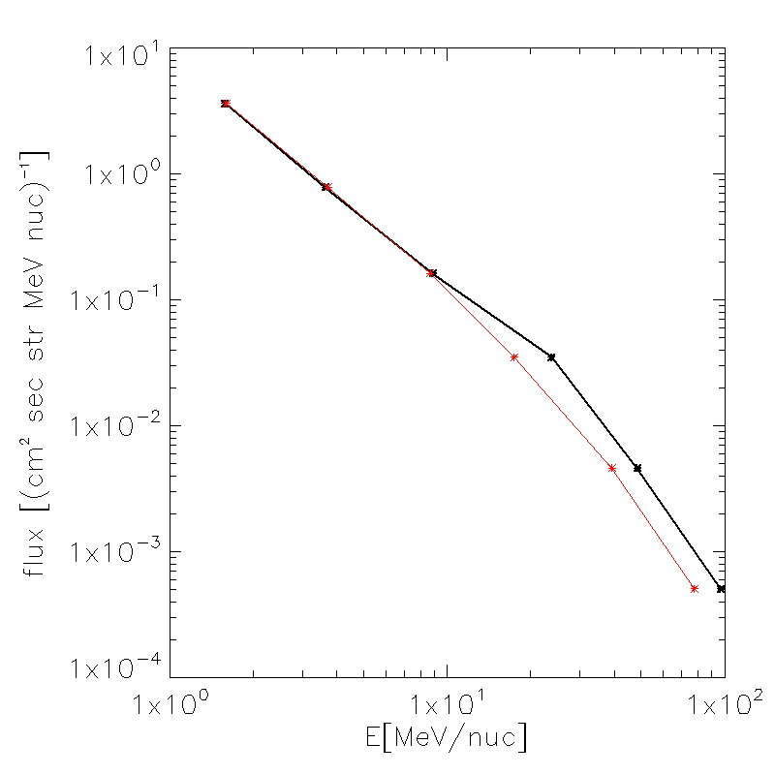
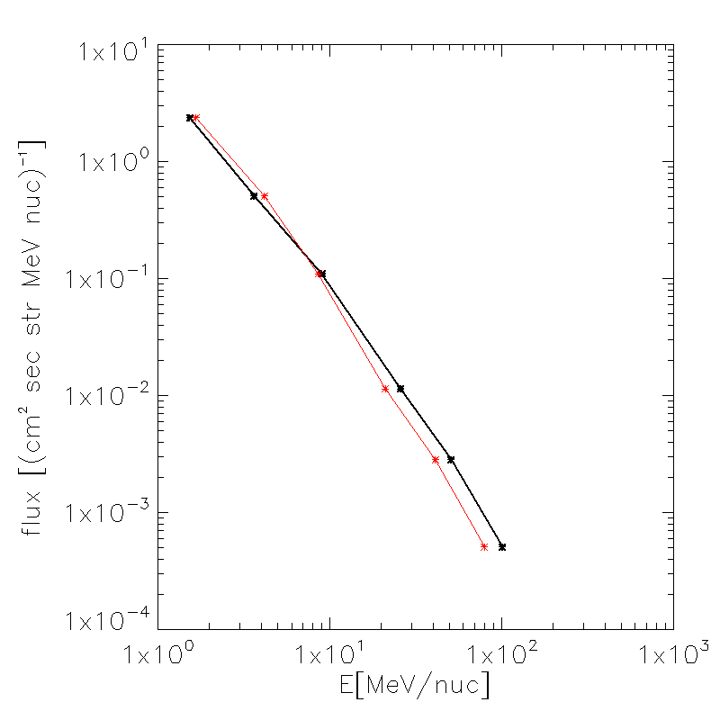
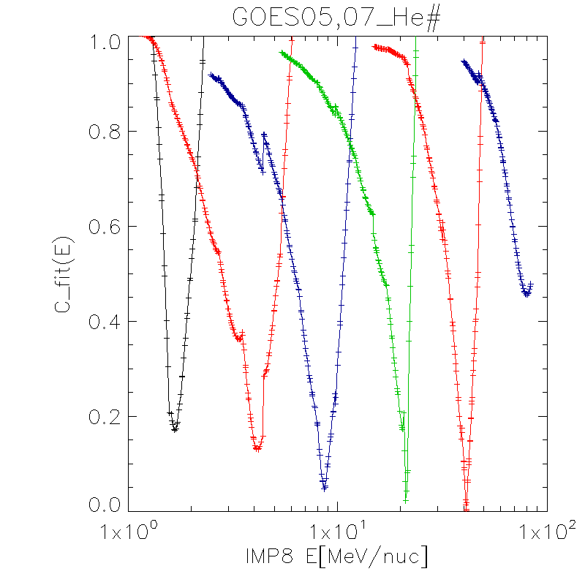
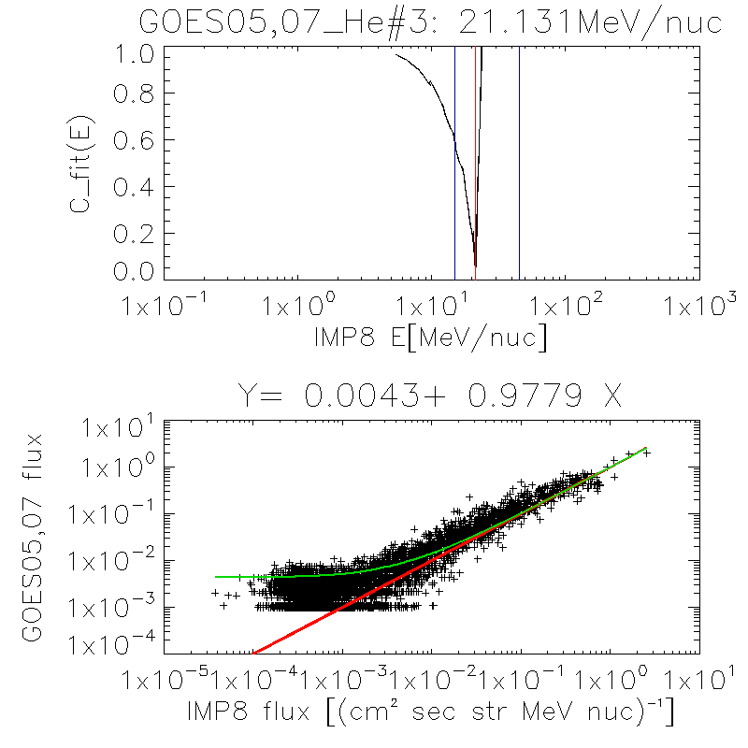
GOES Energy channels
ESA SEPCALIB project established a method to refine the GOES H energy bin definitions using IMP8/GME data: interpolate GME data to find the energy that minimizes the correlation with GOES data
Application to GOES He channels, combining GOES05,07 and GOES08,11 to increase data samples
Channels A1–A3 do not change significantly, channels A4–A6 are shifted down by up to 20 MeV.
Energy centroids for SEM and SEM-2 are very similar.
For GOES13, values found for GOES08,11 were used.

Slide 6
Re-defined GOES He energies
Channel MeV/nuc | GOES05,07 |  | GOES08,11
 | Nominal | New | Nominal | New
A1 | 1.53 | 1.66 | 1.58 | 1.60
A2 | 3.63 | 4.17 | 3.62 | 3.72
A3 | 9.01 | 8.61 | 8.87 | 8.68
A4 | 26.0 | 21.1 | 23.7 | 17.4
A5 | 51.0 | 41.2 | 48.4 | 39.3
A6 | 101.6 | 79.8 | 96.8 | 77.8

Slide 7
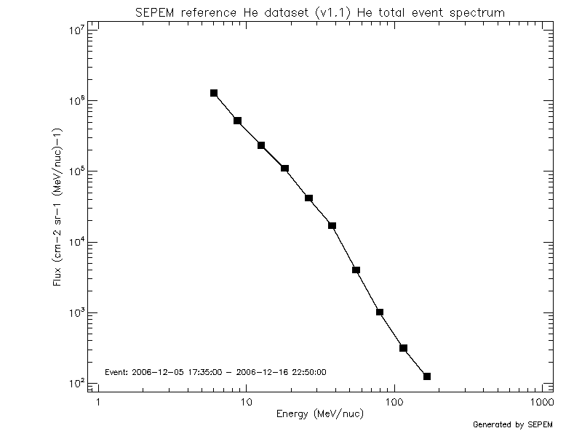
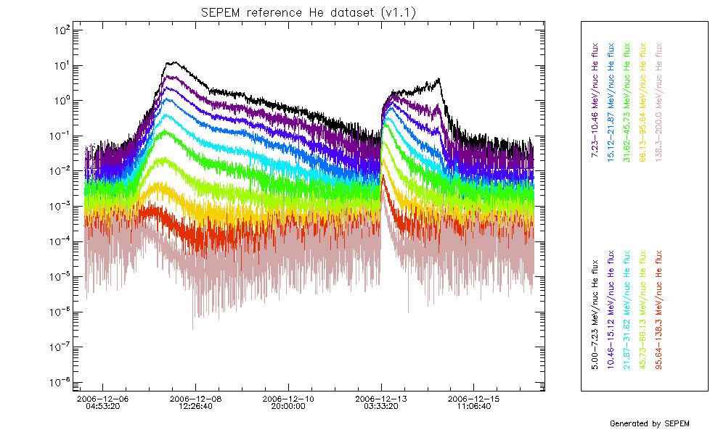
Combined IMP8/GOES dataset
Re-bin fluxes into 10 (11) logarithmically spaced energy channels in [5,200] ([5,300]) MeV/nuc
Combine successive spacecraft data in a single dataset
Dataset | Original Time Span | Time Span of Selected Data | Comments
IMP8/GME | 01/11/1973–26/10/2001 | 01/11/1973–31/12/1983
GOES05/EPS | 01/01/1984-24/03/1987 | 01/01/1984-06/03/1987 | Missing data for Dec 1985 were set to background levels.
GOES07/EPS | 06/03/1987-31/08/1996 | 07/03/1987-28/02/1995
GOES08/EPS | 01/01/1995-17/06/2003 | 01/03/1995-04/06/2003
GOES11/EPS | 01/07/2000-28/02/2011 | 05/06/2003-31/01/2011 | Due to large data gaps, data prior to 21/06/2003 are only used for cross-calibration. Data from GOES12 were used for 1–19/06/2003.
GOES13/EPEAD | 01/05/2010-present | 01/02/2011-present | Data for 22–03/05/2013 were patched with GOES15 data.

Slide 8
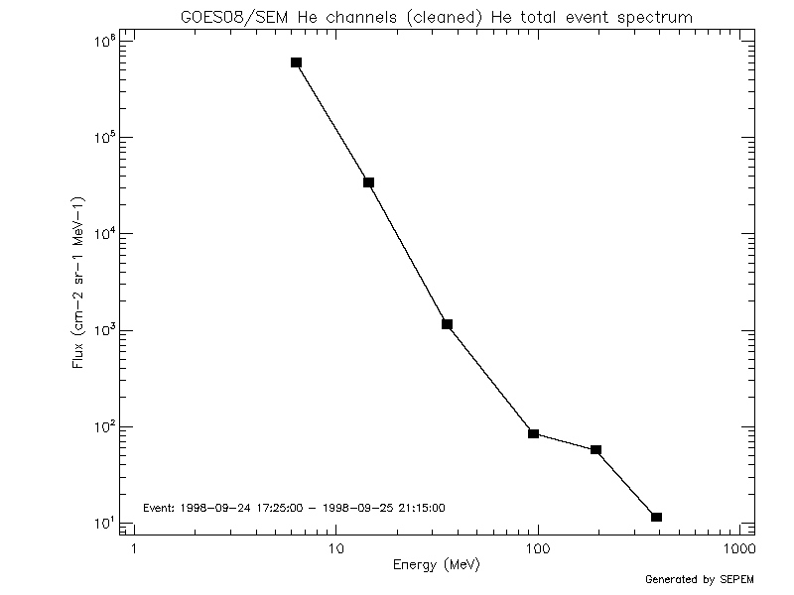
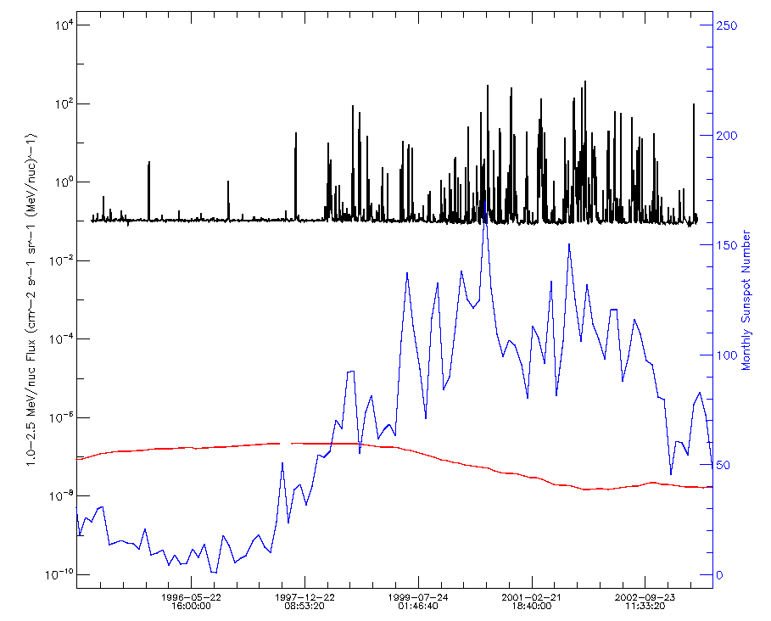
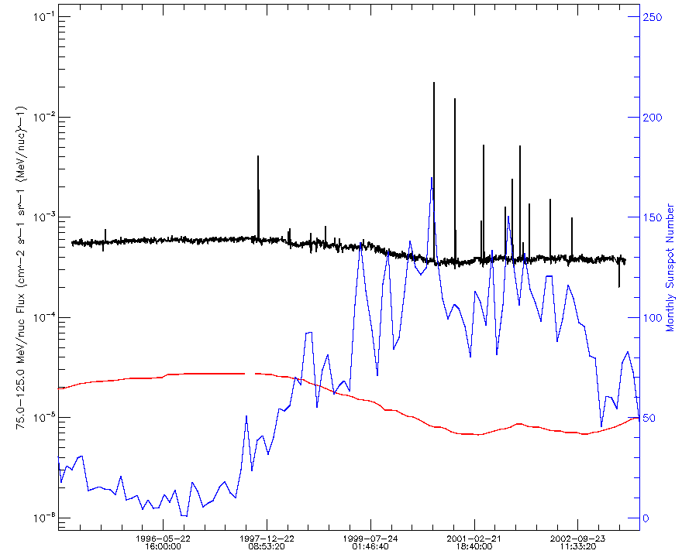
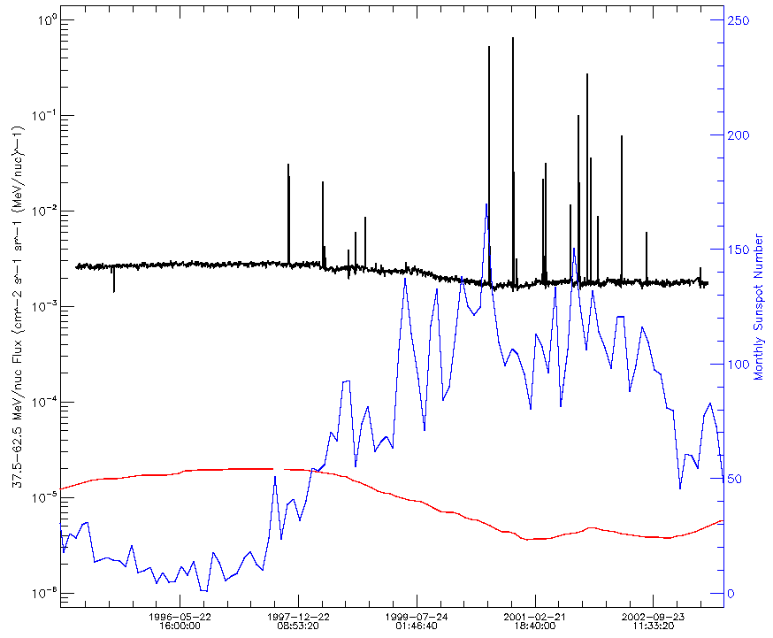
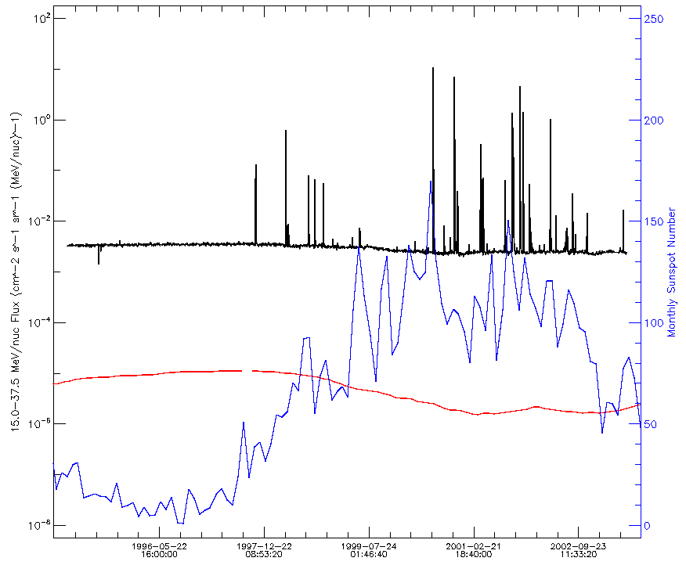
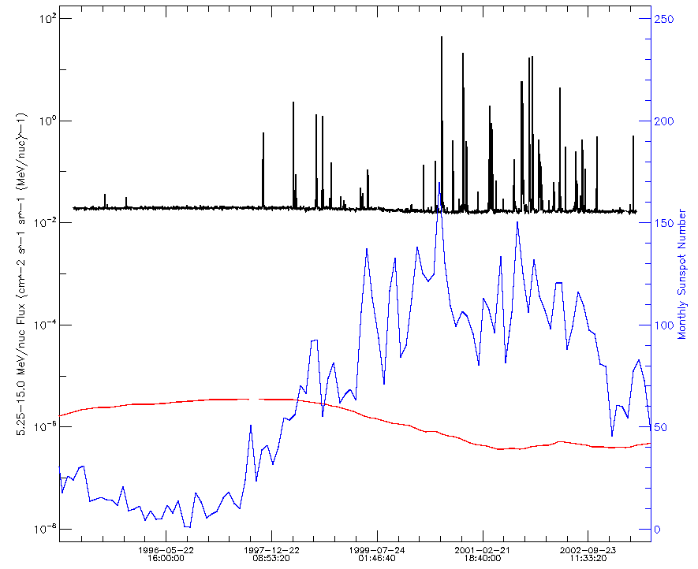
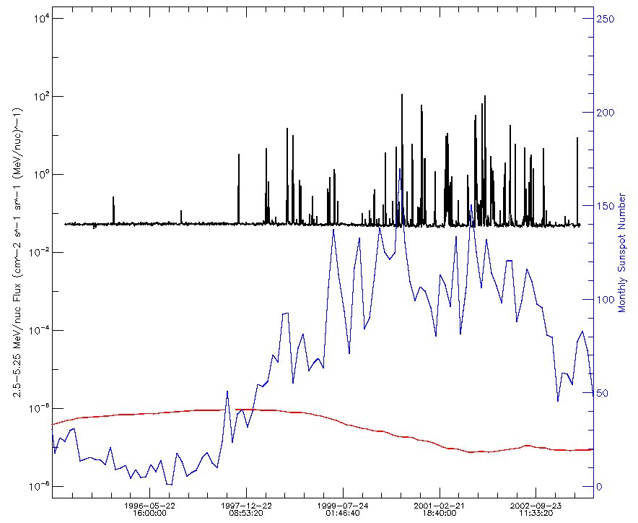
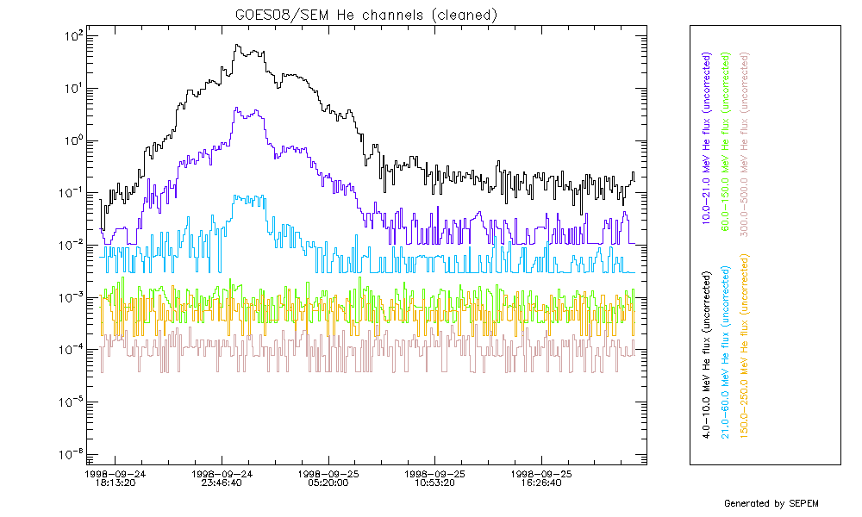
GOES background issues
High background levels or thresholds in A4–A6
Small events are not seen in these channels

Slide 9
Remaining work
Derive and apply an algorithm for background subtraction
Investigate the “invisibility” of small events in high energy GOES channels on event probability analysis
If necessary and feasible, try to use SOHO/ERNE data to “patch” smaller events in the reference dataset
The He dataset is the baseline for the virtual ion dataset (using abundance ratios), hence at least a background subtraction must be applied.

