Slide 1
Highlighted poster (poster 4, session 9)
First Results from the HELCATS Project
Harrison et al.
See also: HELCATS - Heliospheric Cataloguing, Analysis and Techniques Service (Session 9; Poster 21)
The FP7 HELCATS project (start date 1st May 2014; duration 3 years) capitalises on European expertise in heliospheric imaging built up over the last decade, whilst also exploiting long-established European expertise in such areas as solar and coronal imaging as well as the interpretation of in-situ and radio measurements of solar wind phenomena.
HELCATS activities include:
cataloguing transient (CMEs) and background (SIRs/CIRs) solar wind structures imaged by STEREO/HI, including estimates of their kinematic properties based on a variety of established, and other more speculative, modelling approaches;
verifying these kinematic properties, thereby assessing the validity of these techniques, through comparing with solar source observations and in-situ measurements at multiple points in the heliosphere;
assessing the potential for initialising advanced numerical models based on the derived kinematic properties of the transient and background solar wind;
assessing the complementarity of using radio observations (in particular Type II radio bursts and interplanetary scintillation) in combination with heliospheric imaging observations.

Slide 2
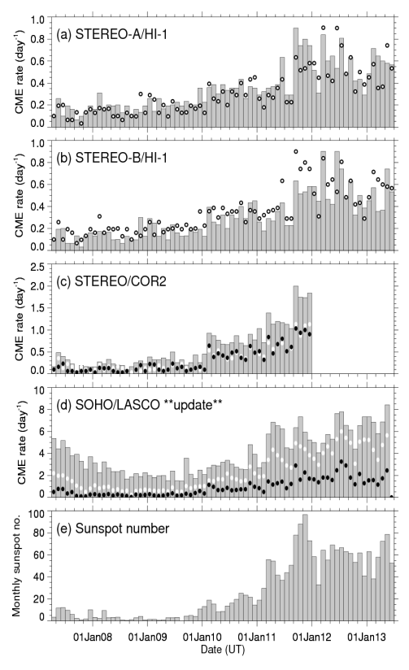
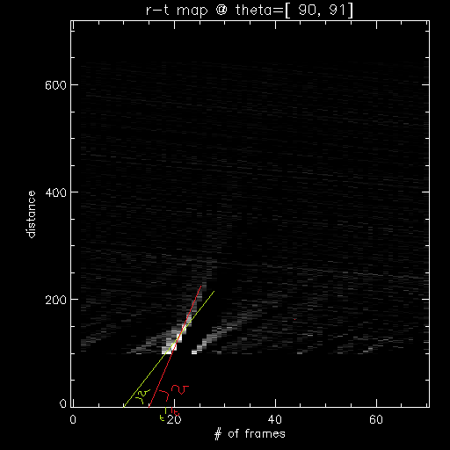
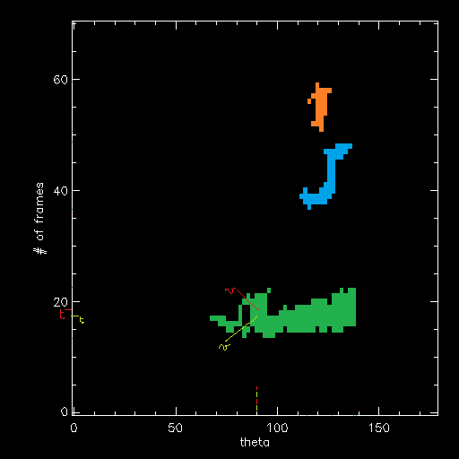
Highlighted poster (poster 4, session 9)
First Results from the HELCATS Project
Harrison et al.
Harrison et al. present some selected initial results from the first 6 months of the HELCATS project. These include the generation of a provisional manual CME catalogue (April 2007 to July 2013) and preliminary results from attempts at automated identification of CMEs, using CACTus.

