Slide 1
SIDC Space Weather briefing
June 5-11, 2017
Cis Verbeeck
and SIDC forecaster team
Solar Influences
Data analysis Centre
www.sidc.be

Slide 2
Report of Solar Activity
Active Regions | 2 low complexity regions
Flaring | X-ray flux background < B2 C2.7 flare
Filaments | No significant filament eruptions
CMEs | No significant CMEs in coronagraph data
Coronal Holes | No significant Coronal Holes

Slide 3
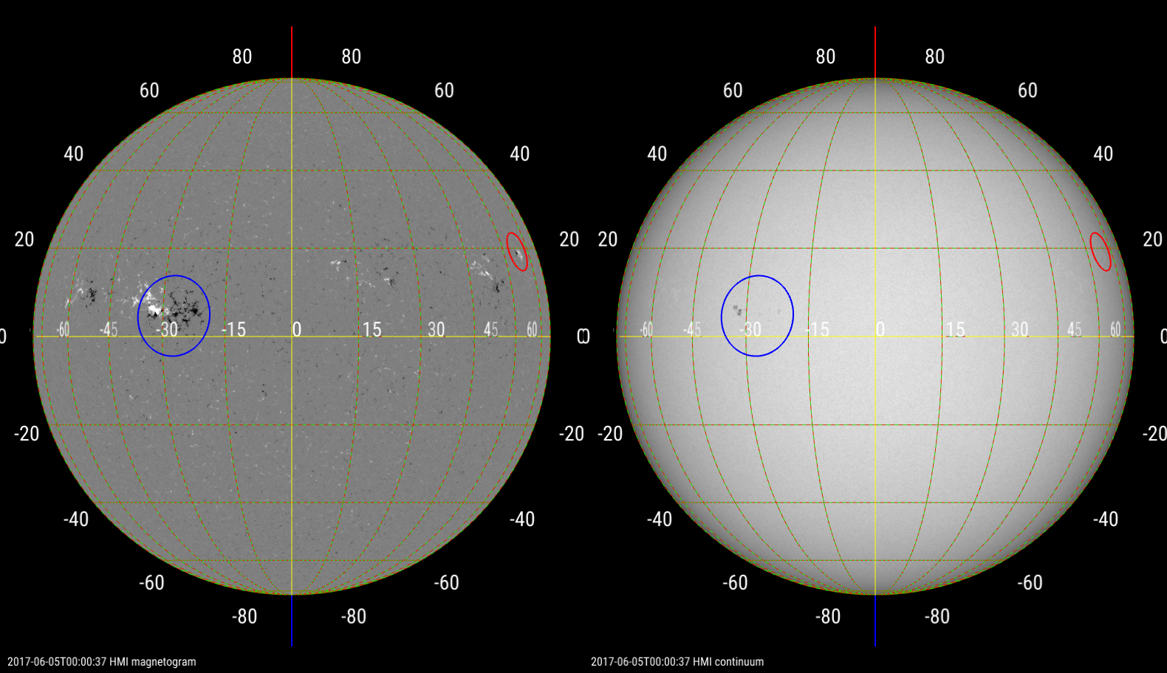
Solar active region evolution
movie

Slide 4
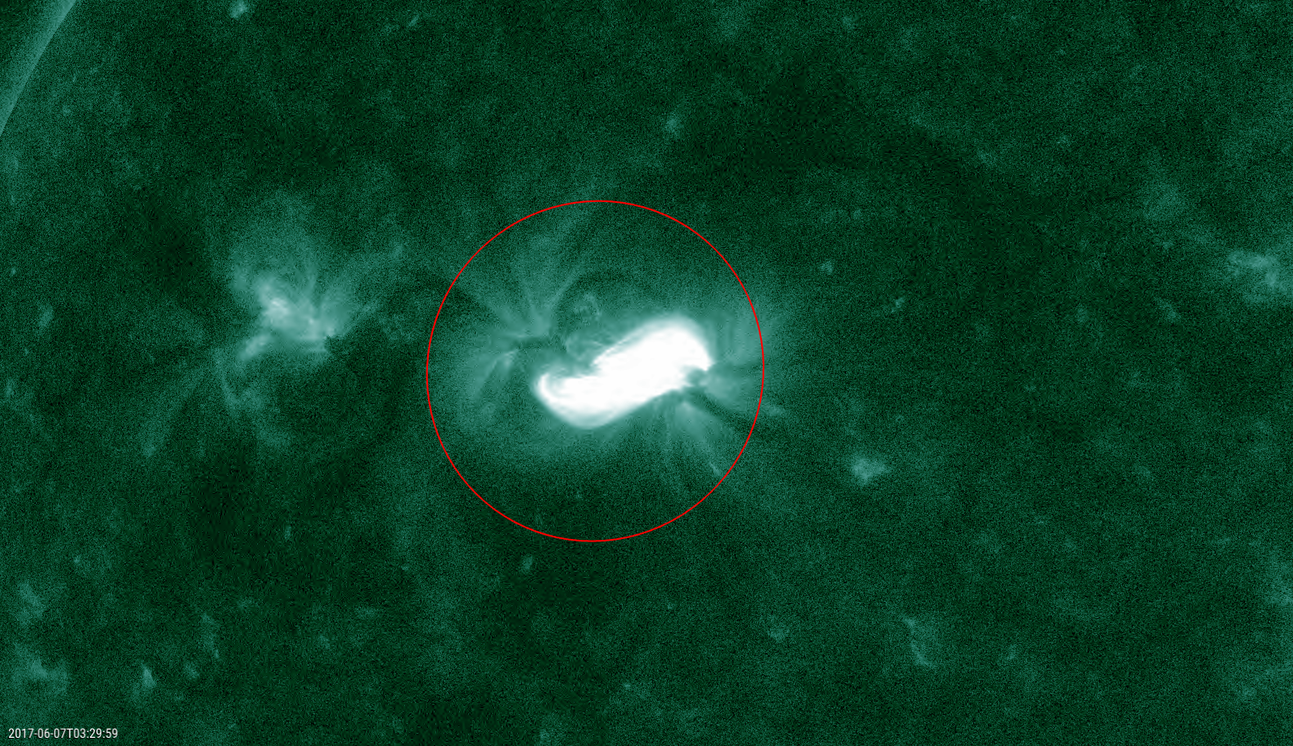
Solar active region evolution 2609
movie

Slide 5
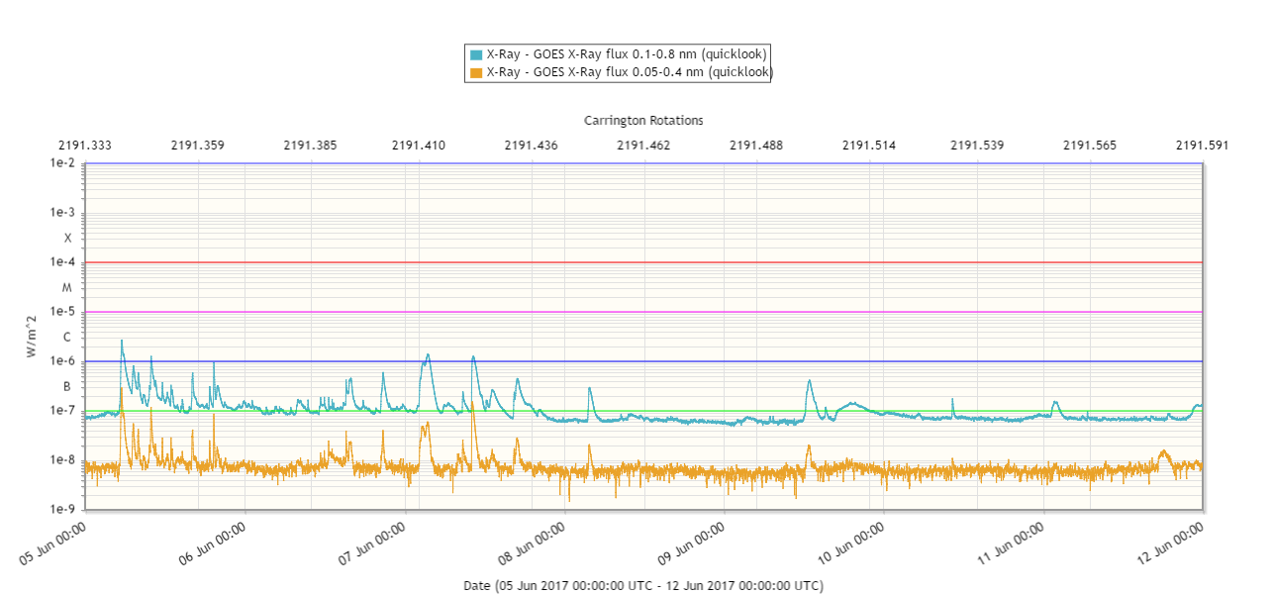
Solar X-ray flux and flaring
Flares
NOAA 2661 & W limb region
NOAA 2661

Slide 6
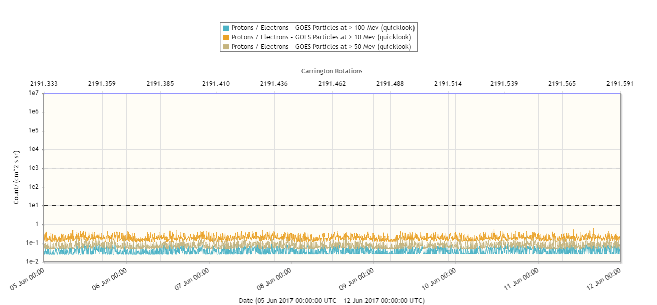
Energetic particles
Protons

Slide 7
Coronal Mass Ejections…

Slide 8
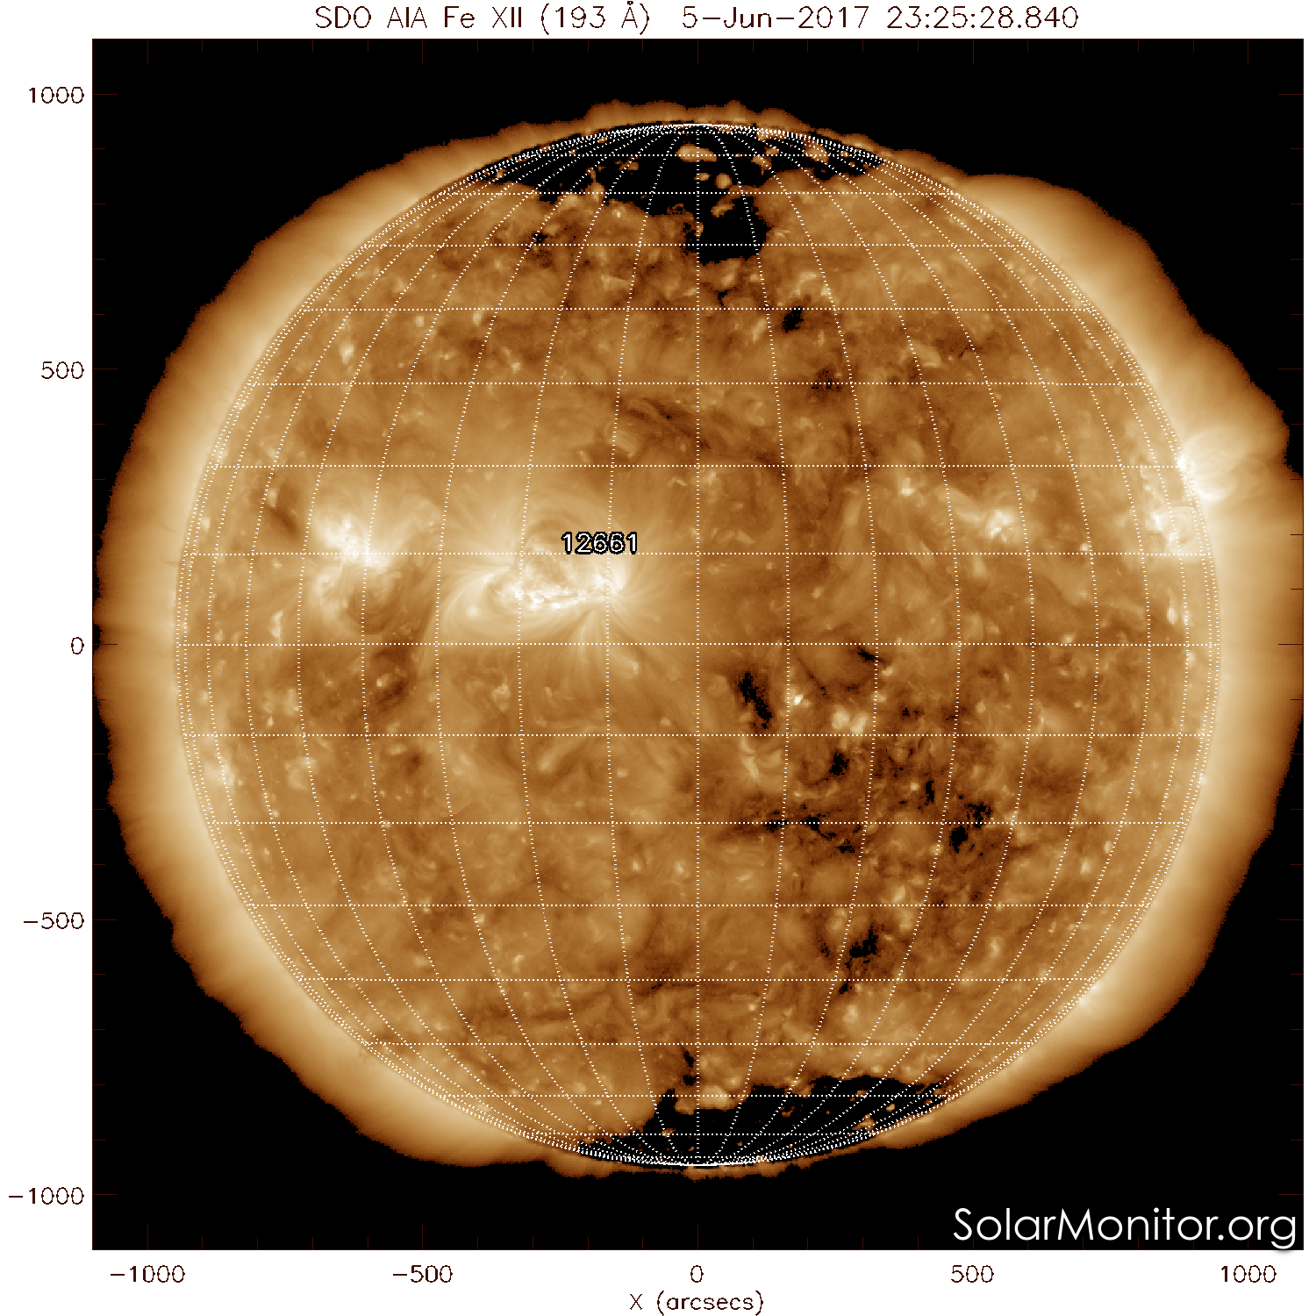
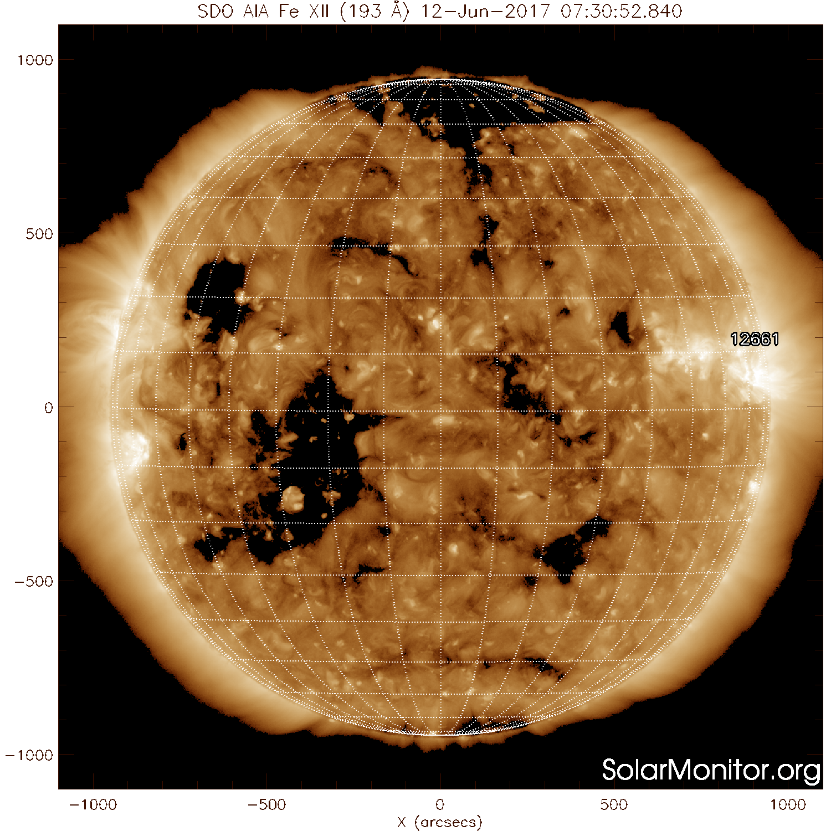
Solar wind
Coronal Holes
Notes:
June 12: negative CH E of central meridian

Slide 9
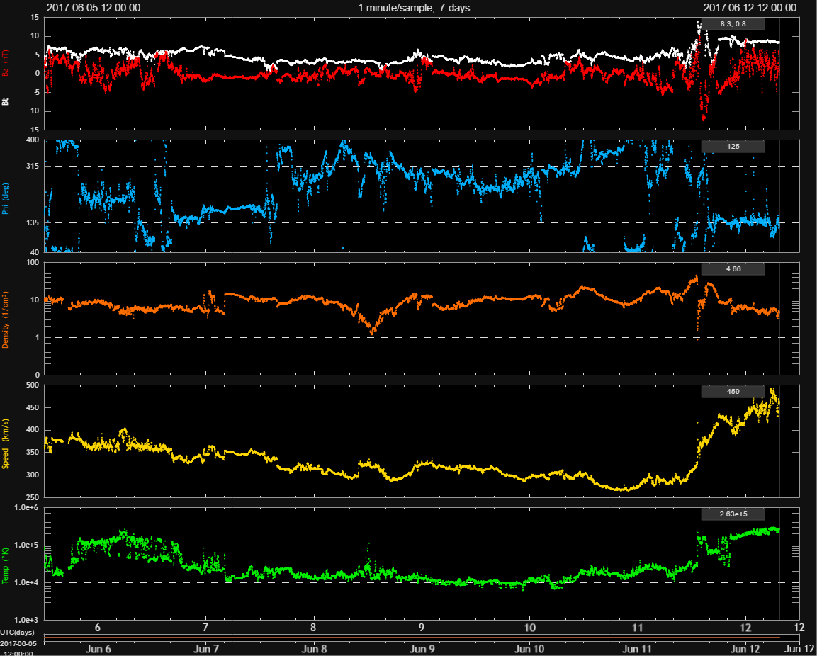
Solar wind
Something

Slide 10
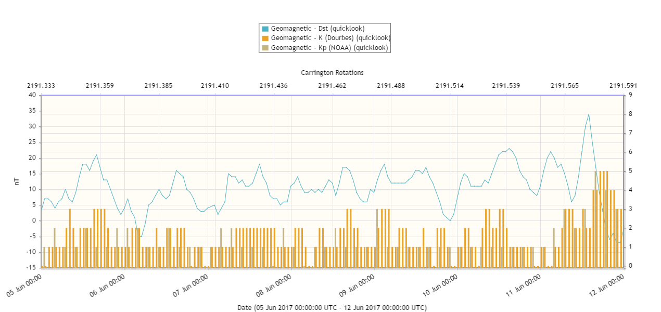
Geomagnetism
Geomagnetic

Slide 11
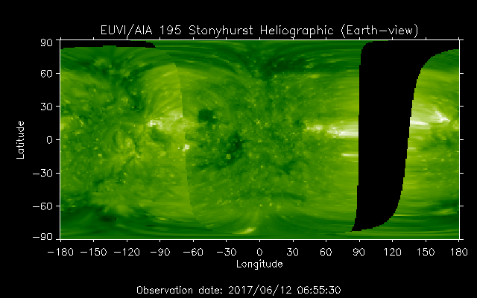
Outlook
`

Slide 12
SIDC Space Weather briefing
See you at a next briefing!
Or visit us at www.sidc.be
Solar Influences
Data analysis Centre
www.sidc.be

