Slide 1
SIDC Space Weather Briefing
15 December 2019 - 22 December 2019
Forecaster's Name & the SIDC forecaster team

Slide 2
Summary Report
Solar activity from 2019-12-15 12:00 UT to 2019-12-22 12:00 UT
Active regions | none
Flaring | # B-class flare: 0 # C-class flare: 0 # M-class flare: 0 # X-class flare: 0
Filaments | One minor insignificant eruption
CMEs | none
Proton Events | none
Solar wind and geomagnetic conditions from 2019-12-15 12:00 UT to 2019-12-22 12:00 UT
Coronal Holes | One CH+ effective
ICME | none
SW Conditions | Enhanced due to HSS max 560km/s
K-indices | max K-index (Dourbes): 3.0 max Kp-index (NOAA): 4
All Quiet Alert: All quiet all week

Slide 3
Solar Activity

Slide 4
Solar active region - start of the week
SDO/HMI White Light 2019-12-15
SDO/HMI Magnetogram 2019-12-15

Slide 5
Solar active region - middle of the week
SDO/HMI White Light 2019-12-18
SDO/HMI Magnetogram 2019-12-18

Slide 6
Solar active region - end of the week
SDO/HMI White Light 2019-12-22
SDO/HMI Magnetogram 2019-12-22

Slide 7
Solar active region & Coronal hole
SDO/AIA 19.3 nm 2019-12-15
SDO/AIA 19.3 nm 2019-12-22

Slide 8
Solar active region & Filament
SDO/AIA 30.4 nm 2019-12-15
SDO/AIA 30.4 nm 2019-12-22

Slide 9
Filament & Filament eruption
H-alpha 2019-12-15
H-alpha 2019-12-22

Slide 10
Solar F10.7cm radio flux

Slide 11
Flaring activity
Probabilities (%) and occurrences (#) of B/C/M/X-flares issued at 12:30 and over the next 24h:
Issue date | 2019-12-15 | 2019-12-16 | 2019-12-17 | 2019-12-18 | 2019-12-19 | 2019-12-20 | 2019-12-21 | 2019-12-22
Probability | ---|01|01|01 | ---|01|01|01 | ---|01|01|01 | ---|01|01|01 | ---|01|01|01 | ---|01|01|01 | ---|01|01|01 | ---|01|01|01
Observed | 00|00|00|00 | 00|00|00|00 | 00|00|00|00 | 00|00|00|00 | 00|00|00|00 | 00|00|00|00 | 00|00|00|00 | 00|00|00|00

Slide 12
Coronal Mass Ejection

Slide 13
Solar proton flux

Slide 14
Solar Wind and Geomagnetic Activity

Slide 15
Solar wind parameters (ACE data)

Slide 16
Geomagnetic activity (K-indexes)

Slide 17
Outlook

Slide 18
Outlook: Solar activity

Slide 19
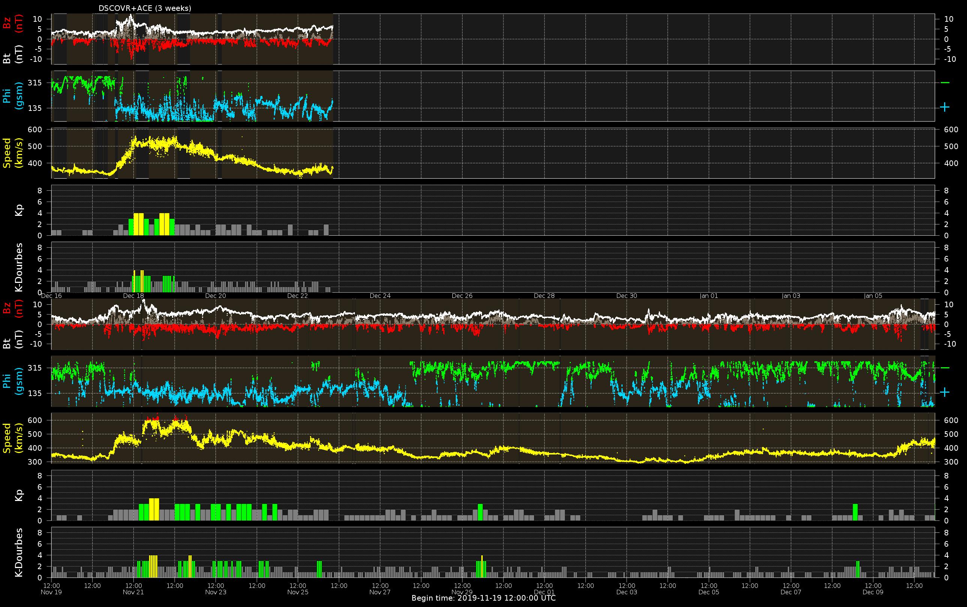
Outlook: Solar wind

Slide 20
Outlook: Geomagnetic activity

Slide 21
SIDC Space Weather Briefing
See you at our next briefing! Or visit us at www.sidc.be

