Slide 1
Analysis of Coronal Heating in Active Region Loops from
Spatially Resolved TR emission
Andrzej Fludra
STFC Rutherford Appleton Laboratory

Slide 2
Contents
Active regions observed with SOHO CDS and MDI
Global Analysis
Spatially-resolved observations of the transition region
Basal heating component
Variability of the TR emission
Conclusions and future work

Slide 3
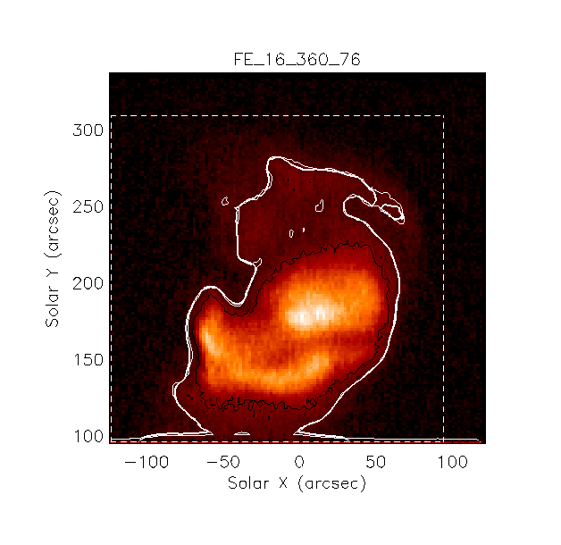
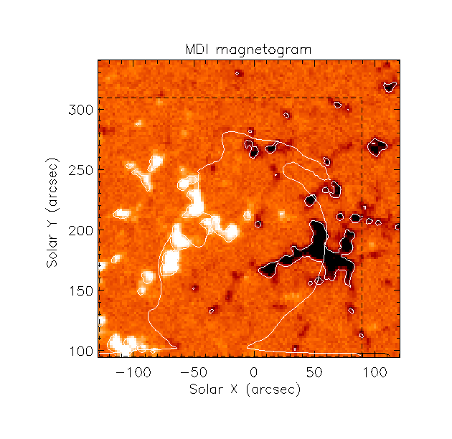
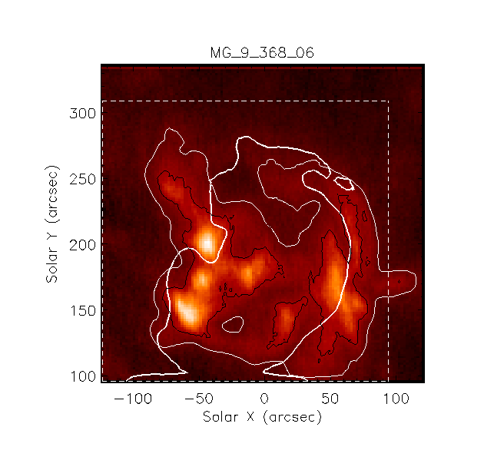
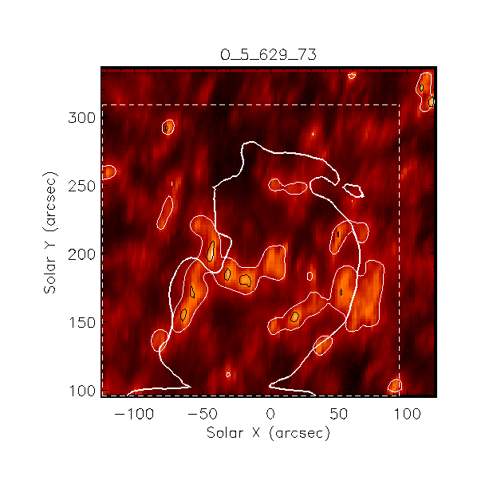
CDS Observations of Active Regions
Fe XVI
2x10⁶ K
MDI
90 – 900 G
Mg IX
9.5x10⁵ K
O V 629.7 A
2x10⁵ K

Slide 4
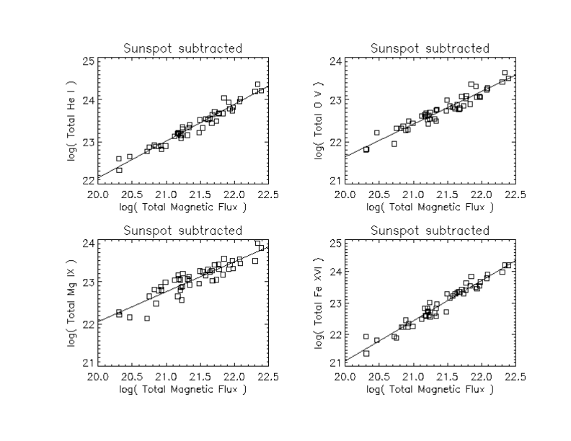
Power Laws from Global Analysis
Detailed derivation, modelling and discussion of applicability:
Fludra and Ireland, 2008, A&A, 483, 609
Fludra and Ireland, 2003, A&A, 398, 297 - inverse method, first correct formulation
I_{ov} ~ Φ^{0.78}
Transition region
AR area dominates these plots.
Heating hidden in the slope.
I_{Fe} ~ Φ^{1.27}
Corona

Slide 5
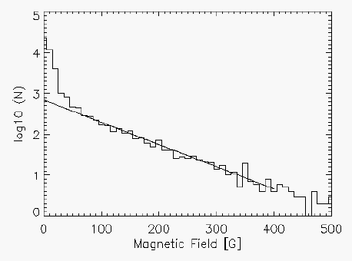

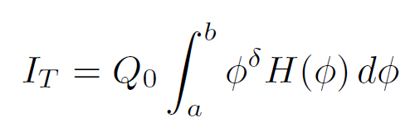

Global Analysis
Seeking λ and δ for individual loops:
H(φ)
Correct method
(inverse problem)
α = 1.27 for Fe XVI, α = 0.76 for OV
Constraints derived from global analysis:
λ - cannot be determined
Limit on δ_{tr} for transition region lines:
0.5 < δ_{tr} < 1
Power law fit to data is only an approximation:
I_{T} = cΦ^{α}
Derive δ from α
Fludra and Ireland, 2008, A&A, 483, 609

Slide 6
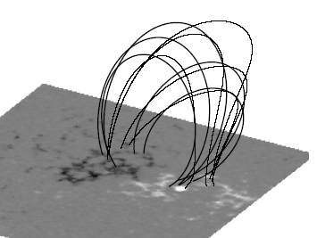
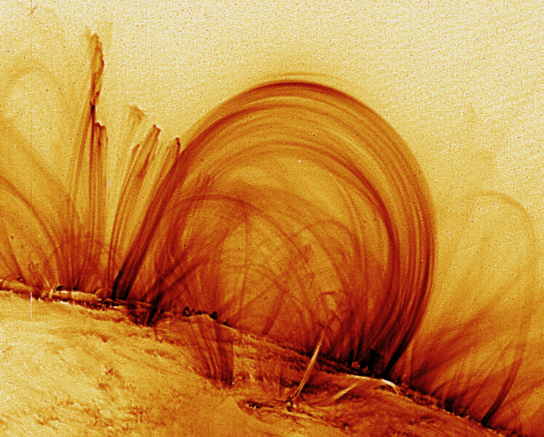
Spatially Resolved Analysis
(transition region)
Coronal lines
Total intensity in a single loop:
TR lines
O V emission
φ
Magnetic flux density, φ

Slide 7
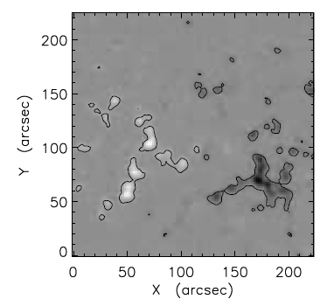
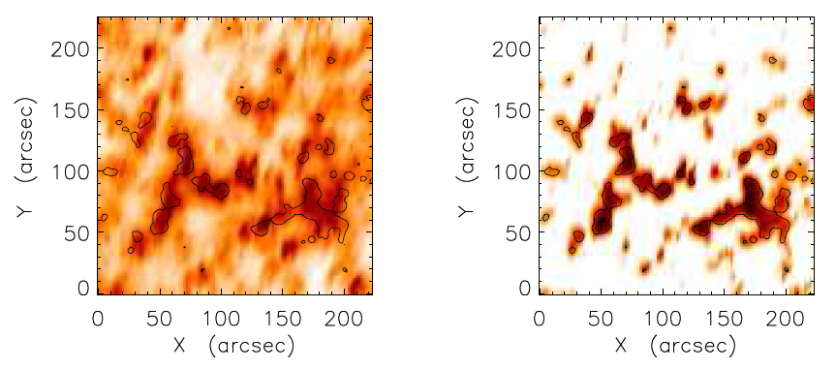
Comparing OV Emission and Magnetic Field
Magnetic field → potential extrapolation → loop length L
Compare at small spatial scales: re-bin to 4’’x4’’ pixels
Observed O V intensity
Simulated O V intensity

Slide 8
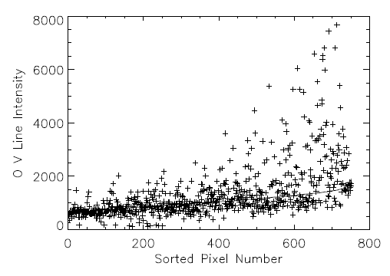
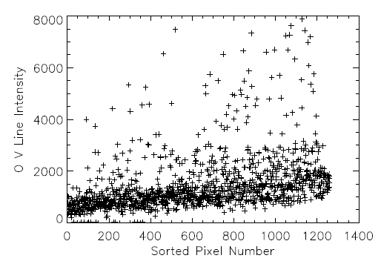
OV Emission in Active Regions
X axis: pixels sorted in ascending order of the simulated intensity of OV line
Model parameters fitted to points below the intensity threshold of 3000 erg cm⁻²
s⁻¹ sr⁻¹
In some active regions: scatter by up to a factor of 5
Fludra and Warren, 2010, A&A, 523, A47

Slide 9
OV Emission in Active Regions

Slide 10
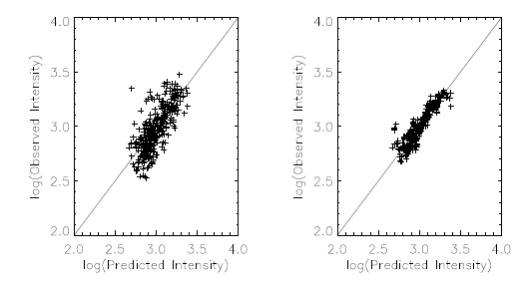
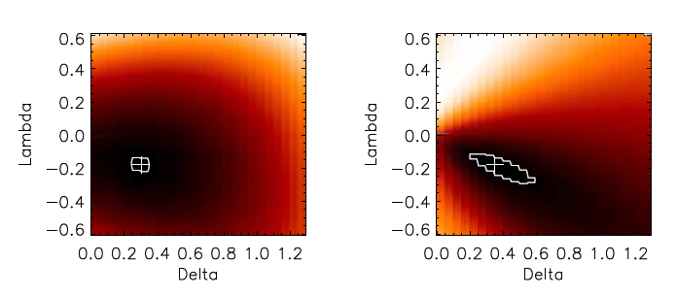
Fitting a model to OV Intensities
observed
smoothed
Vary (δ, λ), find minimum chi²
Chi²
Average result for all regions:
δ = 0.4 +-0.1
λ = -0.15 +-0.07
Fludra and Warren, 2010, A&A, 523, A47

Slide 11
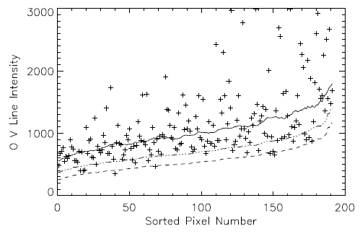
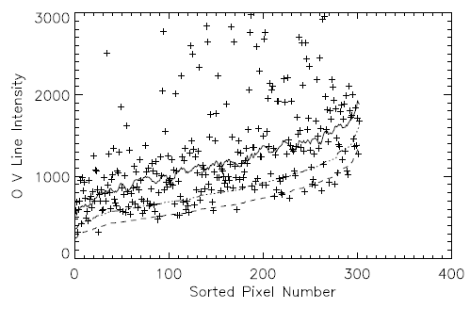
Basal Heating in Active Regions
Lower boundary I_{low} :
I_{bou}(φ,L) = 210 ϕ^{0.45} L^{-0.2}
I_{low} = I_{bou} – 3 σ_{bou}
I_{up} = I_{bou} + 3 σ_{bou,}
σ_{bou =} (4.66I_{bou})^{0.5}
>75% of points are above I_{up}
<25% of points are between I_{bou} +- 3 σ_{bou,}
For those points,
(average intensity ratio)/I_{up} = 1.6-2.0
The lower boundary is the same in 5 active regions = Basal heating
Fludra and Warren, 2010, A&A, 523, A47

Slide 12
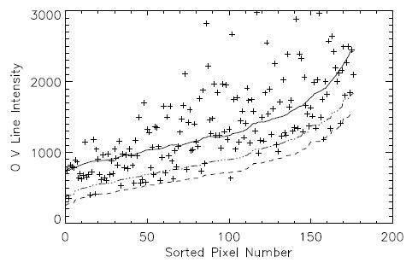
Basal Heating in Active Regions
Fludra and Warren, 2010, A&A, 523, A47

Slide 13
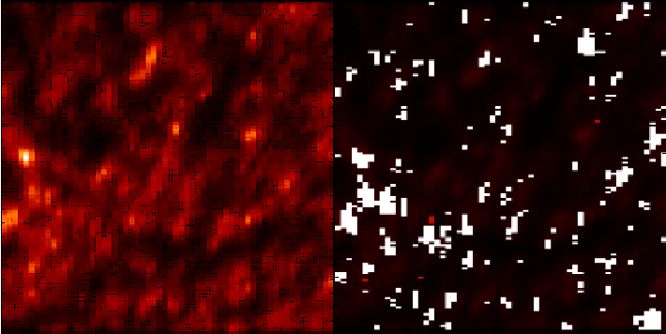
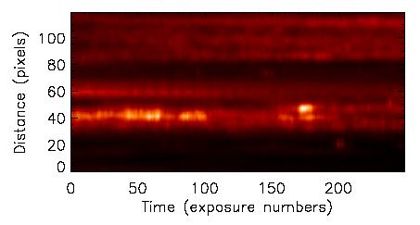
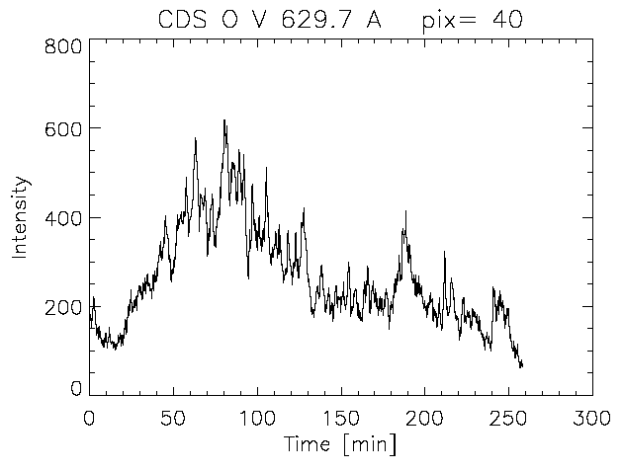
Transition Region Brightenings
CDS O V emission - quiet sun
Event detection algorithm
← 4’ →

Slide 14
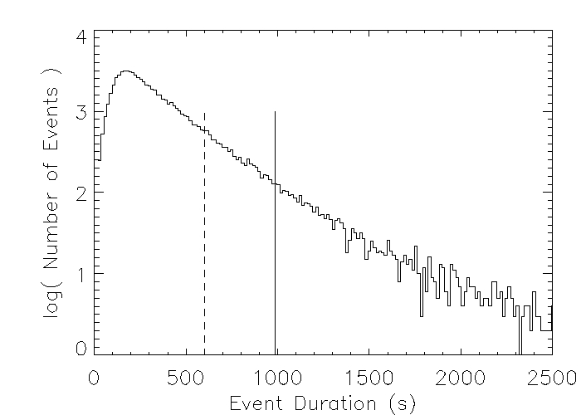
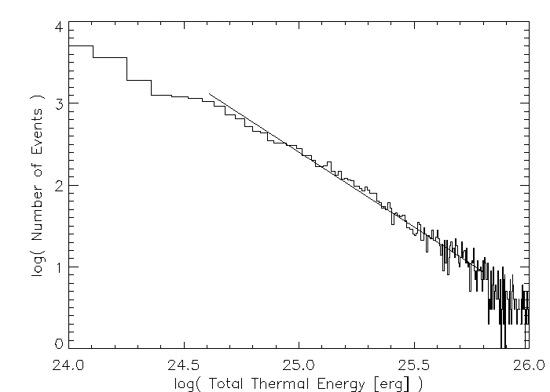
Small Events Statistics
63,500 events with duration shorter than 10 minutes
Global frequency of small scale events of 145 s-1
A distribution of event durations (peak at 165 s)
A distribution of event thermal energy. Slope = -1.8
Fludra and Haigh, 2007

Slide 15
Heating Rate
I_{bou}(φ,L) = 210 ϕ^{0.45} L^{-0.2}
TR line intensity proportional to pressure:
I_{OV} = c P ∫G(T)dT
Scaling law:
P = E_{h}^{6/7} L^{5/7}
Average heating rate:
E_{h} ~ ϕ^{0.5} L⁻¹
Should we substitute chromospheric B for photospheric φ?
What is the heating mechanism?

Slide 16
Summary
Found an empirical formula for the lower boundary of the O V intensities that can be predicted from φ and L.
The lower boundary of O V intensities is the same in 5 active regions.
Interpreted as due to a steady basal heating mechanism
The predominant heating mechanism in the transition region is variable, creating ‘events’ with a continuous distribution of durations from 60 s to several minutes (in quiet sun, peak at 165 s).
Over 75% of pixels have intensities greater than the basal heating level, with average intensity enhancement by a factor of 1.6 – 2.0
Average heating rate
Further study needed to identify the heating mechanism
E_{h} ~ ϕ^{0.5} L⁻¹

