Slide 1
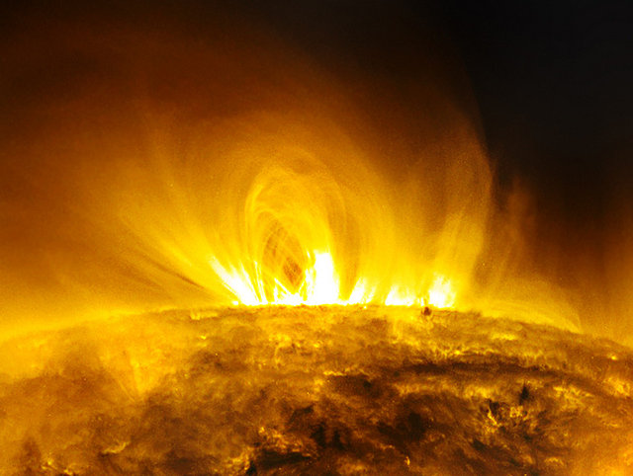
Coronal Cooling and Multithermal Analysis of AIA Loops
Joan Schmelz
Sankaet Pathak, Runpal Dhaliwal, Mac Christian, Christine Fair University of Memphis

Slide 2
Multi-thermal vs. Isothermal
Over dense?
Yes
No
Impulsive
heating
Isothermal OK
(steady heating)
τ_{obs} = τ_{cool}?
Yes
No (τ_{obs} >> τ_{cool})
Isothermal OK
(dynamic)
Multi-strand
Multi-thermal?
Yes
No
J. A. Klimchuk
Loops III Workshop
June 21, 2007
Consistency
Back to the
drawing board

Slide 3
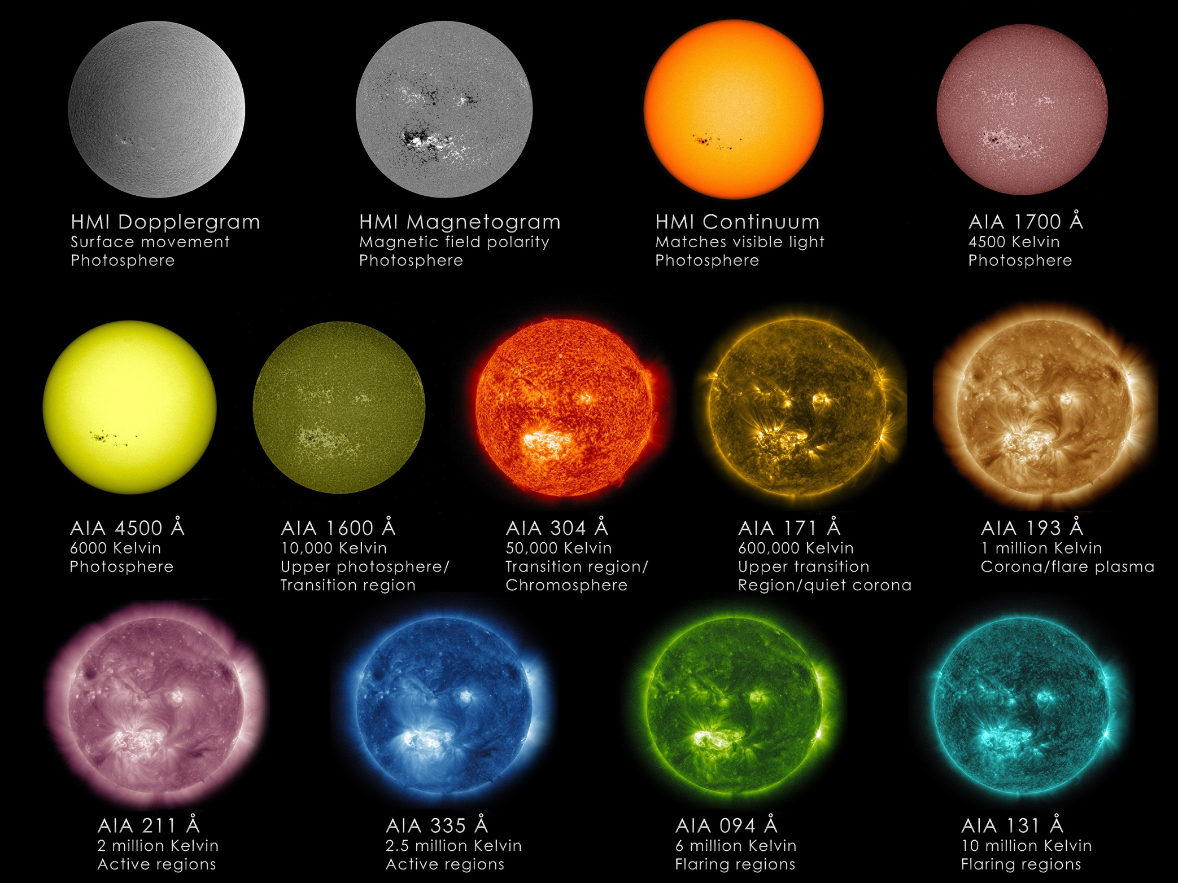

Slide 4
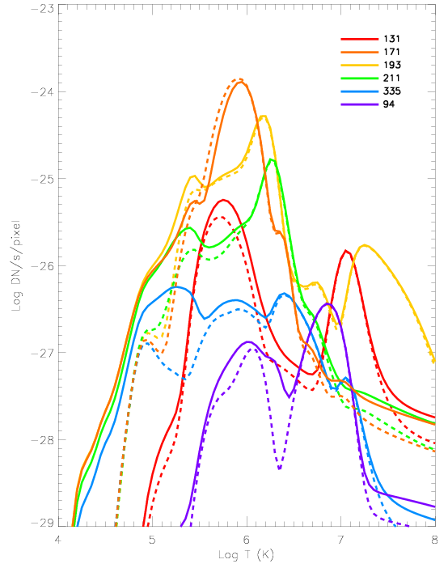
CHIANTI 7.1
Chianti IonEq
Abundances:
Schmelz et al. (2012)

Slide 5
Multi-thermal vs. Isothermal
Over dense?
Yes
No
Impulsive
heating
Isothermal OK
(steady heating)
τ_{obs} = τ_{cool}?
Yes
No (τ_{obs} >> τ_{cool})
Isothermal OK
(dynamic)
Multi-strand
Multi-thermal?
Yes
No
J. A. Klimchuk
Loops III Workshop
June 21, 2007
Consistency
Back to the
drawing board

Slide 6
Over-dense Loops
Lenz et al. 1999, ApJ, 517, L155
Aschwanden et al. 2000, ApJ, 541, 1059
Warren & Winebarger 2003, ApJ, 596, L113
Winebarger et al. 2003, ApJ, 587, 439
Aschwanden et al. 2008, ApJ, 680, 1477

Slide 7
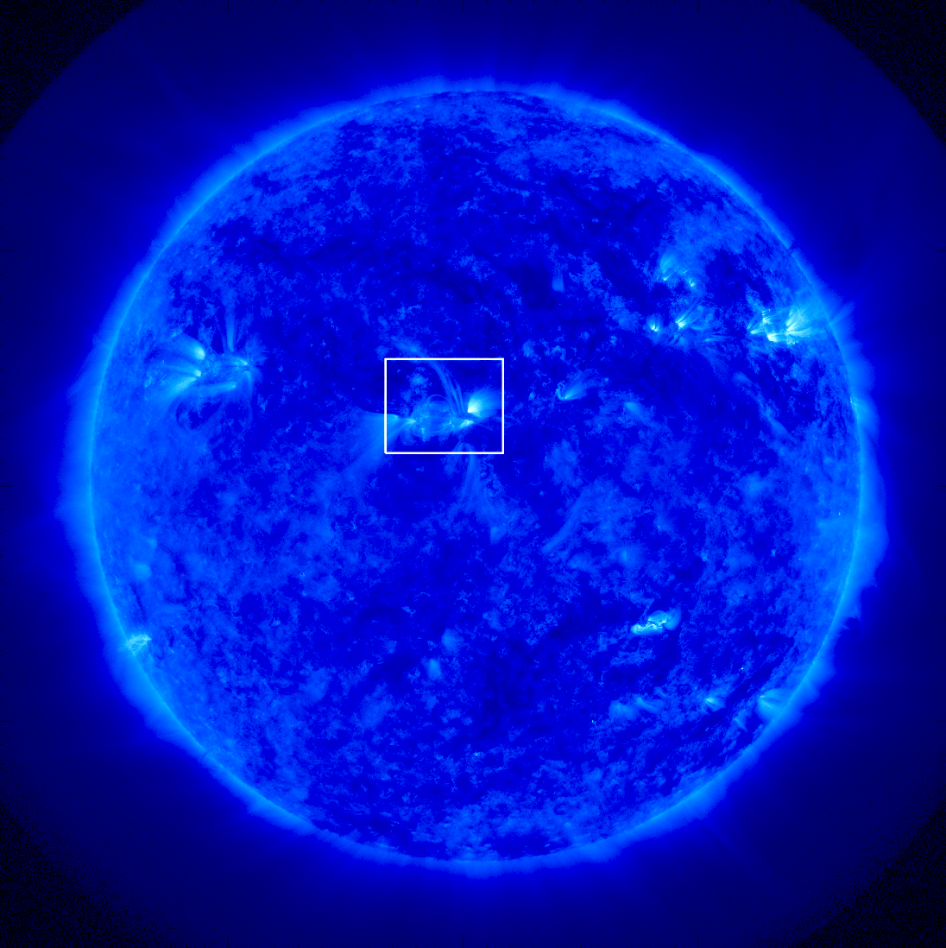
AIA 171 Å Dec 2010

Slide 8
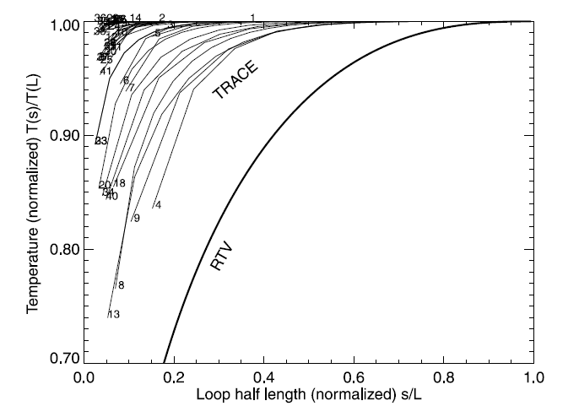
T = 1.2 MK
Aschwanden et al. (2000)

Slide 9
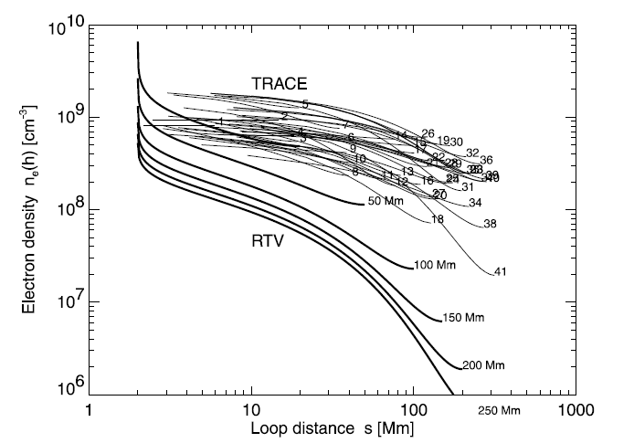
n_{e} = 5.7e8 cm⁻³
Aschwanden et al. (2000)

Slide 10
Multi-thermal vs. Isothermal
Over dense?
Yes
No
Impulsive
heating
Isothermal OK
(steady heating)
τ_{obs} = τ_{cool}?
Yes
No (τ_{obs} >> τ_{cool})
Isothermal OK
(dynamic)
Multi-strand
Multi-thermal?
Yes
No
J. A. Klimchuk
Loops III Workshop
June 21, 2007
Consistency
Back to the
drawing board

Slide 11
Cooling Loops
Winebarger et al. 2003, ApJ, 593, 1164
Winebarger & Warren 2005, ApJ, 626, 543
Ugarte-Urra et al. 2009, ApJ, 695, 642
Mulu-Moore et al. 2011, ApJ, 733, 59
Viall & Klimchuk 2011, ApJ, 738, 24
Viall & Klimchuk 2012, ApJ, 753, 35

Slide 12
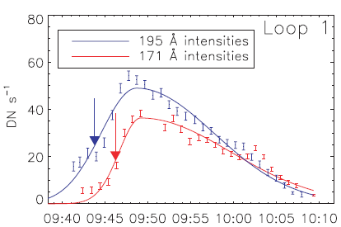
Winebarger et al. (2003)

Slide 13
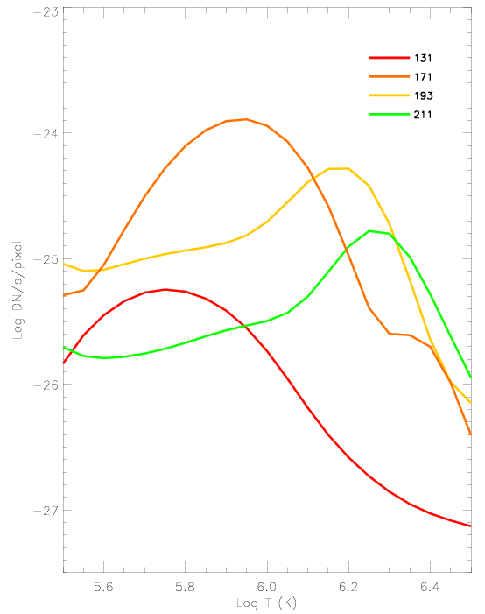

Slide 14
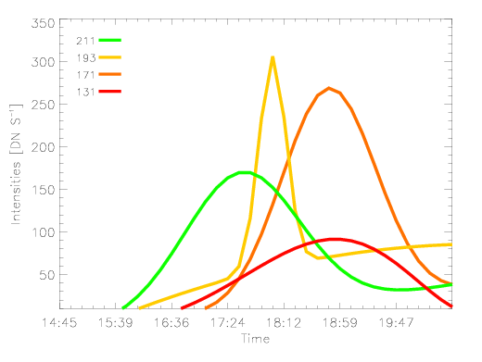
Light Curves
Observed Lifetime
>1.20e4s

Slide 15
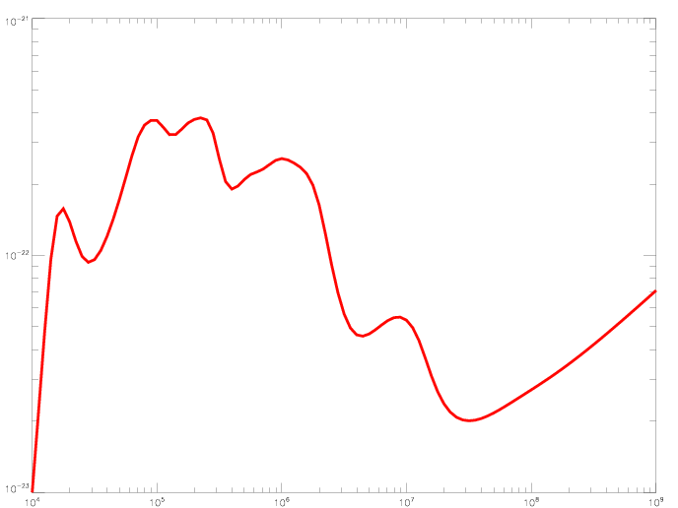
Radiative Cooling Time ~1.67e3 s
Observed Loop Lifetime >1.20e4 s
Radiative Loss (erg cm^3 s^-1)
Temperature (K)

Slide 16
Multi-thermal vs. Isothermal
Over dense?
Yes
No
Impulsive
heating
Isothermal OK
(steady heating)
τ_{obs} = τ_{cool}?
Yes
No (τ_{obs} >> τ_{cool})
Isothermal OK
(dynamic)
Multi-strand
Multi-thermal?
Yes
No
J. A. Klimchuk
Loops III Workshop
June 21, 2007
Consistency
Back to the
drawing board

Slide 17
Cross-Field Temperatures
Schmelz et al. 2001, ApJ, 556, 896
Martens et al. 2002, ApJ, 577, L115
Weber et al. 2005, ApJ, 635, L101
Schmelz & Martens 2006, ApJ, 636, L49
Schmelz et al. 2007, ApJ, 658, L119
Warren et al. 2008, ApJ, 686, L131

Slide 18
Multi-thermal Plasma: DEM
Ι ∝ ∫ R (T) × n_{e}² dl
Change path length to Temp:
n_{e}² dl = DEM(T) dT
DEM = differential emission measure, so
∝ ∫ R (T) × DEM(T) dT

Slide 19
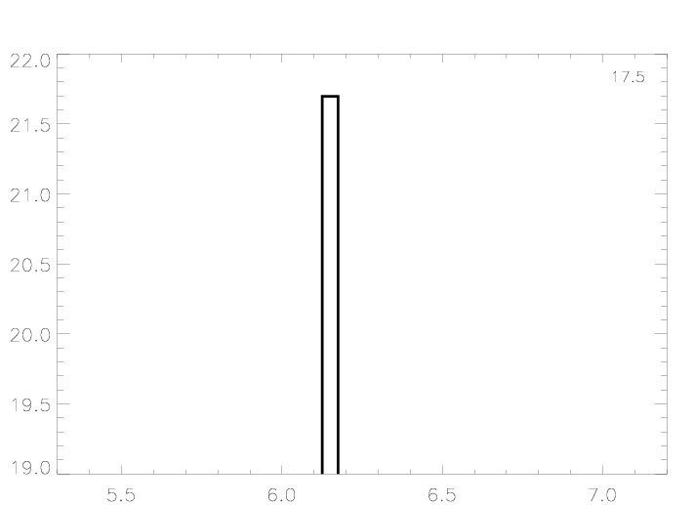
chi^2 = 17.5
Log DEM (cm^-5 K^-1)
DEM_manual
Jason Kimble
Log T (K)

Slide 20
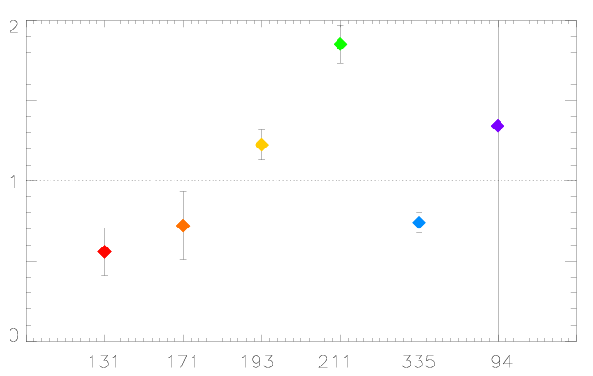
chi^2 = 17.5
Pre-to-Obs Intensity
Filter

Slide 21
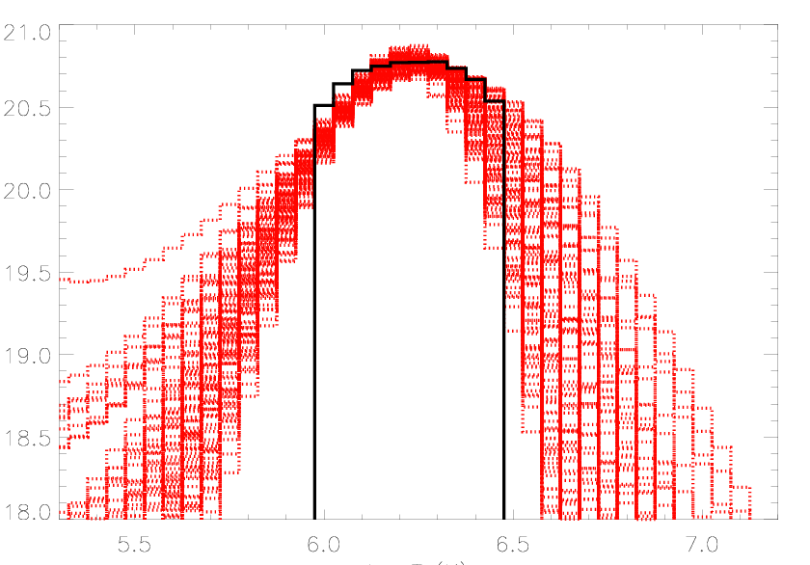
chi^2 = 1.0
DEM_iterative
Mark Weber
Log DEM (cm^-5 K^-1)
Log T (K)

Slide 22
Log DEM (cm^-5 K^-1)
Log T (K)

Slide 23
chi^2 = 1.0
DEM_iterative
Mark Weber
Log DEM (cm^-5 K^-1)
Log T (K)

Slide 24
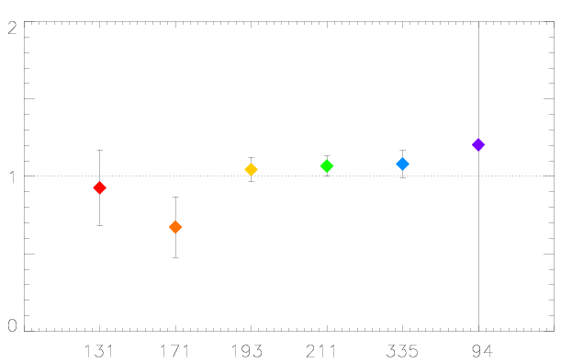
chi^2 = 1.0
Pre-to-Obs Intensity
Filter

Slide 25
Multi-thermal vs. Isothermal
Over dense?
Yes
No
Impulsive
heating
Isothermal OK
(steady heating)
τ_{obs} = τ_{cool}?
Yes
No (τ_{obs} >> τ_{cool})
Isothermal OK
(dynamic)
Multi-strand
Multi-thermal?
Yes
No
J. A. Klimchuk
Loops III Workshop
June 21, 2007
Consistency
Back to the
drawing board

Slide 26
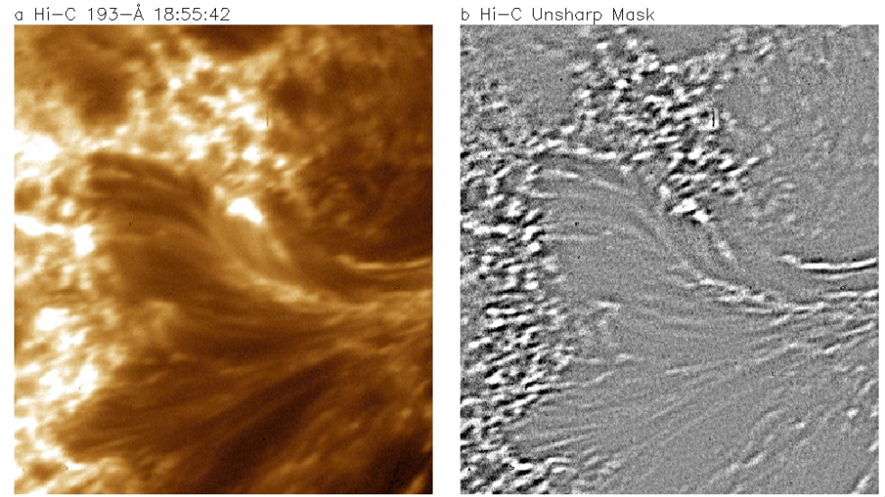
Energy release in the solar corona from spatially resolved magnetic braids
J. W. Cirtain et al. Nature, 493, 501 (24 January 2013)

Slide 28
Conclusions
Observations are now making significant contributes to the coronal heating problem
Coronal loops appear to be multi-thermal and multi-stranded
Consistent picture of heating the coronal with nanoflares, but . . .
There is by no means unanimous agreement

