Slide 1
Evolution of the Global Temperature Structure of the Solar Corona
During the Minimum between Solar Cycles 23 and 24
Richard A. Frazin
Univ. of Michigan
Federico Nuevo, Alberto M. Vásquez
Univ. of Buenos Aires
Z. Huang, M. Jin, W.B Manchester IV
Univ. of Michigan
Submitted to ApJ

Slide 2
Observations
In paper I (Huang et al. 2012, ApJ, 755), we showed that solar minimum, quiet-Sun coronal loops exhibited new structures we dubbed ``down-loops” - loops in which the temperature decreases with height.
The down loops stand in contrast with the expected ``up-loops,” in which the temperature increases with height.

Slide 3
Observations, con’t
We found the quiet-Sun up- and down-loops using the MLDT (Michigan Loop Diagnostic Technique). The MLDT involves several steps:
  Perform EUV tomography in several bands (in this case EUVI-B 171, 195, 284) with 28 days of data
  Given the EUV tomography, calculate the Local Differential Emission Measure (LDEM) distribution. Then, taking moments, determine the electron density N and temperature T.
  Create a Potential Field Source Surface (PFSS) model, based on a synoptic magnetogram

Slide 4
Observations, con’t
  Trace the the PFSS field lines through the tomographic grid and obtain N and T profiles along thousands of loops
  As the quiet-Sun corona appears as diffuse emission, EUV images do not allow one to identify field lines
    Thus, the MLDT allowed the first study of individual quiet-Sun loops

Slide 5
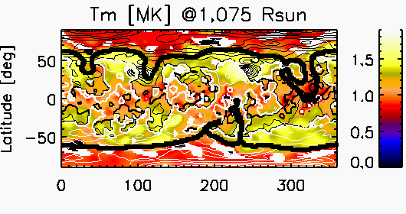
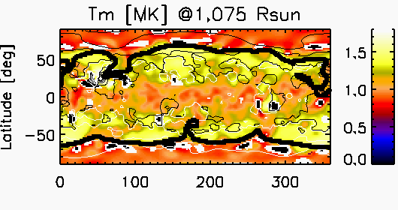
Temperature Maps at 1.075 Rs from DEMT
CR2077
CR2081

Slide 6
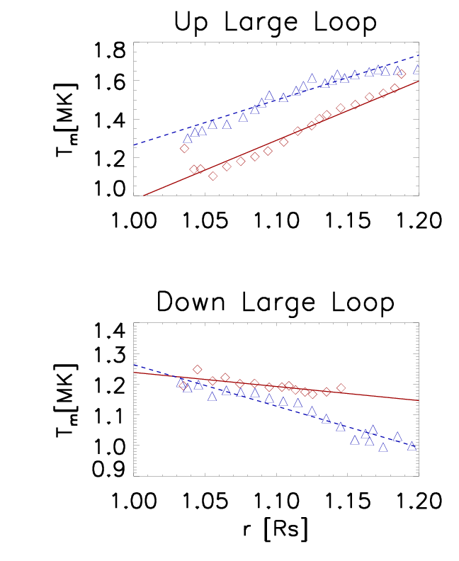
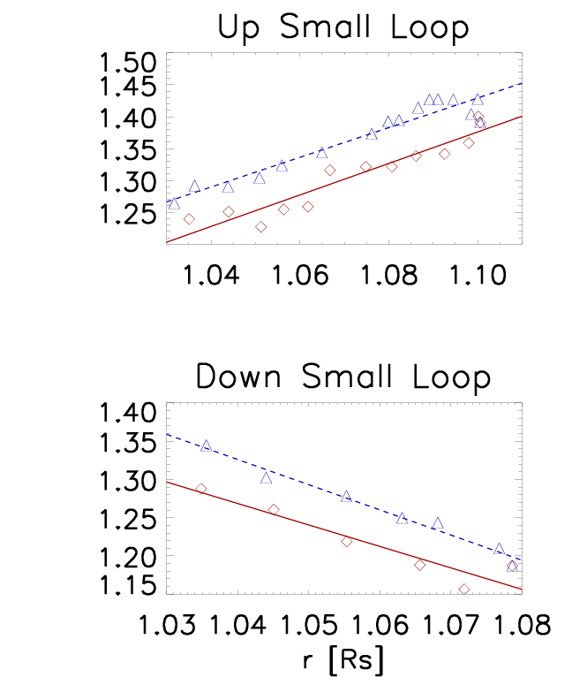
Temperature Profiles of Up & Down Loops

Slide 7
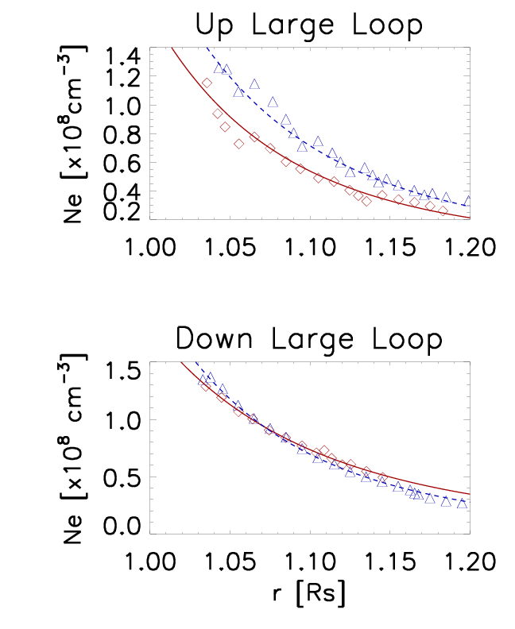
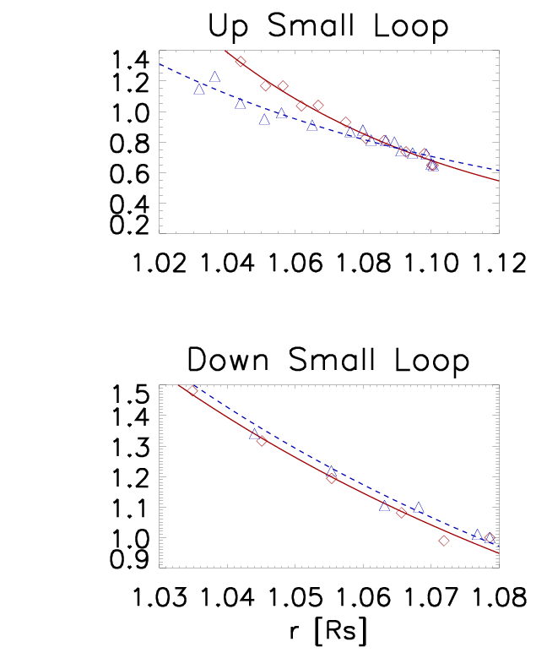
Density Profiles of Up & Down Loops

Slide 8
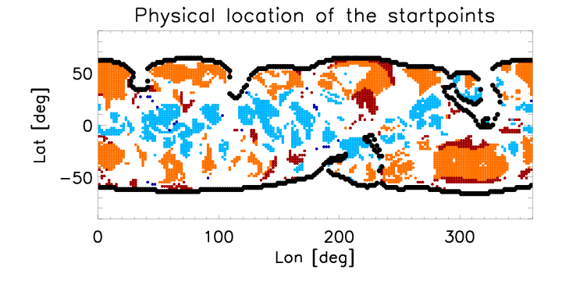
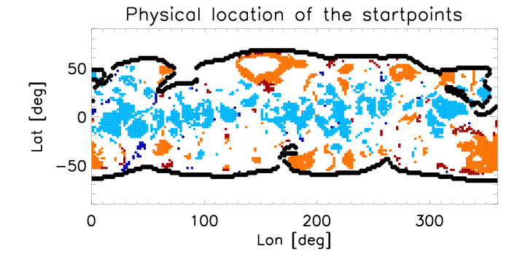
We found that down loops are confined to low latitudes!
CR2077
CR2081

Slide 9
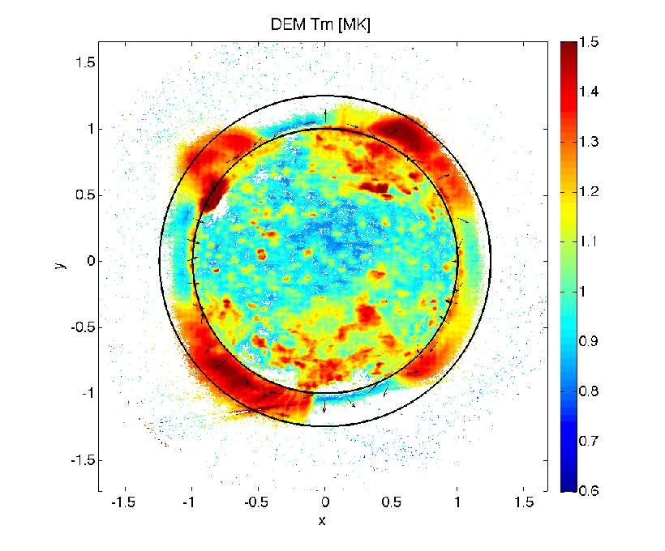
In order to show the down loops are not an artifact of tomography, we did DEM without it
CR2081, notice downward temperature gradients near the equator

Slide 10
Anti-correlation of down-loop population with sunspot number!
sunspot number

Slide 11
Relationship between grad T and T for up and down loops

Slide 12
Relationship between grad T and λ for up and down loops
more scatter in the
up loops ➔ evidence
of different heating physics?

Slide 13
Relationship between grad T and β for up and down loops

Slide 14
Table of β values

Slide 15
So, what’s going on?
The down loops are most prominent at low latitudes at dead solar minimum, and their population quickly decreases with increasing solar activity
Down loops have stronger correlations between grad T and T, and especially, λ (pressure scale height) than do up loops.
Down loops are associated with much higher values of β than are up loops.

Slide 16
Con’t
These findings suggest that the physics of heating the up and down loops is different.
Critically, the down-loops are associated with β > 1, due to the weaker field at the equator, while up-loops have β < 1.
Hydrostatic coronal loop computations show that down-loops are obtained when all of the heating is applied to the foot-points of a loop, while up-loops are obtained when the heating is more uniform (Serio et al. 1981)

Slide 17
Con’t
Matsumoto & Suzuki (2012) performed self-consistent 2.5D MHD solutions from the photosphere to beyond the sonic point. They found that Alfvenic fluctuations created in the photosphere and chromosphere (≈3 min timescale) are transmitted into the corona.
When β≈1 nonlinear processes convert the Alfvenic modes into compressive modes
  These compressive modes form shocks and also are also damped by heat conduction, providing the heating in the low corona ➔ down-loops?

Slide 18
Con’t
  When β < 1, the nonlinear processes that lead to mode conversion are muted, and little energy is put into compressive modes
    The Alfvén waves then provide the heating via wave reflection (to provide counter-propagating waves) followed by turbulent cascades ➔ up-loops?
This paradigm also seems to explain why individual loops cannot be seen in the quiet-Sun corona: everything is heated fairly uniformly by Alfvén waves supplied by the photosphere and chromosphere, and there is little to distinguish neighboring flux tubes.

Slide 19
C’est Tout

Slide 20
Con’t
The relatively small differences in temperatures between the up- and down-loop is also explained by the fact that both types of loops are heated by the same Alfvén waves.

