Slide 1
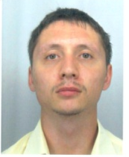


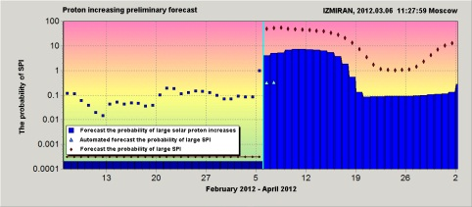
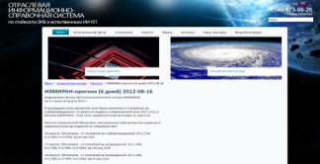
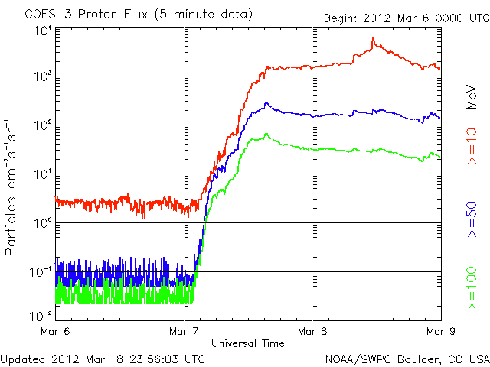
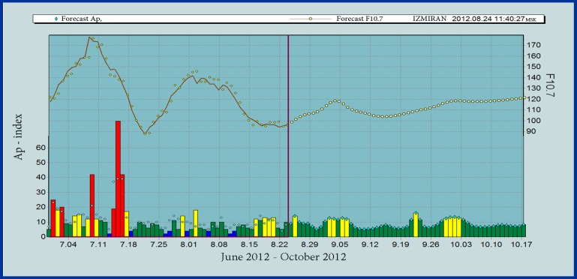
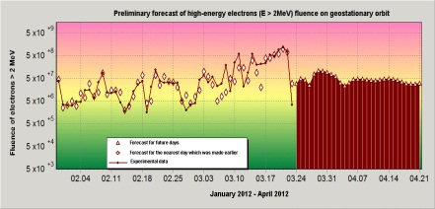
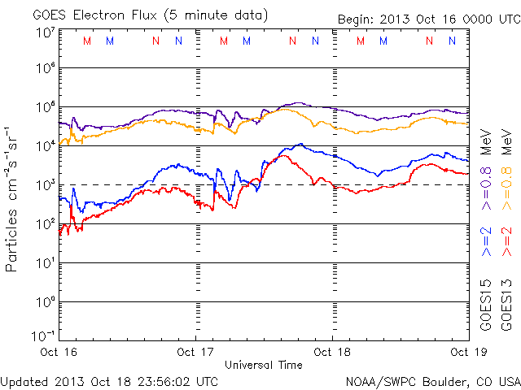
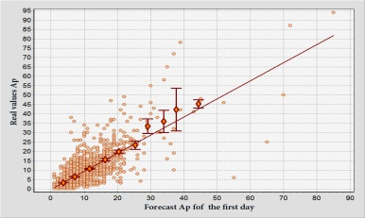
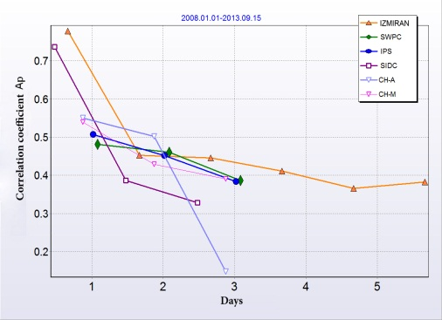
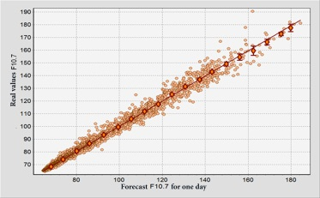
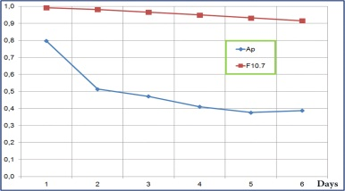
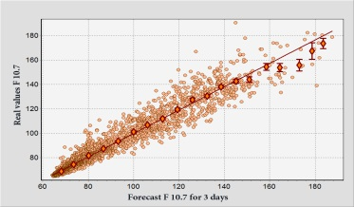
Accuracy assessment of the space weather characteristics forecasts used in the Russian Federal Space Agency Monitoring System
g.a.protopopov@mail.ru
V. Anashin¹, G. Protopopov¹, S. Gaidash², A. Belov²
¹Institute of Space Device Engineering (Moscow, Russia); npk1@niikp.org; ²Pushkov institute of terrestrial magnetism, ionosphere and radio wave propagation (IZMIRAN) (Troitsk, Russia)
THE MONITORING SYSTEM
FORECASTS EXAMPLES
The Russian Federal Space Agency space radiation exposure on electronic components Monitoring System elements operates successfully. The Monitoring System provides a user with space weather elements forecasts:
-Proton events alert
-Geomagnetic activity forecast (6-8 days)
-Solar and geomagnetic activity forecast (55 days)
-Solar proton increasing forecast
-High energy electron fluence forecast
-Space weather integrated review and forecast.
The Monitoring System ground-based segment
experimental prototype was developed.
www.kosrad.ru
The automated system with mathematical model based on previous measurements database and developed by IZMIRAN is used for space weather characteristics forecasts generation
Solar proton increasing forecast as of 06.03.2012
The predicted proton flux increasing probability was 53% for protons with E > 10 MeV and 5% for protons with E > 100 MeV (for quite radiation environment probability for 10 MeV protons is equal to 1-3% and 0.1-0.2% for 100 MeV). Mission control center specialists kept orientation of “Yamal-201” and “Yamal-202” spacecraft due to the proton flux increasing forecast.
SOLAR (F10.7) AND GEOMAGNETIC (Ap) WEATHER FORECAST
F10.7 – Solar radio emission flux (λ= 10.7 cm); Ap – geomagnetic activity index
High energy (E>2 MeV) GEO electron fluence forecasts as of April 2012
Dangerous level
Electron fluence forecasts and flight data are seen to be correlated. Forecast accuracy is about 90% for a long period of time (month and year).
Measured value
Forecast for 55 days
Forecast for the last day
ACCURACY ASSESSMENT OF FORECASTS
For predictions Ap and F10.7 the ​​regression analysis of forecasts for various pre-emption periods with the measured (actual) values ​​of the time interval from 2007 to the present time was made
IZMIRAN - Space Weather Prediction Center IZMIRAN
http://forecast.izmiran.rssi.ru
SWPC - Space Weather Prediction Center ( USA) http://sec.noaa.gov/today.html
IPS - Australian Space Weather Agency
http://www.ips.gov.au/
SIDC –Solar Influence Data Analysis Center- RWC Belgium http://sidc.oma.be/index.php3
CH_A - Space Environment Prediction Center (CAS) - (China) http://www.sepc.ac.cn/ehtml/index.php
CH_М - National Satellite Meteorological Center (NSMC) - (China)
http://www.nsmc.cma.gov.cn/NewSite/NSMC_EN/Channels/100174.html
KAZ – Laboratory of SW diagnostic & forecast, Institute of Ionosphere, Kazakh Republic
BAS – Space Weather & SW Climate Prediction Center of Space Research and Technology Institute of BAS http://www.space.bas.bg/SpaceWeather/index.html
Correlation factor of the measured and forecast values of geomagnetic activity index Ap (depending on the day of forecast confirmation), made by different forecast center of space weather in 2012
Correlation factor of the measured values and index forecasts of solar F10.7 and geomagnetic activity Ap (depending on the day of forecast confirmation)
CONCLUSION
The Russian Federal Space Agency Monitoring system of space radiation exposure on spacecraft electronic equipment elements were developed by the Institute of space device engineering and operates successfully. The Monitoring System provides a correct space weather characteristics preliminary prediction. The accuracy of the space weather characteristics predicted in the Monitoring System is comparable and even higher than the accuracy predicted in other leading world forecast centers.

