Slide 1
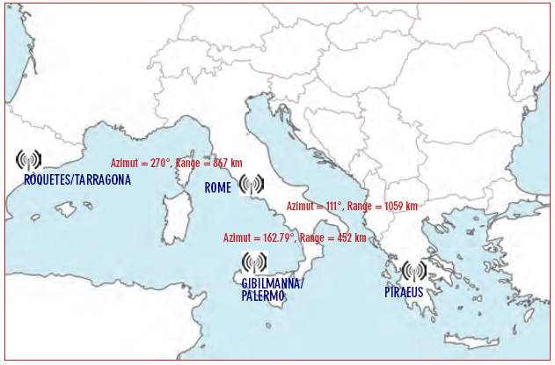
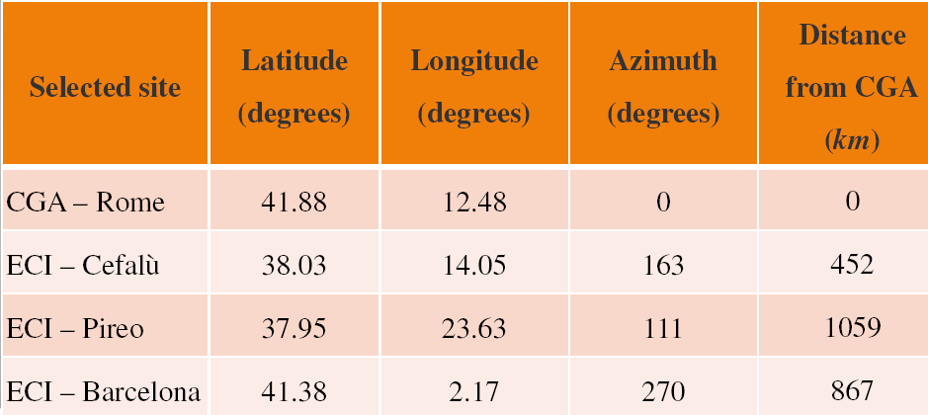
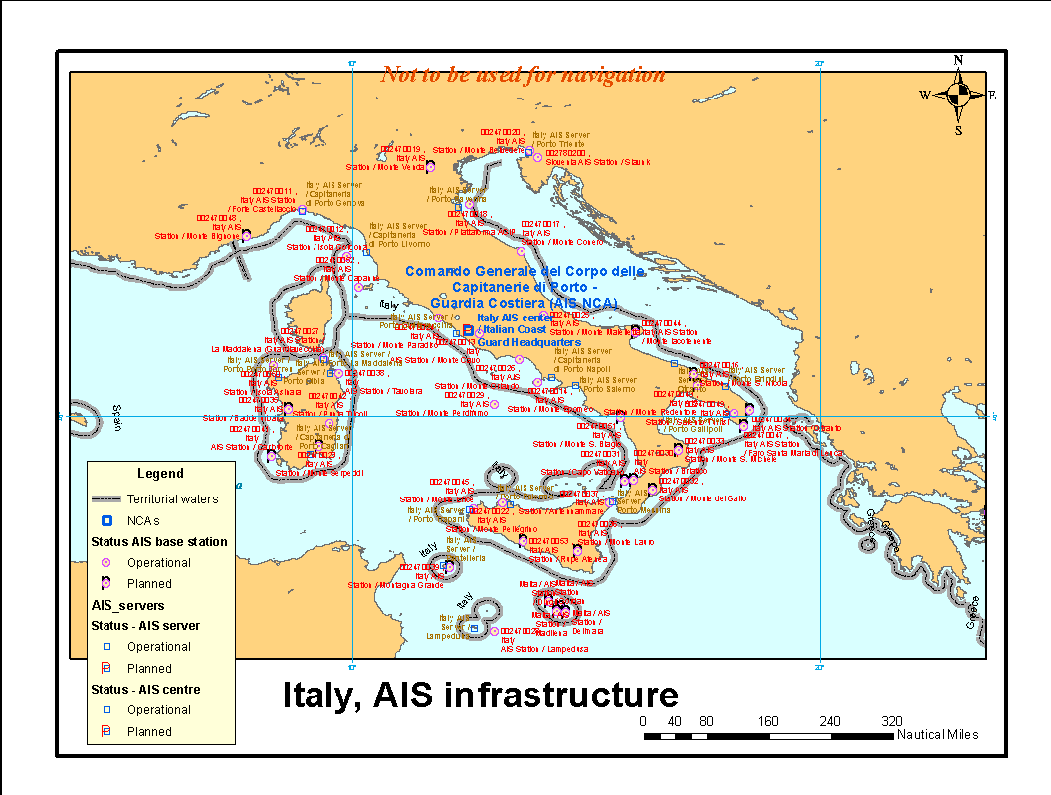
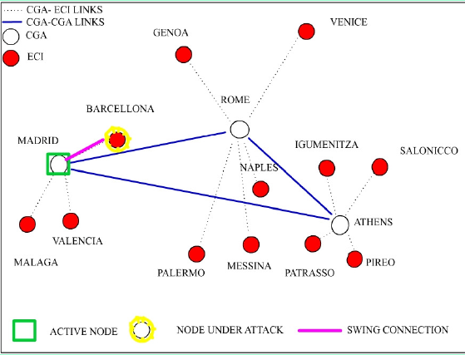
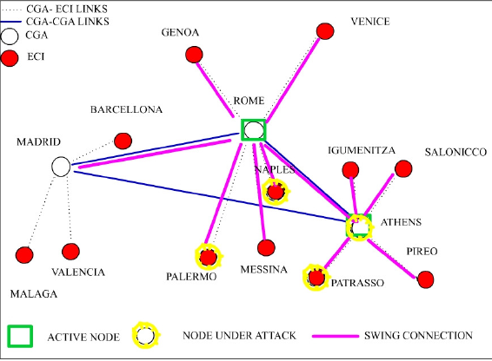
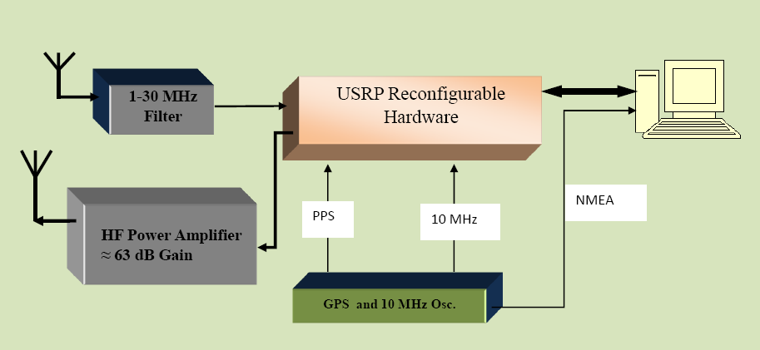
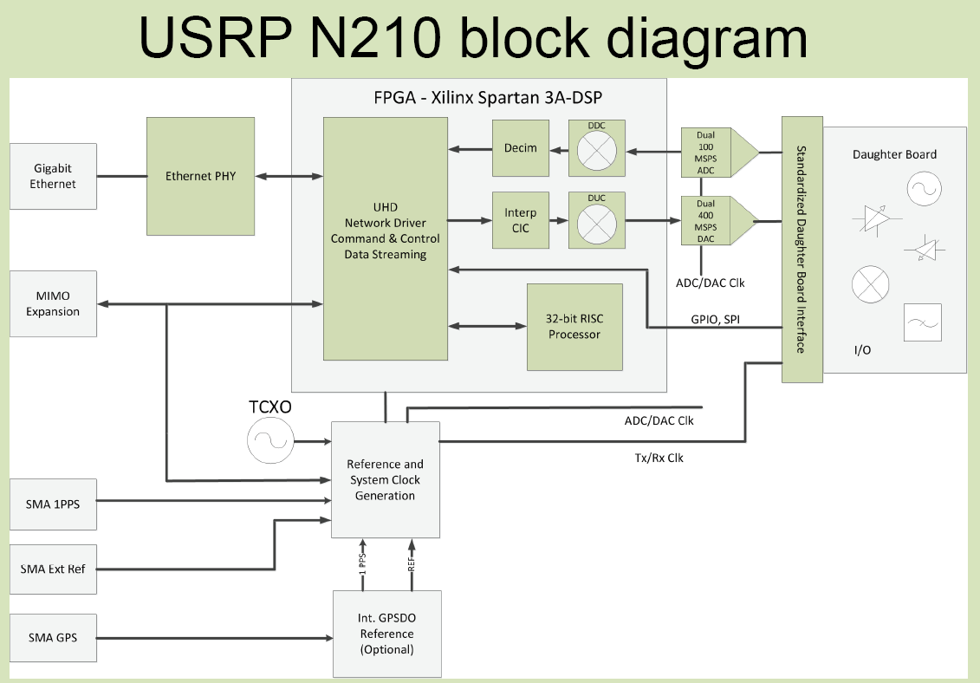
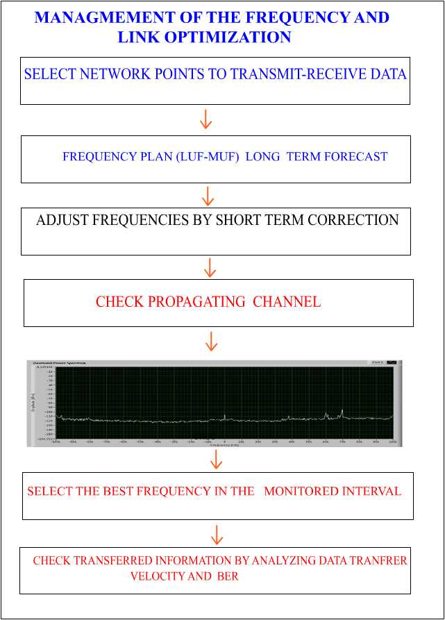
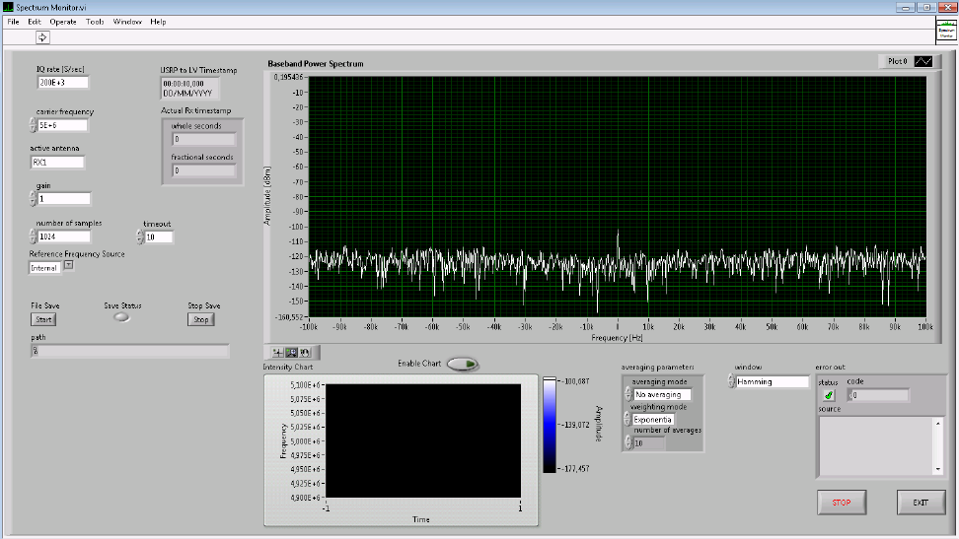
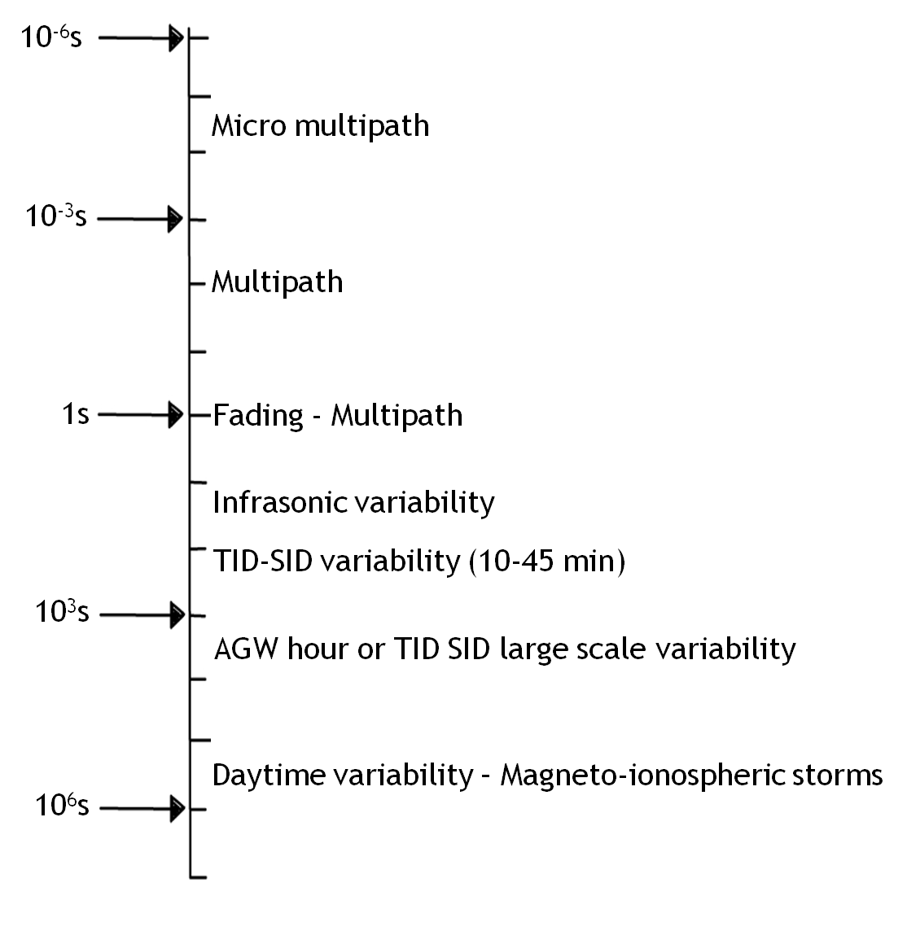
10th European Space Weather week
November 18-22, 2013
ANTWERP, Belgium
SWING PROJECT
Zolesi B.¹, Belehaki A.², Tsagouri I.², Altadill D.³, and Morelli M.⁴
¹ Istituto Nazionale di Geofisica e Vulcanologia, Rome, Italy, ² National Observatory of Athens, Athens, Greece
³ Observatori de l’Ebre, Roquetes, Spain, ⁴ Consorzio Nazionale Interuniversitario per le Telecomunicazioni, Parma, Italy
SWING (Short Wave critical Infrastructure Network based on a new Generation high survival radio communication system) is an European project aimed at studying a large survival high frequency (HF) radio network to link European Critical Infrastructures (ECIs) and Controlling Governmental Agencies (CGAs) among themselves. This system is thought to replace broad band internet transmission, maintaining the minimum flux of essential information for the ECIs management and control, in case of wide scale terrorist attacks able to put out of order internet links over the Mediterranean region. SWING is designed to evaluate the threat and increase the security awareness, as well as the level of protection, of analogous and/or interdependent ECIs. The project has to develop the standard software and hardware tools necessary for implementing communication protocols suited for a reliable and interoperable Short Wave HF radio network back up. Therefore, SWING must also analyze the HF network requirements necessary for alerting and controlling ECIs in case of threat or attack, understand the particular characteristics of the ionospheric channel in order to establish safe HF radio links. It is foreseen a suitable frequency management system for the frequencies selection and a study of a HF radio network architecture for Southern Europe. The use of proper ionospheric channels for data communication requires, in fact, the support of a geomagnetic and ionospheric awareness to provide information on the terrestrial effects generated by the arrival of interplanetary disturbances. Particularly intense solar events can affect the geomagnetic field and ionospheric plasma, changing the ionospheric structure consequently affecting the propagation the HF band.
MOTIVATION: The Council Directive of the European Union has established, by means of the promulgation of the Directive 2008/114/EC, the requirements for the identification and designation of European Critical Infrastructures and the assessment of the need to improve their protection. In this Directive the interest is focused only on the Energy and Transport sectors, considered strategically important. In SWING project we have focused on the maritime sub-sector and individuated three ports in the Mediterranean area as possible ECIs: Barcelona (Spain), Palermo (Italy) and Pireo (Athens-Greece).
The table summarizes the coordinates, the azimuth and the distances between the selected CGA and the corresponding ECIs. The figure shows on the map the links between the CGA and the three ECIs.
Among the numerous functions of the port authorities (search and rescue at sea, safety of navigation, maritime security, protection of the marine environment etc.) only the maritime traffic control is considered here. In this context the Operative Room (OR) of the CGA receives data from 100 very high frequency (VHF) transponders concerning the traffic of the vessels in the Mediterranean Sea under the control of Italian CGA. These data are exchanged by means of an AIS-VTS system.
AIS:
The system named Automatic Identification System (AIS) operates as an electronic transponder installed on
a boat or vessel that continuously transmits a VHF signal containing information including its name,
call sign, type and position etc.
VTS:
Vessel Traffic Services (VTS) are systems intended to establish maritime safety in particular areas of dense shipping. The VTS infrastructure typically consists of a station onshore where the staff maintains a picture of the local maritime traffic.
Each vessel exchanges approximately 1 kbit with the nearest AIS-VTS. Considering the normal vessels
traffic (a hundred of vessels in the sector of competence), the minimum amount of information in this
simulated scenario can reach about 100 kbit.
INTERNET CRITICALITIES OF ECIS AND CGAS
Security threats began more and more sophisticated. The numerous kind
of threats and intrusions to the web services include a huge variety of Malwares
which infect users computers, leakage of personal information, phishing
by means of subtle messages and other kind of attacks like
Denial-of-Services (DoS) and Distributed Denial of Services (DDoS).
DOS
A Denial-of-Service (DoS) attack is designed to hinder or stop the
normal functioning of a web site, server or other network resource. There are various ways for hackers to achieve this. One common method is to flood a server by sending it more requests than it is able to handle. This will make the server run slower than usual (and web pages will take much longer to open), and may crash the server completely.
DDOS
A distributed-Denial-of-Service (DDoS) attack differs only in the fact that this dangerous threat/attack is conducted using multiple machines. The hacker typically uses one compromised machine as the ‘master’ and co-ordinates the attack across other, so-called ‘zombie’, machines.
Most reasonable scenario
Worst case scenario
General requirements for back up HF network in case of an internet failure scenario :
1) Communications between GCAs and ECIs must be guaranteed at least 90% of the day.
2) Each HF terminal must be provided with a pool of frequencies to select the best operating frequencies at each month, day and hour
3) TX power and receiver sensibility must be designed by taking into account the fading characteristics of the HF channel
4) The channel bandwidth, the modulation format and coding rate must be designed on the basis of the desired data throughput
5) SWING must provide half-duplex voice link and data link
6) A supervisor control system must recognize when the internet communications fails so as to activate the SWING network in less than 15 minutes.
Since the technological features and ionospheric channel limit the interval of the operative frequency which can be used to establish the HF link, a frequency management system is necessary for the correct functioning of the SWING network. The main constraints derive from the ionospheric channel conditions which limit the data throughput especially in disturbed SW conditions.
PROPAGATING PHENOMENA IN CASE OF SPACE WEATHER (SW)
COMMON PROPAGATING PHENOMENA OF IONOSPHERIC CHANNEL | MAIN CAUSES OF SIGNAL DEGRADATION DUE TO SW | MAIN EFFECT ON THE SIGNAL
reflection | Irregularities at different spatial scales | time delay (ms)
refraction (depending on the refractive index) | Irregularities at different spatial scales | spreading, differential group delay
absorption | sudden ionization of the lower ionospheric regions (D, E) | deep fading due to SID (tens of dB)
multiple reflections | defocusing layers (spread F etc.) | multipath fading at different time and spatial scales
diffraction, scattering | Irregularities at different volume spatial scales | Short and long term fading
Doppler effect | Motion of the ionospheric layers and time-dependent variation of electron density profiles. | frequency shifting and phase distortion
CONCLUSIONS
Radio communications in Mediterranean region have to take into account the Space Weather effects.
The SWING project is aimed to guarantee transmission of the minimal amount of information necessary to maintain communication control among ECIs and CGAs, even in very critical conditions. This project has to consider a radio propagating scenario that could be very degraded, and to be able to mitigate SW phenomena.
SW disturbances time scale in the HF channel

