Slide 1





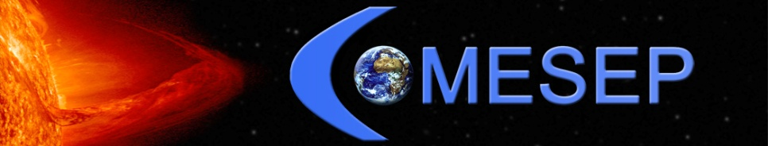
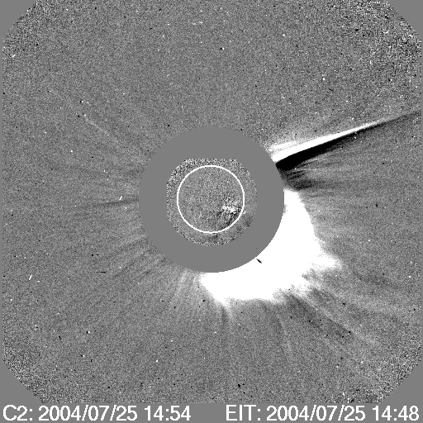
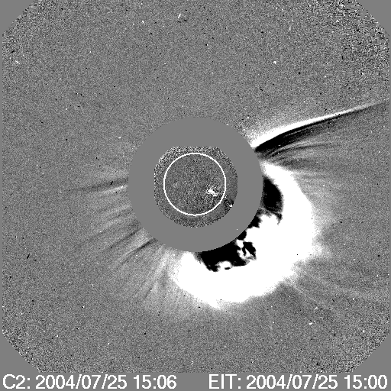
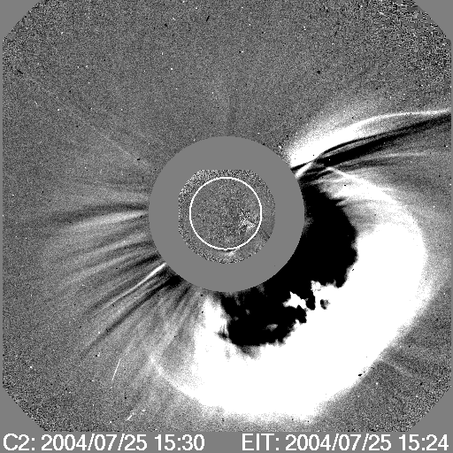
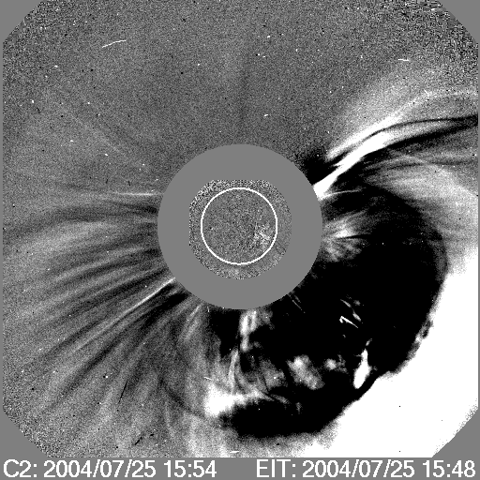
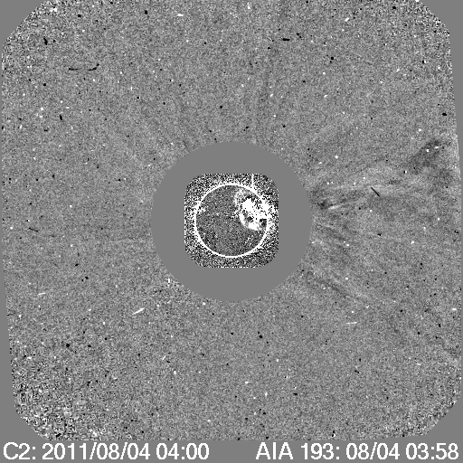
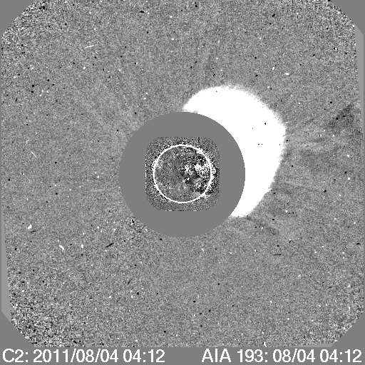
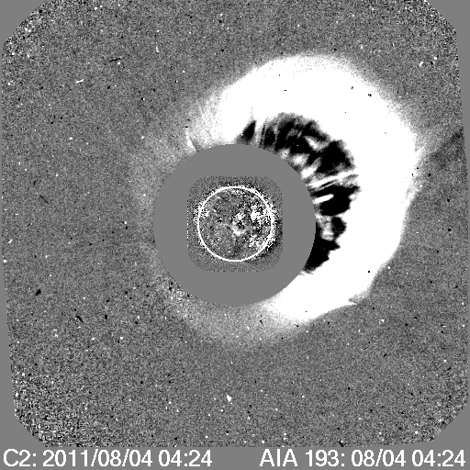
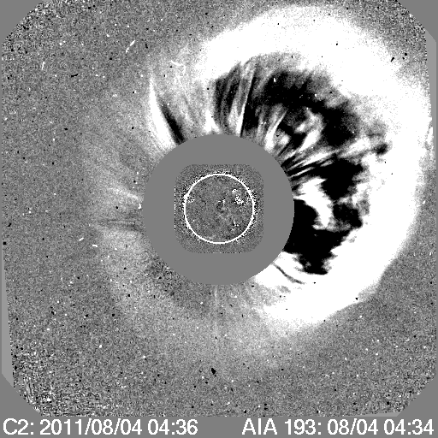
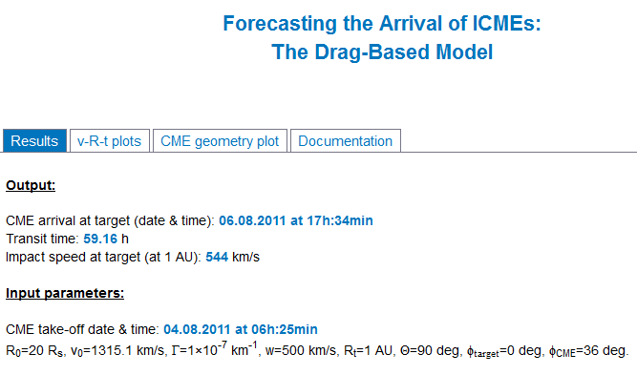
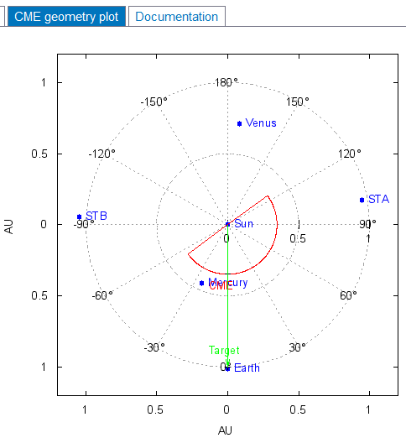
Heliospheric Propagation of ICMEs: The Drag-Based Model
B. Vršnak¹, T. Žic¹, M. Dumbović¹, J. Čalogović¹, A. Veronig², M. Temmer²,
C. Moestl², T. Rollett², L. Rodriguez³
¹ Hvar Observatory, Faculty of Geodesy, Zagreb, Croatia
² IGAM/Institute of Physics, University of Graz, Graz, Austria
³ Royal Observatory of Belgium, Brussels, Belgium
ABSTRACT
The advanced space-weather forecast-tool for predicting the arrival of Interplanetary Coronal Mass Ejections (ICMEs) is presented. The forecast-tool is based on the "Drag-Based Model" (DBM), taking into account the ICME shape using cone geometry with a semi-circular leading edge, spanning over the ICME full angular width. DBM is based on a hypothesis that the driving Lorentz force that launches CME ceases in the upper corona, and that beyond certain distance the dynamics becomes governed solely by the interaction of the ICME and the ambient solar wind. This assumption is founded on the fact that in the interplanetary space fast ICMEs decelerate, whereas slow ones accelerate, showing a tendency to adjust their velocity with the ambient solar wind. In particular, we consider the option where the drag acceleration has the quadratic dependence on the ICME relative speed, which is expected in the collisionless environment, where the drag is caused primarily by emission of MHD waves. This is the simplest version of DBM, where the equation of motion can be solved analytically, providing explicit solutions for the Sun-Earth ICME transit time and the impact speed. Basic DBM results are compared with remotely-measured interplanetary kinematics of several ICMEs, whereas forecasting abilities are tested on the statistical basis by employing in situ measurements. An example is shown for the advanced version of DBM, where geometry of ICME is taken into account.
THE BASIC MODEL
The basic DBM is based on the hypothesis that beyond ~20 solar radii the MHD “aerodynamic” drag caused by the interaction of ICME with solar wind, becomes the dominant force, so the equation of motion becomes:
..
.
.
Running-difference images of the ICME take-off (LASCO/SOHO) and source position (AIA/SDO), providing the basic model input v₀(R₀,t₀) and advanced model input ω and α
r = – γ (r – w) |r – w|
As a consequence fast ICMEs deccelerate, whereas slow ICMEs accelerate ( r w )
CASE STUDIES
.
w is the speed of the solar wind and γ is the drag parameter. The drag parameter depends on characteristics of both ICME and solar wind – the drag is stronger for broader, low-mass ICMEs in a high-density (slow) solar wind.
In the simplest form , we assume γ,w = const.
Comparison of the modeled and observed ICME kinematics (based on STEREO A&B data)
Measurements taken from Liu et al. 2010, ApJ 722, 1762
STATISTICAL STUDY
Comparing calculated and observed transit times and speeds at 1 AU we estimated range of values for γ and w.
Optimal values, γ = 10⁻⁷ km⁻¹ and w = 500 km/s, have been found also by minimizing the scatter of the difference between the observed and calculated transit times (O– C).
Samples used: Schwenn et al., 2005, AnnGeo. 26, 1033, Manoharan, 2006 , SPh 235, 345
ONLINE FORCAST TOOL - EXAMPLE
THE ADVANCED MODEL
http://oh.geof.unizg.hr/DBM/dbm.php
In the advanced form DBM takes into account also the shape of ICME, where ICME is cone-shaped with the semi-circular leading edge spanning over the ICME full angular width 2ω.
INPUT
to the spacecraft
M9 flare
N19W36
CME
v₀(R₀,t₀)=1315.1km/s
HALO, ω=90deg
ICME direction
OUTPUT
In the advanced version we track the propagation of the element moving along the angle α (derived using EUV observations as well), assuming that the overall shape remains unchanged.
CONCLUSION
This work has received funding from the European Commission FP7 Project COMESEP (263252)
AIM: prediction of ICME arrival
BASIC DBM ASSUMPTION: MHD drag governs the propagation of ICME beyond ~20 solar radii
ADVANCED DBM ASSUMPTION: ICME is cone-shaped with the semi-circular leading edge
INPUT: v₀(R₀,t₀) and ω from the coronagraphic observations, source position from EUV observations
PARAMETERS: γ, w=const. and are derived empirically (in simplest form )
OUTPUT: ICME transit time and speed at some distance from the Sun (e.g. 1 AU)
ADVANTAGES: easy handling, straightforward application in the real-time space-weather forecasting
DRAWBACKS: does not predict arrival of shock, typical error for forecast models (~10 h)
ACKNOWLEDGMENT
correspondence:
bvrsnak@geof.hr

