Slide 1
How can Subsurface Flow Properties Contribute to more Accurate Solar Flare Predictions?
Alysha Reinard
University of Colorado and SWPC/NOAA
Rudi Komm, Frank Hill
National Solar Observatory

Slide 2
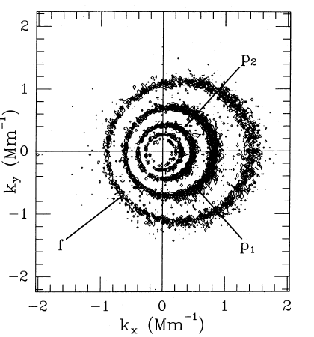
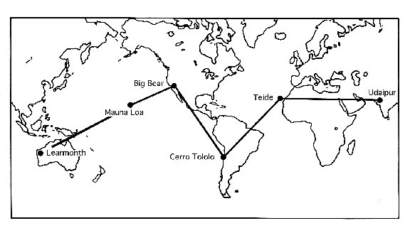
GONG data products
16 depths, 15x15 degrees, 189 regions
Horizontal velocities (v_{x}, v_{y})
Assume incompressible ➔ v_{z}
Vorticity (ω= x v)
Kinetic helicity density (h=ω•v)

Slide 3
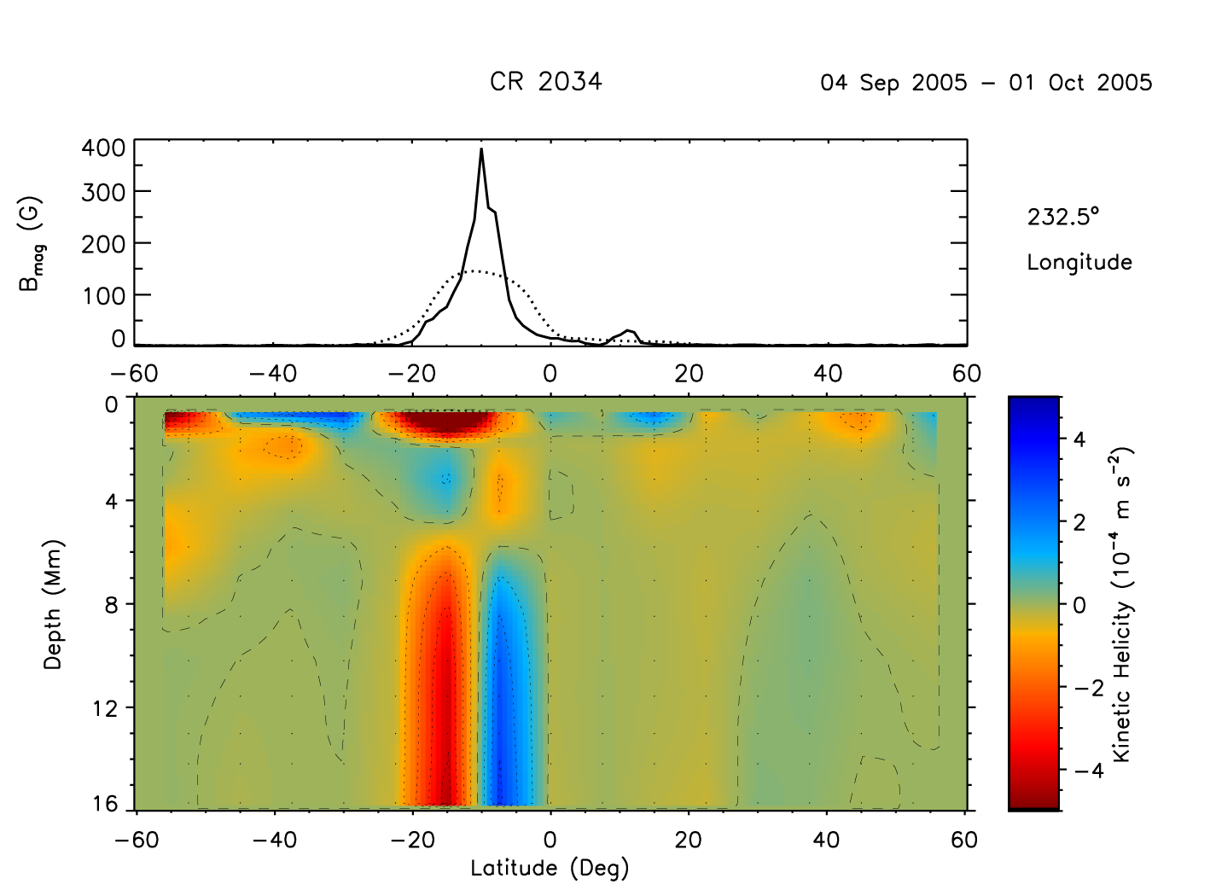
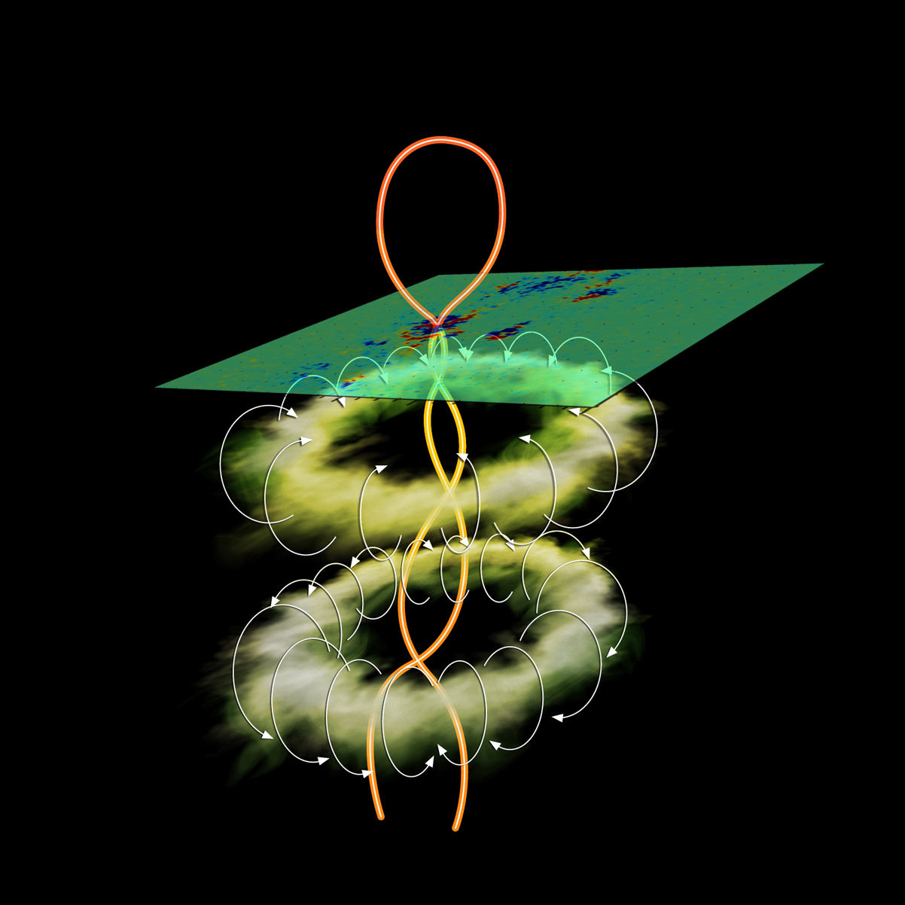

Slide 4
Drop in kinetic helicity precedes X10 flare
Kinetic helicity density
Time (day)
(Komm et al., 2004)

Slide 5
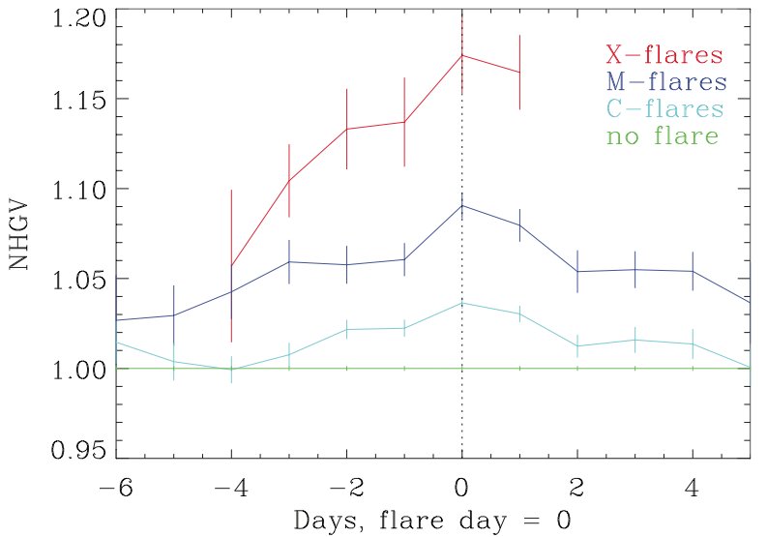
NHGV increase 2-3 days in advance, higher for larger flares
NHGV=Σ∆h(t,z)*Σh(t)
(Reinard et al., 2010)

Slide 6
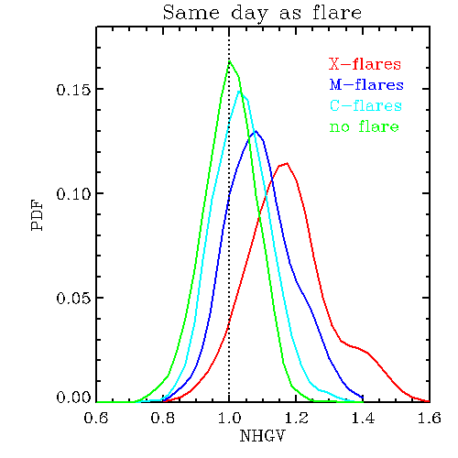
Large overlap, but separate populations
(Reinard et al., 2010)

Slide 7
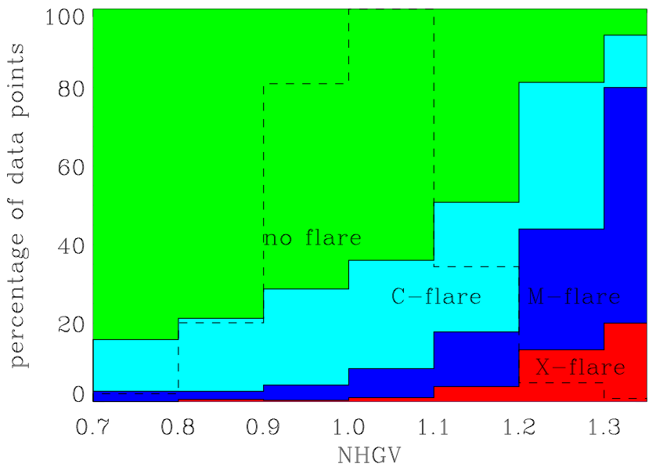
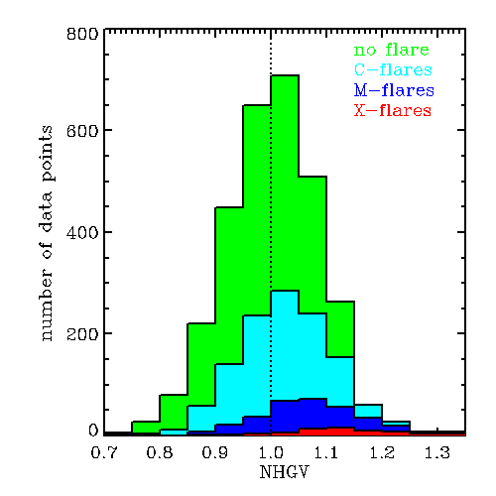
(Reinard et al., 2010)

Slide 8
Eruptive (i.e. CME associated) vs. confined (i.e. no CME) flares

Slide 9
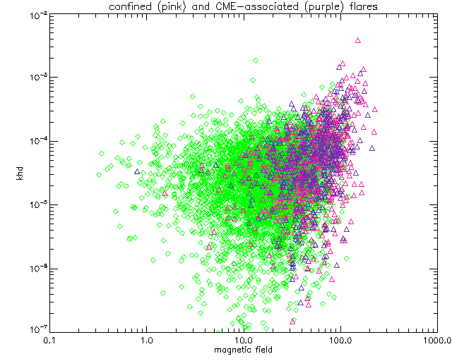
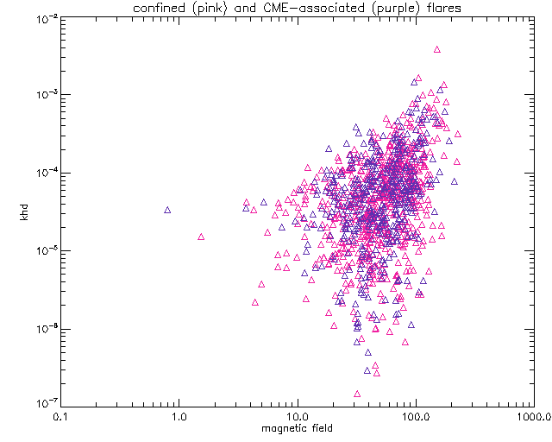
No difference between confined and eruptive flares
Pink = confined
Purple = eruptive
Kinetic helicity density
Magnetic field

Slide 10
Flares in Northern vs. Southern hemisphere
X and M class flares with associated CMEs
  27 (N), 32 (S)
X and M class flares with no associated CMEs
  56 (N), 71 (S)
Active regions with no associated X/M flares
  309 (N), 506 (S)
We normalize KHD by dividing by the average value of all quiet regions in that (E-W) location

Slide 11
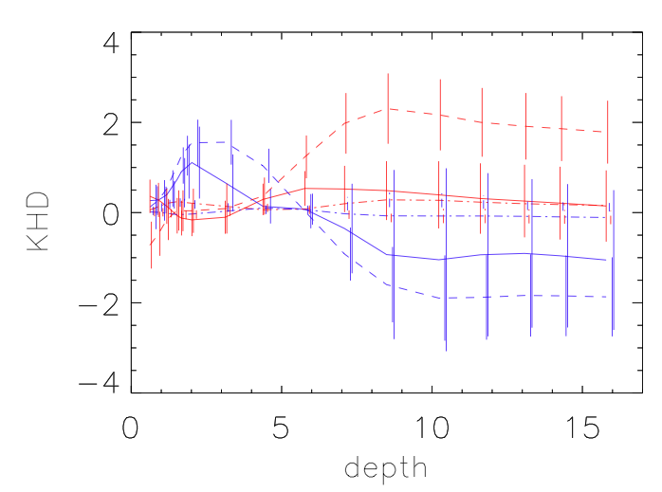
Northern versus Southern hemisphere
Red=N
Blue=S
Solid=eruptive
Dashed=confined
Dotted=no flare
2 days before
flare

Slide 12
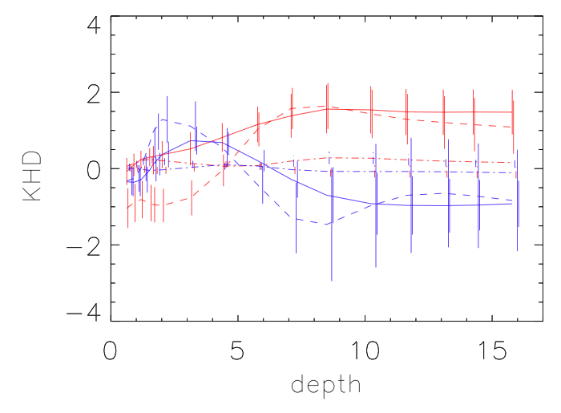
Northern versus Southern hemisphere
Red=N
Blue=S
Solid=eruptive
Dashed=confined
Dotted=no flare
1 day before
flare

Slide 13
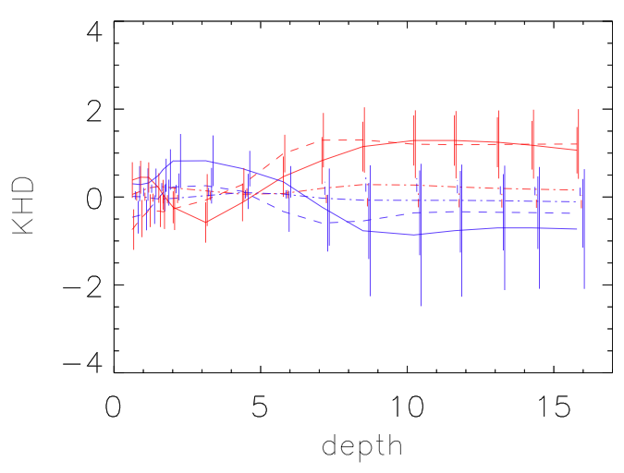
Northern versus Southern hemisphere
Red=N
Blue=S
Solid=eruptive
Dashed=confined
Dotted=no flare
Day of flare

Slide 14
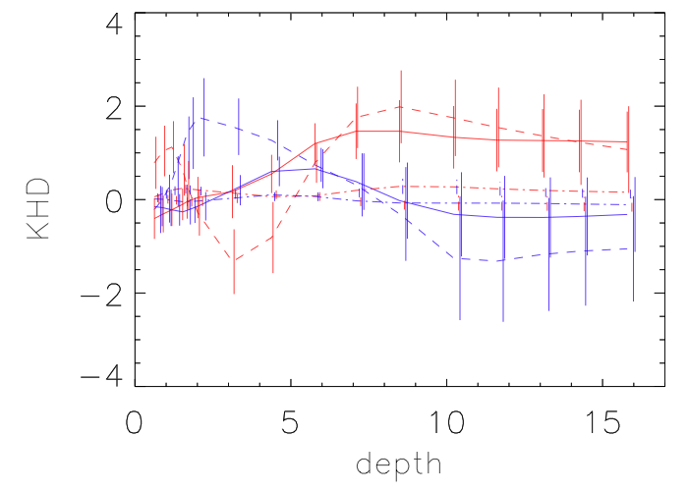
Northern versus Southern hemisphere
Red=N
Blue=S
Solid=eruptive
Dashed=confined
Dotted=no flare
1 day after
flare

Slide 15
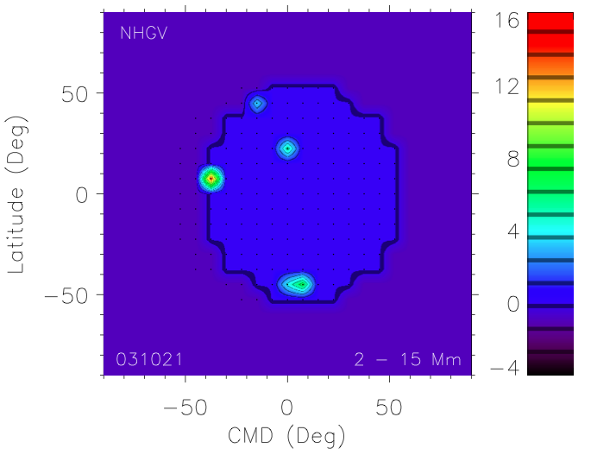
NHGV maps – potential new forecasting tool
M1.4

Slide 16
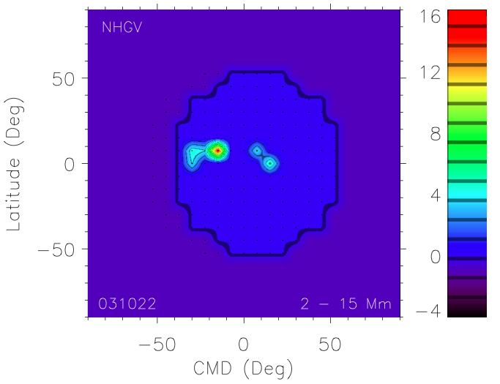
M3.2

Slide 17
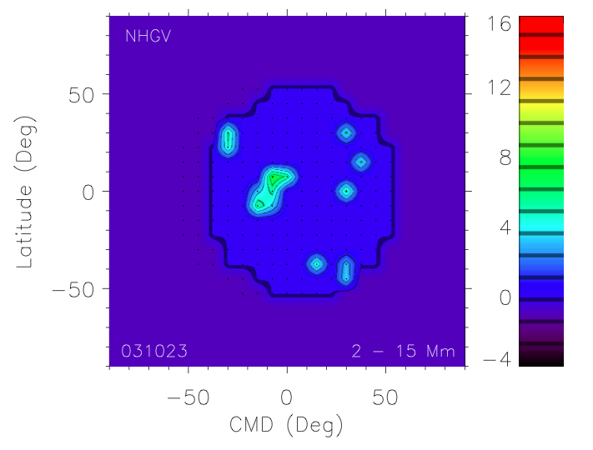
M1.0

Slide 18
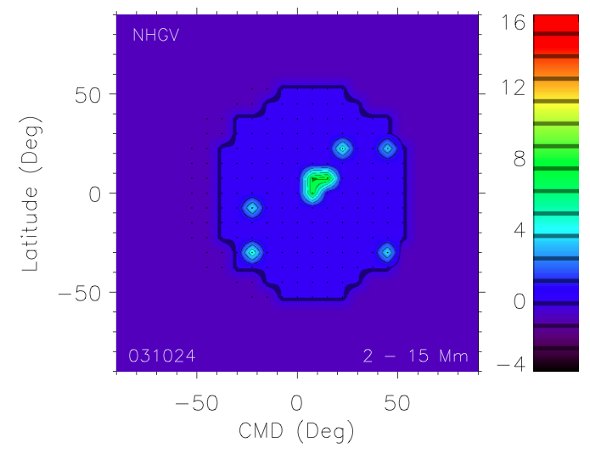
M1.7

Slide 19
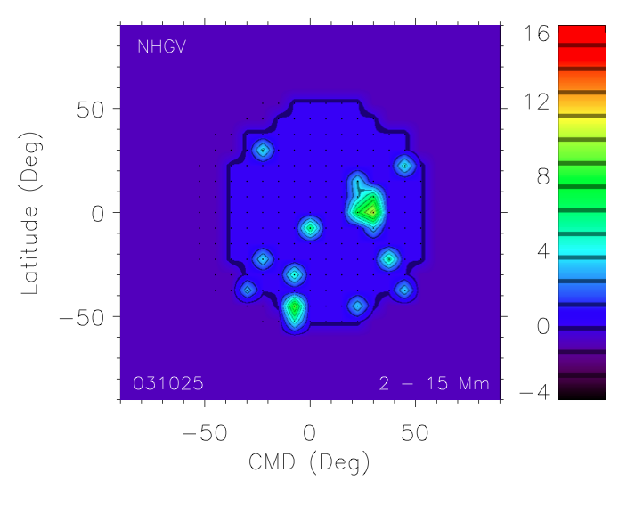
X1.2

Slide 20
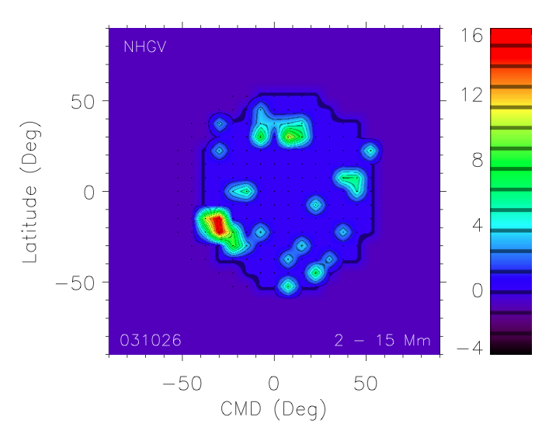
M2.7
X17.2

Slide 21
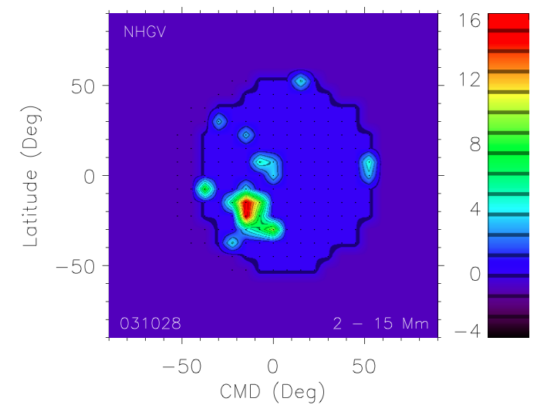
X10.0

Slide 22
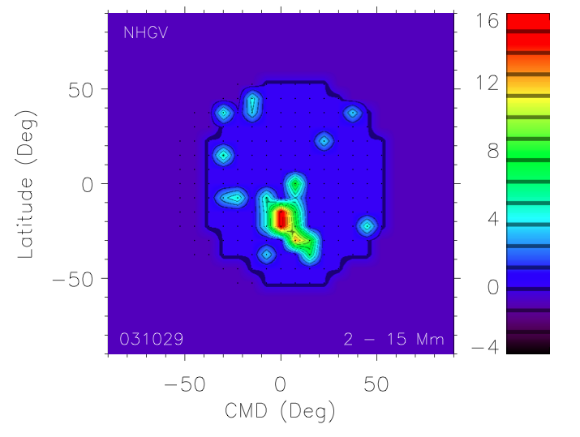
M1.5

Slide 23
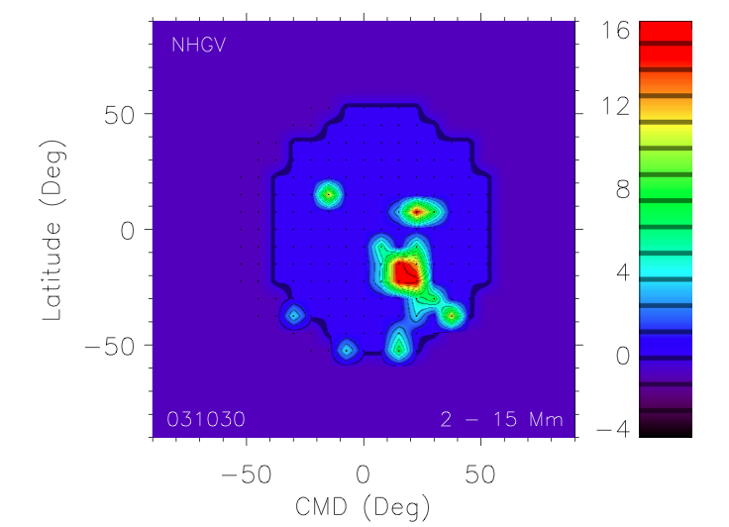
C5.3

Slide 24
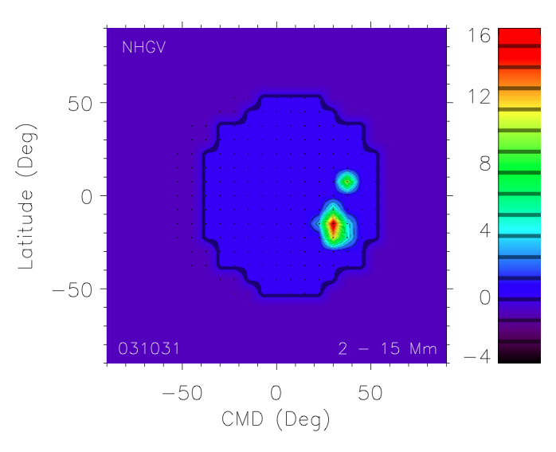
M3.2

Slide 25
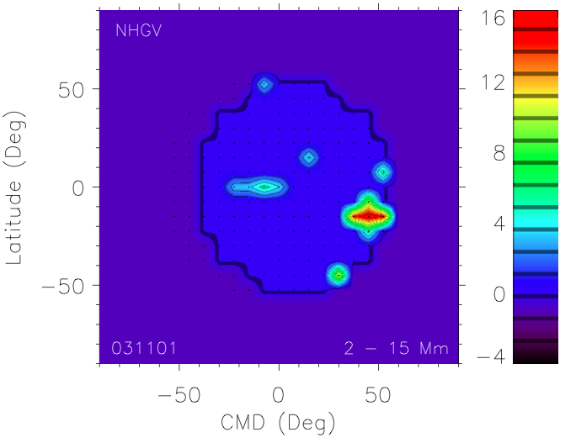
X8.3

Slide 26
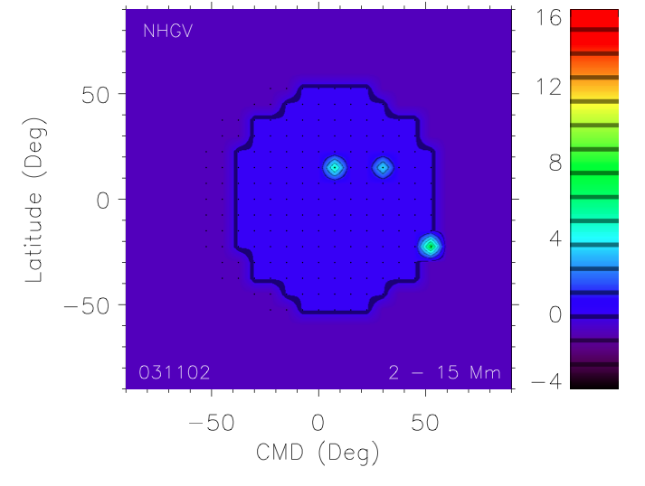
M3.9

Slide 27
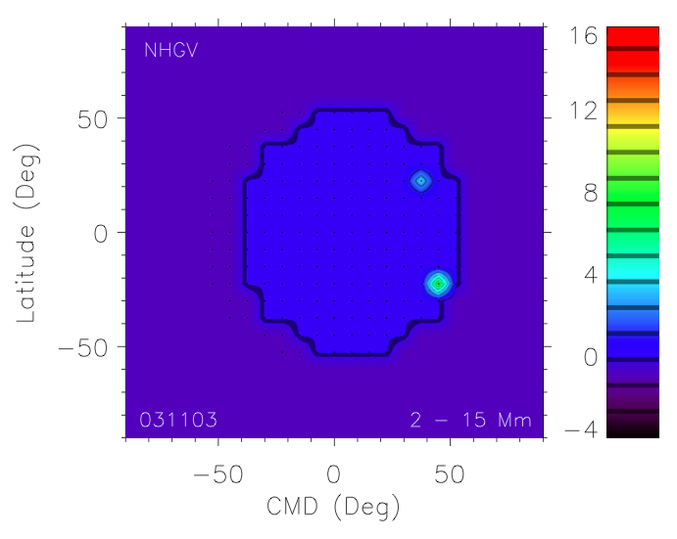
X45

Slide 28
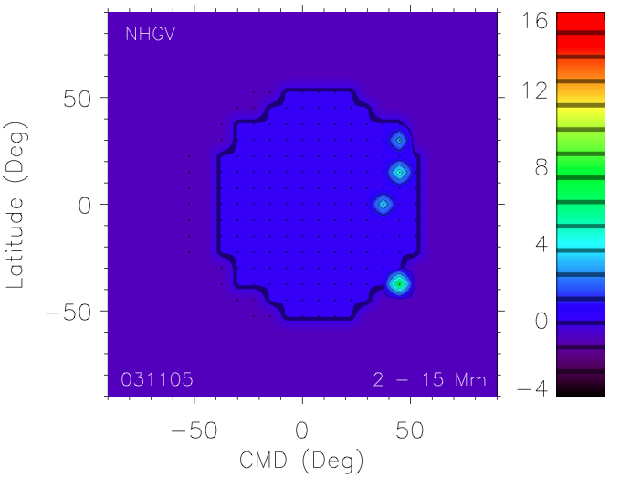
B5.8

Slide 29
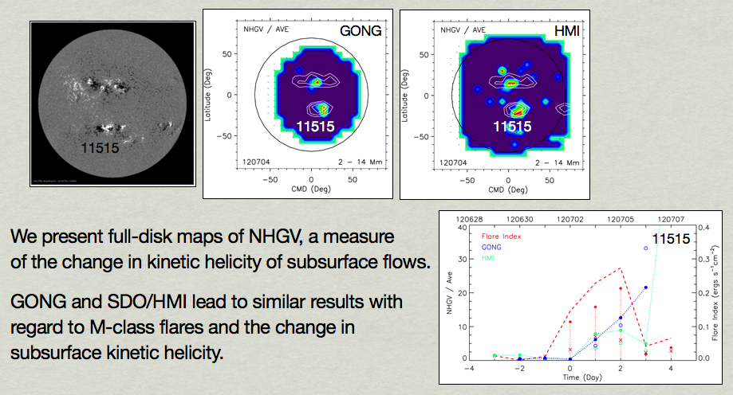
NHGV maps: HMI & GONG
See
Poster

Slide 30
Conclusions
Subsurface precursor of flares
  Indication of flaring and intensity 2-3 days in advance
Further investigation
  No clear difference between confined and eruptive flares
  KHD has opposite sign in N and S hemisphere
    Could incorporate that into NHGV parameter?
New method for visualizing NHGV

