Slide 1
Civil Contingencies Secretariat/ Met Office Risk Preparedness and Operational Mitigation in the UK European Space Weather Week: Antwerp, 18 November 2013
Chris Felton (CCS) and Mark Gibbs (Met Office)

Slide 2
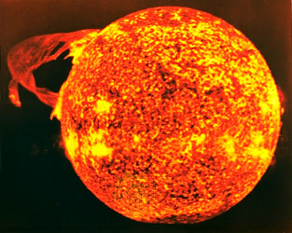
Overview
Why space weather is included in the UK risk assessment?
What awareness is there of this risk in the UK?
What has the UK done to prepare for the risk?
Focus on development by the UK of a
forecasting and alerting capability.
What help do we need from the scientific
and research communities?

Slide 3
The Civil Contingencies Secretariat
Improve the UK’s resilience to absorb, respond to, and recover from potential disruptive challenges of all types.
Short-term horizon scanning and medium term risk assessment
building capability
ensuring consistency
critical infrastructure
supporting community and corporate resilience
planning for the big stuff
.......and dealing with it when it goes wrong
ESWW 2013 - Antwerp
Notes:
Prepare for the common consequences of civil emergencies rather than for every individual emergency scenario
Flexible arrangements for responding to emergencies: scalable and adaptable.
Where necessary, undertake planning and capability building for specific risks in the National Risk Assessment
Encourage community and corporate resilience
Monitor to anticipate emergencies

Slide 4
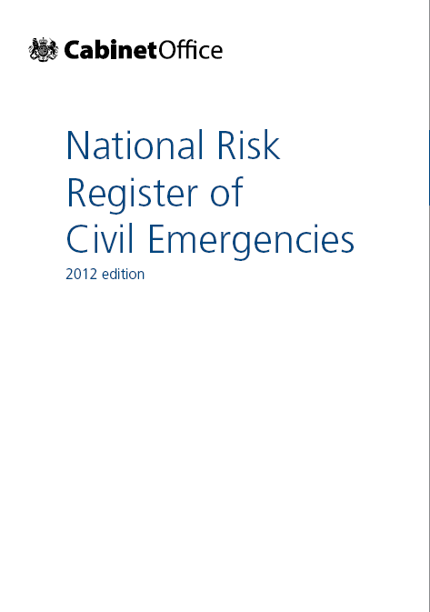
Assessing the space weather risk
UK discussions started May 2010
Space Environment Impacts Expert Group (SEIEG) formed November 2010
Emphasis on (peer reviewed) scientific evidence
Reasonable worst case scenario agreed
Included as a risk in the National Risk Assessment: 2011 and National Risk Register in 2012
ESWW 2013 - Antwerp

Slide 5
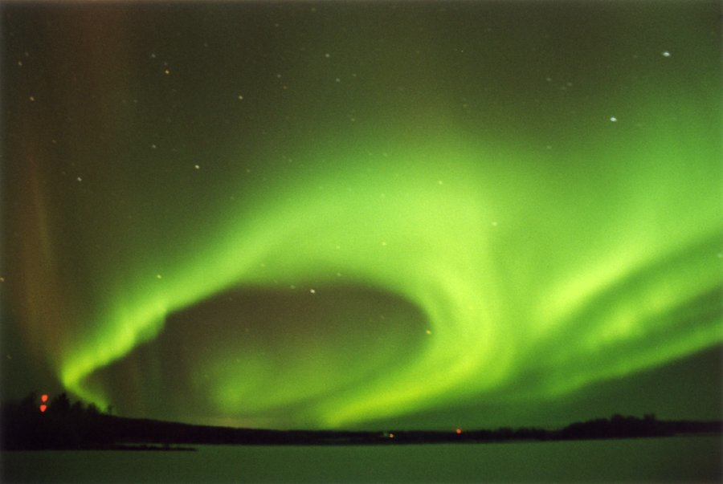
Reasonable Worst Case Scenario
Based on the 1859 Carrington Event
The perfect storm – largest CMEs, solar energetic particle events and solar flares
Our planning assumptions
Geomagnetic storm lasting for approx 3 days – some effects felt for weeks or months
Effects likely to be felt globally
Severity of impact will vary with location
Impacts that are not known or fully understood
On NRA matrix, this scenario is
prioritised as a high likelihood event,
with a medium to high relative impact
for the UK should it occur
Civil Contingencies Secretariat, Severe Space Weather
Notes:
Quebec
6 million poeple
9 hours
Cold wintry Canadian night

Slide 6
Where does space weather fit?

Slide 7
UK awareness of the risk
Government: National risk assessment process has highlighted risk to senior officials and ministers. CCS-led project increased momentum.
Local responders: Low but increasing. Focus on understanding how the risk could impact their area and what they’ll need to do.
Public: Since 2012, Space Weather risk included in public-facing National Risk Register
Industry: National Grid planning well embedded. Other industries’ awareness growing - Royal Academy of Engineering Report in February 2013
ESWW 2013 - Antwerp

Slide 8
UK Government’s approach
Work to understand the nature of this risk for the UK since it first appeared in National Risk Assessment in 2011.
Met Office ‘own’ the risk and developing 24/7 forecasting and alerting capability.
Co-ordination provided by CCS in Cabinet Office. Severe Space Weather Project set up April 2013.
Project accountable to High Impact Hazards Programme Board. Chaired by Director, Civil Contingencies.
SEIEG provides expert advice to ensure the work of the project is informed by scientific evidence. Chaired by Prof Mike Hapgood (RAL Space).
Continue international collaboration (US, Sweden, Canada, EU, NATO)
Main outputs: enhanced capabilities to be reflected in preparedness strategy for responding to a severe space weather incident.

Slide 9
Policy challenges
Significant uncertainties remain. Science still evolving and hard to evaluate interdependencies between impacts.
Impacts likely to be felt internationally. How closely aligned do international responses need to be?
Affected organisations might have global reach. How should Governments work with them?
Can capability required be built by individual organisations or does it need intervention at national or international level?
Timeline from notification of an event to impact is short. What can Governments do once warning is given?

Slide 10
What’s the requirement?
‘Forecasts provide a useful capability which, given sufficient accuracy, could change how space weather is mitigated’
Need for in-country prediction & expertise
Resilient, responsive prediction capability
UK centric advice and impacts
Direct link between forecast provider and central government
Provision of tailored services to critical sectors

Slide 11
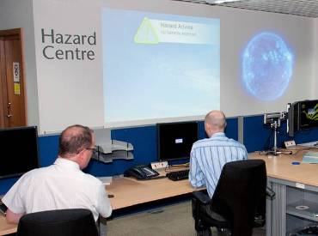
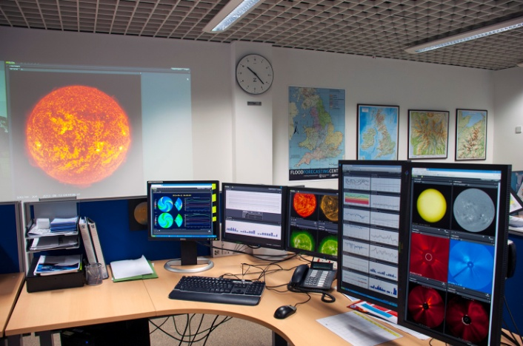
Space Weather operations
UK space weather prediction centre
Utilise existing 24x7 resilient infrastructure
Full 24x7 – April’14
Collaborate, not replicate
Models / knowledge - BGS, BAS, Bath Uni, QinetiQ, DSTL, UCL, Imperial
Strategic relationship with NOAA SWPC
Daily forecast coordination
Accessing data & imagery from NOAA, NASA & BGS
Add UK-centric advice and impacts

Slide 12
What will be available?
Routine
Daily forecasts
Warnings & Alerts – matching SWPC
Sector specific services/web pages
‘Significant event’ – for Govt & key sectors
Pre-event awareness
Daily electronic briefing
Direct alerting

Slide 13
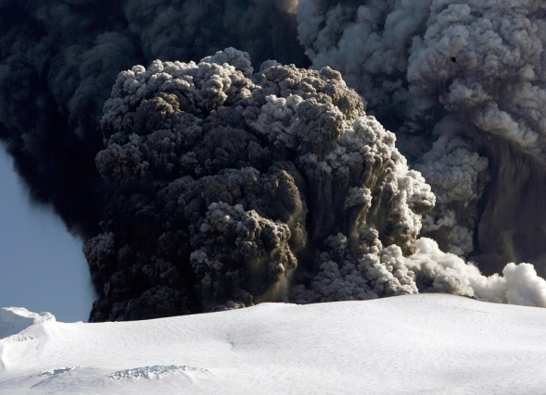
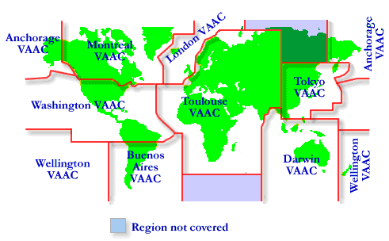
Volcanic Ash Lessons
Consistent information and communication, nationally & internationally
Manage expectations
Provide education and guidance
Defend the importance of good, underlying transparent, peer reviewed science

Slide 14
What can you do to help?
Well established scientific collaboration, including joint satellite programmes
Further refinement of evidence to assess the likelihood of different scenarios
Further develop the ability to forecast and model the impacts, including the interaction between different impacts
Additional space situational awareness capabilities to warn of major events
Filling gaps in our knowledge
Raising awareness with your own governments of this risk
Advice to government during major events
Communication to the public

Slide 15
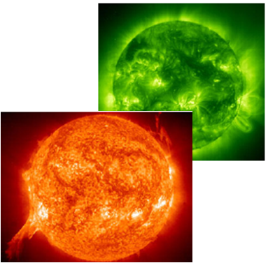
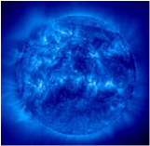
Summary
UK assesses space weather risk as part of comprehensive risk assessment process
Awareness growing in UK, but strongest in scientific and technical communities
We’re still scoping the impacts and policy challenges. But we’re making progress
Significant progress developing UK’s 24/7 forecasting and alerting capability
Clear need for engagement between government, operations and science

Slide 16
Questions?
Chris Felton,
Head of High Impact Hazards, CCS
chris.felton@cabinet-office.x.gsi.gov.uk, +44 (0)20 7276 5012
Mark Gibbs
Head of Space Weather, Met Office
mark.gibbs@metoffice.gov.uk, +44 (0)7867 501403

