Slide 1
Resilience in Basic Functions - Risk Governance in Norway
Erik Thomassen, Head of Analysis Unit,
Directorate for Civil Protection, Norway
10th European Space Weather Week, Antwerp, 18 November 2013

Slide 2
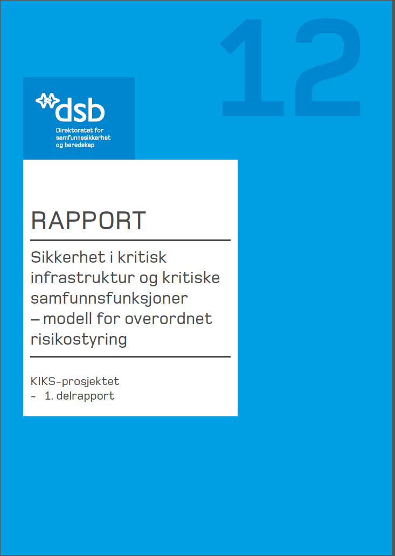
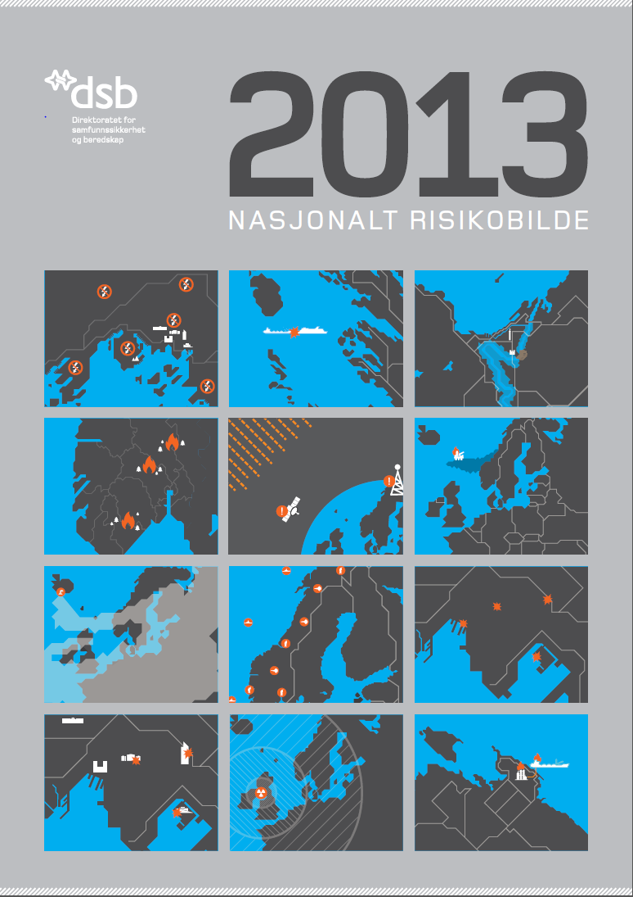
Framework for Risk Governance
What are the basic functions of society?
What should we prepare to encounter?

Slide 3
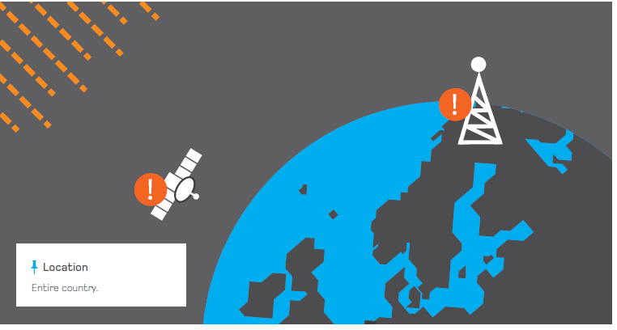
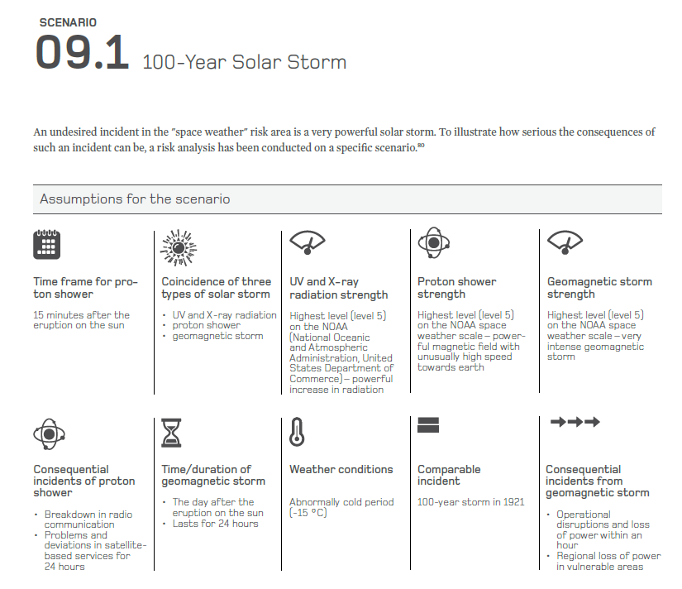

Slide 4
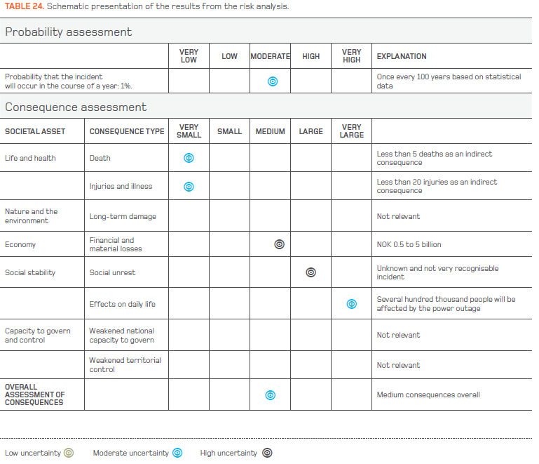

Slide 5
The Norwegian approach to resilience focuses on the core deliveries and services in society – ensuring that basic needs are taken care of
The main strategy is focusing on business continuity. No one should take external deliveries and services for granted
From a Government point of view identifying and designating core deliveries is crucial

Slide 6
Basic Societal Functions
Uphold national security
Maintain governance and crisis management
Secure democratic rule of law
Maintain sufficient food supply
Maintain sufficient supplies of drinking water
Take care of the population´s need for heating
Maintain safety for life and health
Maintain law and order
Maintain financial stability
Maintain basic security for stored information
Secure cultural values of national importance
Protect nature and the environment
E-com services
Electrical power supply
Water supply
Sewage management
Fuel Supply
Goods and passenger transport
Satellite based services
Metrological services

Slide 7
Governance necessitates a more specific identification of the basic functions.
What everyday deliveries are crucial to ensure that the population´s vital needs are taken care of?

Slide 8
Basic Deliveries from the Financial Sector
Maintain Financial Stability
Capability of maintaining functional capital markets |  | Capability of securing the public´s access to necessary means of payment |  | Capability of securing financial transactions from stopping or going astray
Ensure safe transference of capital between actors nationally and internationally | Ensure the public`s access to means of payment to maintain necessary trade in goods and services |  | Ensure that payments and other financial transactions are conducted in a safe manner (correctly and on time, safeguarding the need for integrity, confidentiality and availability) |  | Ensure safe and stable operation of the financial records providing overview of accounts, deposits, mortgages, liens, ownership and insurance

Slide 9
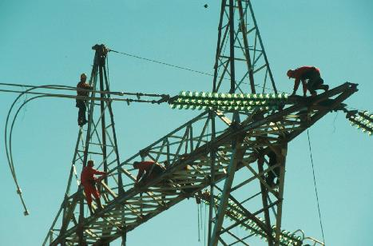
Principles
Owners and operators of enterprises responsible for basic societal functions should build systems to maintain vital deliveries and services in all circumstances
Everyone must take into account the possibility of deficiencies in deliveries they are critically dependent of
This even includes the public
The authorities should clarify responsibility and ensure that owners of enterprises responsible for basic deliveries and services take their responsibility seriously – and define standards and goals
Follow up through audits and reviews in ministries and agencies

Slide 10
Conclusion
The Norwegian Approach focuses on safeguarding the core deliveries from enterprises responsible for basic societal functions
Goals, regulations, public/private partnership, supervision, reviews/audits
All enterprises responsible for deliveries of vital importance to society should plan for upholding their ability to deliver no matter what circumstances might occur
A resilient society must be built from below – through systematic governance on all levels

Slide 11
Thank you for your attention!
erik.thomassen@dsb.no

