Slide 1
Building Capacity for Preparedness
Extreme Space weather
Swedish Civil Contingencies Agency
Emmelie Andersson

Slide 2
MSB’s mission: Develop and support society's ability to handle disasters and accidents
The entire spectrum of threats and risks, from everyday emergencies to major disasters
Local, regional, national, EU, and international
Before, during, and after the occurrence of emergencies, disasters and accidents
Coordinating across sector and jurisdictional boundaries and levels of responsibility
MSB will not take over the responsibility of primary stakeholders. Their missions include the responsibility to coordinate with others as needed
Notes:
Swedish Civil Contingencies Agency is responsible to develop and strengthen society’s capacity to prevent, manage and learn from disasters and crises. MSB has an operational mission to enable and support other stakeholders to deal with accidents, emergencies and disasters when they occur, both nationally and internationally.
We have an all hazards approach, which means that we analyze all kinds of threats and risks. But our systems and modells are generic and we don’t focus on specific causes, but rather on the possible consequences. Since the consequences can be similar for many events. As severe space weather events are rare, this approach is an effective way for us to include it in our analysis.
When there is a disaster or crisis, several stakeholders may have important functions in the management of the event. One part of our operational assignment as outlined in the mandate is to enable coordination and efficient use of relevant stakeholders resources across sector and jurisdictional boundaries. This is facilitated by MSB.
According to normal procedures, MSB will not take over the responsibility from other stakeholders. But, we are responsible to see to that all stakeholders understand and carry out according to their responisbilities. This could be for example to highlight to the Swedish National grid the importance of including space weather impacts in their risk analysis.
Further more to raise the awareness, MSB arranges different types of events where concerned stakeholders are invited and given the possibility to discuss and coordinate.

Slide 3
MSB preparedness
Risk analysis and education
Forecasts from the Swedish Armed Forces
Point of contacts for verifying forecast
Informing relevant sector responsible stakeholders
Coordinate and support the stakeholders

Slide 4
Swedish National Grid
Research
Swedish Transport Administration
LFV Aviation Consulting
Space weather forecaster
Swedish Weather services
MSB
Swedish Post and Telecom Authority
Swedish Maritime Administration

Slide 5
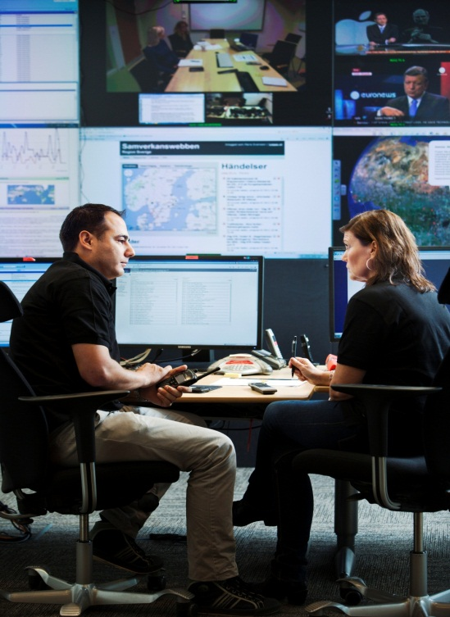
Building capacity
Risk and vulnerability analysis
Contingency plans
The national risk assessment
Pooling existing knowledge
within different sectors

Slide 6
FEMA/MSB/NOAA WS: “Managing Critical Disasters in the Transatlantic Domain – The Case of a Geomagnetic Storm” ,Boulder, Feb 2010
MSB International Round table on Extreme space weather, Stockholm, Sep 2012
JRC/MSB/NOAA WS: Space weather and Power grids, Ispra Italy, Oct 29-30 2013
US/SE/UK NATO CEPC Seminar: Managing Extreme Space weather , Brussels, Nov 15 2013

Slide 7
JRC/MSB/NOAA WS: Space weather and Power grids
Awareness, policy action,
and international cooperation
USA experience - NOAA’s facilities
and their use
Canadian experience,
including a severe event
Space weather and GICs
Risk assessment
and management
Operator requirements
and regulation

Slide 8
Thank you! www.msb.se/en/Prevention/Space-weather/

