Slide 1
A New Solar Observing Network For Space Weather Operations & Solar Physics Research
Frank Hill, NSO, USA
Markus Roth, KIS, Germany
Michael J Thompson, HAO, USA
ESWW10, Antwerp
Nov. 19, 2013

Slide 2
What and Why a Network
No substitute for “complete” temporal and spatial observations of the Sun
Ground-based network (a set of geographically distributed identical instruments) is proven strategy for this
Network is not as vulnerable to space weather as a space platform
Network is ∼10-15 times less expensive than space platforms
Network can be maintained and upgraded for very long time periods
Network provides continual context for large telescope operations

Slide 3
An existing network: GONG
Operating since 1995
Two instruments:
Michelson Interferometer
helioseismology Doppler velocity, intensity and LOS magnetic field
1k x 1k full-disk images in Ni I 676.8 nm
60-sec cadence
AFWA-funded filter system
H-α intensity
2k x 2k full-disk images
60-sec cadence at a given site, 20-sec cadence from network

Slide 4
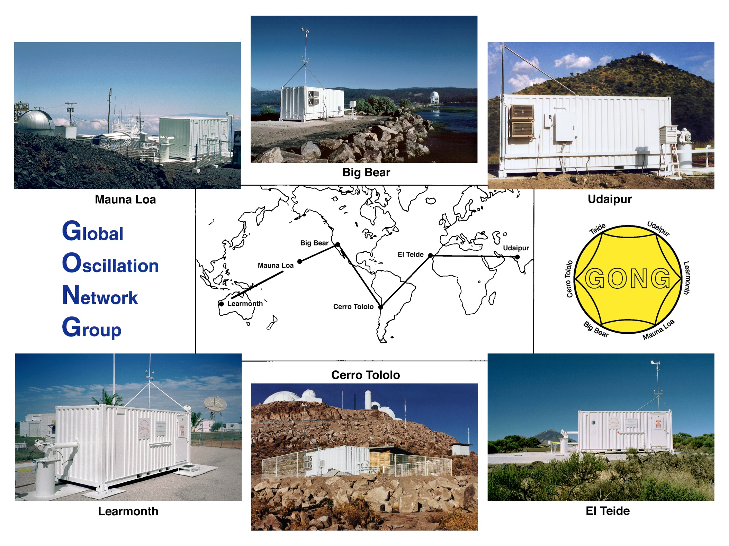

Slide 5
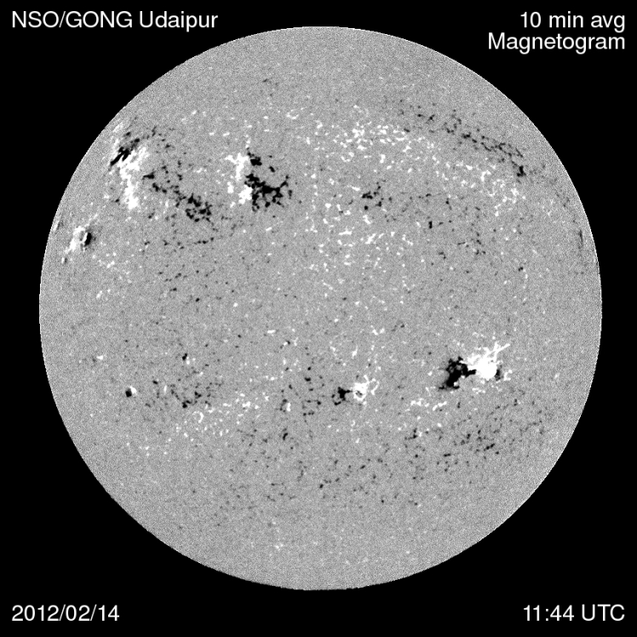
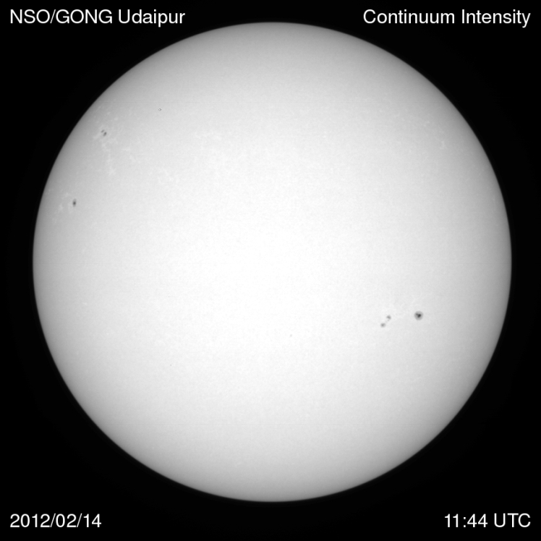
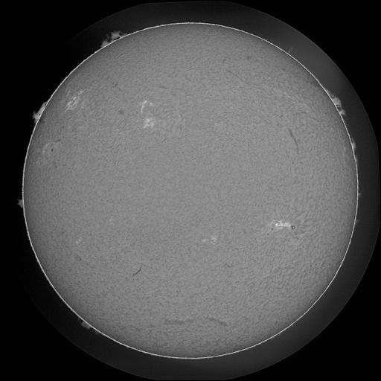
Duty Cycle red<0.5 yellow< 0.7 green>0.82 median=0.91
NSO/GONG Udaipur
Hα Intensity
2012/02/14
These images are returned in near-real time and are available on the Internet

Slide 6
Space Weather Products from GONG
Far-side helioseismic maps every 12 hours
Used by NOAA/SWPC
Magnetic field
10-min average & variance
Synoptic magnetic field map & PFSS coronal field extrapolation from ~8000 magnetograms every hour
Used by NOAA/SWPC for solar wind and geomagnetic storm forecasts
Used by NASA/CCMC
H-α intensity every 20 sec around the clock
Used by US Air Force Weather Agency

Slide 7
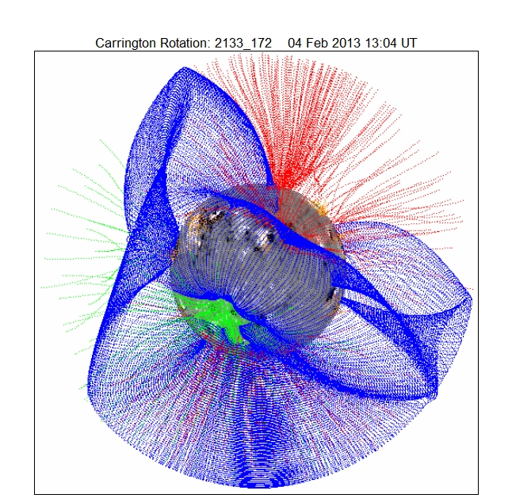
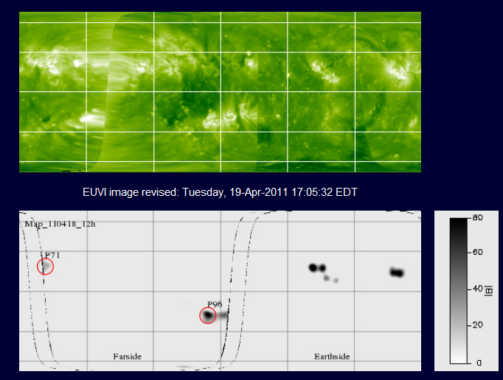

Slide 8
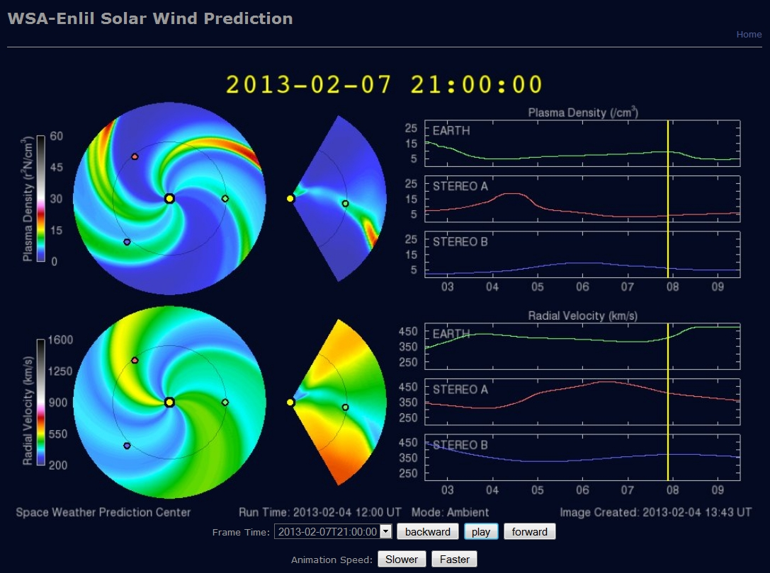

Slide 9
GONG H-α
June 6, 2011
GONG Web sites:
Top level: gong.nso.edu
Synoptic maps & PFSS:
gong.nso.edu/data/magmap
gong.nso.edu/data/magmap/pfss.html
Farside: farside.nso.edu
H-α: halpha.nso.edu

Slide 10
SPRING
Solar Physics Research Integrated Network Group
Multi-wavelength ground-based network to replace GONG and SOLIS
Provide multi-height data for helioseismology, vector magnetometry, irradiance variations and space weather operations
Workshop April 22-24 in Boulder, hosted by HAO
40 participants from all areas, including radio and coronal physics, and space missions
Meeting report published in Space Weather, 11, 392
Many science drivers
Work package of SOLARNET, KIS lead

Slide 11
Science requirements
Full-disk Doppler velocity, vector magnetic field images, and intensity images -> Stokes
Variety of wavelengths
Cadence of no longer than 60 seconds
Spatial resolution of 1” (0.5” pixels)
90% duty cycle
25 year lifetime
Velocity sensitivity: 1 m/s /pixel /image (?)
Magnetic field sensitivity: 5 G /pixel /image (?)

Slide 12
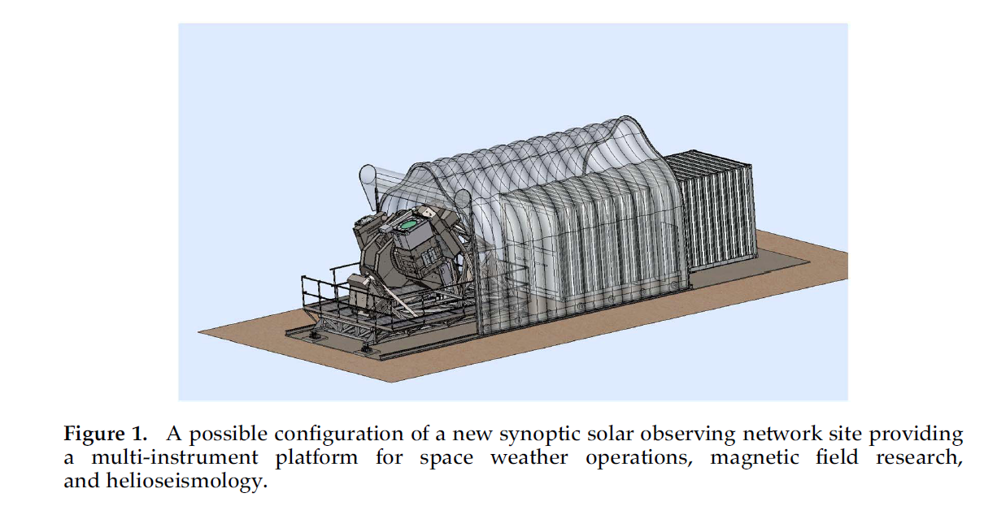
New Network Concept
Multi-instrument platform
Flexibility at each site
Mission-specific instruments, fewer compromises

Slide 13
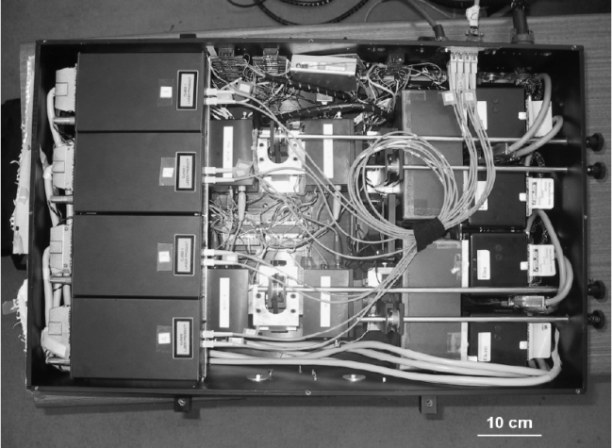
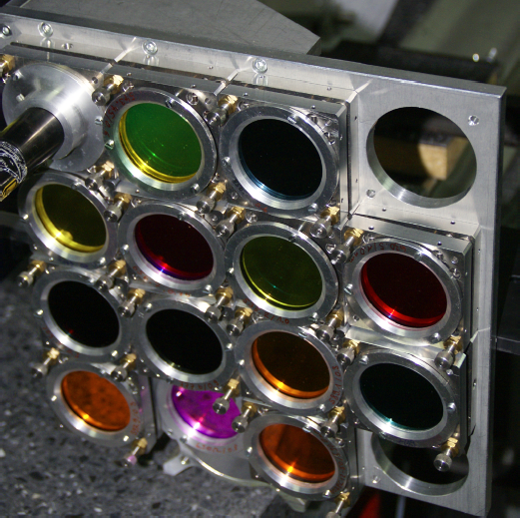
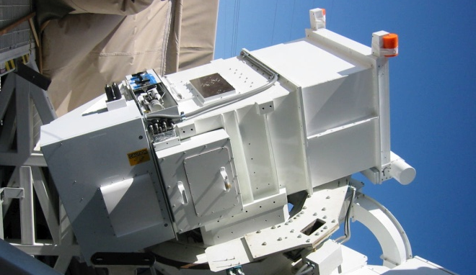
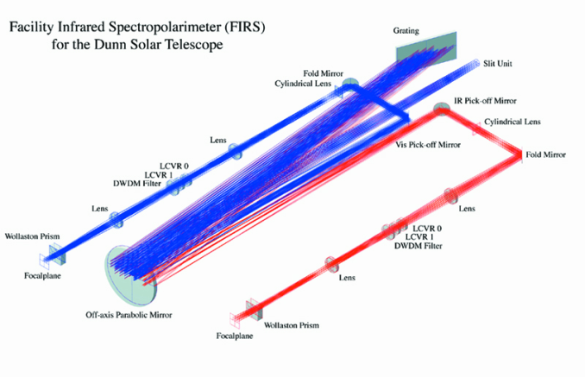
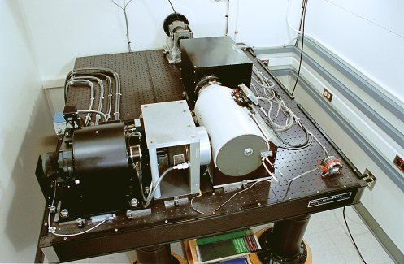
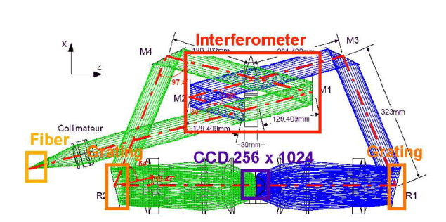
Possible instrument concepts
Filtergraph
Spectrograph
Interferometer

Slide 14
Next steps (2014-2017)
Meeting next week in Freiburg
Develop SRD, TRD
Evaluate instrument concepts
Select two or three for testing
Develop next step proposal
Cost estimates: Development – construction - operations

