Slide 1
Monte Carlo Techniques for SEP Statistical Model Generation & Assessment of Uncertainties
Pete Truscott¹, Daniel Heynderickx², Fan Lei³, Athina Varotsou⁴, Piers Jiggens⁵ and Alain Hilgers⁵
(1) Kallisto Consultancy , UK; (2) DH Consultancy, Belgium; (3) RadMod Research, UK; (4) TRAD, France; (5) ESA/ESTEC, Netherlands
10th European Space Weather Week, Antwerp, Belgium, 19th November 2013
The ESHIEM Project is sponsored by European Space Agency , Technology Research Programme (4000107025/12/NL/GLC )

Slide 2
Contents
ESHIEM Project Background
Sources of ion data and treatment
Sources of uncertainty
Treatment of errors and assessment of relative importance
Summary

Slide 3
Energetic Solar Heavy Ion Environment Models (ESHIEM) Project Background
See Poster 14 for S9 “Spacecraft Operations and Space Weather”– Crosby et al
ESA TRP Activity
Commenced October 2012
Purpose:
  Extend Solar Energetic Particle Environment Model (SEPEM) system to properly account for ions > H⁺
  Treat proton and heavier ion transport with magnetosphere
  Provide faster engineering-level tools to predict physical shielding effects
Current models and their drawbacks:
  PSYCHIC provided as-is, based on IMP8/GME and GOES/SEM to 2001, and ACE/SIS for 2<Z<26 from 1998 to 2004 (also supplemented by other sources)
  Augmented by Reames data, and for Z>28, Apsland & Grevesse (1998)
  Based on cumulative proton fluence for associated CL, and then scaled by ion abundances
  No peak HI flux distributions
  No scope for resampling for other conditions/assumptions

Slide 4
Strategy for Model Development – Data sources
Implement in SEPEM processed/cleaned data for heavy ions
  Flexibility in building new HI models
Reference dataset
  ACE/SIS instrument data (covering just over 1 solar cycle)
  GOES/SEM and IMP8/GME He channel (from 1973 onwards)
  WIND/EPACT/LEMT to validate ACE/SIS extrap. low energy (~<10 MeV)
Generation of abundance ratios up to Z=28 (Ni)
  Energy-dependence
  Explore generation relative to protons or He
  Fill gaps in ACE/SIS with Reames data (ISEE-3) and scaling by nearest neighbour in ACE/SIS
Generation of abundance ratios up to Z>28
  Apsland, Grevesse, Sauval and Scott abundance ratios from photospheric measurements from more up-to-date sources
  Scale depending upon FIP - preferably continuous

Slide 5
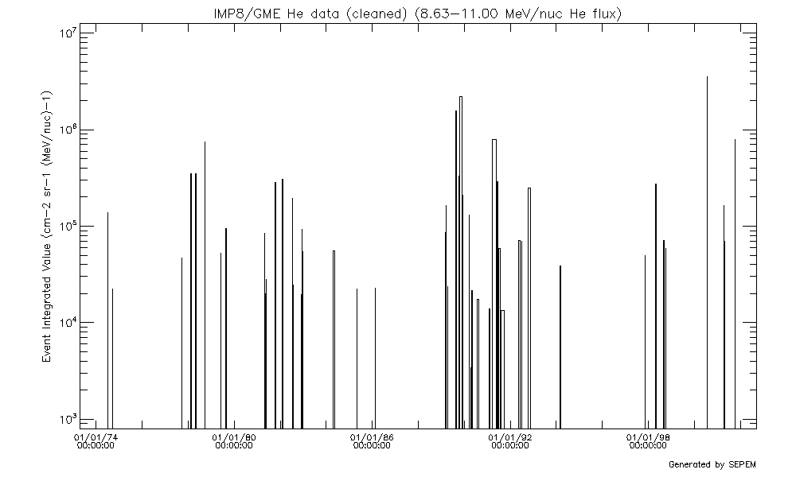
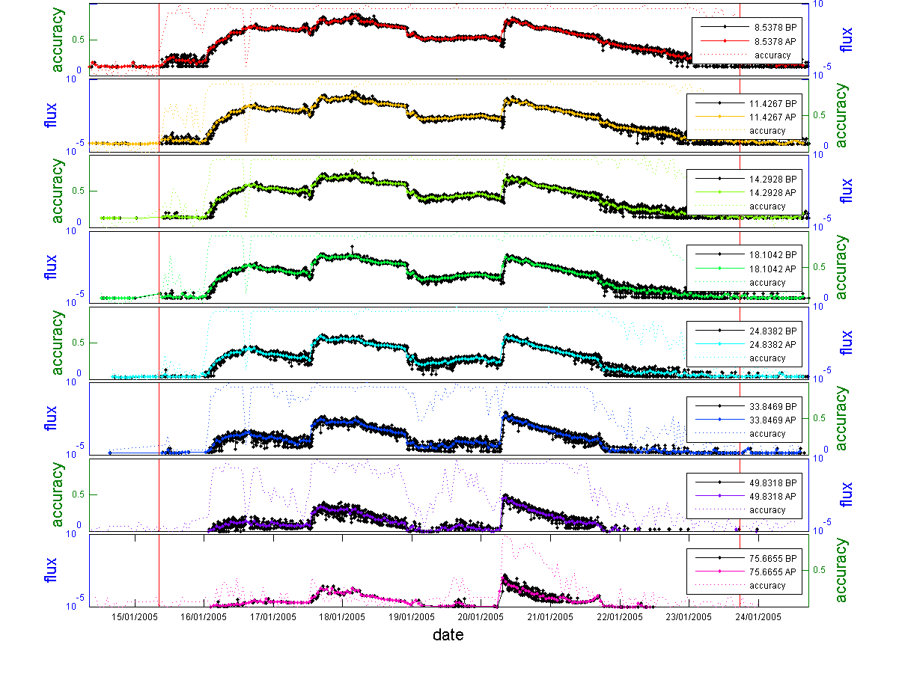
Data Sources and Data Processing
IMP8/GME He fluence
ACE/SIS data for O channels (256s and 1 hour averages)

Slide 6
Sources of Uncertainty
Not typically treated within statistical models
Not addressed within SEPEM System, except for
  There are instrument uncertainties within the source data
  Poisson errors in the Geant4 Monte Carlo results for shielding and SEU calculations
Source environment data errors (outside magnetic field)
  Geometric cross-section of instruments
  Energy range for channels
  Instrument counting statistics (Poisson)
  Adequacy of sampled SEP events forming database
And this is just the start …

Slide 7
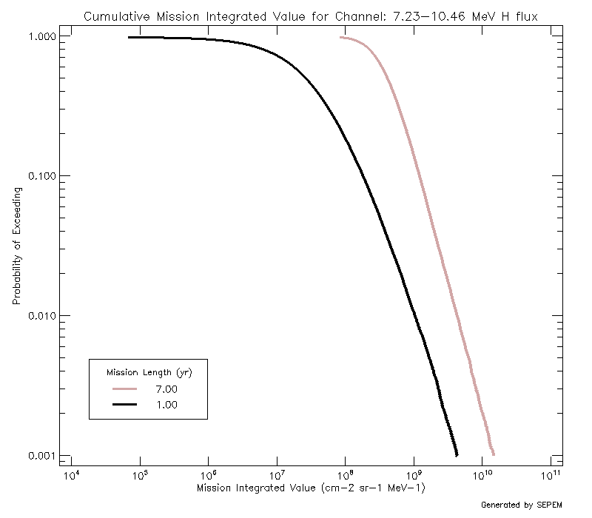
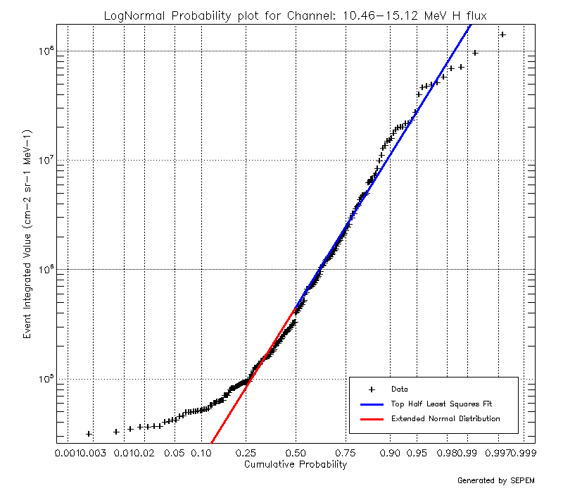
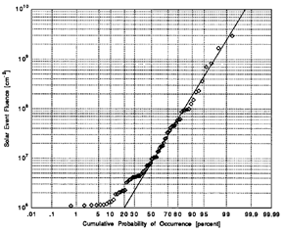
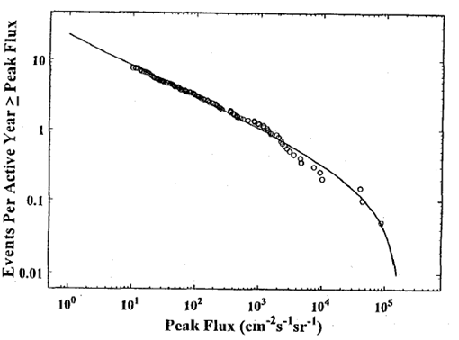
Building a Statistical Model for SEPs
Assumed distribution of event characteristic/magnitude (e.g. fluence or peak flux) based on data
    JPL ESP/PSYCHIC
Assumed time-dependence of events, e.g. Poisson, time-dependent Poisson, Levy distributions
Usually Monte Carlo sample event characteristic to determine average response for specific mission duration
Images from Feynman et al (1993) and Xapsos et al (1999)

Slide 8
Building a Statistical Model for SEPs
Could define parameters in event distribution (e.g. μ and σ in lognormal) to consider not just mean values but worst-case
Extreme value analysis can seem arbitrary and not always useful
Or treat parameters as having intrinsic uncertainty, and that they are independent of each other
Sample uncertainty in μ and σ as part of Monte Carlo process
Weight cumulative fluence / peak flux calculation for mission result by p₁(μ) x p₂(σ)
Note mean event rate, τ, is constant, but could be considered variable with s_{τ} as well

Slide 9
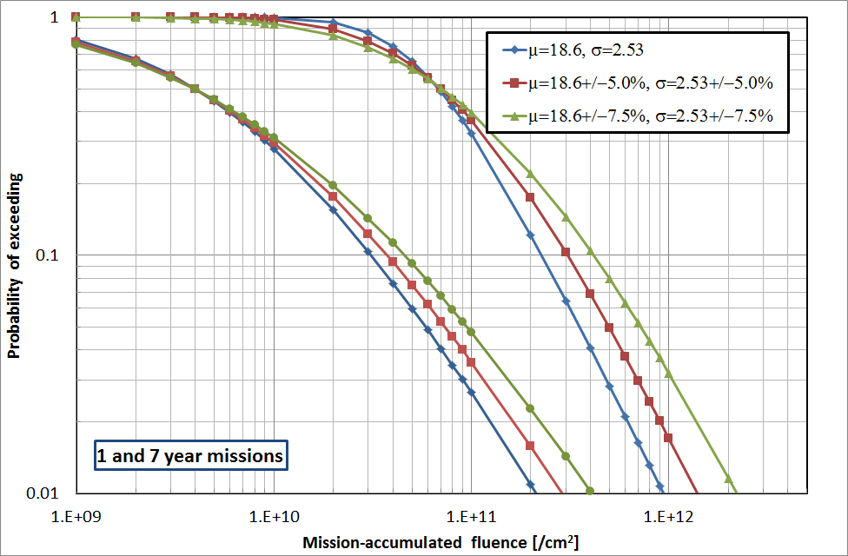
Mission-accumulated event fluence >10MeV - lognormal distribution for event size, Poisson in time (τ=6.15/year)
Rosenqvist et al (2005) suggest mu variation ~4%, and sigma ~6%

Slide 10
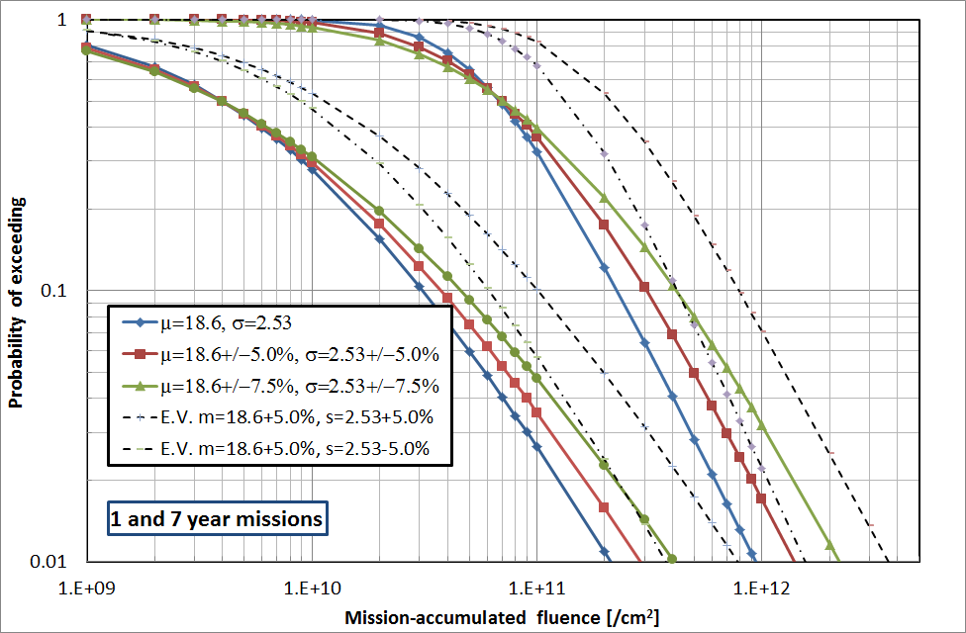
Mission-accumulated event fluence >10MeV- lognormal distribution for event size, Poisson in time (τ=6.15/year)

Slide 11
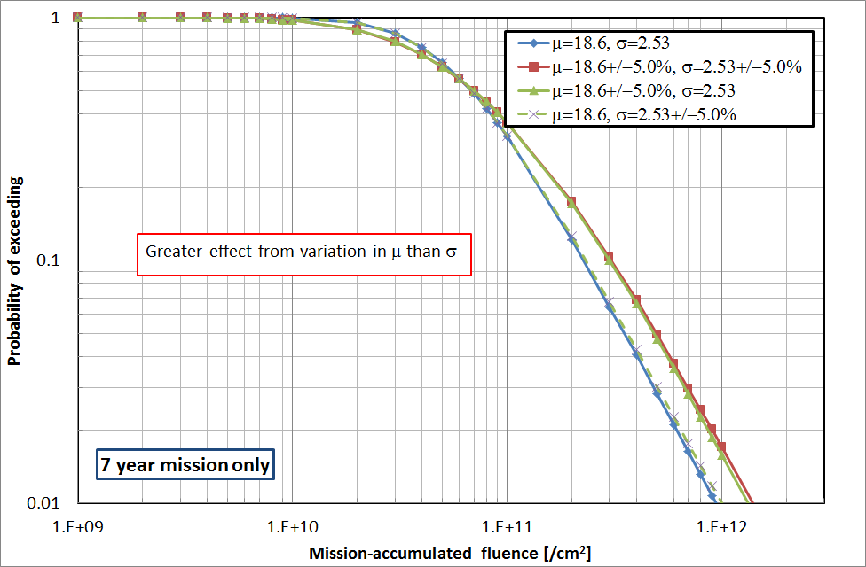
Mission-accumulated event fluence - lognormal distribution for event size, Poisson in time (τ=6.15/year)

Slide 12
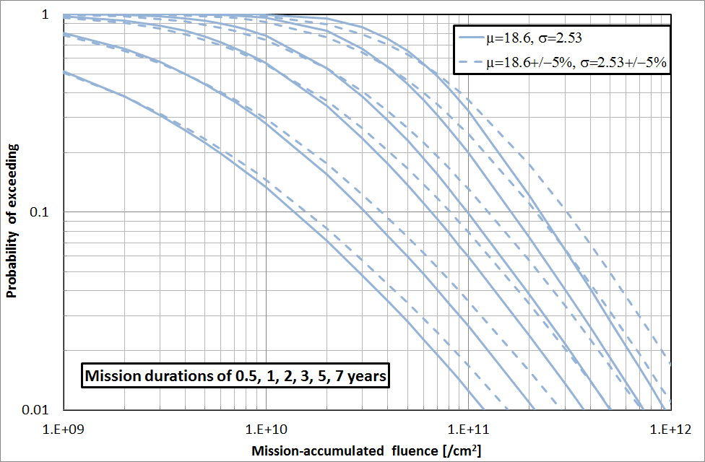
Mission-accumulated event fluence - lognormal distribution for event size, Poisson in time (τ=6.15/year)

Slide 13
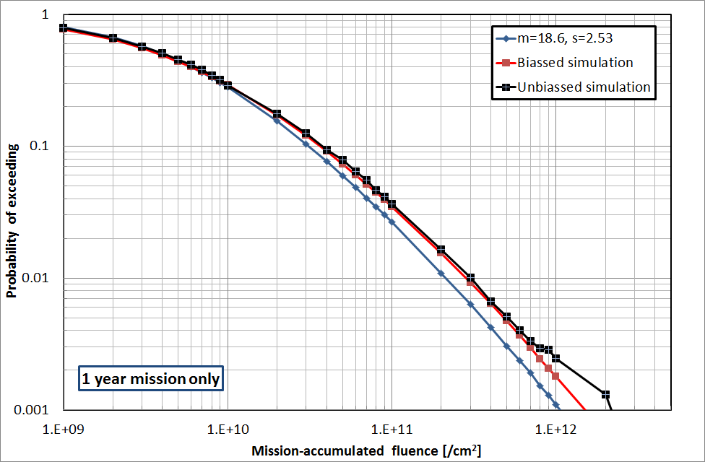
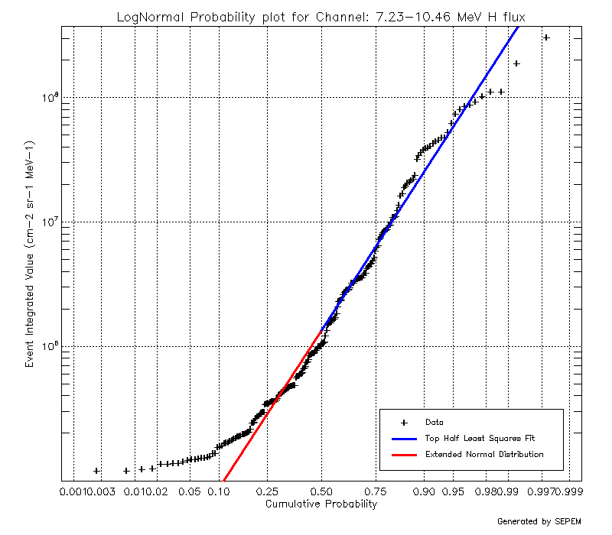
Variance Reduction Techniques (Biassing)
Decreased MC efficiency sampling over event characteristic distributions
  3x to ~10x more Monte Carlo simulations required to maintain statistical significance
Most of events samples are low-intensity
Bias event distribution function by B(φ) to increase sampling, but reduce weight of contribution

Slide 14
Summary
ESHIEM Project is implementing HI datasets into Solar Energetic Particle Environment Model (SEPEM) System, and tools to generate HI SEP models
Treatment and propagation of uncertainties not usually addressed, but an approach considered here
Methodology described from including event distribution uncertainties in SEP statistical model
  For mission-accumulated fluence examples given, we see ~ 50% increase from uncertainty
  For distribution chosen, greater sensitivity on mean event fluence (μ) than slope (σ)
Preliminary analysis to be extended
  Applied to lognormal cumulative fluence, but can be used for other event distributions
  Consider other parameter uncertainties, especially mean event rate,τ
Decreased Monte Carlo efficiency can be offset by variance reduction techniques of necessary

Slide 15
Backup Slides

Slide 16
PSYCHIC Model
Xapsos et al model
Initially developed as proton-only model for cumulative fluences from 1 MeV to >300 MeV for:
  Worst case solar minimum year
  Worst-case solar minimum period
  Average solar minimum year
Data sources:
  IMP-8/GME, providing 30 energy bins covering 0.88 to 486 MeV, with data from 1973.
  GOES/SEM instrument data were used to fill the data gaps in the IMP-8/GME data, and scaled to the GME data. This provided results spanning 1986 to 2001
  IMP-8/CPME data were similarly used to supplement the IMP-8/GME data between 1973 and 1986

Slide 17
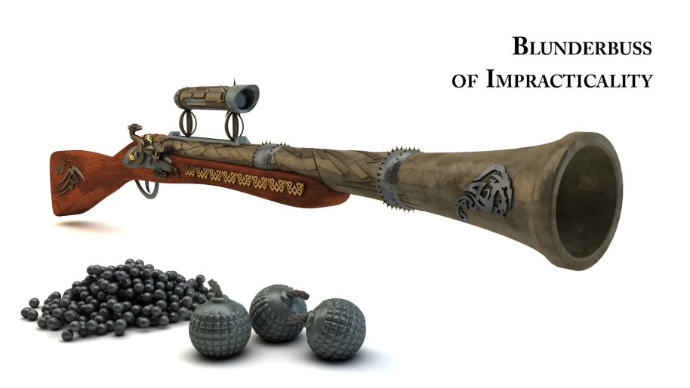
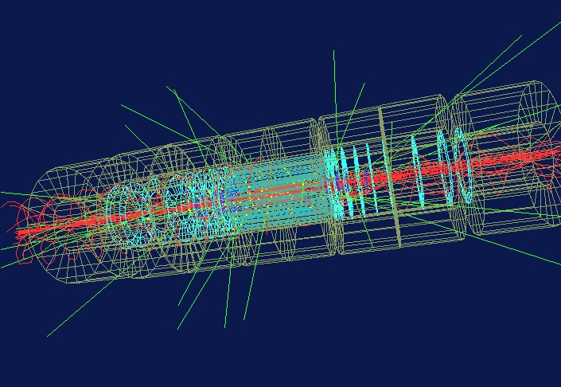
Why Use Monte Carlo?
✓
Monte Carlo is easy to understand
Easier to implement than direct numerical integration, especially integrating over multi-dimensional phase space → LESS MATHS!
Easier to adapt to different conditions
Computationally it’s very inefficient
Its use has grown due to high-performance, low-cost computers
✓
✓
✗
✓
Monte Carlo particle simulation for LHC (courtesy of CERN ATLAS experiment)

Slide 18
Numerical Integration Findings
Direct numerical integration can be performed for more straightforward time-dependent functions (Poisson)
More efficient for shorter mission durations <3 years
Nature of recursive integration makes the approach less efficient than MC for others
Perhaps not as valuable as initial thought considered
WRT Monte Carlo

Slide 19
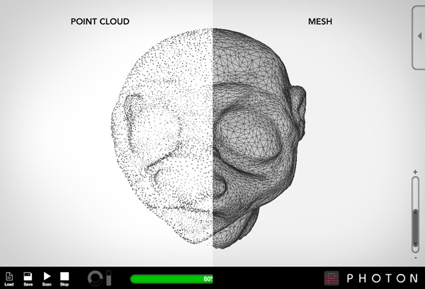
Monte Carlo Method is Integration …
x
x
x
x
x
x
x
x
x
x
x
x
x
x
x
Δy
x
x
x
x
x
x
x
x
x
Δx
x
x
x
x
x
x
x
x
x
x
x
x
x
x
x
x
x
x

