Slide 1



A generic description of planetary aurora
J. De Keyser, R. Maggiolo, and L. Maes
Belgian Institute for Space Aeronomy, Brussels, Belgium
Johan.DeKeyser@aeronomie.be

Slide 2
Context
We consider a rotating planetary body that orbits a star.
The star is assumed to have a stellar wind.
The motion of the body relative to the stellar wind is supersonic, i.e. the wind speed is supersonic or the planet orbits the star very closely at a high orbital speed.
This situation reflects planets in the Solar System, but it may be applicable to many exoplanets as well.

Slide 3
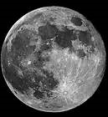
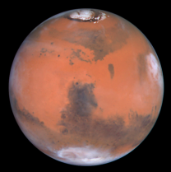
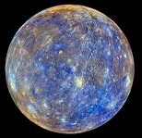
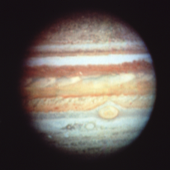
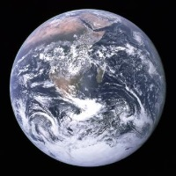
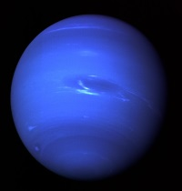
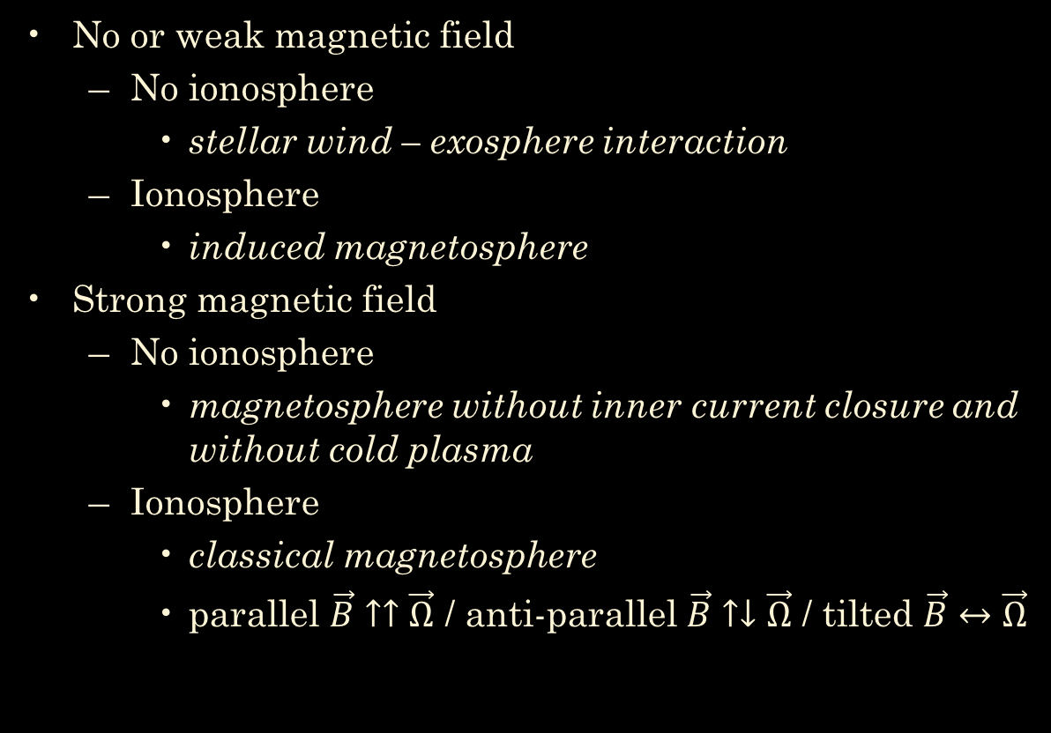
Classification of magnetospheres
No or weak magnetic field
  No ionosphere
    stellar wind – exosphere interaction
  Ionosphere
    induced magnetosphere
Strong magnetic field
  No ionosphere
    magnetosphere without inner current closure and without cold plasma
  Ionosphere
    classical magnetosphere
    parallel $\vec{B}↑↑\vec{Ω}$ / anti-parallel $\vec{B}↑↓\vec{Ω}$ / tilted $\vec{B}↔\vec{Ω}$

Slide 4
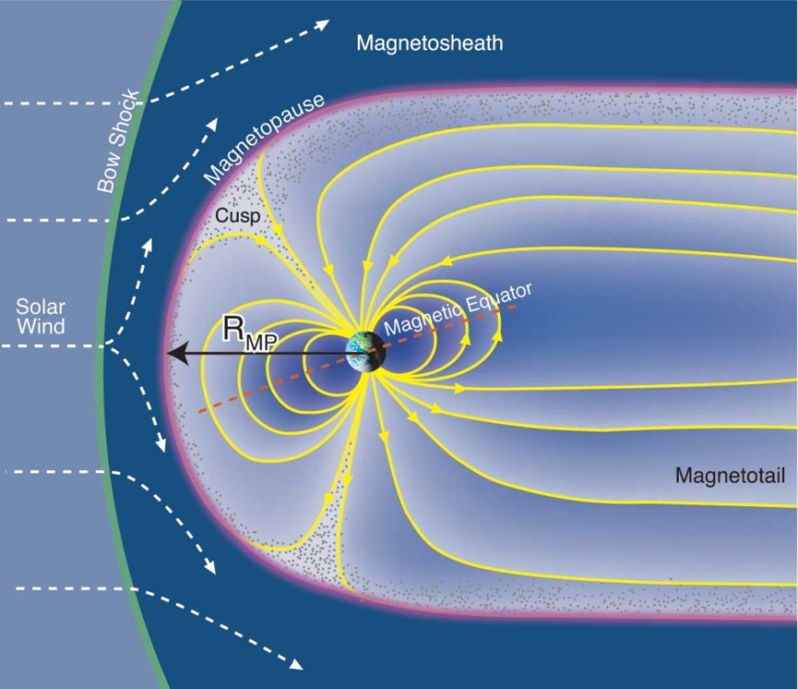
Classical magnetospheres
In “classical magnetospheres”
The planetary object has an intrinsic magnetic field
It is rotating.
It has a conducting ionosphere.
Plasma escapes from the ionosphere.
There may be additional inner sources of plasma.
Such magnetospheres have
a plasmasphere,
a magnetopause & boundary layer,
a magnetotail with a current sheet.

Slide 5
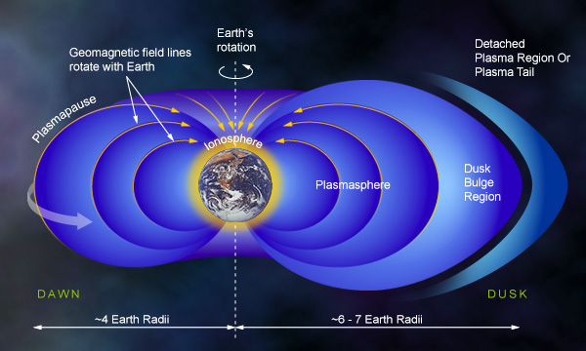
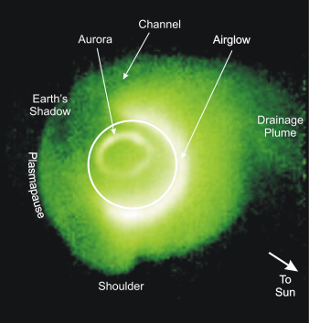
Plasma circulation
Plasma of solar wind origin :
Limited entry of solar wind is possible through various mechanisms (reconnection, diffusion, plasma transfer).
Plasma of terrestrial origin :
Escape from the ionosphere is due to energy input from solar radiation or precipitating particles. These produce a plasmasphere reservoir on closed field lines, which loses mass via a plasmaspheric wind and plumes.

Slide 6
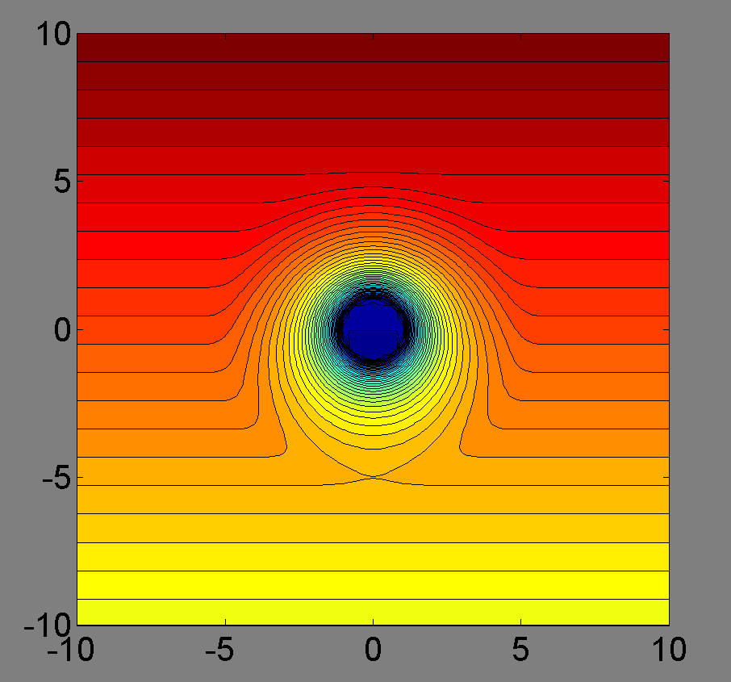
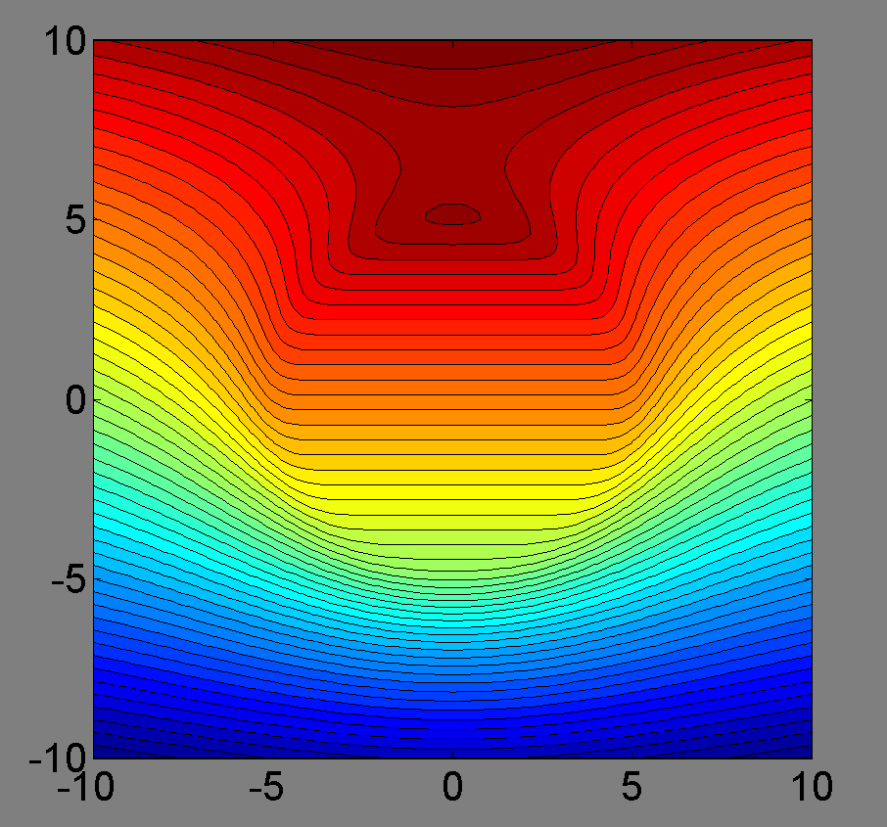
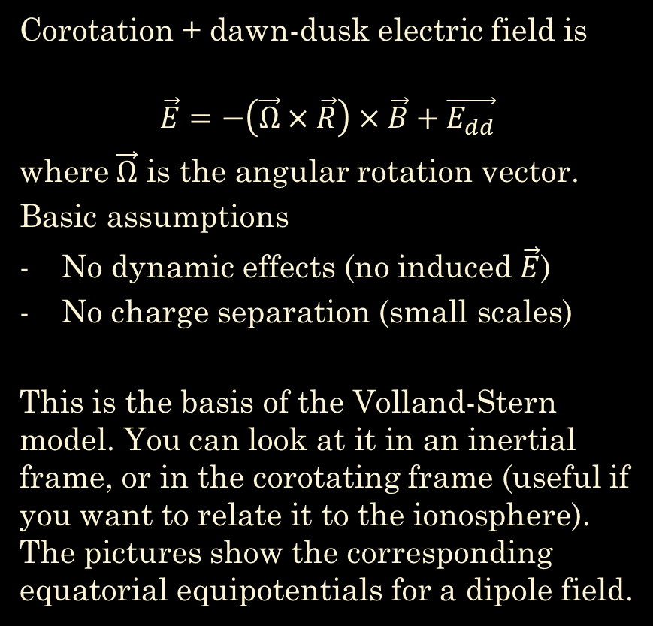
Magnetospheric electric field
Corotation + dawn-dusk electric field is
$$\vec{E}=−\left(\vec{Ω}×\vec{R}\right)×\vec{B}+\vec{E_{dd}}$$
where $\vec{Ω}$ is the angular rotation vector.
Basic assumptions
No dynamic effects (no induced $\vec{E}$)
No charge separation (small scales)
This is the basis of the Volland-Stern model. You can look at it in an inertial frame, or in the corotating frame (useful if you want to relate it to the ionosphere). The pictures show the corresponding equatorial equipotentials for a dipole field.

Slide 7
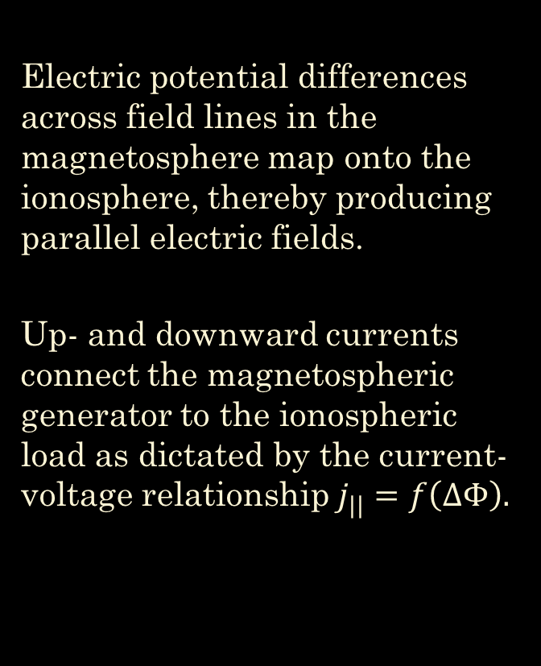
Magnetosphere – ionosphere coupling
Electric potential differences across field lines in the magnetosphere map onto the ionosphere, thereby producing parallel electric fields.
Up- and downward currents connect the magnetospheric generator to the ionospheric load as dictated by the current-voltage relationship$j_{||}=f\left(∆Φ\right).$
parallel potential difference
ionospheric potential
magnetospheric potential

Slide 8
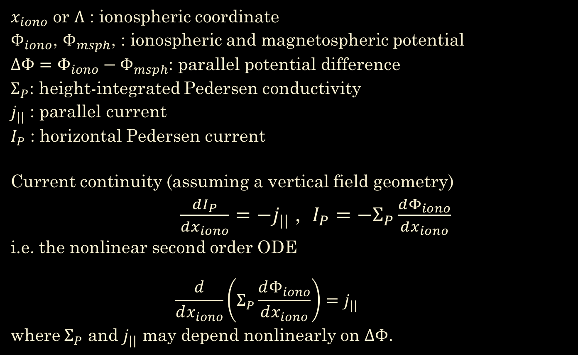
Current continuity
$x_{iono}$ or $Λ$ : ionospheric coordinate
$Φ_{iono}$, $Φ_{msph}$, : ionospheric and magnetospheric potential
$ΔΦ=Φ_{iono}−Φ_{msph}$: parallel potential difference
$Σ_{P}$: height-integrated Pedersen conductivity
$j_{||}$ : parallel current
$I_{P}$ : horizontal Pedersen current
Current continuity (assuming a vertical field geometry)
    $\frac{dI_{P}}{dx_{iono}}=−j_{||}$ , $I_{P}=−Σ_{P}\frac{dΦ_{iono}}{dx_{iono}}$
i.e. the nonlinear second order ODE
    $$\frac{d}{dx_{iono}}\left(Σ_{P}\frac{dΦ_{iono}}{dx_{iono}}\right)=j_{||}$$
where $Σ_{P}$ and $j_{||}$ may depend nonlinearly on $ΔΦ$.

Slide 9
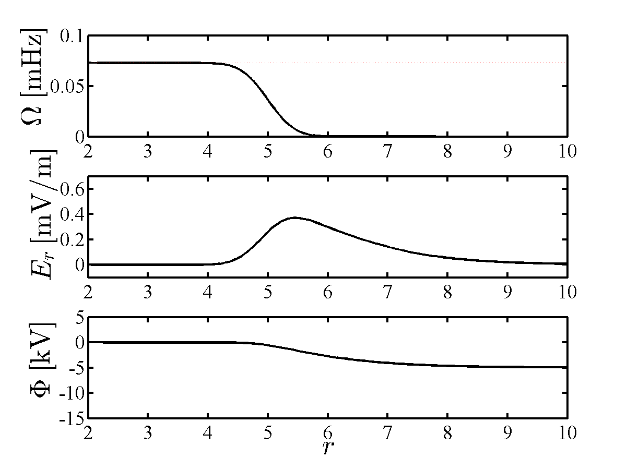
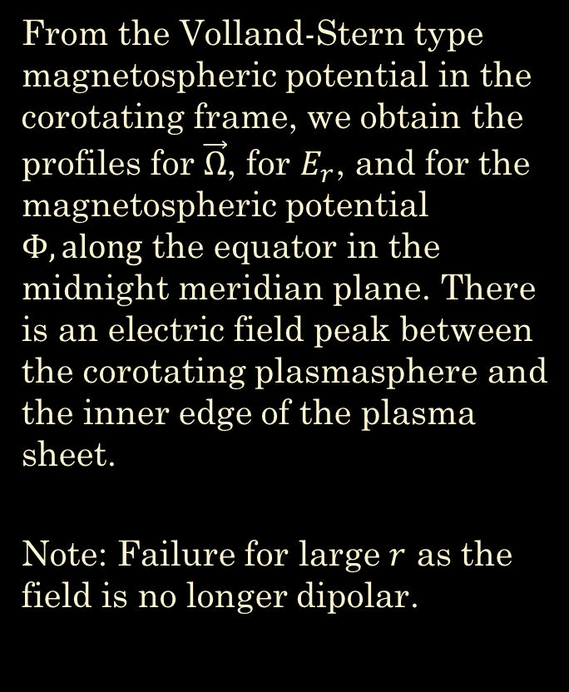
Structure at the midnight meridian
From the Volland-Stern type magnetospheric potential in the corotating frame, we obtain the profiles for $\vec{Ω}$, for $E_{r}$, and for the magnetospheric potential $Φ, along$ the equator in the midnight meridian plane. There is an electric field peak between the corotating plasmasphere and the inner edge of the plasma sheet.
Note: Failure for large $r$ as the field is no longer dipolar.

Slide 10
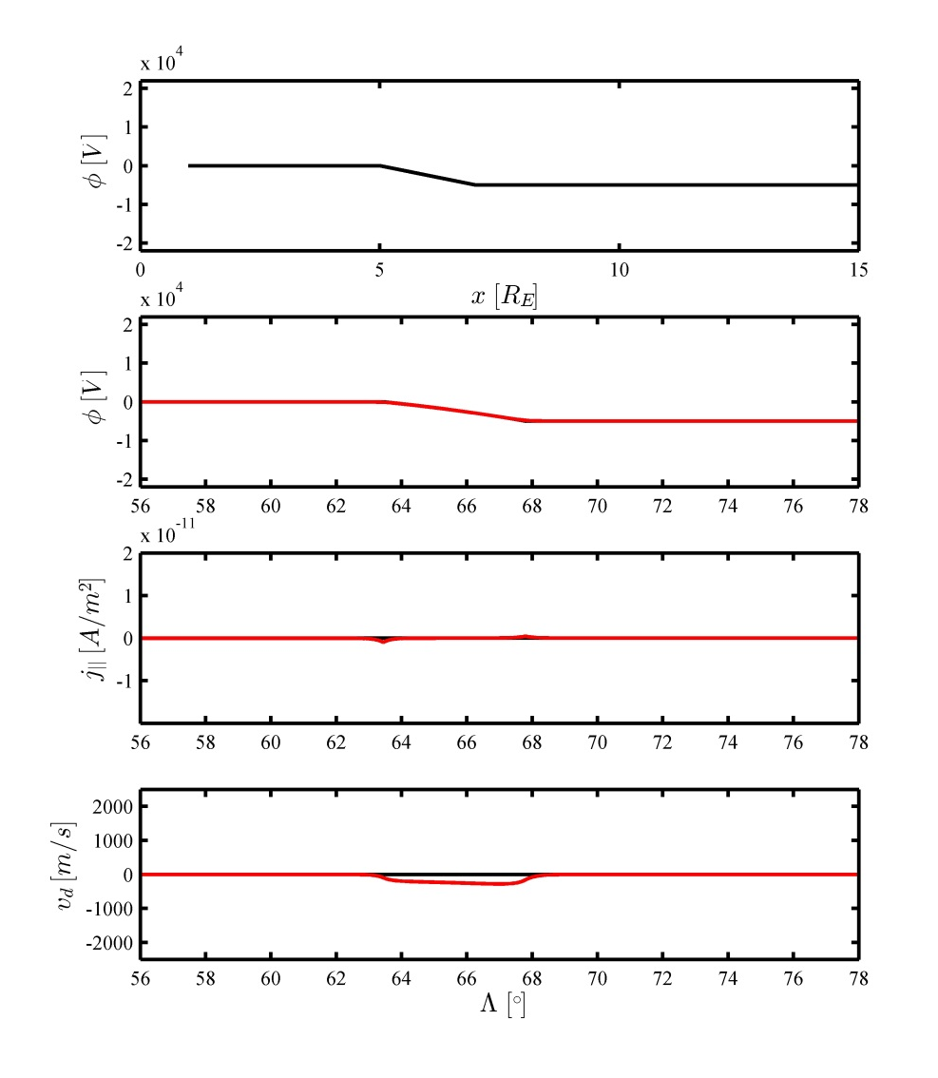

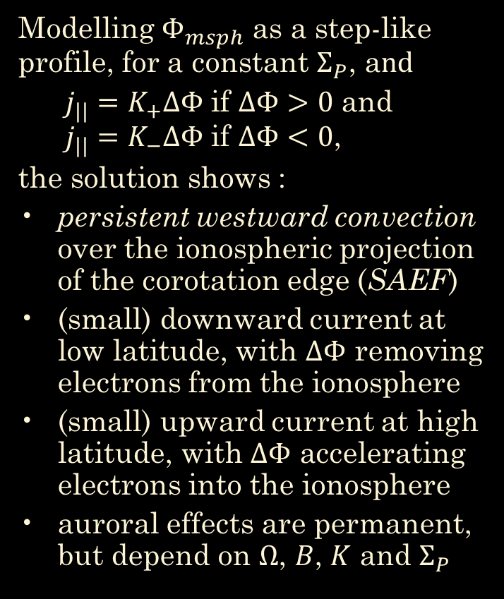
Auroral structure for a $↑↓$ planet
Modelling $Φ_{msph}$ as a step-like profile, for a constant $Σ_{P}$, a$nd$
  $j_{||}=K_{+}∆Φ$ if $∆Φ>0$ and $j_{||}=K_{−}∆Φ$ if $∆Φ<0$,
the solution shows :
persistent westward convection over the ionospheric projection of the corotation edge (SAEF)
(small) downward current at low latitude, with $∆Φ$ removing electrons from the ionosphere
(small) upward current at high latitude, with $∆Φ$ accelerating electrons into the ionosphere
auroral effects are permanent, but depend on $Ω$, $B$, $K$ and $Σ_{P}$

Slide 11
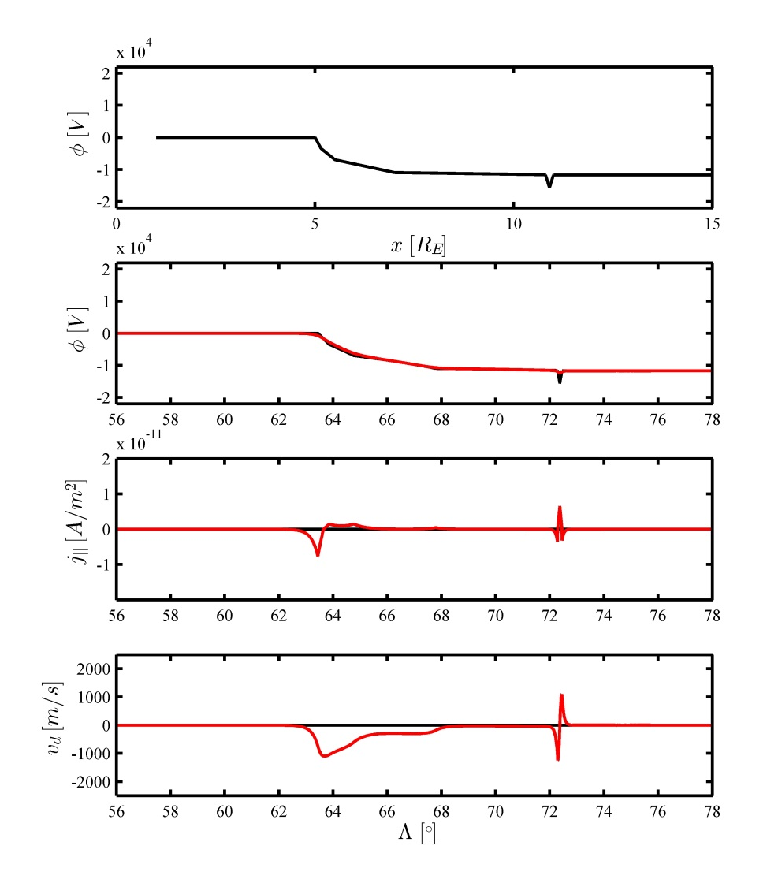
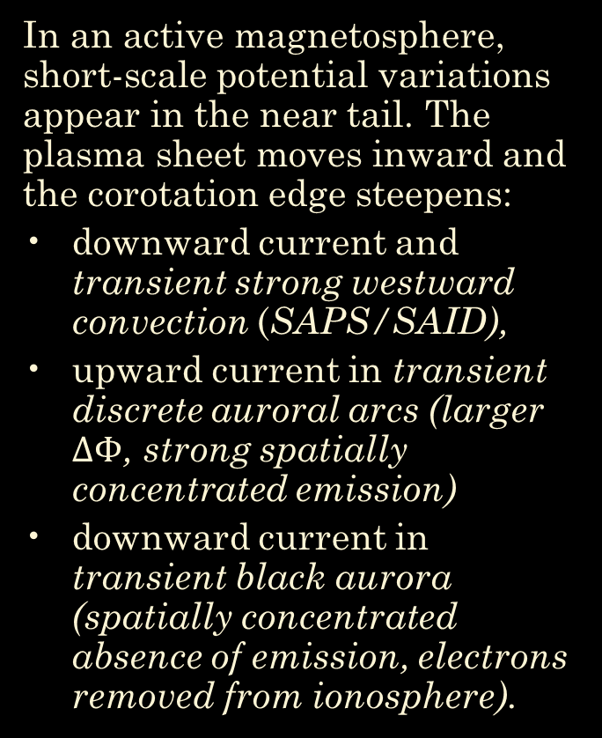
In an active magnetosphere, short-scale potential variations appear in the near tail. The plasma sheet moves inward and the corotation edge steepens:
downward current and transient strong westward convection (SAPS/SAID),
upward current in transient discrete auroral arcs (larger $∆Φ$, strong spatially concentrated emission)
downward current in transient black aurora (spatially concentrated absence of emission, electrons removed from ionosphere).

Slide 12
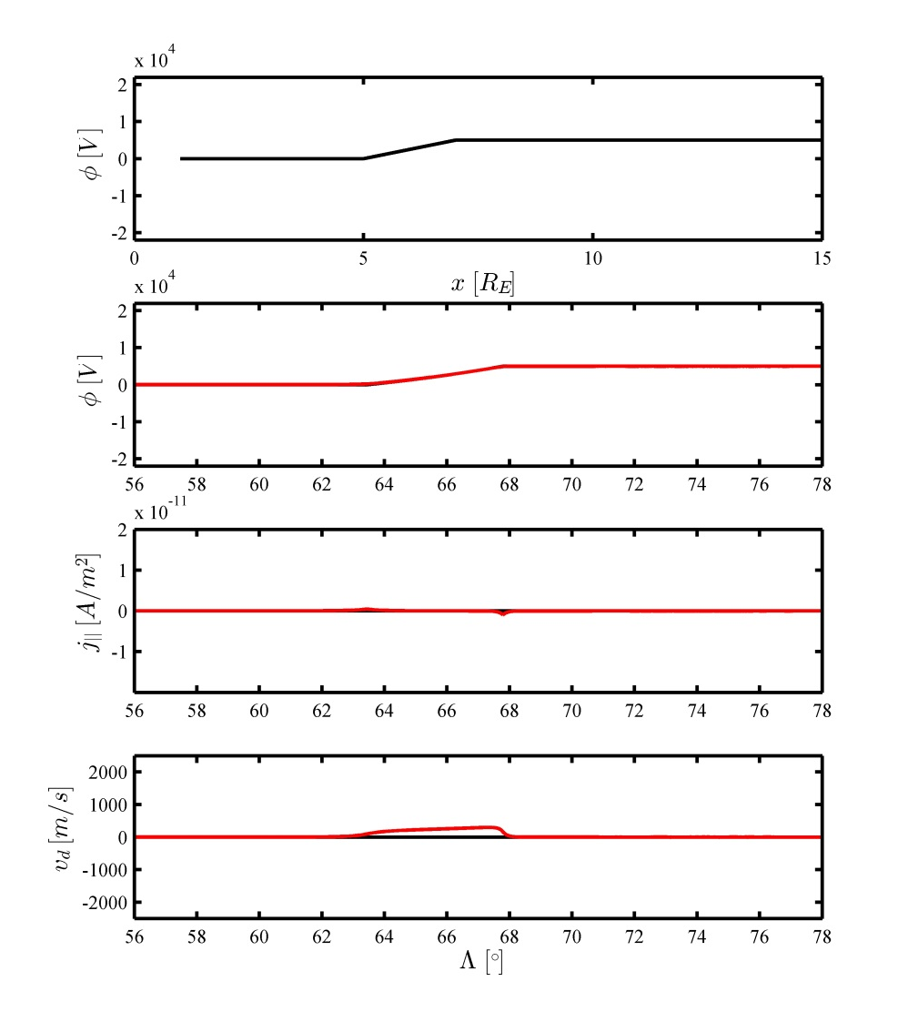

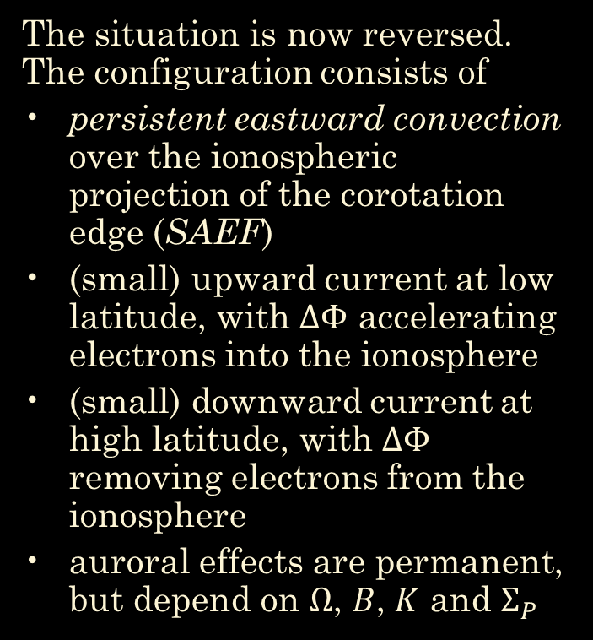
Auroral structure for a $↑↑$planet
The situation is now reversed. The configuration consists of
persistent eastward convection over the ionospheric projection of the corotation edge (SAEF)
(small) upward current at low latitude, with $∆Φ$ accelerating electrons into the ionosphere
(small) downward current at high latitude, with $∆Φ$ removing electrons from the ionosphere
auroral effects are permanent, but depend on $Ω$, $B$, $K$ and $Σ_{P}$

Slide 13
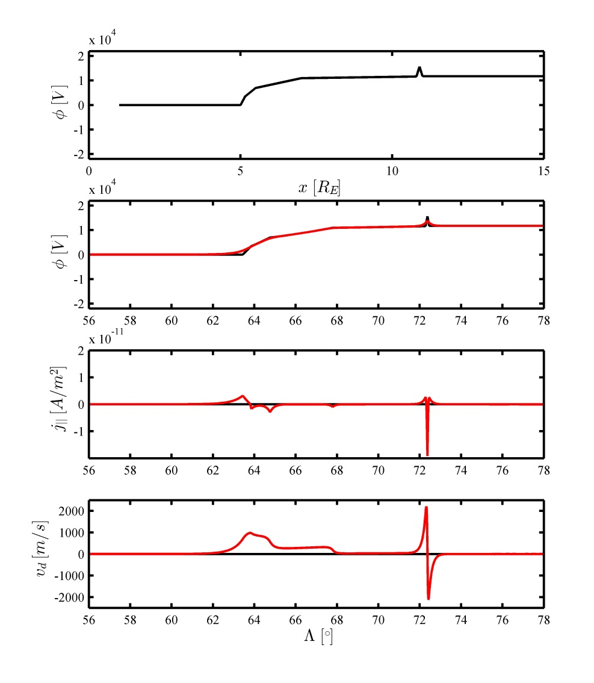
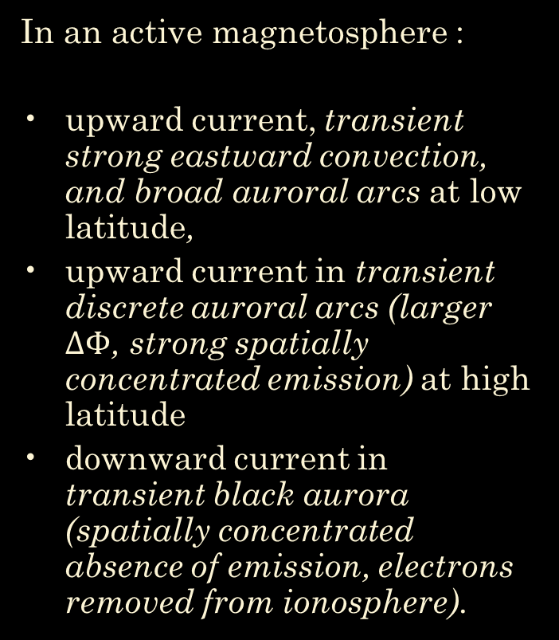
In an active magnetosphere :
upward current, transient strong eastward convection, and broad auroral arcs at low latitude,
upward current in transient discrete auroral arcs (larger $∆Φ$, strong spatially concentrated emission) at high latitude
downward current in transient black aurora (spatially concentrated absence of emission, electrons removed from ionosphere).

Slide 14

Earth : an $↑↓$ planet

Slide 15
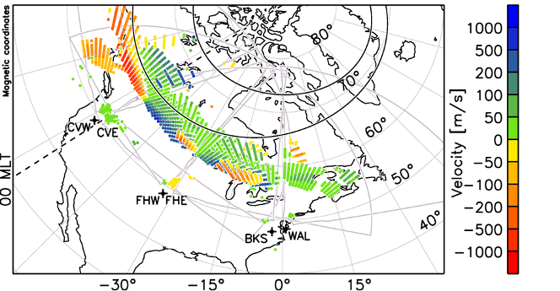
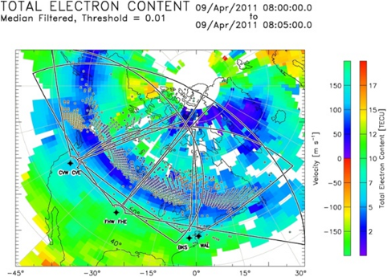
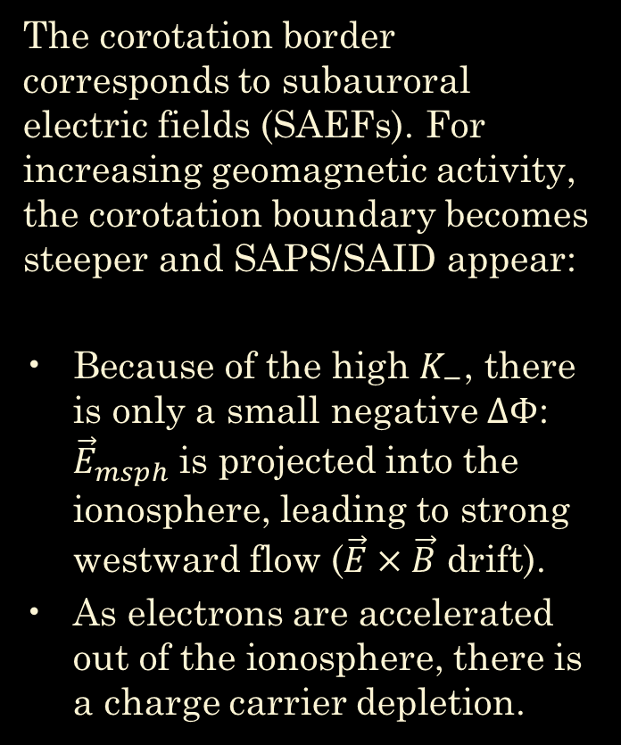
Earth : corotation border
The corotation border corresponds to subauroral electric fields (SAEFs). For increasing geomagnetic activity, the corotation boundary becomes steeper and SAPS/SAID appear:
Because of the high $K_{−}$, there is only a small negative $∆Φ$: ${\vec{E}}_{msph}$ is projected into the ionosphere, leading to strong westward flow ($\vec{E}×\vec{B}$ drift).
As electrons are accelerated out of the ionosphere, there is a charge carrier depletion.

Slide 16
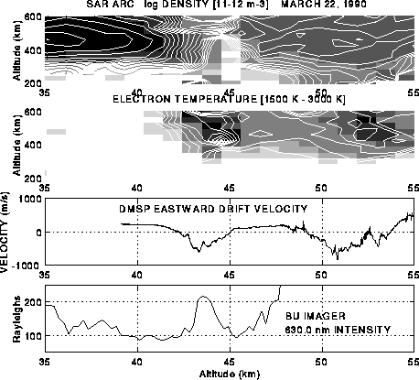
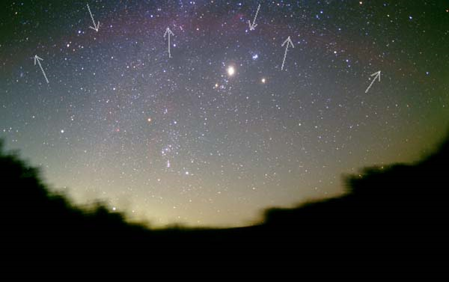
Observations indeed show :
ionosphereic electron depletion
very strong ionospheric flows (> 1 km/s)
ion-neutral collisions may produce stable auroral red arcs (630 nm)
local heating of the ionosphere and upward flow

Slide 17
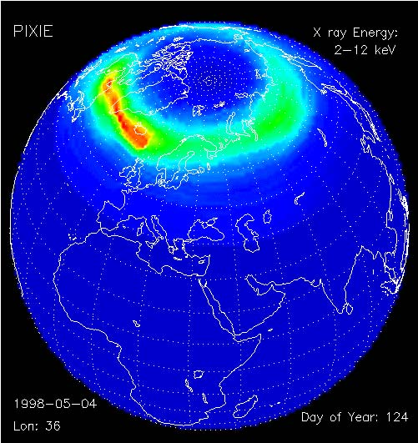
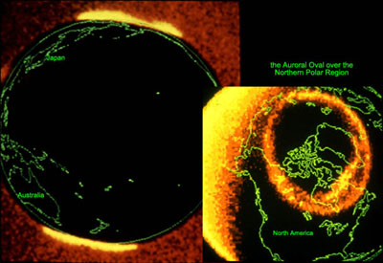
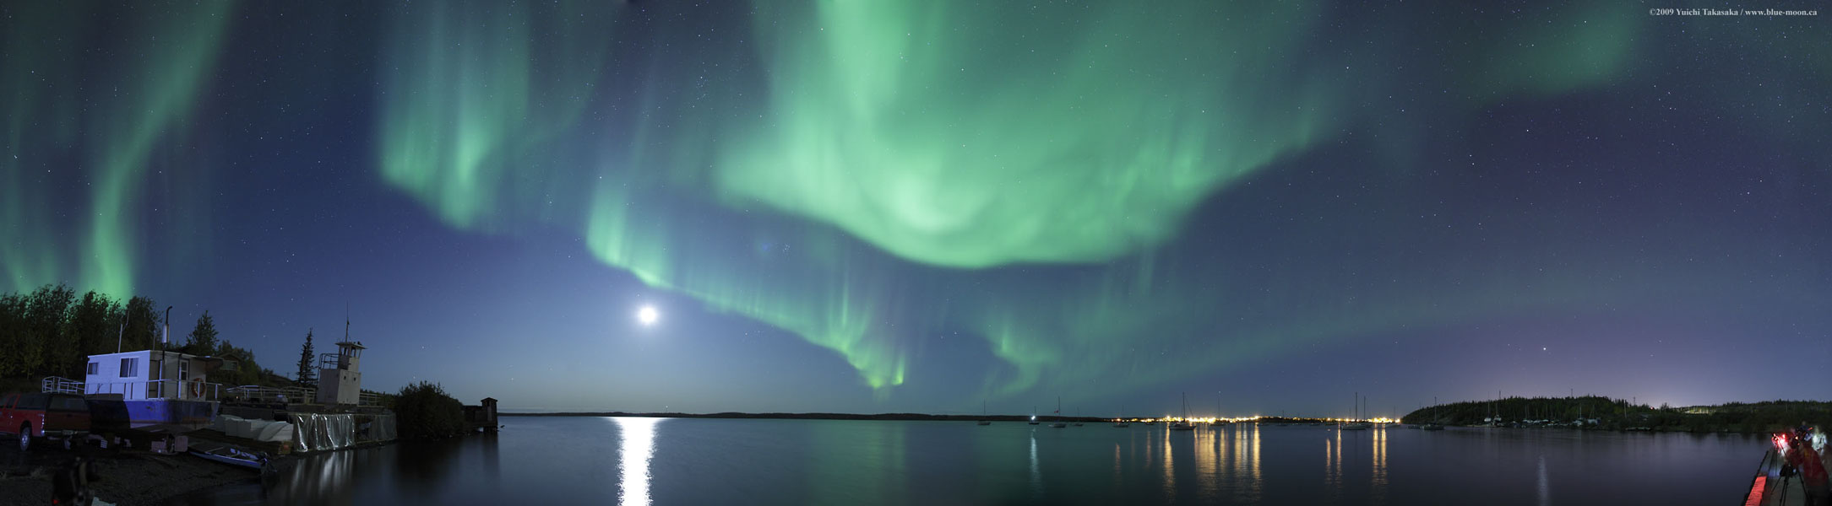
Earth : aurora
Higher latitude :
More or less permanent oval with transient appearance of discrete auroral arcs and black aurora.

Slide 18

Jupiter and Saturn : $↑↑$ planets

Slide 19
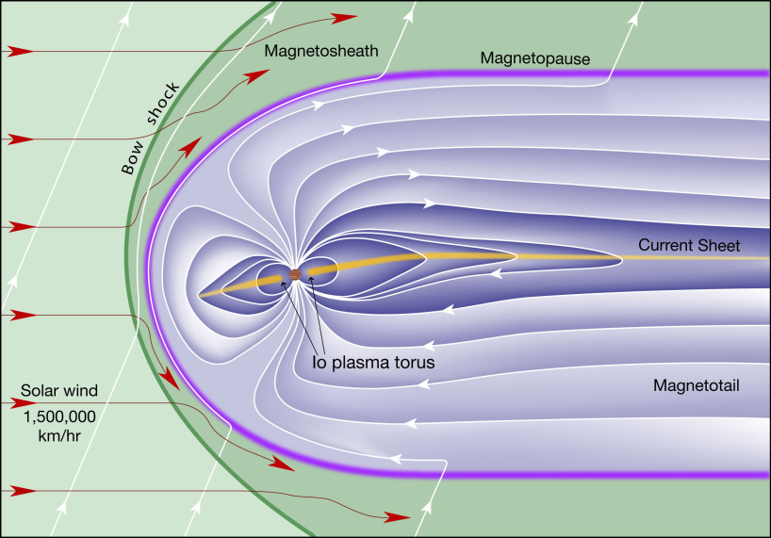
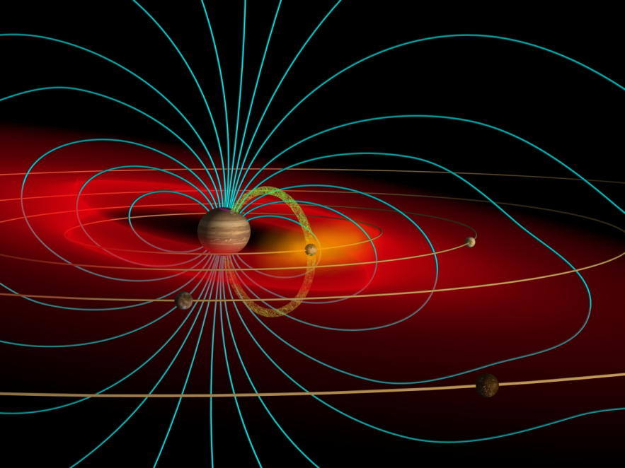
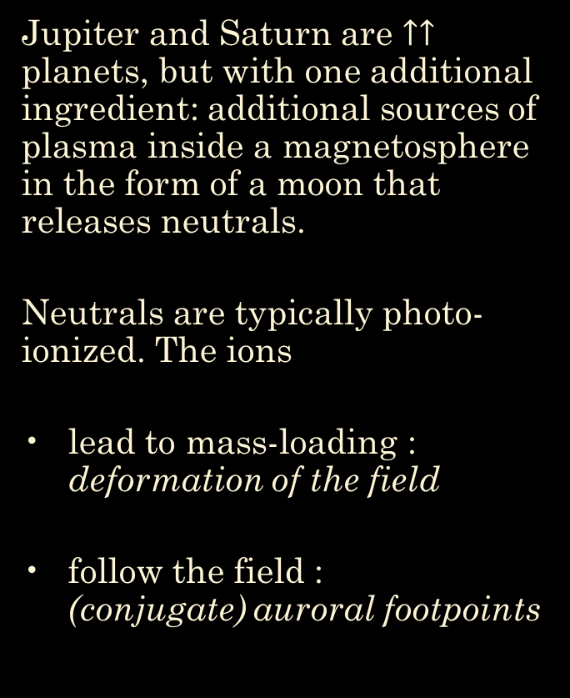
Inner plasma sources
Jupiter and Saturn are $↑↑$ planets, but with one additional ingredient: additional sources of plasma inside a magnetosphere in the form of a moon that releases neutrals.
Neutrals are typically photo-ionized. The ions
lead to mass-loading : deformation of the field
follow the field : (conjugate) auroral footpoints

Slide 20
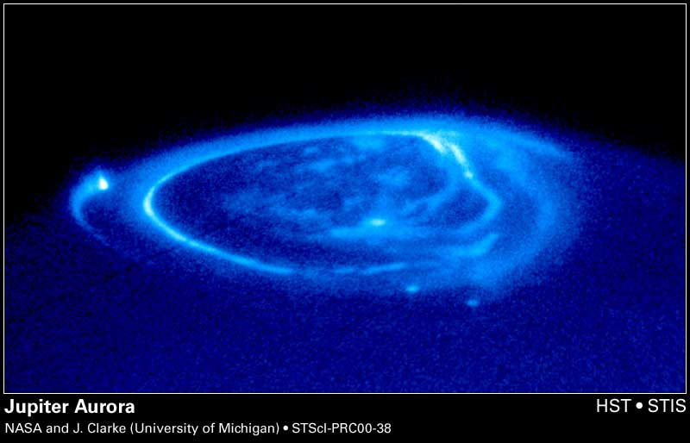
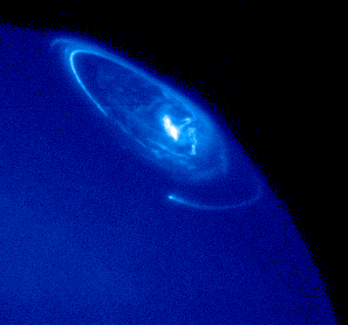
Jovian aurora
Corotation boundary : permanent aurora
Higher latitude : varying, depending on magnetospheric activity
Footpoints of the moons
corotation oval
Io
variable auroral structures
Ganymede
Europa

Slide 21
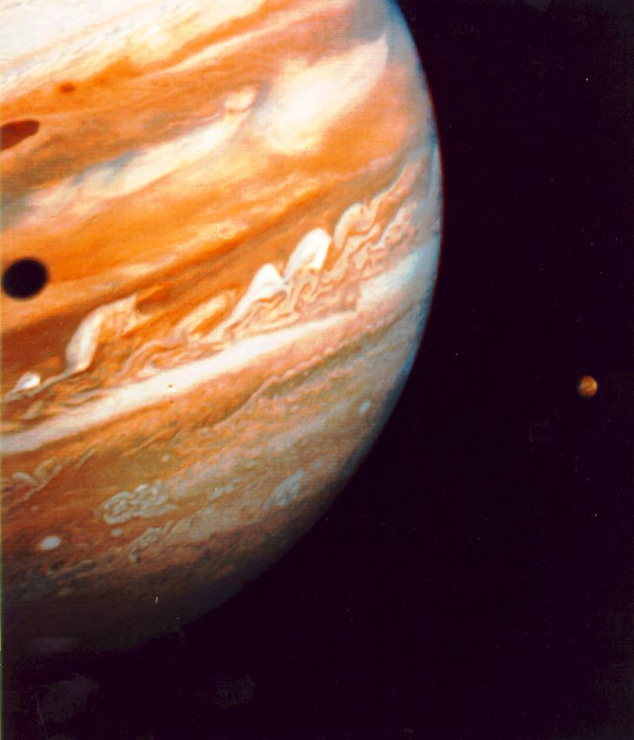
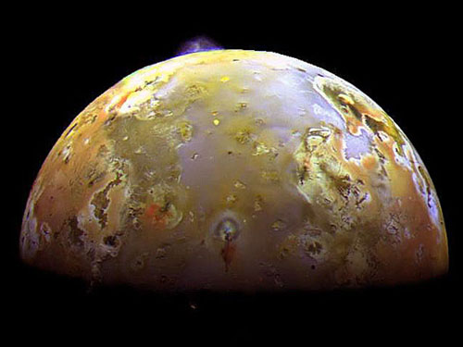
Io
For Jupiter, especially the volcanic moon Io is a source of gas.

Slide 22
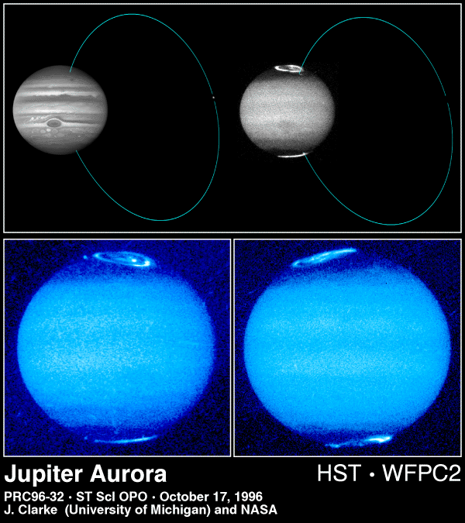
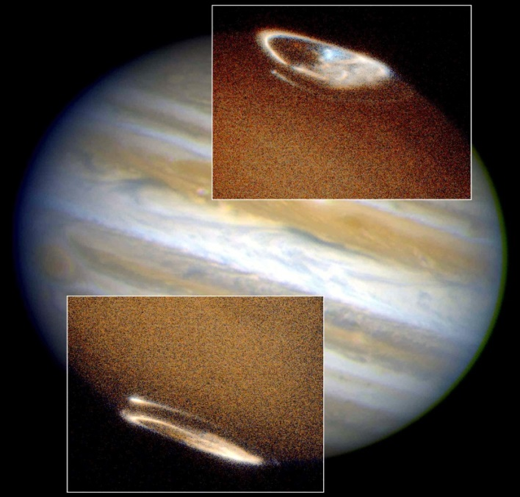
Conjugate aurora
Not only the footpoints, also much or the other aurora are magnetically conjugate.

Slide 23
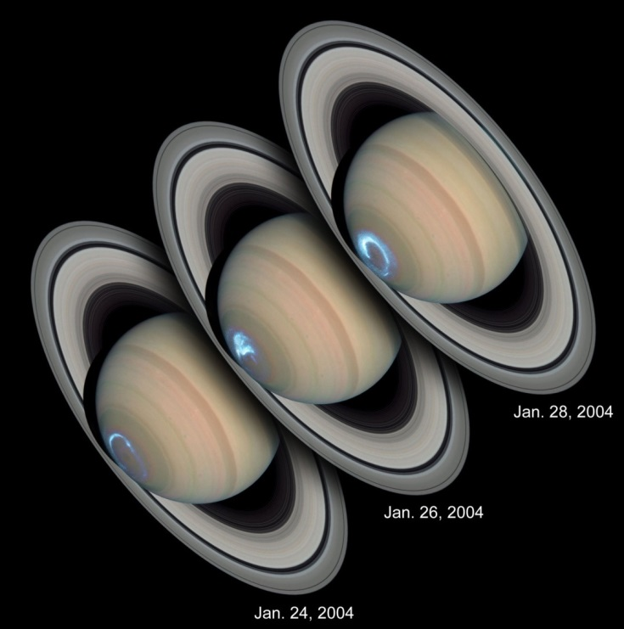
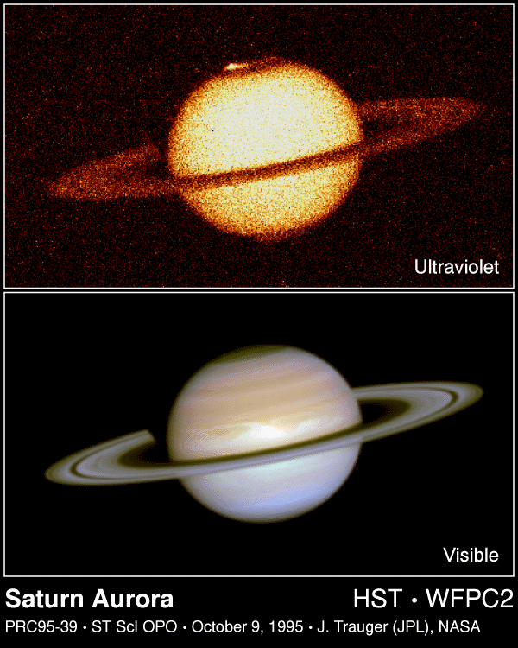
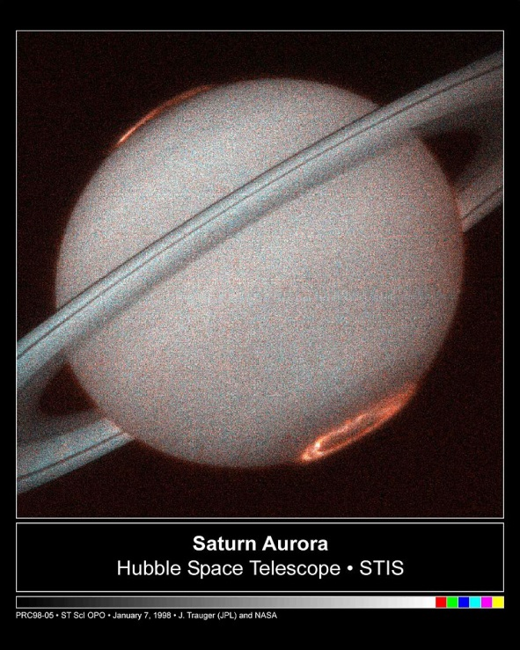
Saturn : same story
Also Saturn has a permanent corotation boundary oval, more transient higher latitude auroras, and moon footpoint auroral spots.

Slide 24
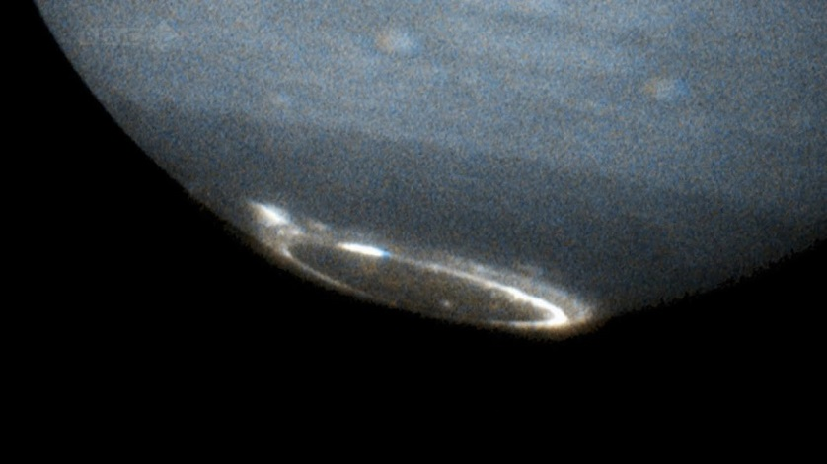
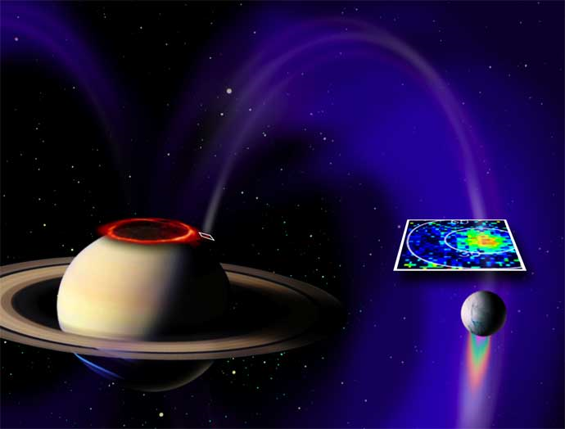
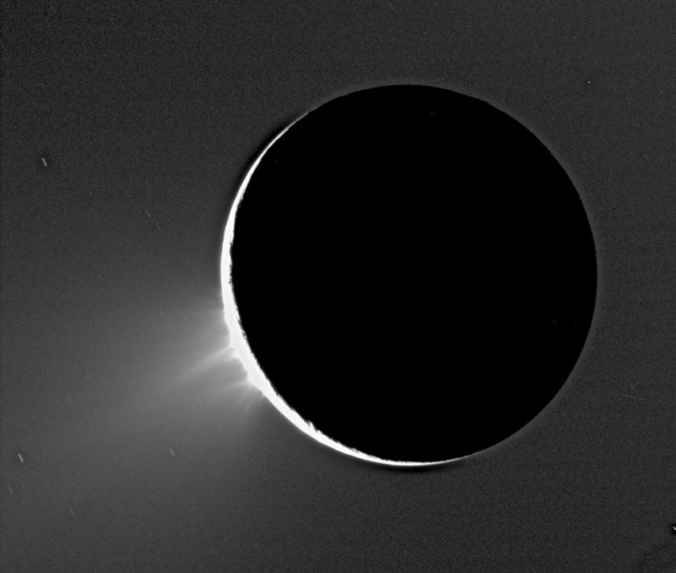
Enceladus
For Saturn, the icy moon Enceladus is a source of gas release from fissures in its crust, fueled by tidal deformation.

Slide 25

Uranus and Neptune :$↔$ planets

Slide 26
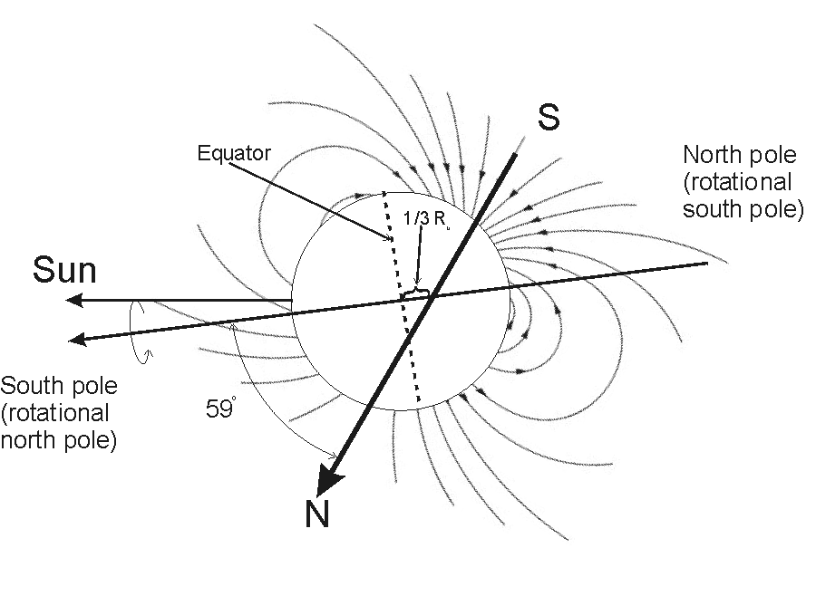
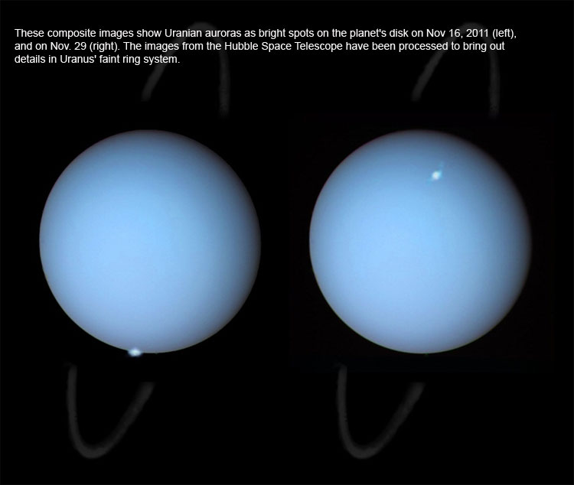



Auroral structure for a $↔$planet
Depends not only on the angle between $\vec{B}$and $\vec{Ω}$, but also on the angle between $\vec{Ω}$ and the ecliptic; there is a seasonal modulation.
Uranus, with obliquity 97°, may be in a situation where one pole constantly points sunward.

Slide 27

Conclusions
The major structure of auroral patterns of magnetized planets can be understood in terms of a simple model of the auroral current circuit.
Details of the actual aurora depend on the size of the dipole field, its strength relative to the stellar wind pressure, and of course on the composition of the planet’s atmosphere.
 | Moon as inner source | Corotation boundary | Higher latitude
parallel $$\vec{B}↑↑\vec{Ω}$$ | conjugate footpoint spots | permanent eastward drift and aurora with transient intensification | transient aurora
anti-parallel $\vec{B}↑↓\vec{Ω}$ | conjugate footpoint spots | permanent westward drift with transient intensification (SAPS/SAID) | permanent aurora + transient arcs
tilted $$\vec{B}↔\vec{Ω}$$ | conjugate spots only when moon is on closed field lines | variable | variable

Slide 28
References
J. De Keyser, M. Roth, and J. Lemaire. The magnetospheric driver of subauroral ion drifts. Geophys. Res. Lett., 25:1625-1628, 1998.
J. De Keyser. Formation and evolution of subauroral ion drifts in the course of a substorm. J. Geophys. Res., 104(6):12,339-12,350, 1999.
J. De Keyser. Storm-time energetic particle penetration into the inner magnetosphere as the electromotive force in the subauroral ion drift current circuit. In S. Ohtani, ed., Magnetospheric Current Systems, Geophysical Monograph Series 118, pages 261-265. AGU, 2000.
M. M. Echim, M. Roth, and J. De Keyser. Sheared magnetospheric plasma flows and discrete auroral arcs: a quasi-static coupling model. Ann. Geophys., 25, 317–330, 2007.
M. M. Echim, R. Maggiolo, M. Roth, and J. De Keyser. A magnetospheric generator driving ion and electron acceleration and electric currents in a discrete auroral arc observed by Cluster and DMSP. Geophys. Res. Lett., 36:L12111, 2009.
F. Darrouzet, D. L. Gallagher, N. André, D. L. Carpenter, I. Dandouras, P. M. E. Décréau, J. De Keyser, R. E. Denton, J. C. Foster, J. Goldstein, M. B. Moldwin, B. W. Reinisch, B. R. Sandel, and J. Tu. CLUSTER and IMAGE Observations of the Plasmasphere: Plasma Structure and Dynamics. Space Sci. Rev., 145(1-2):55–106, 2009. doi:10.1007/s11214-008-9438-9.
J. De Keyser and M. Echim. Auroral and subauroral phenomena: An electrostatic picture. Ann. Geophys., 28:633–650, 2010.
J. De Keyser, R. Maggiolo, and M. Echim. Monopolar and bipolar auroral electric fields and their effects. Ann. Geophys., 28(11):2027–2046, 2010.
J. De Keyser, R. Maggiolo, M. Echim, and I. Dandouras. Wave signatures and electrostatic phenomena above aurora: Cluster observations and modeling. J. Geophys. Res., 116:A06224, 2011.

