Slide 1


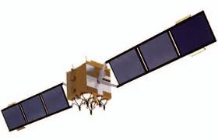

Space Environment Impacts on GEO COMSATs
Whitney Q. Lohmeyer and Kerri Cahoy
MIT

Slide 2
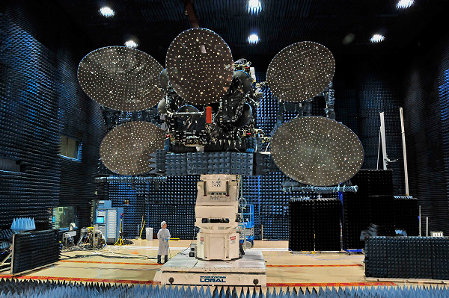
Geostationary Satellite
Telstar 14R– Space Systems/Loral
Notes:
Telstar 14R, also known as Estrela do Sul 2 (Southern Star 2) is a commercial communications satellite built by Space Systems/Loral for Telesat to provide Ku-band communications to South America and the Southern USA. It is a replacement for Telstar 14, whose north solar array failed to open after launch, limiting its mission effectiveness. Unfortunately Telstar 14R experienced the same problem, with its north solar array failing to open too, but is now in service despite that failure.[1]
It was launched 20 May 2011 from the Baikonur Cosmodrome in Kazakhstan aboard an International Launch Services Proton-M rocket.
Telstar 14R is built around the Loral 1300 satellite bus, and has a launch mass of around 5000 kg. It is positioned in geosynchronous orbit at 63 degrees west.

Slide 3
Outline
Motivation
Enabling factor: Satellite Operators’ data
Investigation of Known Anomalies
  Amplifier Anomaly Study
  Solar Array Degradation
Telemetry Algorithm

Slide 4
Motivation
Telemetry data continuously monitored
  By operators for performance
  Not by scientists for sensitivity
Telemetry
Data is sitting in archives, but contains information to help improve satellite design!

Slide 5
Motivation
How sensitive are communications satellites to the radiation environment? Can we quantify?
  To understand how space weather causes anomalies must have both space weather data and satellite telemetry
  Hard to get access to telemetry!
Strategy: partner with operators, focus on key components (amplifiers and power systems)
First-of-its kind MIT/industry collaboration w/Inmarsat in 2011
  Producing important findings
  Other operators now also participating

Slide 6
Satellite Operators
Operator | Inmarsat | Telenor | ARABSat
Headquarters | United Kingdom | Norway | Saudi Arabia
Number of Satellites | 10 | 4 | 3
Number of Bus Types | 3 | 3 | 2
Data Time Range | 1991 – 2012 | 1997 - 2012 | 1996 - 2011
Years of Data | 22 | 16 | 17
Telemetry Obtained | SSPA current and temperature; solar panel current, total bus power; anomaly and SEU list | TWTA current and temperature; solar panel current and total bus power; anomaly and SEU list | Solar panel current and total bus power
Currently obtaining data from Intelsat as well!

Slide 7
What are power amplifiers?
Key components in satellite comm systems
  Strengthen uplink signals that are weakened from free space path loss [1,3,4]
  Amplifier units consume ~85% of the spacecraft bus power [1,2]
Two primary types: solid state power amplifiers (SSPAs) and traveling wave tube amplifiers (TWTAs)
Technologies have evolved over past decades
Free Space
Path Loss

Slide 8
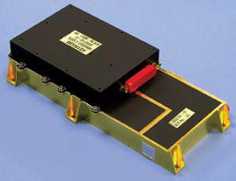
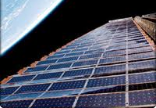
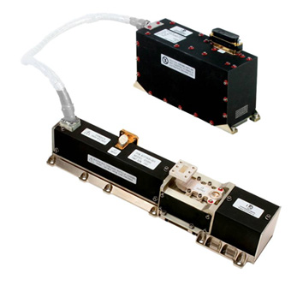
Components
Solid State Power Amplifier (SSPA)
Traveling Wave Tube Amplifiers (TWTA)
Solar Panels
  Silicon, Gallium Arsenide
EADS Astrium
Boeing.com
L-3 ETI Space Qualified TWTA

Slide 9
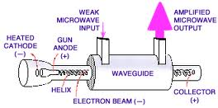
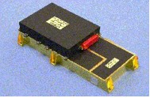
TWTAs vs. SSPAs
TWTA Technology
Traveling wave tube (TWT) and electrical power conditioner (EPC)
Used for high power + high freq.
Provide better efficiency [10]
1992-2006 69% COMSATS used TWTAS [5]
SSPA Technology
Field effect transistor (FET) and EPC [1]
Less complex and cheaper [7,8]
Historically used at L + S band
Competitive in 1980s, new GaN technology is increasing market popularity [4]
EADS Astrium
TWTA [6]
SSPA [9]

Slide 10
Amplifier Anomaly Study
Analyzed solid state power amplifier (SSPA) currents from 8 Inmarsat satellites (1996-2012)
  Amplifiers are the workhorse of the COMSAT
  Redundancy is implemented in design
  For 8 Inmarsat satellites, with hundreds of SSPAs, 26 anomalies over 16 years (with little to no impact on customers)
    This is impressive performance, but we would still like to understand what caused the anomalies – was space weather a factor?
Can the occurrence of anomalies be predicted?
Can we reduce the number of anomalies?

Slide 11
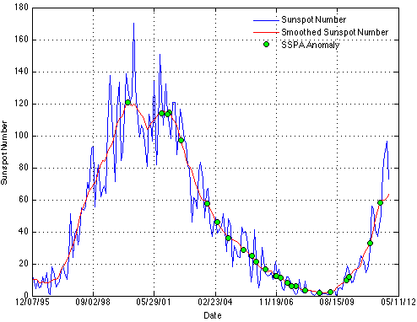
11 Year Solar Cycle

Slide 12
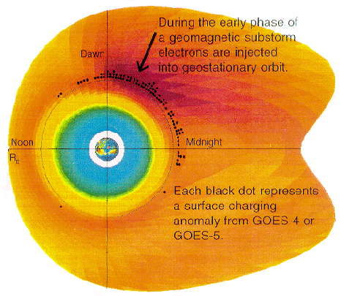
Surface Charging and Local Time

Slide 13
2 MeV Electrons and SSPA Currents

Slide 14
Superposed Epoch of High Energy Electron Flux

Slide 15
Outline
Motivation
Enabling factor: Satellite Operators’ data
Investigation of Known Anomalies
  Amplifier Anomaly Study
  Solar Array Degradation
Telemetry Algorithm

Slide 16
Solar Array Degradation Study
Solar Arrays and the GEO Radiation Environment
  Degradation mechanisms
  Solar cell performance parameters
  Silicon vs. GaAs solar cell technology
Annual Solar Array Degradation
Solar Array Degradation over SPE

Slide 17
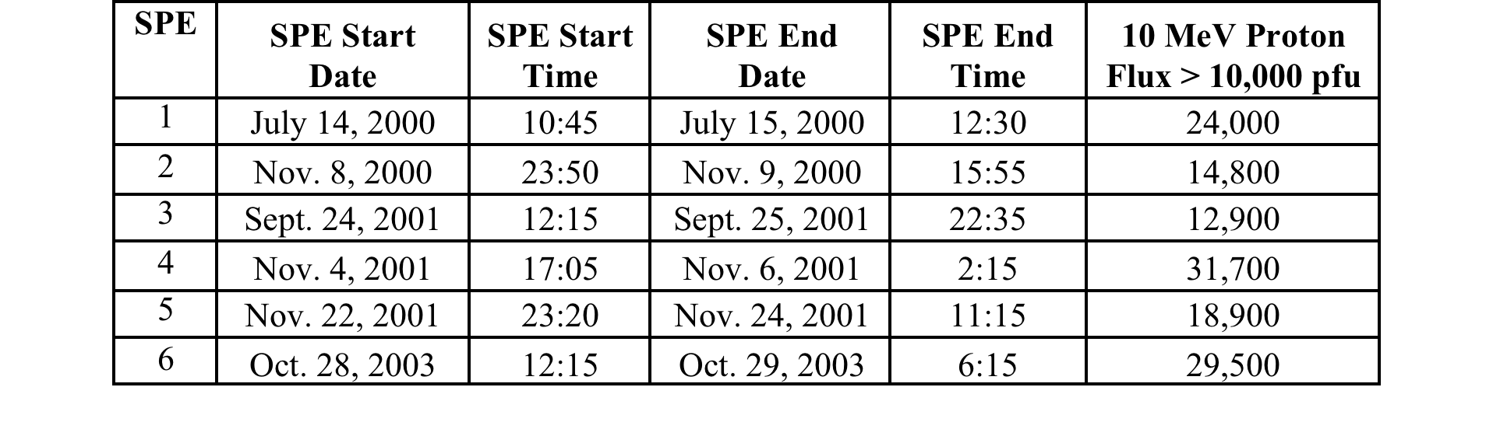
10 MeV SPE > 10,000 pfu

Slide 18
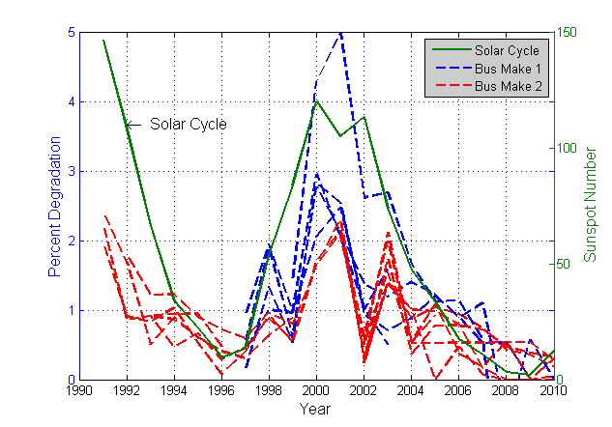
Annual Degradation for Si Cells

Slide 19
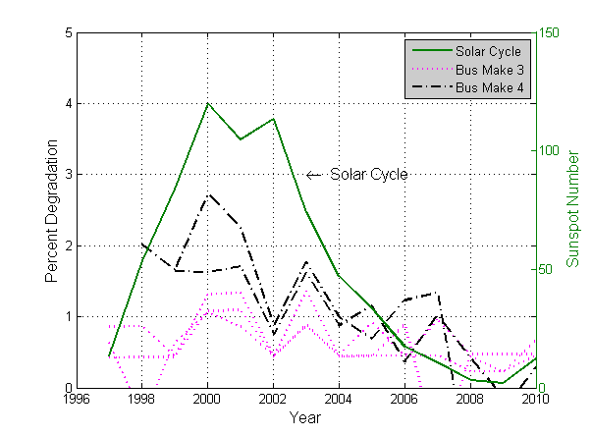
Annual Degradation for GaAs Cells

Slide 20
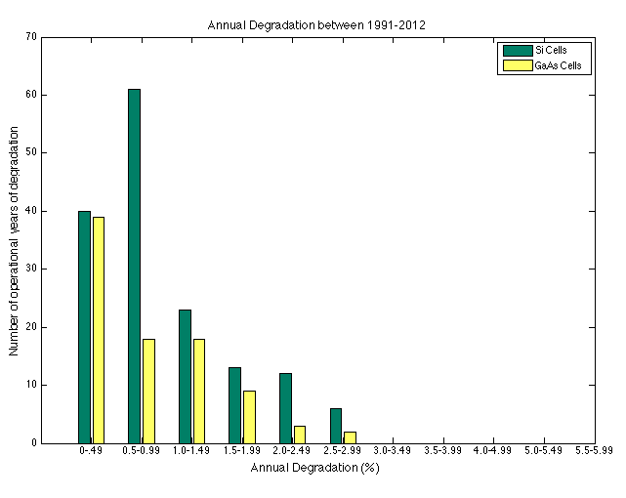

Slide 21
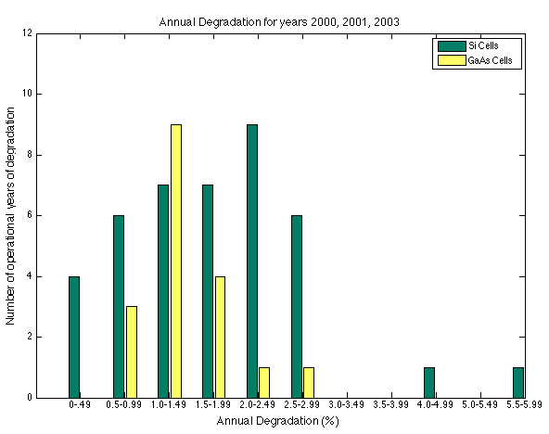

Slide 22
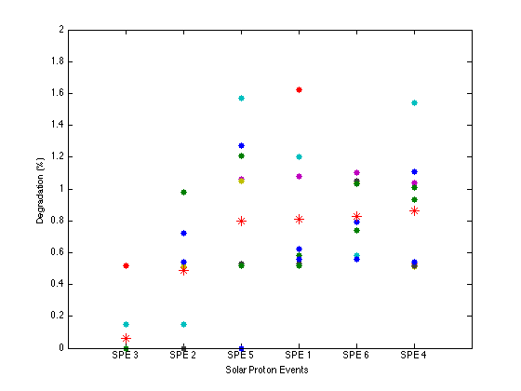
Silicon Cell Degradation over 6 SPEs

Slide 23
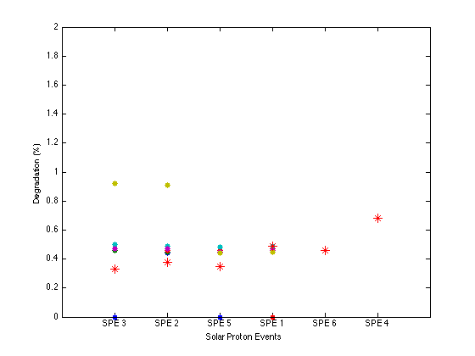
GaAs Cell Degradation over 6 SPEs

Slide 24
Outline
Motivation
Enabling factor: Satellite Operators’ data
Investigation of Known Anomalies
  Amplifier Anomaly Study
  Solar Array Degradation
Telemetry Algorithm

Slide 25
Telemetry Algorithm
Can we identify and explain odd behavior even if there may not have been an anomaly?
Input: telemetry feed (i.e. amplifier current, amplifier temp, total bus power, etc.)
Statistics Module
  Partitions data over environmental events (solar cycle phases, seasons, Extreme 2 MeV Electron events, 10 MeV SPE > 10,000 pfu)
  Compares anomalous activity with nominal
Traffic Module
  Calculates periodicities of the telemetry file
  Are any periodicities in response to the environment?

Slide 26
Statistics Module
Partitions data over environmental events
  Solar cycle phases
  Seasons
  Extreme 2 MeV Electron events
    Obtained from GOES > 2 MeV daily fluence
      73 Events greater than 3 sigma fluence since 1987
      46 Events greater than 4 sigma fluence since 1987
  10 MeV SPE > 10,000 pfu
    Obtained from NOAA SPE List
    6 Events between 2000-2003
Compares anomalous SSPA activity with nominal SSPA activity

Slide 27
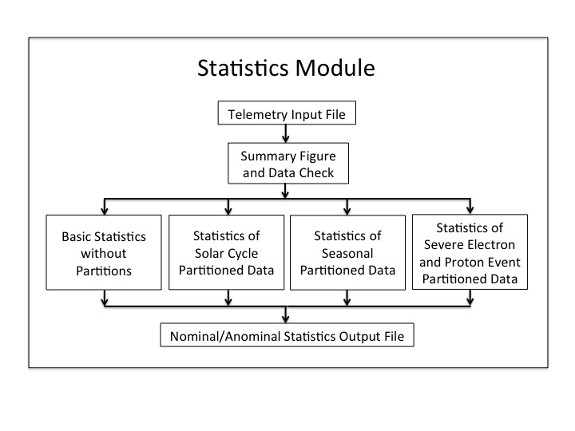

Slide 28
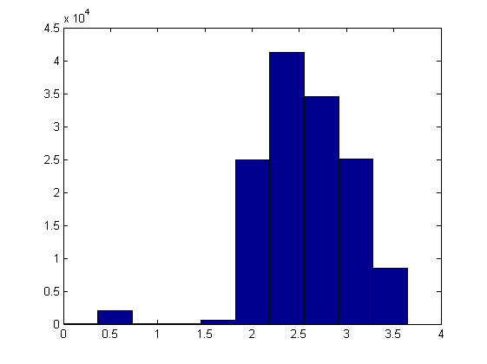

Slide 29
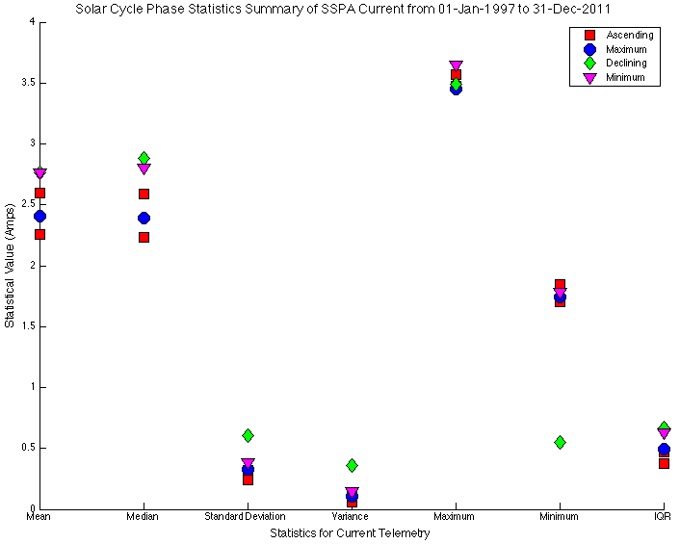
Nominal Amplifier Output
Notes:
Nominal

Slide 30
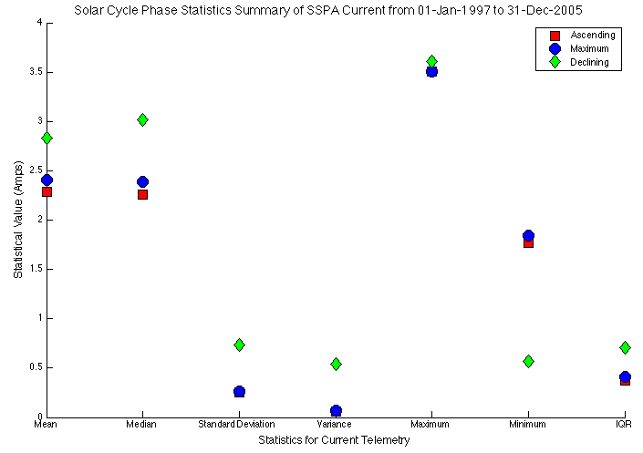
Anomalous Amplifier Output
Notes:
Anomalous

Slide 31
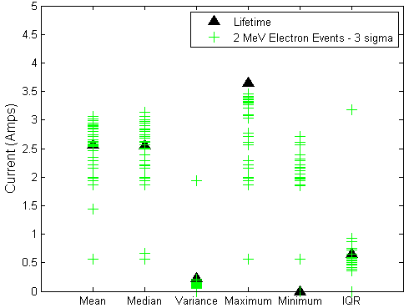
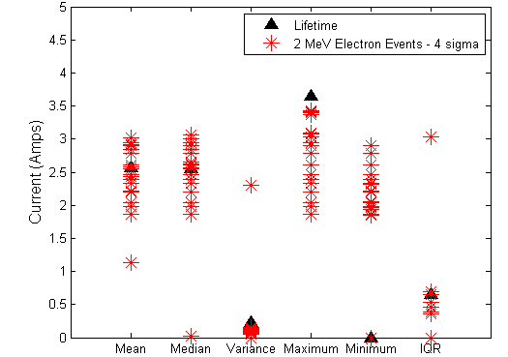
Average Current during 2 MeV Electron Events for a Nominal Amplifier

Slide 32
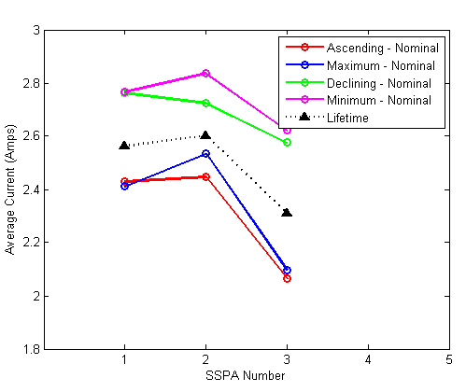
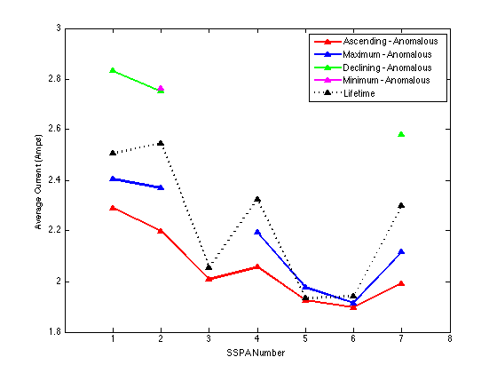
Average Current over Solar Cycle Phases
Nominal SSPAs
Anomalous SSPAs

Slide 33
Average Current over Solar Cycle Phases
Nominal SSPAs
Anomalous SSPAs
Data dropouts after anomalies
What is causing the deviation between ascending/maximum and declining/minimum phase?

Slide 34
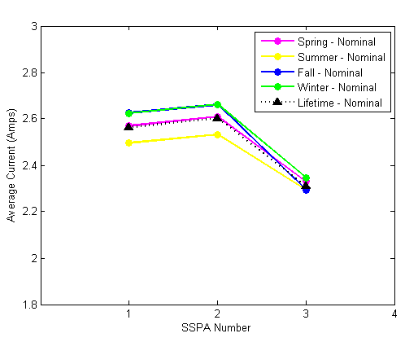
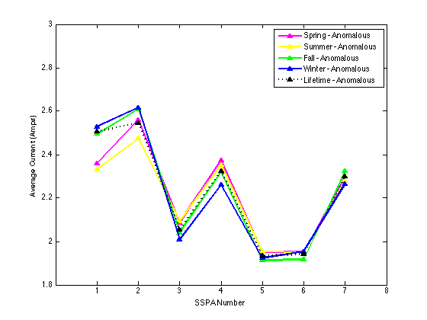
Average Current over Seasons
Nominal SSPAs
Anomalous SSPAs
We do not expect a recurrent deviation in seasonal partitioned data

Slide 35
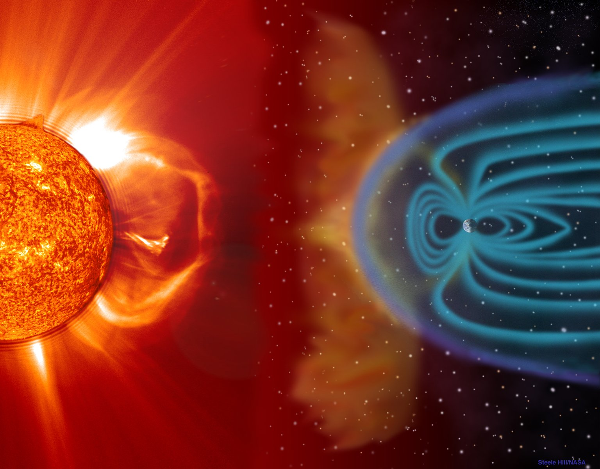
Summary and Future Work
Future Goals for Analysis:
  Amplifier Study
    Continue to investigate internal charging mechanisms
  Solar Array Degradation
    Improve statistics and define Solar Degradation vs. SPE curve
  Telemetry Algorithm
    Run telemetry for remaining buses
    Determine cause of deviation between ascending/maximum and declining/minimum phases
    Plot the current partitioned over severe environmental events

Slide 36
References
[1] Strauss, R. (1993), Orbital Performance of Communication Satellite Microwave Power Amplifiers (MPAs), International Journal of Satellite Communications, 11, 279-285.
[2] Illoken, E. (1987), TWT Reliability in Space, Aerospace and Electronic Systems Magazine, IEEE, 2(7), 22-24.
[3] Robbins et al. (2005), Performance and reliability advances in TWTA high power amplifiers for communications satellites. In Military Communications Conference, 2005. MilCOM 2005, 1887-1890.
[4] Kaliski, M. (2009), “Evalution of the Net Steps in Satellite High Power Amplifier Technology: Flexible TWTAs and GaN SSPAs”, IEEE International Vacuum Electronics Conference, 28-30 April 2009.
[5] Mallon, K.P. (2008), “PL.6: TWTAs for Satellite Communications: Past, Present and Future”, IEEE, 14-15
[6] TWTA Image www2.jpl.nasa.gov
[7] Escalera, N., (2008), Ka-band, 30 watts solid state power amplifier. In Microwave Symposium Digest. 2000 IEEE MTT-S International (Vol. 1, pp. 561-563), IEEE.
[8] Sechi, F., and M. Bujatti (2009), Solid-State Microwave High-power Amplifiers. Artech House, M.A.
[9] SSPA Image http://www.astrium.eads.net/en/equipment/l-band-sspa.html.

