Slide 1
Status of PREMOS data
ESWW 10
Splinter Session
19th November 2013
G. Cessateur for the PREMOS team
PMOD/WRC, Switzerland

Slide 2
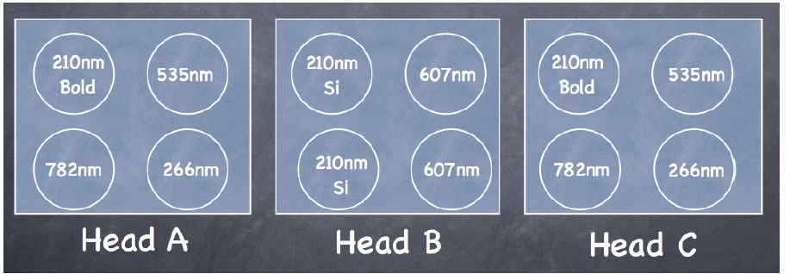
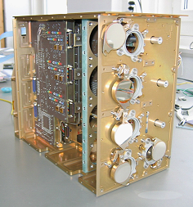
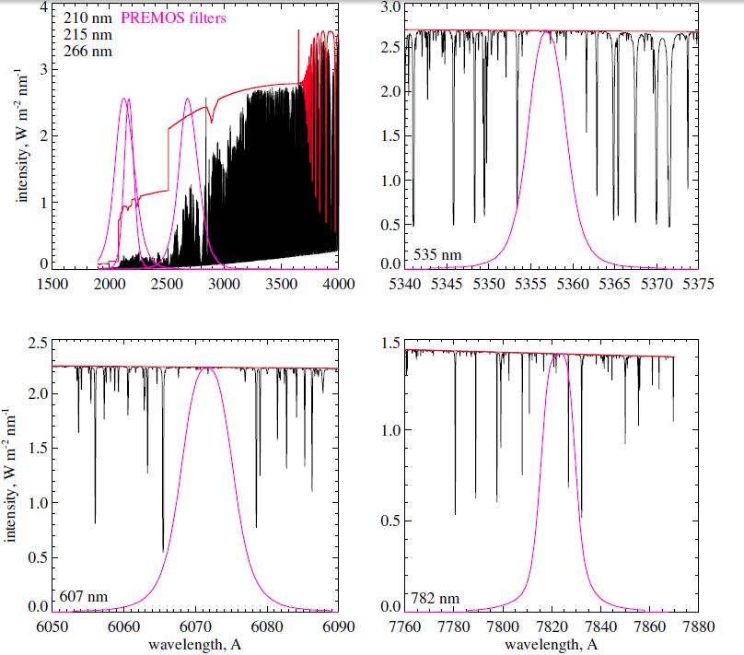
PREMOS instrument
SSI irradiance at 6 wavelengths

Slide 3
Behind the measure…
… the observation strategy
An attempt to assess instrument degradation in a self consistent way by
referring operational measurements to occasional backup operations
correcting the backup channel by initial ageing of operational channel

Slide 4
Redundancy strategies
Head A: operational channel (1 measure every 10s)
Head C: backup channel of Head A (1 measure every day)
Head-B C1,C2 measure during 1 minute (6 samples), about every second orbit
Head-B C3,C4 measure during 2 minutes (12 samples), about once a week

Slide 5
PREMOS-VIS ‘First Light’ ATLAS & SIM spectra convoluted with actual filter transmittance
PREMOS FR | 535nm | 607nm | 782nm
First Light @1AU | 1.913 | 1.858 | 1.174
@ T=20° | 1.961 | 1.858 | 1.203
ATLAS | 1.983 | 1.772 | 1.188
SORCE/SIM | 1.918 | 1.731 | 1.169
 |  0.5% |  +6% |  +2%

Slide 6
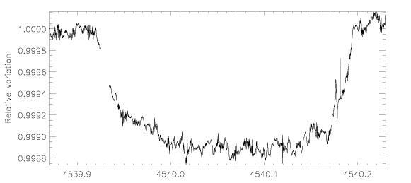
Venus Transit as seen by PREMOS
535nm
≈ 100 ppm
Similar results at 782 nm (and for SIM data), no signature in the UV

Slide 7
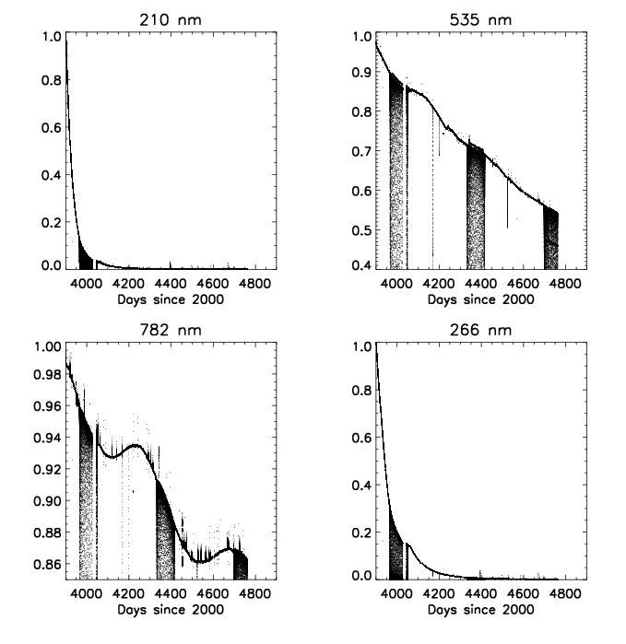
Degradation Issues
Head-A, continuous operation
Strong degradation:
UV channels <1% after 720 days
VIS channel : 65 % left
IR channel > 85 %
Contamination under solar UV exposure

Slide 8
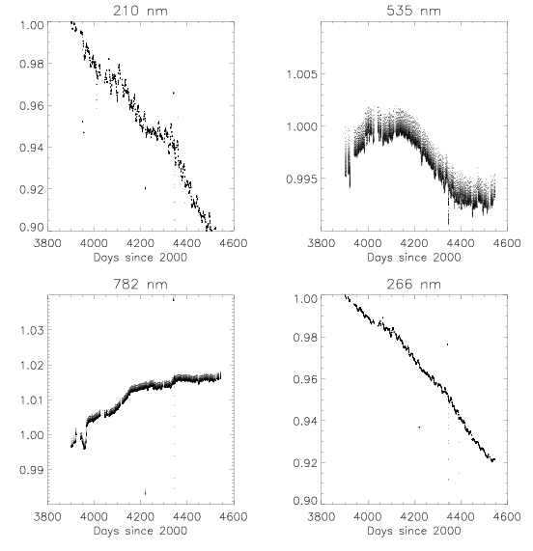
Degradation Issues
Head-C, backup for Head-A
UV channels
210nm – 10 %
266nm – 8 %
VIS-NIR channels
535nm ≈ -1%
782nm +2%

Slide 9
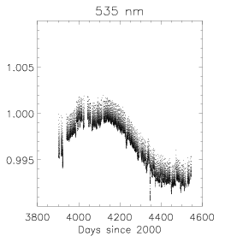
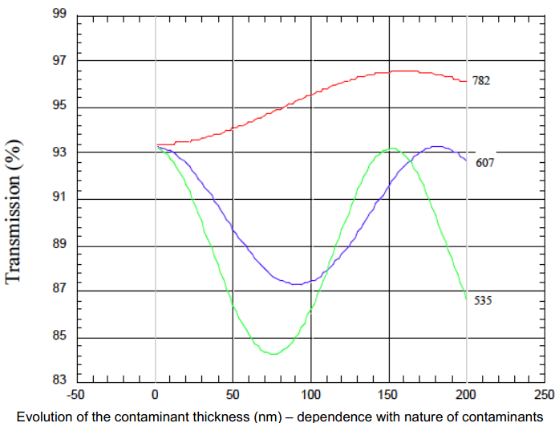
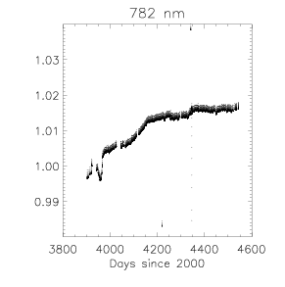
Degradation issues
VIS and IR channels: contamination under solar UV exposure

Slide 10
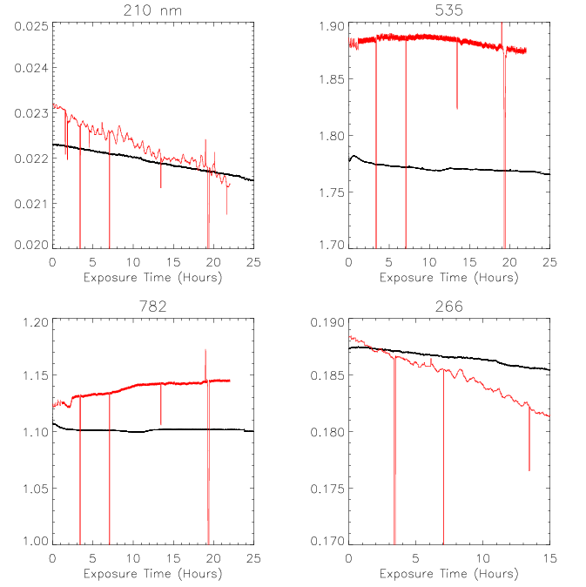
Degradation Issues
Exposure time: Operational vs. Backup
Different behaviour according the time exposure
Degradation of filters according the exposure time (contamination)
Degradation of filters according real time (structural change, increasing of filters’ width,...)

Slide 11
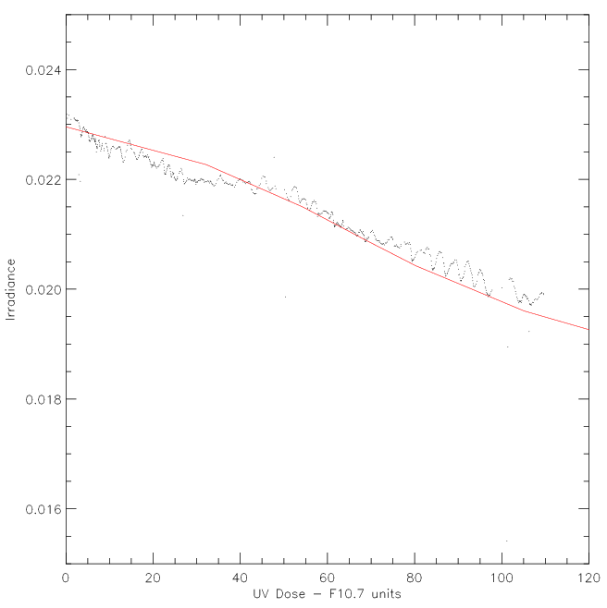
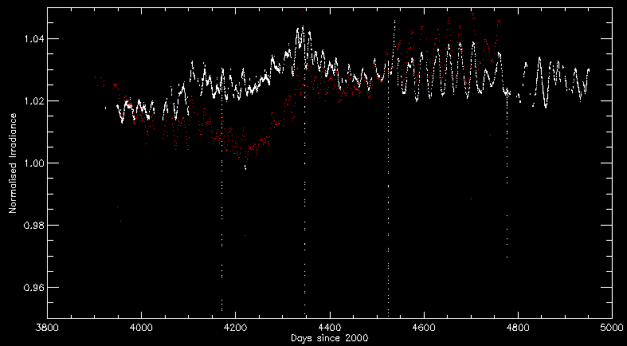
Degradation Issues
UV Dose: Operational vs. Backup

Slide 12
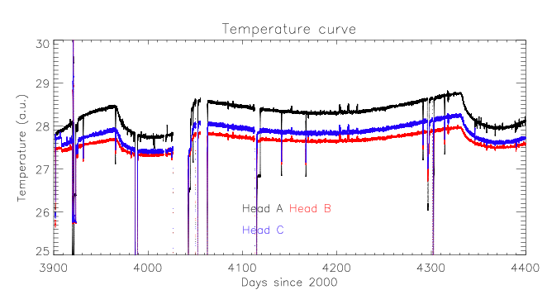
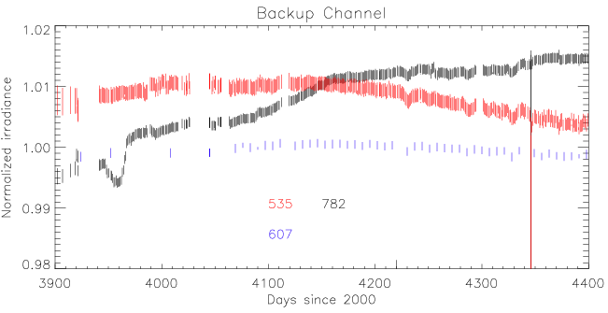
Effect of the temperature
Long term trend
Occultation season

Slide 13
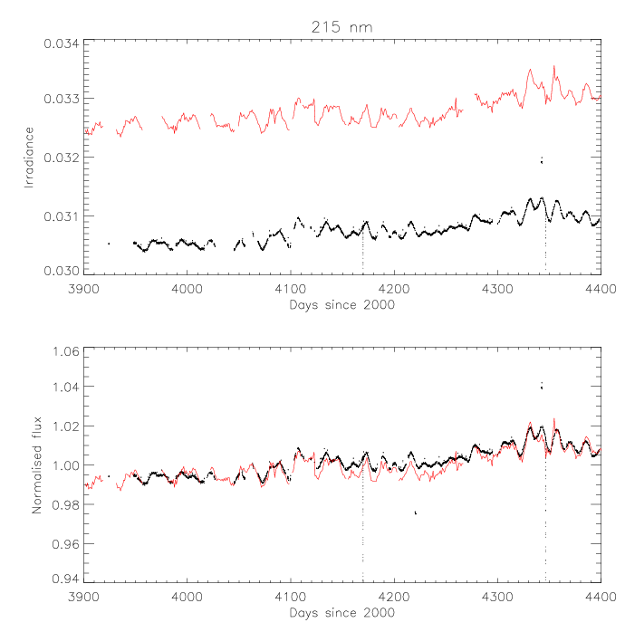
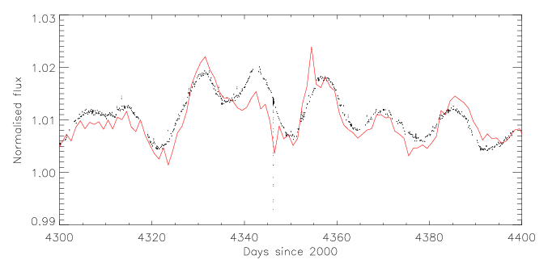
PREMOS investigations
Independant correction
Strong correlation
Rotational modulation more accurate
Solar modelling : current work (paper in preparation)
Similar paper with PROBA2/LYRA data (Shapiro et al, Solar Physics, 2012)
SOLSTICE
PREMOS
13.5 and 27 days modulation

Slide 14
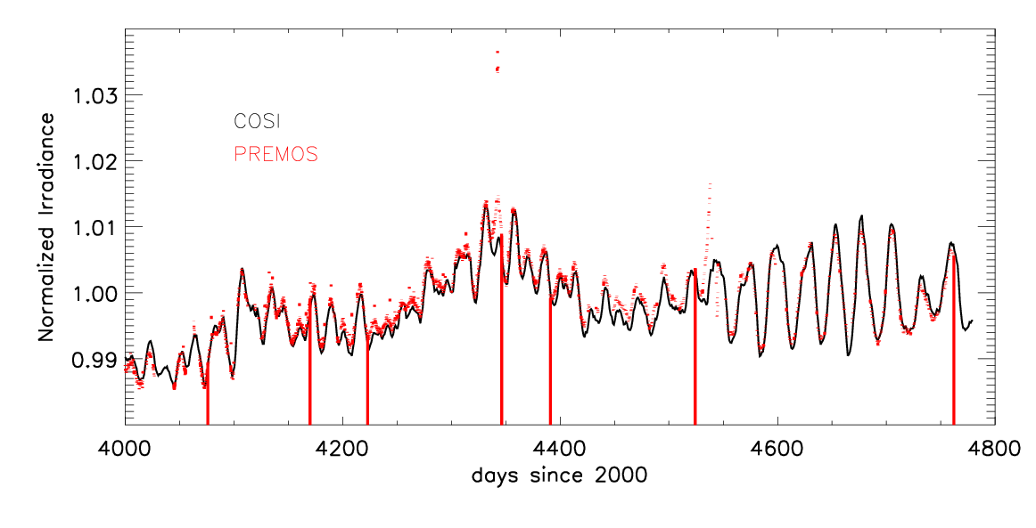
PREMOS investigations
Irradiance at 215 nm
Similar results for irradiance at 210 and 266 nm
PREMOS data could be considered as reference instead of SORCE data
Calibrated data available over 3 years

Slide 15
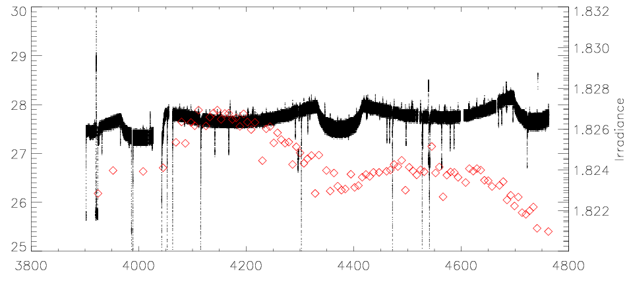
PREMOS investigations
Irradiance at 607 nm: influence of the temperature

Slide 16
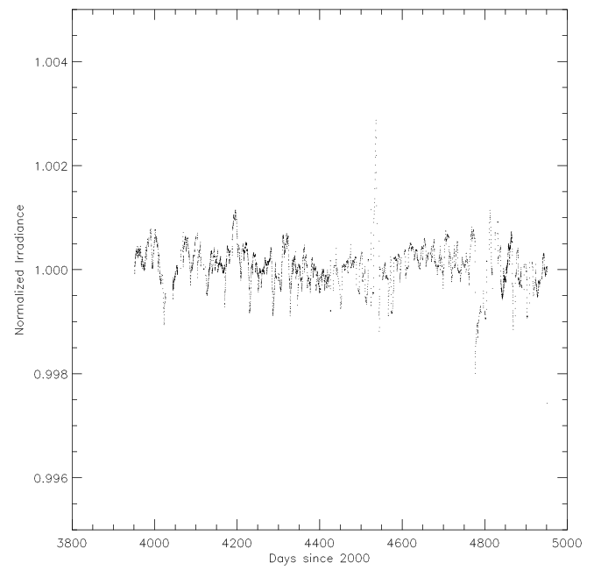
PREMOS investigations
Irradiance at 607 nm

Slide 17
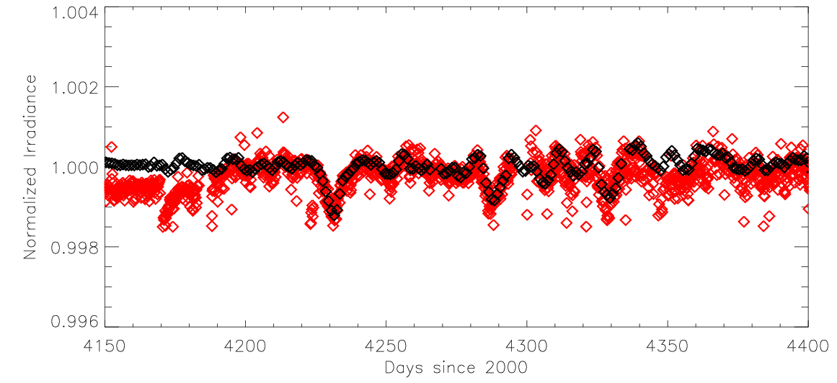
PREMOS investigations
Irradiance at 607 nm
COSI
PREMOS
Strong correlation for solar rotational variations !

Slide 18
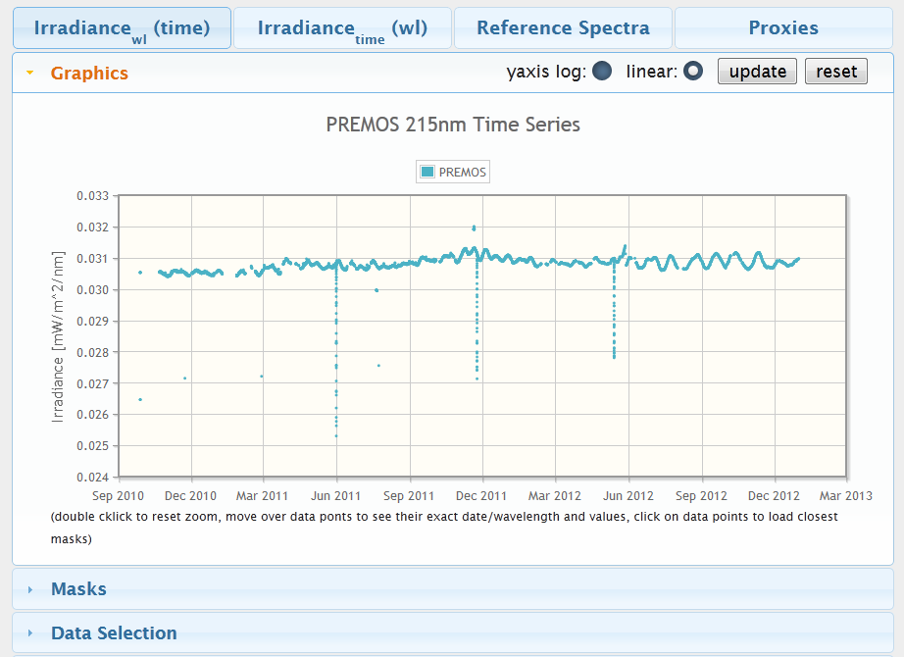
Irradiance at 215nm available (soon 607 nm)

Slide 19
Others channels
UV channels (210 and 266 nm): Degradation effect soon corrected; time series soon available.
Visible channels (535 nm): Back up and operational channels have both unpredicted behavior on long term
Pretty soon: rotational variation will be available
Same conclusions for the infrared channel
Every irradiance time series will be distributed on the SOLID database

Slide 20
Conclusions & Perspectives
PREMOS/PICARD is successfully operating after 3 years in space
Strong correlation between SORCE and PREMOS instruments, but we still have to attach the correct W/m² to the curves.
We are still working on the radiometric calibration; Comparison with SODISM degradation
PREMOS data might be used as reference instead of SORCE for solar modeling purposes

Slide 21
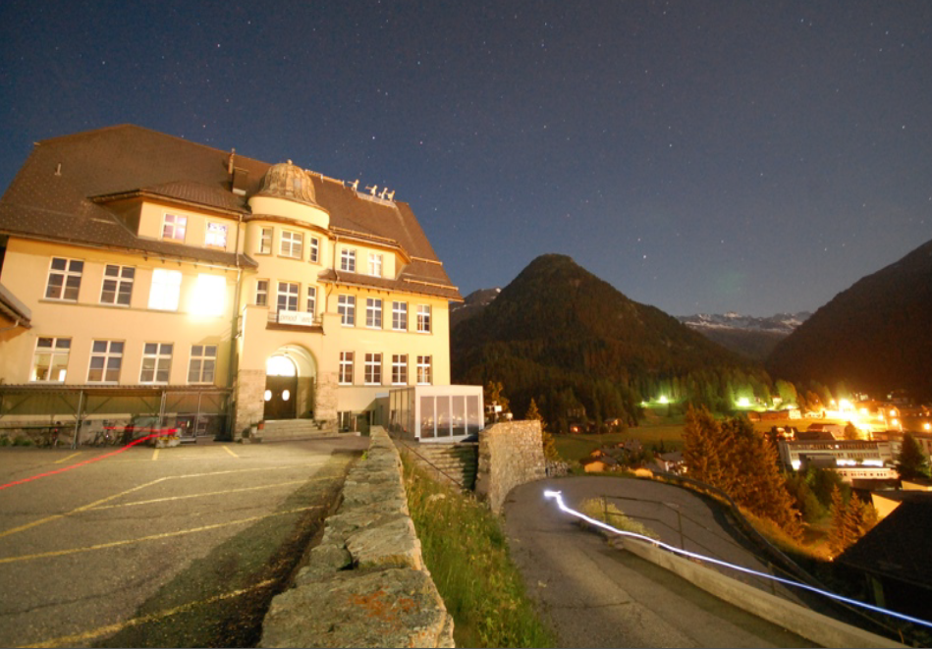
Thank you

Slide 22
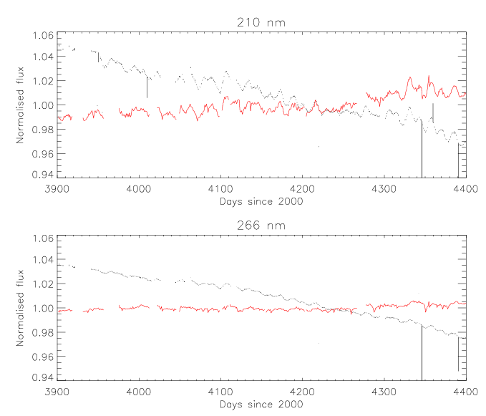
Comparison with SOLSTICE

