Slide 1



ESWW10 Session 13
Cosmic Ray Detectors
Neutron Monitor Splinter
Neutron Monitor Data and the ESA SSA Program
European Neutron Monitor Service
A. Papaioannou
ATHENS NEUTRON MONITOR STATION
Nuclear & Particle Physics Section, Physics Department
National & Kapodistrian University of Athens
ESWW10 Seplinter on Neutron Monitors
Antwerp | 22.11.2013

Slide 2
The European Neutron Monitor Service
This is a scientific research pilot project during which the Neutron Monitor Service will be established, tested and validated
Products of the ENM Service
Multi-station
NM data
GLE Alert
Provide
data from as many NMs as possible
Provide timely GLE alerts of large SEPs/GLEs
ESWW10 Seplinter on Neutron Monitors
Antwerp | 22.11.2013

Slide 3
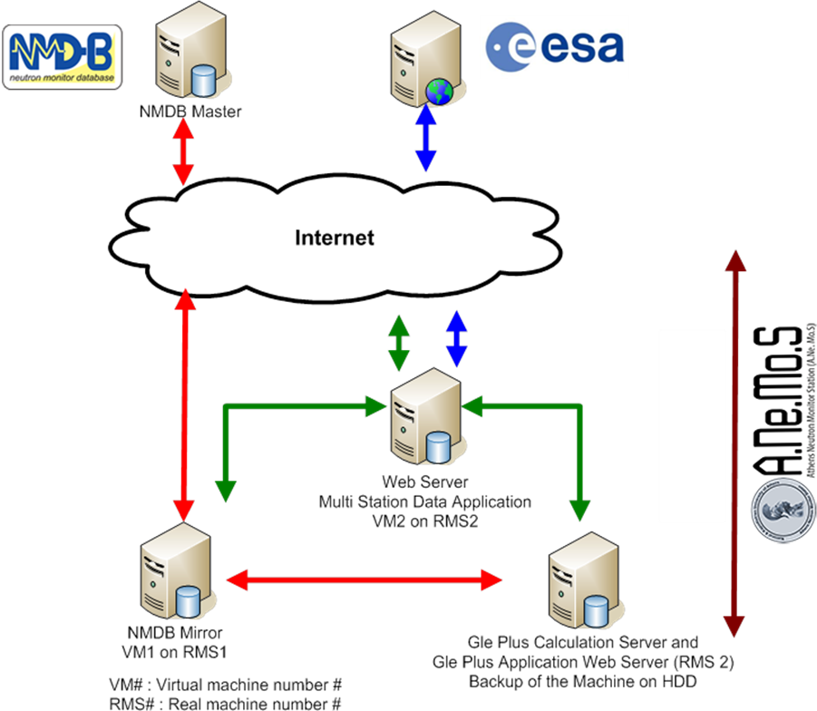
Architecture of the NM Service
Architecture:
Red : Communication with NMDB. Data used for the GLE Alert Process. The GLE Calculation Server receives data from the Athens NMDB Mirror and executes calculations in order to produce the GLE Alert signal
Green: Inter-Athens Station communication. The central point is the Web-Server which communicated both with the NMDB mirror and the GLE Alert Server. It also provides the sharing point to the World Wide Web
Blue: Specific portal for ESA
ESWW10 Seplinter on Neutron Monitors
Antwerp | 22.11.2013

Slide 4
Flash back to recent history I
 | Names | Affiliation | NM Stations
1 | Christian Steigies | Kiel Unviversity, Germany | KIEL 1 and KIEL2
2 | Rolf Buetikofer | Bern University, Switzerland | IGY NM Jungfraujoch (JUNG1), NM 64 Jungfraujoch (JUNG2)
3 | Karel Kudela | Kosice University, Slovakia | Lomnicky Stit (LMKS)
4 | Roger Pyle | Bartol University, USA | Fort Smith NM (FSMT), Inuvik (INVK), McMurdo NM (MCMD), Nain NM (NAIN),Newark NM (NEW), Peawanuck (PWNK), South Pole Bare NM (SOPB), South Pole NM (SOPO), Thule (THUL)
5 | Artem Abunin | IZMIRAN, Russia | MOSCOW NM (MOSC), Mobile Cosmic Ray Laboratory (MCRL), MIRNY NM, Baksan NM (BKSN), Magadan NM (MGDN), Norilsk (NRLK), Novosibirsk (NVBK), TIXIE NM (TXBY),Yakutsk NM (YKTK)
6 | Masha Abunina | IZMIRAN, Russia
7 | Eugenia Eroshenko | IZMIRAN, Russia
8 | Anatoly Belov | IZMIRAN, Russia
9 | Victor Yanke | IZMIRAN, Russia
10 | Yuri Baladin | University of Apatity, Russia | Apatity NM (APTY)
11 | Oscar Garcia Poblacion | Alcala University, Spain | Alcala
12 | Juan Jose Blanco Avalos | Alcala University, Spain
13 | Ignacio Garcia Tejedor | Alcala University, Spain
14 | Anna Lukonivkova | Irkutzk, Russia | Irkutsk,Irkutsk2, Irkutsk3,Norilsk
15 | Olga Kryakunova | Almaty , Kazahkstan | Almaty NM (AATA-B)
16 | Nikolayevskiy Nikolay | Almaty , Kazahkstan
17 | Zhumabayev Beibit | Almaty , Kazahkstan
18 | Sardrieva Irina | Russian Airlines Center, Russia
19 | Laurenza Monica | IAP,Roma, Italy | Rome-SVIRCO Observatory, (ROME)
20 | Dorman Lev. | Tel Aviv University, Israel | ESOI-TAU (ESOI)
Participation from 12 institutes / representing 20+ NM stations
Thank you all !!
November 2013: Athens Meeting on ESA SSA SN-IV3 Project
ESWW10 Seplinter on Neutron Monitors
Antwerp | 22.11.2013

Slide 5
The future is here
The Service
ESWW10 Seplinter on Neutron Monitors
Antwerp | 22.11.2013

Slide 6
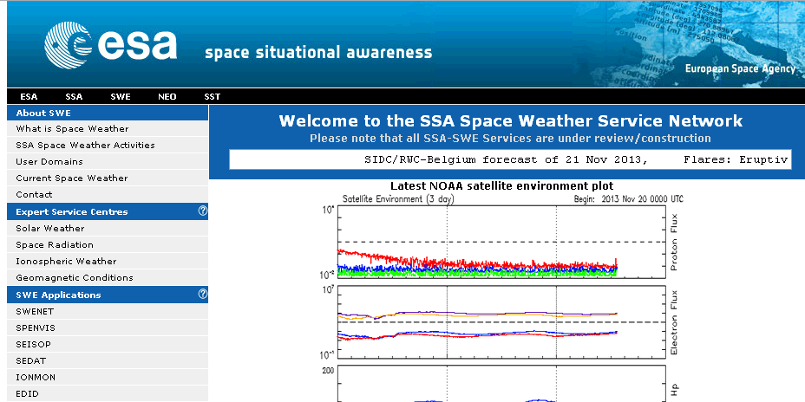
European Neutron Monitor Service
ESWW10 Seplinter on Neutron Monitors
Antwerp | 22.11.2013

Slide 7
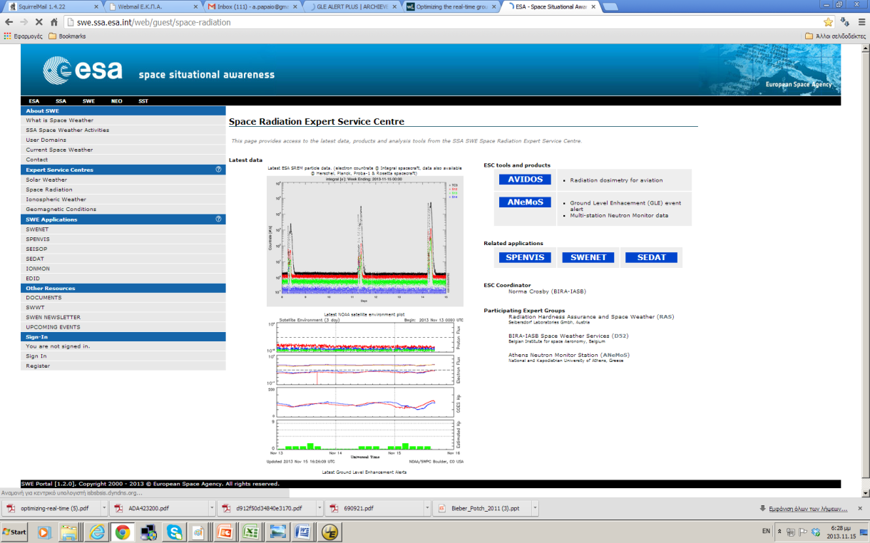
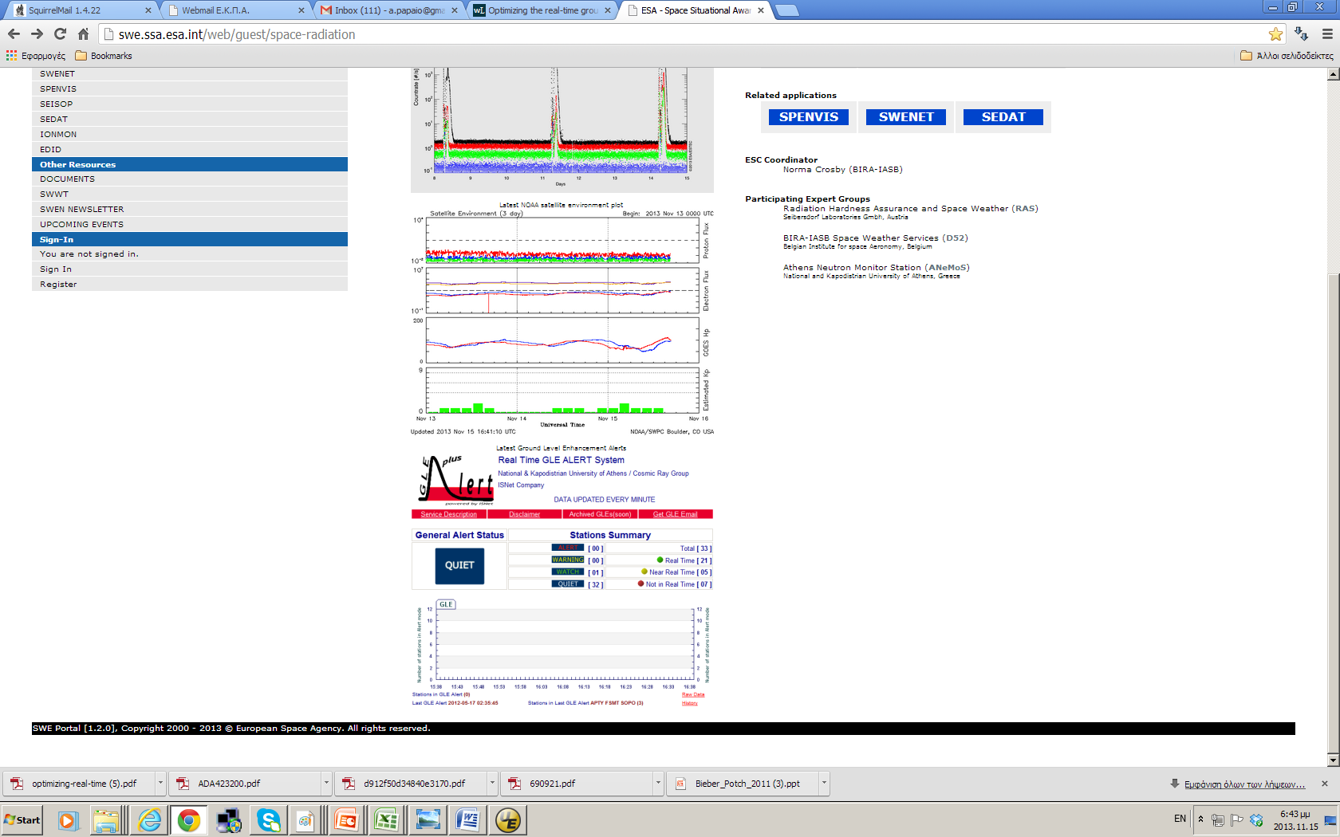
European Neutron Monitor Service
ESWW10 Seplinter on Neutron Monitors
Antwerp | 22.11.2013

Slide 8
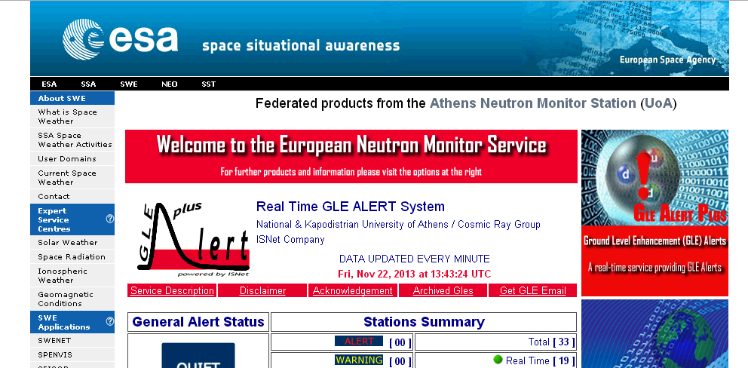
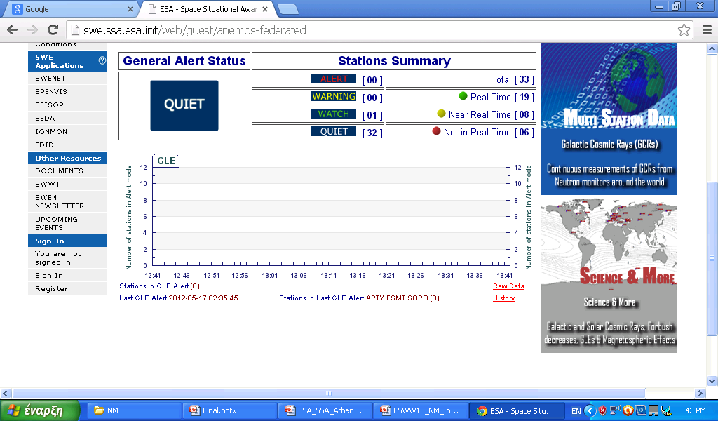
European Neutron Monitor Service
ESWW10 Seplinter on Neutron Monitors
Antwerp | 22.11.2013

Slide 9
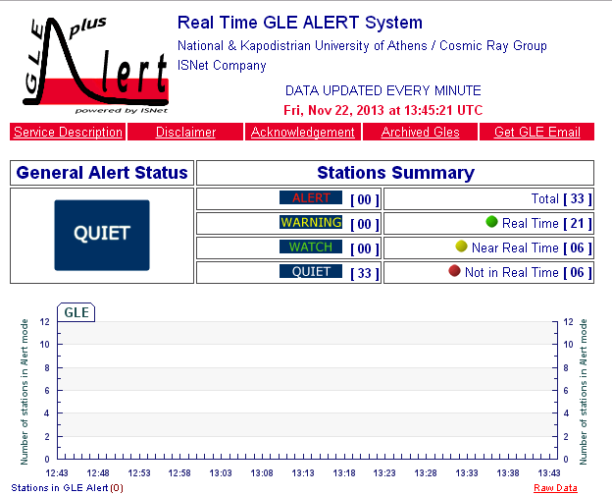
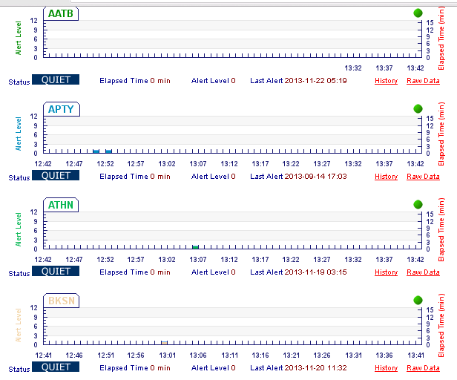
European Neutron Monitor Service
ESWW10 Seplinter on Neutron Monitors
Antwerp | 22.11.2013

Slide 10
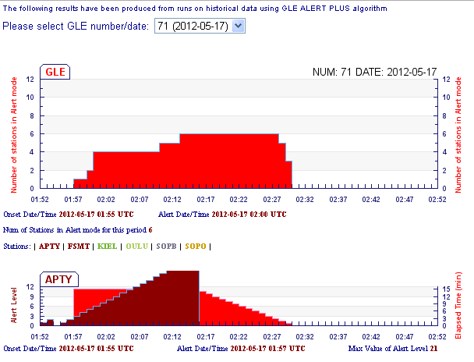
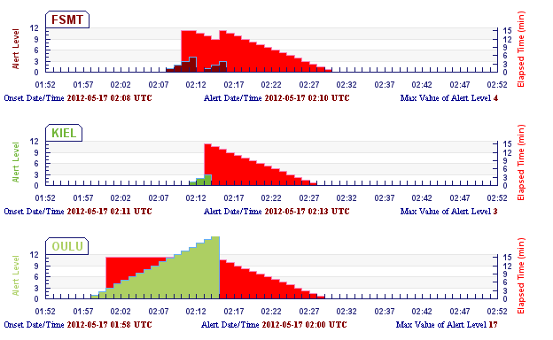
European Neutron Monitor Service
ESWW10 Seplinter on Neutron Monitors
Antwerp | 22.11.2013

Slide 11
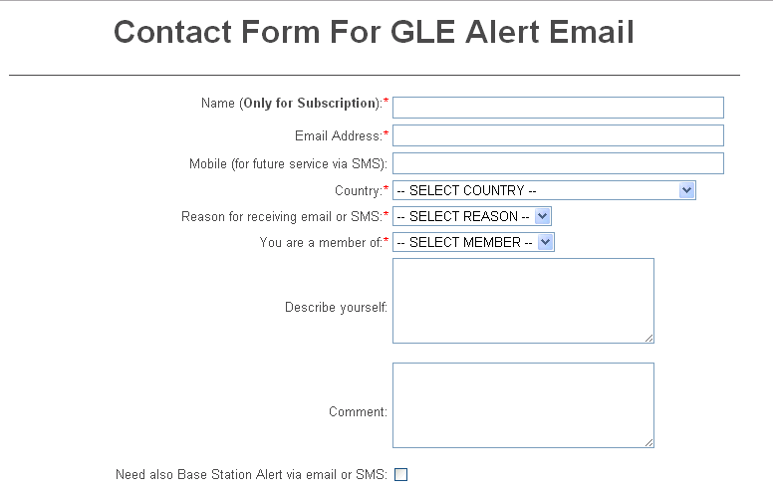
European Neutron Monitor Service
ESWW10 Seplinter on Neutron Monitors
Antwerp | 22.11.2013

Slide 12
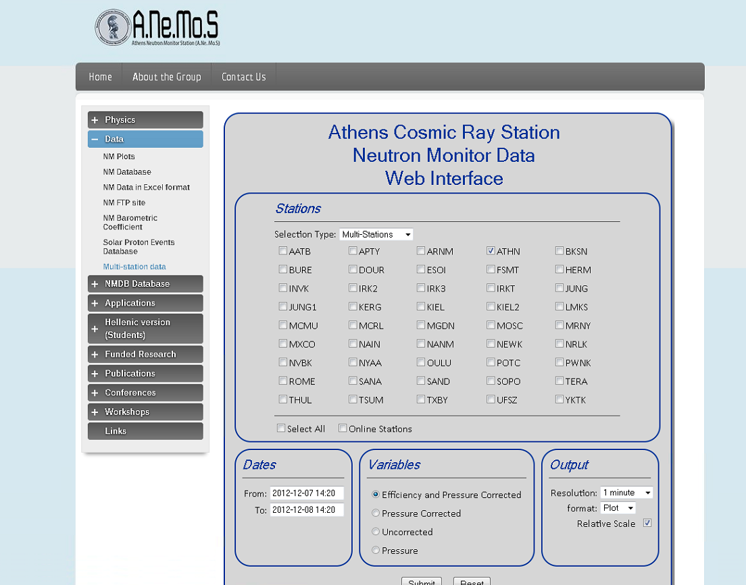
European Neutron Monitor Service
ESWW10 Seplinter on Neutron Monitors
Antwerp | 22.11.2013

Slide 13

European Neutron Monitor Service
ESWW10 Seplinter on Neutron Monitors
Antwerp | 22.11.2013

Slide 14
Flashback from recent history II
Data
ESWW10 Seplinter on Neutron Monitors
Antwerp | 22.11.2013

Slide 15
NMDB (Data Providers)
NMDB managed to collect all available NM data on a worldwide scale, thus it is the single point of access for the easy retrieval and usage of these data
NMDB is an open tool that brings together NMs from around the world
Upgrading NMs within NMDB re-enforces and enhances NMDB’s usability, and impact while is bringing forward the future of the NM community
For the current phase of the testing and validating phase of the ESA SSA SNIV-3 project all stations should try to :
Provide to NMDB High Quality Data
Provide to NMDB High Resolution Data (1-min) Updated Every 1-min
ESWW10 Seplinter on Neutron Monitors
Antwerp | 22.11.2013

Slide 16
Agreements with the Data Providers
Within SNIV-3 project (the current phase of ESA SSA NM Service Development) a coherent proposal for the Operational phase of the Service will be submitted.
[1] The impact of real-time data in the GLE Alert service is very much important, thus high resolution data (1-min) updated every 1-min are needed for the robust operation of the service
[2] The real-time high resolution data availability of each NM will be checked
[3] A statistical survey based upon all historical data within NMDB from 2000 to 2012 will be performed in order to re-validate the GLE Alert software and to perform fine tuning at its parameters
ESA SSA program requests a robust operational service for the GLE Alert
All NM stations that would like to take part in the operational phase should provide their 1-min data to NMDB , checked for quality, updated every 1-min
ESWW10 Seplinter on Neutron Monitors
Antwerp | 22.11.2013

Slide 17
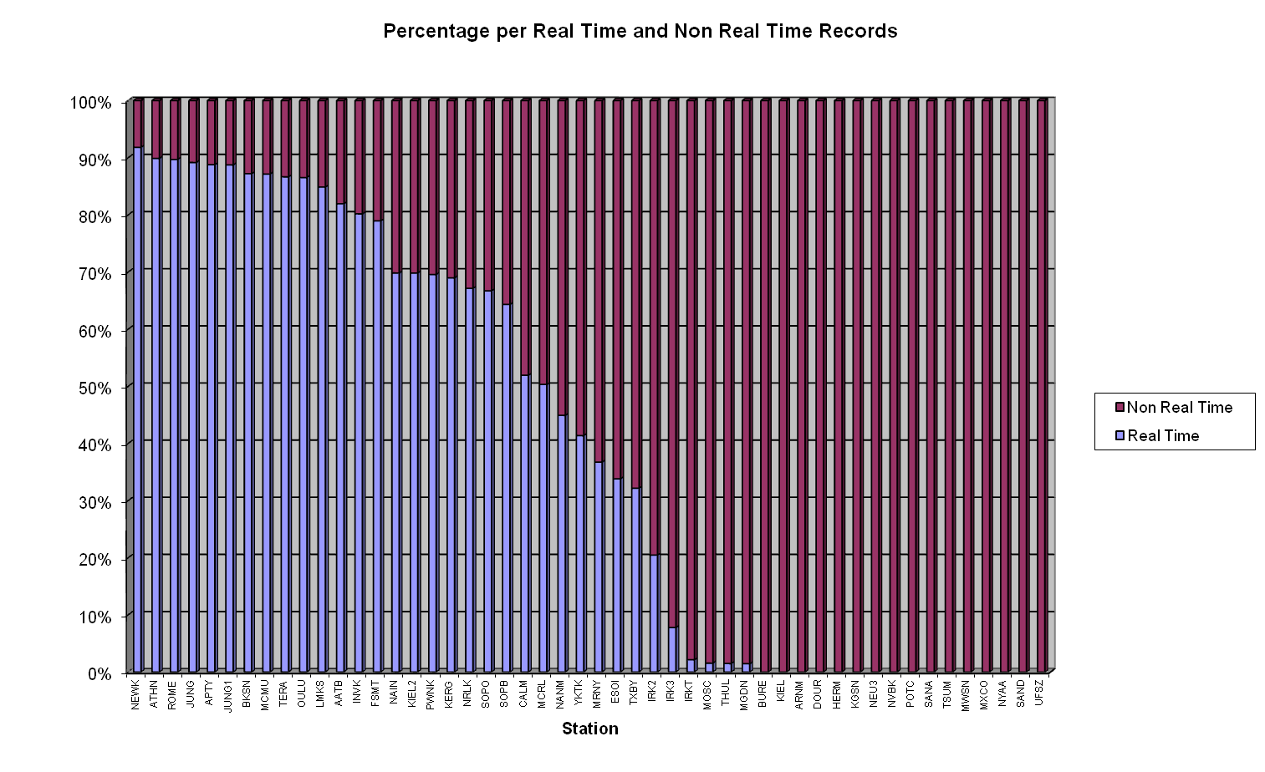
Real-time data
How many minutes within the selected time frame (Jan-Aug 2013) a specific neutron monitor station was in “Real-time” mode, for how many minutes the station was in “Near real-time” mode or in “Not real-time” mode, based on the rate with which the station provided data into NMDB.
ESWW10 Seplinter on Neutron Monitors
Antwerp | 22.11.2013

Slide 18
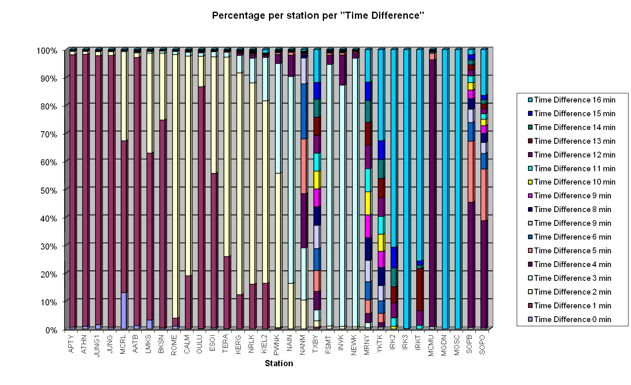
Data flow
The data flow of the measurements is being defined as the time difference of the neutron monitor measurement clock to the clock of the GLE Alert Server. The smaller this time difference is the closer to the robust behavior of the neutron monitor station in terms of its data flow.
ESWW10 Seplinter on Neutron Monitors
Antwerp | 22.11.2013

Slide 19
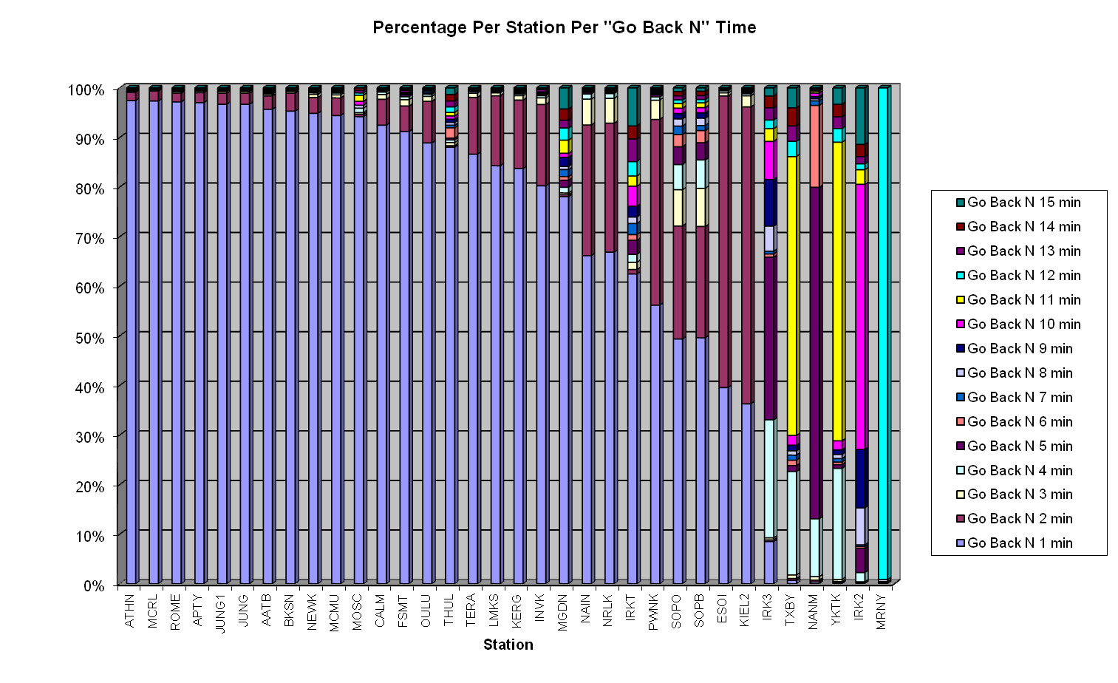
Go-Back N
The basic advantage of Go-Back-N is that we define a time window within which the algorithm goes back N minutes in time in order to take into account delayed measurements of a specific NM station. The application of this algorithm leads to both the usage of plenty more data measurements of a single neutron monitor station and to the usage of more (previously discarded) neutron monitor stations into the establishment of a GLE Alert.
ESWW10 Seplinter on Neutron Monitors
Antwerp | 22.11.2013

Slide 20
Conclusions
The European Neutron Monitor Service is now a fact
Real-time services based upon NMDB is the key
ESWW10 Seplinter on Neutron Monitors
Antwerp | 22.11.2013

