Slide 1
The SWENET Online Archive: 10 years of a European Space Weather Community Resource
H. Laurens¹, A. Glover¹², JP. Luntama¹, E.Amata³, E.Clarke⁴, P. Beltrami⁵, A. Hilgers⁶
SSA Programme Office/ESA, Germany¹, Rhea System, Belgium², IAPS/INAF, Italy³, British Geological Survey, UK⁴, etamax Space, Germany⁵,
TEC-EES/ESA, Netherlands⁶
European Space Weather Week, Liege, Belgium 17th – 21st November 2014

Slide 2
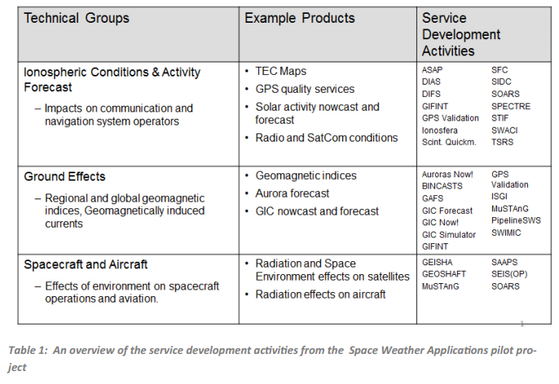
AIM: To review the SWENET archive revisiting the existing metrics to assess the strengths and limitations of a number of prototype services
The SWENET archive: Available via http://swe.ssa.esa.int
Initially established through the ESA Space Weather Pilot Project in 2003
Houses forecast/nowcast data from over 20 different service providers.
Collecting data for almost a complete solar cycle.
Accessed via the ESA SSA Space Weather portal.
European Space Weather Week, Liege, Belgium 17th – 21st November 2014

Slide 3
Chosen services for assessment
GIFINT Service | BINCASTS service
Forecast: Dst Index 1 hour in advance | Nowcast: 3 Hourly and Daily Ap Index
Artificial Neural Network algorithm | Derived from real time observations from as many official Kp/Ap observatories as possible.
Uses only IMF data inputs from ACE
Preliminary metrics: Percent Root Mean Square Error, Scatterplot with linear regression, prediction efficiency and correlation coefficient.
Overall model performance assessed before comparison with other similar models.
GIFINT service comparable to other models although using only IMF inputs may affect its ability to predict the largest geomagnetic storms.
BINCASTS performs well for all levels of geomagnetic activity and against comparable models.
European Space Weather Week, Liege, Belgium 17th – 21st November 2014

