Slide 1






Earth's Magnetosphere Model
in the Framework of the IMPEx Data Model:
Web-Services and Visualization Tools
V. V. Kalegaev¹, , I. I. Alexeev¹, E. S. Belenkaya¹, L.R. Mukhametdinova¹,
M. L. Khodachenko^{2,1}, V. Génot³, E. J. Kallio⁴, T. Al-Ubaidi³, R. Modolo⁵
¹ Skobeltsyn Institute of Nuclear Physics, Lomonosov Moscow State University (SINP MSU), Moscow, Russian Federation
² Space Research Institute, Austrian Academy of Science, Graz, Austria
³ IRAP, CNRS, Toulouse, France
⁴ Finnish Meteorological Institute, Helsinki, Finland
⁵ LATMOS, CNRS/Université de Versailles Saint-Quentin, Guyancourt, France
http://impex-fp7.oeaw.ac.at http://smdc.sinp.msu.ru

Slide 2
IMPEx project -
Integrated Medium for
Planetary Exploration
User Layer
In browser clients
Java client
can
be
more
AMDA
CLWeb
IMPEx portal
3DView
Data providers
Observational data
Simulation models
Tools
Layer
Spacecraft
measurements
SINP
PMM
Compute Services
HMM/PMM Environment
HMM
…
Virtual workspace
impexconf.xml
SOAP methods.wsdl
HMM/PMM
Computational
Services
AMDA
Server
CLWeb
Server
Precalculated data access
Resource
Layer
PMM/HMM
Simulation
Archives
3DView
Server
tree.xml
IMPEx
User

Slide 3
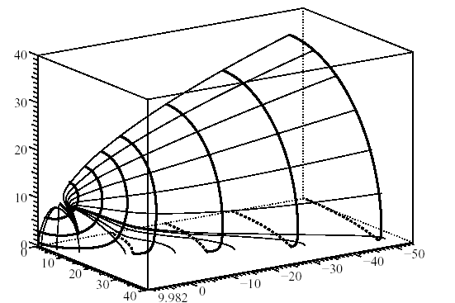
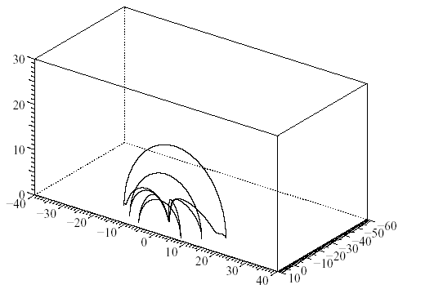
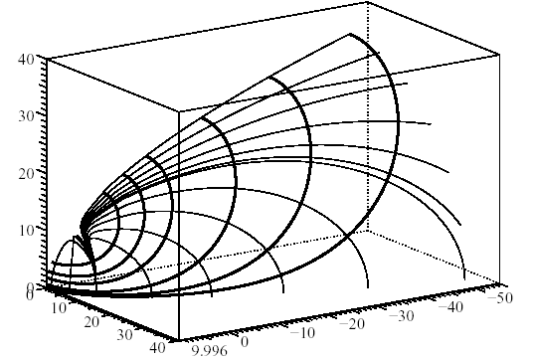
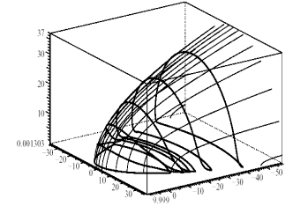
Paraboloid model
PMM structure
Paraboloid model of the Earth's magnetosphere has been developed at Moscow State University to represent correctly the electrodynamics processes in the near-Earth's space . This model is intended to calculate the magnetic field generated by a variety of current systems located on the boundaries and within the boundaries of the Earth's magnetosphere under a wide range of environmental conditions, quiet and disturbed, affected by Solar-Terrestrial interactions simulated by Solar activity such as Solar Flares and related phenomena which induce terrestrial magnetic disturbances such as Magnetic Storms. The model depends on a small set of physical input parameters, which characterize the intensity of large-scale magnetospheric current systems and their location.
BM = B1+B2
B2 = Bsd(ψ , R1) + Bt(ψ , R1,R2, Φ)+ Br(ψ,br) + Bsr(ψ,R1,br) + Bfac(I||)
Bfac
=
B
+
Bcfl
Btail
+
+ …

Slide 4
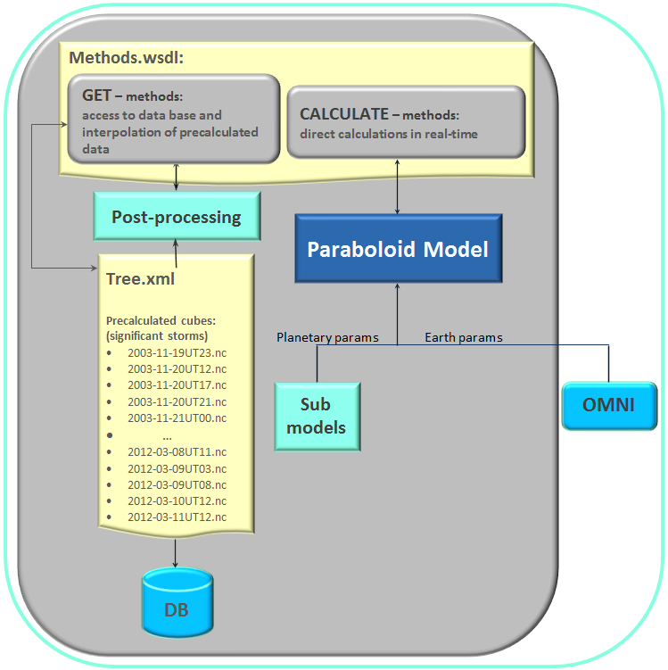
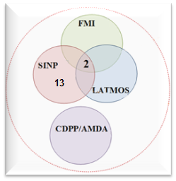

Common set of web-services between simulation databases and tools
Interpolation in the precalculated cubes:
points
lines
cuts
Calculation of the magnetic field:
Earth:
in points, in different time moments;
in points in one time moment;
field lines from selected points;
along spacecraft trajectories;
in a selected cube;
Mercury, Saturn, Jupiter:
in points, in different time moment;
in a selected cube;

Slide 5
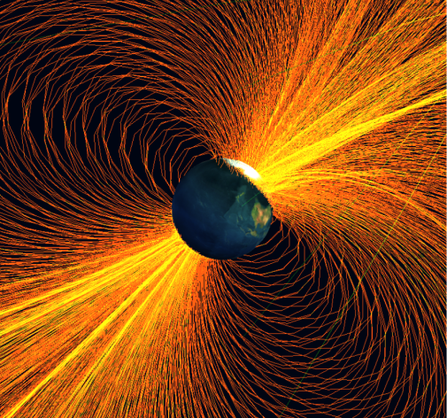

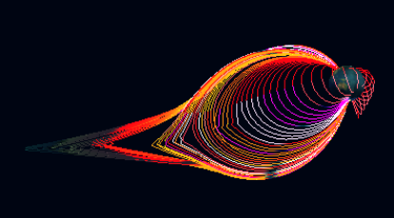
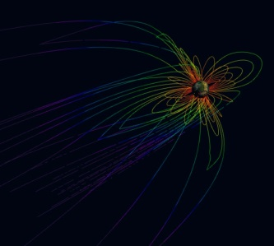
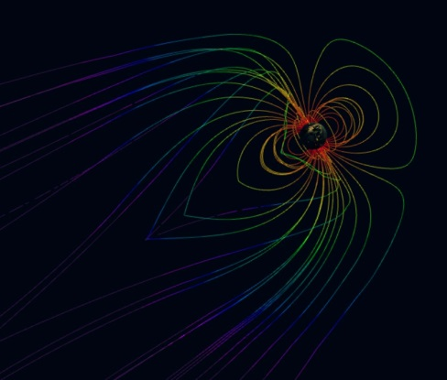
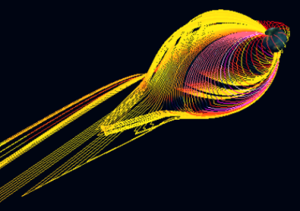
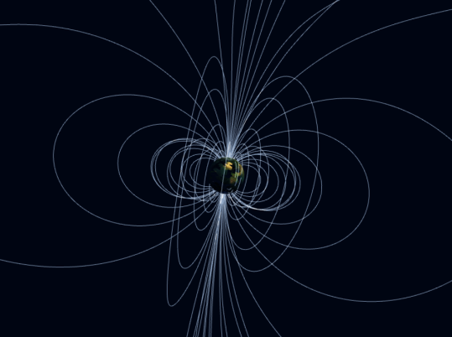
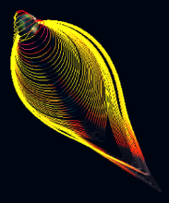
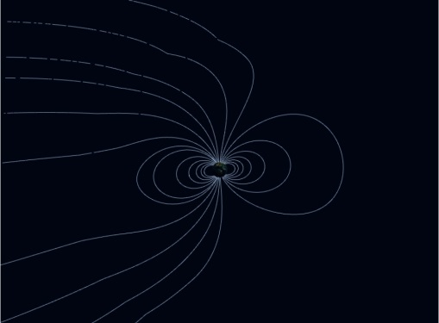
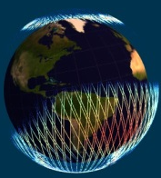
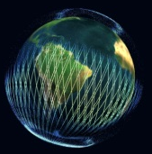
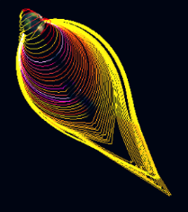
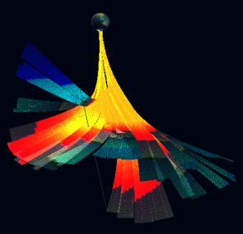
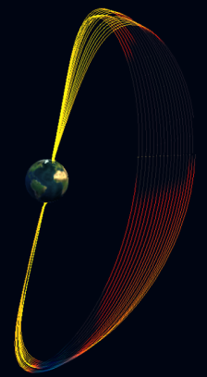
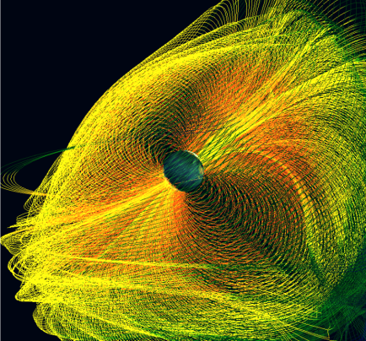
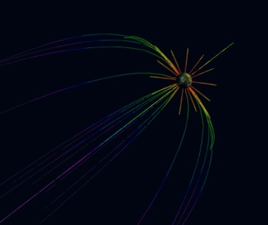
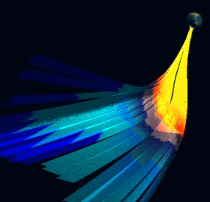
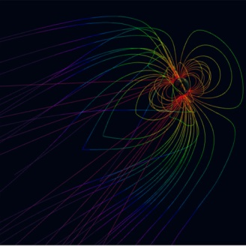

Input parameters can be taken from OMNI by date, or inserted manually

