Slide 1
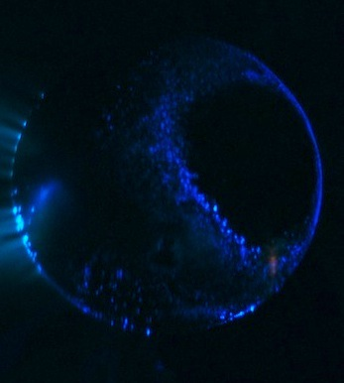
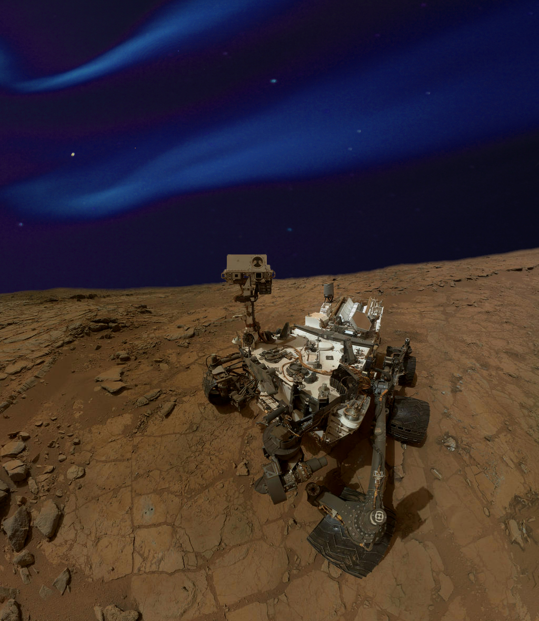
The Blue, red, and Green Aurorae of the Red Planet. J. Lilensten, D. Bernard, M. Barthélemy, G. Gronoff, C. Simon Wedlund, A. Opitz
We simulate the Martian aurora in the visible spectral range both with an experimental setup (the Planeterrella) and with a numerical ionosphere simulation. We show that the electron impact on CO₂ produces strong emissions at 412 nm and 434 nm, i.e., in the blue part of the visible spectrum which are due to the CO₂⁺(A) Fox-Duffendack-Barker bands. The modeling of the electron transport at Mars shows that these blue emissions as well as the emissions of the 630 nm (red) and 557.7 nm (green) lines of atomic oxygen may be observable several times during a solar cycle during strong solar events. The UV aurorae on Mars have a counterpart in the visible spectral range which should be detectable under the right conditions. We discuss what are the most favorable conditions to observe these aurorae discernible with the naked eye.

