Slide 1
Improving Operational Geomagnetic Index Forecasting
Laurence Billingham and Gemma Kelly
British Geological Survey
ESWW11 2014-11-20
poster 13-4e

Slide 2
Improving Operational Geomagnetic Index Forecasting
Laurence Billingham and Gemma Kelly
What is more useful for predicting space weather:
A Lasso or a RandomForest?

Slide 3
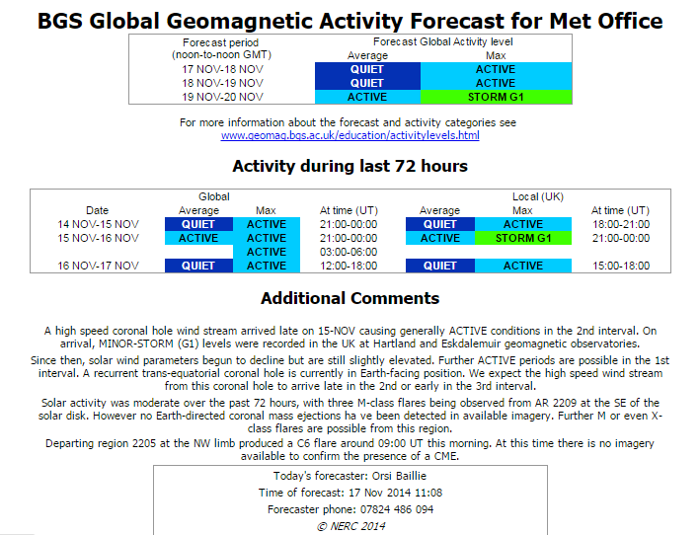
BGS forecasts
Daily geomagnetic forecast
next 3 days
Online:
http://tinyurl.com/BGSSwForc
http://www.geomag.bgs.ac.uk/data_service/space_weather/3dforecast.html
BGS live forecast in lobby today
We show scoping study for new tool to help human forecasters
automatic prediction of 3 hourly a_{p}
Poster 13-4e

Slide 4
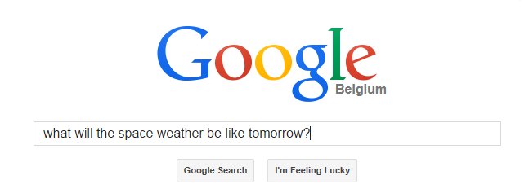
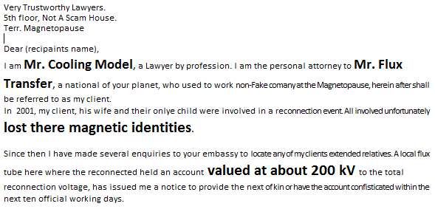
Space weather data assimilation
Limited cf. NWP
Heterogeneous
Difficult to assimilate into physical models
Can we use different approach: Machine Learning?
ML underpins our online lives
I’m a
magnetosphere
looking for a
CME
N.B. BGS NERC does not endorse these services
with at least
3 hours
of
B_{z} < -10nT
Poster 13-4e

Slide 5
BGS’s next top model
ElasticNet
Lasso
SVM
Select data from ~15 years holdings
Train many ML algorithms
Competition
what is best at predicting when shown unseen data
Winner?
Any forecast skill?
Come see poster
Ridge
DecisionTree
train
tune
test
Poster 13-4e
Image credit Nils Olsen and comic-vine

