Slide 1
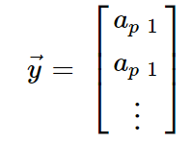
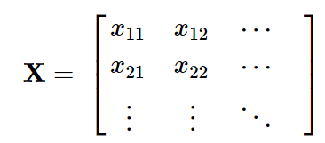
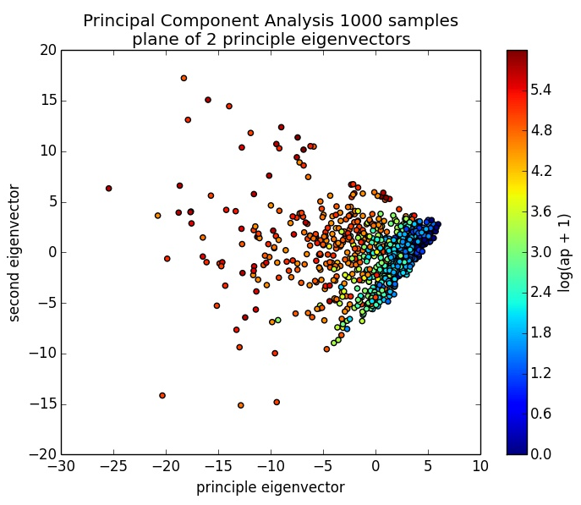
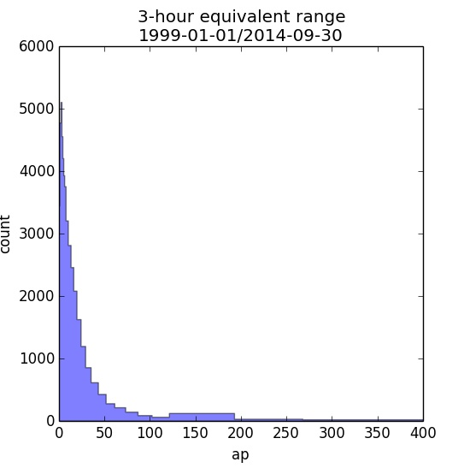
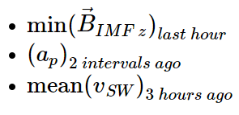
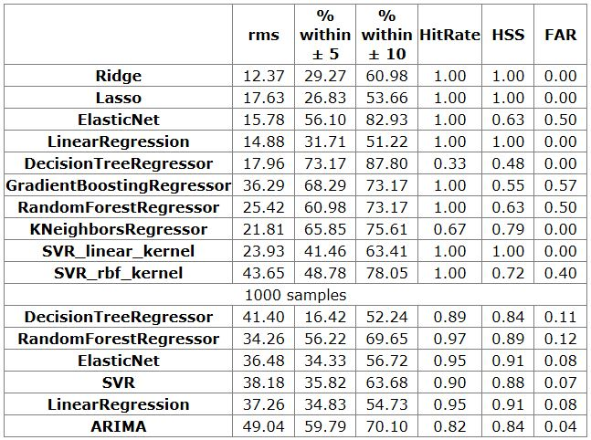
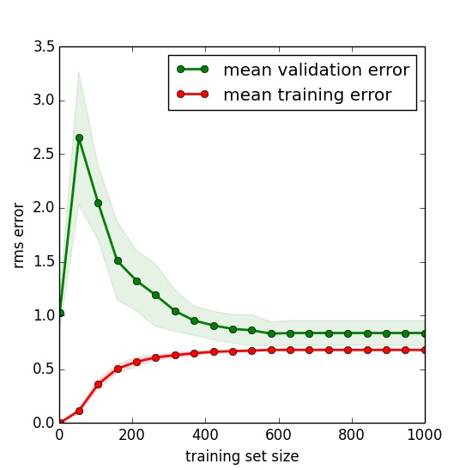
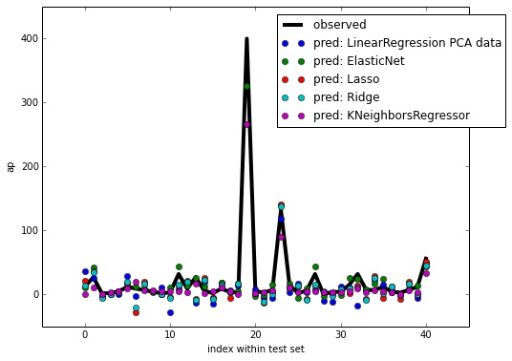
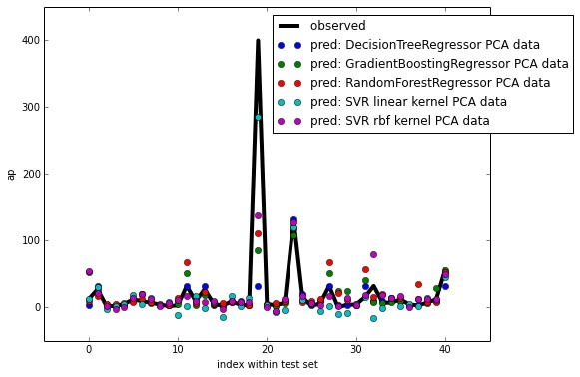
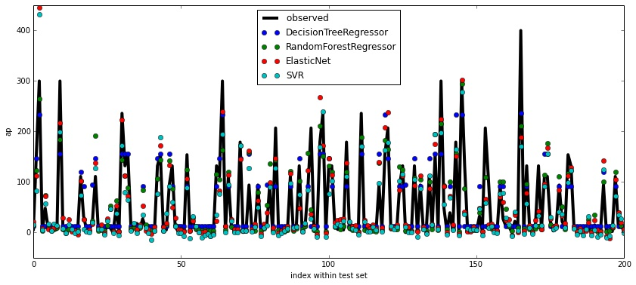
Improving Operational Geomagnetic Index Forecasting
Laurence Billingham [laurence@bgs.ac.uk], Gemma Kelly British Geological Survey, West Mains Road, Edinburgh, UK
1. Introduction
The interest in space weather has never been greater, with society becoming ever more reliant upon technology and infrastructure which are potentially at risk. Geomagnetic storms are potentially damaging to power-grids, communication systems and oil and gas operations.
2. Data
3. Techniques
Machine Learning
A branch of statistics
We use regression algorithms here
Data laid out as for matrix inversion (little like finding best fit line with 2D data)
Many algorithms (see [2] for an excellent introduction), some are like linear regression e.g.
Workflow:
Training: get coefficients from
Tune model parameters against validation set
Test and score model with test set
Predict new a_{p} from unseen data
ARIMA
Auto-regressive moving average
A linear regression over a windowed average of a_{p}
Only input is a_{p} timeline
Currently operational: used here as a baseline quality comparison
Samples times over ~15 years of geomagnetic and solar wind data
Storms rare but important
Balance dataset otherwise storms look like noise
Features selected like
Split: training set, validation set, test set
Training set scaled
Some algorithms require
use Principal Component Analysis to decompose
Geomagnetic indices
Capture magnetic storm severity by summarising lots of data
have become ubiquitous parameterisations of storm-time magnetic conditions
required as inputs by a variety of models
a_{p} index
captures amplitude of the disturbance in horizontal part of the field (see e.g. [1] for more detail)
tracks disturbances within a 3-hour interval
indicates the global level of disturbance
Linear Regression
LR + = Lasso
LR + = Ridge
Same scaling applied to other sets
LR + Lasso + Ridge =
ElasticNet
4.Results
Initial dataset with 205 samples (small set)
Some models much better at identifying storms than others
Large range in rms values and percentage of predictions which are close to the true value
We then increased the total dataset size to 1000 samples (large set) and tested the best performing models
Again range of rms values
All the machine learning models out perform the ARIMA model in terms of rms, HitRate and skill (HSS)
Positive results: worth pursuing for production system
Metrics:
rms: root-mean square error
% within ±N: Percentage of predicted values within ±N of the observed value
HitRate: how well do we predict the storms?
1 = predicted every single storm
0 = missed every storm
HSS: Heidke skill score measures fractional improvement of the forecast over forecast by random chance
HSS = 2 (ad – bc) / [(a+ c)(c + d) + (a + b)(b + d)]
1 = highly skilled
0 = no skill
<0 = worse than random chance
FAR: False alarm rate of storm prediction
0 = no false alarms
1 = all false alarms
Event Forecast | Storm Observed
 | Yes | No | Forc Σ
Yes | a | b | a + b
No | c | d | c + d
Obs Σ | a + c | b + d | a+b+c+d = n
5.Summary and Future Work
Scoping study results positive
value in predictions
proceed to operational system
Here we only predict 1 a_{p} interval into future
Some models easily configures to predict multiple intervals
Others need new train, validate, test cycles
Classification not regression
e.g. G1, ..., G5
More useful aid to human forecaster
Potentially easier computation
Up-weight storm categories: balance dataset
Small set
Small set
Large set
More features per sample
Models converge with few training samples (see fig): models powerful enough
Data mine human forecasts, coronagraph data ...
Science potential in ‘white-box’ models: which features give useful info?
References
[1] McPherron, Magnetospheric Dynamics, in Introduction to Space Physics, edited by Kivelson, Russell, pp. 400-458, Cambridge University Press, 1995.
[2] Hastie et al., The Elements of Statistical Learning Data Mining, Inference, and Prediction, Springer 2009(II)
This work is powered by Python-Scikit-learn
Pedregosa et al., Scikit-learn: Machine Learning in Python, JMLR 12, pp. 2825-2830, 2011.

