Slide 1
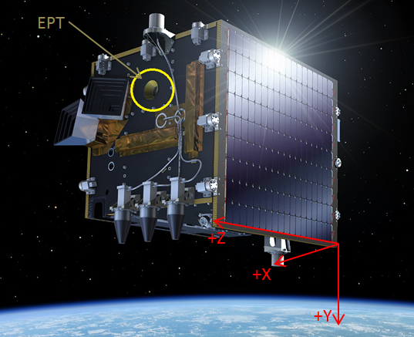
Space Weather Services Based on the Energetic Particle Telescope (EPT) Data
by
Sylvie Benck, Mathias Cyamukungu, Stanislav Borisov
UCL/Center for Space Radiations – Belgium
Outline:
Introduction
Radiation environment characterization
Space weather applications
Conclusion

Slide 2
Introduction | Radiation environment | Space weather | Conclusion
Mission objectives
PROBA-V is an Earth (Vegetation) Observation S/C onto which the EPT and other four instruments have been accommodated as secondary (technology demonstration) payloads;
The objectives of the PROBAV/EPT Data Exploitation project are to perform Space Weather forecasting and to resolve recurrent disputes about the validity of some models of energetic proton fluxes at low altitude.
PROBA-V/EPT Data Exploitation - Methodology
Radiation environment characterization
  Angular distribution model (energetic protons)
  Comparison between the EPT fluxes and existing data and models
  Steady state flux model
  Flux decay time map
  Flux variation rate
Space weather applications
  Flux now-casting and forecasting

Slide 3
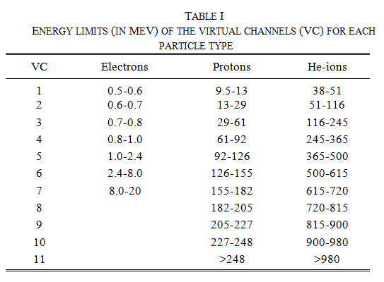
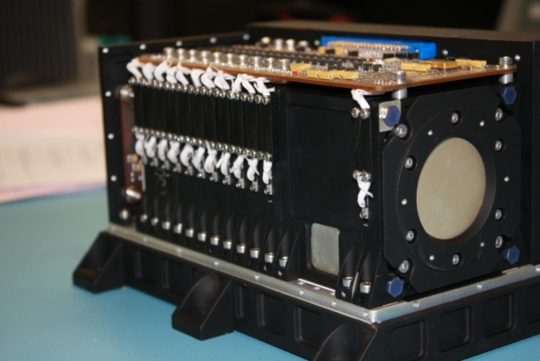
Introduction | Radiation environment | Space weather | Conclusion
The EPT - Instrument performances
Modular instrument;
5.6 W power consumption;
4.6 kg mass, 210 x 162 x 128 mm³ volume;
No contamination of channels devoted to one particle type by the other types: 19 physical channels per particle type (final spectra obtained by unfolding with efficiency matrices);
Capability to measure fluxes of electrons, protons and He ions in the energy channels listed in Table I.
Quite well defined aperture and F.O.V angle (52°).

Slide 4
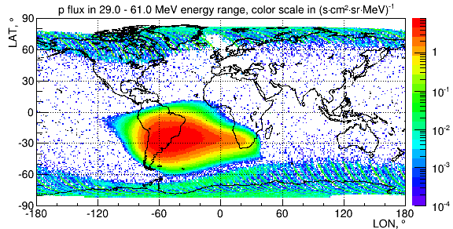
Introduction | Radiation environment | Space weather | Conclusion
PROBA-V/EPT orbit
launched on May 7th, 2013 on a LEO;
820 km altitude;
98.7° inclination;
10:30 – 11:30 Local Time at Descending Node;
period: 101 min;
EPT is oriented WEST when in daylight and oriented EAST when in eclipse.
PROBA-V/EPT measurements of angular distributions of energetic protons
PROBA-V was rotated around the +Y axis before flight at -56°±2° longitude, -20°±2° latitude, 828 km altitude (centered at L=1.27 and B=0.165), defining a so-called Reference Position (RP)

Slide 5
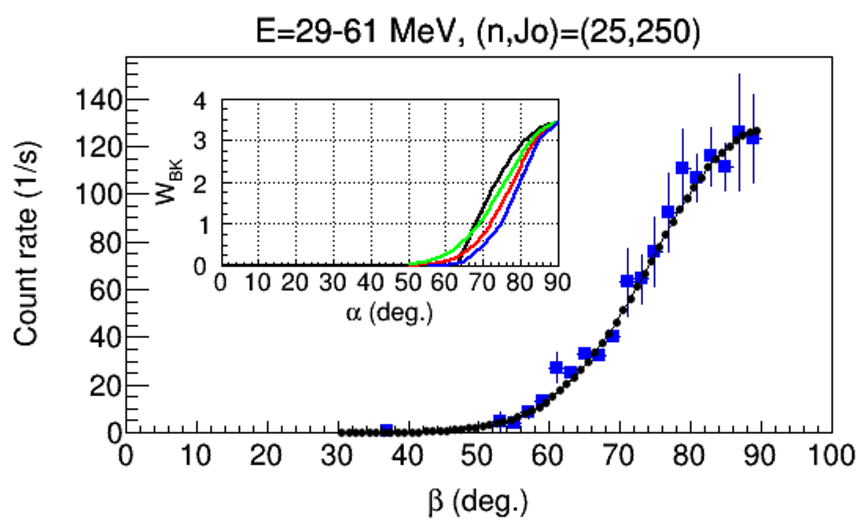

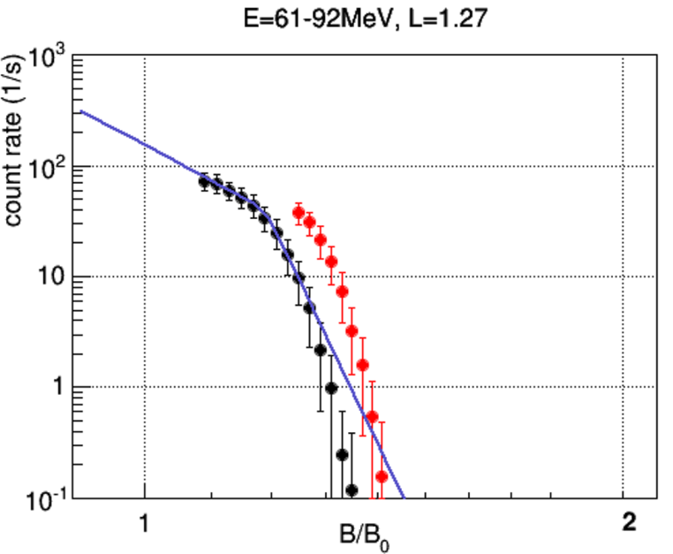
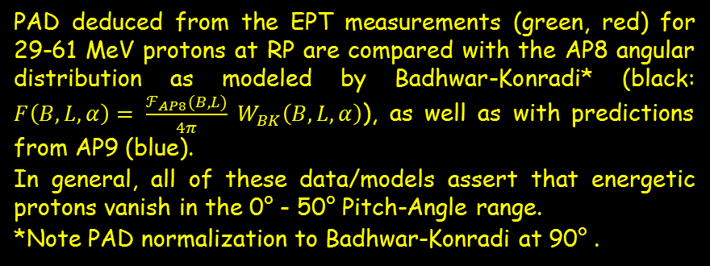
Introduction | Radiation environment | Space weather | Conclusion
PAD of energetic protons at RP
PAD deduced from the EPT measurements (green, red) for 29-61 MeV protons at RP are compared with the AP8 angular distribution as modeled by Badhwar-Konradi* (black: $F\left(B,L,α\right)= \frac{ℱ_{AP8}(B,L)}{4π} W_{BK}\left(B,L,α\right)$), as well as with predictions from AP9 (blue).
In general, all of these data/models assert that energetic protons vanish in the 0° - 50° Pitch-Angle range.
*Note PAD normalization to Badhwar-Konradi at 90° .
East/West asymmetry effect
RP
West (Day)
For 61-92 MeV protons at L=1.27, East/West asymmetry is observed at B/Bo > 1.2.
Thereby, in no way could differences between AP8 prediction and the EPT measurements (if any) be ascribed to systematic errors due to the fact that the EPT acquired 90° PA data at RP during night (East) time only.
East (Night)

Slide 6
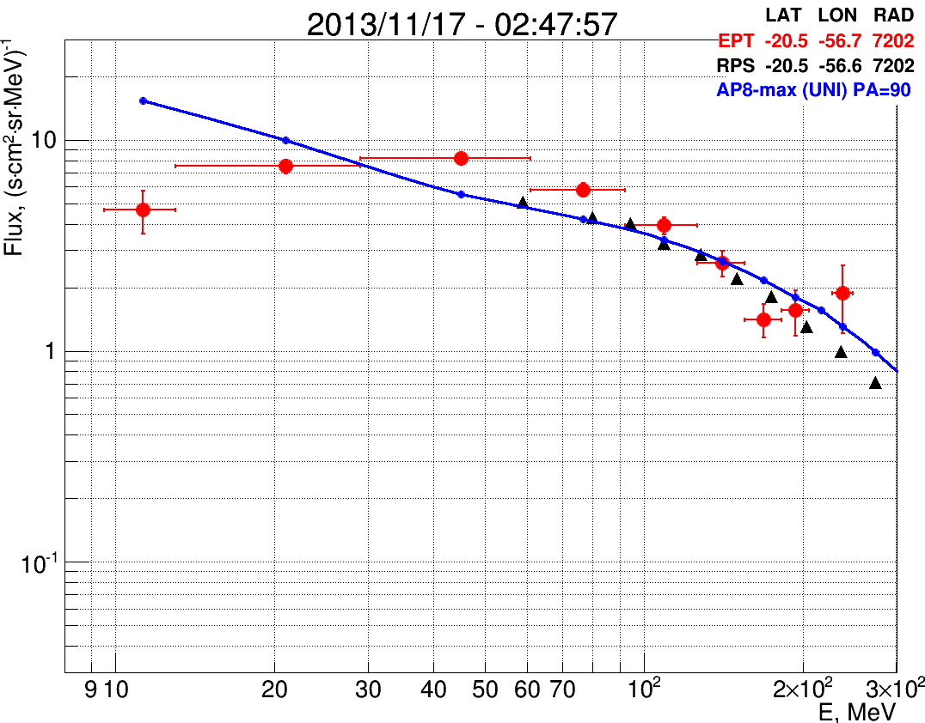
Introduction | Radiation environment | Space weather | Conclusion
How does AP8 compare to EPT, Relativistic Proton Spectrometer (RPS) at RP?
The RPS fluxes have been used to predict the EPT measurements along PROBA-V orbit for 90° (av.) PA.
AP8-max UNIDIRECTIONAL fluxes were evaluated from SPENVIS for the RP.
Observations:
AP8 does not, by an order of magnitude, underestimate the energetic proton (E>100 MeV) fluxes in the RP, when angular distribution information is properly accounted for.
For E<30 MeV, AP8-max UNIDIRECTIONAL overestimates fluxes with regards to EPT at RP.

Slide 7
Introduction | Radiation environment | Space weather | Conclusion
PROBA-V/EPT data used to characterize proton flux variations at various positions
Stable proton flux in SAA
SEP events
Highly variable solar proton flux – Characterization of physical mechanisms at particle source(s), in propagation medium and local environment.
Notes:
Proton fluxes as a function of time for 4 energies at two positions. As expected the fluxes are stable in the SAA. The detection pitch angle PA for the upper graph ranged from 72° to 102° (The last group of points which seems lower is effectively a PA=72°). The data were not averaged and the spread is coming from the statistics in the physical channels (about 20 counts in the physical channel contributing mainly to virtual channel 9.5-13 MeV). The lower plot shows the proton fluxes at high latitude and the effect of SEP can be observed. The fluxes corresponding to 1, 2 or 3 counts in the measured spectra can be observed (horizontal lines essentially observed during flux enhancement at the end of the year).
Concerning SEP events, their characteristics may be analyzed in terms of: raise time, decay time, highest flux reached, PAD….

Slide 8
Introduction | Radiation environment | Space weather | Conclusion
PROBA-V/EPT data used to characterize electron flux variations at various positions
Possible 3-week flux forecast possible based on lifetimes and real-time flux measurements.
The relationship between Dst and the flux variation remains to be understood.
See also Benck et al. , Low altitude energetic electron lifetimes after enhanced magnetic activity as deduced from SAC-C and DEMETER data, Ann. Geophys., 28, 849–859, 2010
L=3.6-3.8, B=0.22-0.46 G, E=0.52-0.61 MeV, T = 4.9±1.1 days
Notes:
Electron fluxes for the indicated energy and position as a function of time (data from 22 May – 24 November 2013). No averaging was done. The spread in data is mainly due to the spread of the counts in the unfolded spectra.
Decay times of electron fluxes were determined (it was presently done by selecting two points on the graph for each period (red, orange, pink); a more precise analysis will follow. These will serve as input for flux predictions in the foreseen space weather applications.
Lifetimes of energetic electrons are strong characteristics of a given position in space. Knowing the actual electron spectrum at that position, the subsequent fluxes may be forecasted up to a few weeks ahead based on the lifetime parameter (see left Figure). The probability of mis-forecasting can also be provided since it amounts to the probability of a geomagnetic storm having effectiveness to change the electron fluxes at that position.

Slide 9
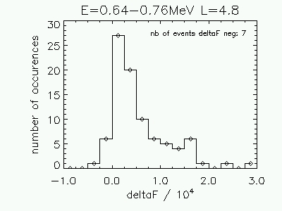
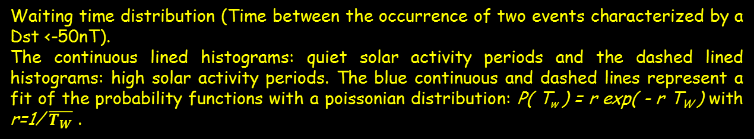
Introduction | Radiation environment | Space weather | Conclusion
Study of relevant parameters for flux forecasting.
Example:
Flux enhancement (deltaF in cm-² s⁻¹ sr⁻¹) distribution functions as deduced from the SAC-C data.
Probability of mis-forecasting
Waiting time distribution (Time between the occurrence of two events characterized by a Dst <-50nT).
The continuous lined histograms: quiet solar activity periods and the dashed lined histograms: high solar activity periods. The blue continuous and dashed lines represent a fit of the probability functions with a poissonian distribution: P( T_{w} ) = r exp( - r T_{W} ) with r=1/ $\overline{T_{W}}$ .
Notes:
Electron fluxes for the indicated energy and position as a function of time (data from 22 May – 24 November 2013). No averaging was done. The spread in data is mainly due to the spread of the counts in the unfolded spectra.
Decay times of electron fluxes were determined (it was presently done by selecting two points on the graph for each period (red, orange, pink); a more precise analysis will follow. These will serve as input for flux predictions in the foreseen space weather applications.
Lifetimes of energetic electrons are strong characteristics of a given position in space. Knowing the actual electron spectrum at that position, the subsequent fluxes may be forecasted up to a few weeks ahead based on the lifetime parameter (see left Figure). The probability of mis-forecasting can also be provided since it amounts to the probability of a geomagnetic storm having effectiveness to change the electron fluxes at that position.

Slide 10
Introduction | Radiation environment | Space weather | Conclusion
The development of the ground segment for EPT data processing involved teams from B.USOC, ESA/Redu, Qinetiq Space and UCL/CSR.
The EPT data are continuously acquired and stored in the PROBA-V host memory from where they are downloaded to the ESA satellite Mission Control Center in Redu at S-band passes every 1h30-3h30 or 8h-14h.
The EPT data acquisition is temporarily interrupted before data transmission (➔ reduced number of data around the Redu station), the EPT is active for > 96.5% of the time.
Redu Center
Data acquisition (TM at S-band pass)
Extraction of the EPT data set
EPT Configuration uploading (TC at S-band pass)
Data Center at B.USOC
Downloading of binary EPT and Ephemeris Data
Decommutation
Validation through remote desktop (by CSR)
EPT Configuration management (by CSR)
Export of EPT data to the Data Center at CSR
Data Center at CSR
Recording of L0 level EPT data
Conversion to L1 level (particle fluxes, geophysical parameters)
Data distribution to the users
Space weather services and radiation environment model
10
Notes:
The EPT data are continuously acquired and stored in the PROBA-V host memory from where they are downloaded to the ESA satellite Mission Control Center (MCC) in Redu, Belgium at S-band passes every 1h30-3h30 or 8h-14h. The EPT data are then complemented with the ephemeris data and transmitted to the Belgian User Support and Operation Center (B.USOC) for decommutation and primary validation. The so-called L0 data which undergo a primary validation are time series comprised of measured counts along with satellite coordinates and EPT housekeeping information. Upon successful validation, the L0 data are transmitted to the EPT Data Center at UCL - Center for Space Radiations (UCL/CSR) for a final validation and flux extraction. The extracted fluxes are stored as L1 data files at UCL and B.USOC from where they can be accessed for use in science and engineering-related studies that are performed in parallel with further data quality control. The data extraction procedure is described in more details in the following section. A high degree of autonomy is built into the EPT operations, allowing maximum flexibility for the user, while providing maximum operational availability. Although, the EPT data acquisition is temporarily interrupted before data transmission (which results in a reduced number of data around the Redu station), the EPT is active for > 96.5% of the time.

Slide 11
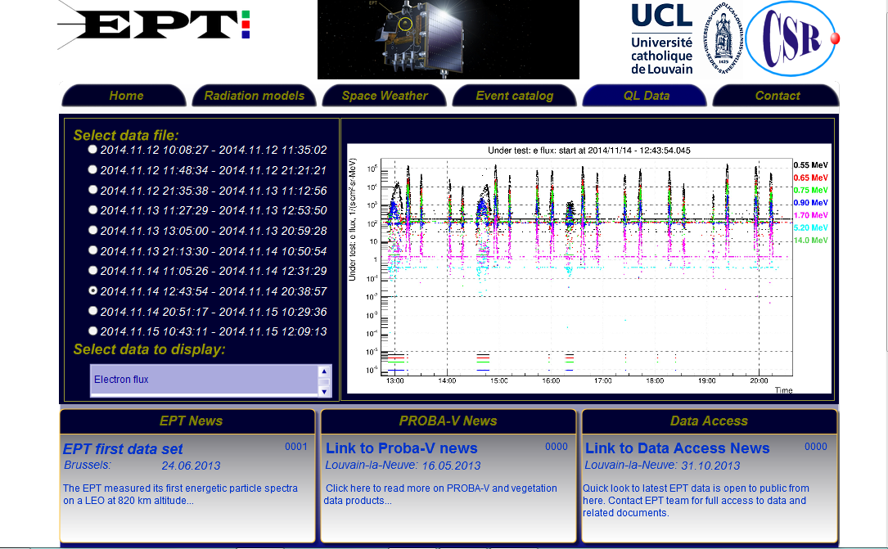
Introduction | Radiation environment | Space weather | Conclusion
http://web.csr.ucl.ac.be/csr_web/probav/

Slide 12
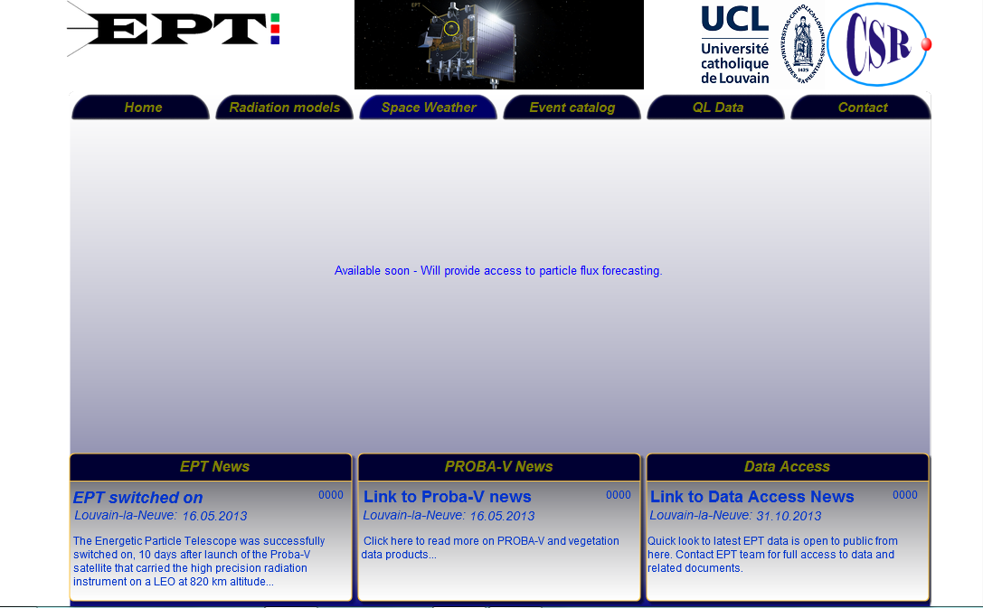
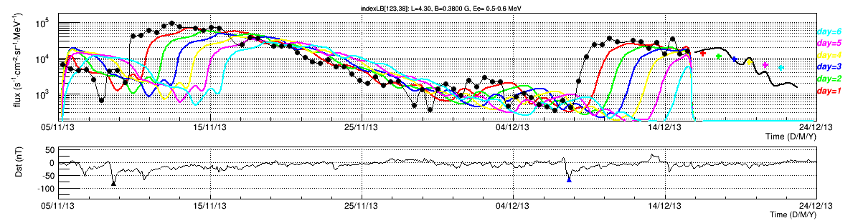
Introduction | Radiation environment | Space weather | Conclusion
Present day
15/12/13 14:00:00

Slide 13
Introduction | Radiation environment | Space weather | Conclusion
The PROBA-V/EPT and RBSP/RPS data are exploited to validate proton flux models at various positions for various energy ranges, while the flux angular distributions are taken into account;
No order of magnitude differences between AP8 (unidirectional max @ 90° PA) fluxes and PROBA-V/EPT measurements are observed for investigated positions along PROBA-V orbit. Moreover, conditions under which such huge discrepancies might be observed have been identified;
A case study shows that the AP9 v1.0 proton angular distribution is steeper than measured by PROBA-V/EPT and predicted from RBSP/RPS at a RP (AP9 v1.2 implemented an RPS-based correction);
PROBA-V/EPT data are used to characterize the (e-, p, He) flux dynamics at various space environments (decay times, …);
The development of flux forecast applications is underway and the web-site will be activated by beginning of next year;
Reference papers for the EPT data are available at request: sylvie.benck@uclouvain.be

Slide 14
Introduction | Radiation environment | Space weather | Conclusion
Acknowledgment
The authors are grateful to C. Baijot, D. Gerrits, S. Ilsen, K. Mellab, J. Naudet, C. Semaille, E. Tilmans, and J. Van Hove for authorizing, preparing and performing the off-pointing maneuvers without which PAD measurements at PROBA-V positions would not have been performed.
Special thanks to the PROBA-V/EPT team at B.USOC and QinetiQ Space for taking care of the data.
The CSR team also thanks P. Coquay, J. Nijskens, H. Verbeelen, and W. Verschueren at the Belgian Science Policy – Space Research and Applications (BELSPO) for support to the PRODEX project entitled “PROBA-V/EPT – Data Exploitation”, ESA Contract C4000107617.
Thank you!

