Slide 1
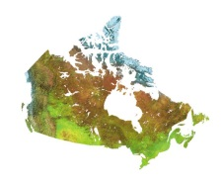
Characterization of high latitude GPS sensed ionospheric irregularities: Case studies Reza Ghoddousi-Fard¹, Paul Prikryl², Kjellmar Oksavik^{3,4}, C. van der Meeren³, François Lahaye¹, and Donald Danskin² ¹ Canadian Geodetic Survey, Natural Resources Canada, Ottawa, Canada ² Geomagnetic Laboratory, Natural Resources Canada, Ottawa, Canada ³ Birkeland Centre for Space Science, Dept. of Physics and Technology, University of Bergen, Norway, ⁴ Arctic Geophysics, The University Centre in Svalbard, Norway Reza.Ghoddousi-Fard@NRCan.gc.ca

Slide 2
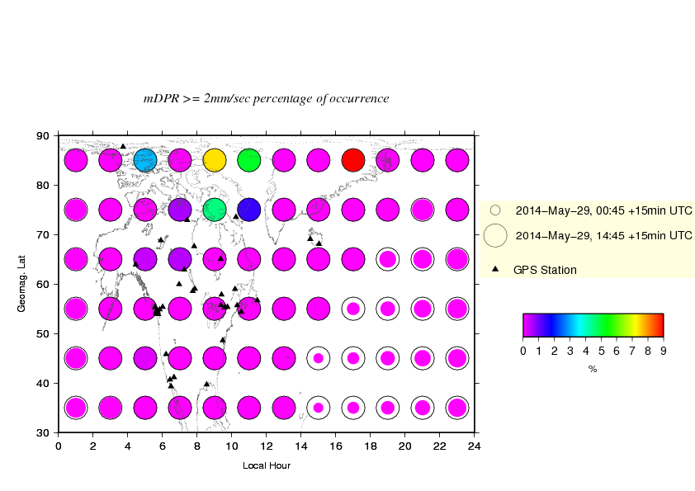
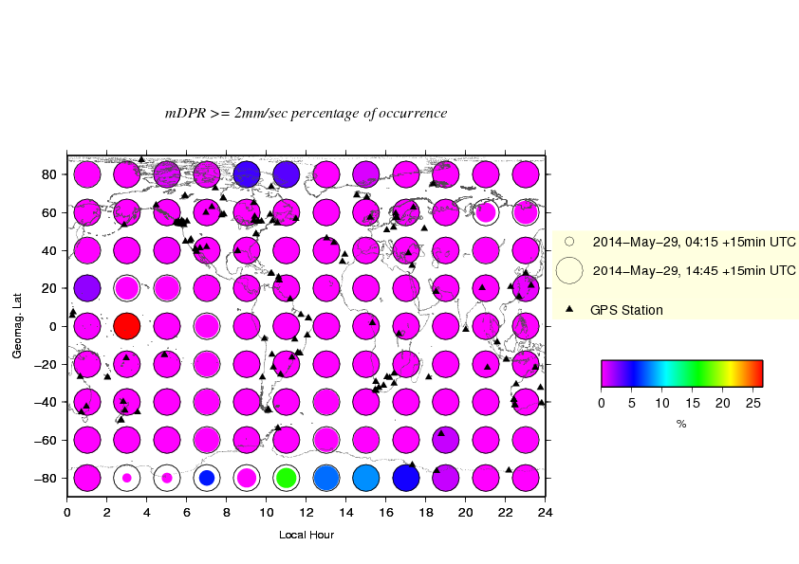
Ghoddousi-Fard et al. “Characterization of high latitude GPS sensed ionospheric irregularities: Case studies.“
At the Canadian Geodetic Survey (CGS) of Natural Resources Canada (NRCan) about 160 globally distributed 1Hz GPS stations are being used in near-real-time to derive phase rate variation statistics (Ghoddousi-Fard et al., 2013a) by means of mapped-to-zenith absolute mean (mDPR) and standard deviation (sDPR) of delta phase rate as defined below:
$$mDPR= \frac{\left|〈f(I_{g},ε_{g})〉\right|}{m(e)}$$
$$sDPR=\frac{\sqrt{〈{f(I_{g},ε_{g})}^{2}〉−{〈f(I_{g},ε_{g})〉}^{2}}}{m(e)}$$
where $f(I_{g},ε_{g})$ is the rate of the so-called geometry-free GPS dual frequency phase at two consecutive epochs which contains contributions from GPS phase ionospheric effects variations ($I_{g}$) and the phase multipath and noise ($ε_{g}$); and m(e) is an elevation angle (e) dependent mapping function.
GPS phase rate variations over Canada and adjacent regions have been analyzed during 2013 and early 2014. A number of scintillation events over polar, auroral and sub-auroral latitudes correlated with coronal mass ejections or high-speed solar wind streams have been identified and their analysis is complemented with observations from dedicated scintillation receivers from Canadian High Arctic Ionospheric Network (CHAIN) and a new multi-constellation receiver network in Svalbard.
Less affected by noise and multipath.
Better correlated with phase scintillation index.
A schematic near-real-time ionospheric irregularity and data coverage representation system: regional (left), global (right):

Slide 3
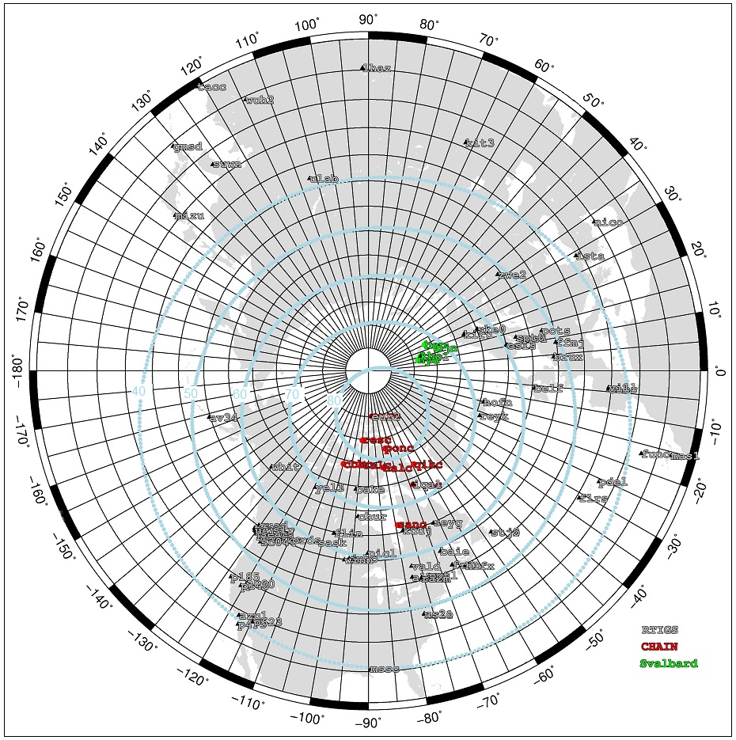
Ghoddousi-Fard et al. “Characterization of high latitude GPS sensed ionospheric irregularities: Case studies.“
Scintillation receivers complemented by 1Hz geodetic receivers.
High latitude 1Hz GPS RTIGS receivers
CHAIN GPS scintillation receivers
Svalbard GNSS scintillation receivers

Slide 4
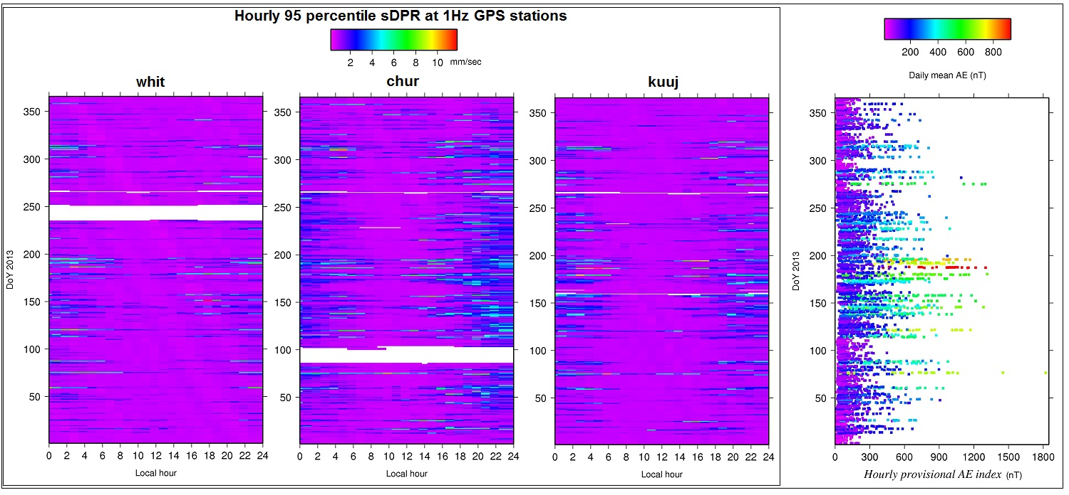
GPS phase ionospheric irregularities over auroral zone: Primarily a night time phenomena
Ghoddousi-Fard et al. “Characterization of high latitude GPS sensed ionospheric irregularities: Case studies.“
Year 2013 GPS phase rate statistics over Canadian auroral zone vs. AE index
DoY 187 (Jul 6): Highest daily mean AE in 2013
16-17 UT, DoY 76 (Mar 17): Highest hourly AE in 2013

Slide 5
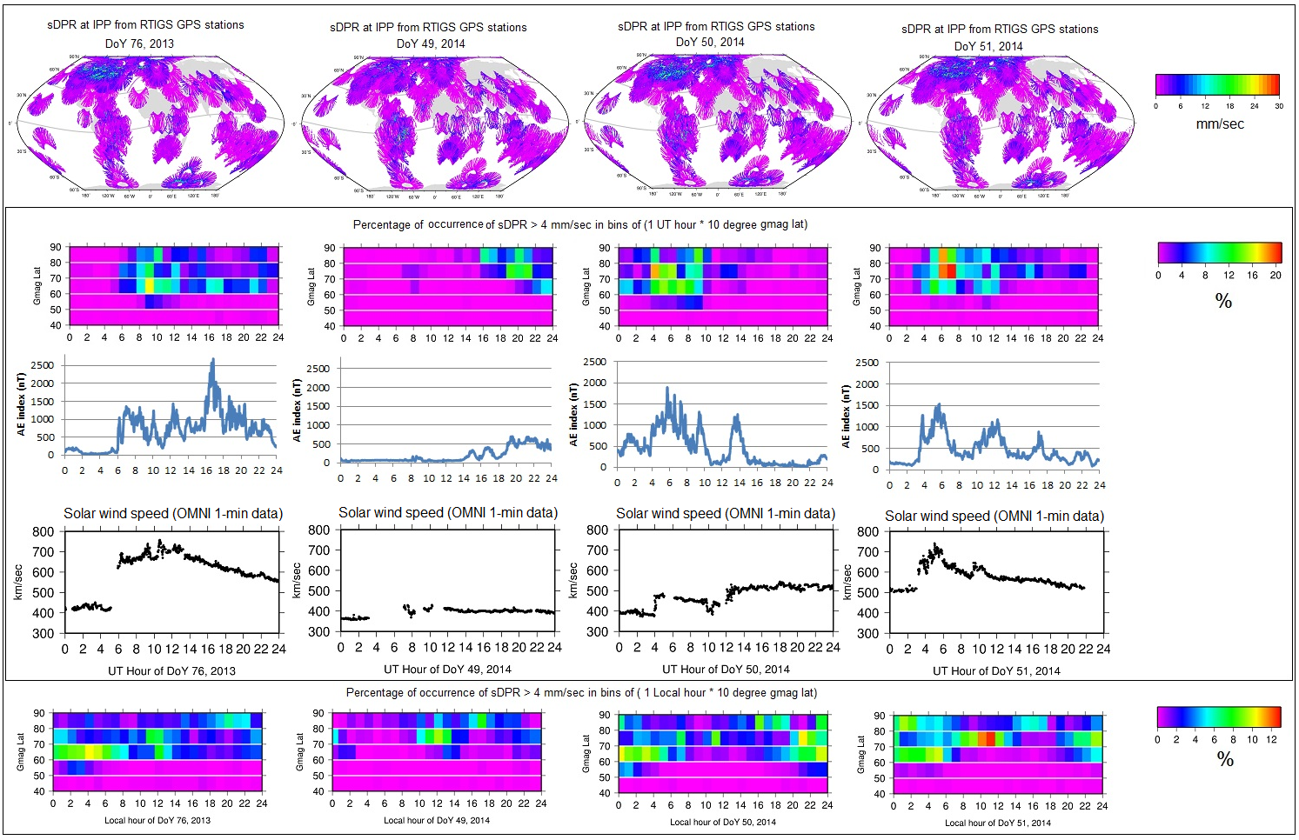
Ghoddousi-Fard et al. “Characterization of high latitude GPS sensed ionospheric irregularities: Case studies.“
Scintillation case studies: 1Hz GPS-based sDPR index responding to geomagnetic disturbances
24 hours sDPR at IPPs from global RTIGS stations being monitored in near-real-time at CGS of NRCan.
Geomagnetic storm.
See: Ghoddousi-Fard et al., 2013b
Geomagnetic storm.
Geomagnetic storm;
see next slide!
Correlation between large sDPR occurrences over high latitudes (gmaglat>40) with AE and solar wind speed is evident.
Mostly quiet!
GPS phase disturbances mostly occurred near local noon and around local midnight.

Slide 6
Ghoddousi-Fard et al. “Characterization of high latitude GPS sensed ionospheric irregularities: Case studies.“
Hourly sDPR at IPPs from 1HZ RTIGS GPS stations (geod. lat > 25) and AE index variations during Feb. 20 (DoY 51), 2014

Slide 7
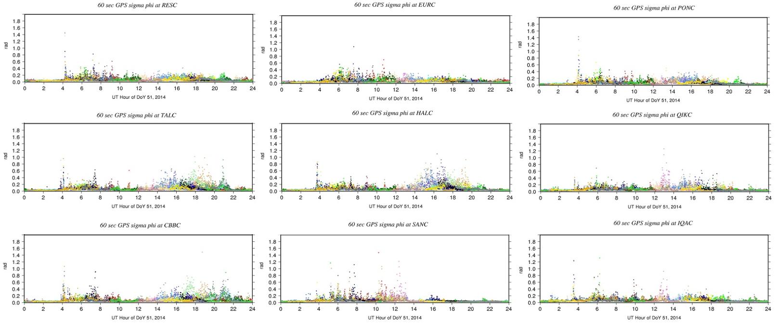
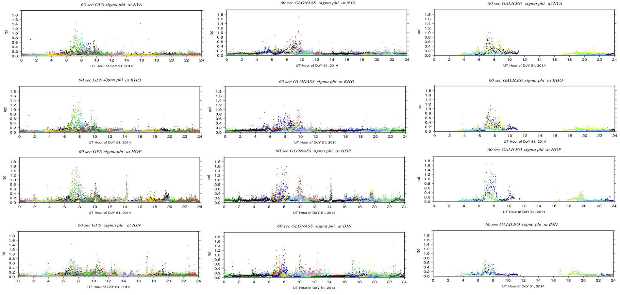
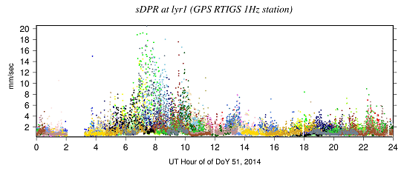
Ghoddousi-Fard et al. “Characterization of high latitude GPS sensed ionospheric irregularities: Case studies.“
A look at phase scintillation index ( ) at CHAIN and Svalbard stations during Feb. 20, 2014 (DoY 51)
GPS at CHAIN stations
sDPR at RTIGS 1HZ GPS station in Svalbard
GPS, GLONASS and Galileo at Svalbard stations
at most CHAIN stations show a phase scintillations increase at ~4 UT when rapid increase of solar wind speed occurred (and AE increased by about 1000 nT). However GNSS receivers as well as sDPR at RTIGS station at Svalbard do not show significant increase until ~7 UT. One may note that at 4 UT most CHAIN stations are near local mid-night whilst Svalbard is at morning-dawn sector.

Slide 8
Ghoddousi-Fard et al. “Characterization of high latitude GPS sensed ionospheric irregularities: Case studies.“
Summary and conclusions:
GPS dual frequency phase rate statistics being monitored in near-real-time at CGS of NRCan are responding to ionospheric irregularities over high latitudes and are well correlated with geomagnetic indices.
2013 dual-frequency GPS phase rate statistics over Canadian auroral zone confirms increased disturbances primarily over local midnight. However during periods of geomagnetic storms such irregularities can occur during local day-time as well. At higher latitudes phase scintillation is a frequent phenomena even without geomagnetic storms.
Proxy indices derived from geodetic 1 Hz GPS receivers complement scintillation receivers. Careful analysis of both geodetic and scintillation receivers’ background phase fluctuations resulting from instrumentation and near-field effects are crucial to avoid misleading interpretation of data.
References:
Ghoddousi-Fard R., P. Prikryl, and F. Lahaye (2013a). GPS phase difference variation statistics: A comparison between phase scintillation index and proxy indices. Advances in Space Research, 52, 1397-1405, DOI: 10.1016/j.asr.2013.06.035.
Ghoddousi-Fard R., P. Prikryl, and F. Lahaye (2013b). GPS phase difference variations and phase scintillation index: A comparison. Presentation given at International Reference Ionosphere Workshop 2013, Olsztyn, Poland, 24-28 June 2013. [http://www.uwm.edu.pl/kaig/iri_workshop_2013/]
Acknowledgements:
Canadian High Arctic Ionospheric Network (CHAIN) and International GNSS Service (IGS) are thanked for data access.

Slide 9
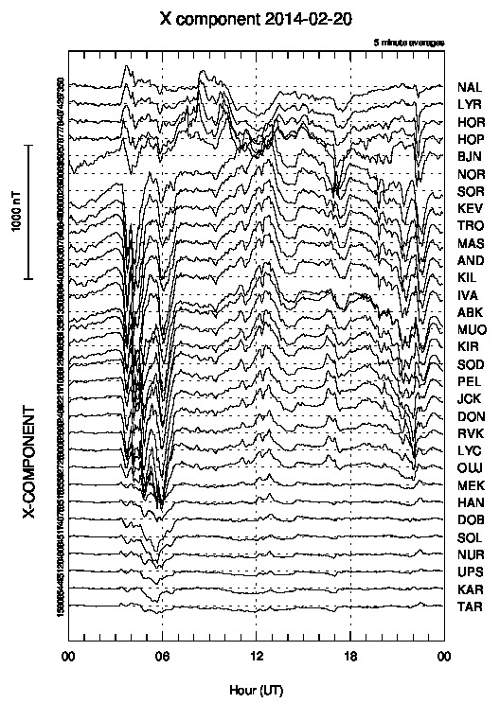
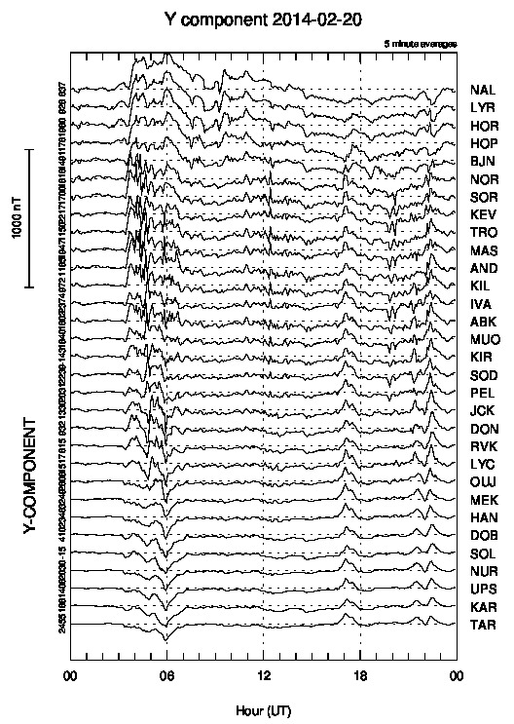
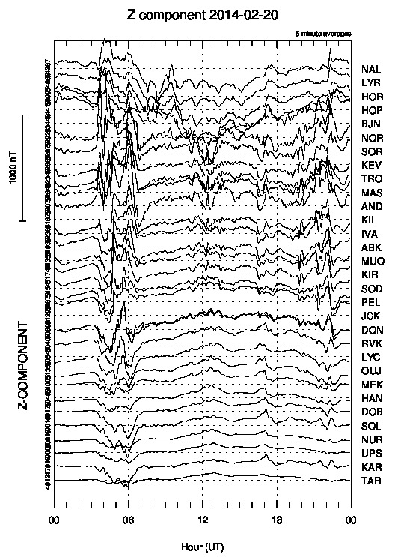
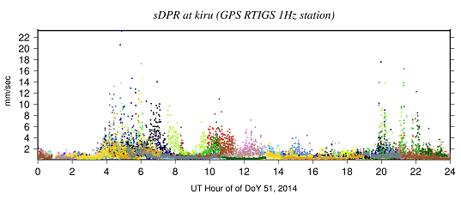
Ghoddousi-Fard et al. “Characterization of high latitude GPS sensed ionospheric irregularities: Case studies.“
Backup slide
http://space.fmi.fi/image/

