Slide 1
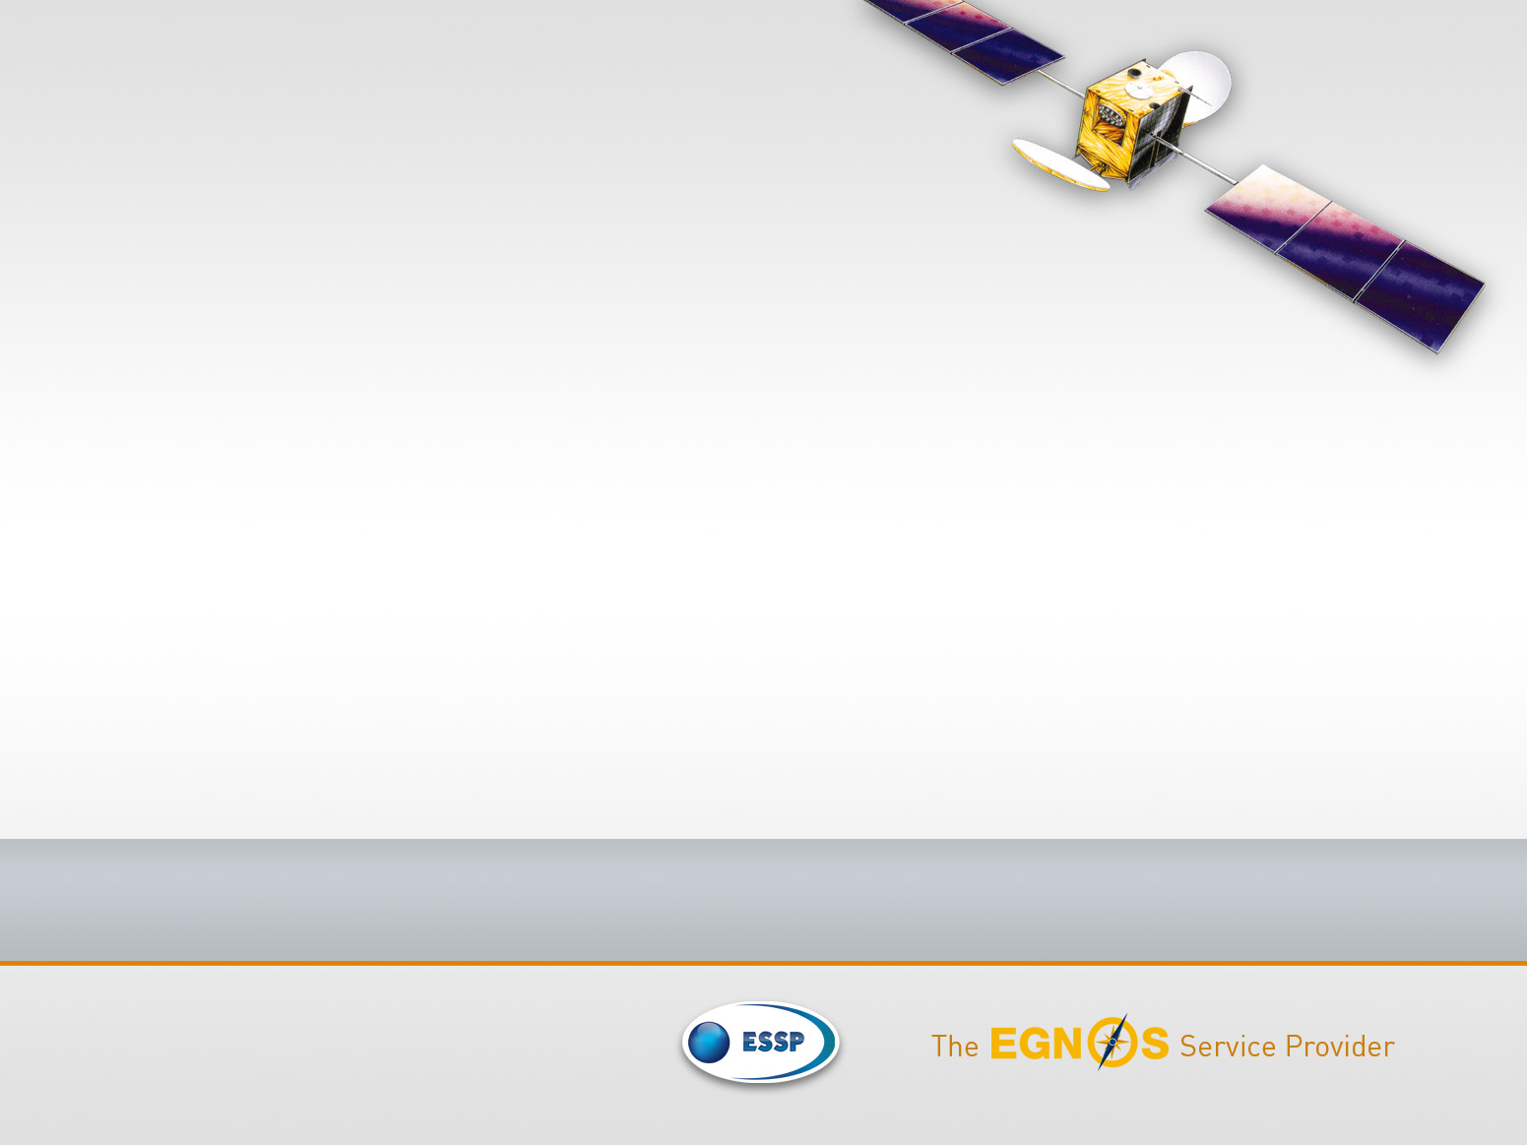
Space Weather Effects over EGNOS Performance in the North of Europe
11th SWW, Liege, 17th November 2014
Presenter author: Pedro Pintor
Authors: R. Roldán, J. Gómez, C. de la Casa, R.M. Fidalgo

Slide 2
  SBAS impacted by Ionosphere
EGNOS (left) and WAAS (right) LPV performance results on 19th (top) and 27th February 2014 (bottom) from ESSP and FAA websites
2

Slide 3
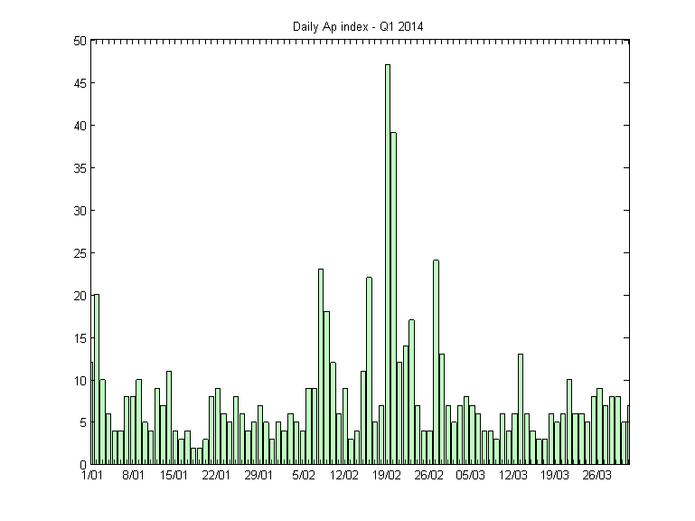
  Geomagnetic indexes
Several indexes represent the disturbances in the ionosphere:
K/Kp index: The K index provides a representation of disturbances in the magnetic field, during a 3-hour interval.
A/Ap index: The A index represents a daily average value of the geomagnetic activity measured at a specific station.
3

Slide 4
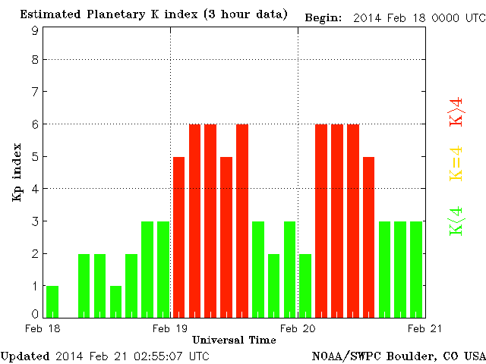
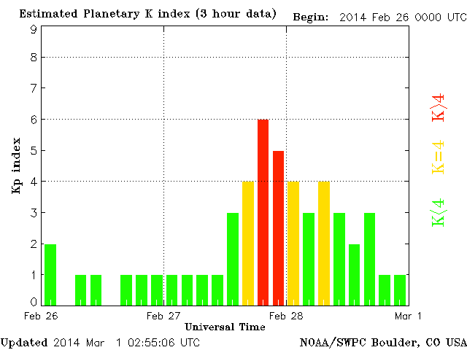
  Reaction of geomagnetic indexes
The 3-hour Kp indexes during the 19th (left) and 27th (right) February 2014 from NOAA/SWPC.
However, both WAAS and EGNOS were much more impacted on 27th.
4

Slide 5
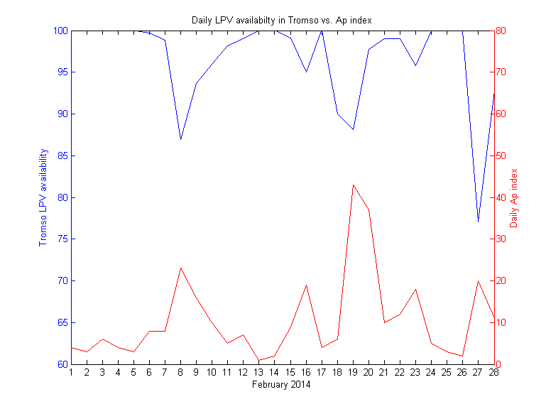
  Reaction of geomagnetic indexes
Correlation of Ap index and EGNOS LPV Availability at RIMS Tromso(Norway)
Although correlated, similar variations in Ap index does not produce similar variations in a specific location
5

Slide 6
  Geomagnetic indexes limitations
Then, the use of Kp and Ap indicators presents some limitations:
Level of correlation
Temporal resolution
Geographical applicability
6

Slide 7
  Need of a different approach
SBAS
Performance depends on Ionosphere
IONO indicators present limitations
?
7
Notes:
SBAS systems model its ionospheric corrections and integrity information from Total Electron Content (TEC).
TEC disturbances are known to be also correlated to geomagnetic storms (Mendillo, 2007) and local time (Biquiang et al.,2007).
storms, at the same time can be traced to exchanges between the Earth’s magnetosphere and the interplanetary conditions originated by the Sun (Zhang et al., 2007).
Space weather research is bent on understanding a series of phenomena originated when the Sun liberates matter into the solar system:
coronal mass ejections (Webb, et al, 2012),
solar flares(Hudson, 2011)
coronal holes (Cranmer, 2002)
solar prominences and filaments (Van Ballegooijen et al., 1989).
Moreover, the matter blown out from the sun moves away from it in a continuous but varying flow and is called the solar wind.
The magnetic field of the solar system, arising from the magnetic activity of the Sun is called the interplanetary magnetic field (IMF).

Slide 8
  Need of a different approach
SBAS
Performance depends on Ionosphere
IONO indicators present limitations
Look for new dependencies directly from the cause of geomagnetic storms
8
Notes:
SBAS systems model its ionospheric corrections and integrity information from Total Electron Content (TEC).
TEC disturbances are known to be also correlated to geomagnetic storms (Mendillo, 2007) and local time (Biquiang et al.,2007).
storms, at the same time can be traced to exchanges between the Earth’s magnetosphere and the interplanetary conditions originated by the Sun (Zhang et al., 2007).
Space weather research is bent on understanding a series of phenomena originated when the Sun liberates matter into the solar system:
coronal mass ejections (Webb, et al, 2012),
solar flares(Hudson, 2011)
coronal holes (Cranmer, 2002)
solar prominences and filaments (Van Ballegooijen et al., 1989).
Moreover, the matter blown out from the sun moves away from it in a continuous but varying flow and is called the solar wind.
The magnetic field of the solar system, arising from the magnetic activity of the Sun is called the interplanetary magnetic field (IMF).

Slide 9
  Our different approach
SBAS iono
Depends on TEC (RTCA MOPS 229)
TEC
Correlated to Geomagnetic storms (Mendillo, 2007)
Geomagntic storms
Earth’s magnetosphere exchanges with interplanetary conditions (Zhang, 2007)
Interplanetary conditions
Interplanetary conditions originated by solar phenomena:
Coronal Mass Ejections (Webb, 2012)
Solar flares (Hudson, 2011)
Coronal holes (Cranmer, 2002)
Solar prominences and filaments
Solar phenomena
originates
Solar wind
Interplanetary Magnetic Field (IMF)
9
Notes:
SBAS systems model its ionospheric corrections and integrity information from Total Electron Content (TEC).
TEC disturbances are known to be also correlated to geomagnetic storms (Mendillo, 2007) and local time (Biquiang et al.,2007).
storms, at the same time can be traced to exchanges between the Earth’s magnetosphere and the interplanetary conditions originated by the Sun (Zhang et al., 2007).
Space weather research is bent on understanding a series of phenomena originated when the Sun liberates matter into the solar system:
coronal mass ejections (Webb, et al, 2012),
solar flares(Hudson, 2011)
coronal holes (Cranmer, 2002)
solar prominences and filaments (Van Ballegooijen et al., 1989).
Moreover, the matter blown out from the sun moves away from it in a continuous but varying flow and is called the solar wind.
The magnetic field of the solar system, arising from the magnetic activity of the Sun is called the interplanetary magnetic field (IMF).

Slide 10
  Presentation of our analysis
The method of analysis searches a relation among:
Earth’s magnetic field
TEC rate
SBAS perfo
Inter
planetary magnetic field
Solar wind speed
Solar phenomena
(Zhang, 2007)
NOAA reports
10

Slide 11
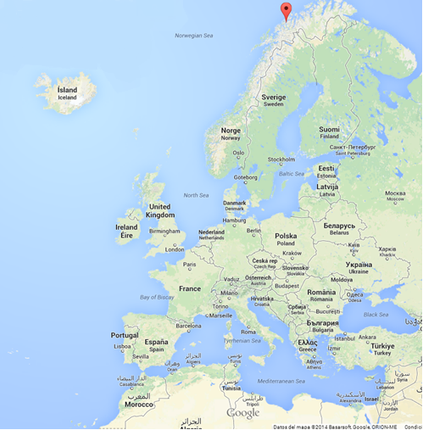
  Presentation of our analysis
Tromso (Norway)
Latitude: 69º 39’
Longitude: 18º 57’
EGNOS
Limit of the service area (70º N)
Our analysis: North of Europe
IONO degradations are also present in the south but they are related to scintillation
Source: Google
11

Slide 12

  Presentation of our analysis
Event #2
Event #2cont
Event #3
Event #1
12

Slide 13
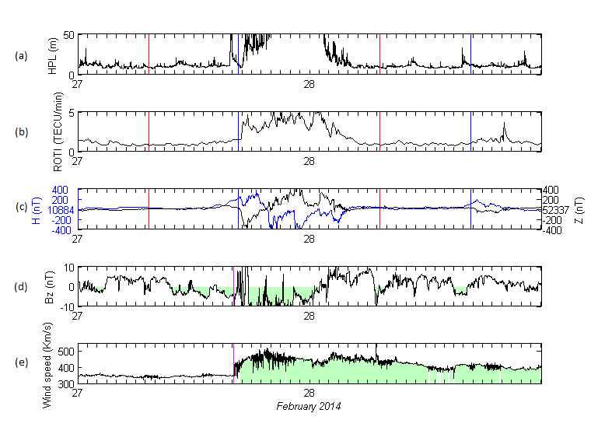
  Event #1: 27th-28th
18 UTC Kp=4
21 UTC Kp=6
17 UTC
02 UTC
00 UTC Kp=4
03 UTC Kp=3
17 UTC
02 UTC
15 UTC
04 UTC
CME assoc. to a X4.9 flare erupted at 0049UTC on February 25th
16 UTC
02 UTC
Temporal profiles of (a) the EGNOS LPV HPL in Tromso, (b) ROTI for Northern Norway (67⁰-72º) (c) H and Z components of the geomagnetic field in Tromso (d) IMF Bz component (e) solar wind speed.
13

Slide 14
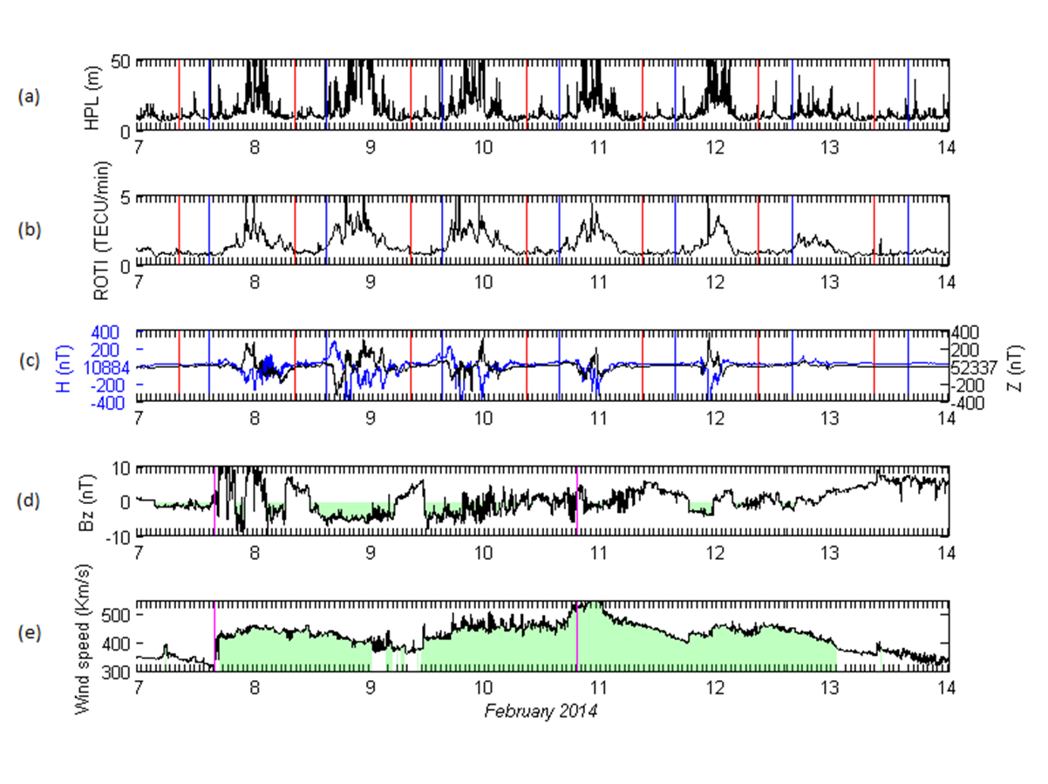
  Event #2: 7th-13th
Max Kp=5
9th 21 UTC
No degradations during daylight
CME assoc. to a M3.8 flare on 4th
CHHSS on 9th
16 UTC
19 UTC
Temporal profiles of (a) the EGNOS LPV HPL in Tromso, (b) ROTI for Northern Norway (67⁰-72º) (c) H and Z components of the geomagnetic field in Tromso (d) IMF Bz component (e) solar wind speed.
14

Slide 15
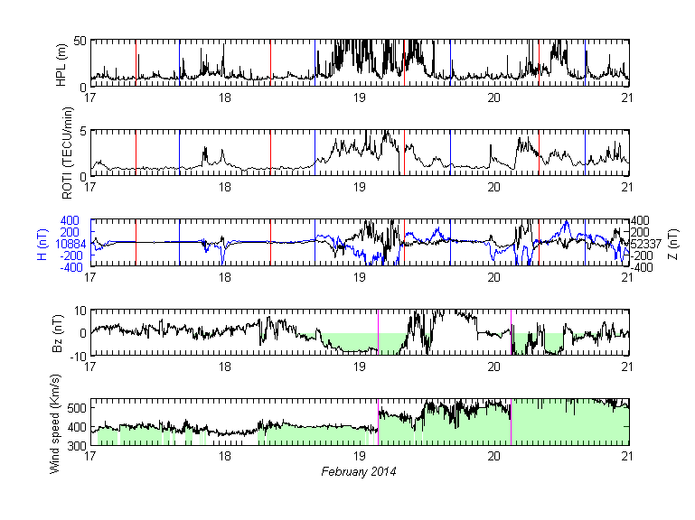
  Event #3: 18th-20th
21 UTC Kp=3
00 UTC Kp=5
03 UTC Kp=6
06 UTC Kp=6
09 UTC Kp=5
12 UTC Kp=6
CME 16th
FILAMENT ERUPTION 18th
13 UTC
03 UTC
Temporal profiles of (a) the EGNOS LPV HPL in Tromso, (b) ROTI for Northern Norway (67⁰-72º) (c) H and Z components of the geomagnetic field in Tromso (d) IMF Bz component (e) solar wind speed.
15

Slide 16
  Acknowledge to data providers
EGNOS | ESSP
Rate of TEC index at ground | Norwegian Mapping Authority (NMA)
Earth’s magnetic field | Tromso Geophysical Observatory (TGO)
ACE spacecraft & reports | NOAA
16

Slide 17

  Conclusions
This study finds a link between EGNOS LPV performance outliers and:
  Variations in the ROTI
  Earth’s magnetic field
  Solar wind speed
  IMF Bz component
  Other parameters can also be used for monitoring (AATR, …)
17

Slide 18
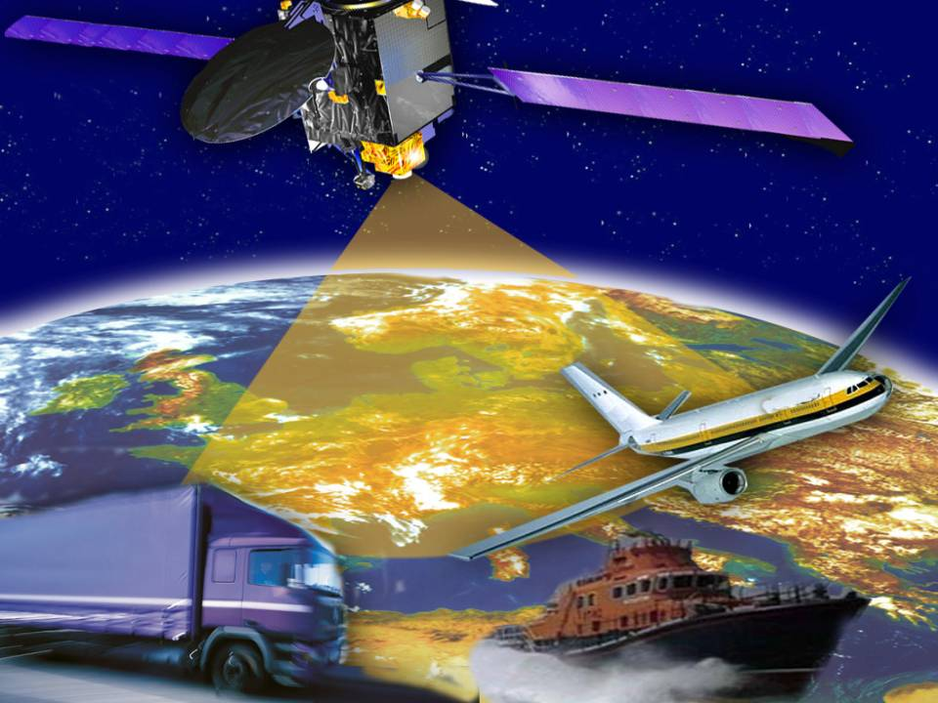

Thanks!
26 Oct 2009
EVENT TITLE
18

Slide 19

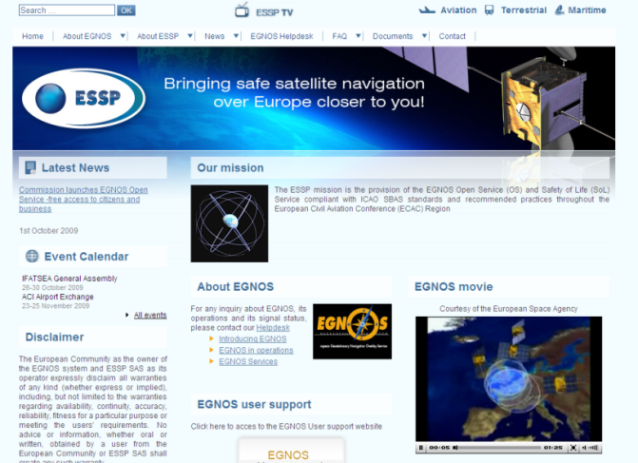
How to Contact ESSP?
ESSP Website:
  www.essp-sas.eu
EGNOS User Support Website:
  http://egnos-user-support.essp-sas.eu
EGNOS User Helpdesk:
  Egnos-helpdesk@essp-sas.eu
  +34 911 236 555 (24/7)
  Others:
  Communication@essp-sas.eu

