Slide 1
Cross-calibration of SOHO/ERNE proton and heavy ion measurements with other particle instruments at L1
E. Valtonen, M. Paassilta, R. Vainio, O. Raukunen, and E. Riihonen
Space Research Laboratory
Department of Physics and Astronomy
University of Turku

Slide 2
Contents summary
L1 instrument cross-calibrations within SEPServer project
ERNE instrument
Instrumental effects
Finding solutions
Conclusions

Slide 3
L1 instrument cross-calibrations within SEPServer project
SEPServer
EU FP7 funded project 2010-2013
Server to access SEP and related EM data and analysis tools
Data quality assessment
Cross-calibration of instruments at L1
E.g., SOHO/ERNE, SOHO/EPHIN, ACE/EPAM, and ACE/SIS proton and helium spectra and SOHO/ERNE and ACE/SIS heavy ion spectra
See also Poster Id 72832 by B. Heber et al.
Generally relatively good agreement, but also some instrumental effects found

Slide 4
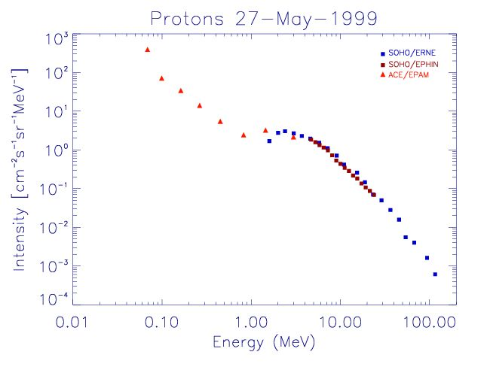
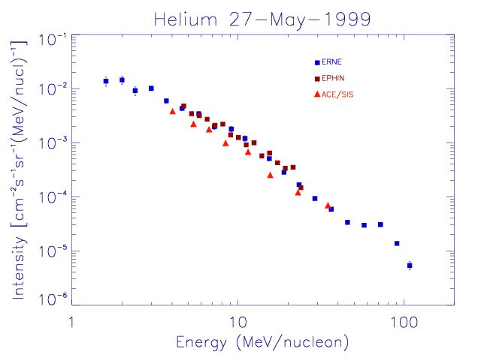
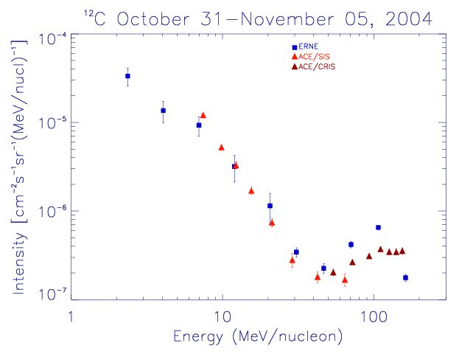
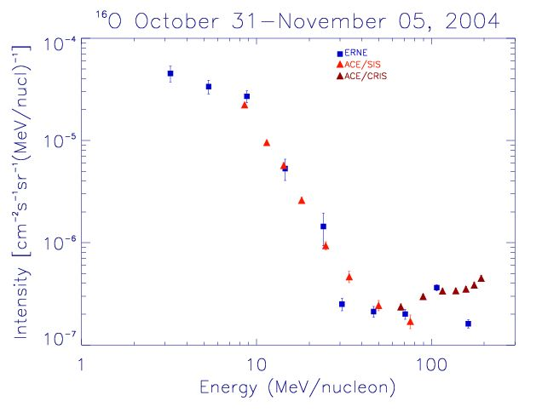
“Relatively good agreement”

Slide 5
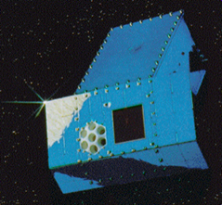
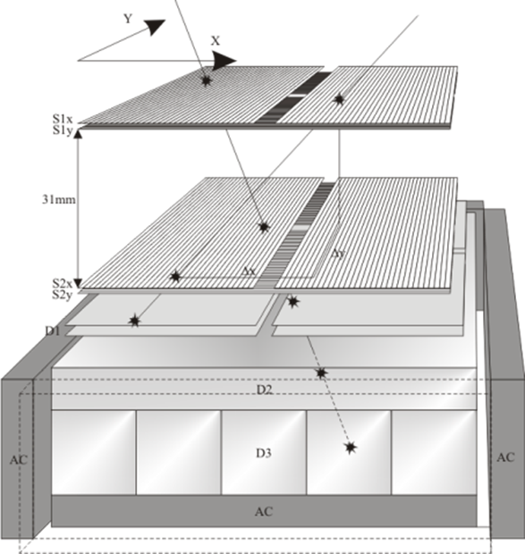
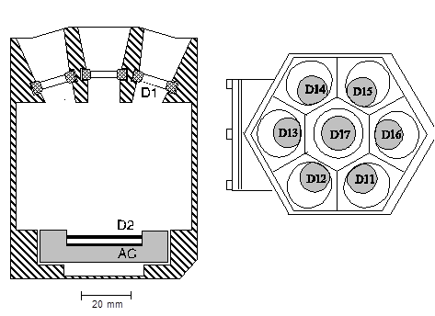
ERNE instrument
High Energy Detector (HED)
Two sensors
Four layers of strip detectors
70 mm
D1
Low Energy Detector (LED)
D2
D3
Proton and helium spectra constructed onboard
Heavy ions as pulse heights to ground

Slide 6
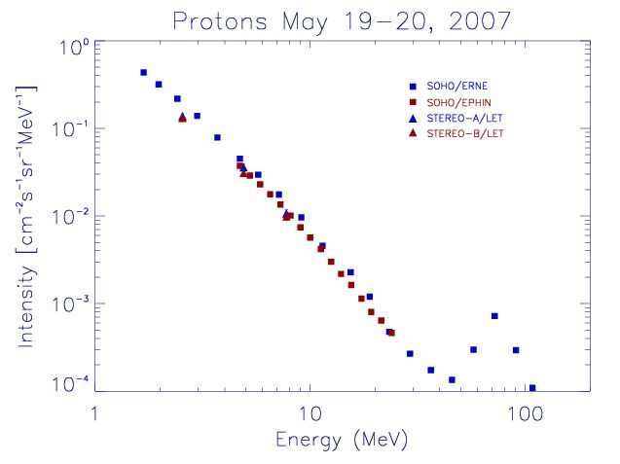
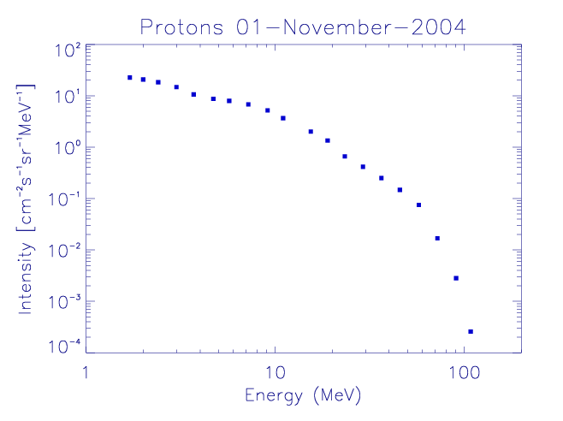
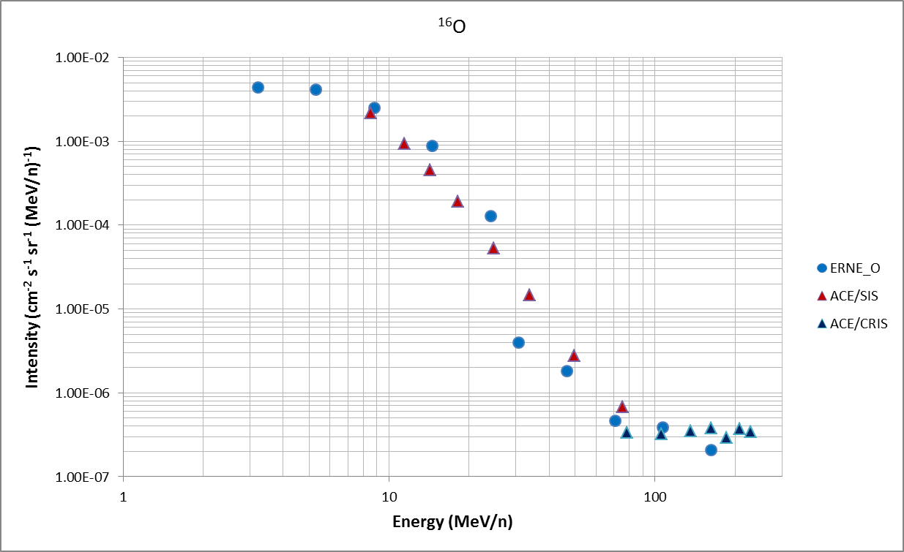
Instrumental effects
?
?
Bump
Steep fall?
In addition:
Saturation of HED during largest SEP events
Not considered here
Inaccurate G?

Slide 7
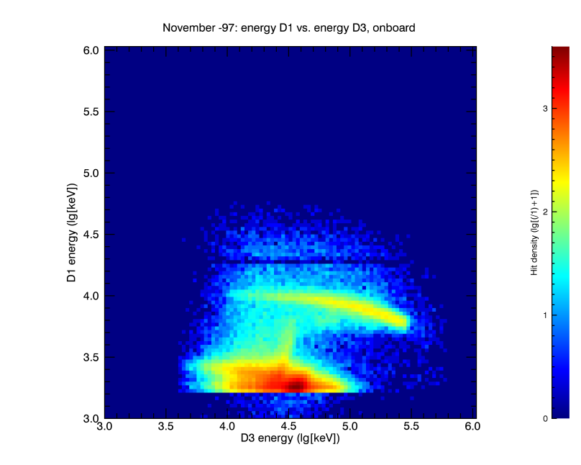
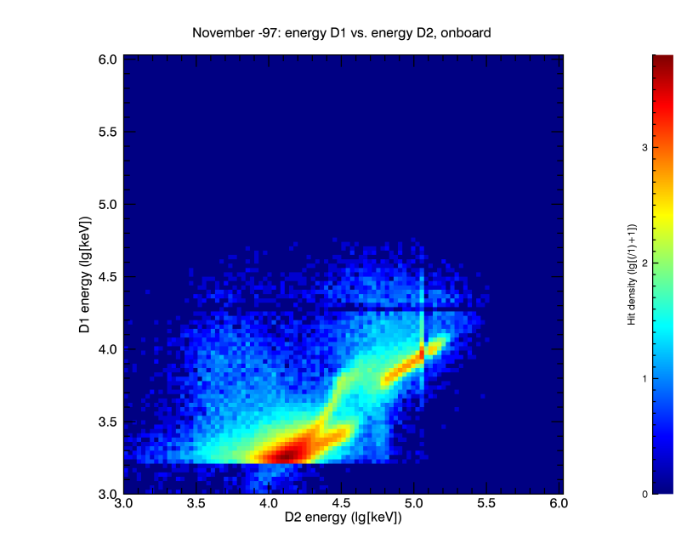
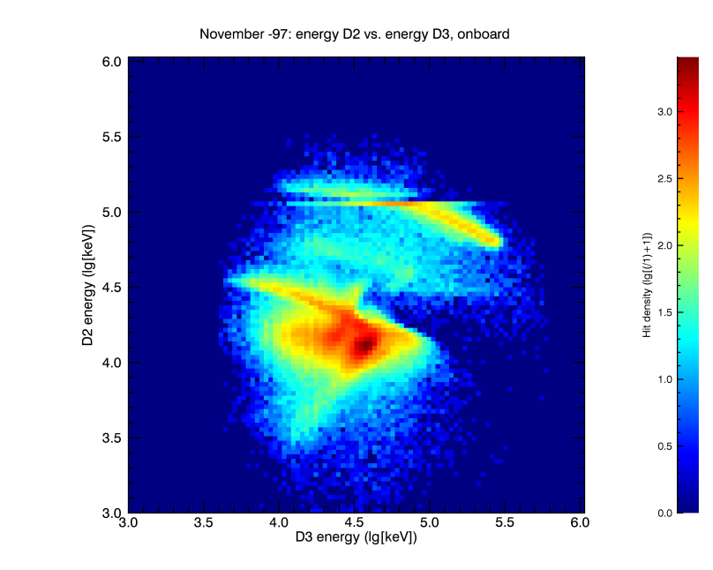
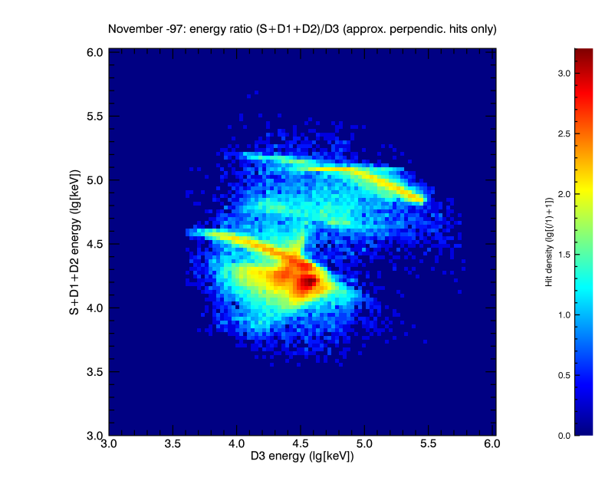
Finding solutions
Bump in proton spectrum
Due to background: inefficient anticoincidence shield
Particles “stopping” in D3
Helium
Protons
Background

Slide 8
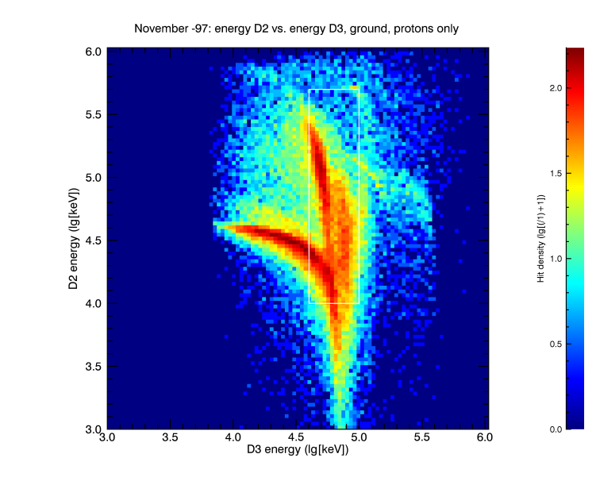
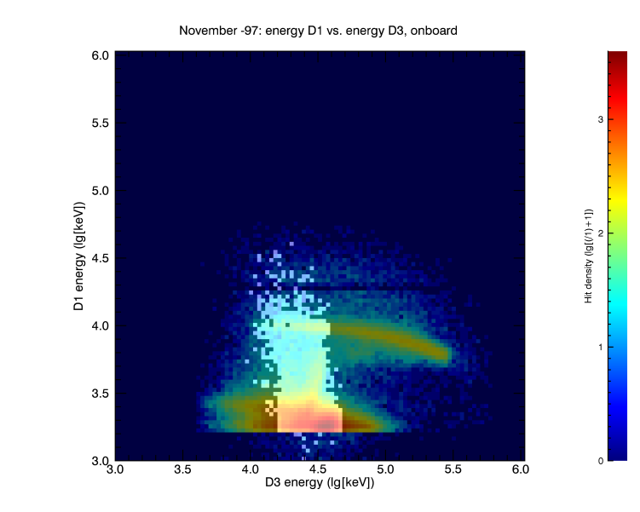
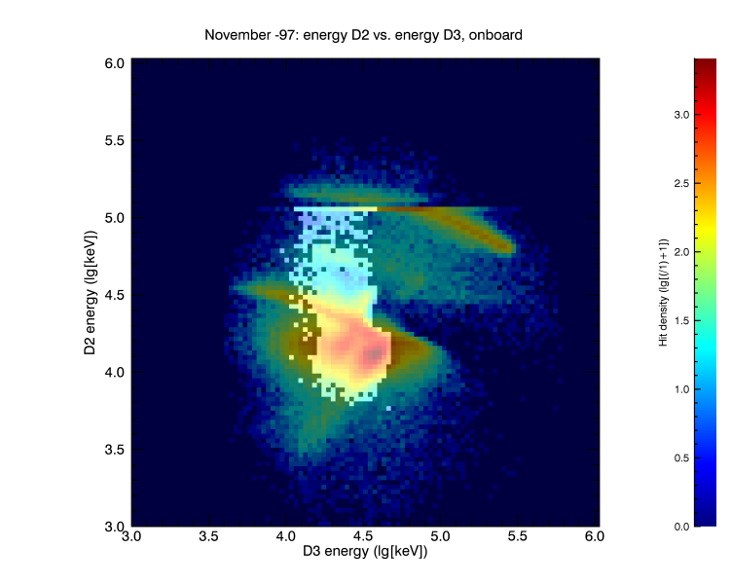
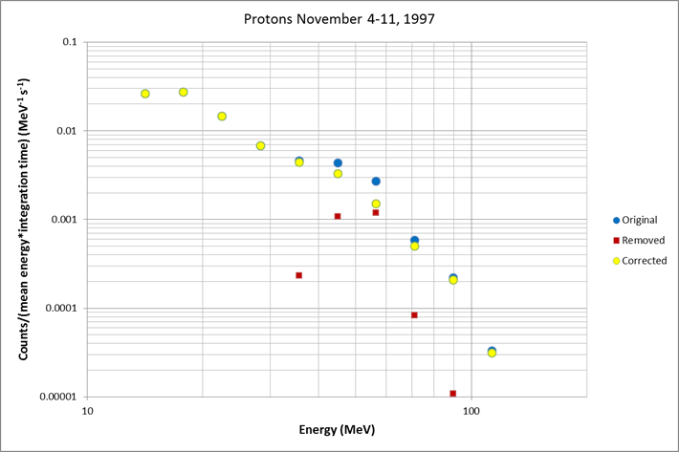
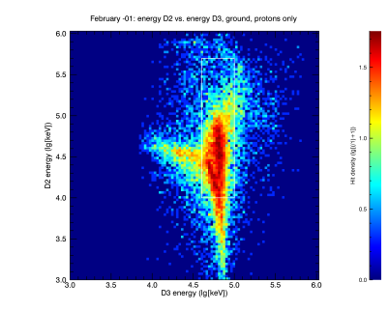
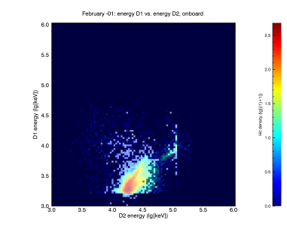
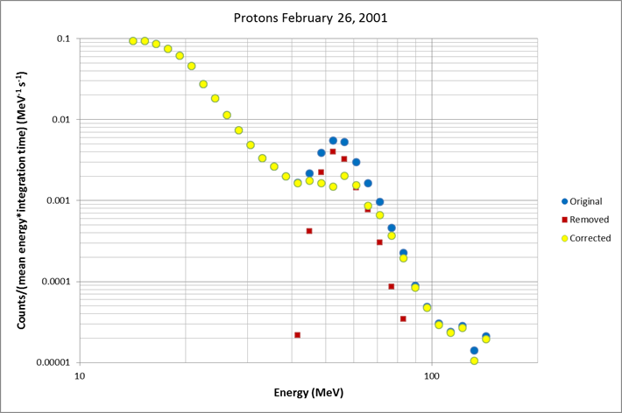
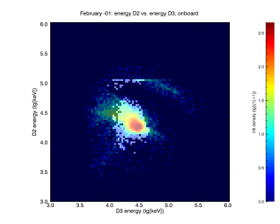
Ground-processed
Selected ground-processed converted to onboard-analysed

Slide 9
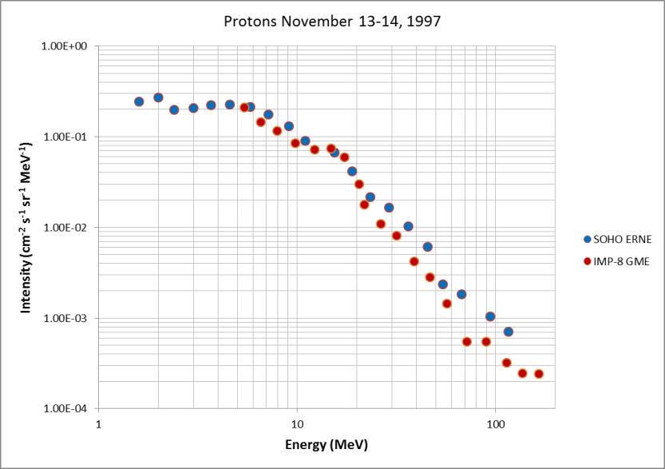
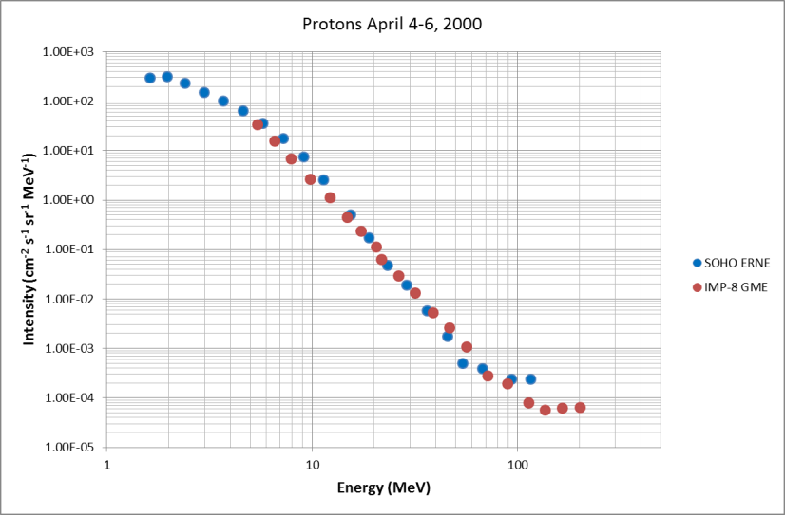
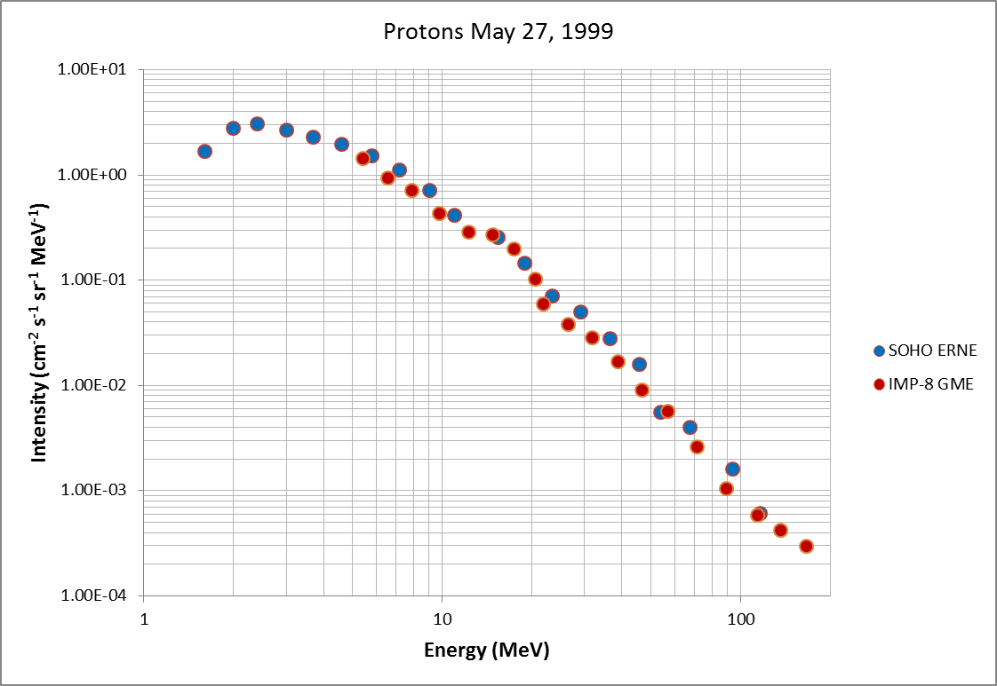
Finding solutions
Steep fall of proton spectrum
Partial cause: onboard event selection?
Cuts out highest energy protons
Instrument aging?
IMP-8 GME data from
http://dev.sepem.oma.be/index.php

Slide 10
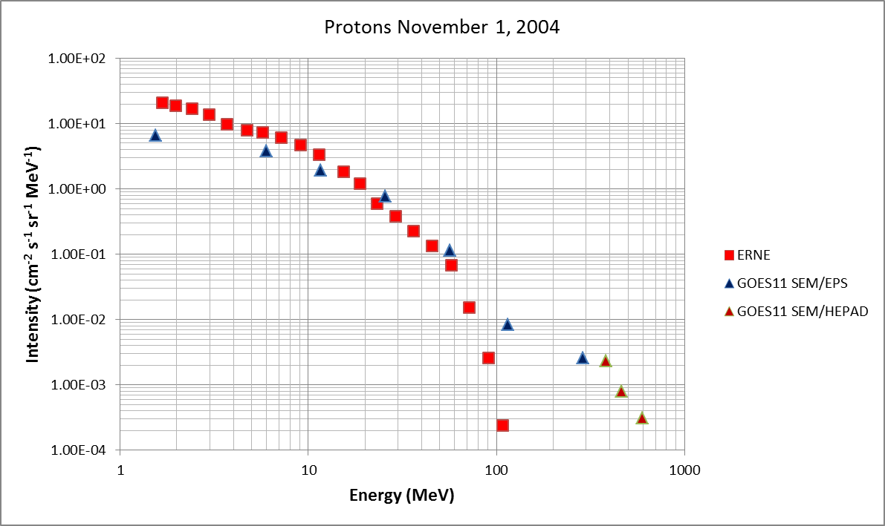
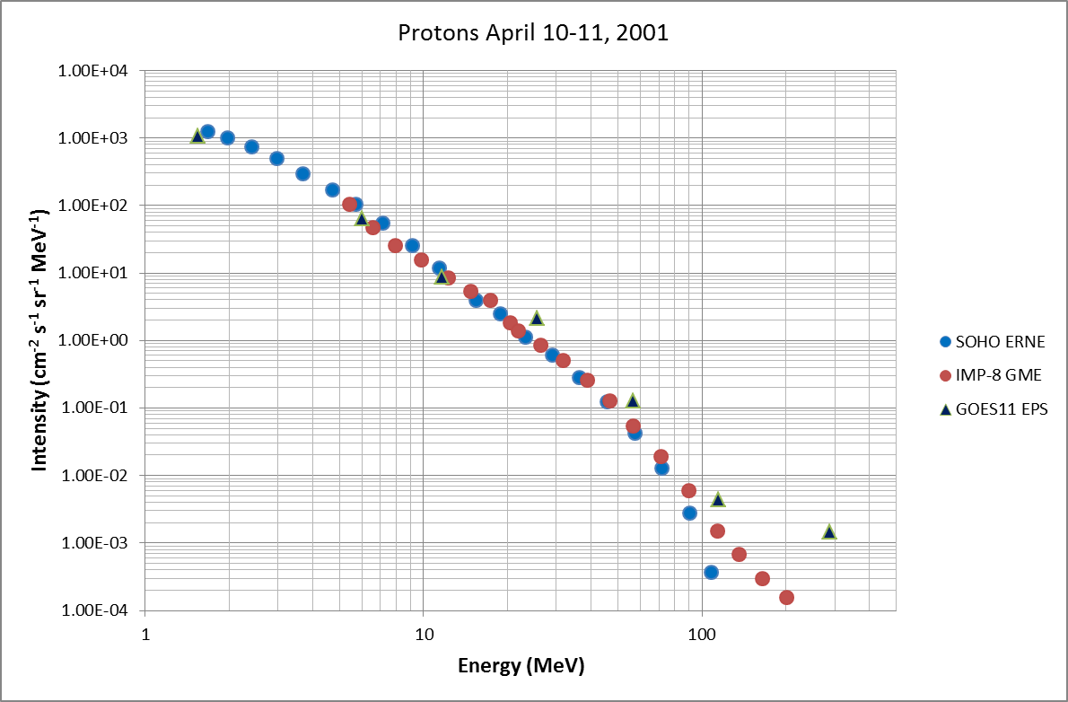
GOES 11 SEM data from
ftp://satdat.ngdc.noaa.gov/sem/goes/
data/new_avg/2004/11/goes11/csv/

Slide 11
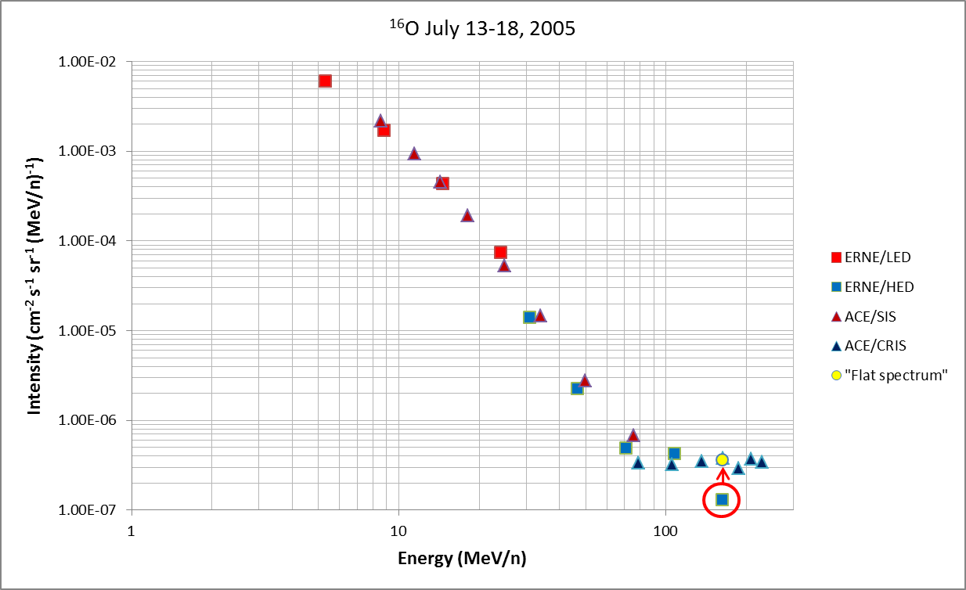
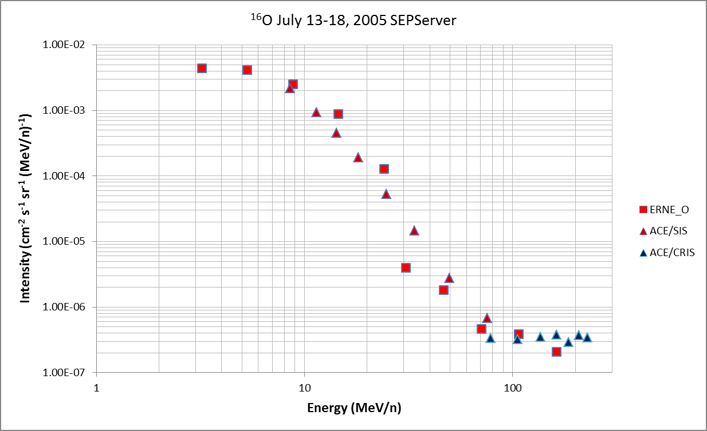
Finding solutions
Geometric factor for heavy ions
New calculation for ERNE/LED
Geant 4 simulation fro ERNE/HED ¹⁶O
Updated G

Slide 12
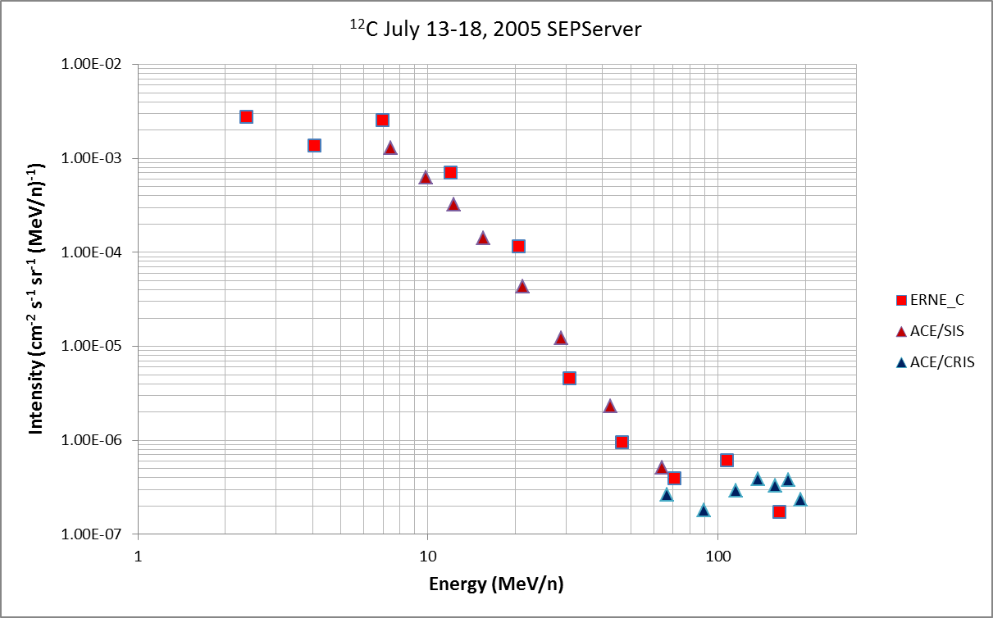
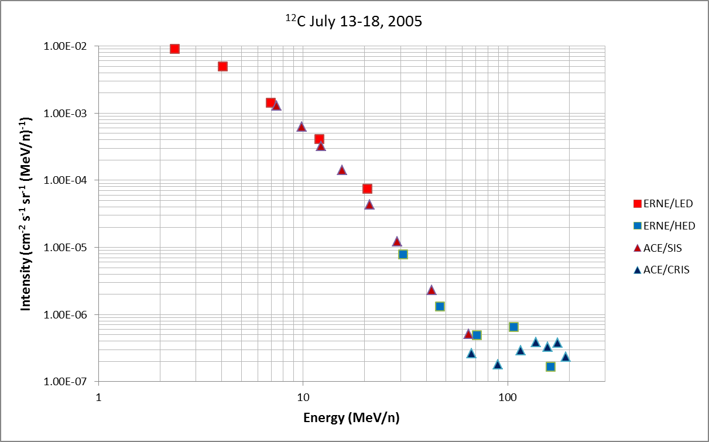
Updated G
For heavy ion measurements, see also poster in Session 8 by Raukunen et al.

Slide 13
Conclusions
Cross-calibration work of L1 particle instruments continued from the SEPServer project
SOHO ERNE proton spectrum investigated with the goal of improving match with other instruments
Small SEP event/quiet time “bump” removal
Steep spectral fall at energies $≳$70-80 MeV
Further work required
Heavy ion spectra with slightly revised geometric factors
Geant 4 verification of geometric factors for all (heavy) elements

