Slide 1



Comparative data quality assessment for ACE SIS, ACE EPAM, WIND 3DP, SOHO/ERNE, and SOHO EPHIN during selected solar energetic particle events
B. Heber¹, N. Dresing¹, P. Kühl¹, R. Gomez-Herrero², O. Malandraki³, A. Papaioannou³, P. Marhavilas⁴, E. Valtonen⁵, O. Raukunen⁵, V. Riihonen⁵, and D. Heynderickx⁶
¹Christian-Albrechts-Universität zu Kiel, Germany, ²Universidad de Alcalá, Departamento de Física y Matemáticas, Spain, ³IAASARS, National Observatory of Athens, Greece, ⁴Democritus University of Thrace, Greece ⁵University of Turku, Finnland,⁶DH Consultancy, Belgium

Slide 2
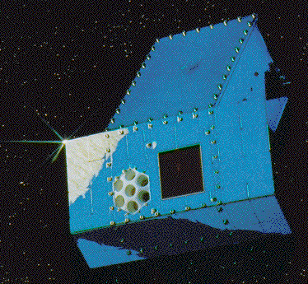
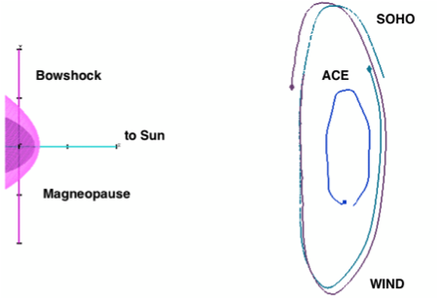
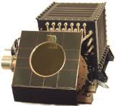
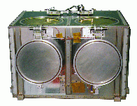
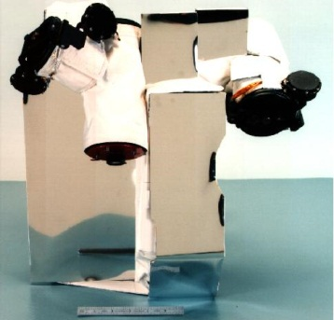
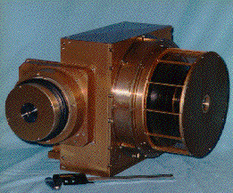
SOHO/ERNE
SOHO/EPHIN
ACE/SIS
dE/dx-E technique
ACE/EPAM
WIND/3DP
Magnet foil
technique

