Slide 1
The new Sunspot Number A full recalibration
ROB STCE
Frédéric Clette
World Data Center SILSO, Royal Observatory of Belgium
L. Svalgaard Stanford University
J.M. Vaquero Universidad de Extremadura
E.W. Cliver National Solar Observatory, Sunspot

Slide 2
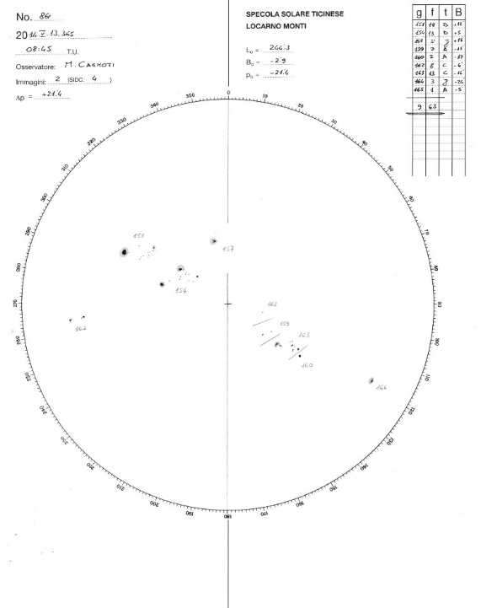
Sunspot Number: definition
Wide range of applications:
Constraint for solar dynamo models
Quantitative reference for solar irradiance and solar wind reconstructions, cosmogenic isotopes, as timebase for Sun-driven processes
Tracer of the long-term solar influences on Earth (climate change, atmospheric drag, cumulative GIC effects).
Wolf Number (Wolf 1851): W= 10 Ng + Ns
≠ Sunspot number:
Multiple stations
Statistical k personal scaling factors
Fröhlich & Lean 2004

Slide 3
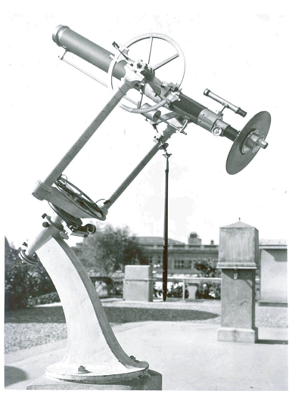
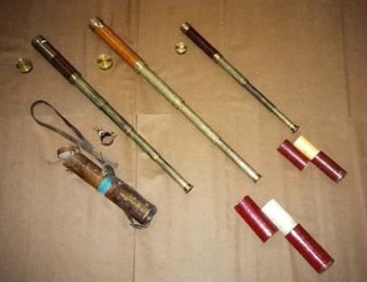
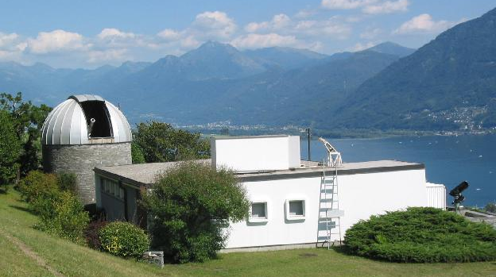
Sunspot Number: a composite series
Historical reconstruction (1749-1849):
Scale adjusted to Wolf’s observations
Primary Wolf observations (1849-1893):
Standard 83mm refractor
Small 37 and 43 mm travel telescopes
Zürich period (1893-1980):
New counting method: 0.6 factor
1955: Zürich + Specola (Locarno) stations

Slide 4
Sunspot Number: a composite series
Historical reconstruction (1749-1849):
Scale adjusted to Wolf’s observations
Primary Wolf observations (1849-1893):
Standard 83mm refractor
Small 37 and 43 mm travel telescopes
Zürich period (1893-1980):
New counting method: 0.6 factor
1955: Zürich + Specola (Locarno) stations
Brussels period (1981-now):
Statistics over worldwide network
New pilot station: Specola (Locarno)

Slide 5
Group sunspot number: a recent construction
New larger data set back to 1610 (Hoyt & Schatten 1998):
Group counts only:
lower dependency on evolution of optical quality of telescopes (mainly before 19th century)
Built as a single series
Commonly used for long-term reconstructions of solar irradiance and cosmogenic isotopes (e.g. Hathaway et al. 2002, Solanki and Krivova 2004, Wang et al. 2005, Krivova et al. 2007, Vieira et al. 2011, Shapiro et al. 2011 and Owens and Lockwood 2012)
Single non-visual scaling reference: RGO photographic catalogue
Visual
RGO
SOON

Slide 6
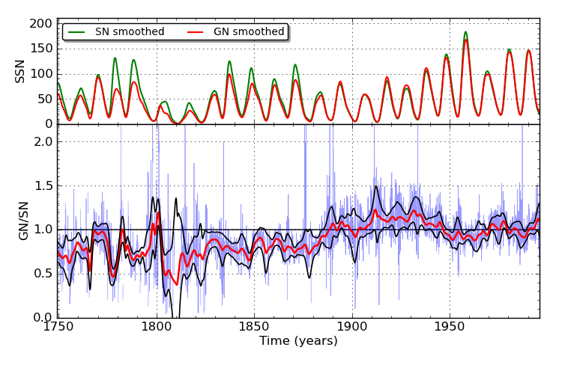
SN and GN: major discrepancies

Slide 7
Metrological approach
SN treated like any absolute index (e.g. TSI):
Accuracy: based on a model of the measuring process
Base data:
Exclusively direct sunspot counts (tables, drawings)
Original documents (metadata):
Instrument and method descriptions
Indications of changes
Re-counting (statistical tests, effect of a change of method)
No use of any external calibration reference:
geomagnetic indices, cosmogenic isotopes: only indirect indices
Subject to additional disturbing factors (Earth magnetism, deposition processes)
Parallel data series are used only for final validation

Slide 8
The 1880-1915 « Greenwich » trend (GN)
All values before 1880 are about 40% lower than the SN
~40%

Slide 9
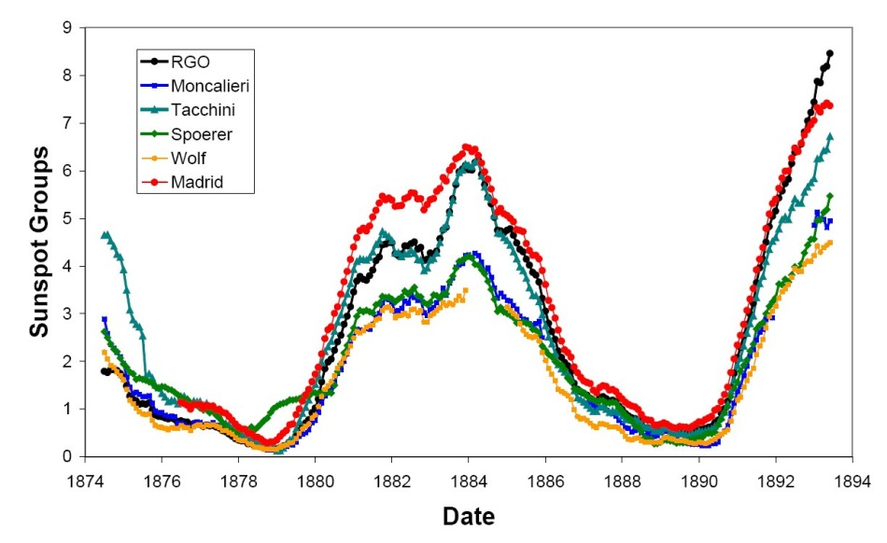
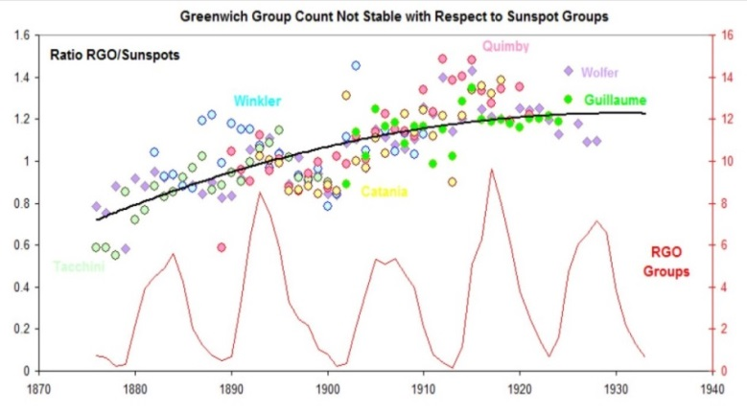
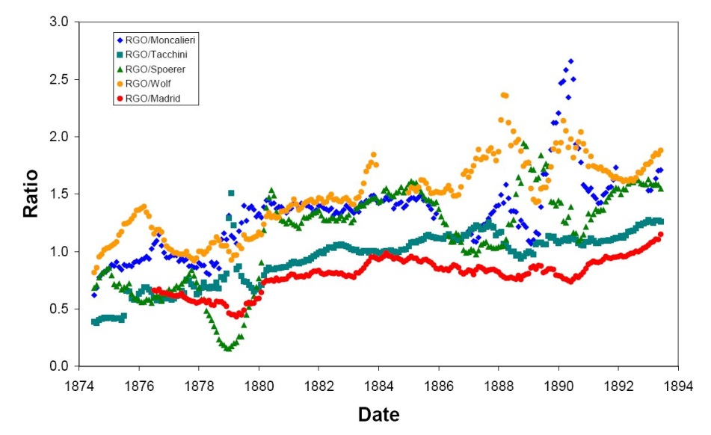
The 1874-1915 « Greenwich » trend (GN)
Ratio of the RGO group count relative to parallel visual observers (Svalgaard 2012 ,Vaquero 2013)
Ratio increases by ~40% from 1880 to 1915
Indications of changes in the early RGO data set (Willis et al, 2013):
Photographic plate type
Measuring method
Svalgaard, 2012
Vaquero, SSN Workshop, 2013
the R_{Z}-R_{g} discrepancy is due to an underestimate of R_{g} before 1880

Slide 10
Group Number: a full reconstruction
Same base visual data as Hoyt&Schatten before 20th century
Visual group counts for the 20th century, instead of the RGO GN
New cross-calibration strategy: long-duration “backbone” observers (Svalgaard 2013)
4 sequences of simultaneous observers with mutual overlap
Backbone observer | Time interval
Staudach | 1749 - 1798
Schwabe | 1794 - 1883
Wolfer | 1841 - 1944
Koyama | 1916 - 2014

Slide 11
The 1947 « Waldmeier » jump (SN)
Sharp jump around 1947 : ratio R_{g}/R_{Z} decreases by ~15-20%
~20%

Slide 12
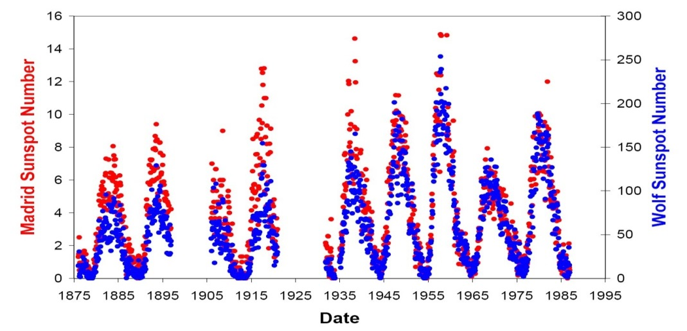
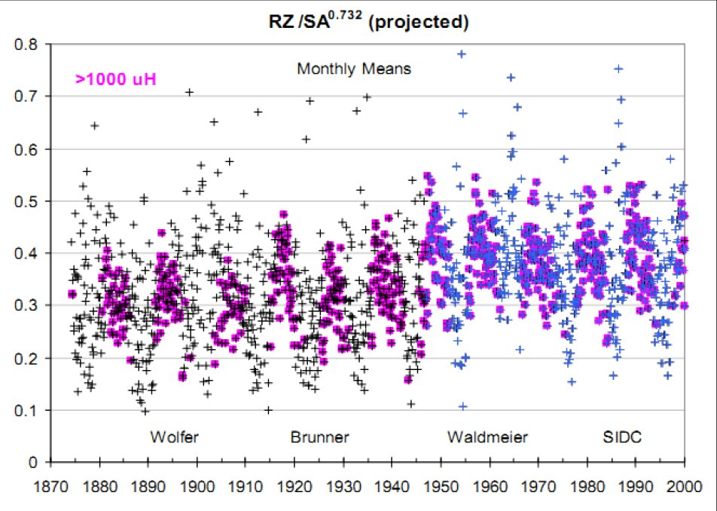
The 1947 « Waldmeier » jump (SN)
Jump in SSN confirmed by different cross-comparisons:
long-duration stations (e.g. Madrid) (Vaquero 2012)
Sunspot area (RGO) (Svalgaard 2012)
No indications of changes in the RGO data around 1940-50
Change in the SSN scale typical amplitude 20%
Madrid SSN
Vaquero, SSN Workshop, 2012
RGO sunspot area
Svalgaard, SSN Workshop, 2012
SSN - N_{G}
Svalgaard, 2012

Slide 13
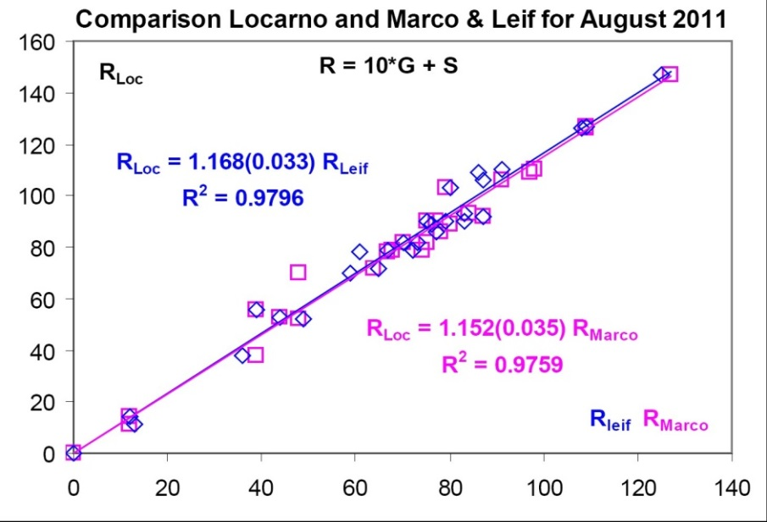
The 1947 « Waldmeier » jump (SN)
Sunspot weighting (introduced by M. Waldmeier around 1947):
Large spots with penumbrae counted as 2, 3, 4 or 5 according to size.
Specola station (Locarno) trained to the method (1955): Still in use !
4
6 =3x1+3
9 = 3x3
Blind test (2003 – 2014): double counting by Marco Cagnotti
Mean ratio W_{w} / W_{u} = ~1.16
Lower proposed value of 1.11 (Lockwood et al. 2014)
W_{w}
Svalgaard, 2011
W_{u}

Slide 14
The 1947 « Waldmeier » jump (SN)
The inflation factor depends on the activity level:
Locarno data 2003-2014
Range: w= 1.09 (minimum) to 1.20 (maximum SN=115)
Linear fit: w= 1.10 + R_{i} / 1150
The time averaged ratio will depends on the amplitude of the cycles included in the average (for 1981-2014, w=1.20)

Slide 15
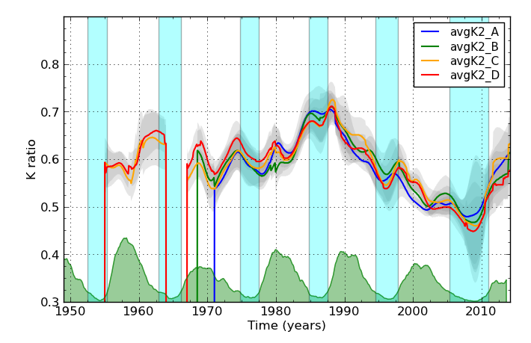
The 1980-2014 « Specola » drifts (SN)
Drift of the main Specola observer versus the average of all long-duration stations in the SIDC-SILSO network:
Amplitude: 20%
Two reversals
Starts only in 1981 (end of the Zürich reference)
All raw observations are preserved in the SILSO database :
541000 values
Full recalculation in progress
Broad choice of possible alternate scaling references

Slide 16
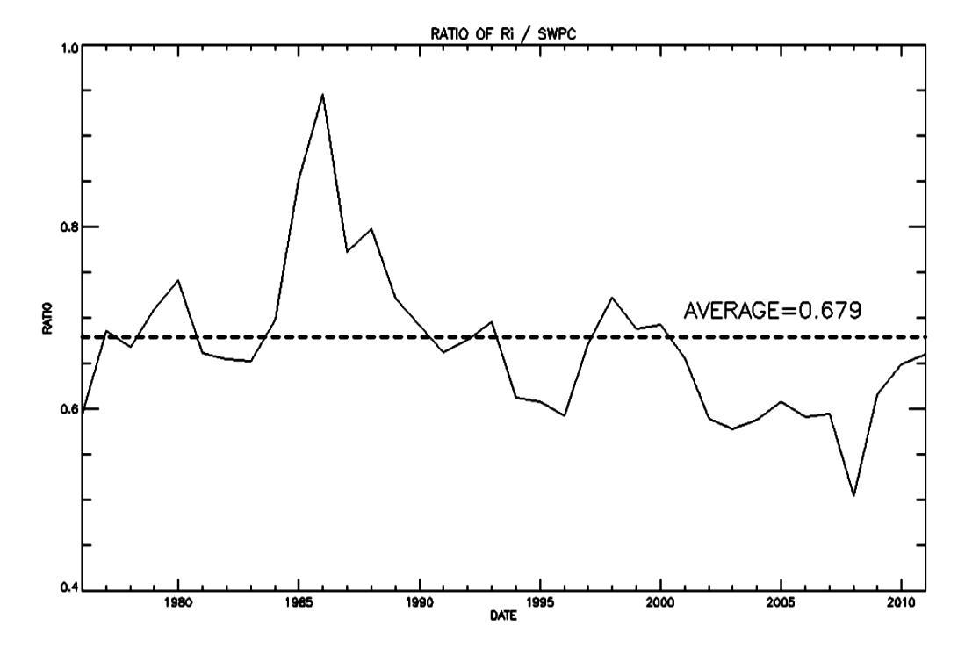
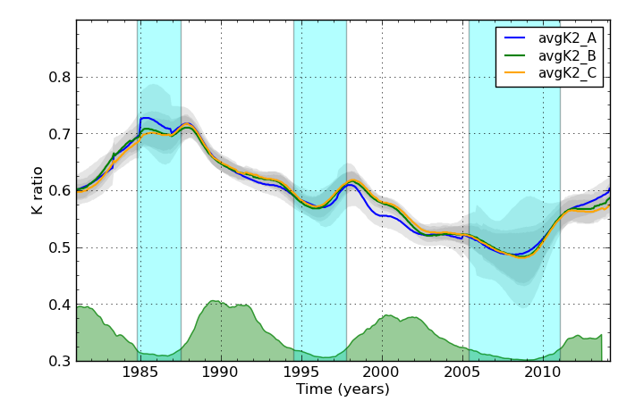
Boulder SN comparison: same trends
D. Biesecker, 1st SSN Workshop, 2011

Slide 17
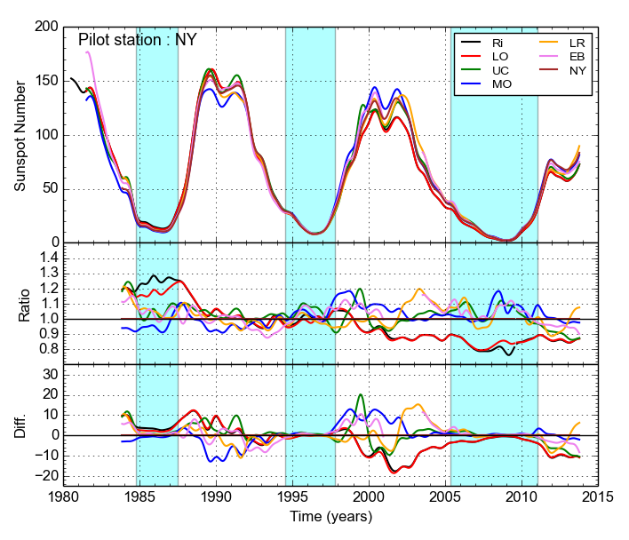
SN 1981-2014: full recalculation
First run: only single pilot stations with long duration > 25 years
No more trend for all series:
Only the orginal R_{i} and the new Locarno-based SN deviate systematically in the same way
All alternate station show temporary inhomogeneities
Need to implement a multi-station reference (subset of core pilots stations)
Powerful new tool to study and improve the SN calculation method
For more details see poster 1
of this session

Slide 18
The 1849 Schwabe-Wolf transition
The Wolf correction (Lenssu et al. 2013): SN should be reduced by 20% before 1849
The GN scale is less reliable over 1849-1859: mixture of Wolf and rescaled Schwabe values (Wolf, 1861, 1862, 1863) used as Wolf’s data with k=1 (Hoyt & Schatten 1994)
Amplitude of the 1849 jump is uncertain
Correction possibly valid for 1835-1849, but the Schwabe scale increased over 1826-1835 (Lenssu et al. 2013)
The correction for SN data before 1826 is lower than the 20% jump in 1849
Lenssu et al. 2013
Misconception: Wolf’s 1.25 scale correction is not based on geomagnetic data !

Slide 19
Other investigated corrections
Uncertainties in the early sunspot data:
The 1790-1799 gap: « missing cycle 4» ? (Usoskin et al. 2001, 2009, Zolotova & Ponyavin 2011)
The 1740-1749 gap (Usoskin 2003, Vaquero 2007, Vaquero & Trigo 2014)
Maunder Minimum: overestimated data coverage by H&S (Clette et al. 2014)
Work still in progress
RGO - SOON
Schwabe - Wolf

Slide 20
Combining all main corrections: early preview
aa

Slide 21
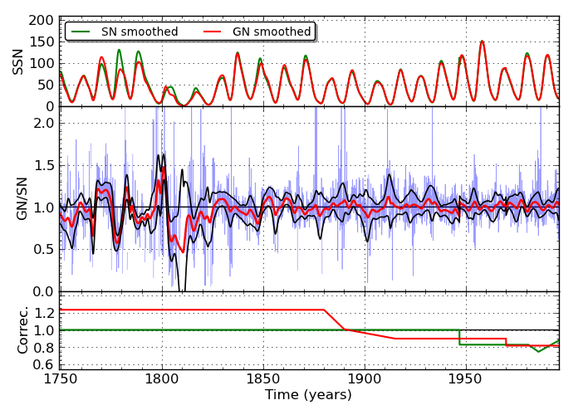
Combining all main corrections: early preview
aa
Clette, Svalgaard, Vaquero, Cliver, 2014
Space Science Reviews, Aug. 2014, Springer Online First , 69 pages
DOI 10.1007/s11214-014-0074-2
Arxiv: http://arxiv.org/abs/1407.3231

Slide 22
Combining all main corrections: early preview
aa
Clette, Svalgaard, Vaquero, Cliver, 2014
Space Science Reviews, Aug. 2014, Springer Online First , 69 pages
DOI 10.1007/s11214-014-0074-2
Arxiv: http://arxiv.org/abs/1407.3231
SN
weighting
Specola
drift
RGO trend
RGO/
SOON

Slide 23
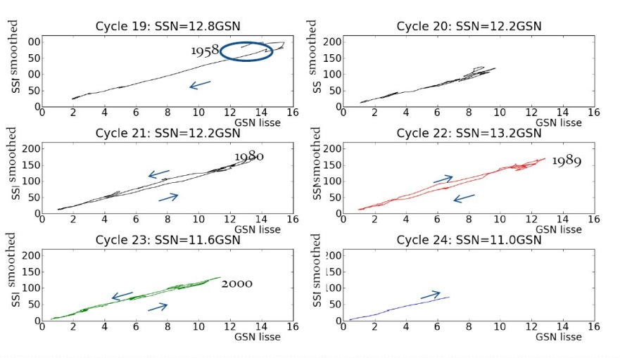
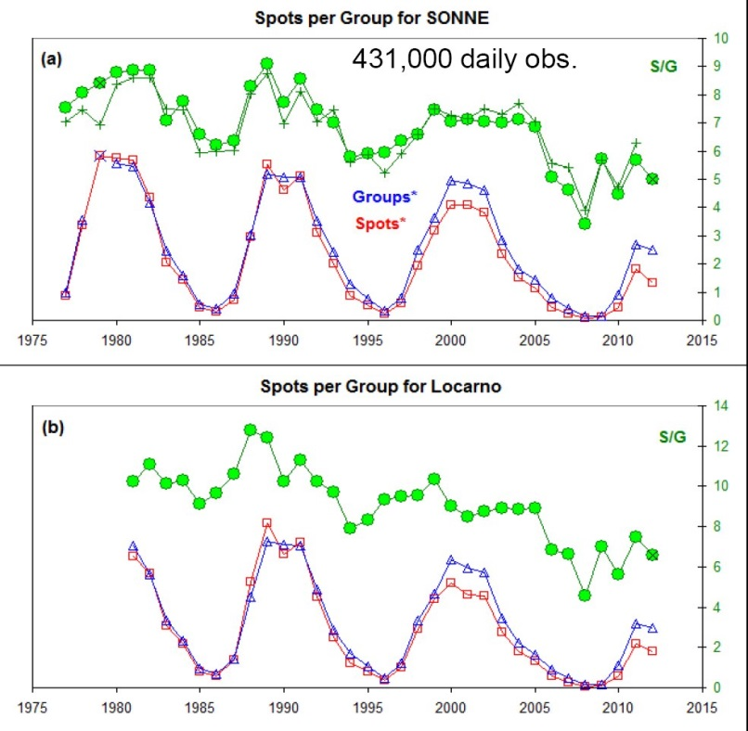
A variable number of spots/group
Reconstructed GN series (SILSO, SONNE):
Both indices R_{i} and R_{g} calculated from the same data set
SONNE SN/GN
Locarno SN/GN
Cycle | Ns/Ng | North | South | R_{i}/R_{G} | North | South
19 | 11.3 |  |  | 12.8
20 | 10.3 |  |  | 12.2
21 | 10.4 |  |  | 12.2
22 | 11.9 | 12.5 | 10.7 | 13.0 | 13.5 | 12.5
23 | 9.3 | 9.5 | 8.7 | 11.6 | 11.5 | 11.9
24 | 8.5 | 8.7 | 6.4 | 11.0 | 11.2 | 10.3
Changing R_{i}/R_{G} ratio :
Stable over cycles 19 to 22
Decline in cycle 23 and 24
Decrease of the average number of spots per group by ~30%

Slide 24
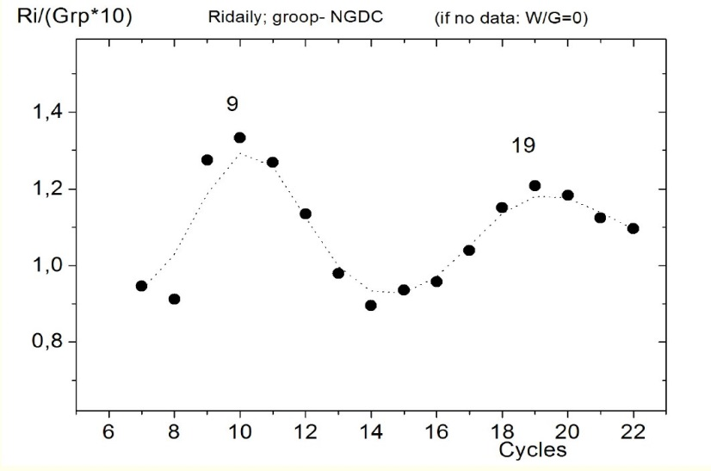
A variable number of spots/group
Apparent secular variations of the ratio SN/GN (Tlatov 2013):
Higher uncertainties in early data:
group and sunspot numbers based on different sets of observations.
N_{S}/N_{G} increase for stronger cycles ?
A full agreement between SN and GN cannot be expected
SN and GN carry a different information about the solar dynamo
Tlatov 2013

Slide 25
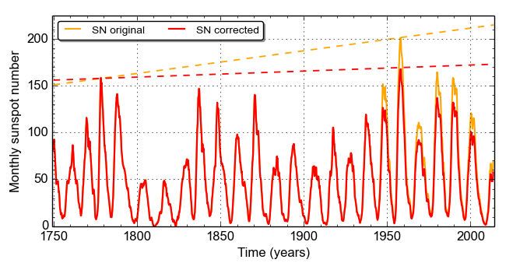
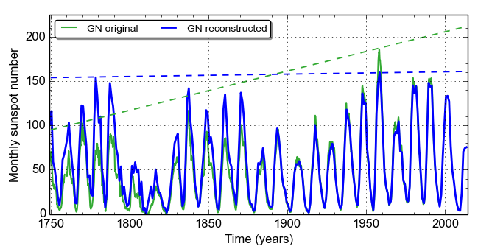
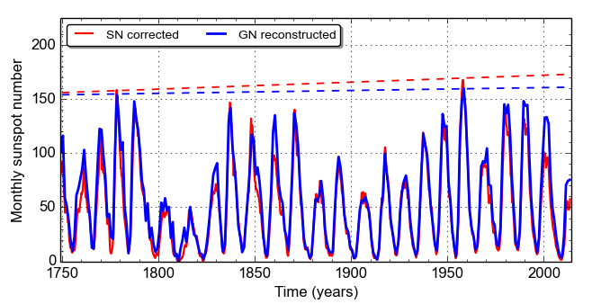
Implications: long-term (preview)
Trend +15%/century Trend +40%/century
SN correction: SN /1.20 after 1947 GN correction: GN * 1.37 before 1880
Corrected SN & GN series agree
Secular trend is largely eliminated < 5% / century
Soon after the Maunder Minimum, solar activity was similar to present levels

Slide 26
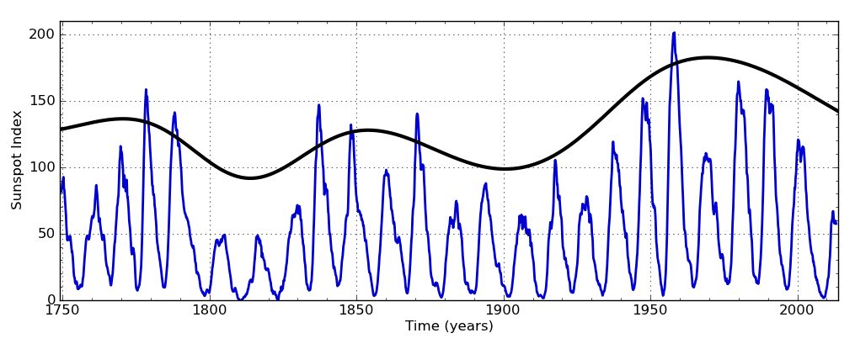
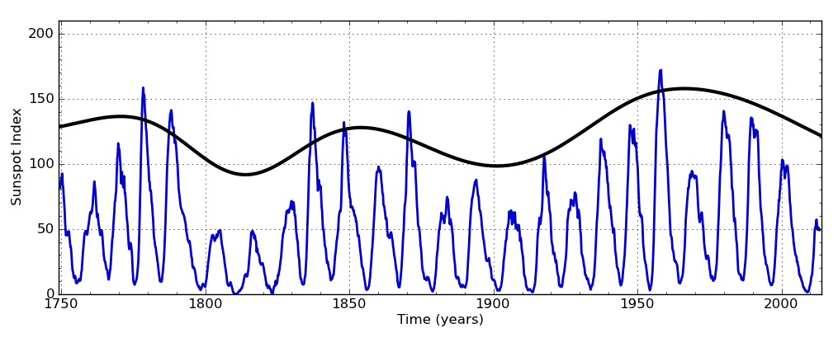
Long-term integration: a moderate Modern Maximum ?
Time-integrated responses to the solar input:
Cosmogenic isotopes: deposition processes (ice, sediments)
Earth climate: thermal inertia of oceans
Gaussian running mean over 22 years (2 solar cycles):
Original series
Ratio Max cycles 3-19 = 1.27
Ratio 22-yr envelope = 1.30
Corrected series
Ratio Max cycles 3-19 = 1.08
Ratio 22-yr envelope = 1.17
The clustering of high solar cycles reduces the time-integrated effects of the corrections by 50%

Slide 27
Conclusions and prospects
Release of new SN and GN series in spring 2015:
In preparation:
Uncertainties (error bars)
Implementation of a versioning system
New conventions:
Removing the 0.6 Zürich factor
Continuous mean SN values between 0 and 11 (no more 0-11 jump)
Implications:
Variable number of spots per group (scale-dependant mechanism)
Limited rise of average solar activity since the Maunder minimum:
Reconstructions of the solar output need revision: e.g. concept of a Grand Maximum in the 20th century is questioned (Solanki et al. 2004, Abreu et al. 2008, Usoskin et al. 2012, 2014)
Full recalculation of the modern SN now started:
Improved method: composite multi-station reference (to be identified)
Powerful tool for assessing the role of various factors on the SN (statistics of k coefficients, group splitting, visual observer practices)

Slide 28
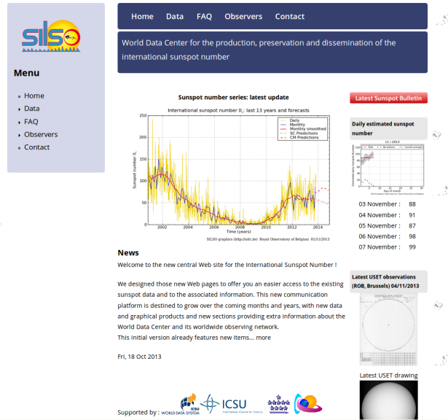
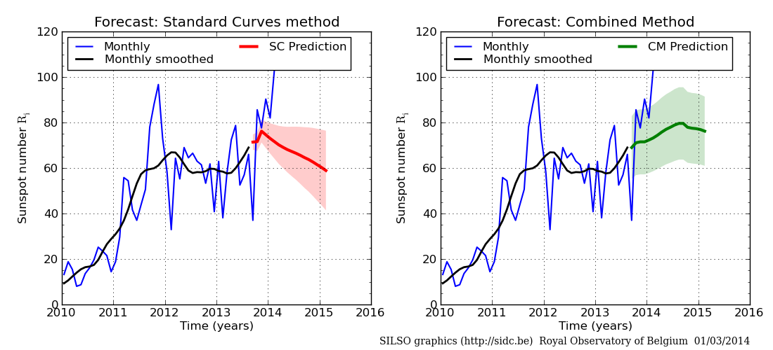
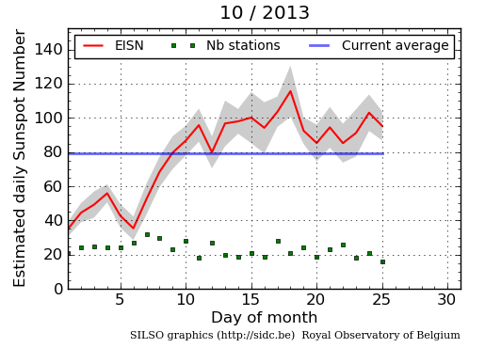
For the latest information, please visit …
WDC – SILSO Sunspot Index
and Long-term Solar Observations
http://sidc.be/silso
Sunspot Number Workshops
http://ssnworkshop.wikia.com/wiki/Home
Historical Archive of Sunspot Observations
http://haso.unex.es/

Slide 30
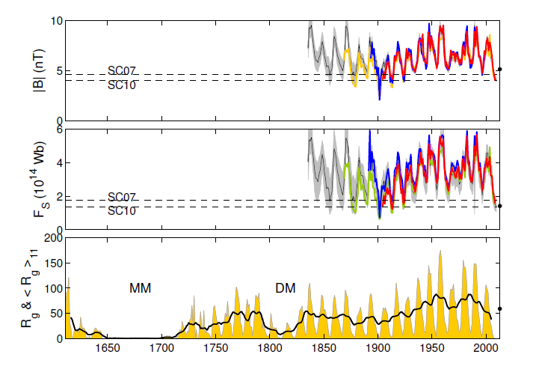
Open solar flux from geomagnetic indices: latest update
Similar conclusions: recent open magnetic field reconstructions show no clear trend over last 180 years (Lockwood, Living Reviews SP, 9/2013)

Slide 31
Wolf’s different telescopes
K coefficient for 37mm “Pariser” travel telescope = 1.5 (confirmed by current observations by Thomas Friedli, Wolf Gezelschaft, Zürich)

Slide 32
The 1893 Wolf-Wolfer transition (SN)
Simultaneous Wolf & Wolfer observations 1876-1893 (17 years)
Origin of the 0.6 = 1/1.667 Zürich factor applied to SN after 1892
Our determination (ratios of yearly means): 1.653 +/- 0.047 (agreement to better than 1%)
Very robust scaling of the SN over the 1876 visual-to-photography transition in the H&S Group Number

Slide 33
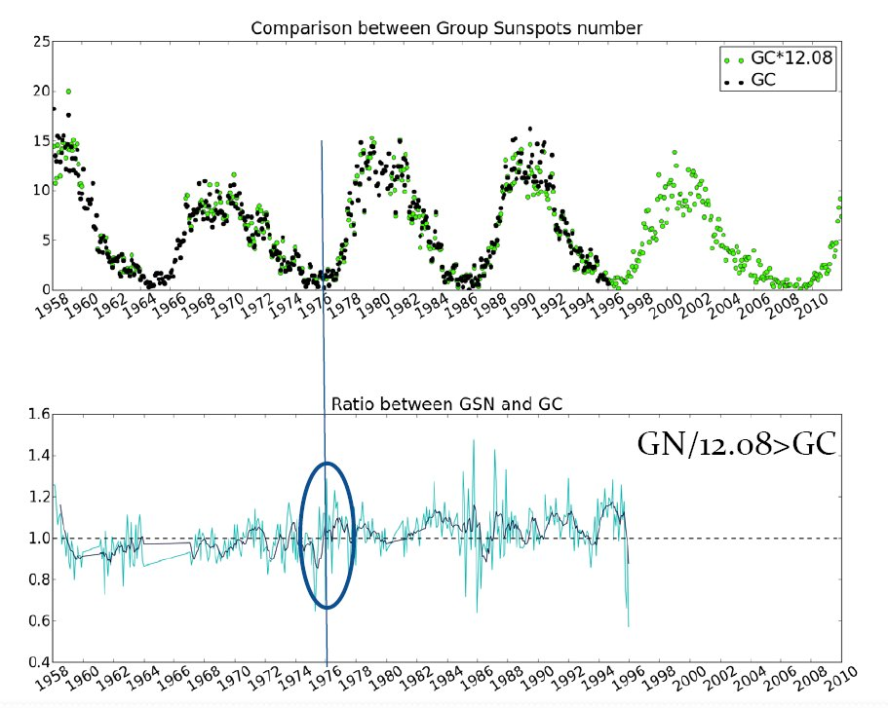
The RGO-SOON jump
Reconstruction and extension of the Group Number R_{g} up to 2012 (WDC – Sunspot database)
Good overall match with R_{g} from Hoyt & Schatten: ratio near 1.0 and constant except for
Scale jump at the RGO-SOON transition in 1976
SOON GN 10% higher than the RGO GN (cf. Lockwood et al. 2014)
R_{g} Hoyt & Schatten
Rg SILSO reconstruction
Ratio R_{g}(HS)/R_{g}(SILSO)
Wauters & Clette, SSN Workshop 2013

Slide 34
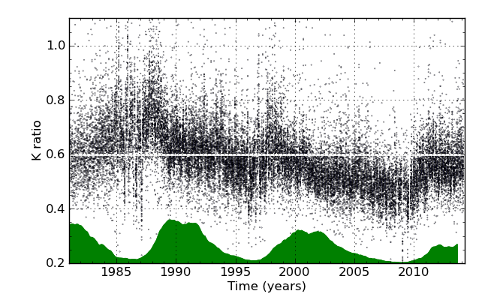
The 1980-2014 « Specola » drifts (SN)
All k coefficients vs time before correction

Slide 35
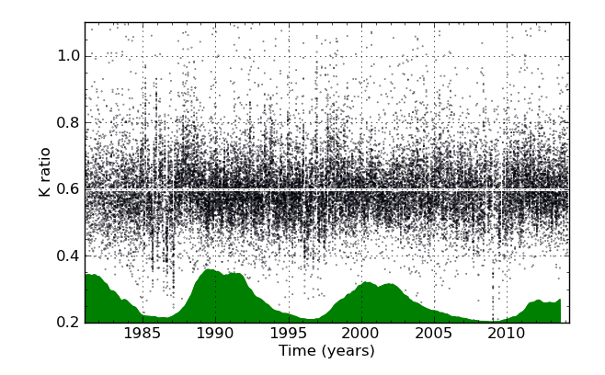
The 1980-2014 « Specola » drifts (SN)
After correction based on a multi-station average reference

Slide 36
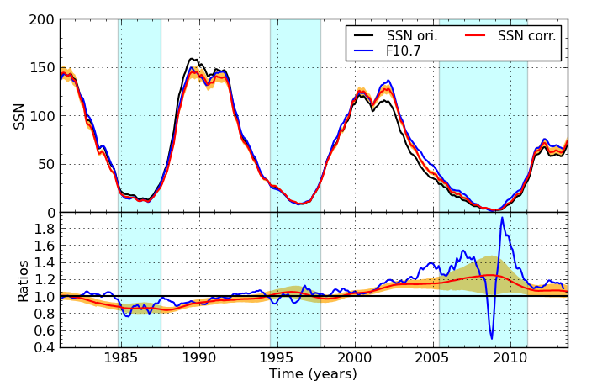
Implications: recent cycles
Maximum 22 second peak is higher, almost equal to first peak
Cycle 22
Slightly decreased (- 5 to10%)

Slide 37
Implications: recent cycles
Maximum 23 second peak becomes higher than the first peak.
New maximum in 2002 instead of 2000
Cycle 23
Slightly increased (+ 5 to 10%)
Cycle 23 decline raised by about 20%

Slide 38
Implications: recent cycles
Better overall agreement
Still significant disagreement during the decline of cycle 23
Return to a better match in cycle 24

Slide 39
Implications: recent cycles
Cycle 24
Only slight increase (+ 3%)

Slide 40
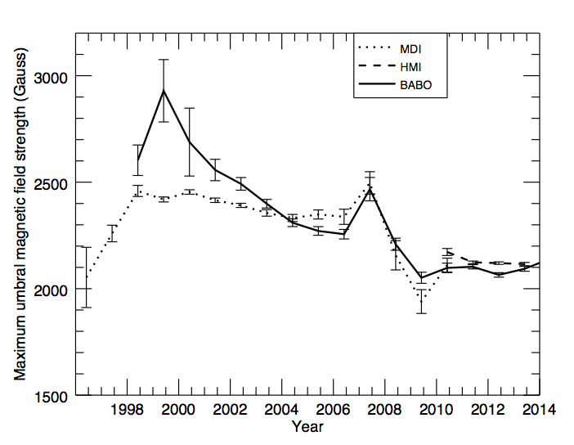
Global scale-dependent decline
True global change in sunspot properties
Supported by parallel studies:
Scale-dependant small-spot deficit in cycle 23 (Lefèvre & Clette 2011 2012, Kilcik et al. 2011, Nagovitsyn 2012)
Global decline of core magnetic fields in sunspot umbrae (Livingston & Penn 2009, 2012; Penn & Livingston 2006):
Stabilisation since 2009
Lefèvre & Clette 2011
F. Watson, NSO, 2014

