Slide 1
From Maunder Minimum to the recent Grand Solar Maximum
11:45 Tuesday November 18
auditorium Roger
Session: 6. Key solar observables for assessing long-term changes of the Geospace
Time allowed 25 min

Slide 2

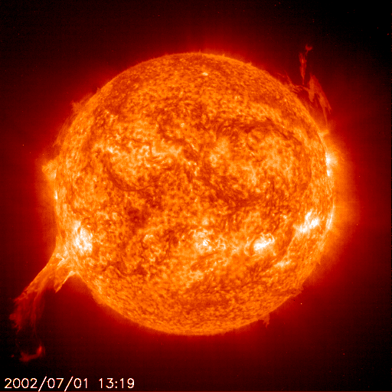
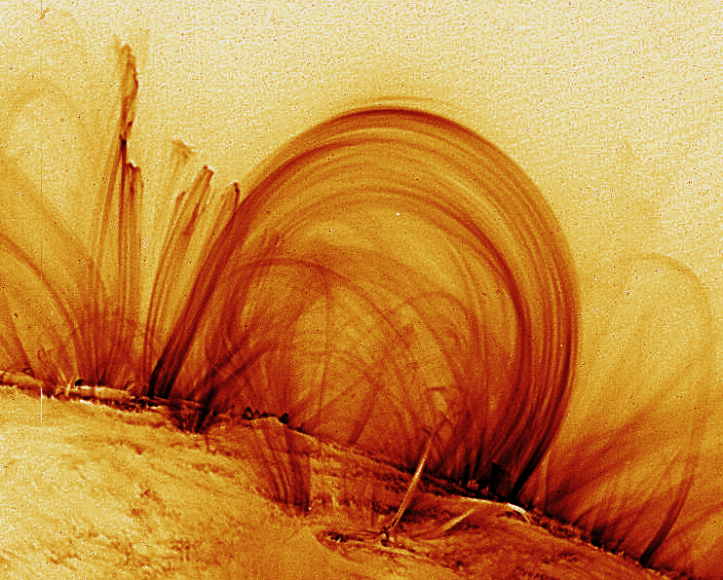
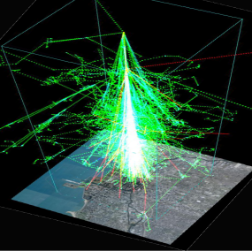

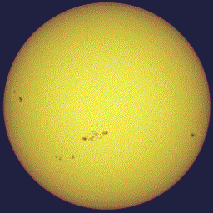
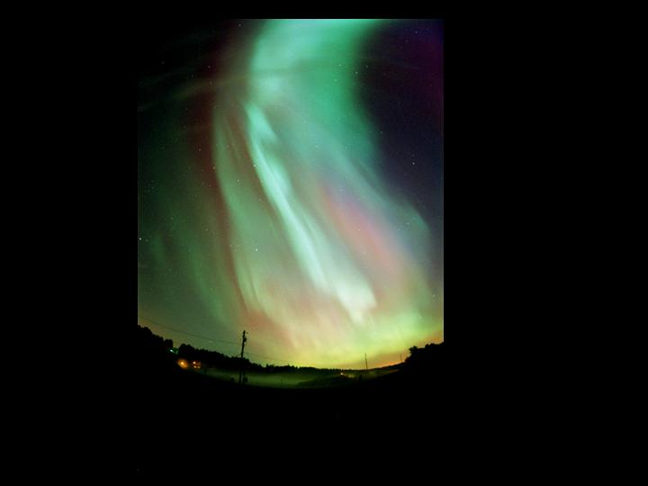
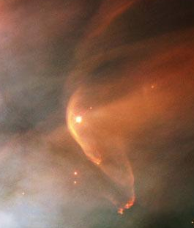
From Maunder Minimum to the recent Grand Solar Maximum
Mike Lockwood, C.J. Scott, M.J. Owens, & L. Barnard
(Department of Meteorology, University of Reading,
& Space Science and Technology Department,
STFC/Rutherford Appleton Laboratory )
11th European Space Weather Week, Liege, 18th November 2014
Session: 6. Key solar observables for assessing long-term changes of the Geospace

Slide 3
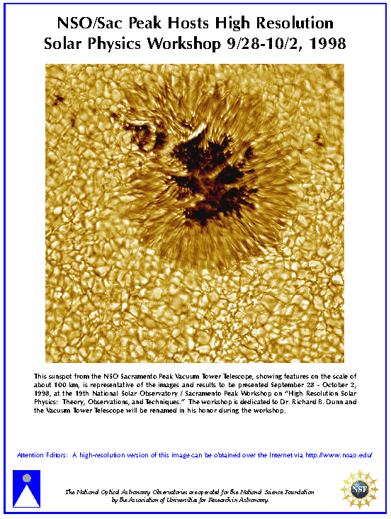

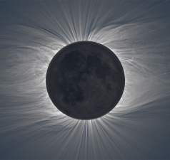
Solar change on timescales of days to millennia
The past 400 years
The past 9300 years
Use of geomagnetic data
Streamer belt width
The future

Slide 4
Solar change on timescales of days to millennia
The past 400 years
The past 9300 years
Use of geomagnetic data
Streamer belt width
The future

Slide 5
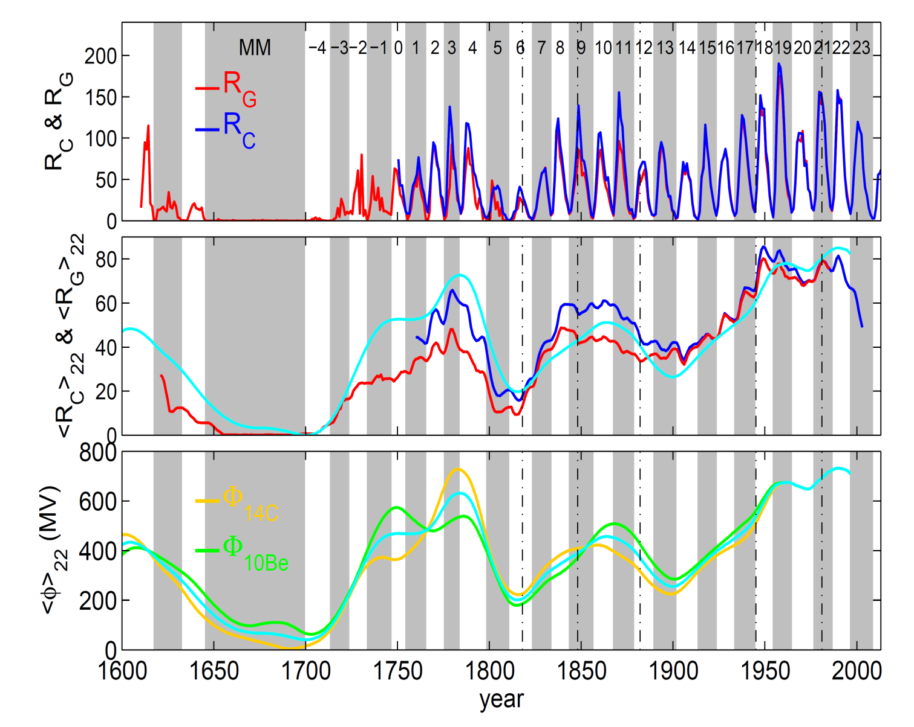
Sunspot numbers and cosmogenic isotope records
• Annual means of corrected sunspot number, R_{C} & group sunspot number, R_{G}
(Lockwood et al, 2014)
• 22-year means of R_{C} & R_{G} with φ₂₂
• 22-year means of modulation potential from ¹⁴C (φ_{14C}) & ¹⁰Be (φ_{10Be}) and the mean of the two, φ₂₂ = <φ_{14C}>₂₂+<φ_{10Be}>₂₂)/2
(Usoskin, 2013)

Slide 6
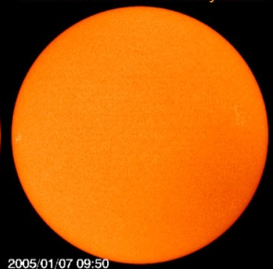

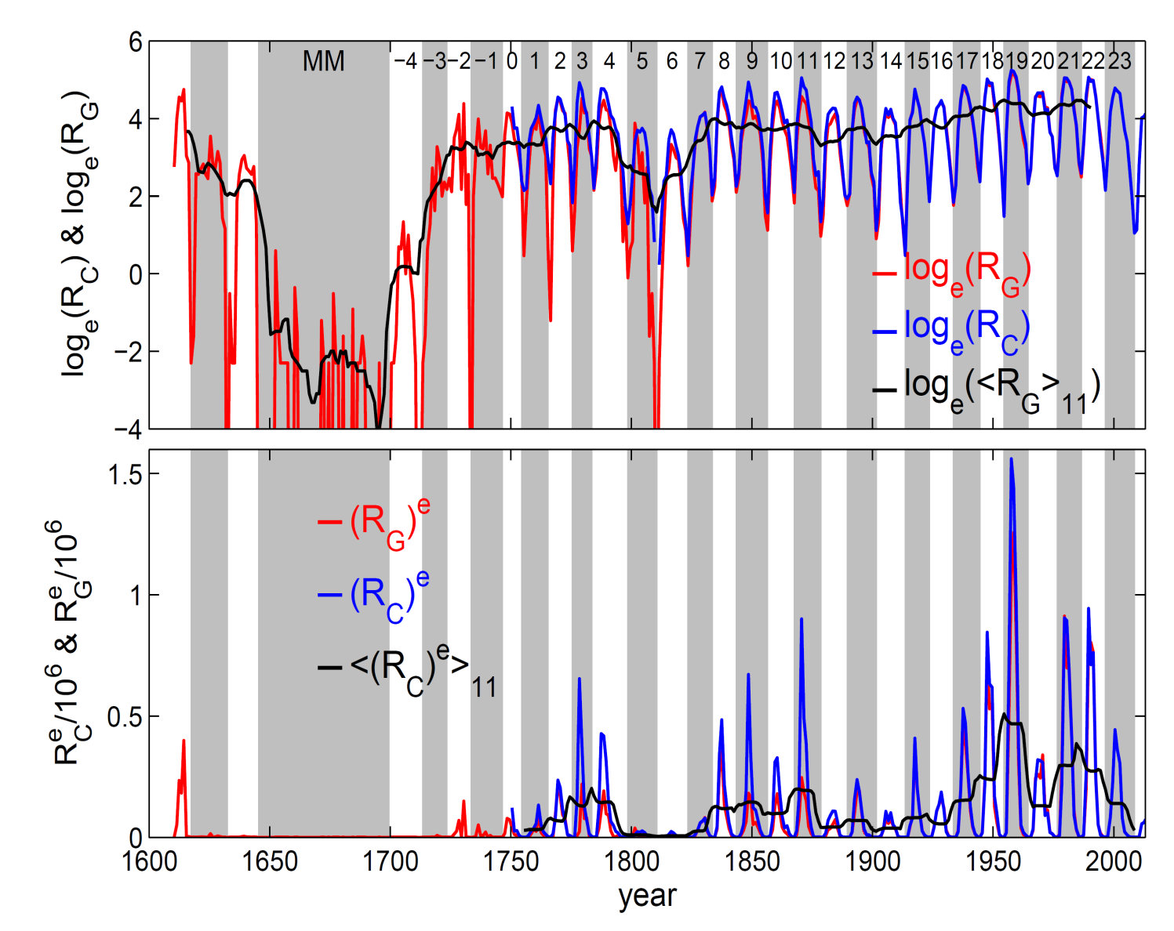
Sunspot numbers on a logarithmic scale
• Annual means of corrected sunspot number, R_{C} & group sunspot number, R_{G}
• Top: R_{C} & R_{G}
on log_{e} scale along with 11-year means of R_{G} in black - highlights the Maunder minimum.
• Bottom: R_{C} & R_{G}
to the power e, along with 11-year means of R_{c}^{e} - highlights the
recent grand maximum

Slide 7
Solar change on timescales of days to millennia
The past 400 years
The past 9300 years
Use of geomagnetic data
Streamer belt width
The future

Slide 8
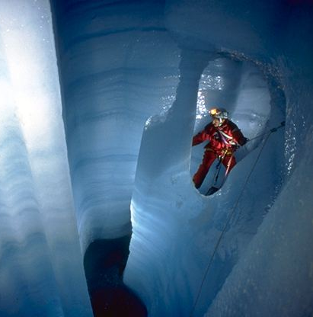

Millennial Variation
φ composite (22-year means) from cosmogenic isotope ¹⁰Be cores by Steinhilber et al. (2008)
1000
800
600
400
200
0
we have just left the most recent grand maximum, defined by φ ≥ 600 MV
Solar Modulation Potential, φ (MV) →
-6000 -4000 -2000 0 2000
φ = 168 MV
Year AD →
Maunder minimum
composite from Solanki et al., 2004; Vonmoos et al., 2006 & Muscheler et al., 2007

Slide 9
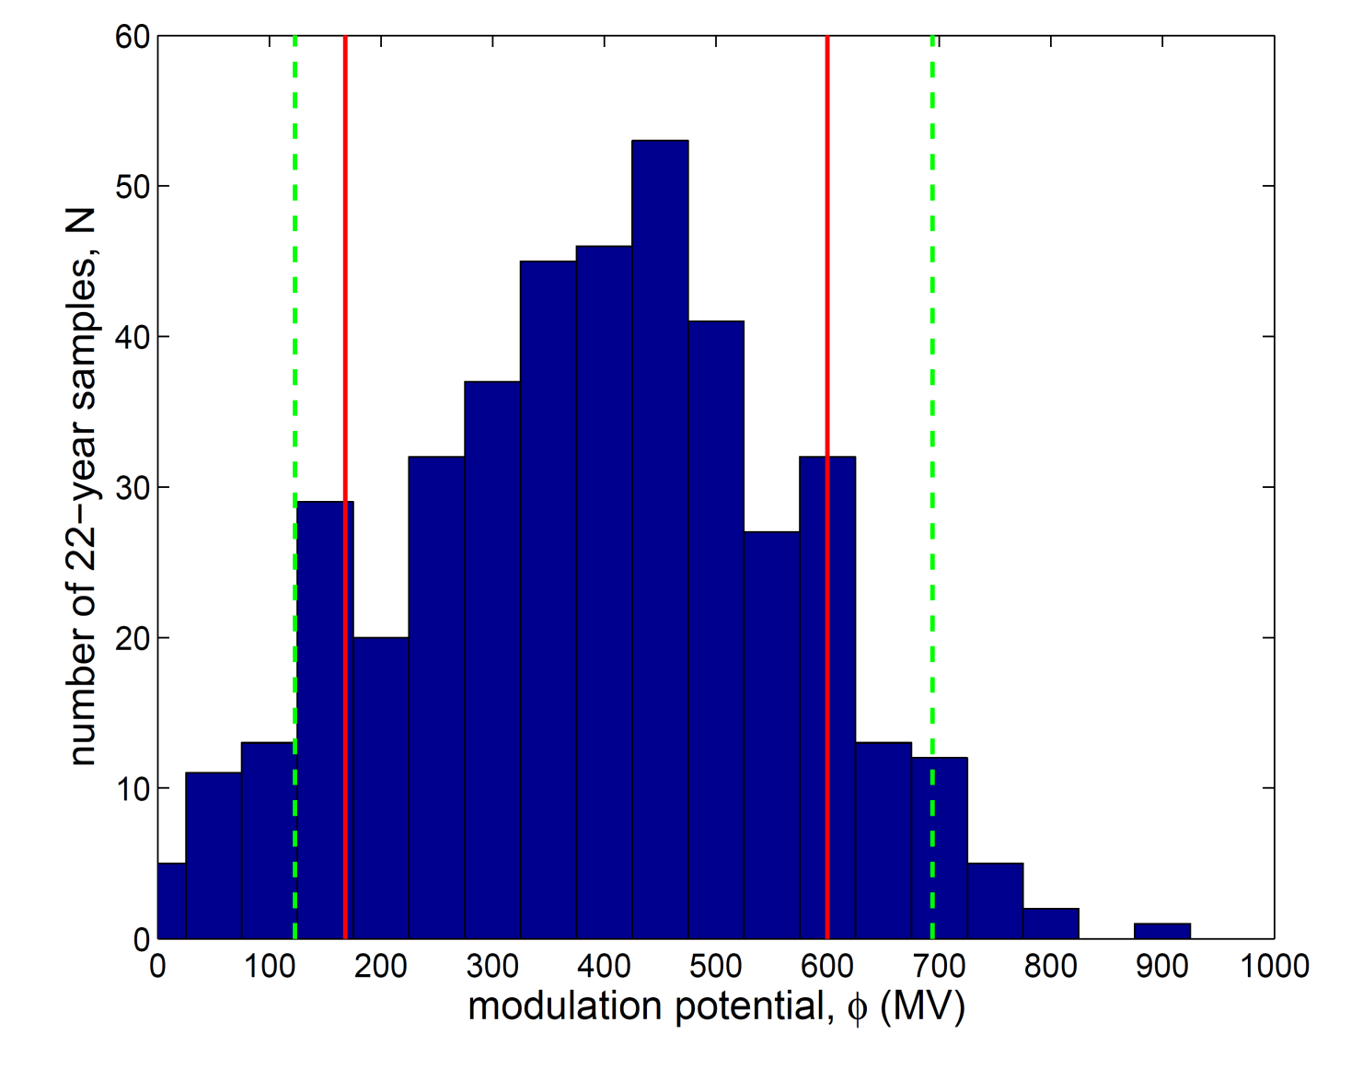
Distribution of φ over 9300 years
(22-year means) from cosmogenic isotope ¹⁰Be cores by Steinhilber et al. (2008)
• Red lines are at 168 MV and 600 MV, near deciles of distribution (50 of 424 samples (12%) have φ ≥ 600 MV and 12% have φ ≥ 168 MV
• Using φ ≥ 600 MV defines 24 grand maxima
• Using φ ≤ 168 MV defines 22 grand minima
Low point of Maunder minimum
φ = 123 MV
Peak of recent grand maximum
φ = 694 MV

Slide 10
Solar change on timescales of days to millennia
The past 400 years
The past 9300 years
Use of geomagnetic data
Streamer belt width
The future

Slide 11
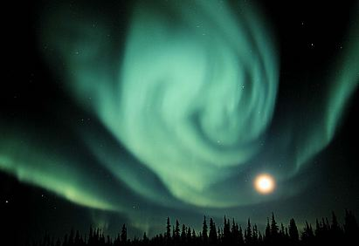
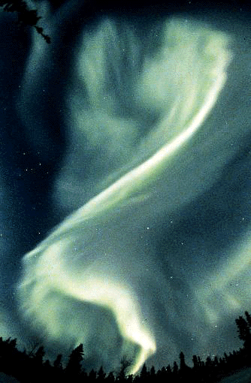
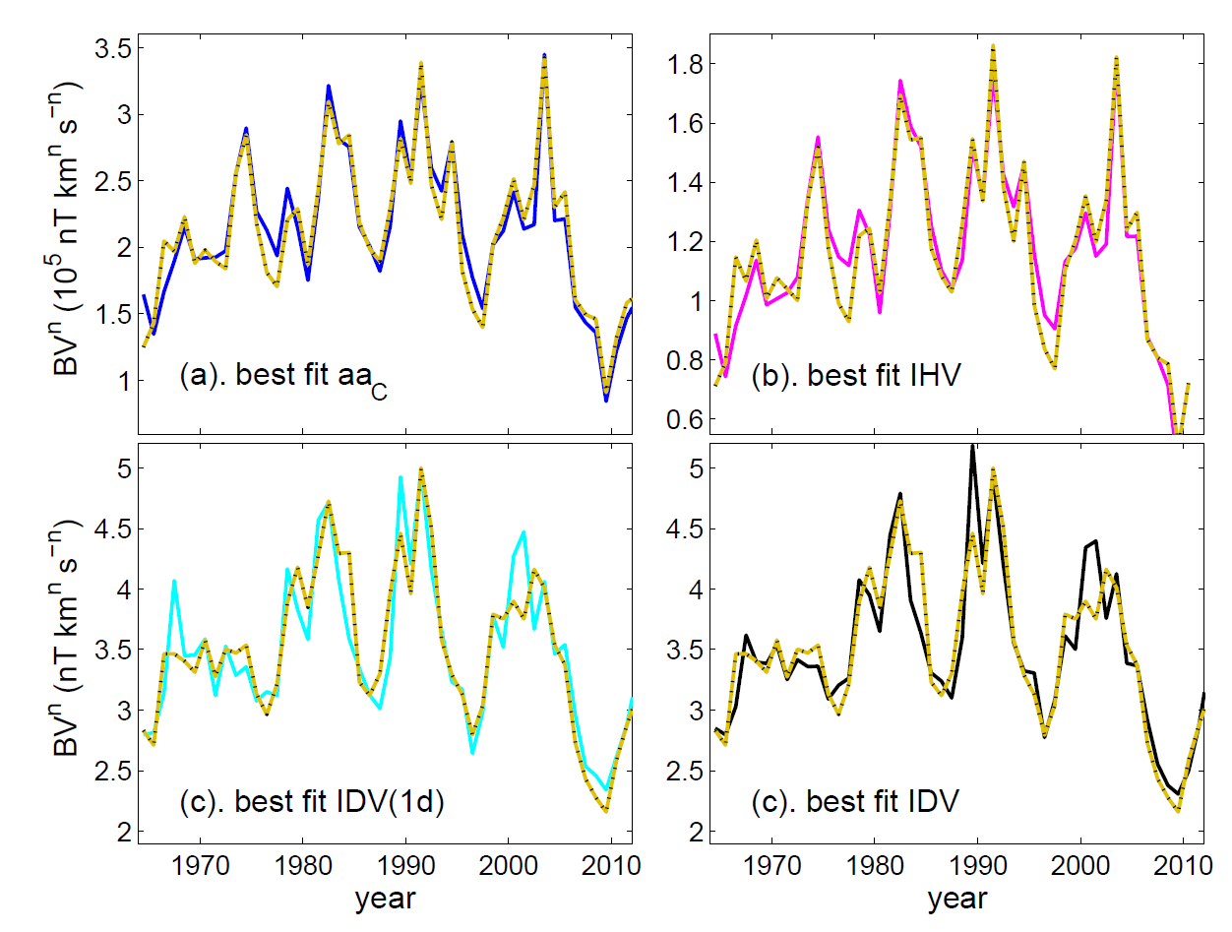
Dependence of different geomagnetic activity indices on IMF B×(V_{SW})^{n}
interplanetary data (annual means)
• all indices depend on B
• but depend on (V_{SW})^{n} with different n
• We use pairings with different n to reconstruct B and V_{SW}
best fit aa_{C}
best fit IHV
n = 1.7±0.8 r = 0.961
n = 1.6±0.8 r = 0.952
best fit IDV(1d)
best fit IDV
n = −0.1±1.1 r = 0.919
n = −0.1±1.1 r = 0.908

Slide 12
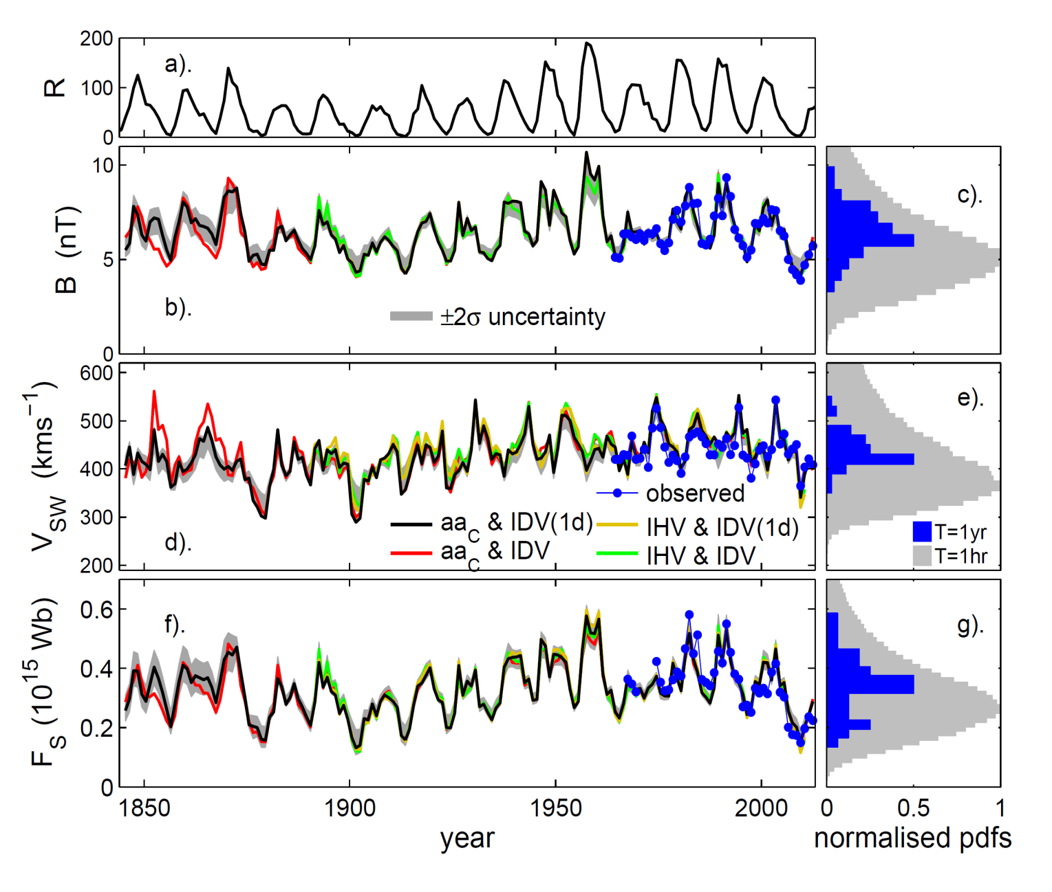
Geomagnetic Reconstructions
of near-Earth IMF, B, solar wind speed, V_{SW},
and the Open Solar Flux (OSF), F_{S}
• Sunspot
number, R
• near-Earth
IMF, B
• near-Earth
solar wind
speed, V_{SW}
• Open Solar
Flux (OSF)
(from Lockwood
et al., Annales
Geophys, 2014)

Slide 13
Geomagnetic Reconstructions
of near-Earth IMF, B, solar wind speed, V_{SW},
and the Open Solar Flux (OSF), F_{S}
• note that first calibrated magnetometer made in 1832
• available reliable continuous and usable data starts in 1844
• need models based on sunspot number to get back to Maunder minimum

Slide 14
Geomagnetic Reconstructions
of near-Earth IMF, B, solar wind speed, V_{SW},
and the Open Solar Flux (OSF), F_{S}
• systematic difference only before 1870 when IDV index (the IDV-aa_{C} combination is in red) is not IDV at all but is Bartel’s q index which is both different & inhomogeneous

Slide 15
Geomagnetic Reconstructions
of near-Earth IMF, B, solar wind speed, V_{SW},
and the Open Solar Flux (OSF), F_{S}
• the minima in annual mean V_{SW} at 1878 and 1900 are only slightly greater than the lowest hourly means in the satellite data
• suggests slow and fast solar wind speeds the same but Earth continuously in slow solar wind

Slide 16
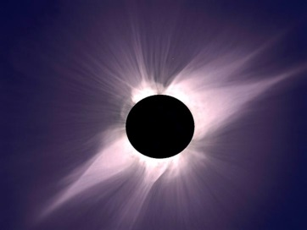
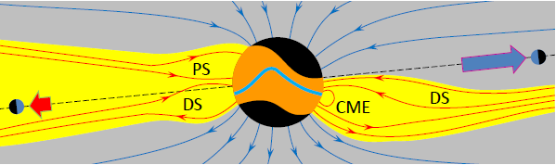
Solar wind speed at Earth and the streamer belt width: concept
• streamer belt comprises dipole streamers (DS) and pseudostreamers (PS) and is filled with slow solar wind
• during the solar cycle streamer belt width varies
• thinnest around sunspot minimum so Earth spends more time solar in continuous fast solar wind of polar coronal holes
• We infer it was thicker when solar activity was low so Earth remained almost continuously in slow solar wind

Slide 17
Solar change on timescales of days to millennia
The past 400 years
The past 9300 years
Use of geomagnetic data
Streamer belt width
The future

Slide 18
Streamer belt width: a model
• Divides total open flux into coronal hole and streamer belt components: F_{S} = F_{CH} + F_{SB}
• Applies Solanki et al (2000) continuity concept to both F_{CH} & F_{SB}
• All new open flux emerges into streamer belt and that emergence is dominated by CMEs – emergence rate quantified as a function of sunspot number by Owens et al. (2011)
• Streamer belt flux that escapes disconnection transfers to coronal hole on a fixed distribution of timescales

Slide 19
Solar wind speed at Earth and the streamer belt width: model
• Disconnection of streamer belt flux such that fractional loss rate varies over the solar cycle with current sheet tilt as predicted by Owens et al. (2012) and found by Owens and Lockwood (2013)
• Disconnection of coronal hole flux occurs at a constant fractional rate
• Ratio F_{SB}/(F_{CH} + F_{SB}) gives streamer belt width

Slide 20
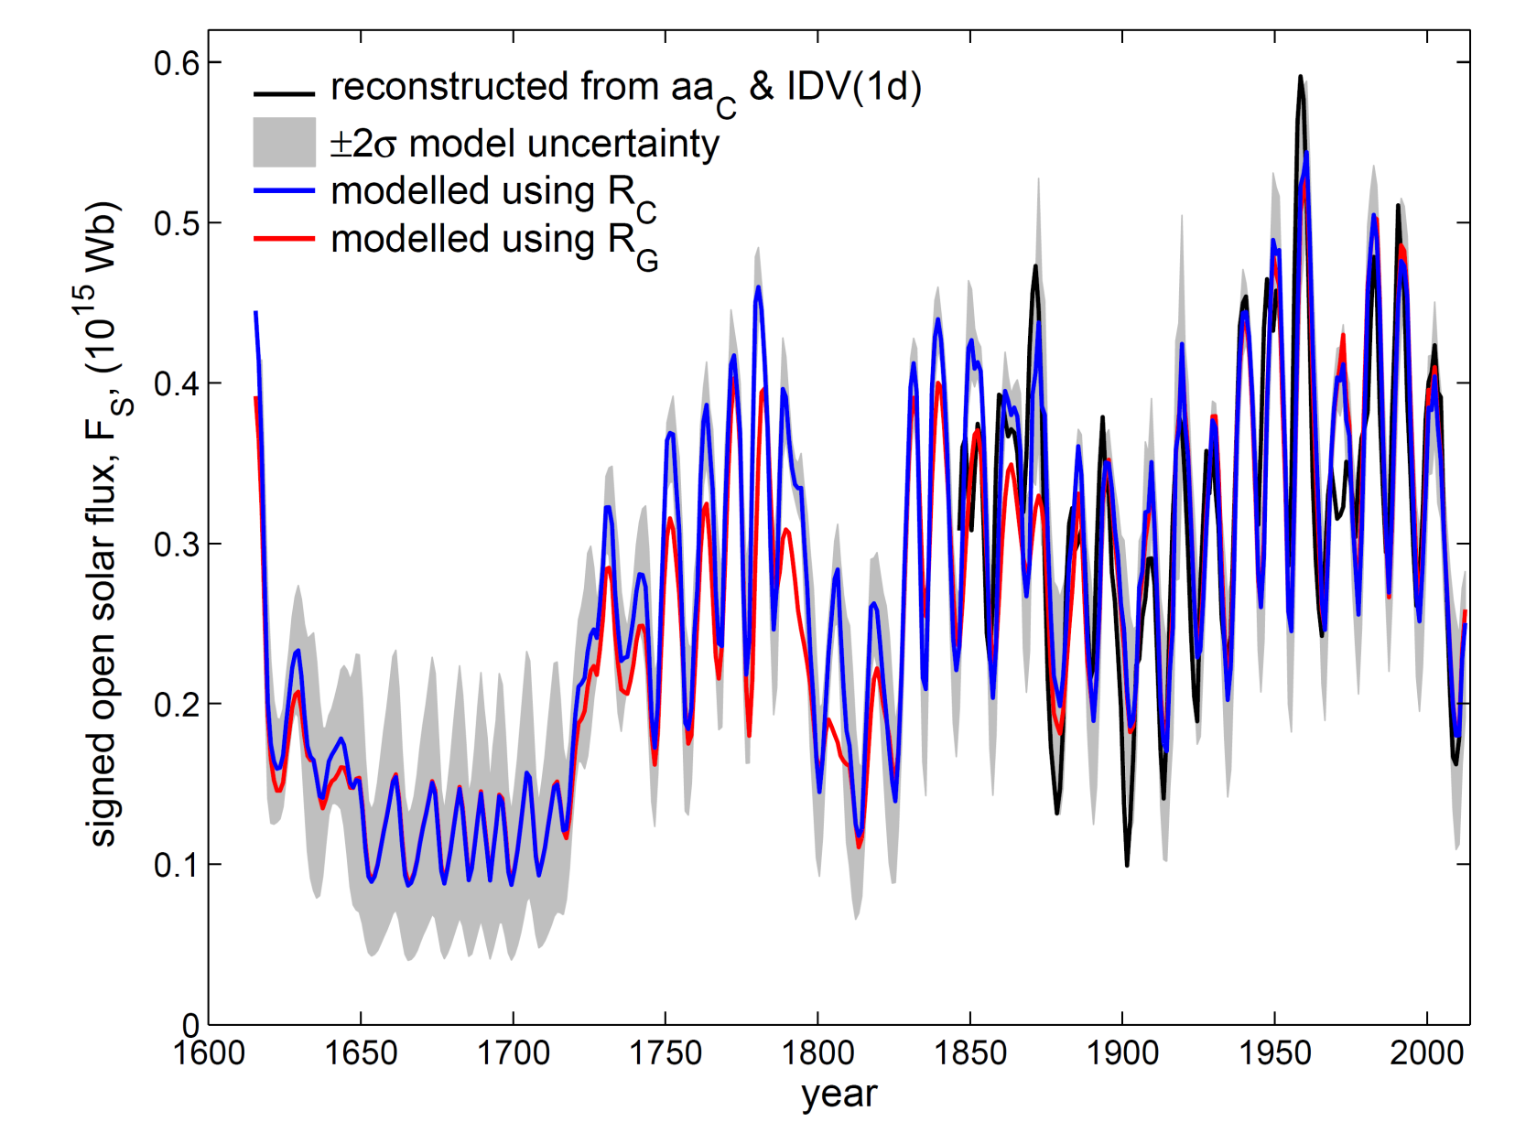
Model results: total open solar flux
(one free fit parameter)
• Reproduces total open solar flux F_{S} from reconstructions very well with just two free fit parameters (the ratio of HCS tilt to the streamer belt fractional loss rate and the coronal hole fractional loss rate)

Slide 21
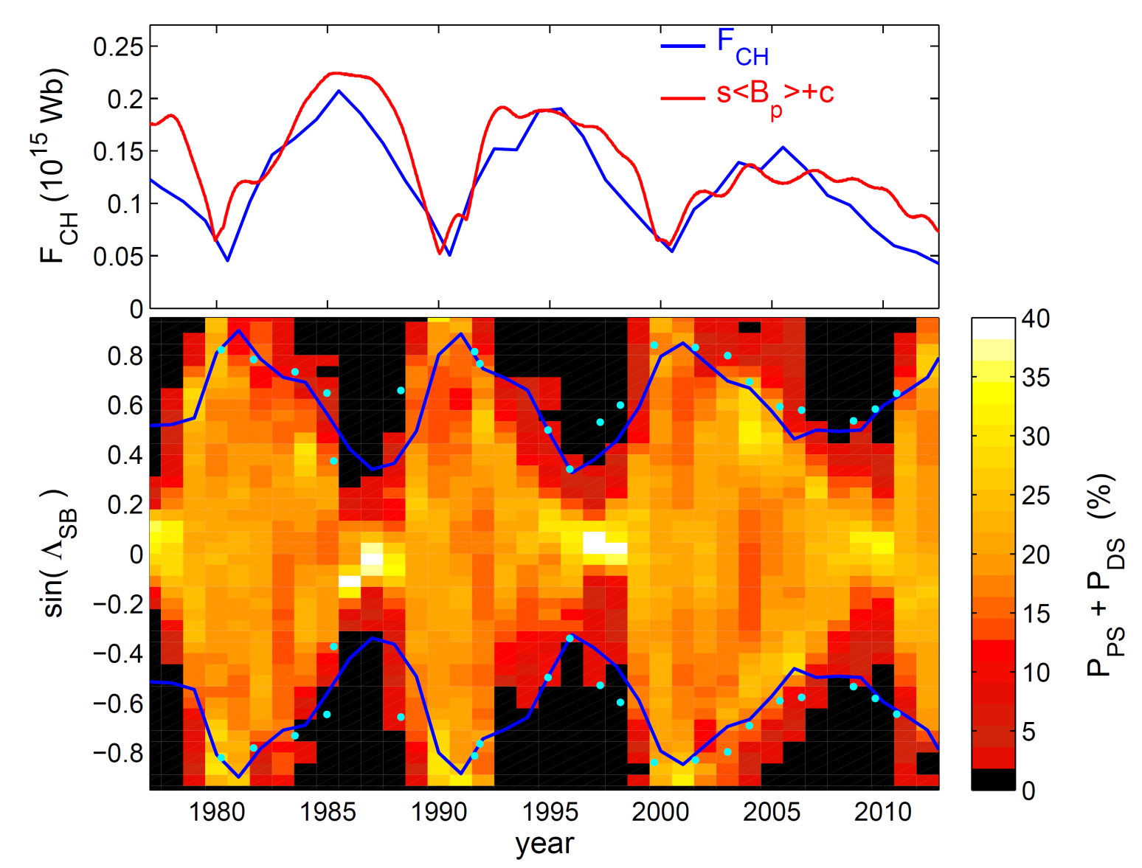
Model results: streamer belt width in recent cycles (3 free fit parameters)
• Top: modelled coronal hole flux F_{CH} (in blue) consistent with polar field from date from magnetographs (in red)

Slide 22

Model results: streamer belt width in recent cycles (3 free fit parameters)
• Bottom: modelled streamer belt width (in blue) consistent with streamer belt from magnetograph data (Owens et al., 2012) and from eclipse images (cyan dots)
• Note model has captured the variation in width at sunspot minimum

Slide 23
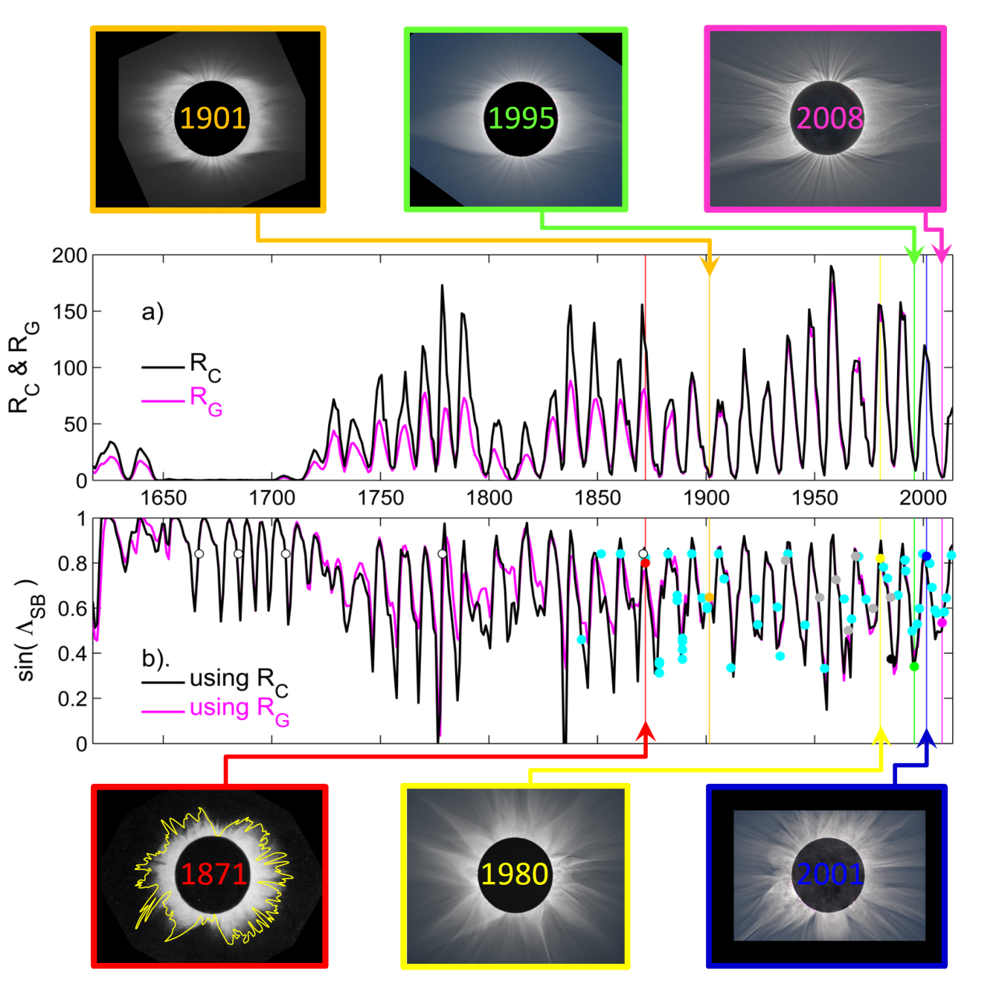
Model results: streamer belt width since the Maunder minimum
• Lower panel shows streamer belt width modelled for corrected sunspot number composite R_{C} (in black) and group sunspot number R_{C} (in mauve)

Slide 24
Model results: streamer belt width since the Maunder minimum
• Model matches SB widths from eclipse images (dots: coloured dots relating to the examples shown for sunspot minimum along the top and sunspot maximum along bottom)
• Grey dots are from the catalogue of Loucif & Koputchmy (1989)
• Open circles are from written reports

Slide 25
Model results: streamer belt width since the Maunder minimum
• Model predicts streamer belt was broader at all phases of remnant cycles during the Maunder minimum
• such that Earth would have remained continuously within streamer belt and seen only slow solar wind

Slide 26
Solar change on timescales of days to millennia
The past 400 years
The past 9300 years
Use of geomagnetic data
Streamer belt width
The future

Slide 27
Superposed epoch study of the end of grand maxima
(24 previous events in 9300 yrs)
↓ end of grand solar maximum
800
600
400
200
0
Solar Modulation Parameter, φ (MV) →
-80 -40 0 40 80
time after end of grand maximum (yrs) →

Slide 28
Probabilities of φ after the end of a Grand Solar Maximum
• Recent grand solar maximum (GSMax, φ≥600MV)
ended in 2006
• Recent descent faster than in all previous 24 cases
• 5% chance another GSMax starts in 50 years
• 15% chance a GSMin (φ≤168MV)
starts in 50 years
This century
GSMax
Modulation Potential, φ (MV) →
1941-2006
GSMin
Years after end of GSMax →

Slide 29
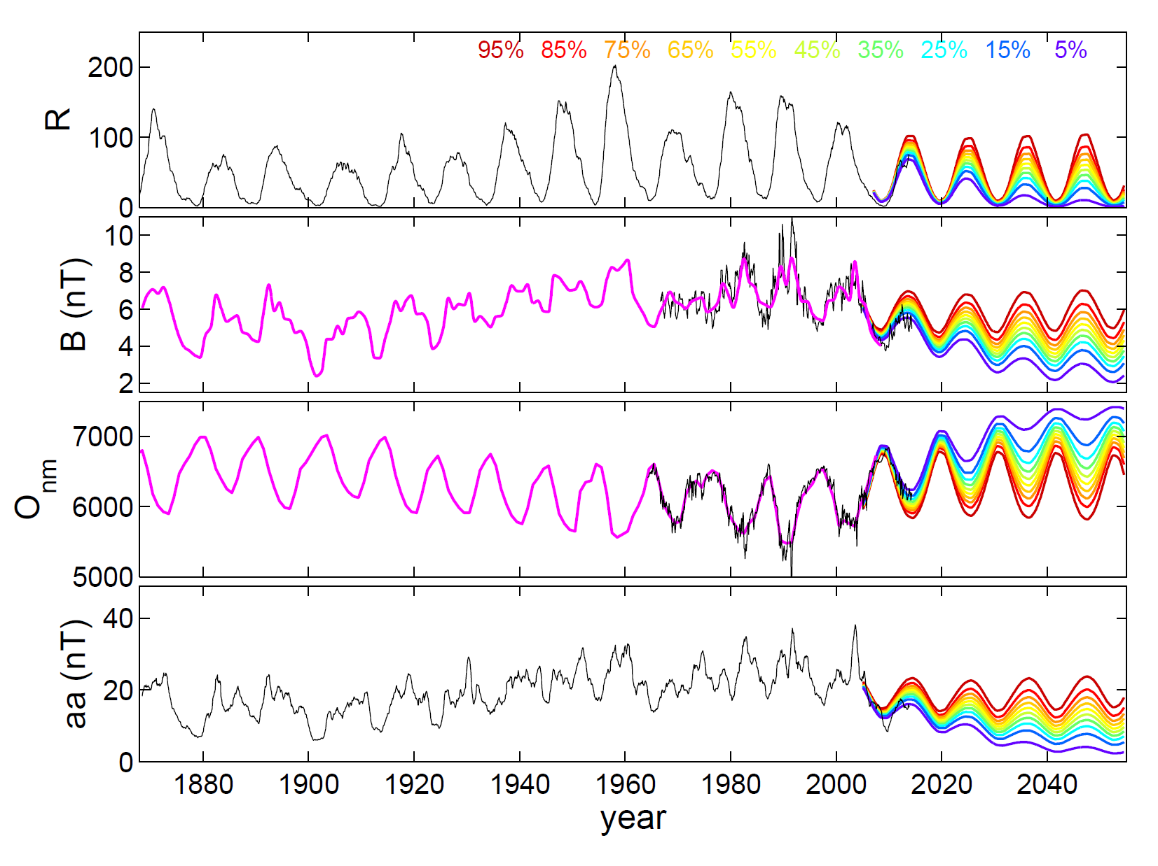
Predictions for the future: Probabilistic analogue forecasts from cosmogenic isotope data by Barnard et al. (2011)
• Sunspot number, R
• Near-Earth IMF, B
• Oulu neutron monitor GCR counts
• aa geomagnetic index

Slide 30
as cycle 24 develops all are following the blue lines: i.e. in the top 5-15% most rapid descents seen in the last 9300 years
• Sunspot number, R
• Near-Earth IMF, B
• Oulu neutron monitor GCR counts
• aa geomagnetic index

Slide 31
Conclusions
• 1941-2006 formed a grand solar maximum
(GSMax defined by φ≥600MV)
• Variation between Maunder minimum and
this GSMax seen in several reconstructed
solar and heliospheric parameters
• Solar wind speed lower when open solar flux
is low, suggests a broader streamer belt
• Small (5%) chance of another GSMax within
50 years but decline in parameters thus far
is as expected for a new GSMin in 50
years time (15% chance)

Slide 32
Space Weather Implications
• Not known!
• Past experience from the space age may be of limited value
• Lower heliospheric fields may allow greater SEP escape from inner heliosphere but may also limit SEP acceleration
• Effect on solar wind number density, Alfvén speed & Alfvén Mach number of events?
• Many Ground Level Events have been seen when solar activity is lower (e.g. in the 1940s)

