Slide 1
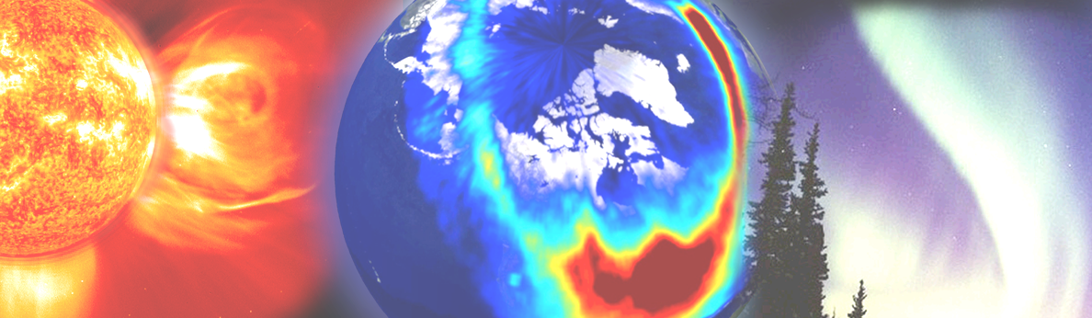

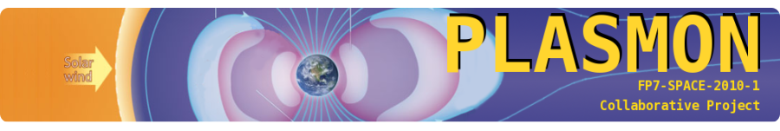
The challenges and problems in measuring energetic electron precipitation into the atmosphere.
Key solar observables for assessing long-term changes of the Geospace: Tuesday November 18, 11:00-13:00
Mark A. Clilverd
British Antarctic Survey, Cambridge, United Kingdom
With contributions from
Craig Rodger, University of Otago, Dunedin, New Zealand
Annika Seppälä, Finnish Meteorological Institute, Helsinki, Finland
The research leading to these results has received funding from the European Community's Seventh Framework Programme ([FP7/2007-
2013]) under grant agreement n° 263218

Slide 2
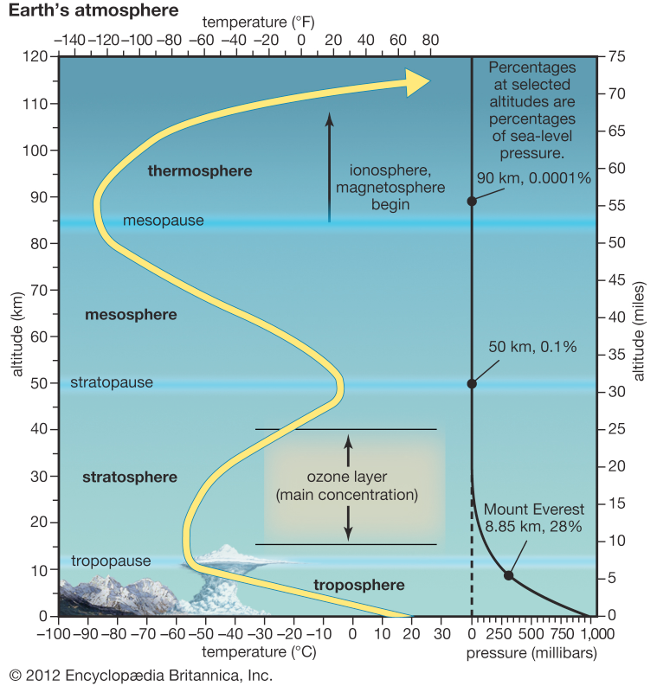
Middle atmosphere - coupling region between space weather, ionosphere and lower atmosphere
Energetic Particle Precipitation impact region

Slide 3
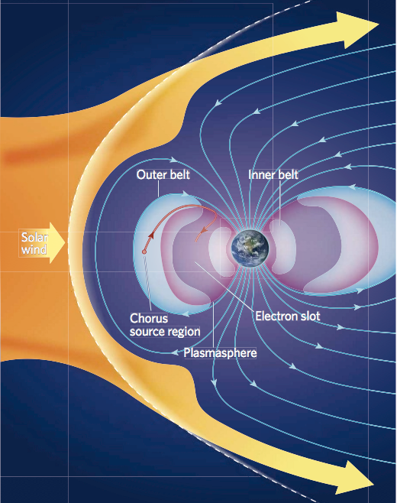
Energetic Particle Precipitation into the atmosphere
Solar Protons
Solar Proton Event
  Impacts whole polar cap
  Sporadic
Energetic Electron Precipitation
  Around auroral oval
  From the Radiation Belts
  Inner belt: very stable, occasionally affected by solar storms
  Outer belt: Dynamic, strongly influenced by solar storms
Solar and Radiation Belt particles a major source of ionisation in the middle atmosphere.
Particle energy important: Determines the altitude of the impact.
Radiation Belt Electrons
Rodger and Clilverd, Nature, 2008

Slide 4
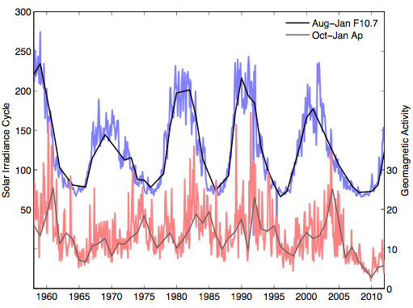
Energetic Particle Precipitation and the Solar Irradiance cycle

Slide 5
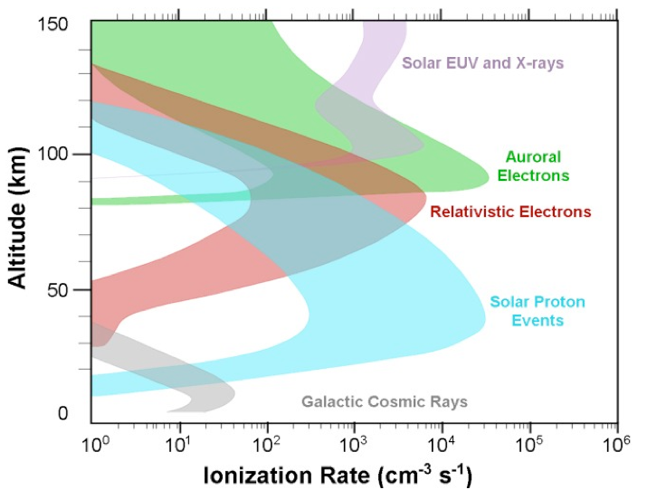
Energetic Particle Precipitation into the atmosphere -
Solar forcing into the atmosphere
SPEs and Radiation Belt electrons interact with the atmosphere by ionising, dissociating etc. gas molecules.
  Causes aurora (>100km). Affects chemical balance.
Major source of ionisation in the middle atmosphere.
Particle energy determines the altitude of the impact.
few keV
100 of keV to MeV
1-1000 MeV

Slide 6
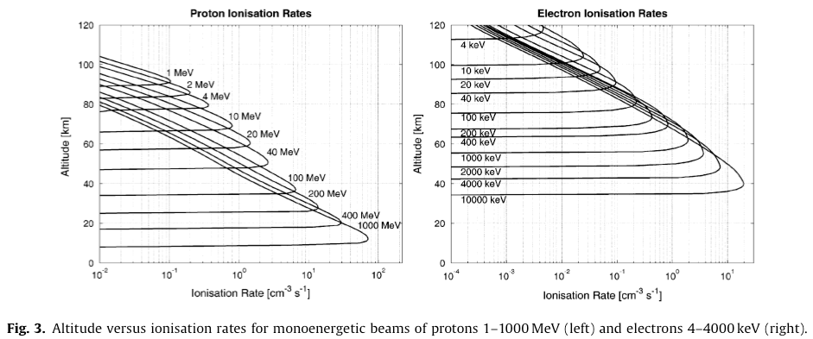
Energetic Particle Precipitation into the atmosphere:
Particle energies and impact altitudes
Ionospheric D layer
Flux: 1 protons/cm²/s/sr
Flux: 100 electrons/cm²/s/sr
Turunen et al., 2009.

Slide 7
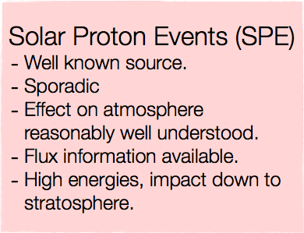
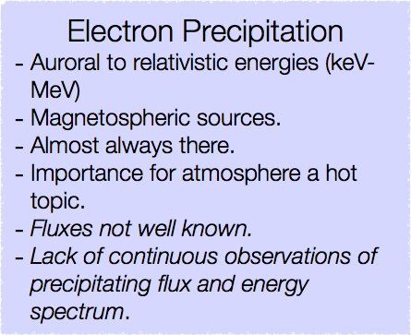
Energetic Particle Precipitation into the atmosphere:
Particle energies and impact altitudes
D layer
Flux: 1 protons/cm²/s/sr
Flux: 100 electrons/cm²/s/sr
Turunen et al., 2009.

Slide 8
What happens when the particles reach the atmosphere?
Precipitation into the polar atmosphere
(30 - 100 km) increases ionisation.
Protons and electrons from the Sun/magnetosphere
Enhanced production of NOx and short-lived HOx through ion chemistry.*
NOx lifetime long during polar winter → Contained/transported in polar vortex
*Ionisation is the main source during winter
Important contribution to ozone balance.
2(NO + O3) → 2(NO2+ O2)
NO2 + hν → NO + O
NO2 + O → NO + O2
Total: 2O3 → 3O2
Effect on LW & SW radiative heating and cooling
Natural forcing to the atmosphere. Regional scale effects.
Atmospheric Dynamics

Slide 9


Particle impact on atmospheric constituents
-
+
-
-
Ionisation of
N2 & O2
-
-
-
+
-
+
O2⁺ reacts to form water cluster ions e.g.
O2⁺ + O2 → O4⁺
O4⁺ + H2O → O2⁺∙H2O + O2
Further reactions to produce exited N(²D)
N2⁺ + O → NO⁺ + N
N2⁺ + e⁻ → N + N
O⁺ + N2 → NO⁺ + N
N⁺ + O2 → O⁺ + NO → NO⁺ + O →O2⁺ + N
NO⁺ + e⁻ → N + O
Water cluster ions react to produce HOx. For example
O2⁺∙H2O + H2O → H3O⁺∙OH + O2
H3O⁺∙OH + e⁻ → H + OH + H2O
Net: H2O → H + OH
N(²D) reacts to form NO
N(²D)+O2 → NO + O
Enhanced
HOx and NOx
HOx (H + OH + HO2)
Short chemical lifetime.
Rapid but short lived ozone loss in the mesosphere (50-80km).
NOx (N + NO + NO2)
Only destroyed by sunlight. Long chemical lifetime in dark.
Subject to transport.
Important for stratospheric (15-50km) ozone balance.

Slide 10
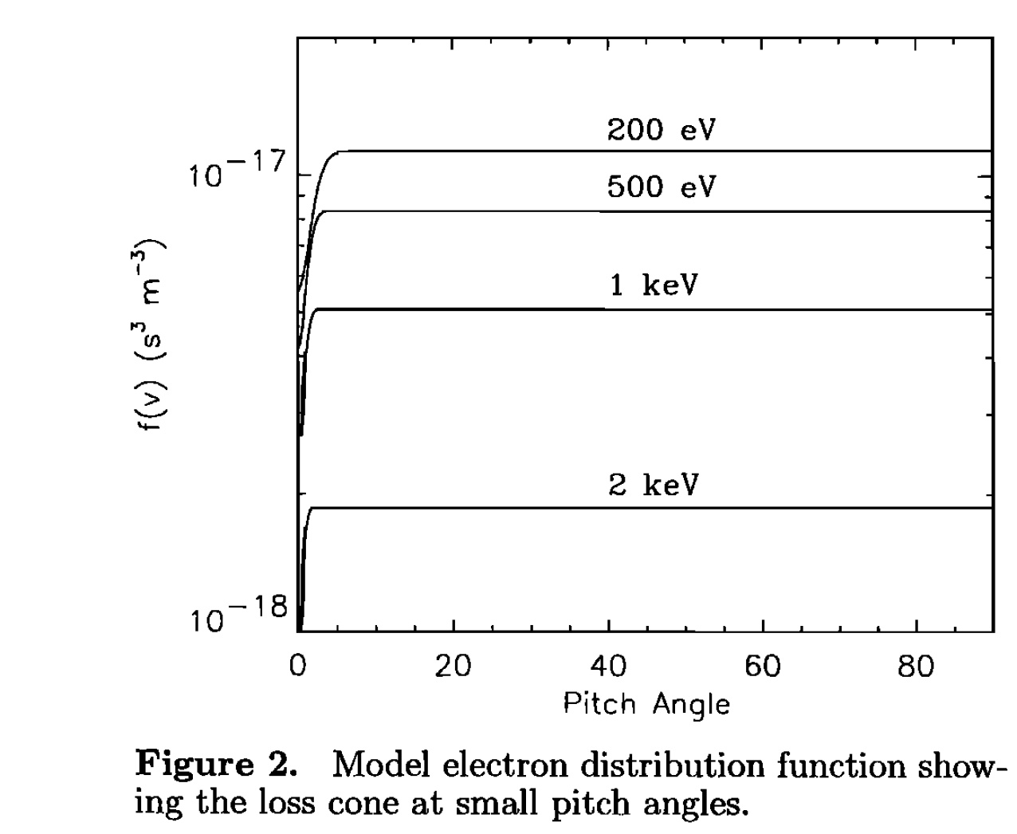
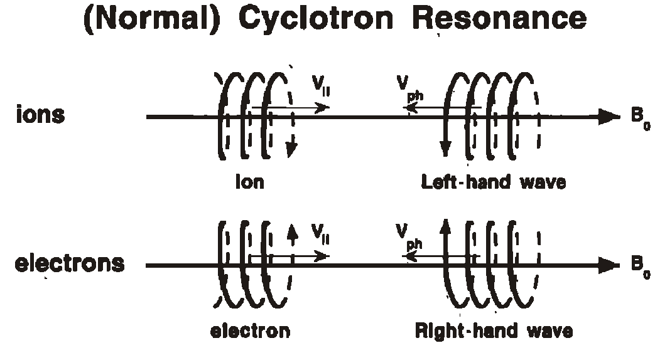
The motion of an electron in a magnetic field
For normal resonance the relative motion between the wave and particle Doppler shifts the wave up to the cyclotron frequency of the particle.·Image adapted from Tsurutani, B. T., and G. S. Lakhina, Some basic concepts of wave-particle interactions in collisionless plasmas, Rev. Geophys., 35(4), 491–501, doi:10.1029/97RG02200, 1997.
Horne, R. B., and R. M. Thorne (2000), Electron pitch angle diffusion by electrostatic electron
cyclotron harmonic waves: The origin of
pancake distributions, J. Geophys. Res., 105,
5391–5402, doi:10.1029/1999JA900447

Slide 11
The motion of an electron in a magnetic field
If you have an electron detector which measures pitch
angles >4°then those electrons are trapped in the
radiation belts. Only <4° (at the equator) will impact
on the atmosphere. NOAA POES satellites have such a
detector and are our best dataset for energies >100 keV

Slide 12
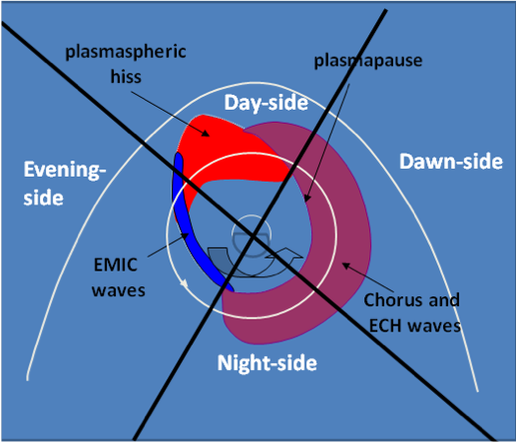
Energetic Particle Precipitation from the Radiation Belts
Storm
Kp
Earth’s magnetic field becomes more disturbed by solar storms
Wave processes within the radiation belts become more dynamic
DEMETER
observations
DEMETER
Electrons are precipitated into the atmosphere at the polar regions
POES observations
POES
Distance from Earth
Clilverd et al., 2014

Slide 13
The motion of an electron in a magnetic field
Wave-electron interactions push electrons towards pitch
angles that will result in them hitting the atmosphere
– known as the bounce-loss cone angle (BLC)

Slide 14

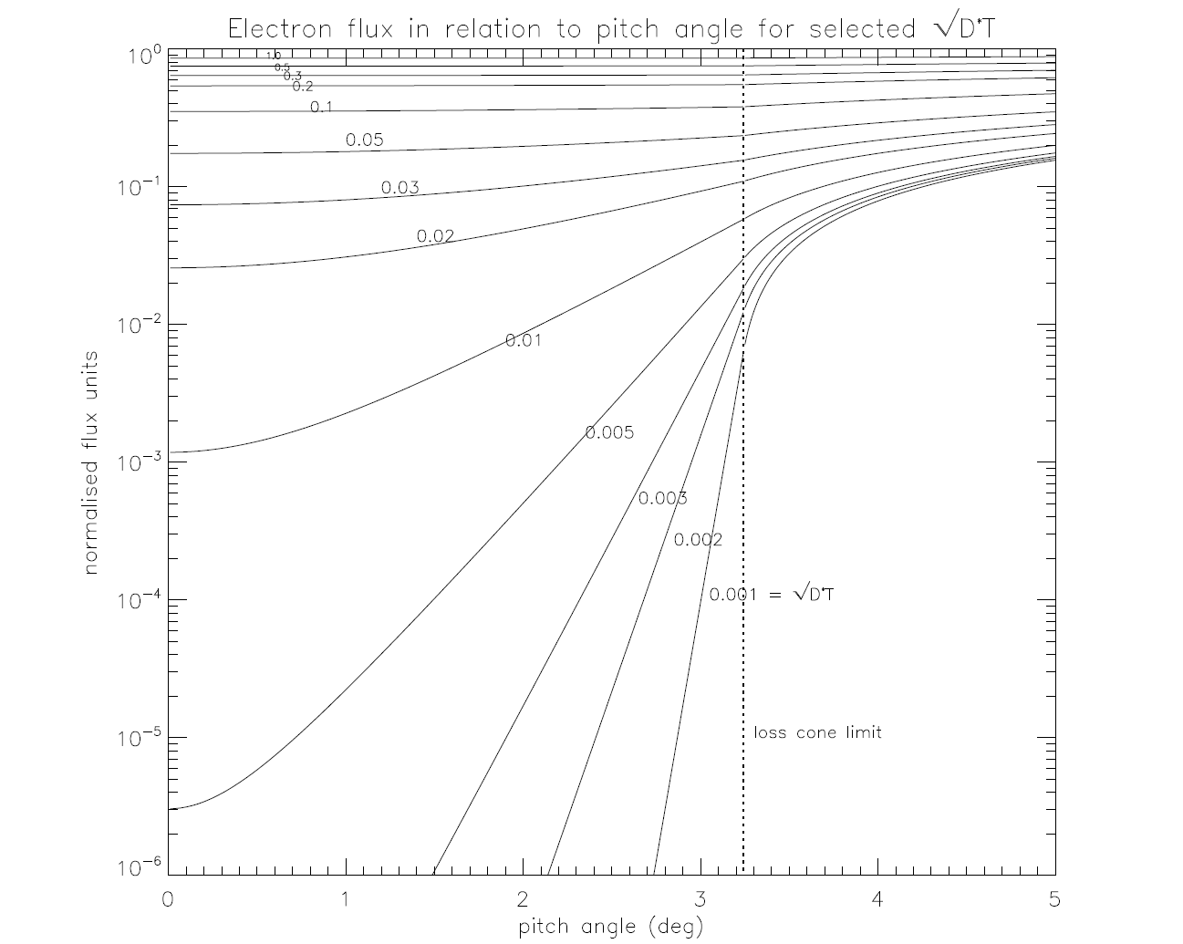
The bounce-loss cone in more detail
The BLC
Electrons diffuse into the BLC and are lost
into the atmosphere

Slide 15
The bounce-loss cone in more detail
POES has a detector that is about 2° wide
(equivalent)

Slide 16
The bounce-loss cone in more detail
Weak diffusion: POES sees low fluxes of electrons, but more are hitting the atmosphere
– the bucket is in the wrong place!

Slide 17
The bounce-loss cone in more detail
Strong diffusion: POES sees high fluxes of electrons, better idea of the flux hitting the atmosphere
– the waterfall has moved to the bucket

Slide 18
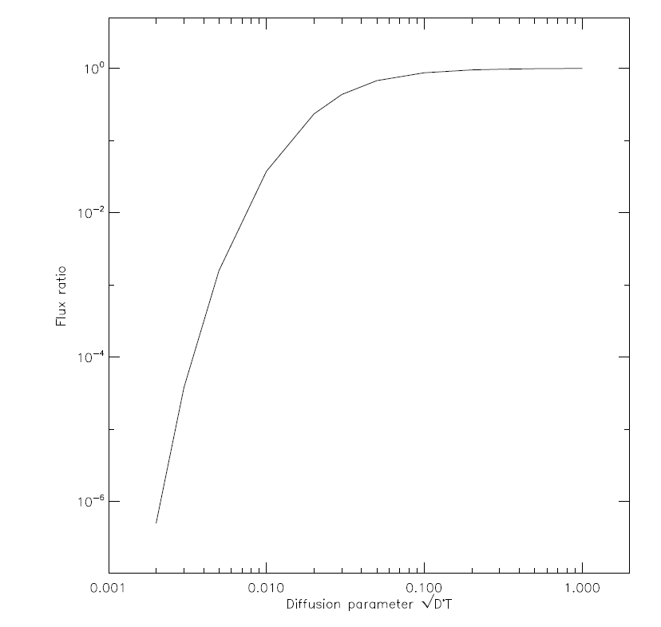
The bounce-loss cone in more detail
Factor of x1
Strong diffusion
Factor of
x1/1000
weak diffusion
Ratio between precipitated and trapped electrons as a function of diffusion parameter
and it is probably energy dependent, with more
influence at higher energies

Slide 19
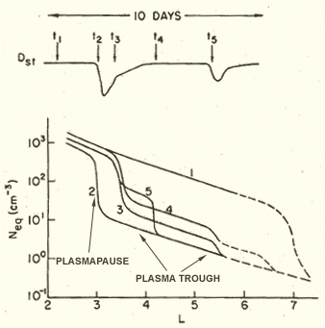
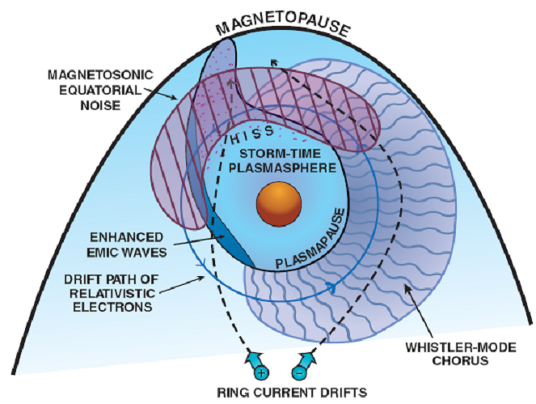
What drives strong and weak diffusion?
Distance from Earth (Re)
The waves are
dependent on the
position of the
plasmapause
There are many different waves,
which drive weak and strong
diffusion depending on storm levels

Slide 20
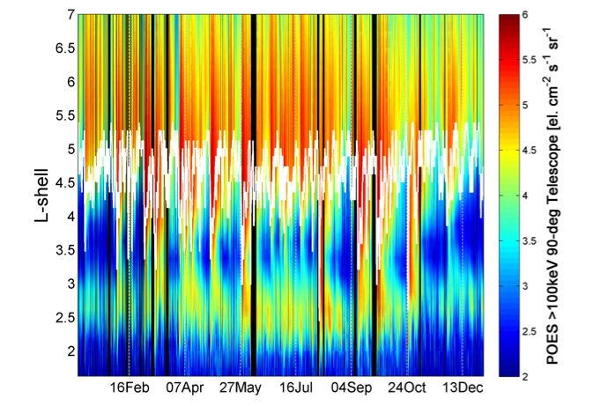
Energetic Particle Precipitation into the atmosphere – POES data
2011

Slide 21
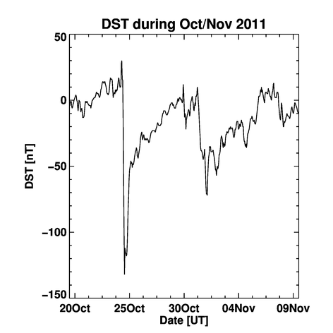
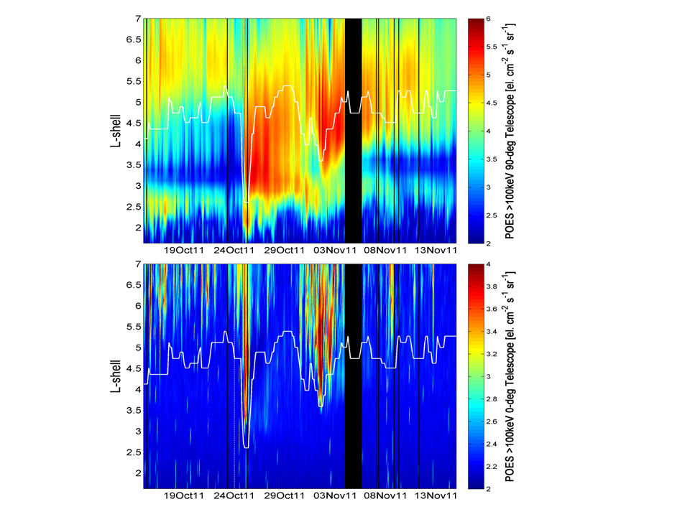
Energetic Particle Precipitation into the atmosphere – POES data
>100 keV electrons
trapped
Even on an individual
storm case the
plasmapause is
important (and dynamic)
precipitating
plasmapause

Slide 22
The POES instrument sensitivity limit
POES has 3 detectors, >30 keV, >100 keV, >300 keV
All have a sensitivity limit of 1 count/s or ~100 el. cm⁻²s⁻¹sr⁻¹
●In the BLC the >30 keV detector is >1 c/s for 99% of the time
● In the BLC the >100 keV detector is >1 c/s for 54% of the time
● In the BLC the >300 keV detector is >1 c/s for 14% of the time
If you use the 3 detectors to determine the energy
spectrum then it is likely to be inaccurate a large % of
the time.

Slide 23
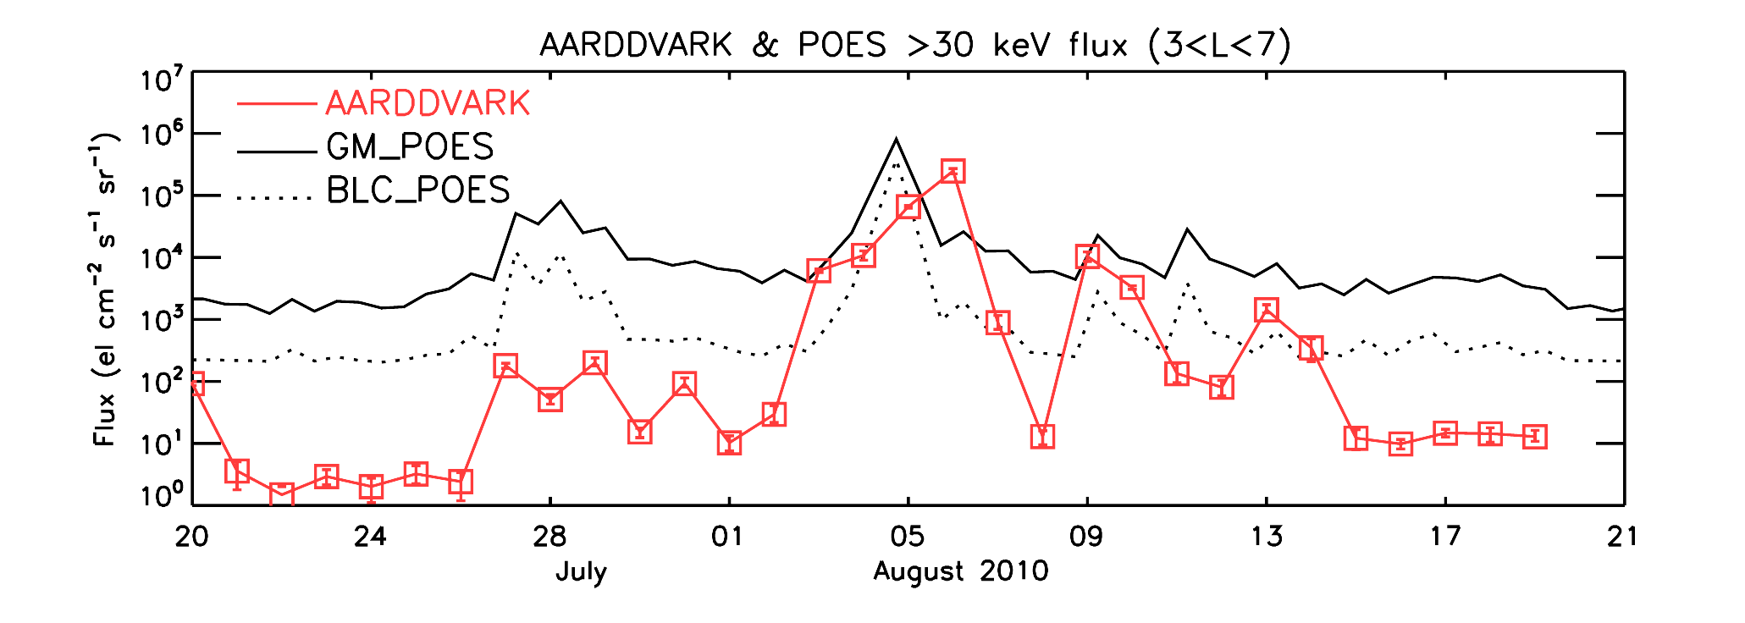
An example of POES and ground-based fluxes
storm
Radiation belt precipitation fluxes during a storm in 2010.
AARDDVARK ground-based precipitation fluxes ‘agree’
with POES BLC fluxes for high fluxes, but not low fluxes.
A geometric mean (trapped and BLC combined) also
‘agrees’ at high fluxes, but not low.

Slide 24
Summary
● It is hard to measure precipitating electron fluxes
accurately by satellite (BLC and strong/weak diffusion).
● The plasmapause has a strong influence on where
precipitation occurs, and it is very dynamic.
● POES makes useful measurements of medium energy
electron precipitation into the atmosphere.
● But be very careful of strong/weak diffusion conditions.
● Strong diffusion periods (big geomagnetic storms) give
the most reliable flux measurements.
● Watch out for the instrument sensitivity floor between
storms – low fluxes are not necessarily low enough.

Slide 25
Conclusions
Energetic Particle Precipitation affects atmospheric chemistry during winter (both HOx and NOx).
  Impacts Ozone balance (30-80 km)
We think electron precipitation events are particularly important for long timescale impacts and regional climate.
To include this effect - and not just an Ap parameterisation - in atmospheric and climate models we need more information about electron precipitation fluxes and energies.
Thank you for your attention!

