Slide 1
Trend detection in solar spectral irradiance data
T. Dudok de Wit, M. Kretzschmar, M. Schöll
CNRS and University of Orléans
Summary
Maintaining long-term stability in solar spectral irradiance measurements is a major challenge !
Are there alternative methods of checking for the existence of (possibly uncorrected) trends ?
We propose: a non-parametric comparison of UV irradiance data with various solar UV proxies.
No assumption is made the functional relationship between proxy and UV, as long as it is one-to-one.
We apply the method to hotly debated SORCE/SOLSTICE data (version 13).
Each slide takes 30 seconds
Each of the 5 slides lasts for 20 to 30 seconds

Slide 2
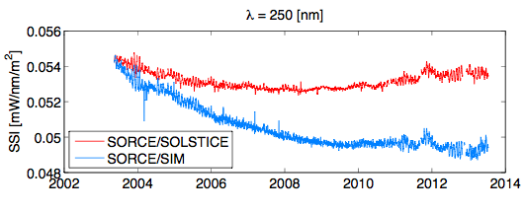
Trends : example
Two instruments are observing the same wavelength
Which one is right ?
SORCE/SOLSTICE ☐ yes ☐ no
SORCE/SIM ☐ yes ☐ no
Trend correction is crucial for quantifying solar forcing of climate : we need a diagnostic for this !
Each slide takes 30 seconds
Each of the 5 slides lasts for 20 to 30 seconds

Slide 3
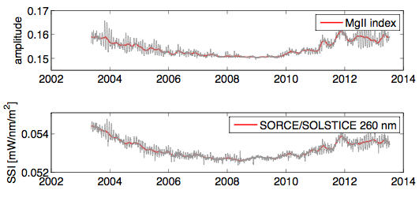
Method
Assume that irradiance I(t) and proxy P(t) are related by I(t) = f[P(t)] No need to model f(P), just assume it is monotonic
Get trend by comparing when a proxy reaches the same level twice, and look up in the irradiance (+ some maths to get the trend correction out of this)
correction
Each slide takes 30 seconds
Each of the 5 slides lasts for 20 to 30 seconds

Slide 4
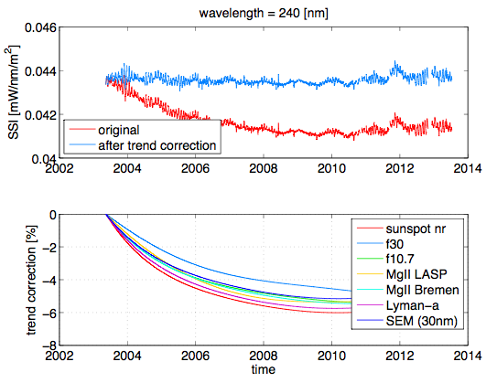
Results : example
Original and detrended irradiance record
Trend, as estimated from various solar proxies
Excellent agreement between various proxies = trend in the UV is unlikely to be physical
Each slide takes 30 seconds
Each of the 5 slides lasts for 20 to 30 seconds

Slide 5
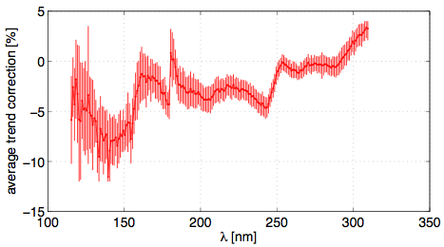
Conclusions
Trends estimated from SORCE/SOLSTICE are significant !
In bands with large trends, the observations also disagree with irradiance models such as NRLSSI and SATIRE.
Evidence for uncorrected instrumental trends ? ….
true flux is overestimated
true flux is underestimated
Average correction
Error bars reflect impact of various proxies
Each slide takes 30 seconds
Each of the 5 slides lasts for 20 to 30 seconds

