Slide 1







60 years of multi-wavelength solar radio observations as proxies for upper atmosphere modelling
T. Dudok de Wit¹⁾, S. Bruinsma²⁾, K. Shibasaki³⁾
¹⁾ LPC2E, University of Orléans, ²⁾ GRGS, CNES, Toulouse,
³⁾ Nobeyama Solar Radio Observatory, Nagano
Full article:
Dudok de Wit et al.,
SWSC (2014)
Summary
Daily observations of the solar radio flux in various wavelengths (1-30 cm) have been carried out since the 1950’s
We have merged them into one unique and homogenous database (available for download)
The radio flux at 30 cm is a better proxy for upper atmosphere modelling than the usual 10.7 cm flux
Each of the 5 slides lasts for 20 to 30 seconds

Slide 2
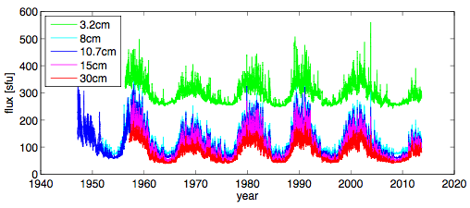
60 years of solar radio observations
Daily, and carefully calibrated measurements of centimetric wavelength have been made since the 1950’s (Penticton, Ottawa, Toyokawa, Nobeyama)
Each slde takes 30 seconds
Each of the 5 slides lasts for 20 to 30 seconds

Slide 3
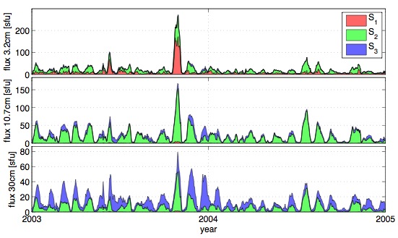

Physical underpinning
By using blind source separation, we find that the solar rotational variability can be decomposed into 3 contributions (see below)
  Gyroresonance (= active sunspot groups)
  Gyroresonance (= mostly sunspots)
  Bremsstrahlung (= mostly plages and faculae)
3.2 cm flux
10.7 cm flux
Decomposition of the solar radio flux (excerpt) into its three contributions
30 cm flux
Each slide takes 30 seconds
Each of the 5 slides lasts for 20 to 30 seconds

Slide 4
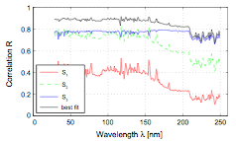
30cm: a better proxy for the UV
The 30 cm flux (red) is systematically better correlated with the the solar EUV-UV irradiance (2003-2013) than the usual 10.7 cm flux (blue)
Correlation between radio flux and irradiance in the UV
Correlation estimated for solar rotational variability (NOT solar cycle)
Each slide takes 30 seconds
Each of the 5 slides lasts for 20 to 30 seconds

Slide 5
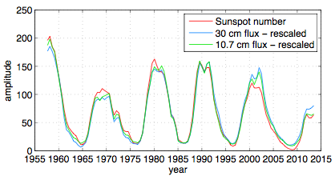
Long-term evolution
All wavelengths exhibit the same long-term evolution (because they are all dominated by Bremsstrahlung)
Each slide takes 30 seconds
Each of the 5 slides lasts for 20 to 30 seconds

