Slide 1
COMESEP and the SEP Forecast Tool Highlighted poster 1
ESWW11, 17-22/11/2014, Liège

Slide 2
The COMESEP Project
COronal Mass Ejections and Solar Energetic Particles: forecasting the space weather impact
http://www.comesep.eu/
Feb. 2011 – Jan. 2014
Coordinator: Norma B. Crosby (BIRA-IASB)
EU FP7 project with 7 Teams and 3 External Collaborators
Main goal: Build an operational space weather alert system to forecast SEP radiation storms and geomagnetic storms based on risk analysis

Slide 3
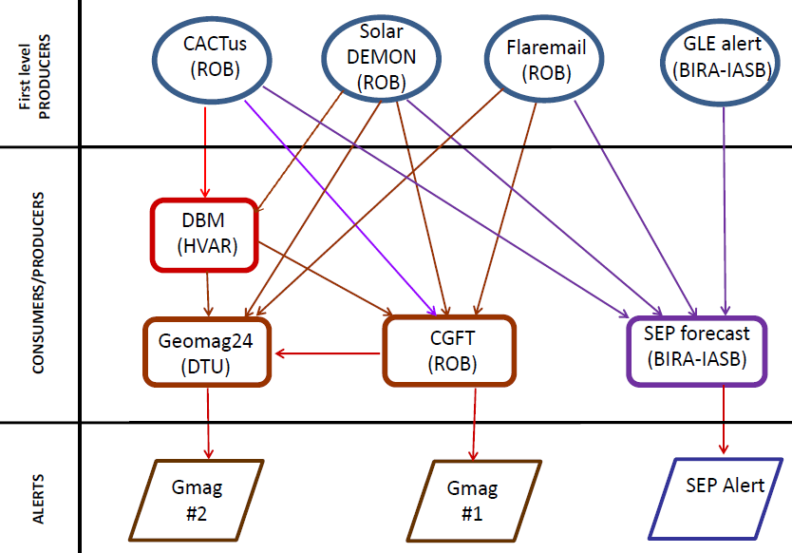
The COMESEP Alert System
Fully automated system
observation of solar feature
Issuing alerts

Slide 4
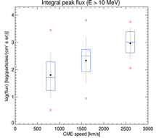
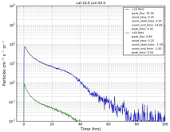
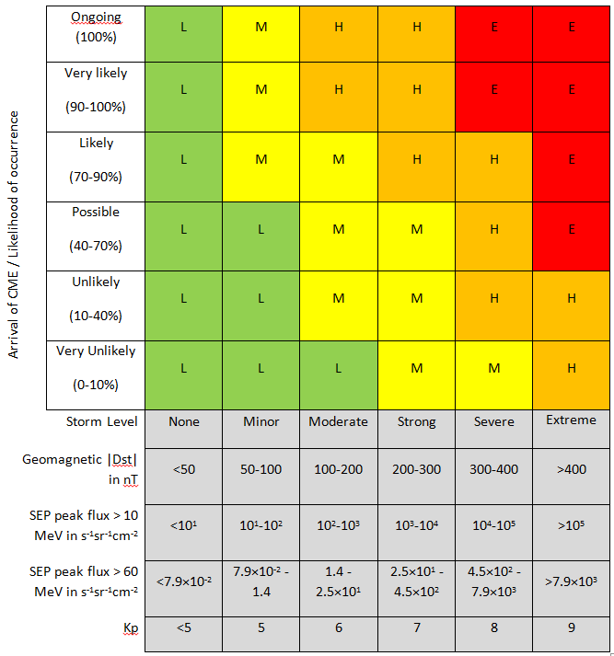
The SEP Forecast Tool
TRIGGER
CME
SOHO/LASCO
Flare loc.
SDO/AIA 94
Flare ≥ M1
GOES X Ray
GLE Alert Plus
Univ. of Athens
Extra information from other tools used. Alert update if arrival after Flaremail.
Statistical analysis SC 23
Test particle model
Protons:
E>10 MeV
E>60 MeV

Slide 5
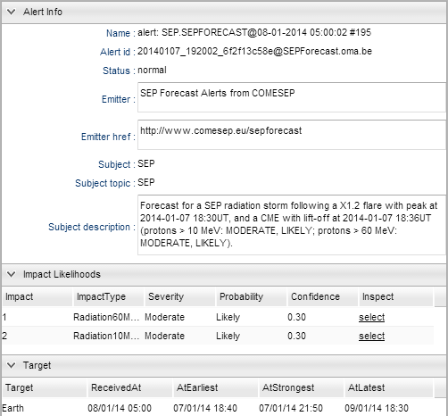
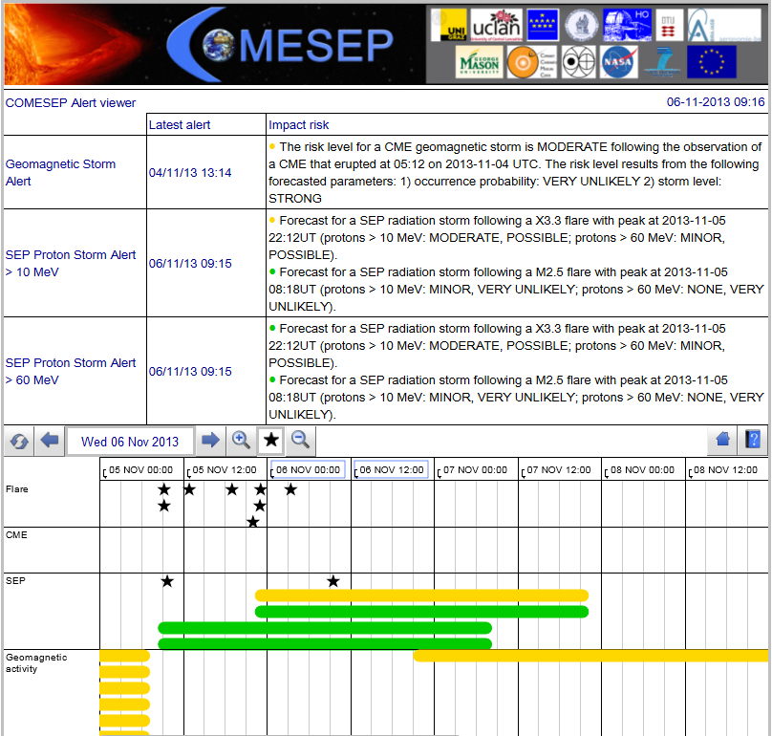
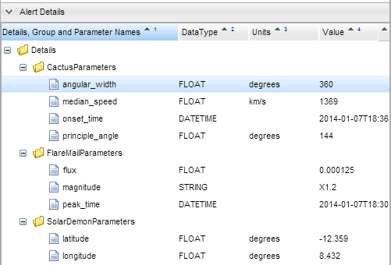
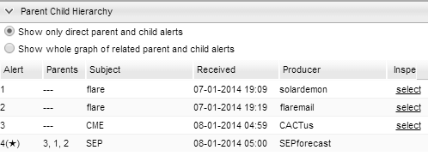
The COMESEP Alert Page
http://www.comesep.eu/alert
Alert info
Alert details
Parent child hierarchy
Alerts though email subscriptions
More info at poster & fair

