Slide 1
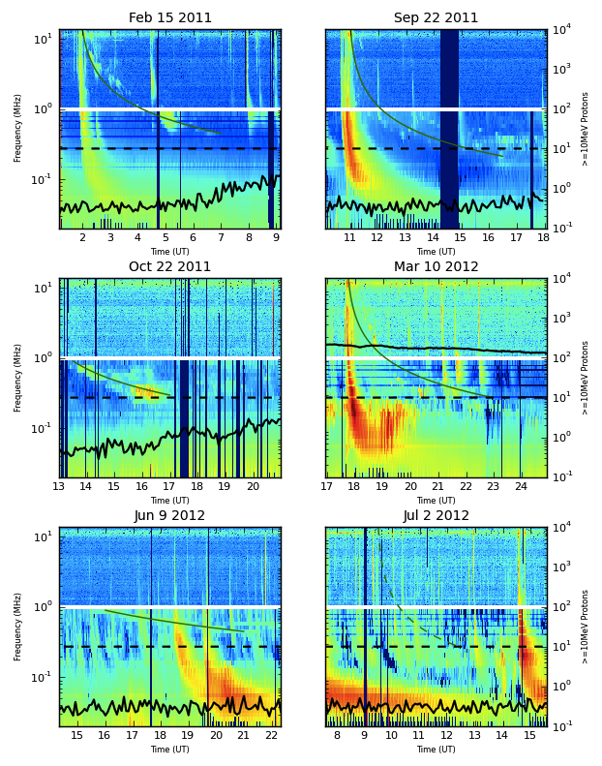
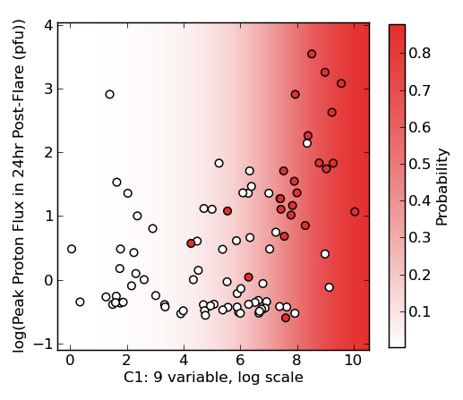
Correlating Type II and III Radio Bursts with Solar Energetic Particle Events (L. Winter, S. Huston, K. Ledbetter, R. Quinn; AER)
Analysis of the Wind/WAVES radio burst and the GOES proton properties led to finding that radio properties (e.g., type II and type III peak flux) can be used to predict the peak proton flux level.
SEP Events
non-SEP Events
Wind/WAVES observations were analyzed for all type II bursts from 2010 to mid-2013
Principal Component from radio properties

