Slide 1
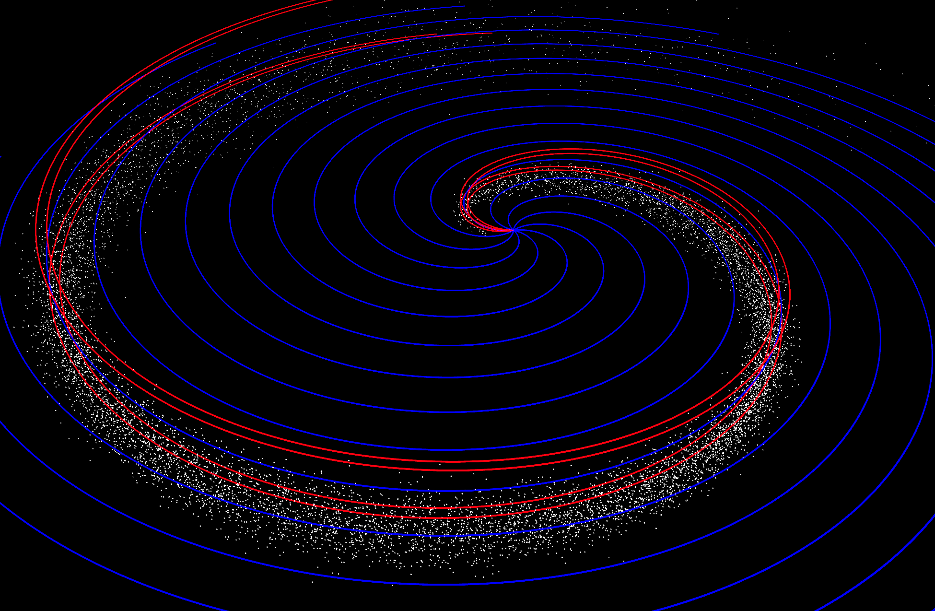




SPARX: a propagation based modelling system for SEP radiation space weather forecasting
Mike Marsh; S. Dalla; T. Laitinen; M. Dierckxsens; N. B. Crosby
mmarsh@uclan.ac.uk
Jeremiah Horrocks Institute, University of Central Lancashire, Preston, UK
See Marsh et al., 2014, SpWea, submitted, arXiv:1409.6368

Slide 2
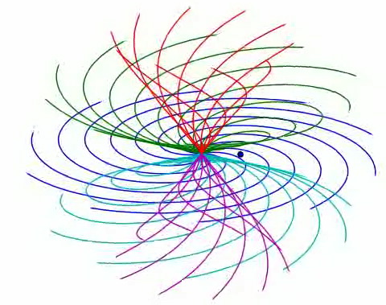
SPARX: Test particle SEP modelling
Advantages:
Physics based modelling
Particle propagation determined by solution of equations of motion alone, for large number of test particles.
Naturally 3D: describes cross-field transport and includes drifts
No assumption of field line tied propagation.
Model setup:
Initial shock-like spatial and power law energy distributions are specified. Simple Parker IMF. Solar rotation included.
Scattering determined by prescribed mean free path 𝝺=0.3 AU.

Slide 3
Operational running
Part of the COMESEP Alert System (www.comesep.eu/alert)
Triggered by automated detection of a solar eruptive event
Output database of pre-made runs of unit ‘tiles’ at given longitude/ latitude are combined to construct shock-like injection region at 2 AU

Slide 4
SPARX Output
Uses empirical scaling with SXR flare peak flux to ‘normalise’ particle counts
Simulated X10-class flare
Source region N20
3 observers at 1 AU with relative views of source at W60, W20, E20
Use information on location and velocity to build synthetic flux profiles at 1 AU
t = 1 hr
t = 24 hrs
t = 48 hrs
t = 72 hrs

Slide 5
SPARX Output
Synthetic flux profiles are calculated at 3 observer locations at 1 AU to simulate the event originating at locations relative to the Sun-Observer line (60W, 20W, 20E).
Note the change in profile morphology with observer longitude due to the corotating energetic particle stream.
SPARX output products:
Flux profile vs time | Time of maximum flux
Peak flux | Event duration
E>10 MeV
E>60 MeV
W60
W20
E20

