Slide 1
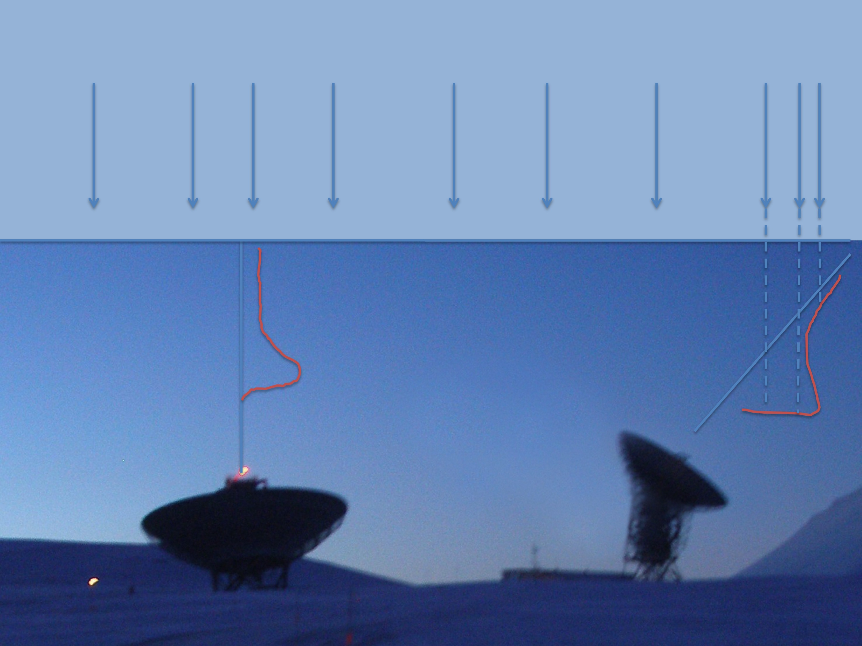
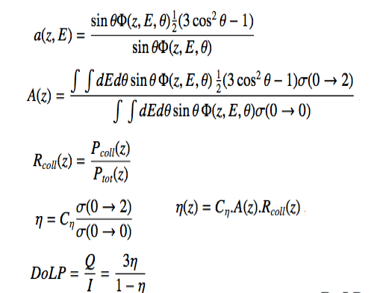
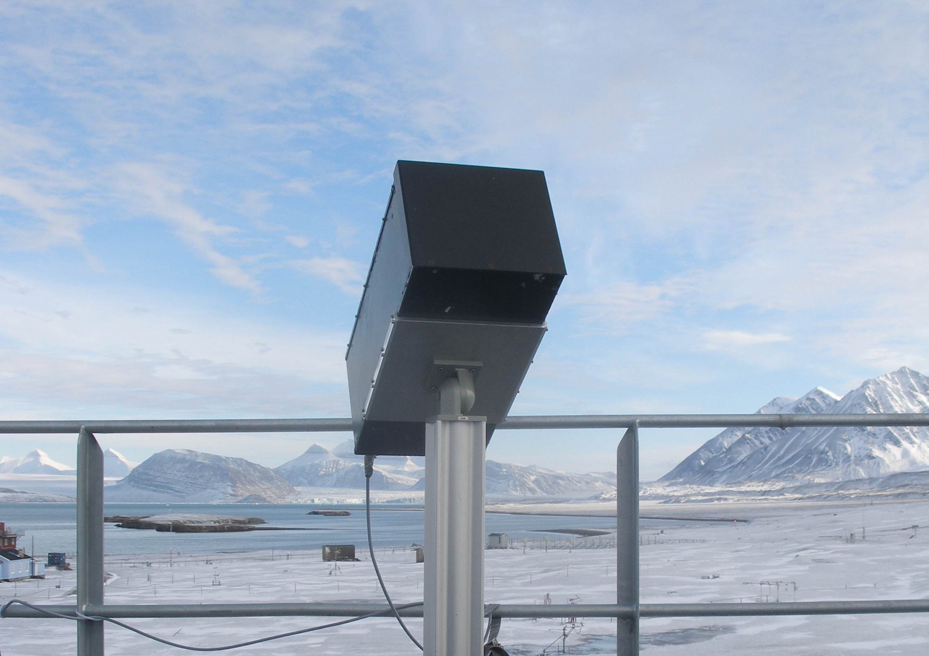
The thermospheric auroral red line polarization: comparison between theory and observations J. Lilensten, V. Bommier, M. Barthélemy, D. Bernard, H. Lamy, J. Moen, M. G. Johnsen, U. P. Løvhaug and F. Pitout
We present here a comparison between observations and theoretical polarization of the auroral red line during a coordinated observing campaign in February 2012 in the Svalbard archipelago. The measured DoLP is 1.92% ± 0.12%.The computed DoLP maximizes at 213 km with a value of 1.79%. We discuss this discrepancy and show that it may give access to the scattering phase function, which is a parameter that cannot be measured in laboratory for the atomic oxygen.
However, the DoLP varies significantly with different parameters showing that the solution is degenerated. It could become a tool for space weather applications if used along with other thermosphere/ionosphere measurements.

