Slide 1
Topical Discussion Meeting t13 The Prototype SafeSpace Space Weather Service
Ioannis A. Daglis¹, Sebastien Bourdarie², Christos Katsavrias¹
Afroditi Nasi¹
¹Department of Physics, National and Kapodistrian University of Athens, Athens, Greece,
²ONERA/Department of Space Environment, Toulouse, France
ESWW 18, 24-28 October 2022, Zagreb, Croatia
Notes:
Hope page - top

Slide 2
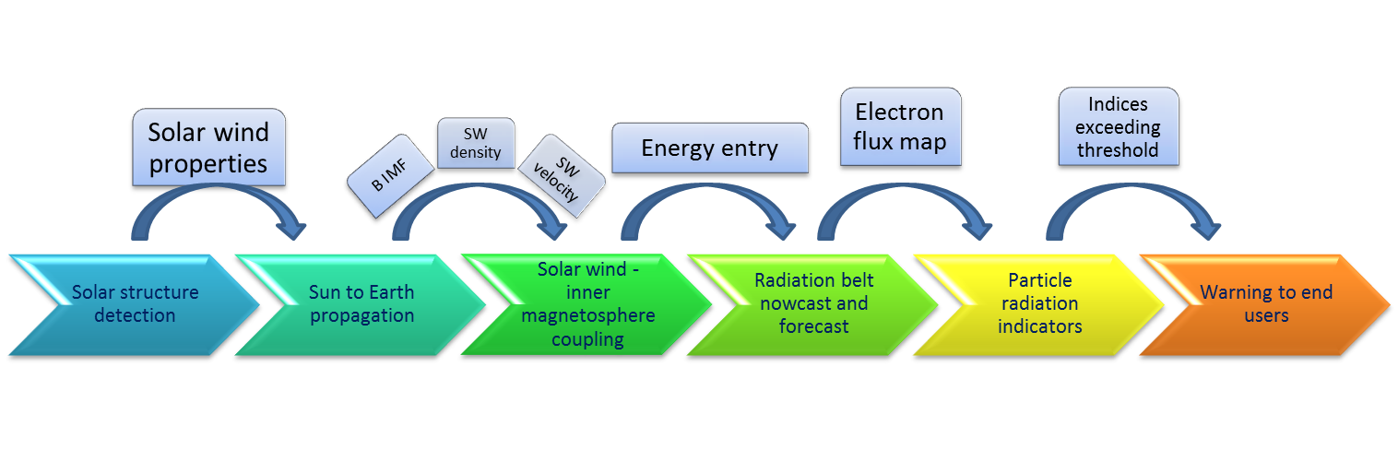
SafeSpace Space Weather Service
Deliver a prototype forecast service of particle radiation indicators, based on sophisticated upgraded model of Van Allen electron belt.
Enable forecast capabilities with lead time of 2 to 4 days.
ESWW 18, 24-28 October 2022, Zagreb, Croatia
Notes:
Hope page - top

Slide 3
SafeSpace Space Weather Service
ESWW 18, 24-28 October 2022, Zagreb, Croatia
Notes:
Hope page - top

Slide 4
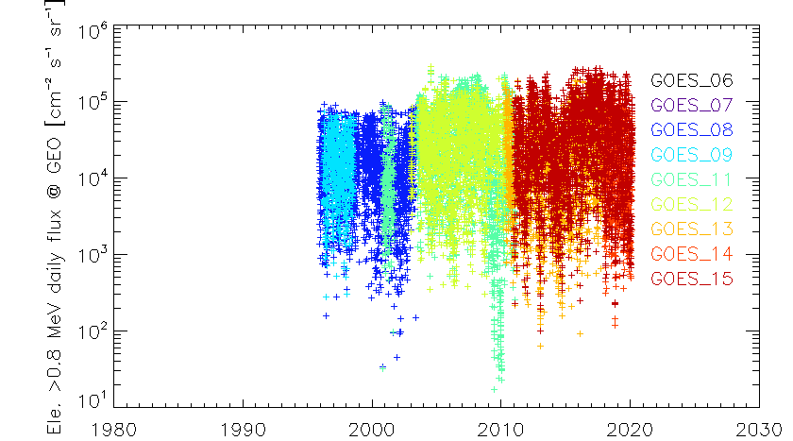
Radiation Belt Activity Indices and Warning
Internal charging induced by >400 keV electrons (typical time-range hours to days)
Indices are prepared on the basis of long term in-situ data:
@GEO GOES electron data are used
@Navigation GPS (and Galileo) electron data are used
@LEO POES electron data are used
ESWW 18, 24-28 October 2022, Zagreb, Croatia
Notes:
Hope page - top

Slide 5
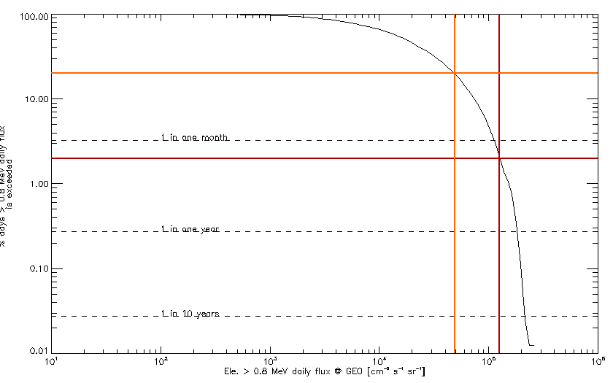
Radiation Belt Activity Indices and Warning
Internal charging induced by >400 keV electrons (typical time-range hours to days)
Indices are prepared on the basis of long term in-situ data:
@GEO GOES electron data are used
@Navigation GPS (and Galileo) electron data are used
@LEO POES electron data are used
ESWW 18, 24-28 October 2022, Zagreb, Croatia
Notes:
Hope page - top

Slide 6
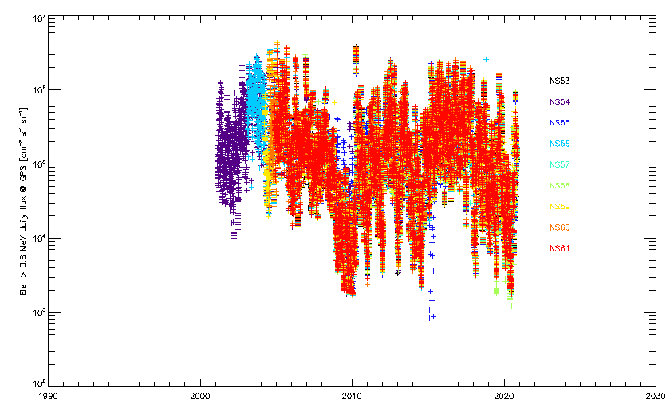
Radiation Belt Activity Indices and Warning
Internal charging induced by >400 keV electrons (typical time-range hours to days)
Indices are prepared on the basis of long term in-situ data:
@GEO GOES electron data are used
@Navigation GPS (and Galileo) electron data are used
@LEO POES electron data are used
ESWW 18, 24-28 October 2022, Zagreb, Croatia
Notes:
Hope page - top

Slide 7
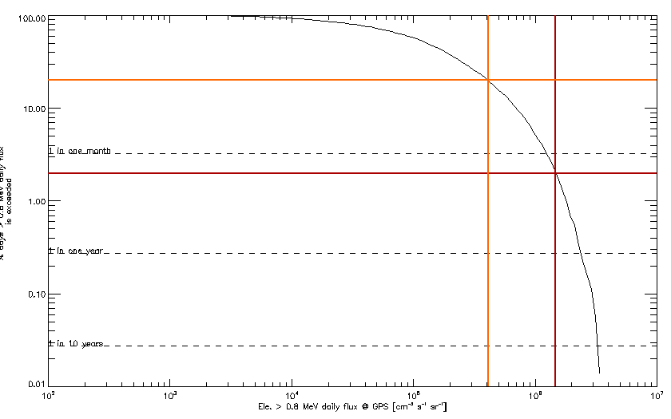
Radiation Belt Activity Indices and Warning
Internal charging induced by >400 keV electrons (typical time-range hours to days)
Indices are prepared on the basis of long term in-situ data:
@GEO GOES electron data are used
@Navigation GPS (and Galileo) electron data are used
@LEO POES electron data are used
ESWW 18, 24-28 October 2022, Zagreb, Croatia
Notes:
Hope page - top

Slide 8
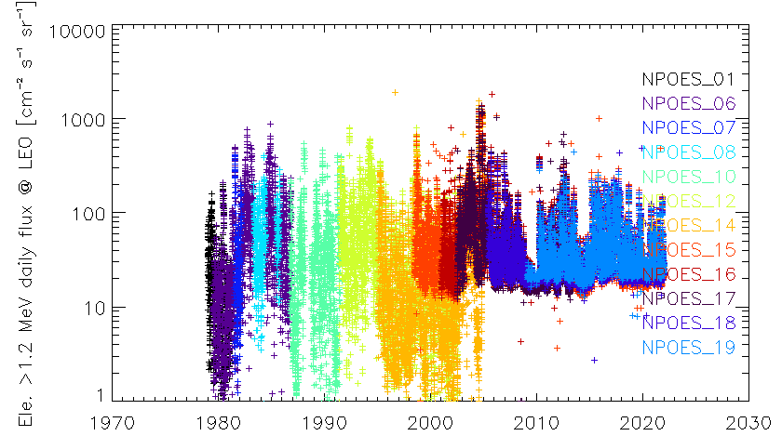
Radiation Belt Activity Indices and Warning
Internal charging induced by >400 keV electrons (typical time-range hours to days)
Indices are prepared on the basis of long term in-situ data:
@GEO GOES electron data are used
@Navigation GPS (and Galileo) electron data are used
@LEO POES electron data are used
ESWW 18, 24-28 October 2022, Zagreb, Croatia
Notes:
Hope page - top

Slide 9
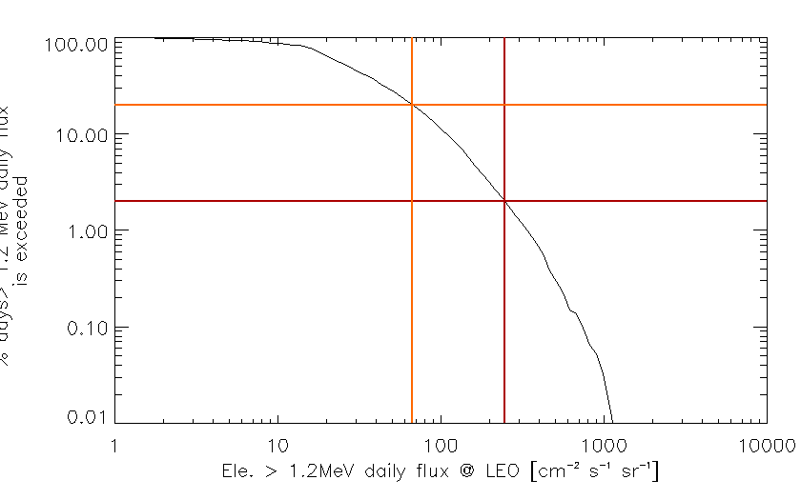
Radiation Belt Activity Indices and Warning
Internal charging induced by >400 keV electrons (typical time-range hours to days)
Indices are prepared on the basis of long term in-situ data:
@GEO GOES electron data are used
@Navigation GPS (and Galileo) electron data are used
@LEO POES electron data are used
ESWW 18, 24-28 October 2022, Zagreb, Croatia
Notes:
Hope page - top

Slide 10
SafeSpace Service
http://www.safespace-service.eu/
ESWW 18, 24-28 October 2022, Zagreb, Croatia
Notes:
Hope page - top

Slide 11
SafeSpace Service
http://www.safespace-service.eu/
Daily distribution of fluence values and the corresponding exceedance probability based on historical data.
The black star corresponds to the median value.
The colored dots correspond to the 25th-75th and 5th-95th percentile range.
ESWW 18, 24-28 October 2022, Zagreb, Croatia
Notes:
Hope page - top

Slide 12
SafeSpace Service
http://www.safespace-service.eu/
Prediction
2%
20%
Daily mean fluence values and the corresponding exceedance probability based on historical data
Today
ESWW 18, 24-28 October 2022, Zagreb, Croatia
Notes:
Hope page - top

Slide 13
Summary
SafeSpace Service is a prototype service of radiation belt environmental indicators corresponding to internal charging induced by >400 keV electrons.
These environmental indicators are prepared on the basis of long-term in-situ data.
Three orbits of interest: GEO / GNSS MEO / LEO.
User-defined thresholds for the low / moderate / intense activity.
Provision of daily mean electron fluence up to 4 days ahead.
Provision of daily cumulative distribution function.
ESWW 18, 24-28 October 2022, Zagreb, Croatia
Notes:
Hope page - top

Slide 14
Thank you
for your attention
ESWW 18, 24-28 October 2022, Zagreb, Croatia
Notes:
Hope page - top

Slide 15
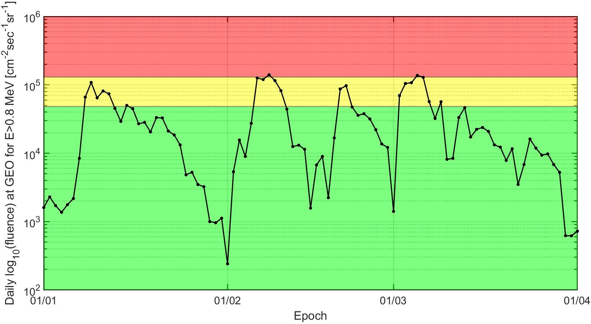
SafeSpace Service: future additions
Last 3 months historical data
ESWW 18, 24-28 October 2022, Zagreb, Croatia
Notes:
Hope page - top

